Slide 1
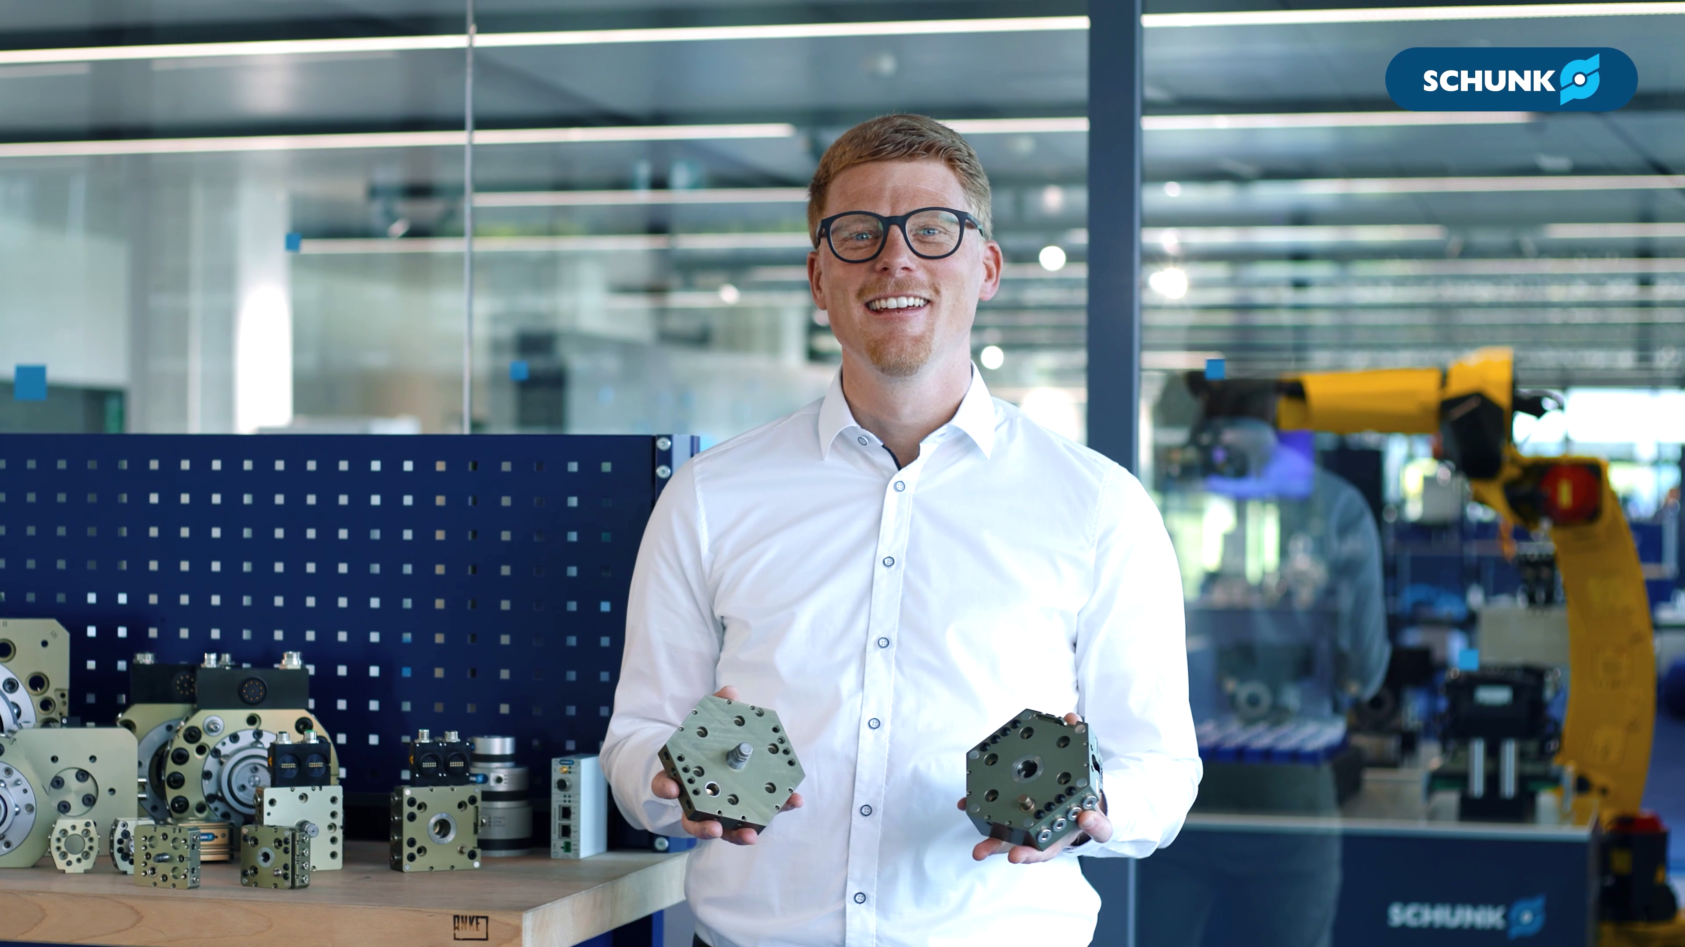


CPB
Discover unmatched flexibility

Slide 2


CPB
Discover unmatched flexibility

Slide 3
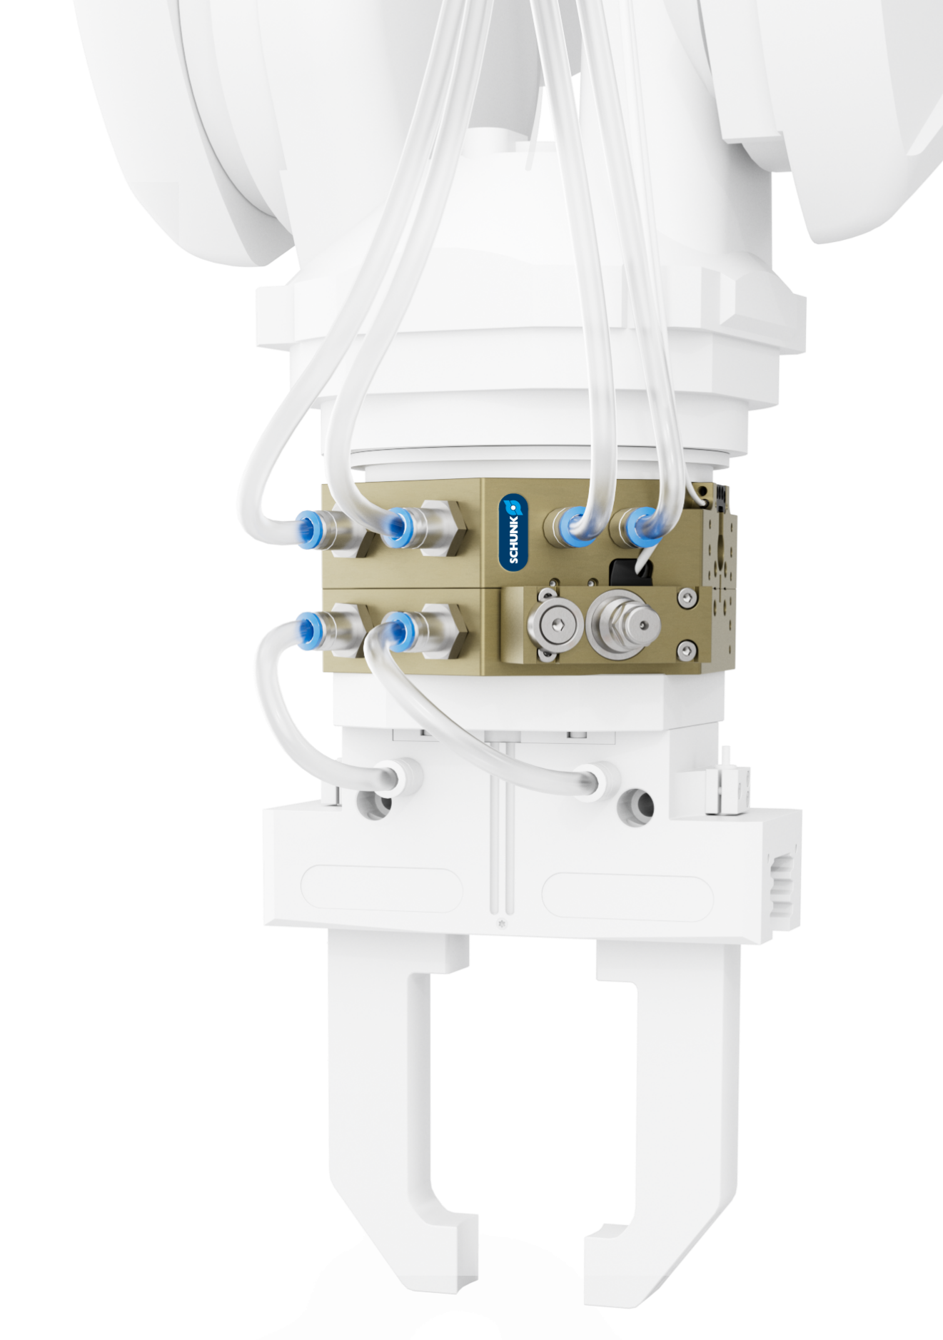
Your added value
Flexible. Compact. Future-proof.
Robot PLUS | Automatic Toolchanger CPB
  Proven looking technology
  The positive-locking, self-retaining bold mechanism made of vacuum-hardened stainless steel, provides maximum stability and durability
  Integrated energy supply
  Pneumatic feed-throughs ensure a reliable supply of tools and are also suitable for vacuum transmission
  Easy assembly
  The integrated ISO interfaces on the robot and the tool side allow quick assembly and reduce the effort during commissioning

Slide 4
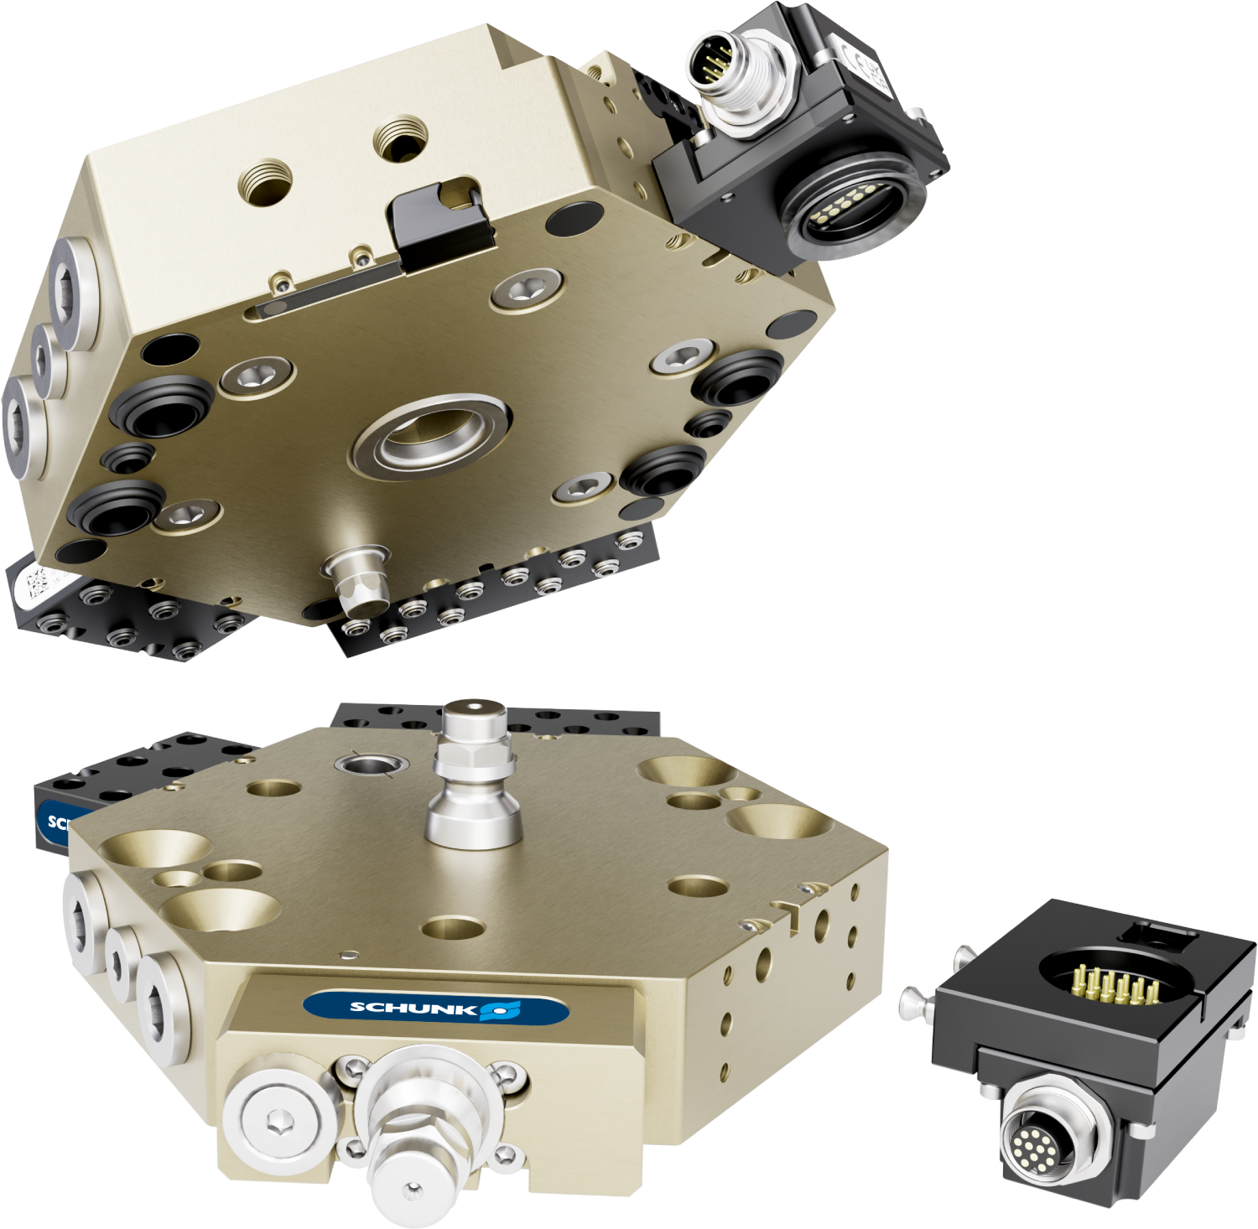
Your added value
Flexible. Compact. Future-proof.
Robot PLUS | Automatic Toolchanger CPB
Versatile
media transfer
A broad range of signal, pneumatic, fluid, and communication modules expand the application options of the tool changer
Process-reliable sensor scanning
Optionally available sensors check the
locking status and the presence of
end effectors
Improved option modules
Thanks to the integrated pin interface,
the modules are easy to attach and convince with their low interfering
contours
Maximum operational safety
The self-retaining locking system with integrated spring provides reliable coupling, even in case of an unexpected pressure drop

Slide 5
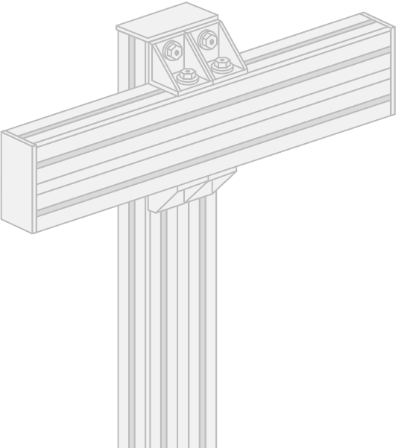
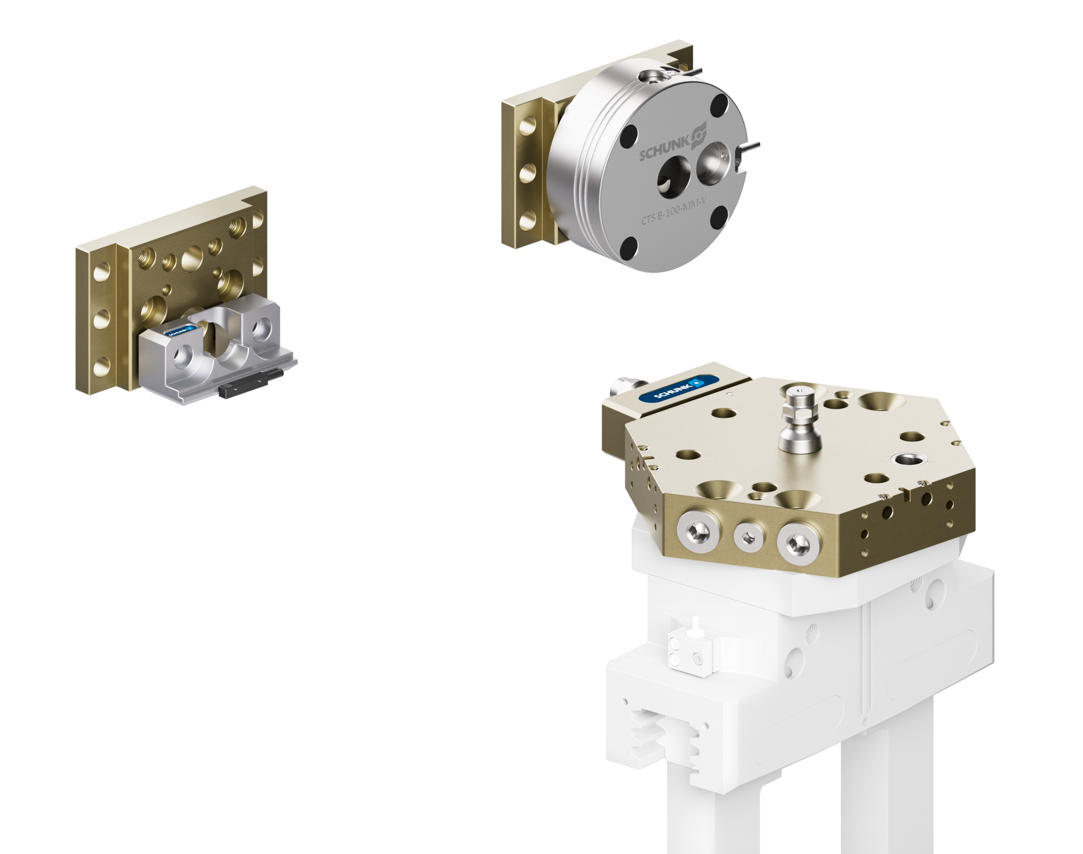
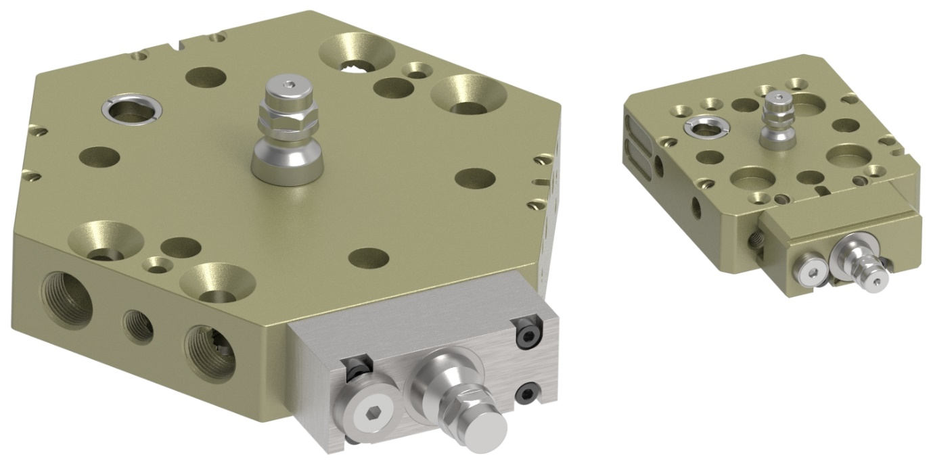
Extensive range of accessories (CTS B)
Robot PLUS | Automatic Toolchanger CPB
3 sizes 050, 085 and 300, available in active (with locking) and passive (without locking) versions
Mounting surface „A“ on all CPB adapters for mounting the CTS B bolt
CTS B
active
CTS B
passive

Slide 6
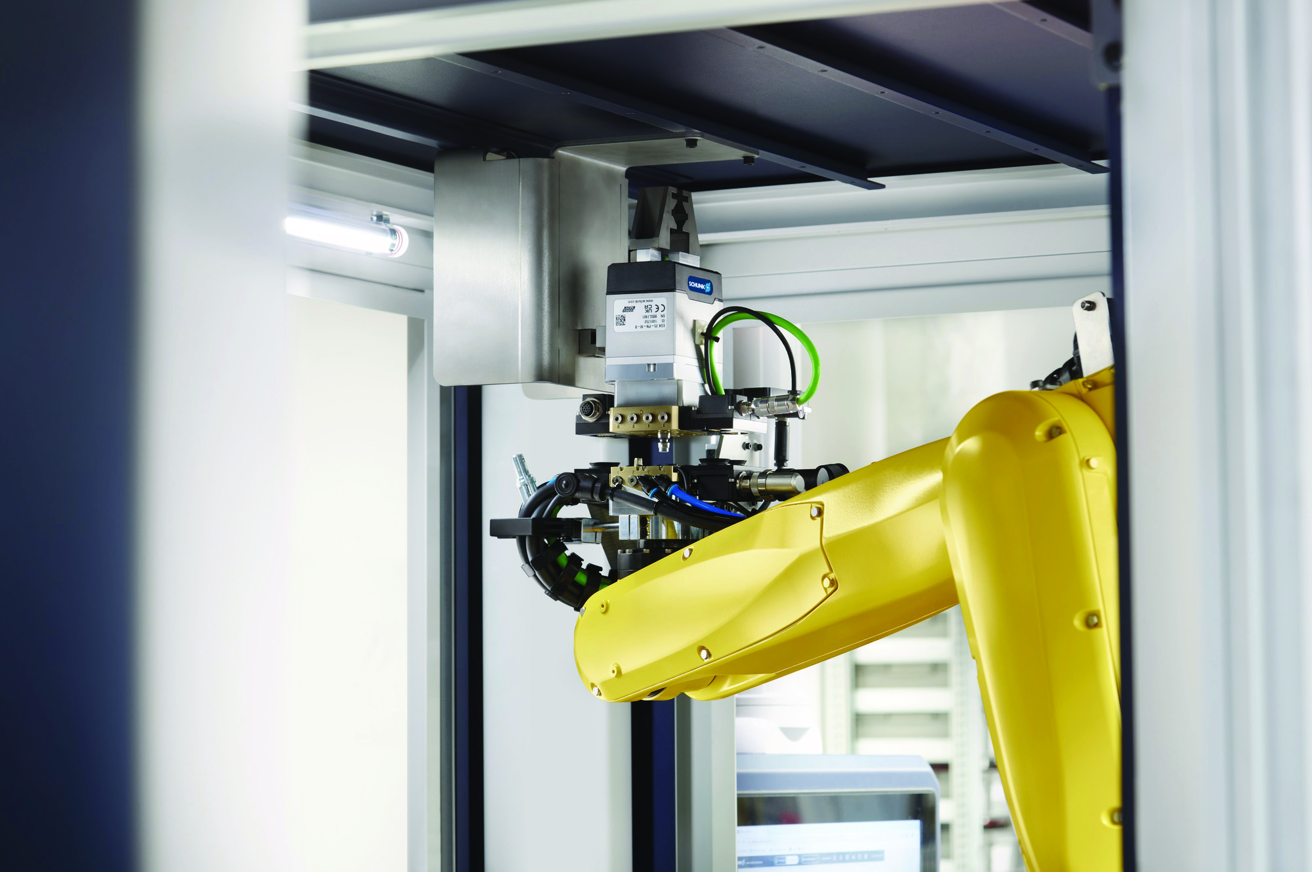
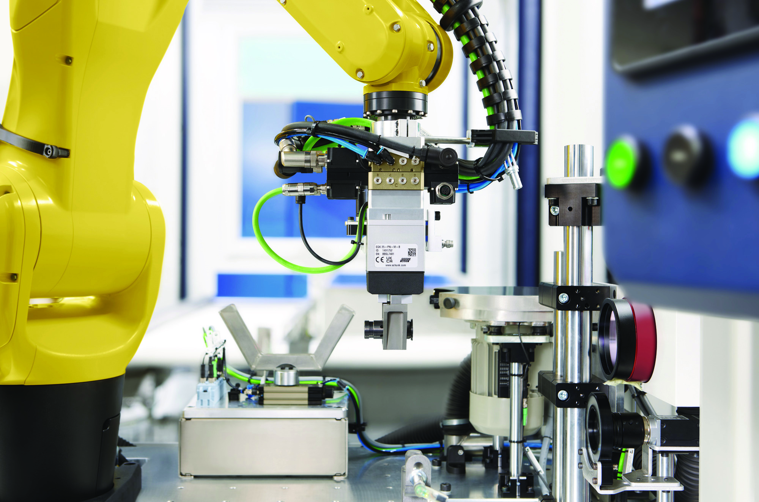
Application
Robot PLUS | Automatic Toolchanger CPB

Slide 7
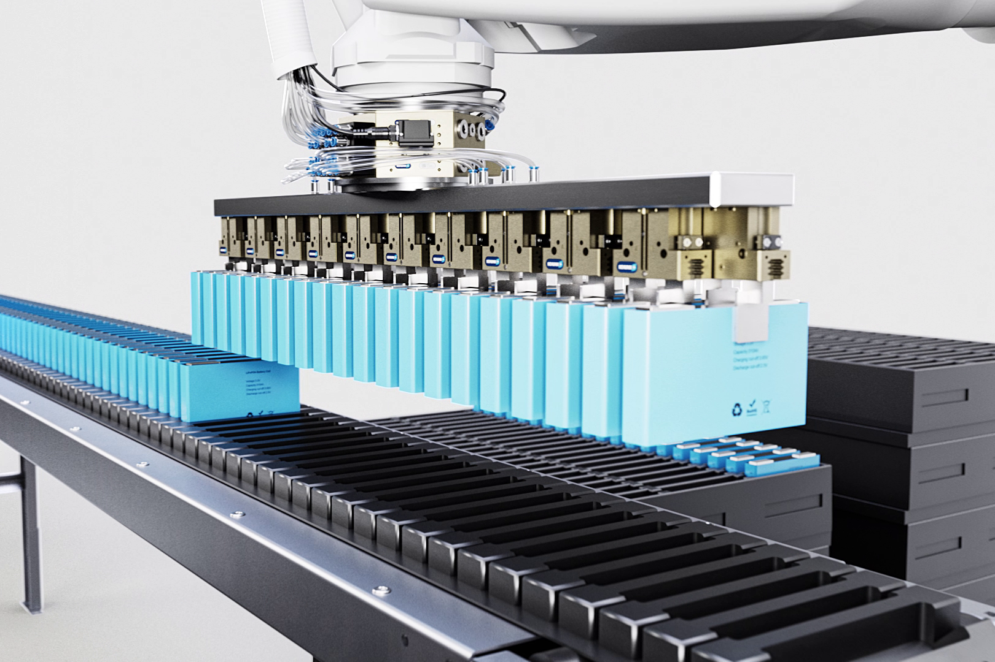
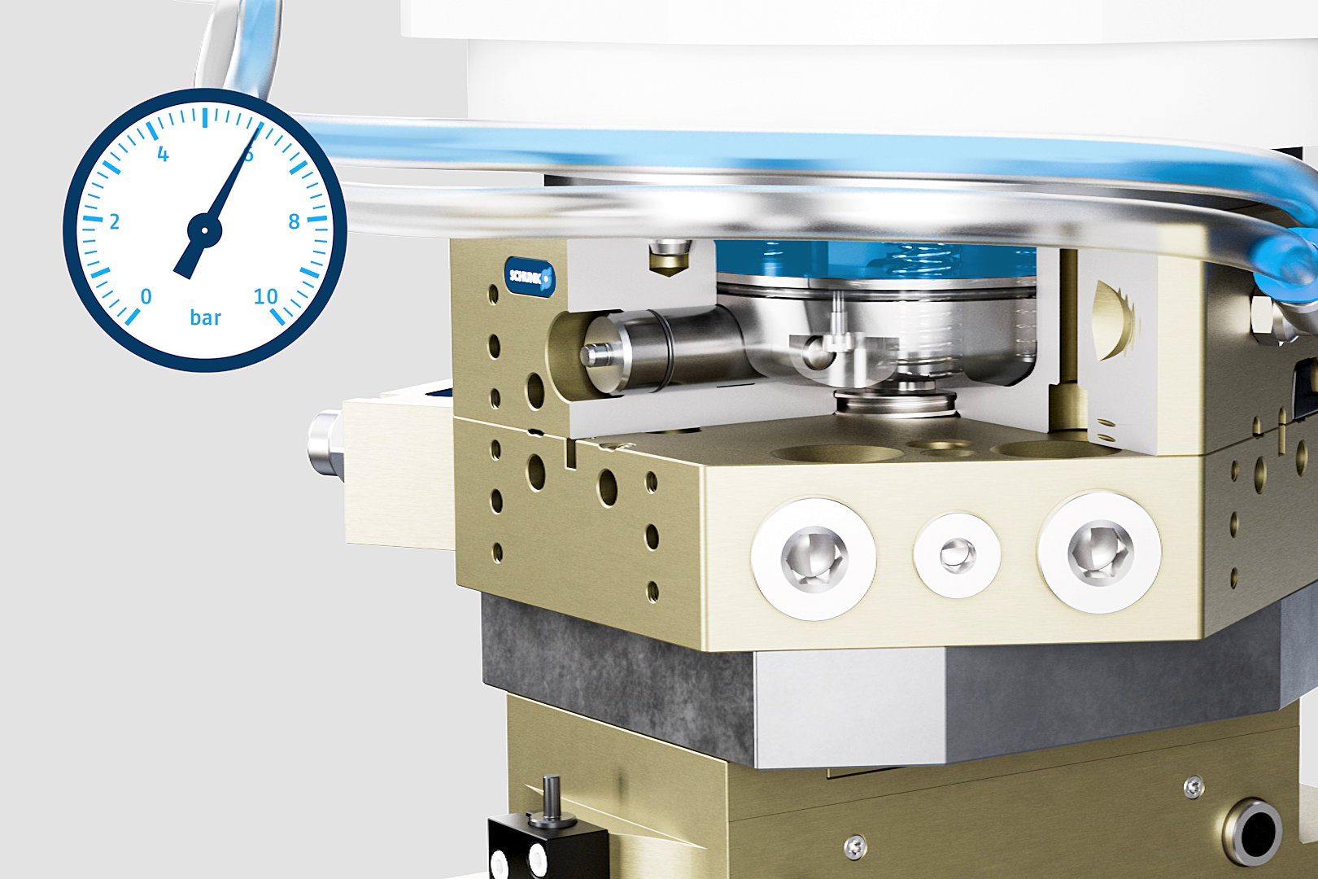
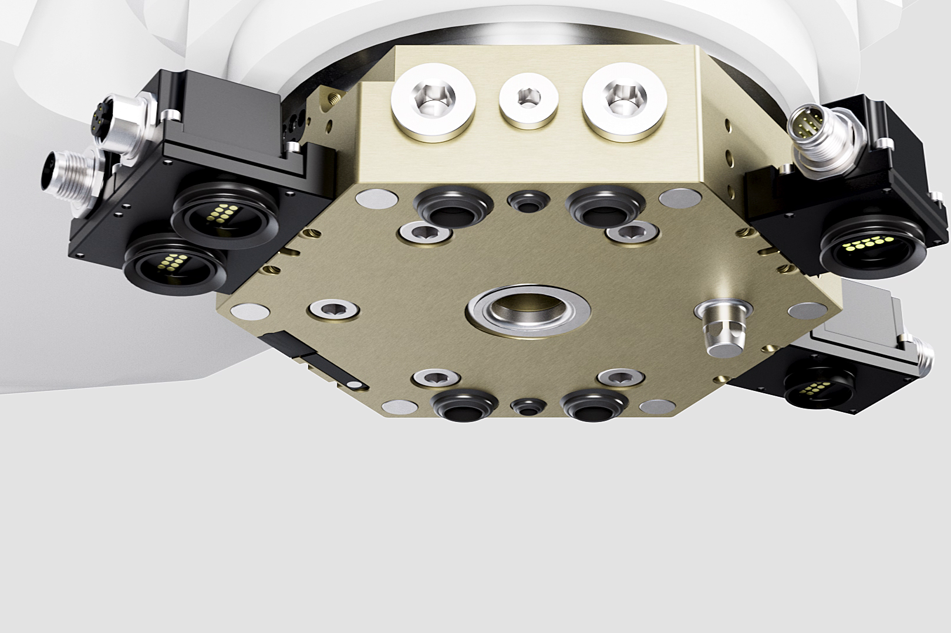
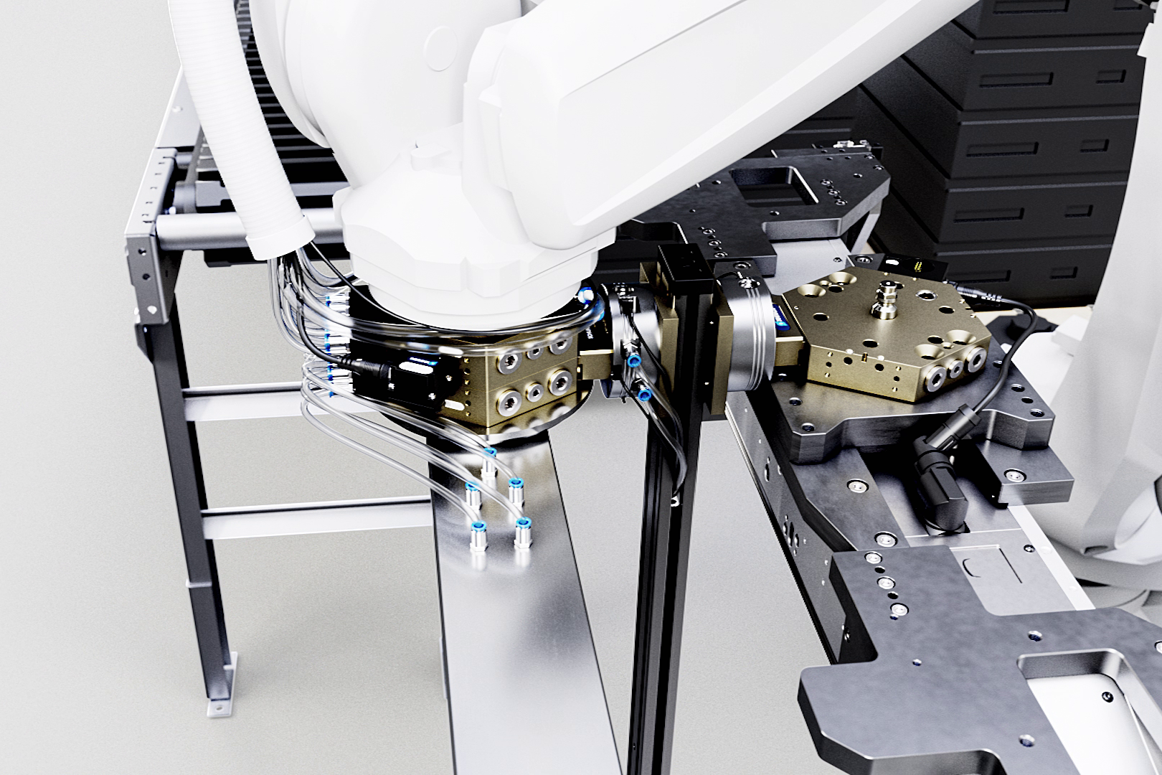
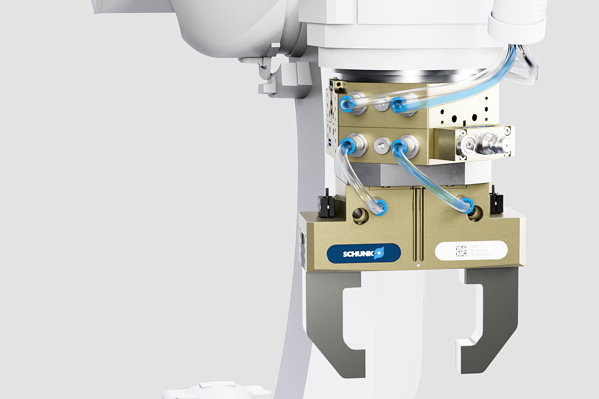
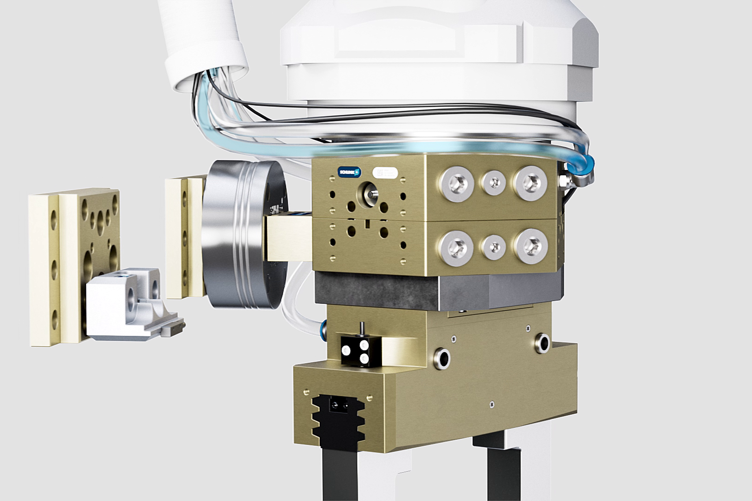
Product animation
Robot PLUS | Automatic Toolchanger CPB
Animation

Slide 8

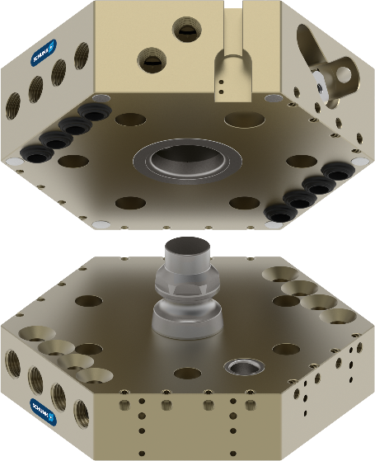
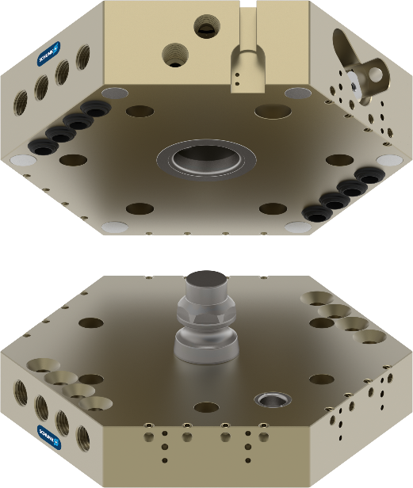
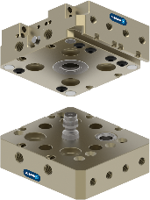
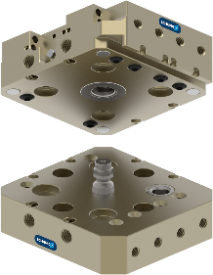
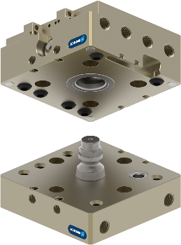
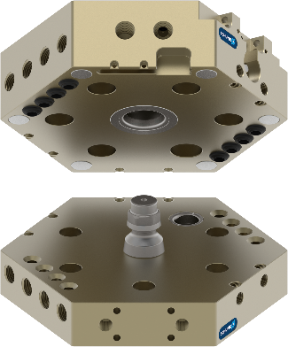
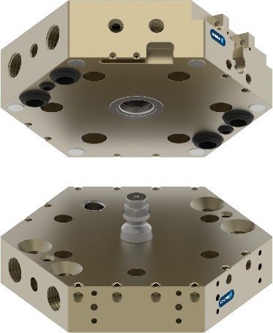
CPB
From the Machine Table to the Robot
Robot PLUS | Automatic Toolchanger CPB
Size | Payload | Weight when coupled | Max. dynamic moment M_{X} / M_{Z} | Sensors inductive for lock/unlock prepared | Sensors inductive for tool presence prepared | Repeat accuracy | Operating pressure | Amount of mounting surfaces for optional modules
 | [kg] | [kg] | [Nm] |  |  | [mm] | [bar]
CPB 040 | 20 | 0,41 | 100 / 100 |  |  | 0,015 | 4,5-7 | 2
CPB 050 | 35 | 0,57 | 125 / 125 |  |  |  |  | 2
 |  |  |  |  |  |  |  | 2
CPB 063 | 50 | 1,23 | 350 / 350
 |  |  |  |  |  |  |  | 3
CPB 080 | 85 | 1,92 | 500 / 500
 |  |  |  |  |  |  |  | 3
CPB 100 | 100 | 3,03 | 800 / 600
 |  |  |  |  |  |  |  | 3*
CPB 125 | 200 | 7,22 | 2.000 / 1.000
CPB 160 | 300 | 10,56 | 3.000 / 1.500 |  |  |  |  | 3*

Slide 9
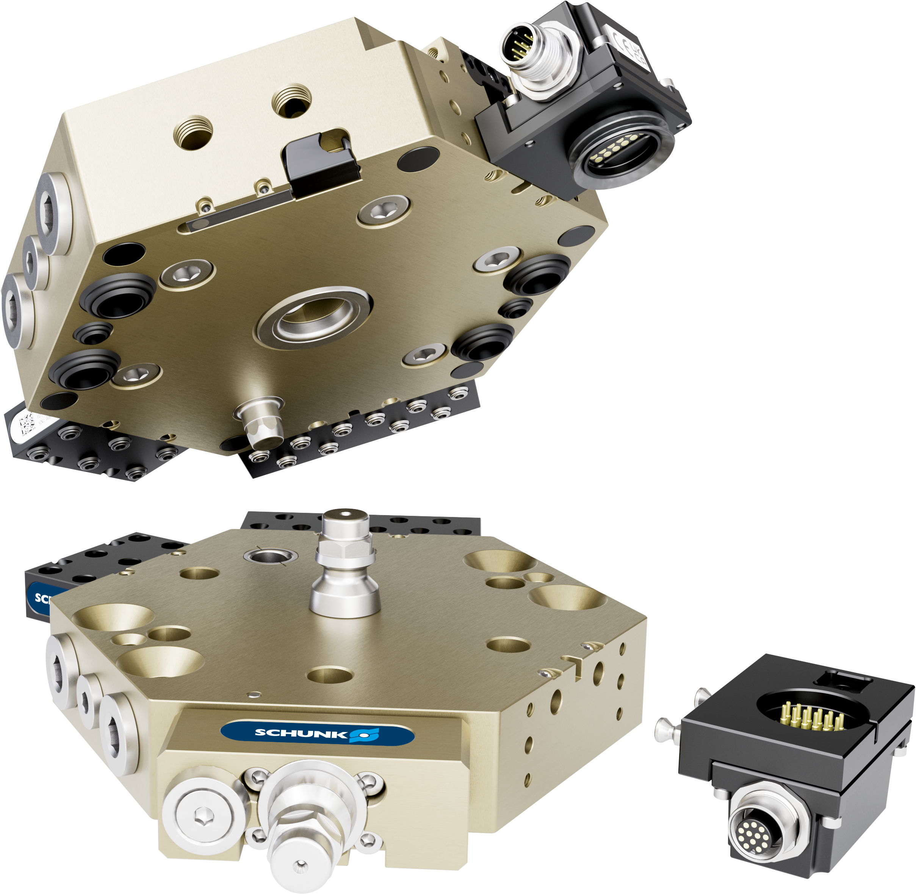
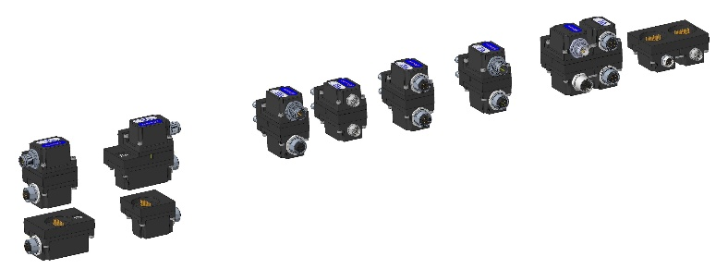
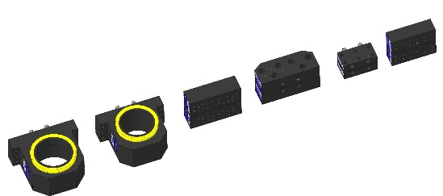
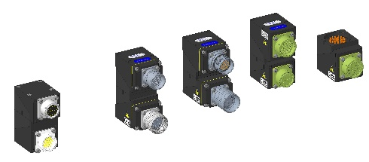
Option modules (COB)
Robot PLUS | Automatic Toolchanger CPB
SIGNAL | COMMUNICATION | POWER | PNEUMATIC | VACUUM
> 50 Variants
COB S12R/L + Tool coding | COB CB2 | COB CB2 | COB A6M5 | COB V1A
COB P4 | COB CB1 | COB CB3 | COB A618A | COB V2A
COB S8 + Tool coding | COB CIO1 |  | COB A10M5
 | COB CB3
 | COB CB4
 | COB CB6
All optional modules with serialization using DMC code
Newly developed COB option modules, can be screwed directly to CPB

Slide 10
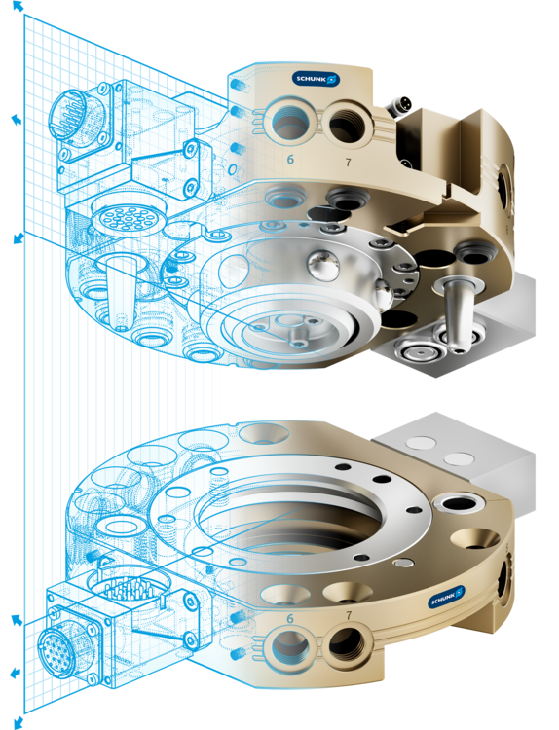
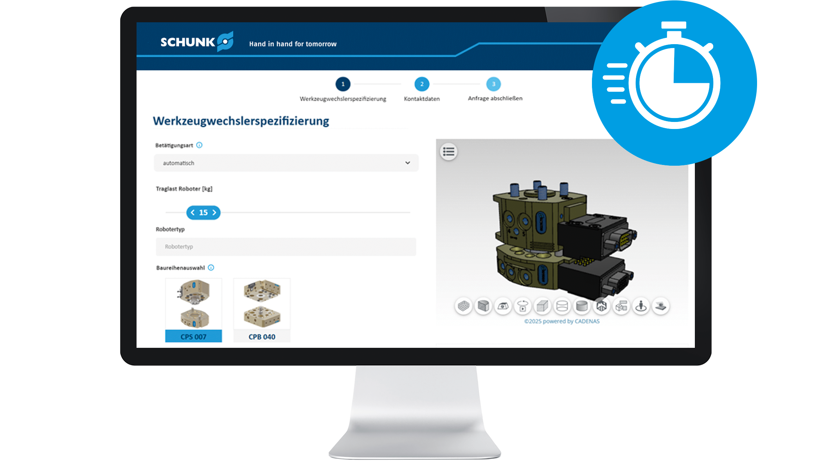
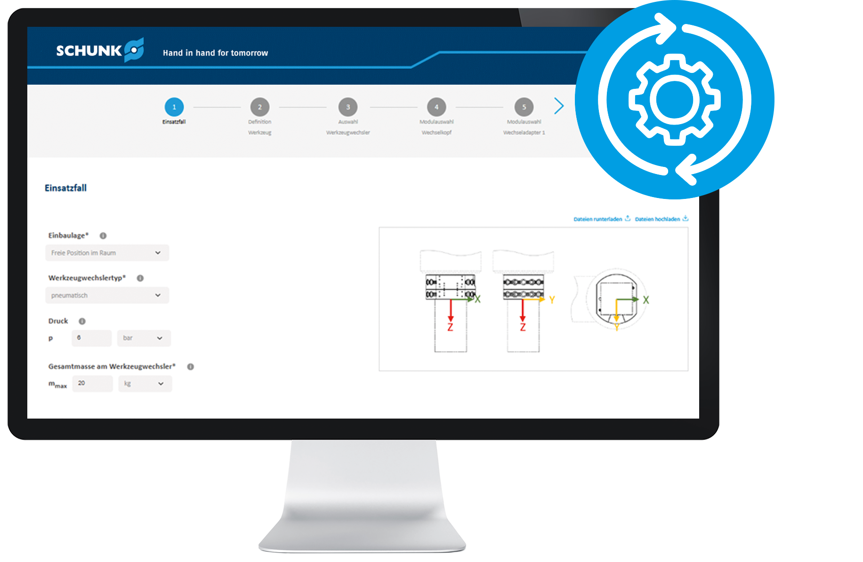
Two ways, one goal
The perfect tool changer for your project!
Robot PLUS | Automatic Toolchanger CPB
Fast & simple
Optimal & precise
Are you at the start of your project? Configure your tool changer quickly and easily and download the right CAD data for your concept in just a few clicks.
Are you looking for the perfect solution for your application? Configure an optimum tool changer based on your process and tool parameters and receive a technically valid solution, including CAD data and data sheet.
To the configurators

Slide 11


Slide 12




Portfolio
In modern manufacturing, flexibility and efficiency are key.
SCHUNK's Robot PLUS portfolio is specifically designed to enhance your production processes. It offers a comprehensive range of tool changers, compensation units, and force/torque sensors – developed based on decades of experience.
Partnering with SCHUNK means benefiting from a combination of high-quality products and comprehensive, reliable support that drives and supports your automation projects worldwide.

Slide 13

Portfolio
Tool Changer
Compensation unit
Force/torque Sensor
Automatic Tool Changer
CPS
Force/torque Sensor FTS
Compensation unit AGM
Automatic Tool Changer
CPB
Manual Tool Changer CMS

