Slide 1
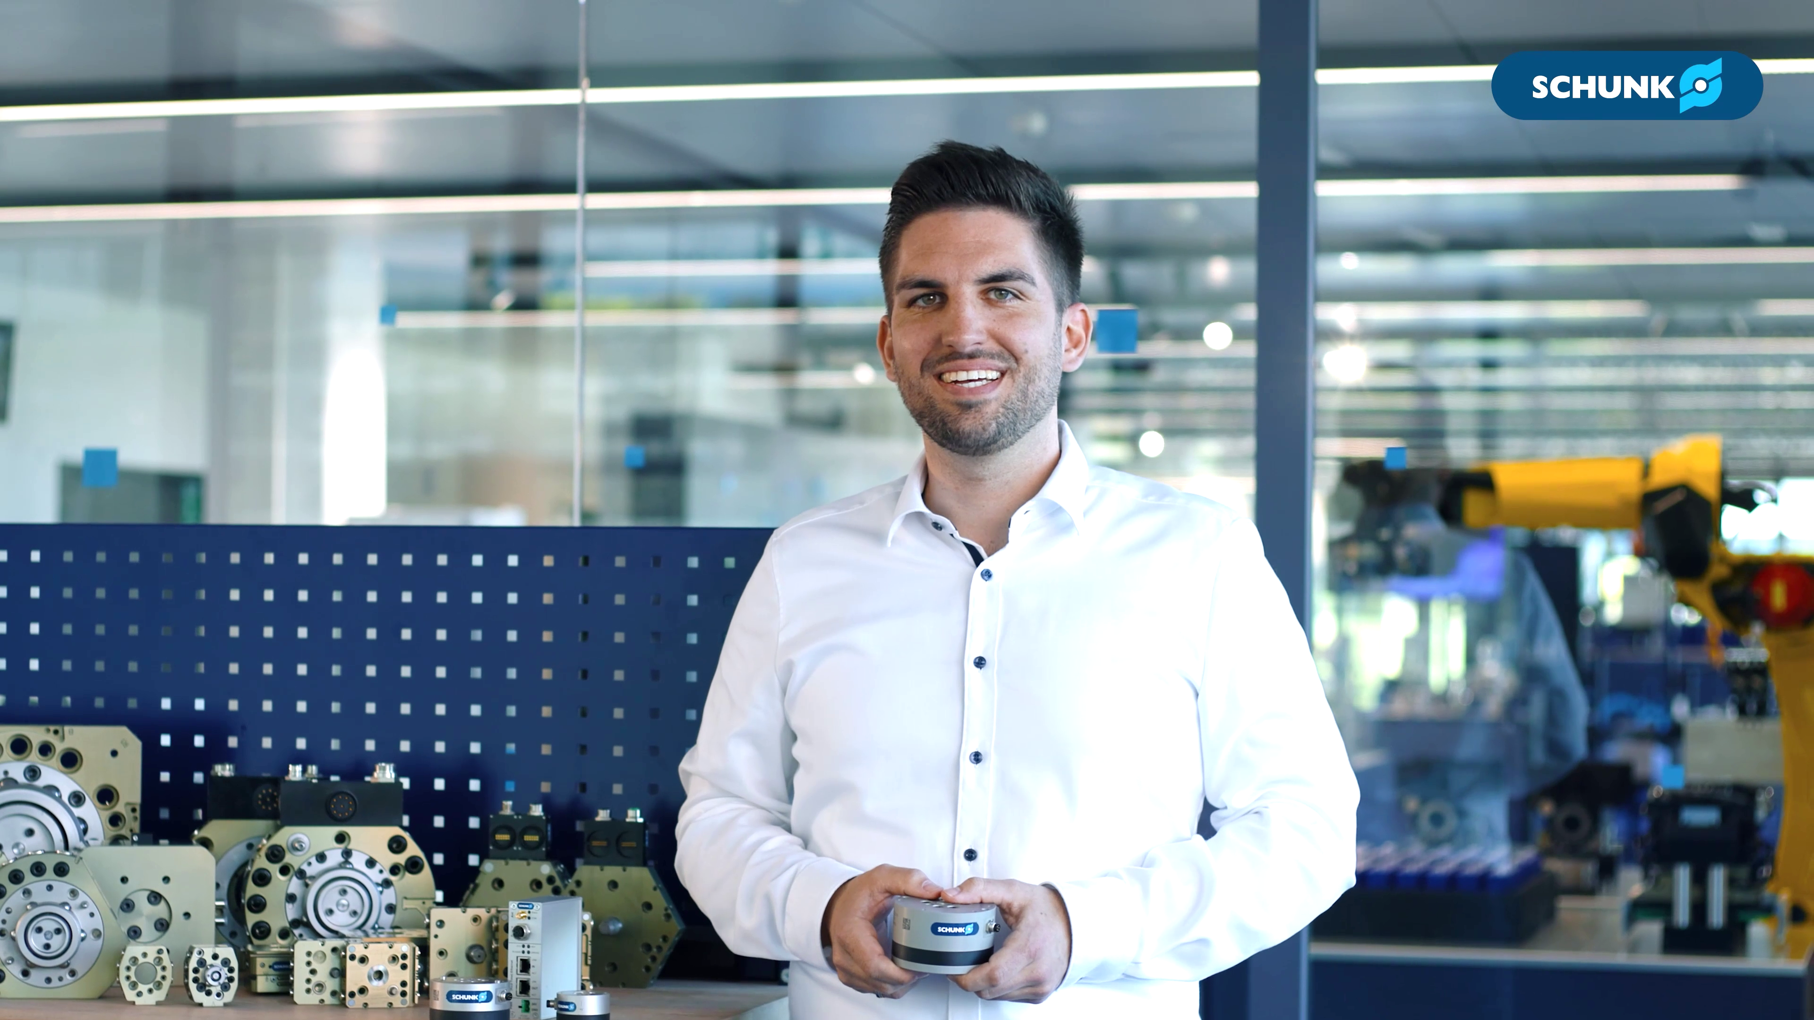


Fingerspitzen-gefühl für Ihre Roboter
FTS
A sense of touch for your robots

Slide 2
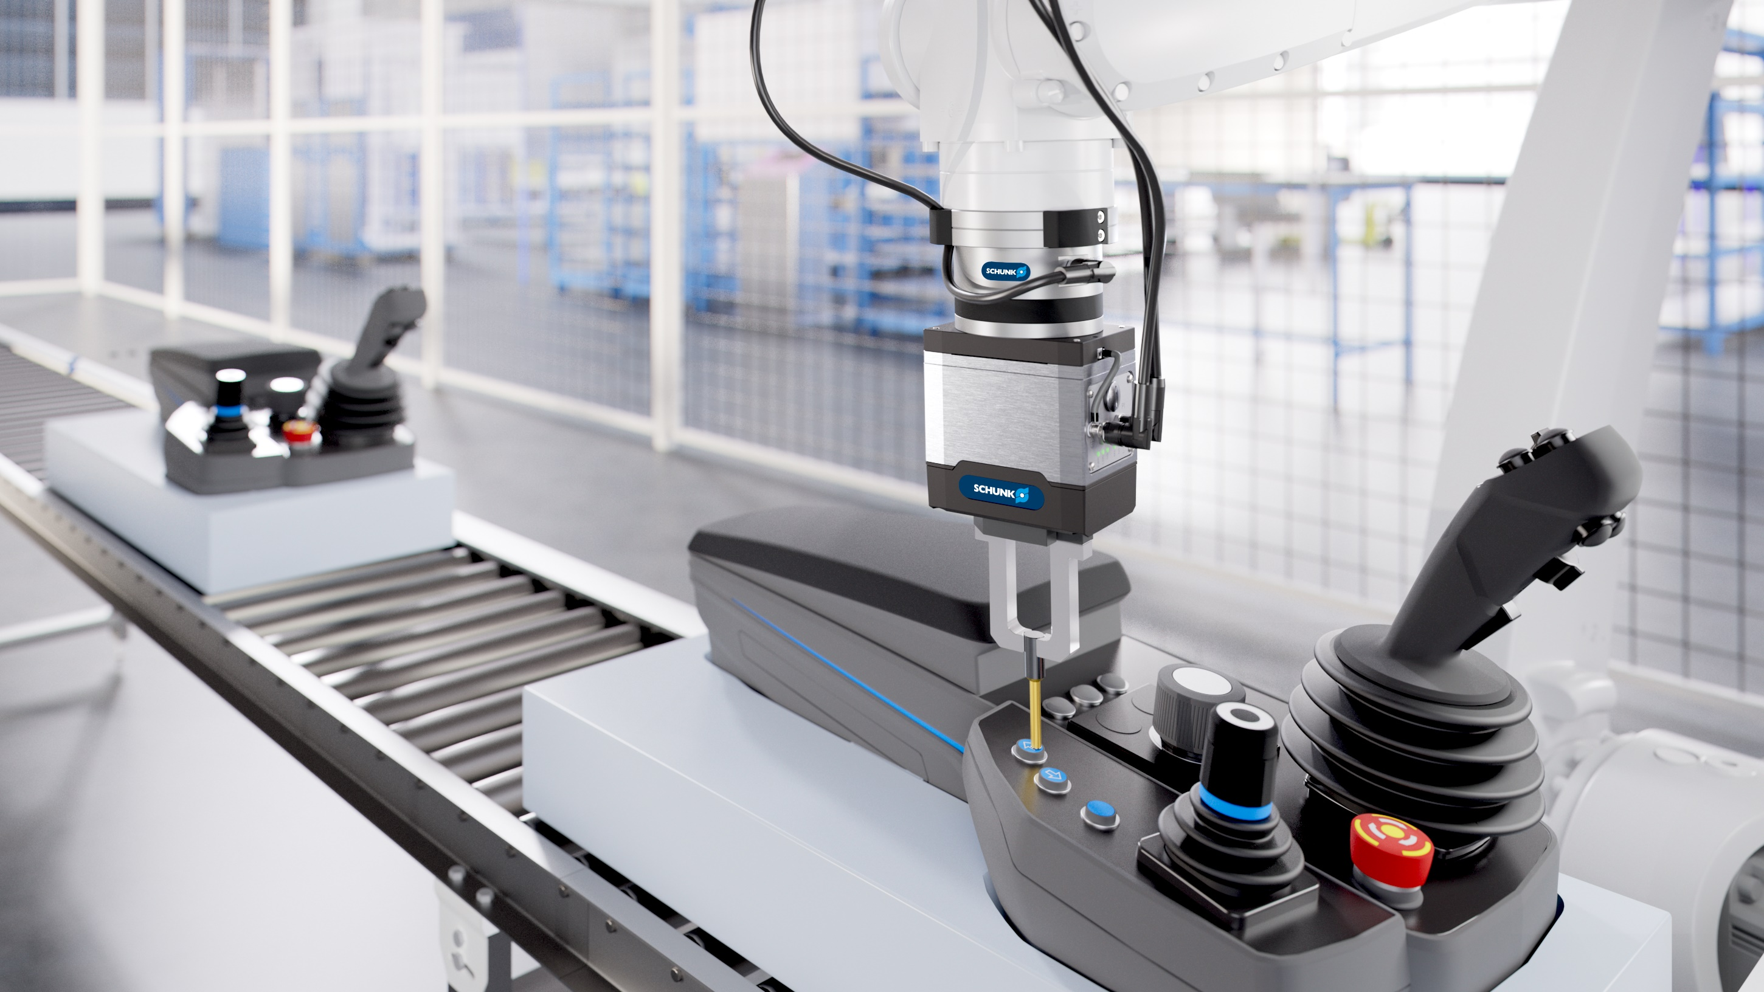

FTS
A sense of touch for your robots

Slide 3
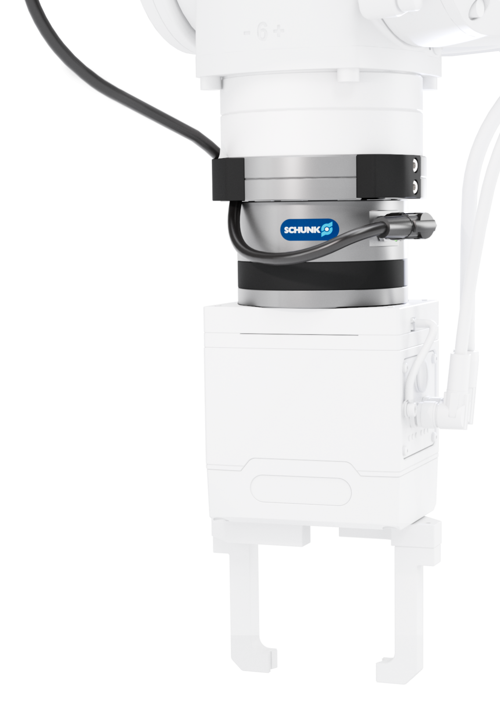
Your added value
Precise. Compact. High-resolution.
Robot PLUS | Force Torque Sensor FTS
  ​​Maximum precision
  The strain gauges of the FTS detect the mecha - nical deformation of the sensor body and convert it into high-precison signals in all six degrees of freedom (Fx, Fy, Fz, Mx, My, Mz)
  Seamless integration
  The interface box with the communication interfaces EtherNet/IP, EtherCAT and PROFINET enables simple and flexible integration into customer network topologies
  Intuitive commissioning
  The SCHUNK Control Center simplifies commis - sioning thanks to the user-friendly interface and creates synergies with other SCHUNK products

Slide 4
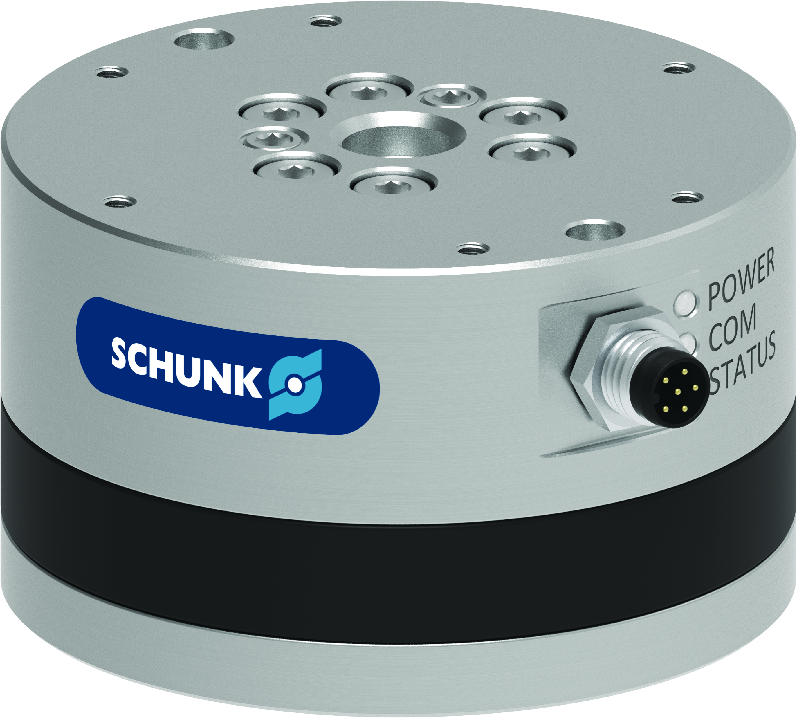
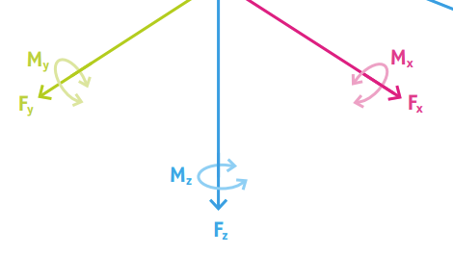
More Features
Robot PLUS | Force Torque Sensor FTS
Simple assembly
Thanks to standardized ISO mounting patterns on the tool side and adapter plates on the robot side, the FTS can be mounted quickly and easily
Robust sensor body
The high rigidity ensures excellent measurement accu - racy and durability, even in dynamic applications
Visual condition monitoring
Integrated LEDs for power, communication and status simplify condition monitoring
Reliable protection
Thanks to protection class IP67, the sensor is suitable for use in demanding environments ​
Maximum flexibility
With nine sizes and large measurement ranges (Fxy: 125–16,000N, Fz: 300–32,000N, Mxyz: 4.5–2,800Nm), the series offers the right solution for any application

Slide 5
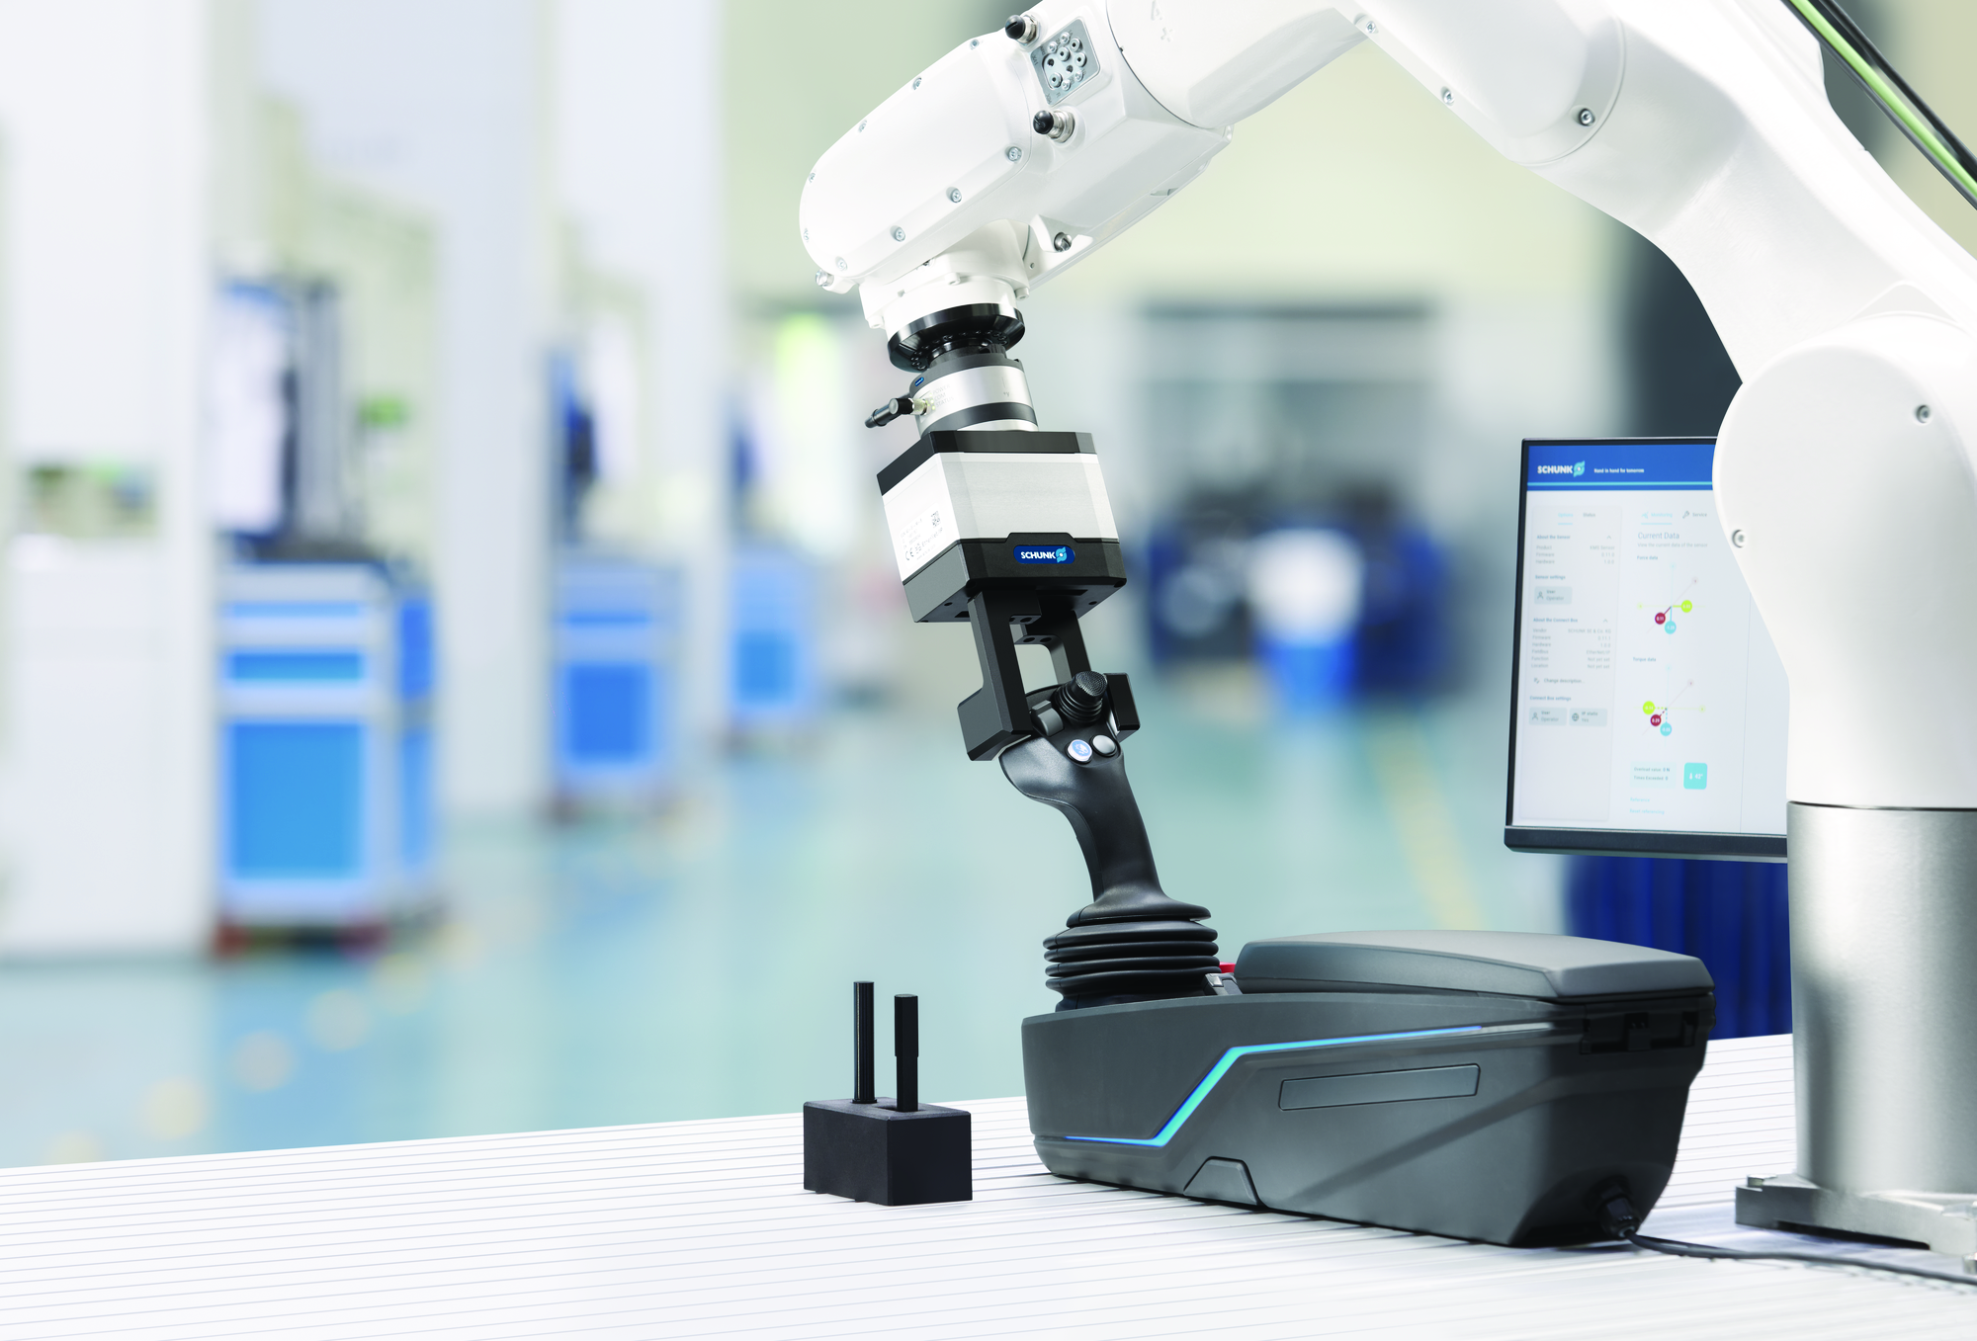
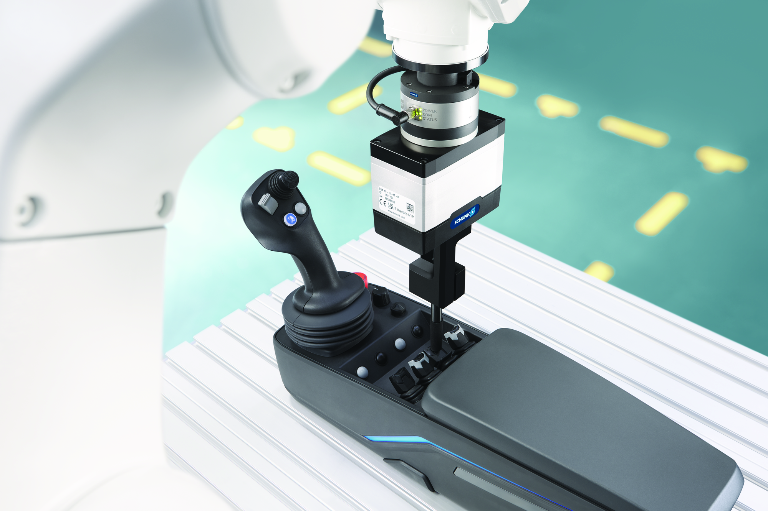
Application
Robot PLUS | Force Torque Sensor FTS

Slide 6
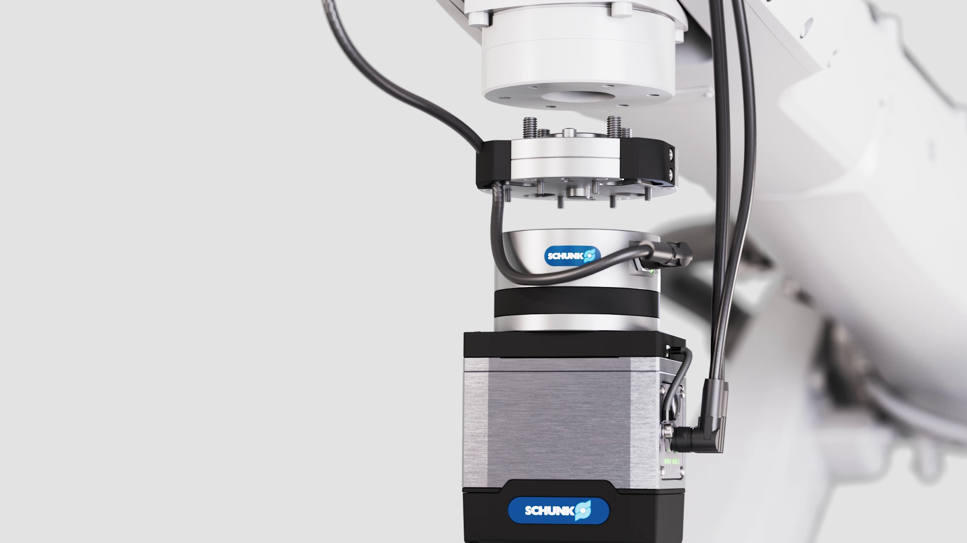
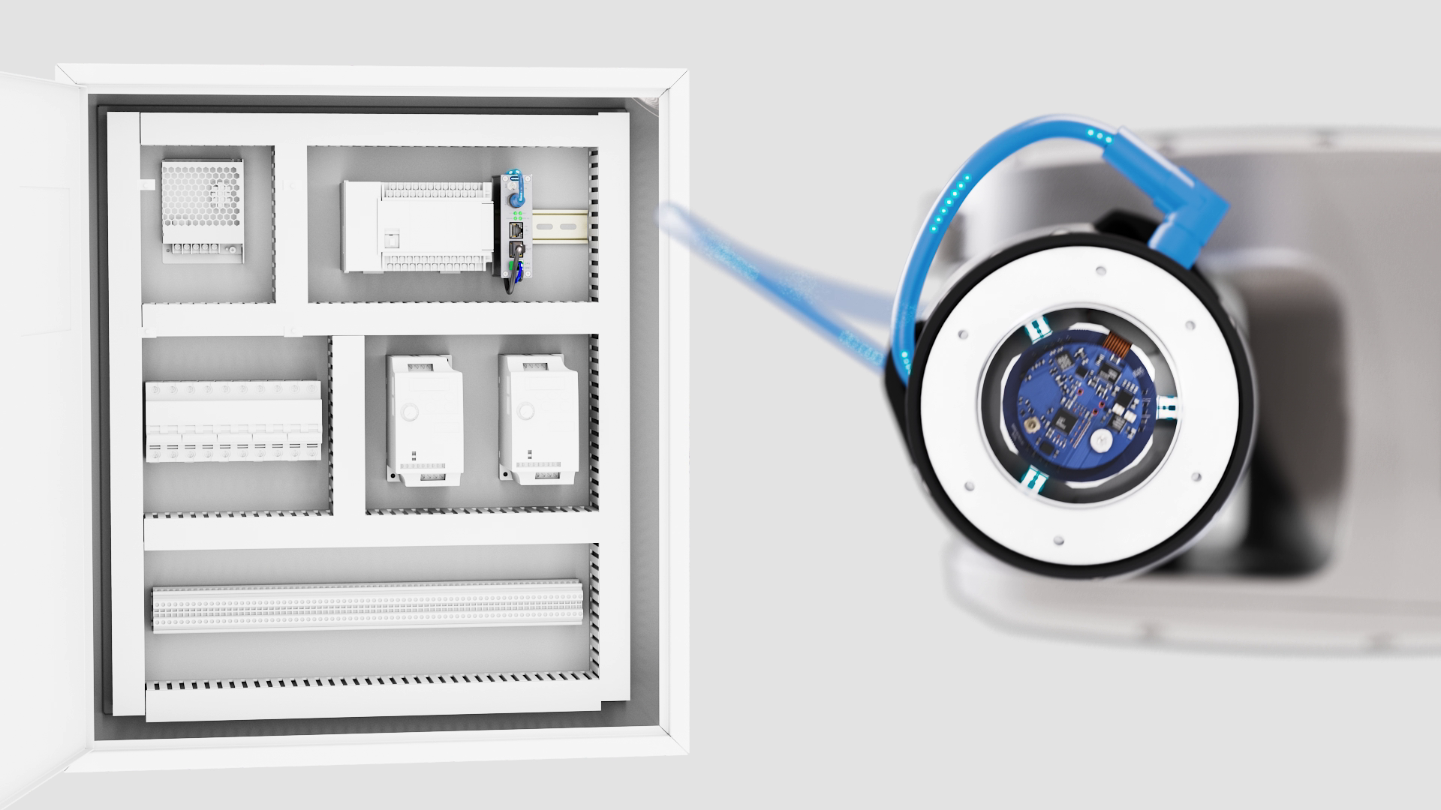
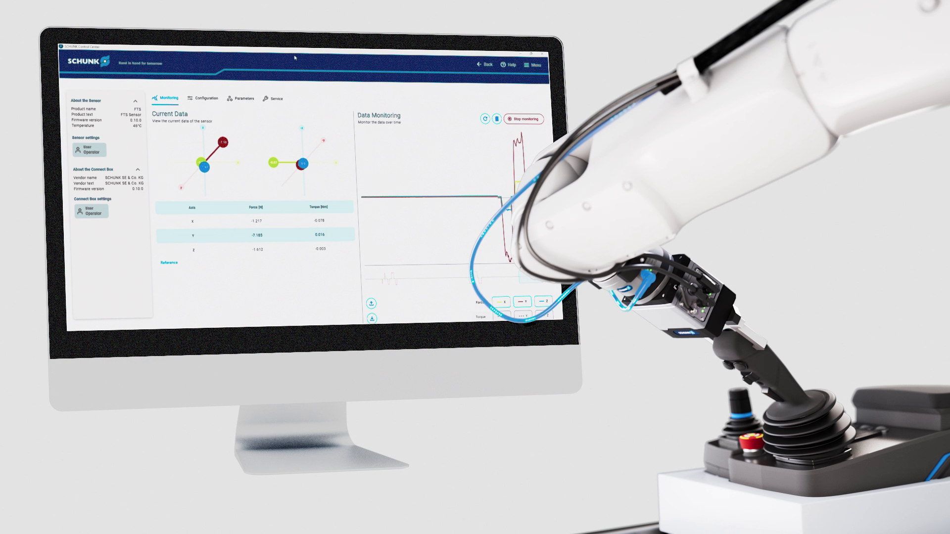
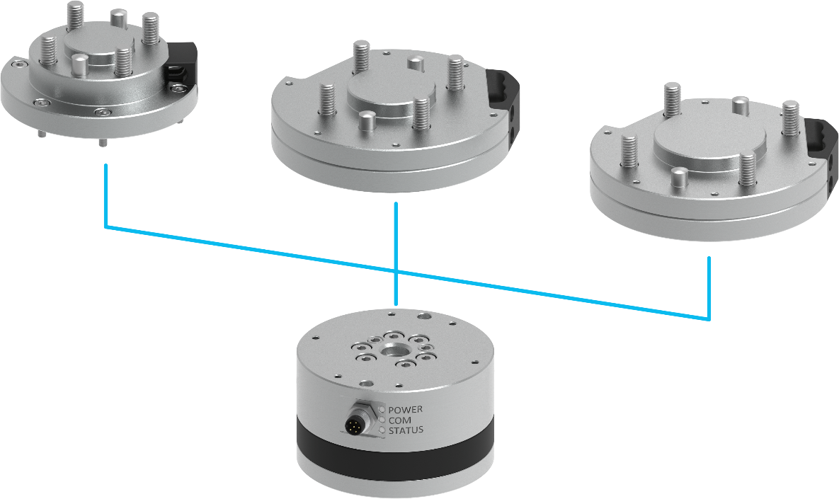
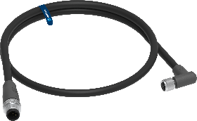
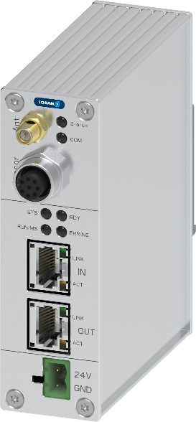
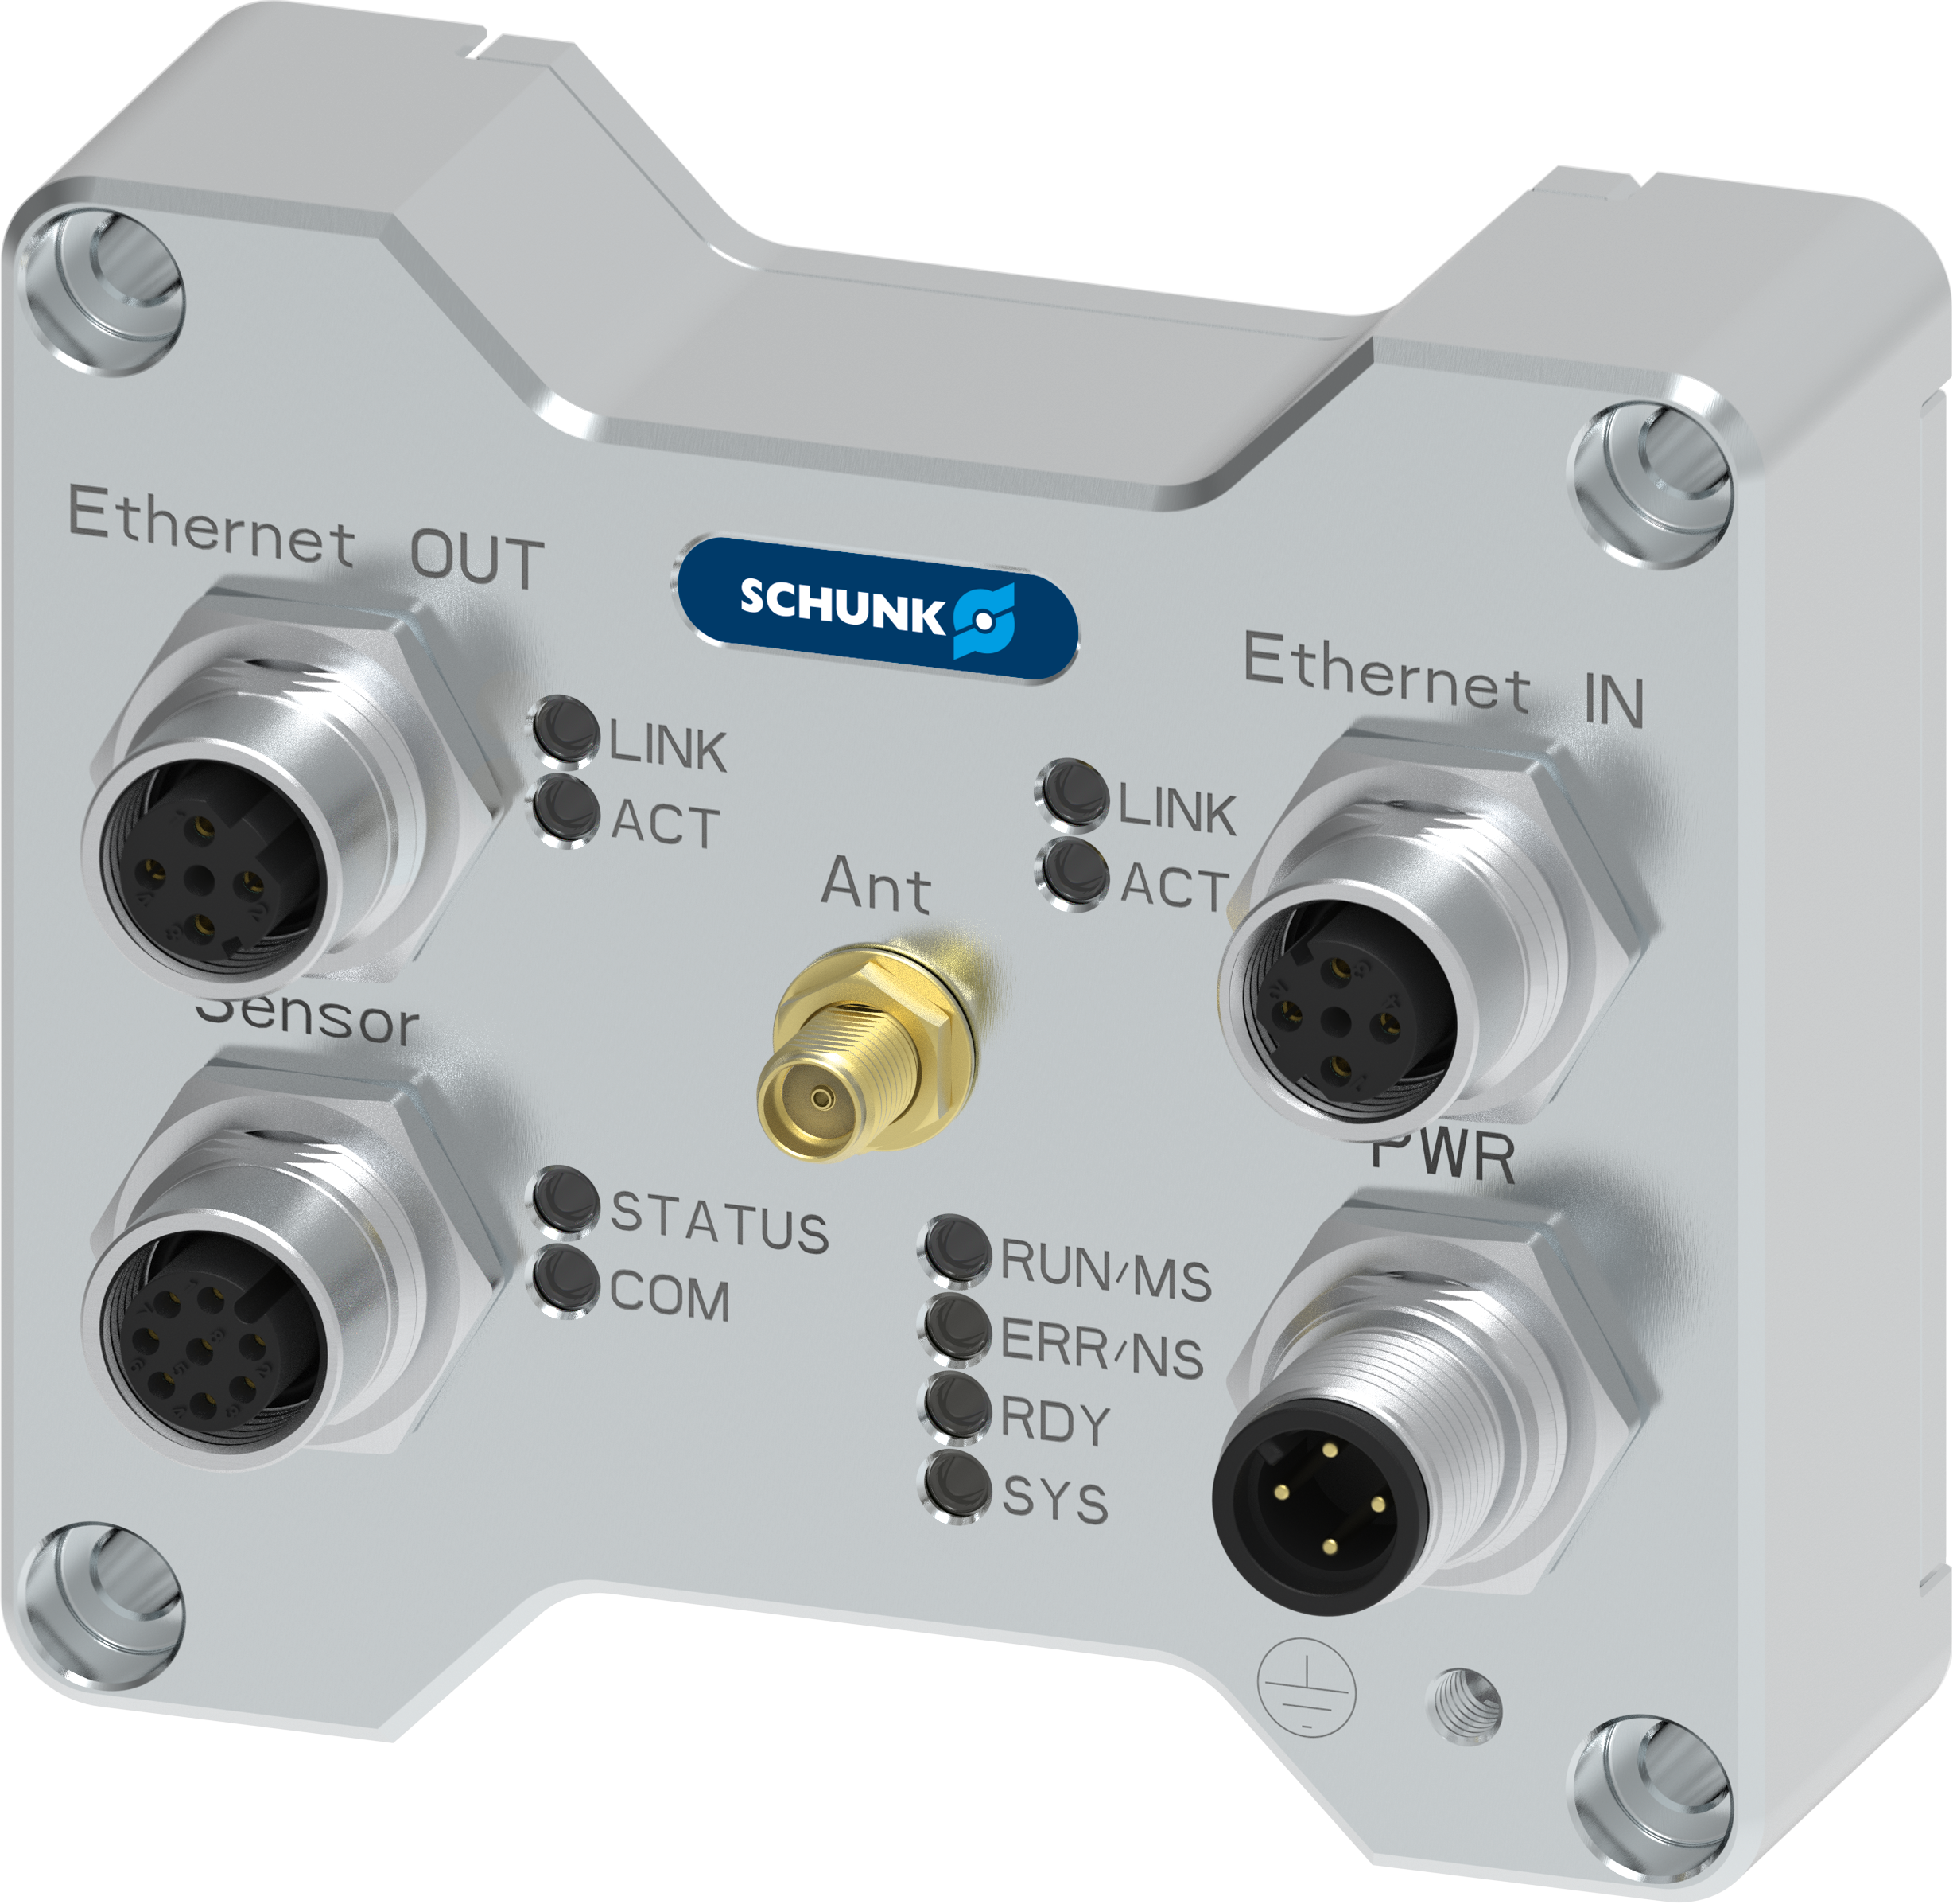
Large portfolio of accessories
Robot PLUS | Force Torque Sensor FTS
SCHUNK Control Center
For commissioning and analysis
Cable
5 lenghts
2 variants
Interface-Box
1 for all Interfaces
2 variants (IP67)
ISO-Adapter
3 sizes for each Sensor

Slide 7
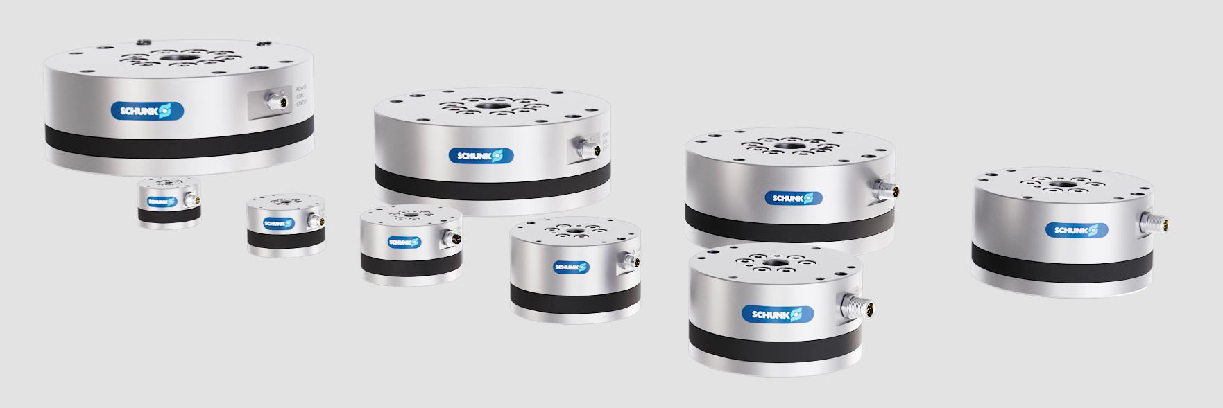
Variety of sizes
Robot PLUS | Force Torque Sensor FTS
  Wide range of applications: The consistent series with 9 sizes offers the right solution for every application
FTS 250
FTS 200
FTS 160
FTS 125
FTS 047
FTS 056
FTS 070
FTS 085
FTS 105

Slide 8
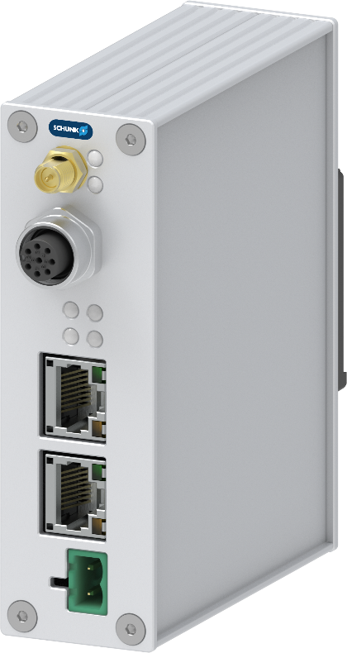





Interface Options
Robot PLUS | Force Torque Sensor FTS
Ethernet TCP/UDP
EtherNet/IP
EtherCAT
PROFINET

Slide 9
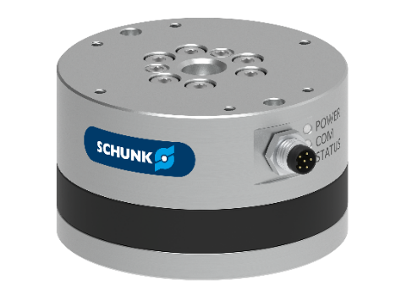


System overview FTS
Robot PLUS | Force Torque Sensor FTS
FTS | 056 | 600 | 11
Series Force Torque Sensor | Size Outer Diameter Ø56mm | Measurement Range Fz 600 N | Measurement Range Mxyz 11 Nm
FTS | IFB | PN
Series Force Torque Sensor | Interface Face Box | PN PROFINET EI EtherNet/IP EC EtherCAT EN Ethernet | - IP67 (optional)
FTS | C | M8 | M12 | 10
Series Force Torque Sensor | Cable | M8 Size 047 - 085 M12 Size 105 - 250 | M12 Interface Box | 10 m Cable length

Slide 10
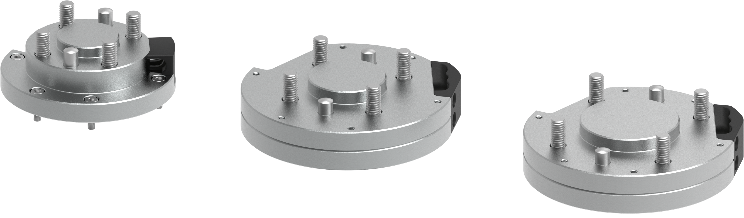
Interface plates
Robot PLUS | Force Torque Sensor FTS
  Easy assembly​: Thanks to standardized ISO mounting patterns and adapter plates, the FTS can be integrated quickly and seamlessly​​
Size | Diameter | Mesurement Range |  |  | Tool side | Robot side Interface plate (optional)
 | Ø | Fx/Fy | Fz | Mx/My/Mz |  | S (small) | M (medium) | L (large)
FTS 047 | 47 mm | 125 N | 300 N | 4,5 Nm | ISO 31,5 | ISO 25 | ISO 31,5 | ISO 40
FTS 056 | 56 mm | 250 N | 600 N | 11 Nm | ISO 40 | ISO 31,5 | ISO 40 | ISO 50
FTS 070 | 70 mm | 500 N | 1200 N | 28 Nm | ISO 50 | ISO 31,5 + ISO 40 | ISO 50 | ISO 63
FTS 085 | 85 mm | 1000 N | 2400 N | 70 Nm | ISO 63 | ISO 50 | ISO 63 | ISO 80
FTS 105 | 105 mm | 2000 N | 4800 N | 175 Nm | ISO 80 | ISO 63 | ISO 80 | ISO 100
FTS 125 | 125 mm | 3200 N | 7800 N | 350 Nm | ISO 100 | ISO 80 | ISO 100 | ISO 125
FTS 160 | 160 mm | 5000 N | 12500 N | 700 Nm | ISO 125 | ISO 100 | ISO 125 | ISO 160
FTS 200 | 200 mm | 10000 N | 20000 N | 1400 Nm | ISO 160 | ISO 125 | ISO 160 | ISO 200
FTS 250 | 250 mm | 16000 N | 32000 N | 2800 Nm | ISO 200 | ISO 160 | ISO 200 | ISO 250

Slide 11


Slide 12





Portfolio
In modern manufacturing, flexibility and efficiency are key.
SCHUNK's Robot PLUS portfolio is specifically designed to enhance your production processes. It offers a comprehensive range of tool changers, compensation units, and force/torque sensors – developed based on decades of experience.
Partnering with SCHUNK means benefiting from a combination of high-quality products and comprehensive, reliable support that drives and supports your automation projects worldwide.

Slide 13

Portfolio
Tool Changer
Compensation unit
Force/torque Sensor
Automatic Tool Changer
CPS
Force/torque Sensor FTS
Compensation unit AGM
Automatic Tool Changer
CPB
Manual Tool Changer CMS

