Slide 1
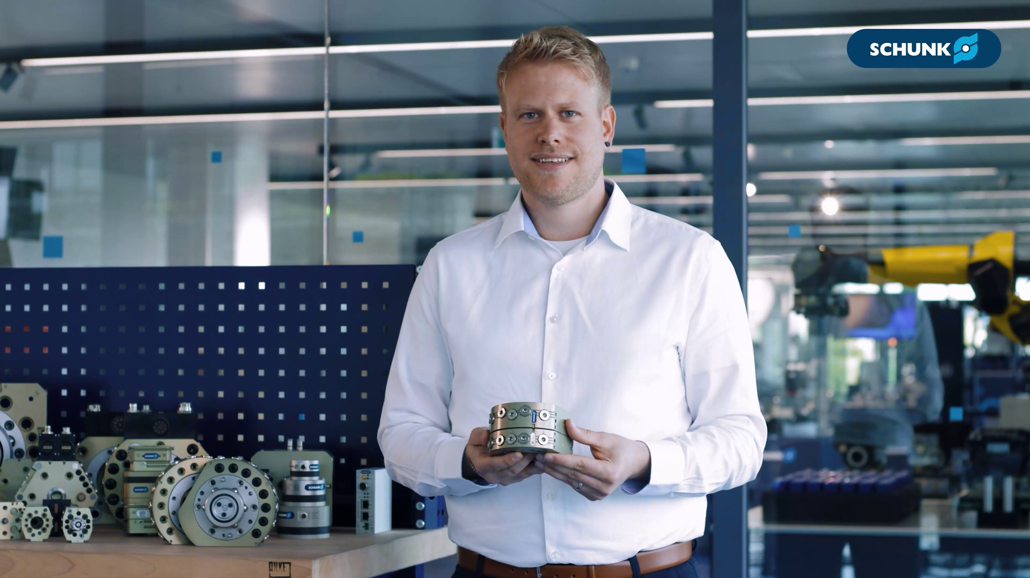


CPS
Fast & easy changing of end effectors on the robot

Slide 2

CPS
Fast & easy changing of end effectors on the robot

Slide 3
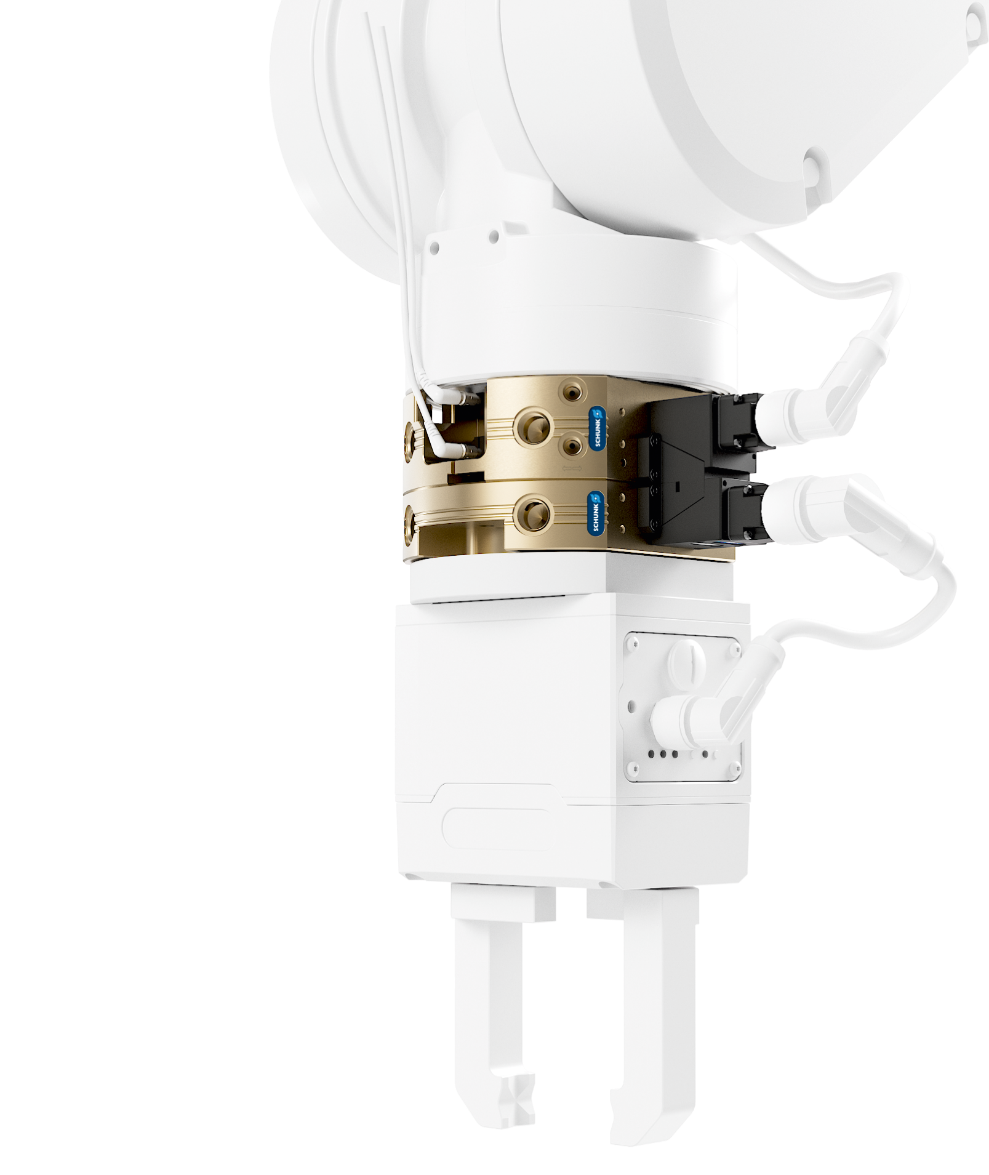
Your added value
Modular. Robust. Flexible.
Robot PLUS | Automatic Toolchanger CPS
  Consistent compatibility
  Thanks to full compatibility with SWS change masters and adapters, existing applications can be expanded or replaced on a 1:1 basis using the CPS system.
  Optimal size selection
  The CPS offers a wide range of applications with 18 sizes
  Versatile media transmission
  The broad range of signal, pneumatic, fluid, and communication modules expands the application possibilities of the tool changer
  Longevity
  The use of hardened steel in all functional parts increases durability and extends service life

Slide 4
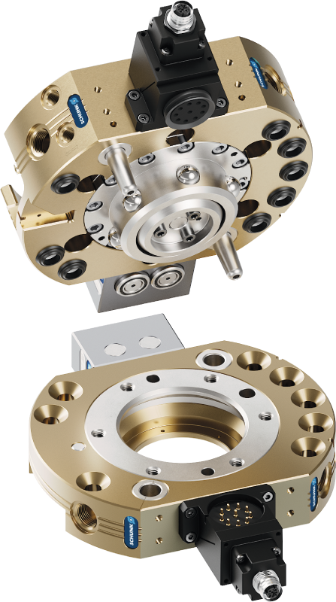
More Features
Robot PLUS | Automatic Toolchanger CPS
Easy assembly
Assembly can be done quickly
and easily via standardized adapter plates or ISO flange patterns
Sensor queries
Optionally available sensors
enable a process-safe verification
of the locking status of the
quick-change master and the
presence of the adapter
Integrated energy supply
The integrated pneumatic
pass-throughs ensures a reliable
supply of the handling modules
and tools
New locking mechanism
The new self-retaining locking system
with an integrated spring ensures
reliable coupling between the change
master and the adapter, enhancing
operational safety in the event of
an unexpected air pressure drops

Slide 5
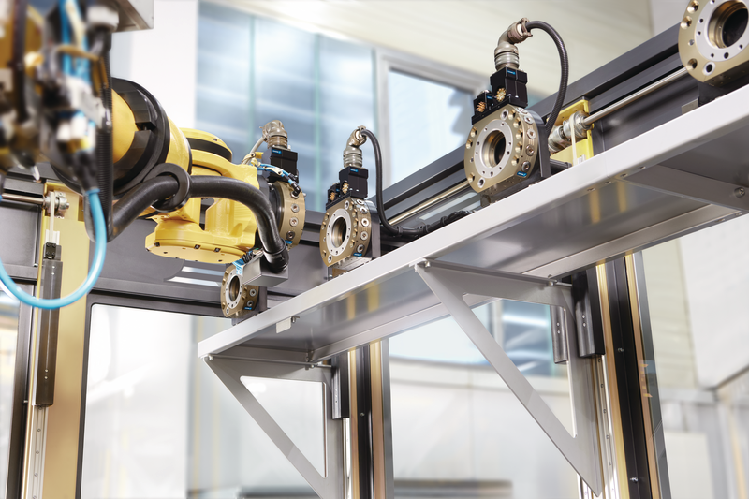
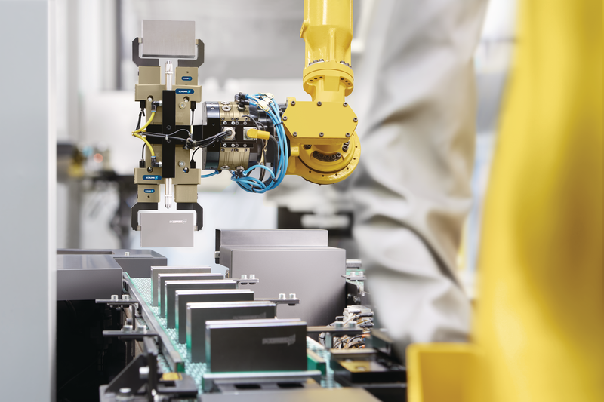
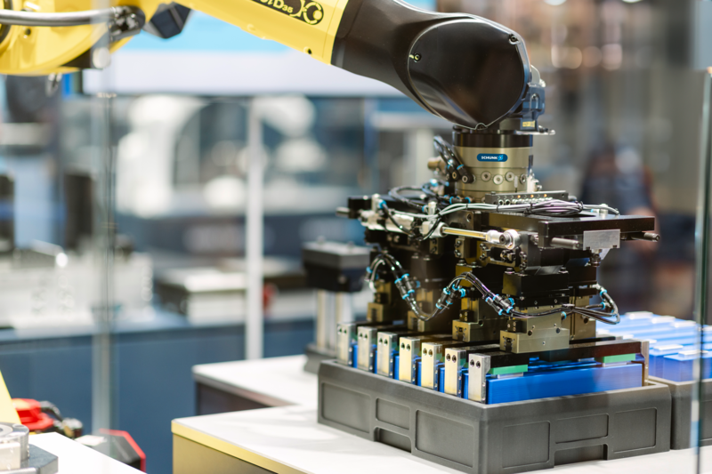
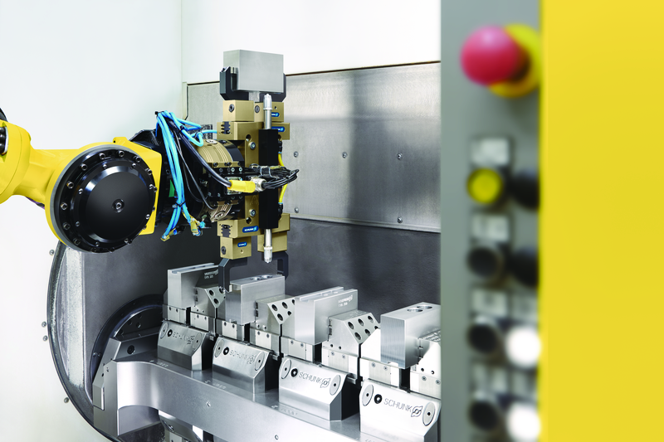
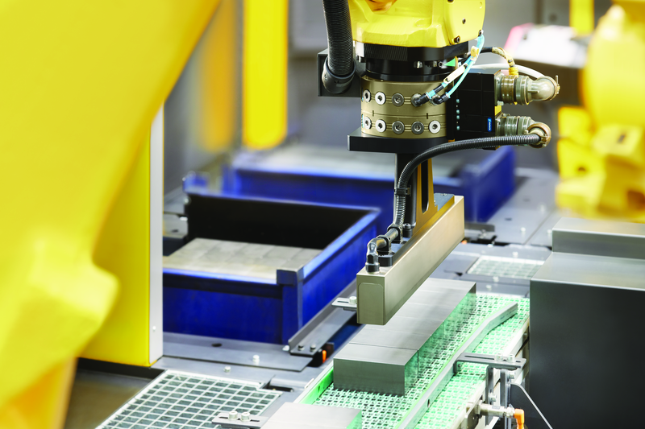
Application
Robot PLUS | Automatic Toolchanger CPS

Slide 6
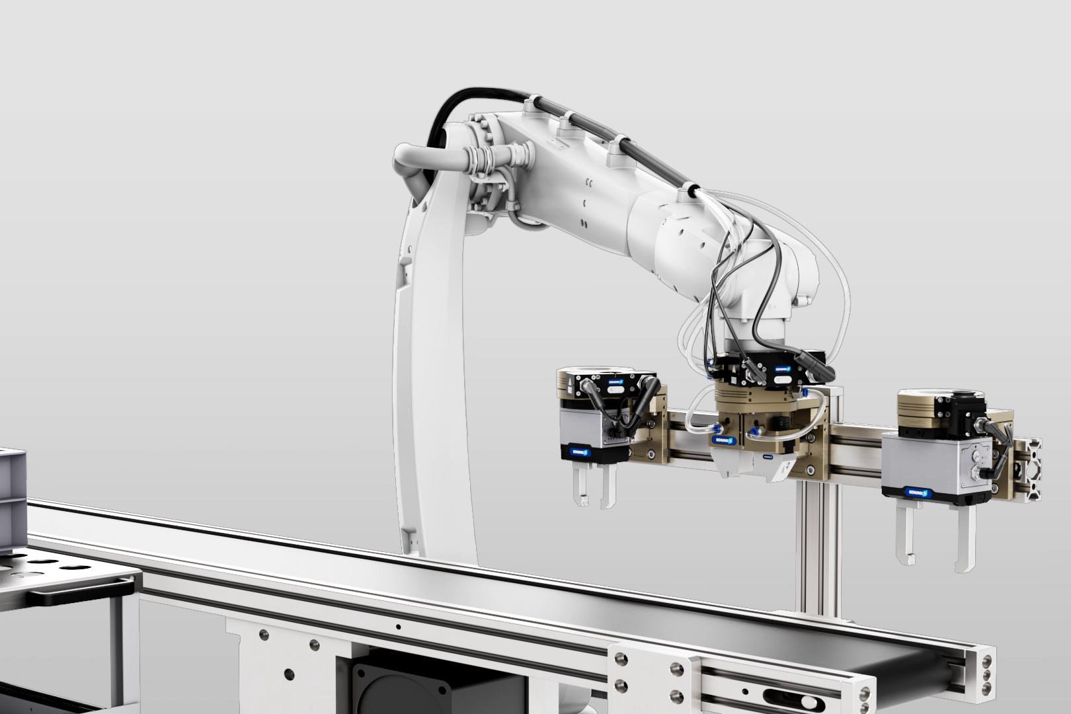
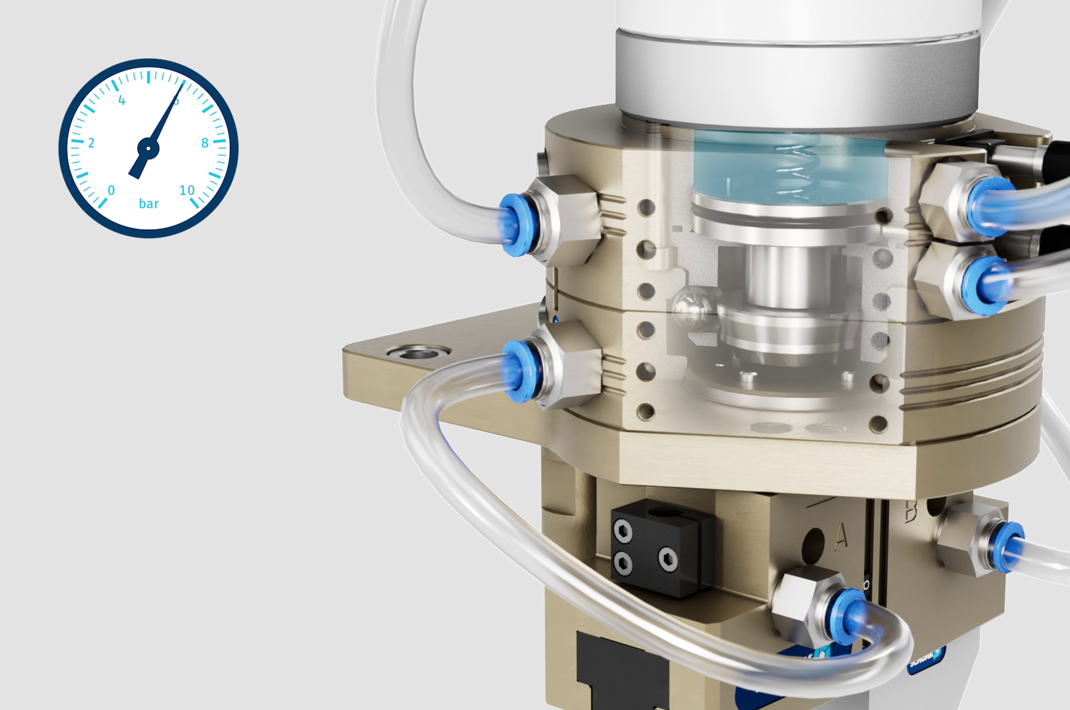
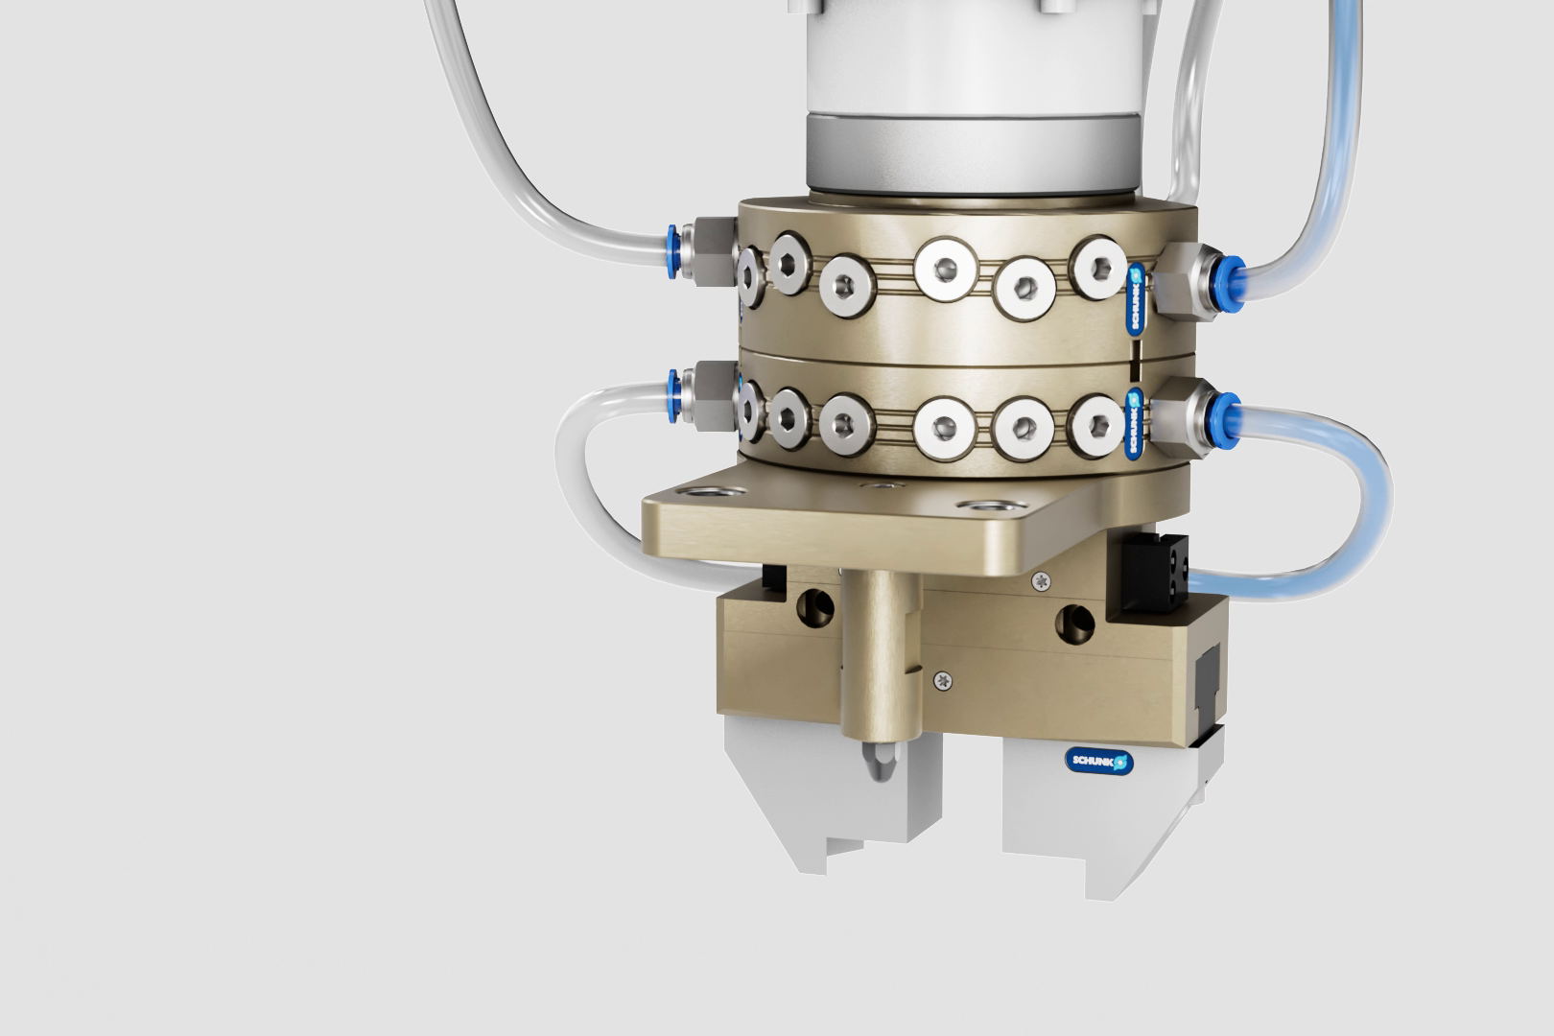
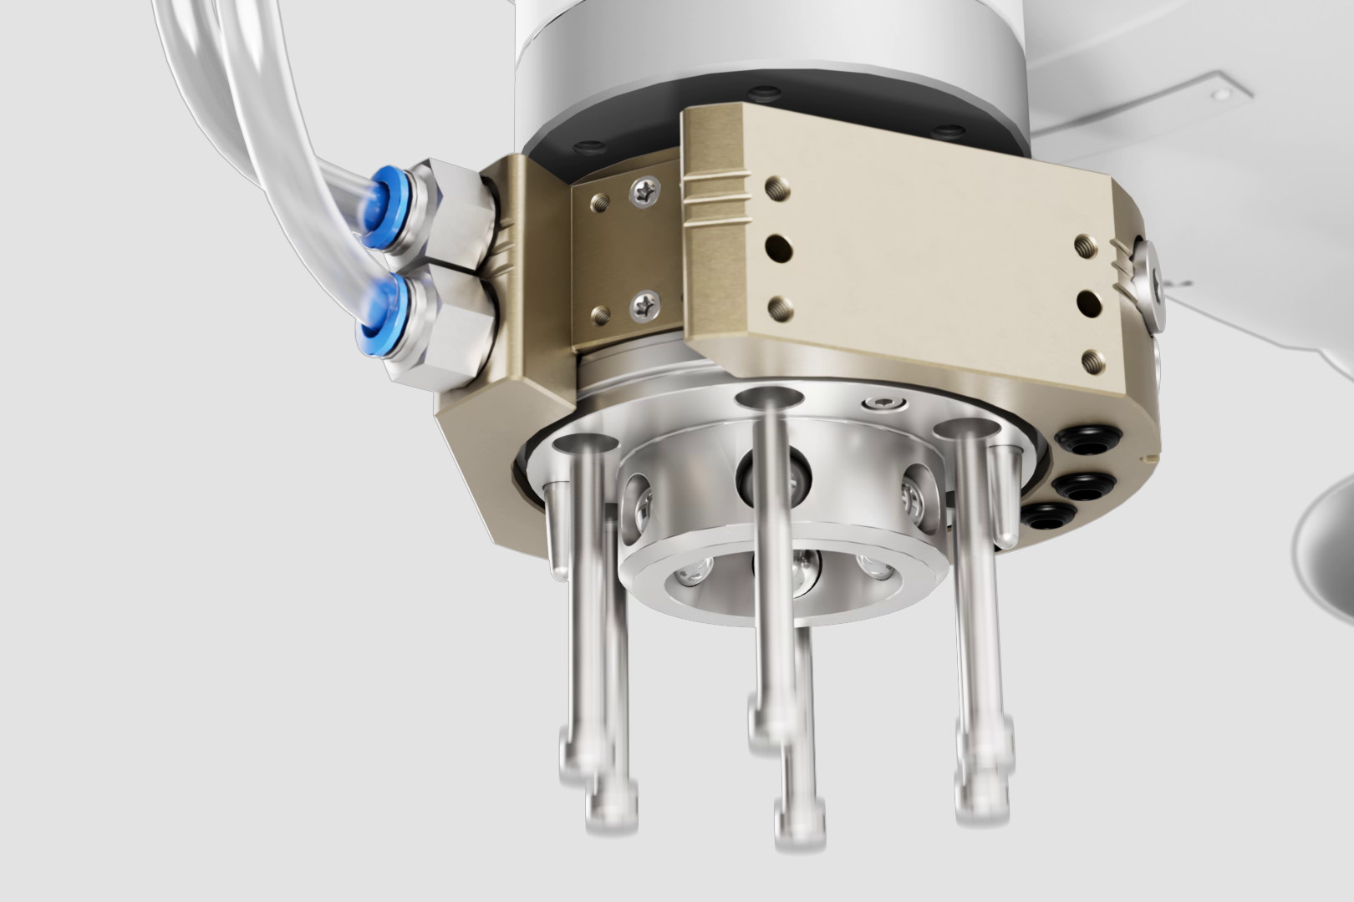
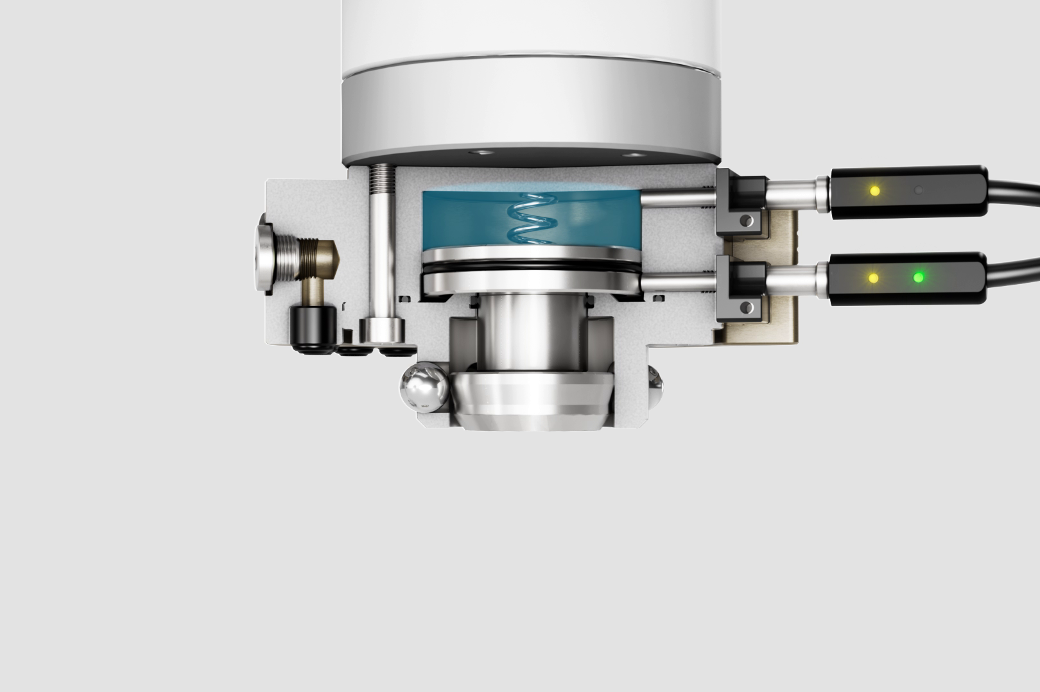
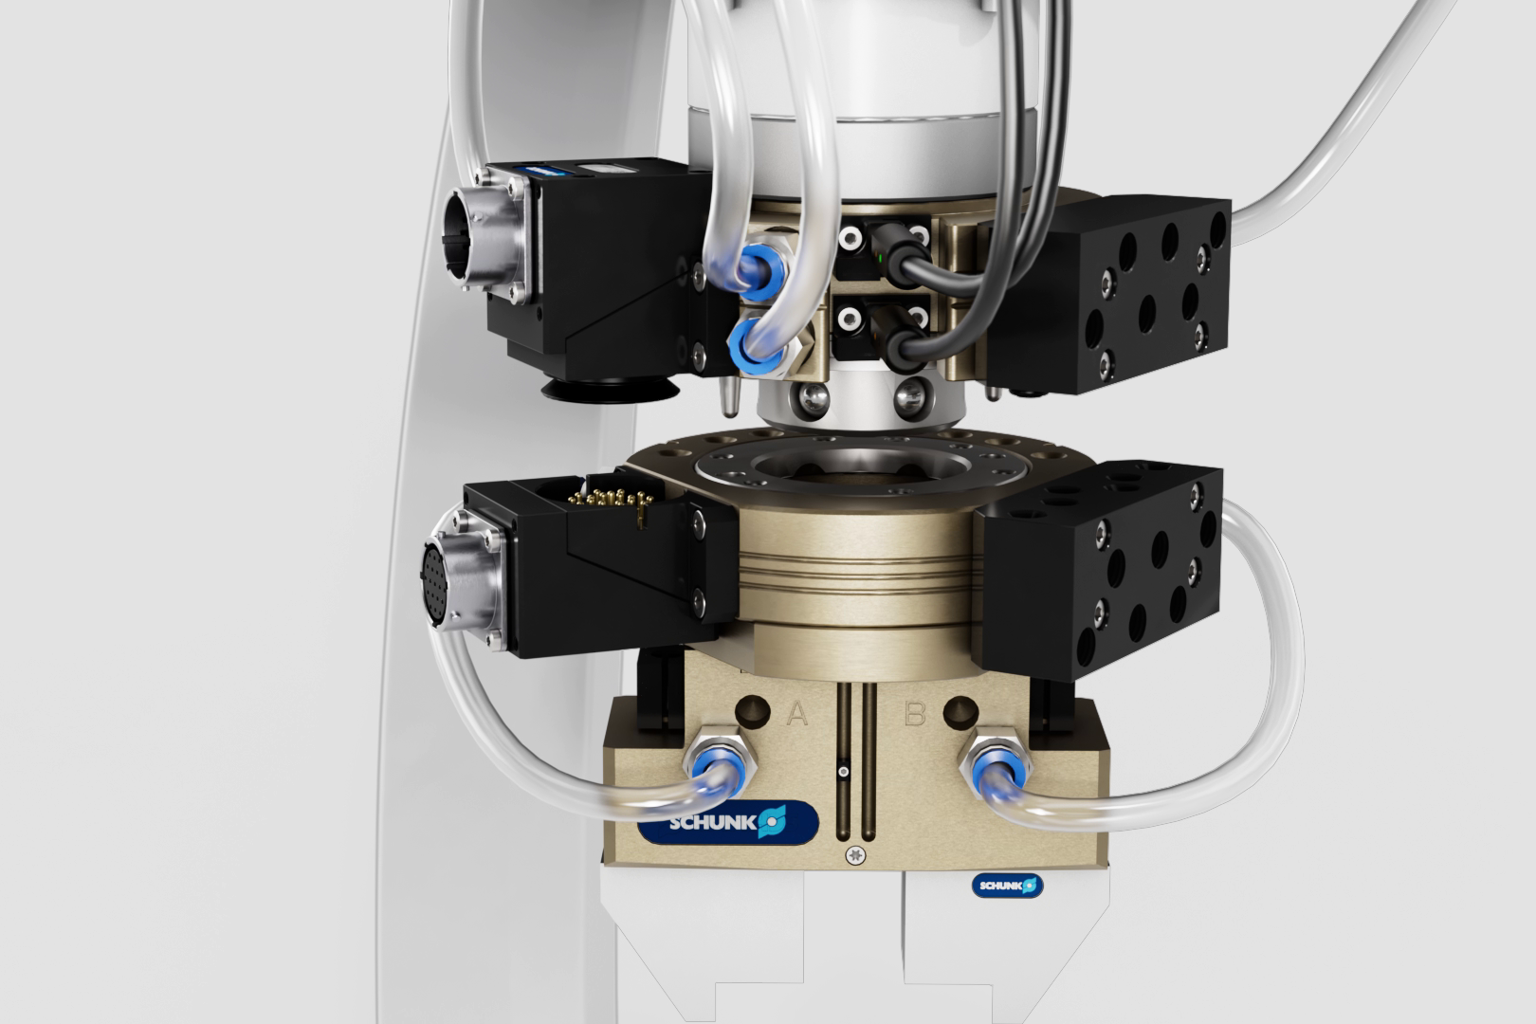
Product animation
Robot PLUS | Automatic Toolchanger CPS
Animation

Slide 7
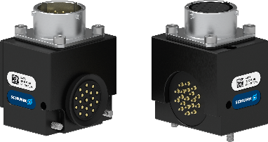
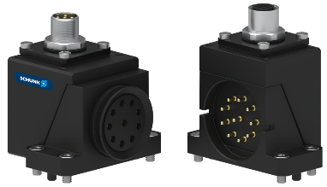
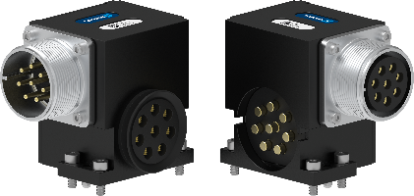
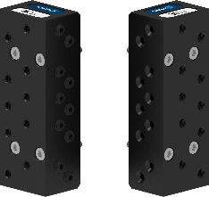
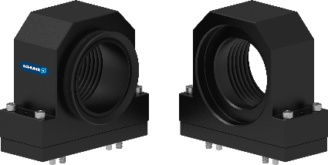
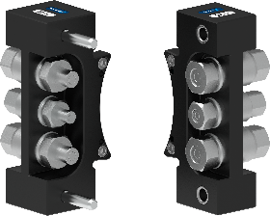
COS
Option modules for all kind of applications
Robot PLUS | Automatic Toolchanger CPS
SIGNAL | COMMUNICATION | POWER | PNEUMATIC | VACUUM | HYDRAULIC / FLUID
> 200 variants
Max. 48 VAC / 5 A | EtherNet | Up to 500 VAC / 45 A | NBR form sealings | NBR lip sealings | Up to 150 bar
Digital signals | EtherNet/IP |  | M5, G 1/8“, G 1/4“, G 3/8“, G ½“ | G ¾“, G 1,1/2“, G 2“ | Up to 8 bar
 | ProfiNet

Slide 8
Variety of sizes - 18
Robot PLUS | Automatic Toolchanger CPS
Playload | Size | Preferred product | General data Weight coupled Max. dyn. moment (Mxy/Mz) Amount of screw-on surfaces | Advantages of the preferred product | General data Repeat accuracy Operating pressure Grease
<16kg | CPS 001 CPS 007 CPS 011 | CPS 007 | 0,05 kg … 0,42 kg 2/6 Nm … 35/50 Nm 1x optional modules | Integrated sensors for lock/unlock ISO flange pattern robot side Additional pneumatic ports | 0,015mm 4,5 … 6,9 bar H1 Grease
<35kg | CPS 020 CPS 021 CPS 029 | CPS 021 CPS 029 | 0,86 kg … 1,66 kg 100/80 Nm … 120/150 Nm Up to 3 optional modules | Larger pneumatic ports in the housing G 1/8" instead of M5) Additional flats for modules | 0,015mm 4,5 … 6,9 bar H1 Grease
<50kg | CPS 040 CPS 041 CPS 046 | CPS 040 | 1,87 kg … 2,98 kg 350/350 Nm … 350/400 Nm Up to 5 optional modules | Integrated sensors for lock/unlock | 0,015mm 4,5 … 6,9 bar H1 Grease
<100kg | CPS 060 CPS 071 CPS 076 | CPS 076 | 2,00 kg … 3,68 kg 500/400 Nm … 800/1.800 Nm Up to 2 optional modules | Integrated sensors for lock/unlock Tool presence montoring prepared ISO flange pattern robot side | 0,015mm 4,5 … 6,9 bar H1 Grease
<300 kg | CPS 110 CPS 160 CPS 210 | CPS 110 CPS 160 CPS 210 | 6,60 kg … 9,30 kg 1.000/1.800 Nm … 3.500/1.800 Nm Up to 4 optional modules | Integrated sensors for lock/unlock Tool presence monitoring prepared ISO flange pattern robot side | 0,015mm 4,5 … 6,9 bar H1 Grease
<700 kg | CPS 310 CPS 510 | CPS 310 CPS 510 | 20,00 kg … 28,00 kg 5.000/4.500 Nm … 10.000/4.500 Nm Up to 6 optional modules | Integrated sensors for lock/unlock Tool presence monitoring prepared ISO flange pattern robot side | 0,015mm 4,5 … 6,9 bar H1 Grease

Slide 9
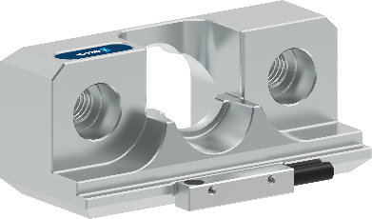
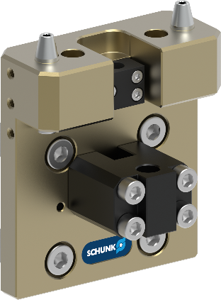
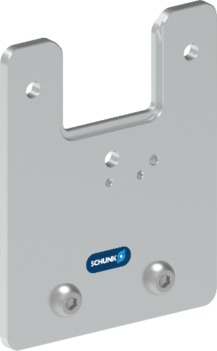
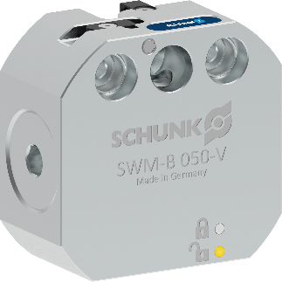
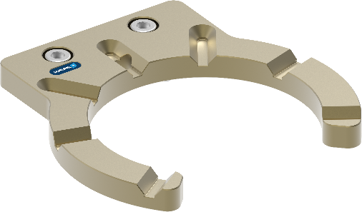
Large portfolio of accessories (CTS)
Robot PLUS | Automatic Toolchanger CPS
CTS B passive
(without locking)
CTS P
Pin & Bushing
CTS T
Storage tray
CTS B aktive
(with locking)
CTS C
Bolt storage
Notes:
Focused to the existing Systems
Wording from SWM to CTS
CTS P: 1:1 replacement
CTS C: 1:1 replacement
CTS T: 1:1 replaement

Slide 10
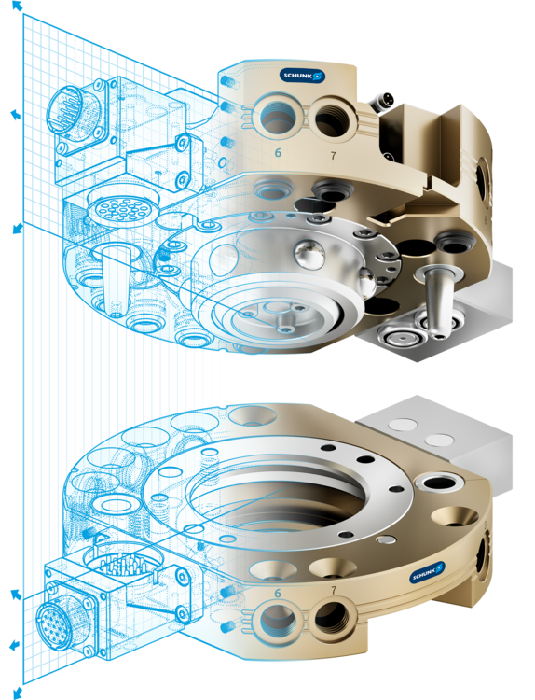
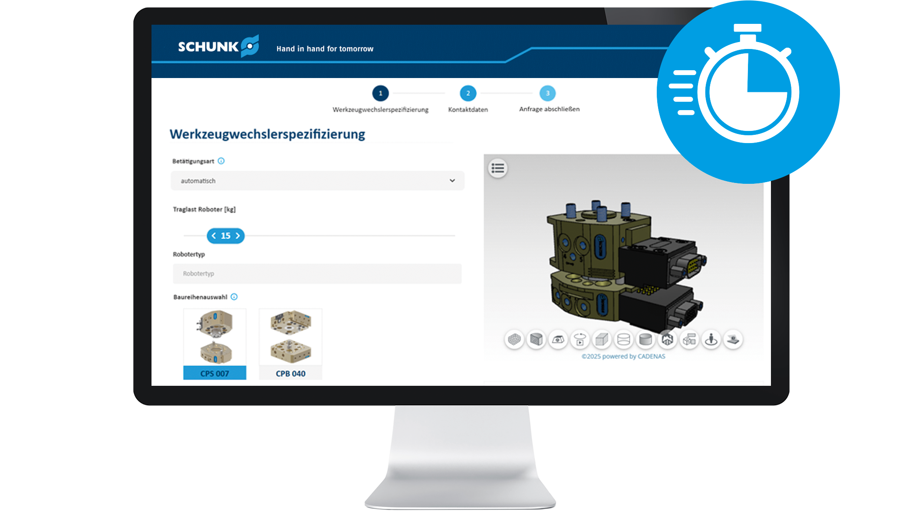
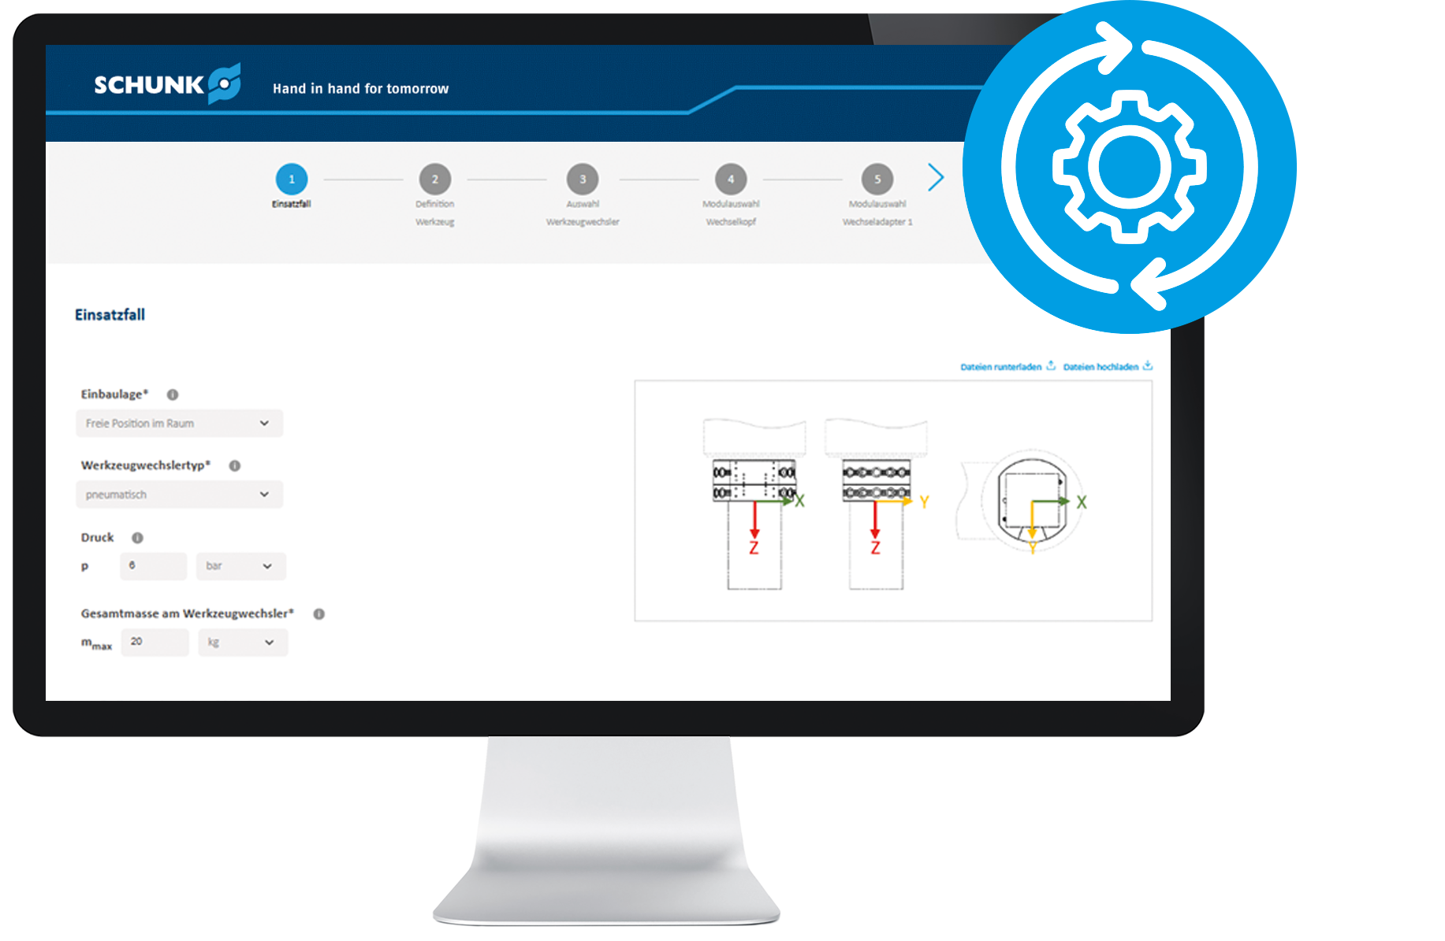
Two ways, one goal
The perfect tool changer for your project!
Robot PLUS | Automatic Toolchanger CPS
Fast & simple
Optimal & precise
Are you at the start of your project? Configure your tool changer quickly and easily and download the right CAD data for your concept in just a few clicks.
Are you looking for the perfect solution for your application? Configure an optimum tool changer based on your process and tool parameters and receive a technically valid solution, including CAD data and data sheet.
To the configurators

Slide 11



Slide 12




Portfolio
In modern manufacturing, flexibility and efficiency are key.
SCHUNK's Robot PLUS portfolio is specifically designed to enhance your production processes. It offers a comprehensive range of tool changers, compensation units, and force/torque sensors – developed based on decades of experience.
Partnering with SCHUNK means benefiting from a combination of high-quality products and comprehensive, reliable support that drives and supports your automation projects worldwide.

Slide 13

Portfolio
Tool Changer
Compensation unit
Force/torque Sensor
Automatic Tool Changer
CPS
Force/torque Sensor FTS
Compensation unit AGM
Automatic Tool Changer
CPB
Manual Tool Changer CMS

