Slide 1
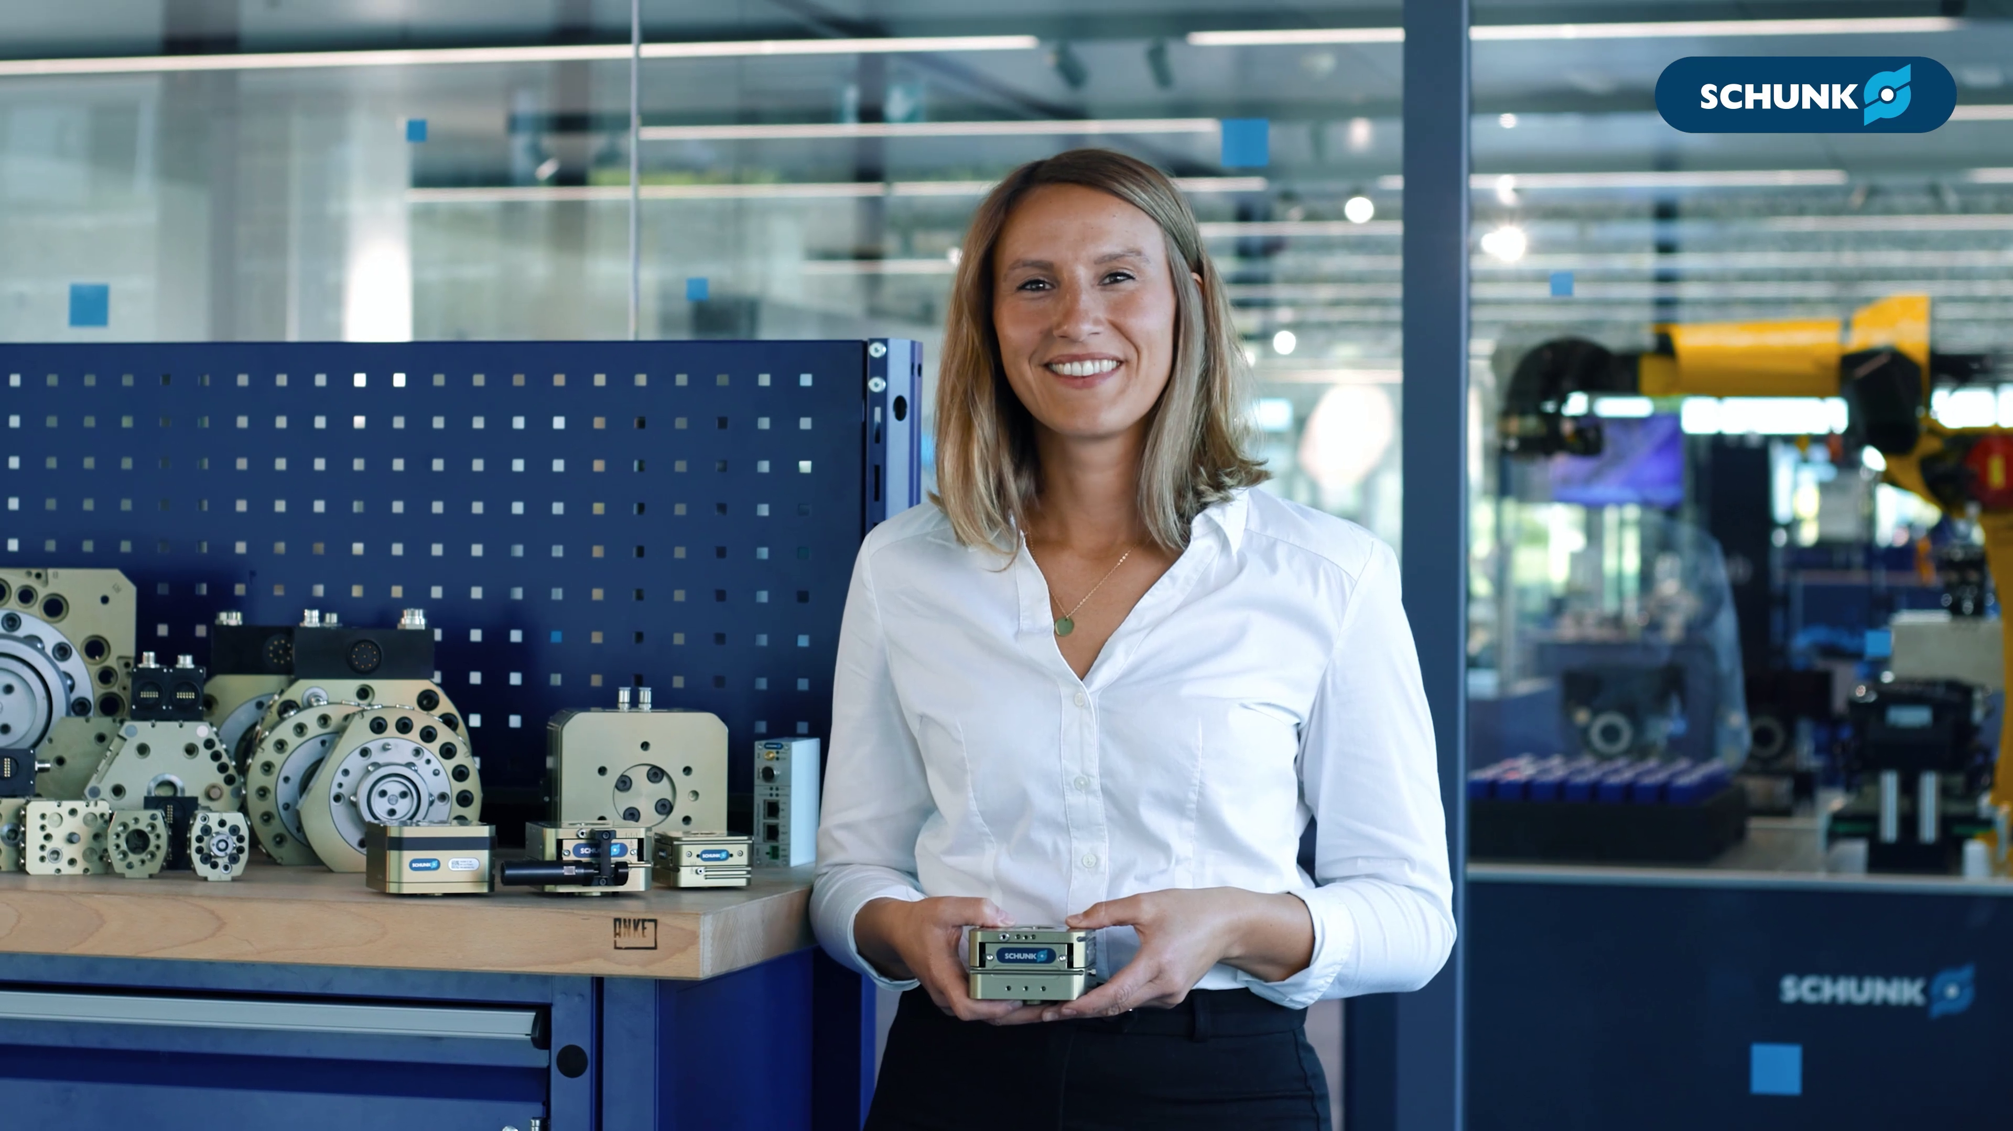

AGM
Mastering tolerances and
enhancing reliability

Slide 2

AGM
Mastering tolerances and
enhancing reliability

Slide 3
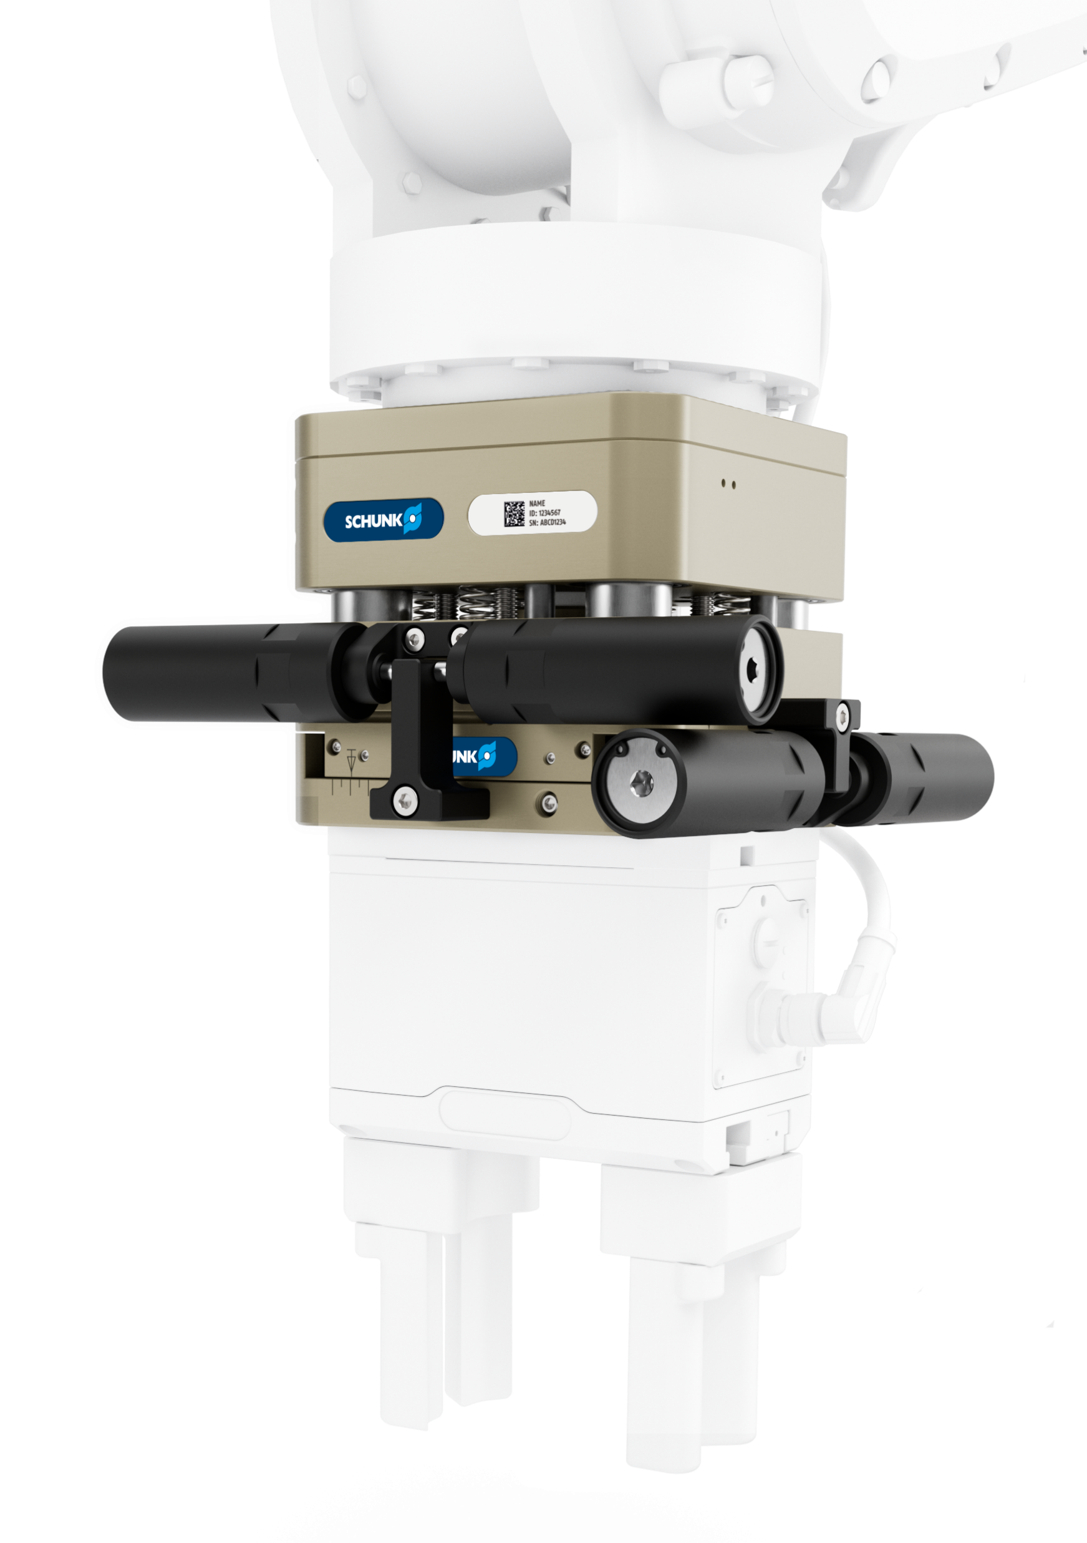
Your added value
Precise. Reliable. Modular
Robot PLUS | Modular compensation units AGM
  Broad load capacity range​
  With the AGM units, loads ranging from a few grams to over 500 kg can be handled
  No compromises on the interfering contour​
  The AGM product family offers the perfect unit for a wide range of applications with 23 sizes
  Easy to assemble​
  The integrated, continuous ISO interface on both the robot and tool sides, from ISO 31,5 to ISO 200, is compatible with most robot types
  Always the right compensation behaviour
  The wide portfolio enables compensation in XY-, Z-, W-, XYZ-, WZ-direction
  ​

Slide 4
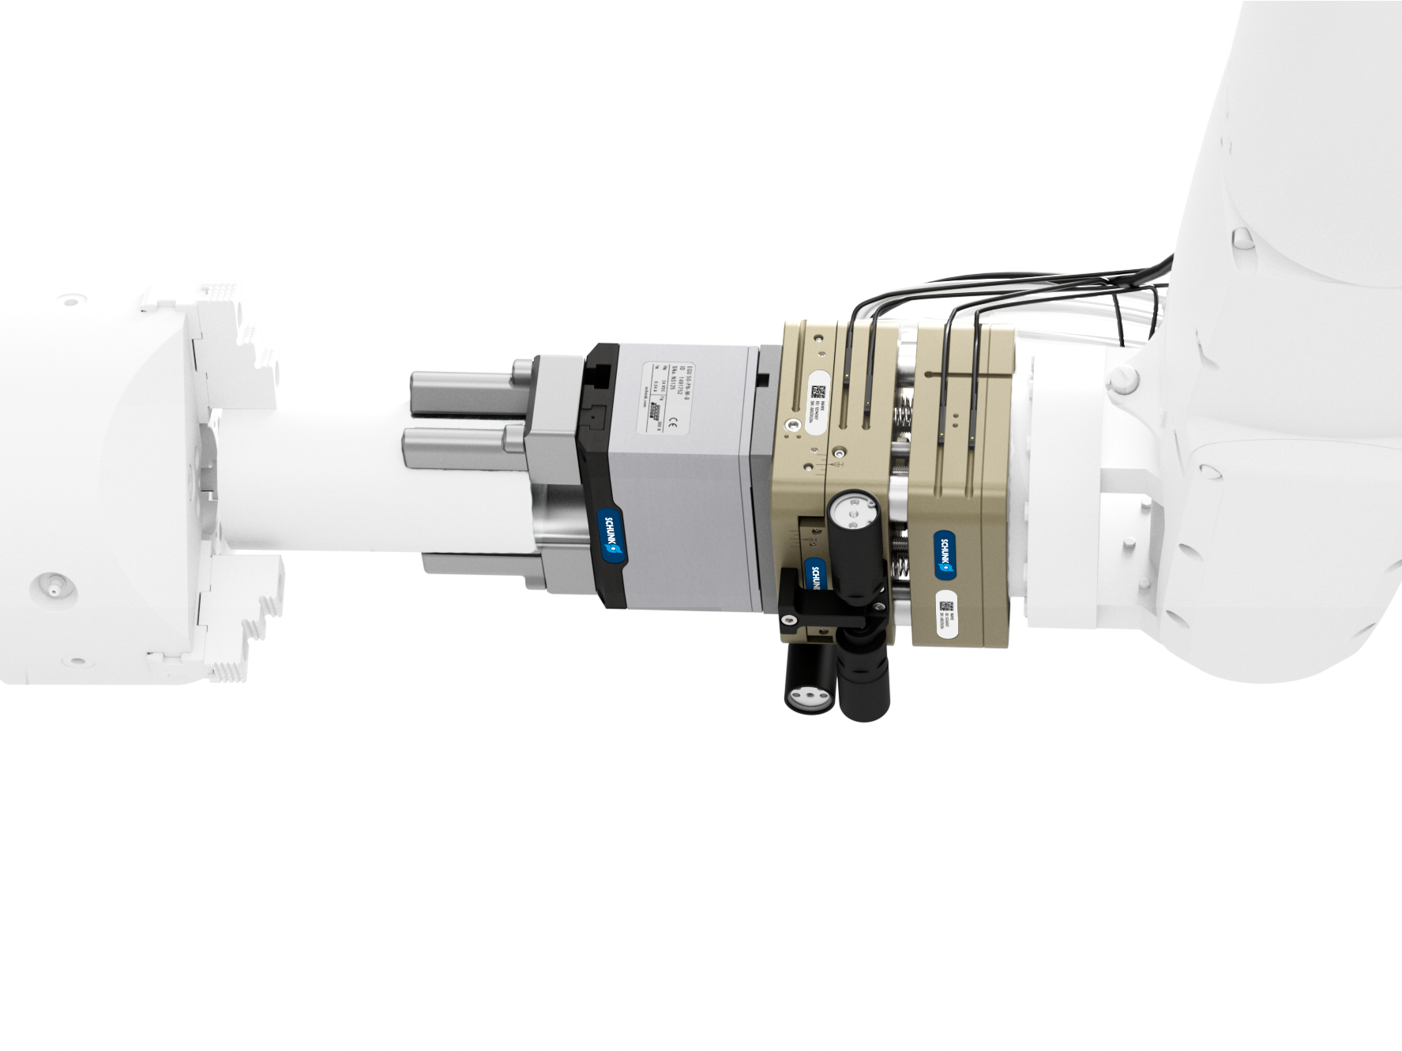
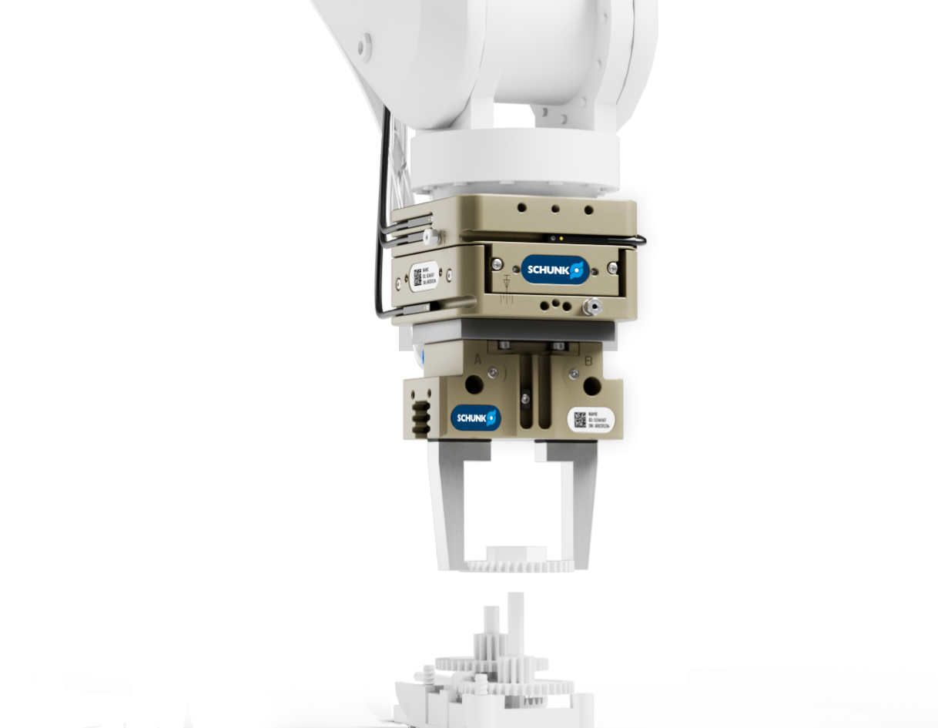
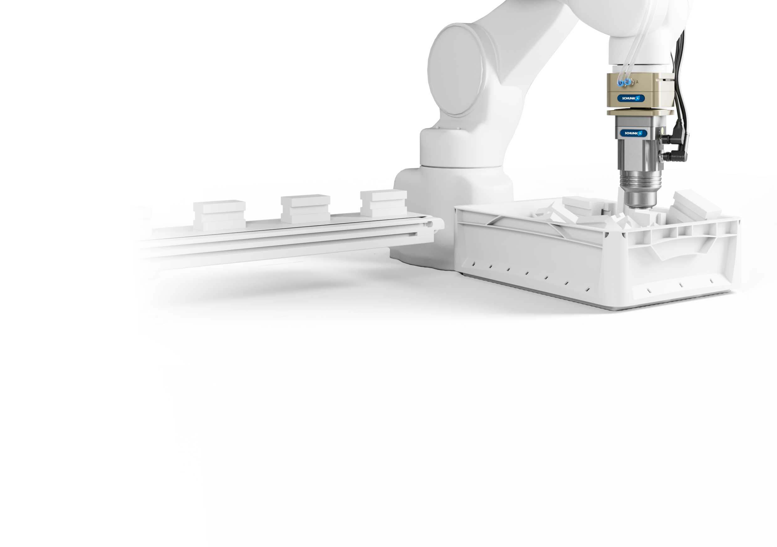
Further advantages depending on application
Robot PLUS | Modular compensation units AGM
AGM-XYZ
AGM-XY
AGM-W
  Machine loading
  Increased process stability and efficiency
  Precise insertion of components
  Weight compensation with patented spring cartridges, the component is held in a defined position
  Insertion processes
  Compensation of inaccurracies and offset
  The manually adjustable stroke allows continuous limitation or locking of the compensation path
  Suitable for delicate and fragile components
  Bin-Picking
  Angular compensation offsets the varying orientations of the components
  Pneumatic locking and unlocking supports highly dynamic processes
  The pressure-dependent deflection torque enables optimally controlled angular compensation

Slide 5
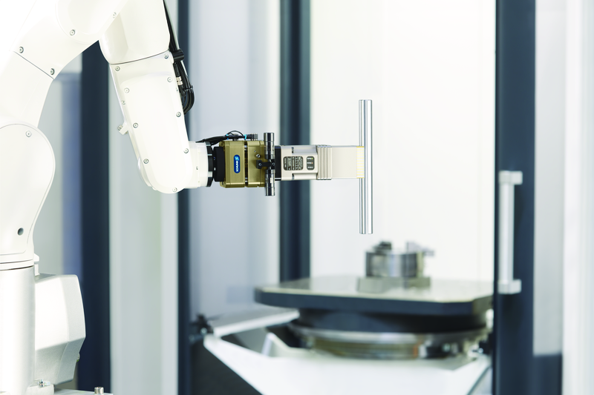
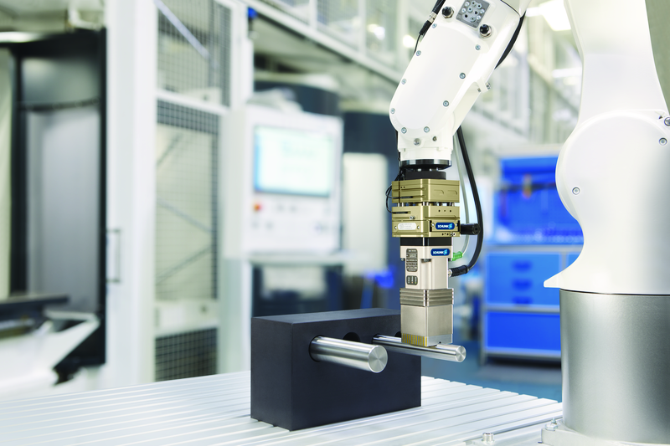
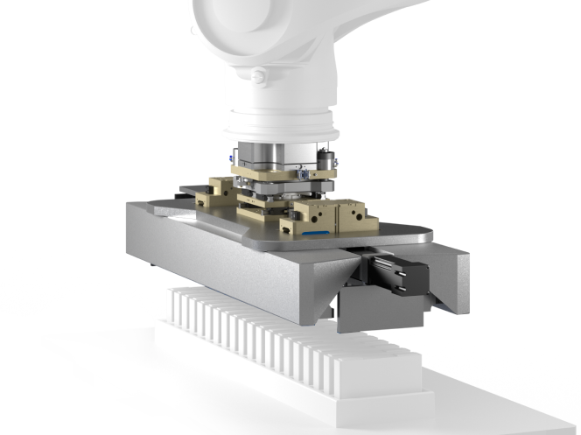
Applications
Robot PLUS | Modular compensation units AGM
  Machine loading
  Pick & Place
  Battery Handling

Slide 6
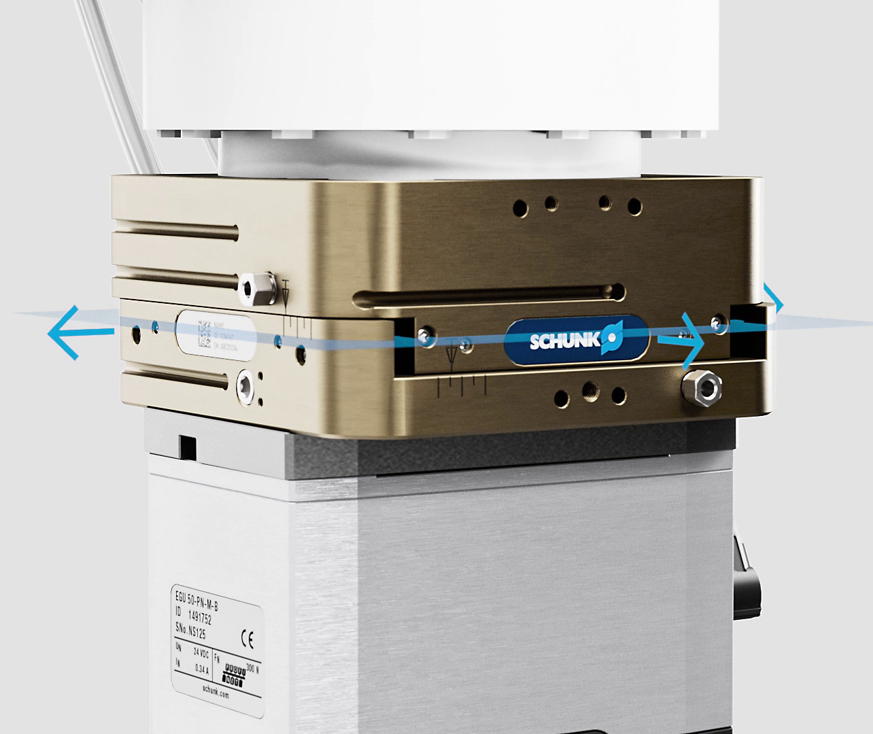
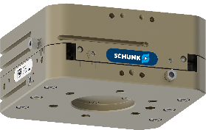









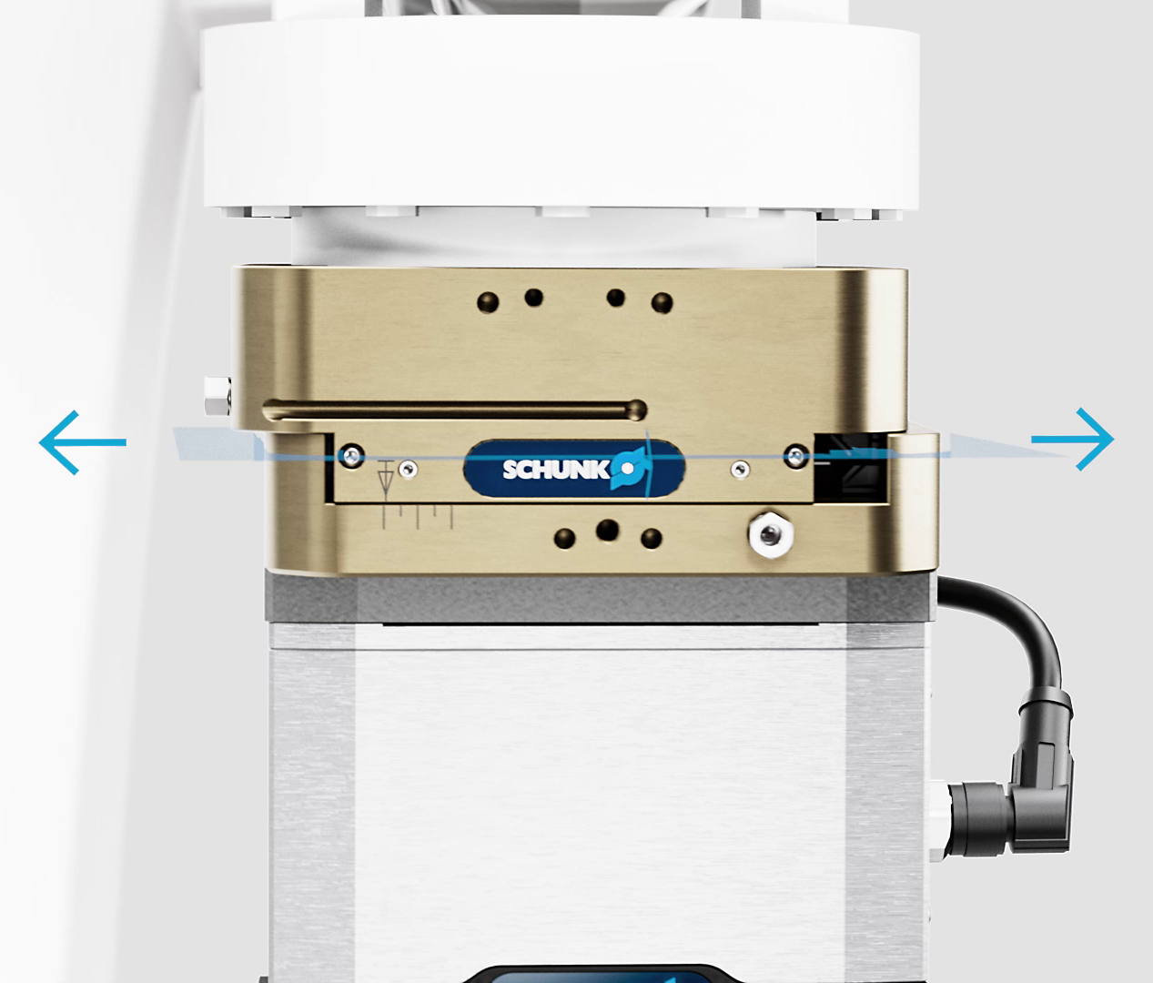
AGM-XY
Compensation behavior & sizes
Robot PLUS | Modular compensation units AGM
AGM-XY 031
AGM-XY 040
AGM-XY 050
AGM-XY 063
AGM-XY 080
AGM-XY 100
AGM-XY 125
AGM-XY 160
AGM-XY 160L
AGM-XY 200

Slide 7


AGM-XY
Technical Data
Robot PLUS | Modular compensation units AGM
Size | Recommended handling weight, vertical | Recommended handling weight, horizontal | Compensation in XY | Net Weight | Monitoring prepared | Adjustable Stroke limitation | Standard adapter plates | Weight compensation | Modularity: XYZ
 | [kg] | [kg] | [mm] | [kg]
AGM-XY 031 | 4,7 | 2,4 | ± 2 | 0,5 | inductive or magnetic | Abfrage vorbereitet via stroke limitation |  | via spring and air cartridge
AGM-XY 040 | 9,5 | 5,7 | ± 3 | 0,8
AGM-XY 050 | 18 | 9 | ± 4 | 1
AGM-XY 063 | 32,5 | 17 | ± 5 | 2
AGM-XY 080 | 68 | 25 | ± 7 | 3,6
AGM-XY 100 | 130 | 60 | ± 9 | 5,8
AGM-XY 125 | 190 | 90 | ± 10 | 10,9
AGM-XY 160 | 250 | 130 | ± 12 | 21,8
AGM-XY 160L | 350 | 180 | ± 15 | 31,7
AGM-XY 200 | 520* | 350* | ± 15* | 41,8*
* Technical Data under reservation

Slide 8
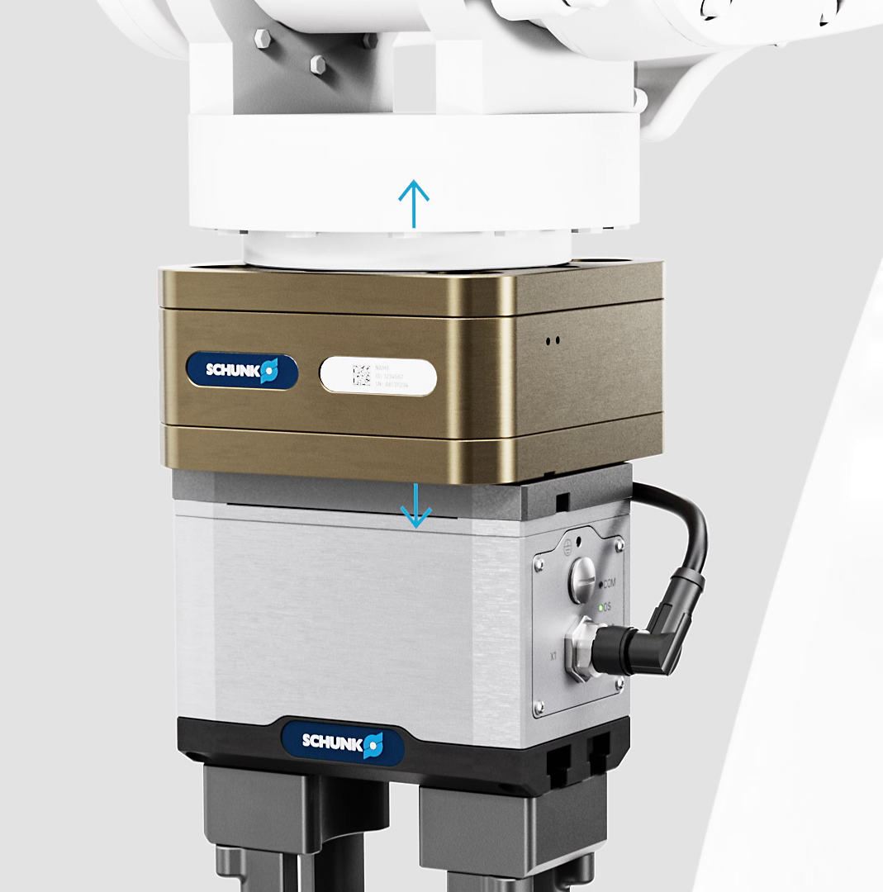
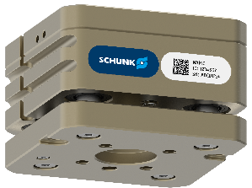
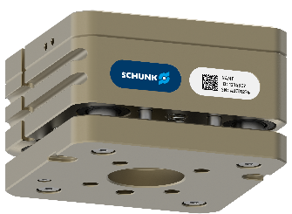
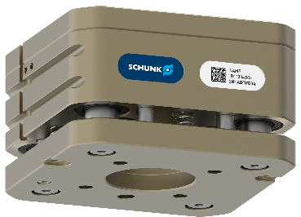
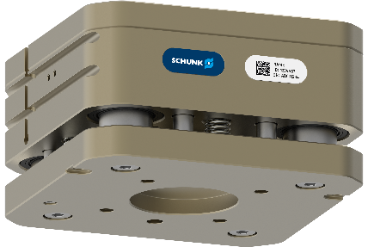
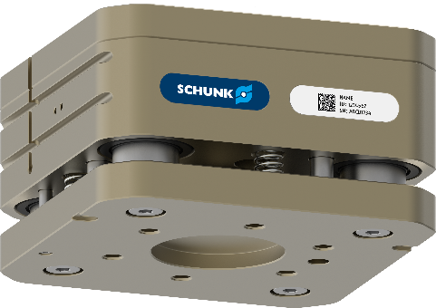
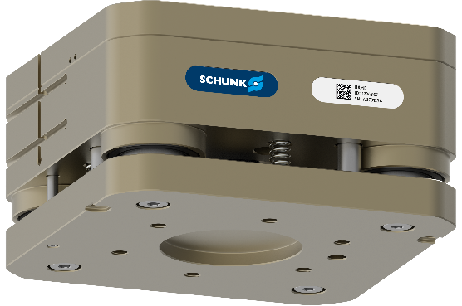
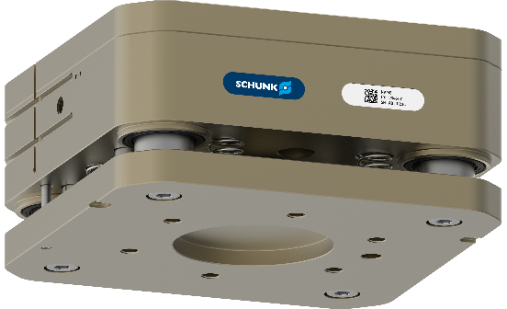
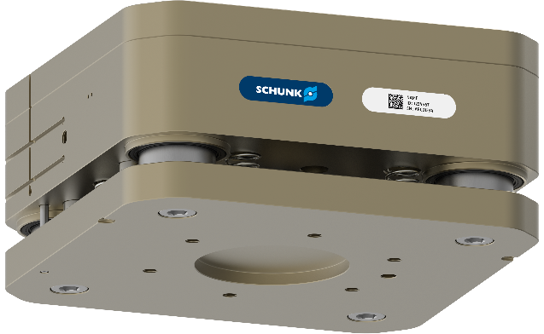


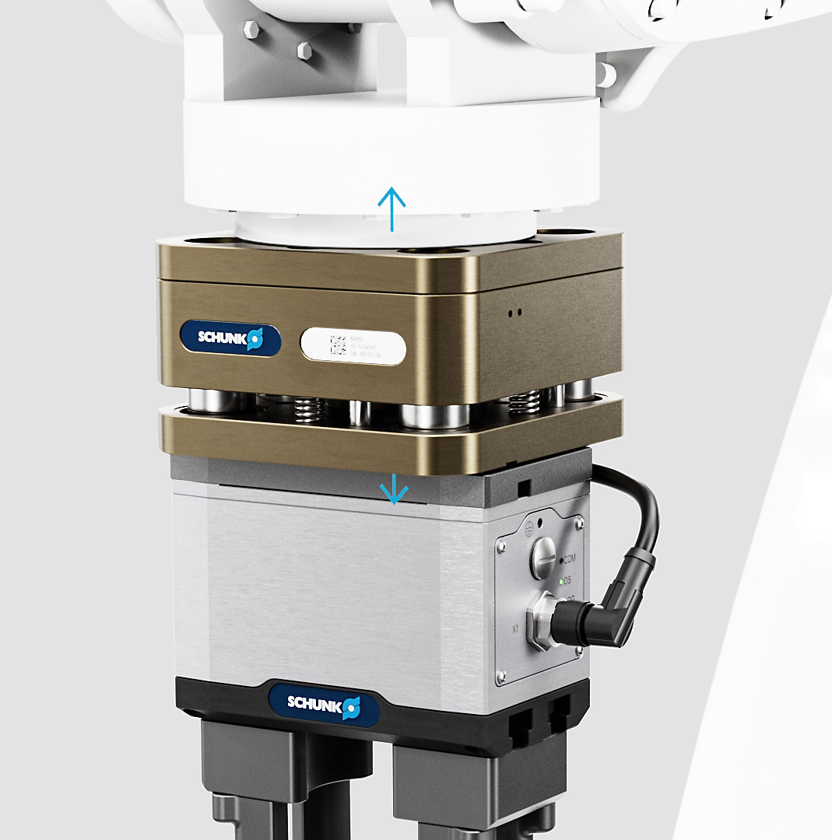
AGM-Z
Compensation behavior & sizes
Robot PLUS | Modular compensation units AGM
AGM-Z 031
AGM-Z 040
AGM-Z 050
AGM-Z 063
AGM-Z 080
AGM-Z 100
AGM-Z 125
AGM-Z 160
AGM-Z 160L
AGM-Z 200
Notes:
Folie fertig

Slide 9

AGM-Z
Technical Data
Robot PLUS | Modular compensation units AGM
Size | Recommended handling weight, vertical | Recommended handling weight, horizontal | Compensation in Z | Net Weight | Monitoring prepared | Standard adapter plates | Modularity: WZ | Modularity: XYZ
 | [kg] | [kg] | [mm] | [kg]
AGM-Z 031 | 4 | 4 | 4 | 0,5 | inductive or magnetic
AGM-Z 040 | 8 | 5,7 | 4 | 0,7
AGM-Z 050 | 12 | 12 | 6 | 1,0
AGM-Z 063 | 24 | 18 | 8 | 1,9
AGM-Z 080 | 45 | 32,5 | 10 | 3,6
AGM-Z 100 | 85 | 74 | 15 | 6,0
AGM-Z 125 | 135 | 107 | 15 | 9,7
AGM-Z 160 | 230 | 150 | 15 | 19,3
AGM-Z 160L | 290 | 230 | 20 | 25,2
AGM-Z 200 | 500* | 360* | 20* | 37,8*
* Technical Data under reservation

Slide 10
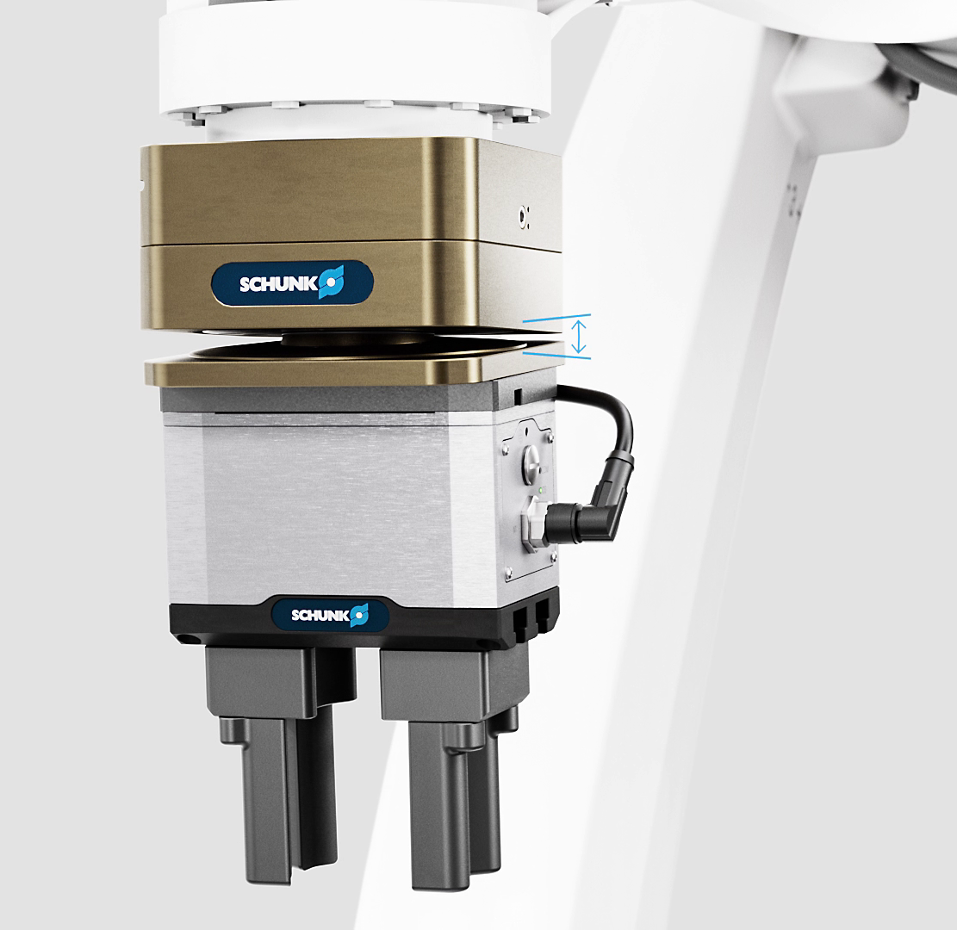
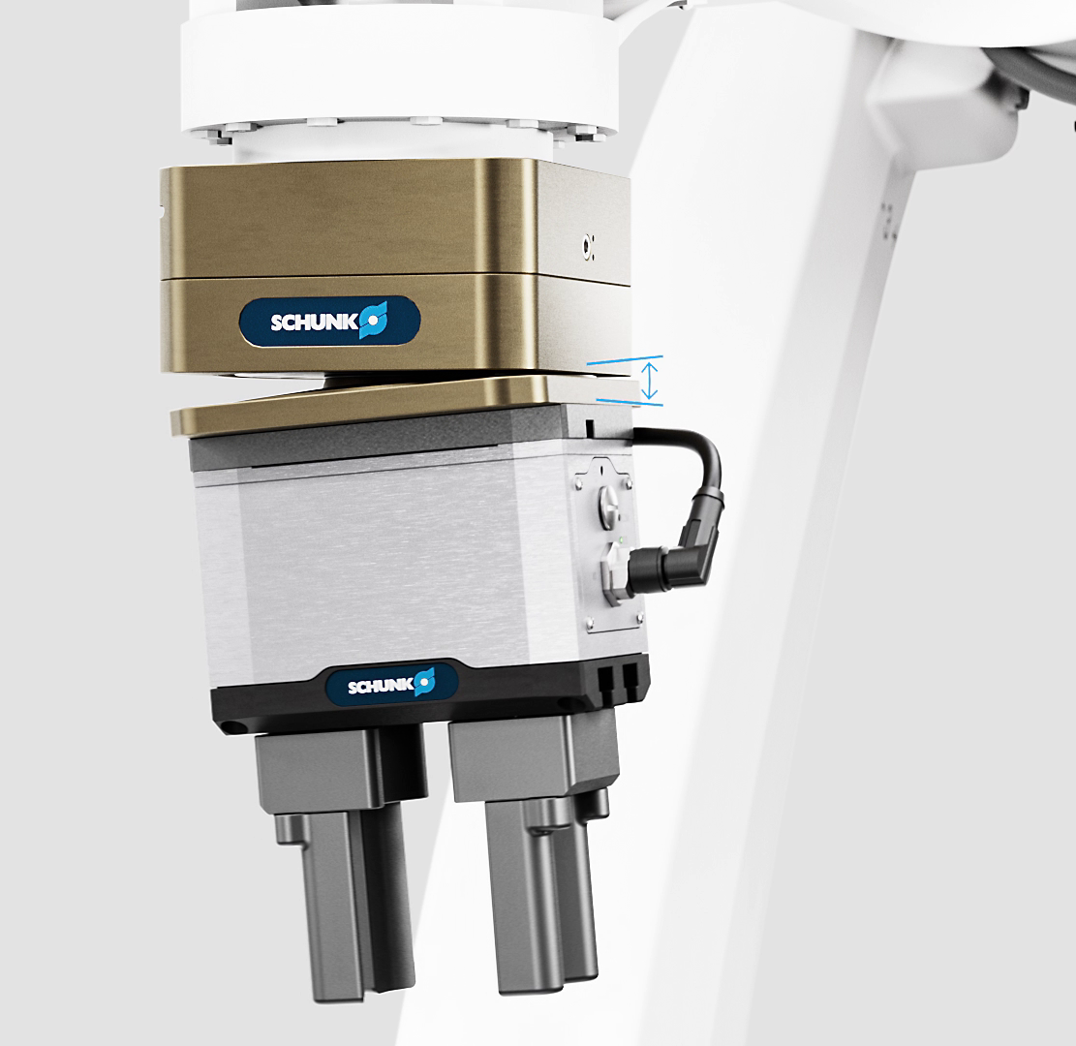
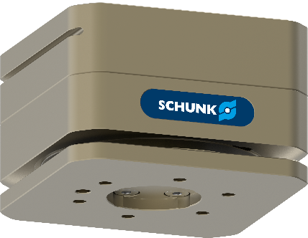


AGM-W
Compensation behavior & sizes
Robot PLUS | Modular compensation units AGM
Target application Bin Picking
AGM-W 050
AGM-W 063
AGM-W 080

Slide 11
AGM-W
Technical Data
Robot PLUS | Modular compensation units AGM
Size | Recommended handling weight, vertical | Recommended handling weight, horizontal | Compensation angular | Net Weight | Monitoring prepared | Standard adapter plates | Adjustable weight compensation | Modularity: WZ
 | [kg] | [kg] | [°] | [kg]
AGM-W 050 | 12 | 12 | ± 5 | 1,2 | inductive or magnetic |  | via control piston
AGM-W 063 | 24 | 20 | ± 5 | 2,3
AGM-W 080 | 49 | 32 | ± 5 | 4,0
Notes:
Folie fertig

Slide 12
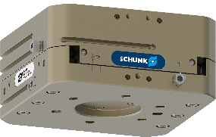

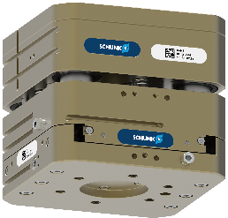
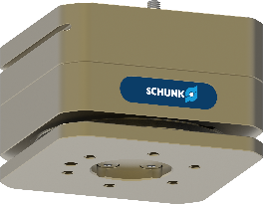
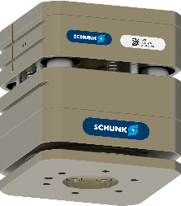
Combination options thanks to modular series
Robot PLUS | Modular compensation units AGM
AGM-XY
AGM-Z
AGM-XYZ
Advantages
  Lower installation height
  Lower weight
  compared to the combination of single components
+
=
AGM-W
AGM-Z
AGM-WZ
+
=

Slide 13
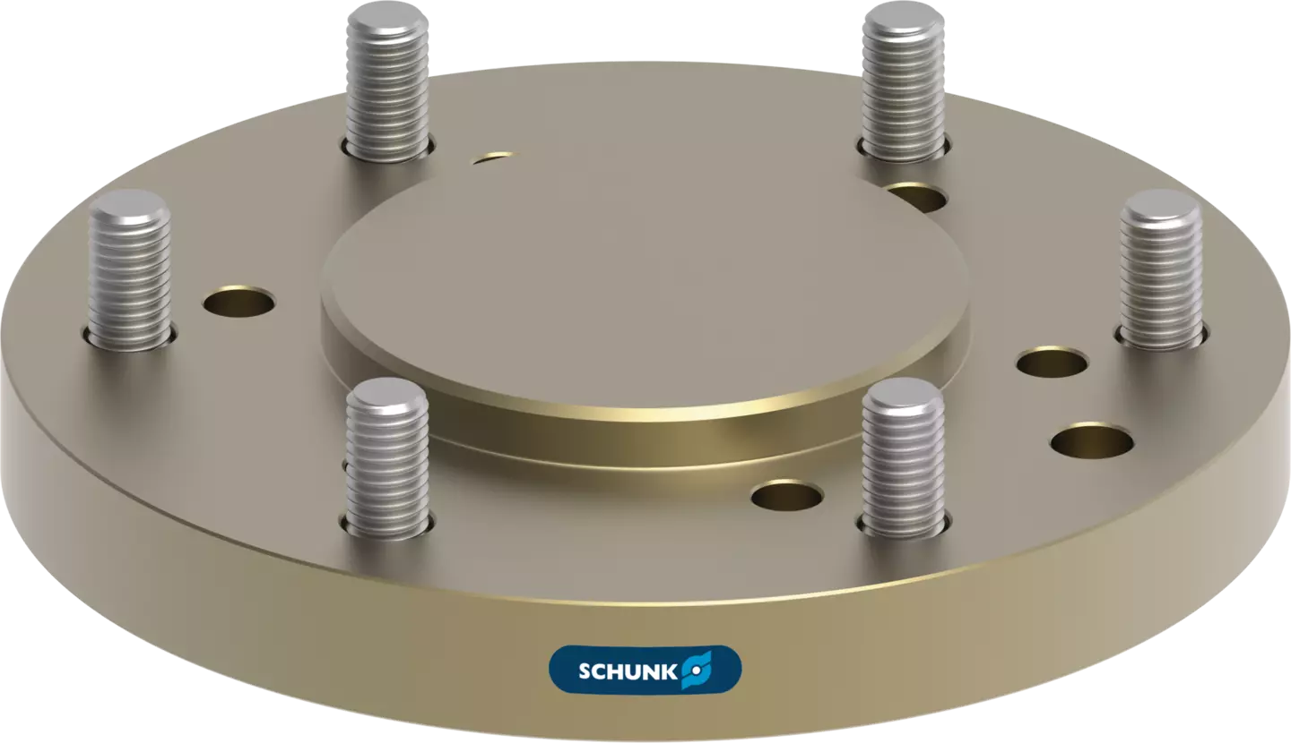
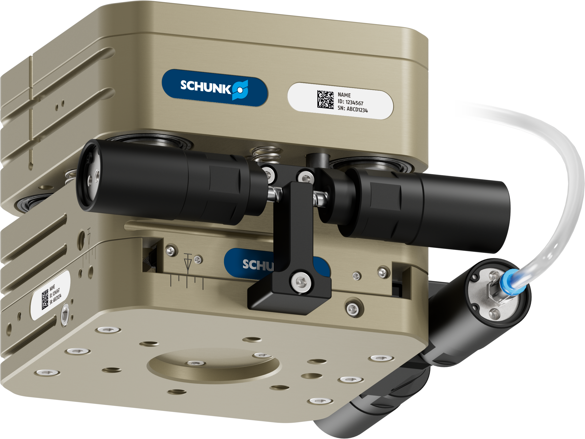
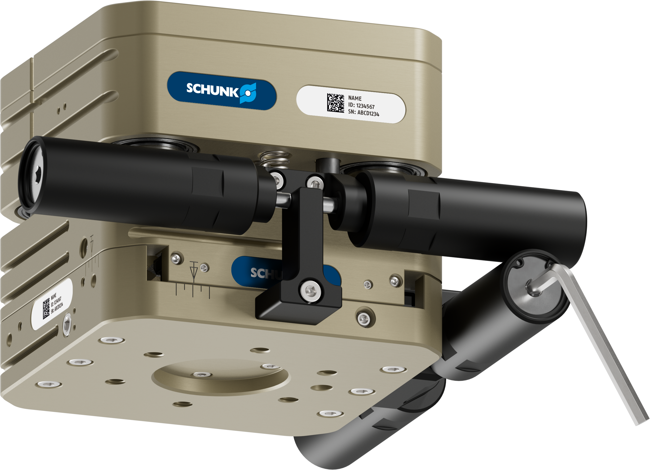
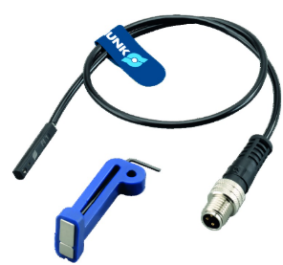
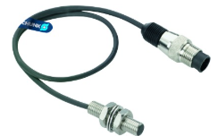
Broad portfolio of accessories
Robot PLUS | Modular compensation units AGM
Effective weight compensation in horizontal applications
thanks to patented spring and air cartridges for AGM-XY and AGM-XYZ
Standardized adapter plates
In addition to the integrated ISO interface, one adapter plate per size is available for a smaller and one for a larger ISO interface
Automated
air cartridge
Most comprehensive range of sensors
Numerous magnetic and inductive monitoring options
optionally available for all sizes
Manual
spring cartridges

Slide 14
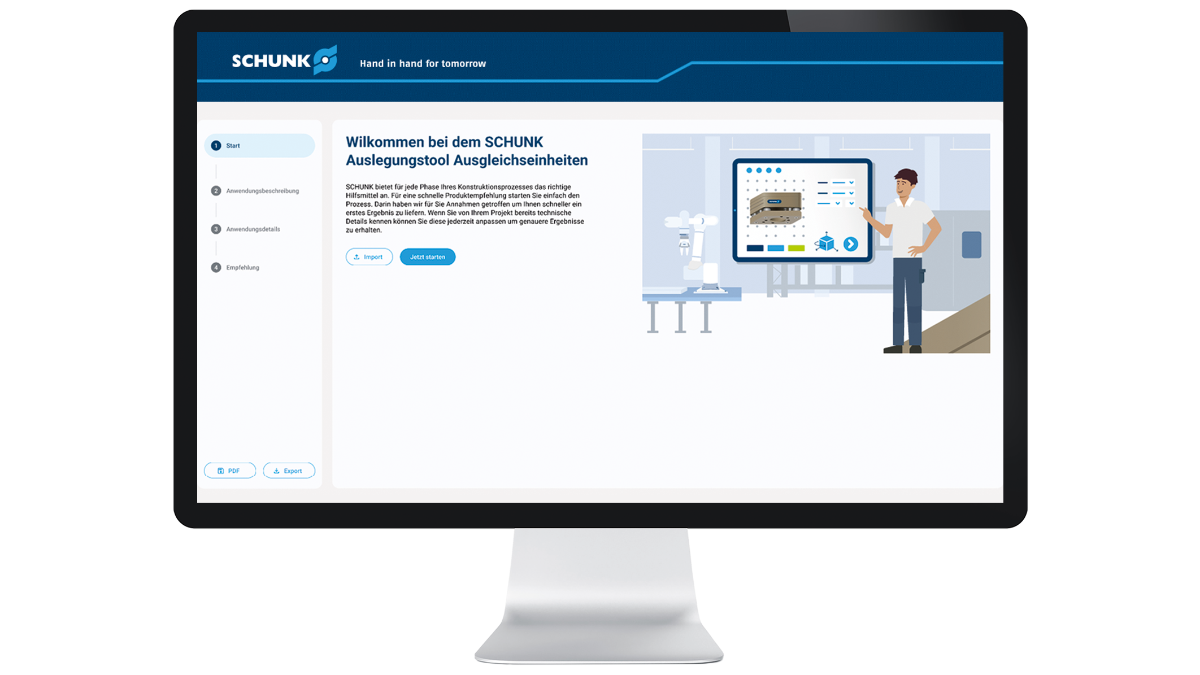

Sizing assistant compensation units
Simple. Online. Customized
Robot PLUS | Modular compensation units AGM
To the sizing assistant

