Slide 1

SCHUNK Engineering
Solution Book - Defense
Note:
This presentation contains confidential information and is only released for non-public use by customers and suppliers.
Consultation with specialist department may be necessary.
- Remove this note before use -

Slide 2
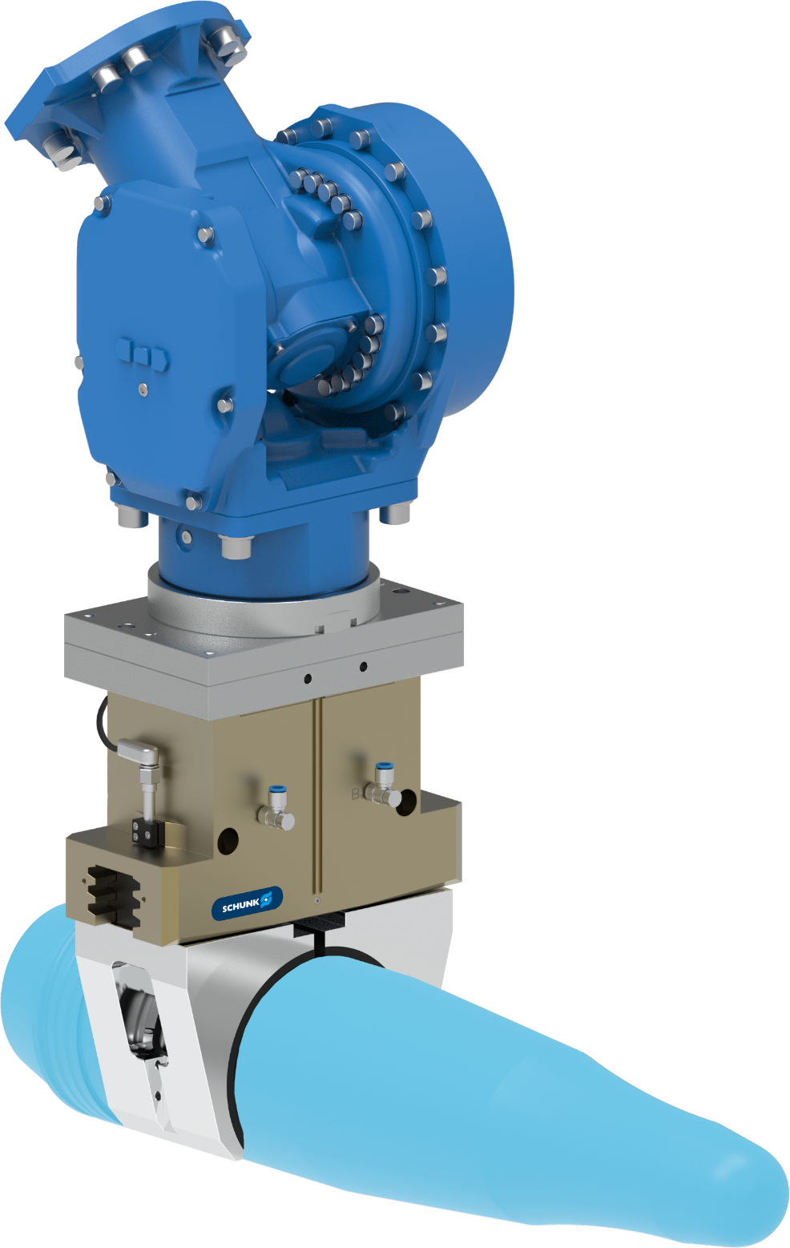



2-Finger parallel gripper
Compact design for secure handling
Defense - Weapons handling
Function / Customer benefit
2 Finger parallel gripper for a secure handling of missiles for combat aircraft
Scope
Gripper: PGN plus P 240-2-AS
      Stroke per Jaw: 17 mm
      Gripping force: 14.000 N
      Weight: 12 kg
Customer needs
  Very high safety factor
  Very high reliability
  High flexibility
PGN plus P 240-2-AS
TYPICAL PRODUCTS
TYPICAL PROCESS
REQUIREMENTS
RELIABILITY
STRONG
Notes:
SCHUNK ID: 318643 PGN-plus-P 240-2-AS / 307110 DRG 100-90-AS | Assembly: 318643 (tbc)
Contact: Marc Murtra, Spain

Slide 3
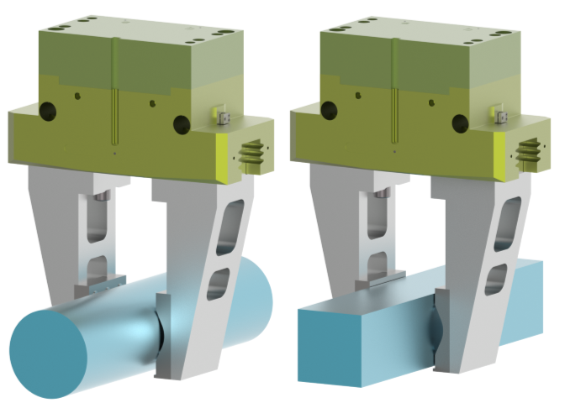
2-Finger parallel gripper
Compact design for secure handling
Defense - Weapons handling
PGN plus P 380-1-AS
Function / Customer benefit
2 Finger parallel gripper for a secure handling of artillery shells (Ø155mm)
Scope
Gripper: PGN plus P 380-1-AS
      Stroke per Jaw: 45 mm
      Gripping force: 13.800 N
      Weight: 36 kg
Jaws:
      Top jaws: weight reduced
      clamping inserts: for raw materials in cylindrical and square shape
Customer needs
  Very high safety factor
  Very high reliability
  High flexibility
Top jaw
Clamping inserts
for cylindrical/square shape
Notes:
Gripper for the production of artillery shells Ø155 mm
Only offer status, ABB lost the order against a competitor
Customer: ABB – Friedberg (KD-Nr.411011)
End customer: RHEINMETALL
SCHUNK ID: 1591893 | GEI/AKO/PGN+P380/AUB
Contact: Marcel Dietrich, SCHUNK HQ

Slide 4
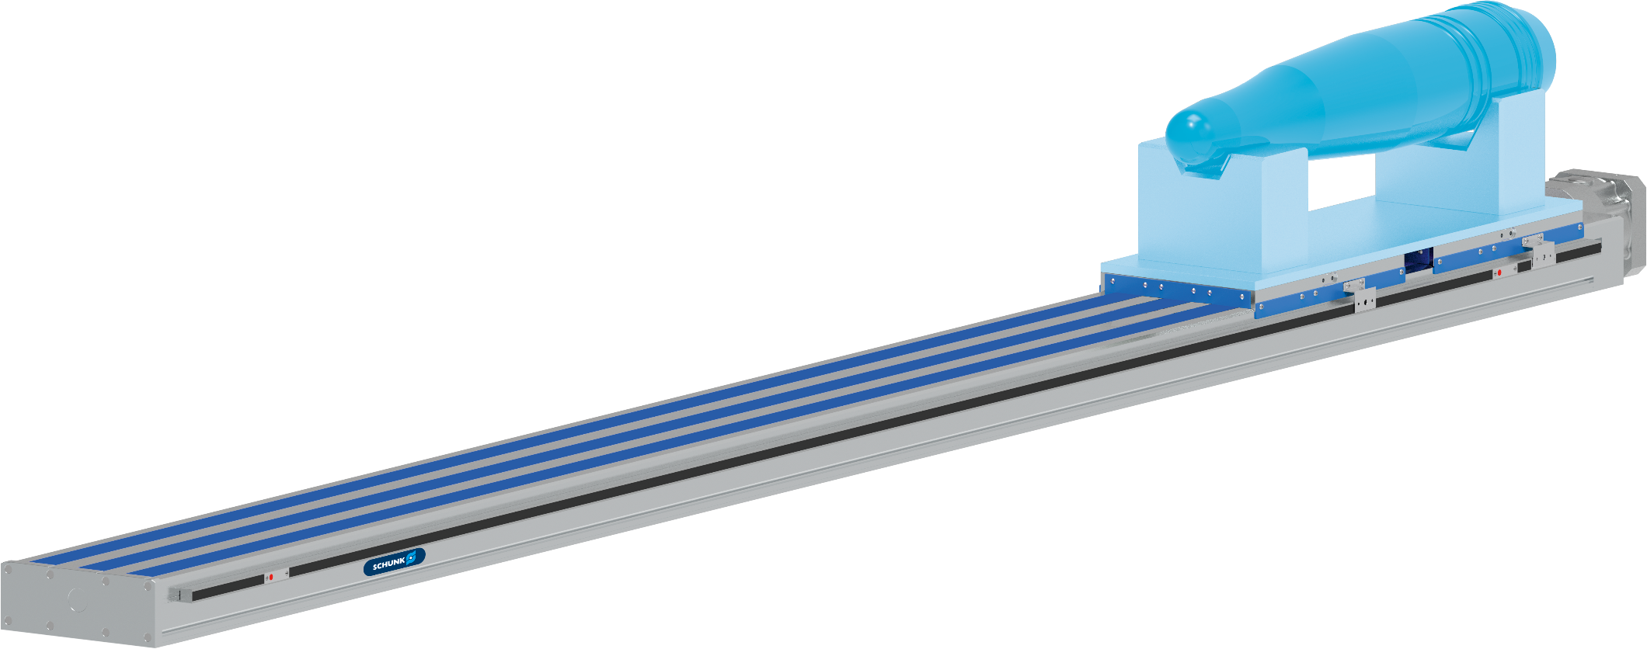

Ball Screw Actuator
Accurate positioning, high payload capacity, and high speed
Defense - Laser Marking Artillery Shell
Function and benefits
Linear actuator to position artillery shells for laser marking process.
Scope
  Linear Axis: Delta 240
  Mech. stroke: 2200 mm
  total length: 3238 mm
  repeatability accuracy (+/-): 0,03 mm
  Weight: 145 kg
Customer needs
  High repeatability and position accuracy
  High speed capability
  Heavy payload capacity
second page available
Notes:
SCHUNK ID: 1578842 Delta 240-C-SSS-M-3240-2200-3238-4SAG-2010-1ES10-18BL10-1-MK3-GS24 | Assembly: 1578842
Contact: Rick Hunsucker, USA

Slide 5

Ball Screw Actuator
Accurate positioning, high payload capacity, and high speed
Defense - Laser Marking Artillery Shell
Linear axis Delta
(Delta 240-C-SSS-M-3240-2200-3238-4SAG-2010-1ES10-18BL10-1-MK3-GS24)
Notes:
SCHUNK ID: 1578842 Delta 240-C-SSS-M-3240-2200-3238-4SAG-2010-1ES10-18BL10-1-MK3-GS24 | Assembly: 1578842
Contact: Rick Hunsucker, USA

Slide 6


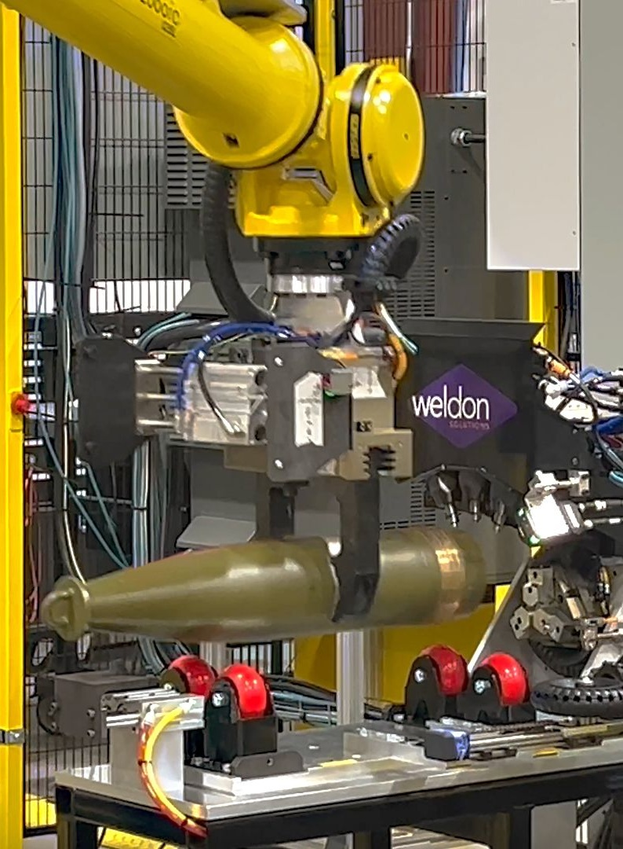
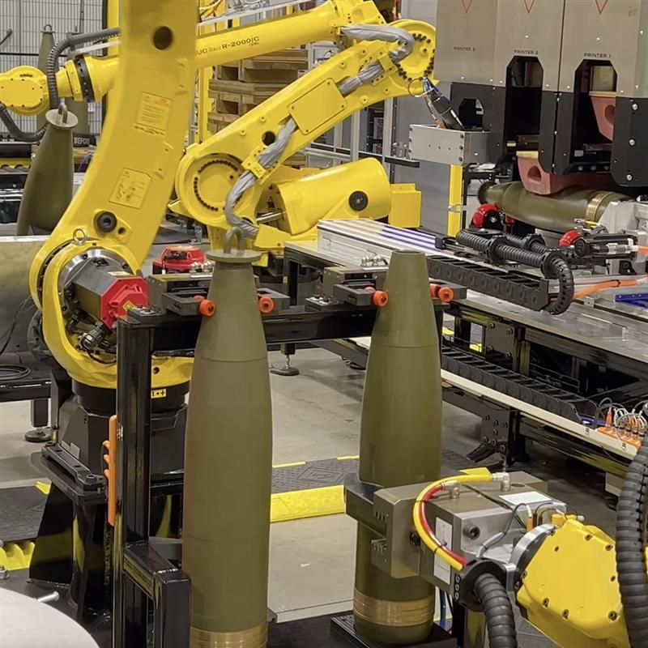
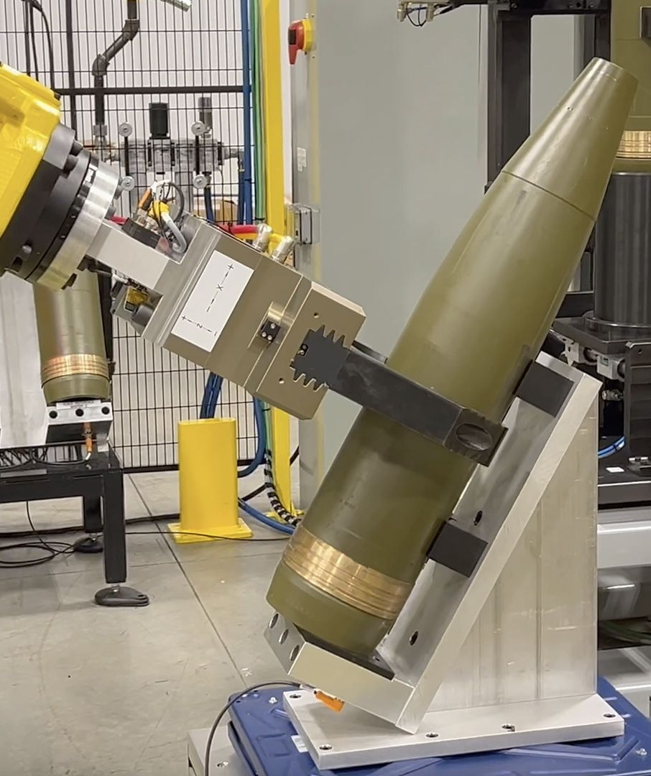
General Dynamics Ordnance and Tactical Systems: 155 mm artillery shell production
Defense
Linear axis Delta
PGL-plus-P
PGN-plus-P
PGN-plus-P
PGN-plus-P
Source: Weldon Solution - LinkedIn, post 1; talkbusiness.net;

Slide 7
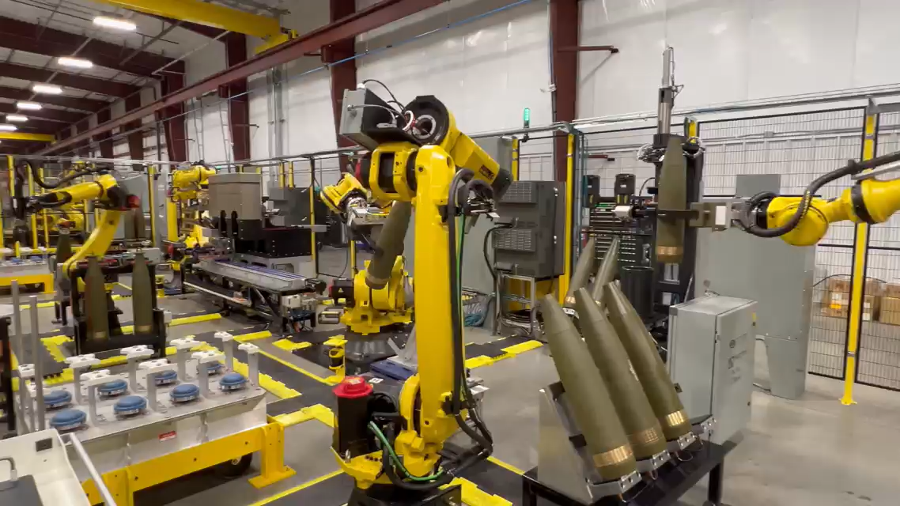
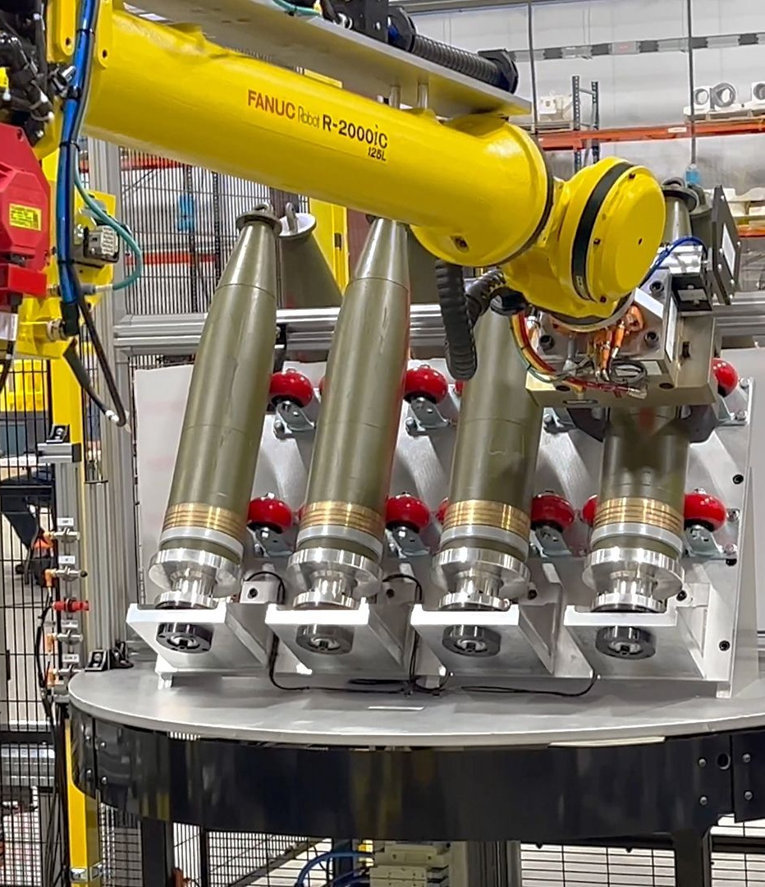
General Dynamics Ordnance and Tactical Systems: 155 mm artillery shell production
Defense
PGN-plus-P
Source: Weldon Solution - LinkedIn, post 2; Weldon Solution - LinkedIn, post 3

Slide 8
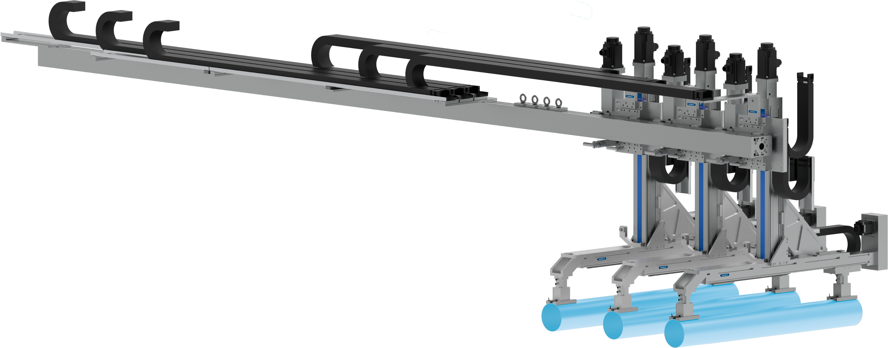
X-Y-Z Gantry System + Magnetic Gripping
Flexible Handling of Varied Cylindrical Workpieces
Defense - Weapons Assembly
Notes:
SCHUNK ID: Assembly: 380646

Slide 9
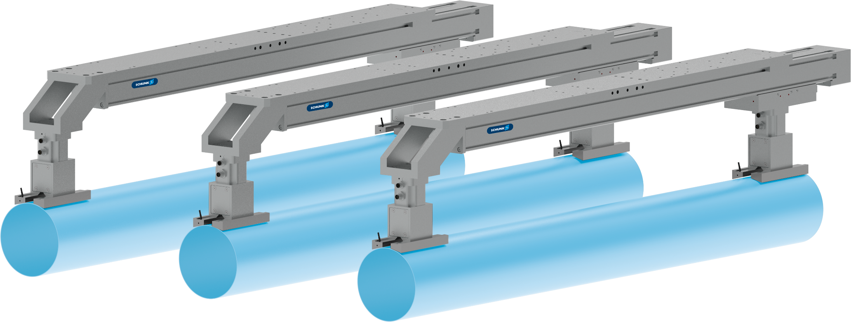
Magnetic Gripping
Flexible Handling of Varied Cylindrical Workpieces
Defense - Weapons Assembly
Function
Magnetic gripper for flexible gripping
Customer benefit
  Single tool handles many diameters
  No changeover or moving parts
Customer work piece
Missile bodies
Scope
Gripper: EMH-DP 080-B
  Payload for horizontal magnet surface: 19 kg
  Payload for vertical magnet surface: 7.5 kg
  Weight: 3 kg
EMH-DP 080-B
PVL EMH-DP 080 Ø150-Ø260
Custom for project
TYPICAL PRODUCTS
TYPICAL PROCESS
REQUIREMENTS
RELIABILITY
STRONG
Notes:
SCHUNK ID: 1475116, EMH-DP 080-B | Assembly: 380646
1597200, PVL EMH-DP 080 Ø150-Ø260 (Custom PVL for project)
Contact: Blake Hall, USA

Slide 10
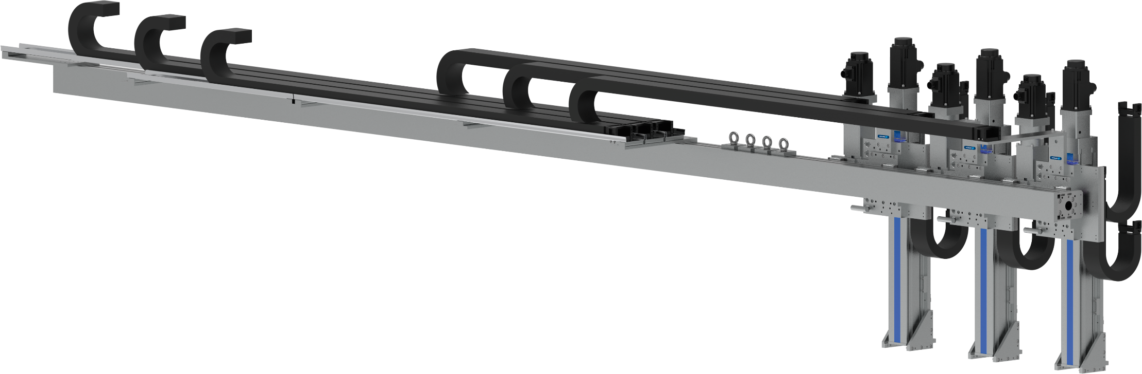
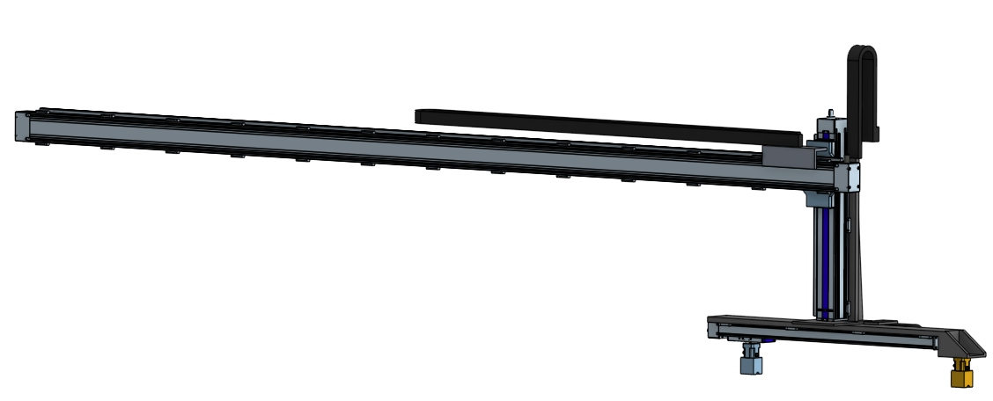
X-Y-Z Gantry System
Flexible Handling of Varied Cylindrical Workpieces
Defense - Weapons Assembly
Function
Gantry system for precise pick-and-place
Customer benefit
  Fast, precise actuators move workpieces reliably as intended
Scope
  2x Gamma 120-ASH
  Mech. stroke: 4.600 mm
  Weight: 100 kg
  2x Beta 140-C-ZSS
  Mech. stroke: 4.600 mm
  Weight: 80 kg
  8x Beta 110-SRS-M
  Mech. stroke: 500 mm
  Weight: 35 kg
  8x Beta 100-D-SSS
  Mech. stroke: 1.000 mm
  Weight: 30 kg
Gamma 120-ASH
Beta 100-D-SSS
Beta 140-C-ZSS
Beta 110-SRS-M
Notes:
SCHUNK ID: 1588788/1588795, Beta 140-C-ZSS-50AT10-E-220-4622-5182-AK-AZ* | Assembly: 380646
1588787, Beta 110-SRS-M-2510-500-980-1-MGK2-GS24
1588789, Beta 100-D-SSS-M-2005-1000-1410-2SAG-1-URT3
1586690/1588793, Gamma 120-ASH-40AT10-E-240-4676-6026*
Contact: Blake Hall, USA

Slide 11
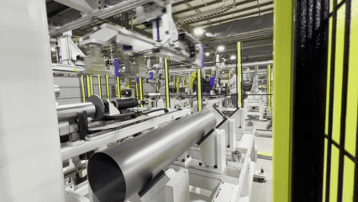
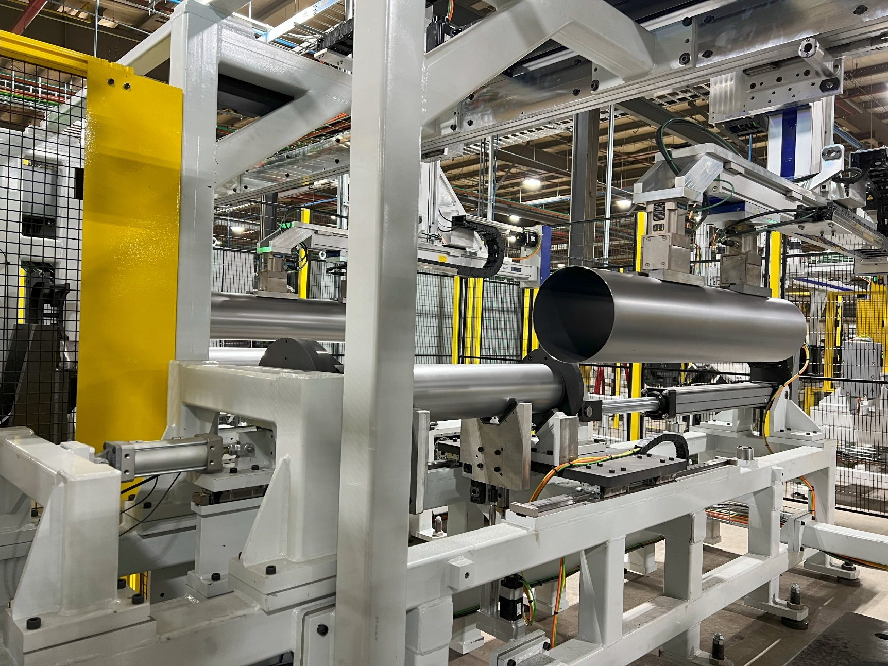
Magnetic Gripping / X-Y-Z Gantry System
Flexible Handling of Varied Cylindrical Workpieces
Defense - Weapons Assembly
Notes:
SCHUNK ID: 1475116, EMH-DP 080-B | Assembly: 380646
1597200, PVL EMH-DP 080 Ø150-Ø260 (Custom PVL for project)
1588788/1588795, Beta 140-C-ZSS-50AT10-E-220-4622-5182-AK-AZ*
1588787, Beta 110-SRS-M-2510-500-980-1-MGK2-GS24
1588789, Beta 100-D-SSS-M-2005-1000-1410-2SAG-1-URT3
1586690/1588793, Gamma 120-ASH-40AT10-E-240-4676-6026*
Contact: Blake Hall, USA

Slide 12
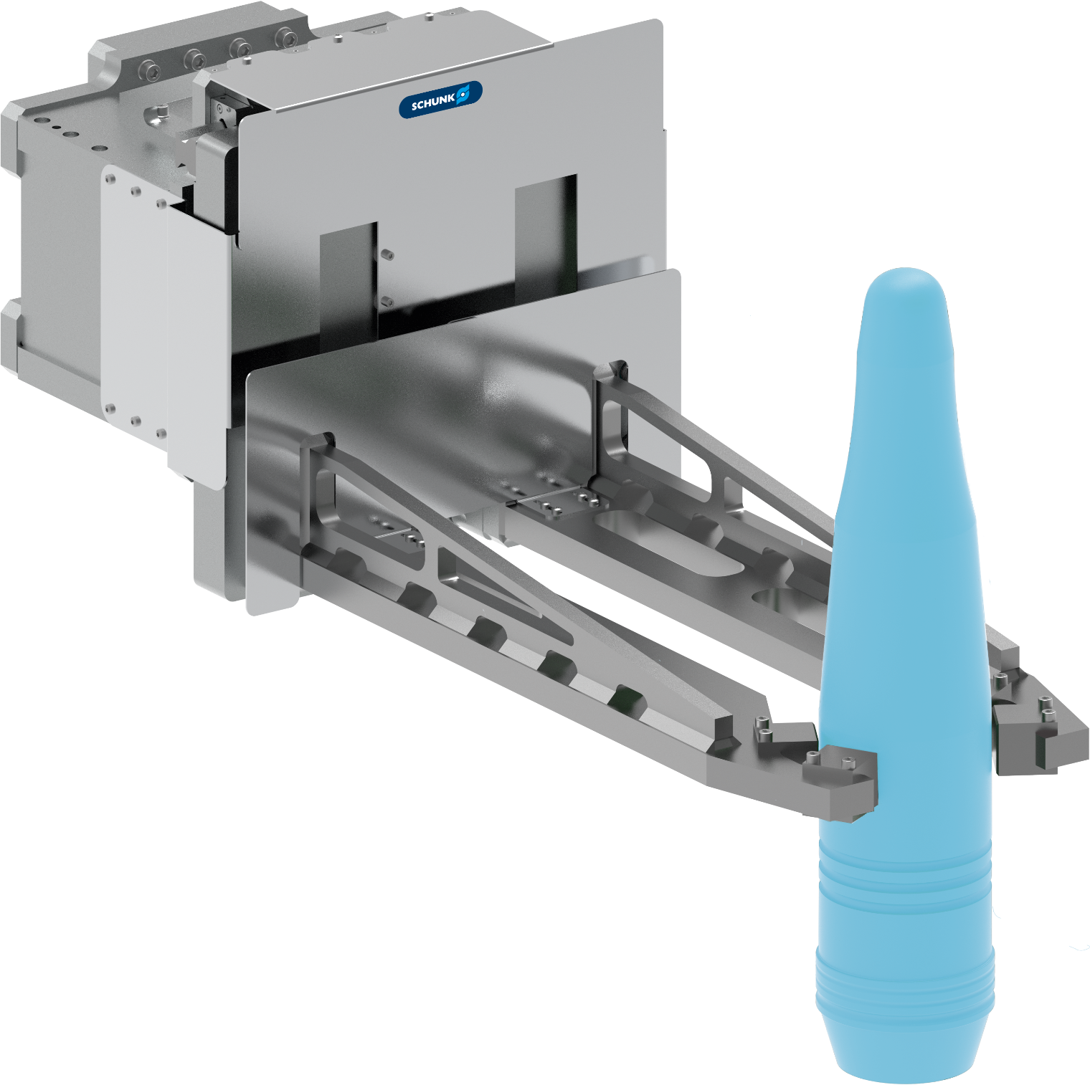
Handling of artillery shells to/from curing oven
Defense - Grenade Handling
Function and benefits
Parallel gripper with customized finger and pads to handle artillery shells to/from curing oven
Customer benefit
  handling of hot parts: specially designed and shield gripper to allow for handling in very tough, high-temperature environment
Customized top jaws
with special inserts for tight gripping
Expert project planning teams
Sizing, design and assembly by SCHUNK
Notes:
SCHUNK ID: 1608679

Slide 13
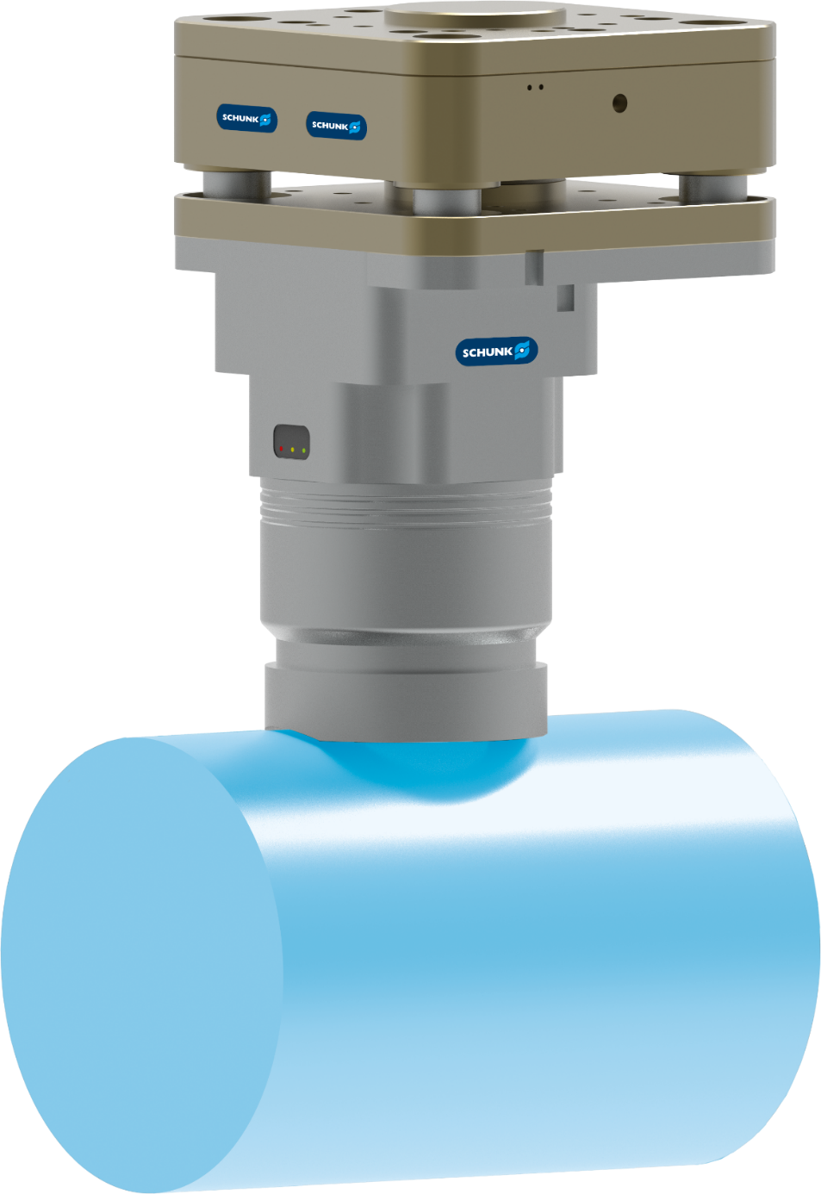
Magnetic Gripping
Bin picking of Varied Cylindrical Workpieces
Defense - Weapons Assembly
Function
Magnetic gripper for flexible gripping
Customer benefit
  Single tool handles many diameters
  vertical & horizontal handling
Customer work piece
Missile bodies, raw material
Scope
Gripper: EMH-DP 080-B
  Payload for horizontal magnet surface: 175 kg
  Payload for vertical magnet surface: 70 kg
  Weight: 8 kg
Compensation unit: AGM-Z 125
  Compensation Z: 15 mm
  Weight. 10 kg
AGM-Z 125
EMH-RP 114
PVL EMH-RP 114
customized for project
TYPICAL PRODUCTS
TYPICAL PROCESS
REQUIREMENTS
RELIABILITY
STRONG
Notes:
SCHUNK ID: - (2025_10_06_THW_EMH_billet_bin_picking)
AGM-Z 125 incl sensor MMS 22-PI2-S-M8-PNP
Adapter plate
EMH-RP 114
Connection cable 10 m, straight connector (logic + power supply)
Pole extension with with recess for Ø 200 mm
Contact: Thomas Wahl, HQ Germany

Slide 14

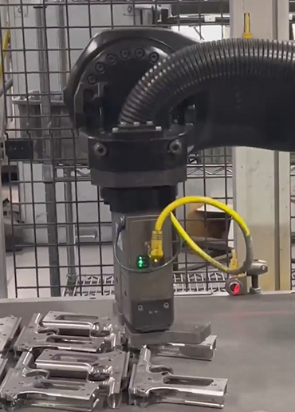
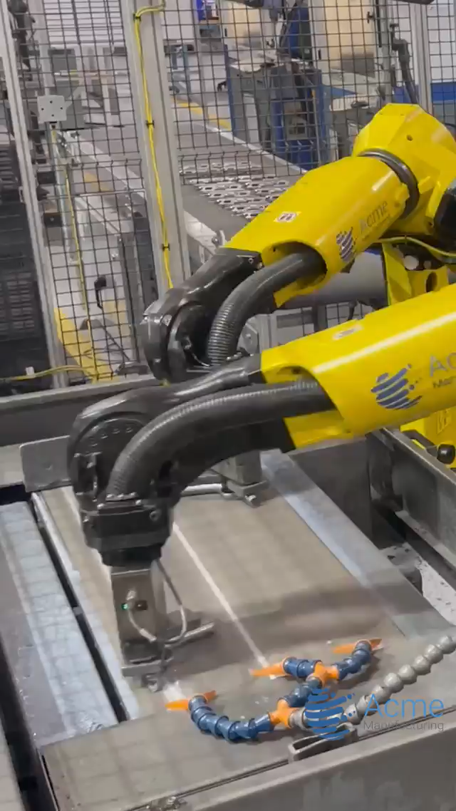
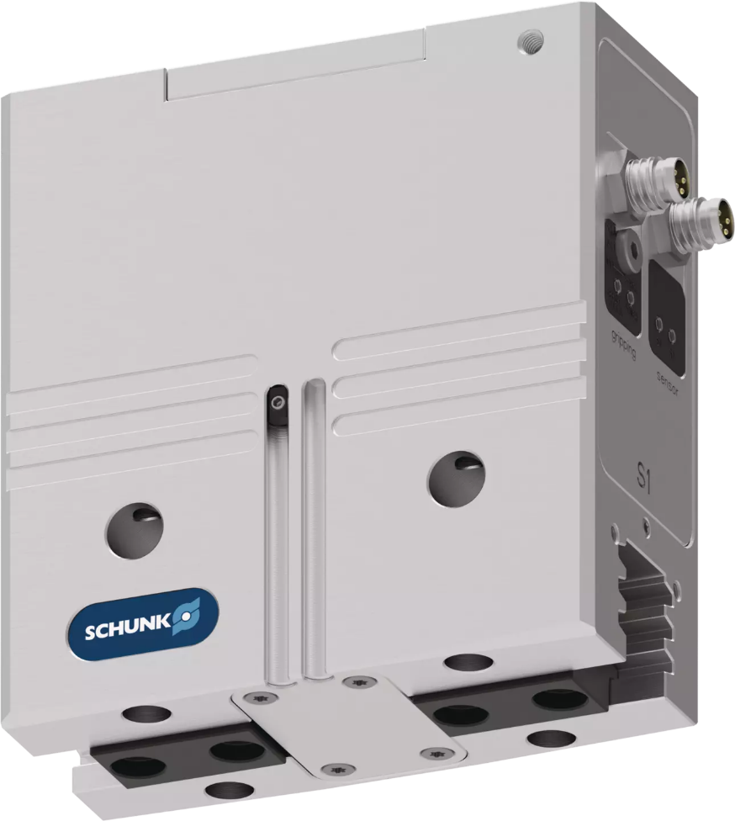
Wet abrasive pistol frame lapping process
PGN-Plus-E
Defense - Weapons Assembly
PGN-plus-E
video shows PGN-plus-E in IO-Link version with additional dust cover
Source: Robotics in Firearms Manufacturing
Notes:
SCHUNK ID: -

