Slide 1

SCHUNK Engineering
Solution Book - Electronic
Note:
This presentation contains confidential information and is only released for non-public use by customers and suppliers.
Consultation with specialist department may be necessary.
- Remove this note before use -

Slide 2
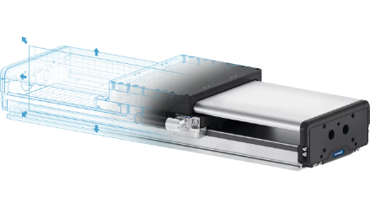
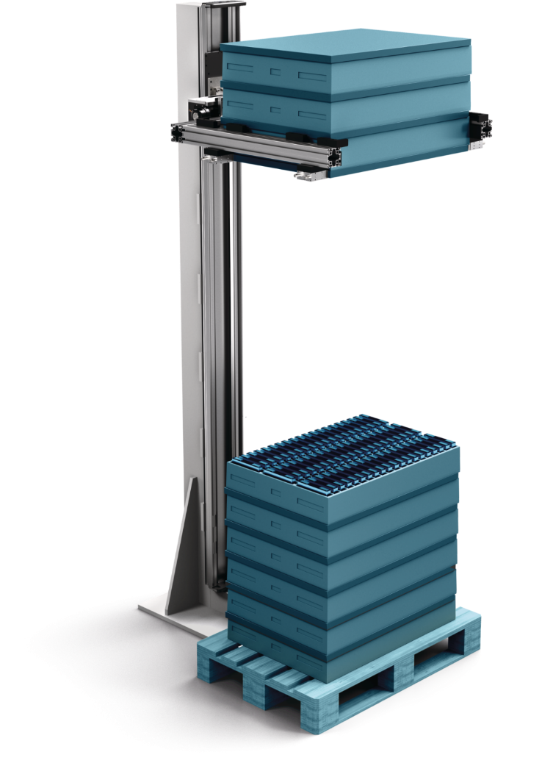
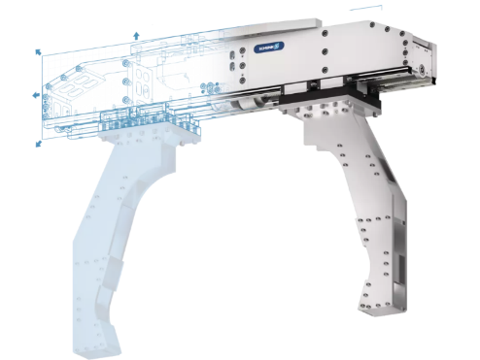

Material Lifter
Lifting trays for automated unloading
Electronic - Intralogistics
Function
Lifting trays layer by layer for automated unloading.
Customer benefits
Compact and space saving:
Using the z-axis vs. x/y-axis saves valuable installation / floor area
Flexibility - virtually universal:
The Material Lifter with configurable axis and gripper can be adapted to many applications in terms of size, load, speed, …
Expert project planning team
Sizing, design and assembly by SCHUNK
+
additional slides available

Slide 3
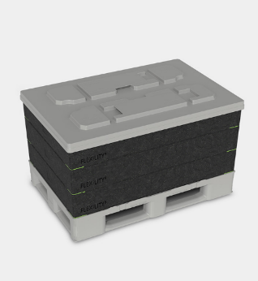
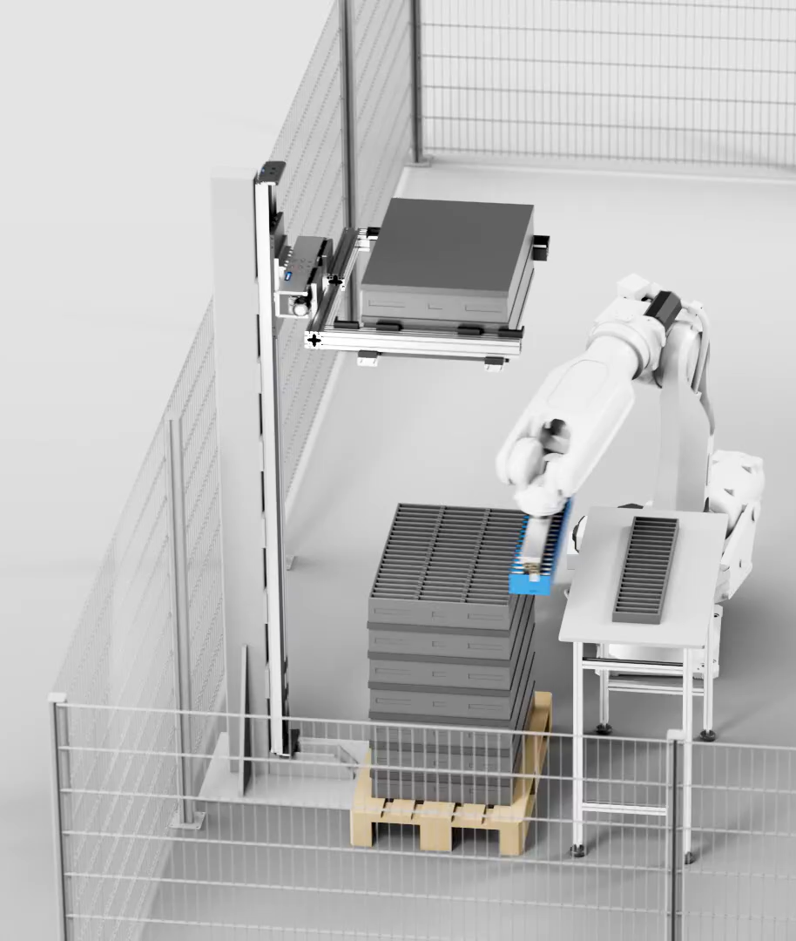
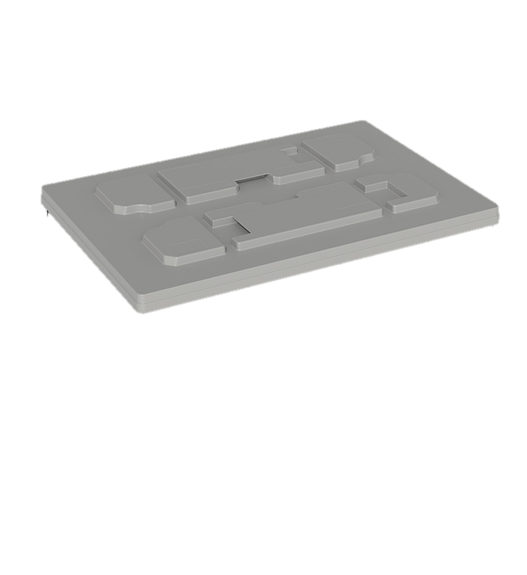
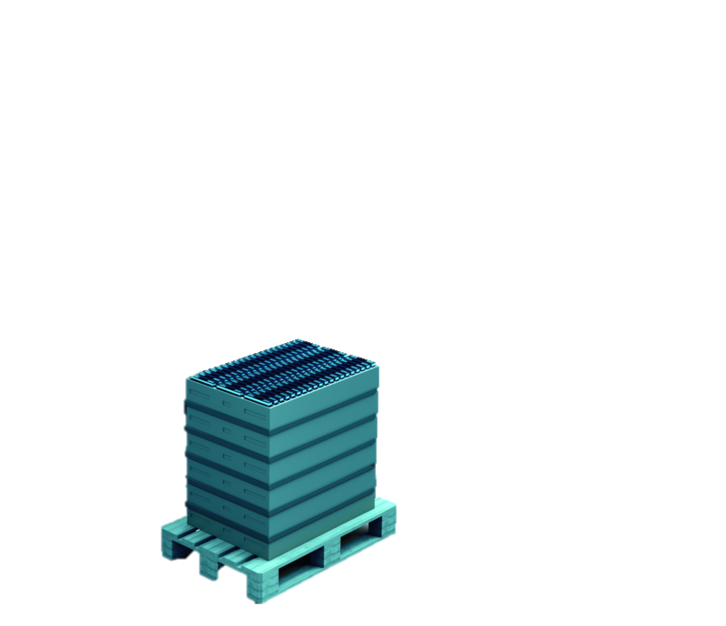
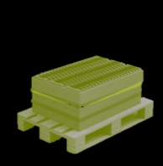
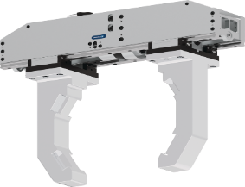
Material Lifter
Lifting trays for automated unloading
Electronic - Intralogistics
Cover handling
Saves
Floorspace
Pure
Flexibility

Slide 4
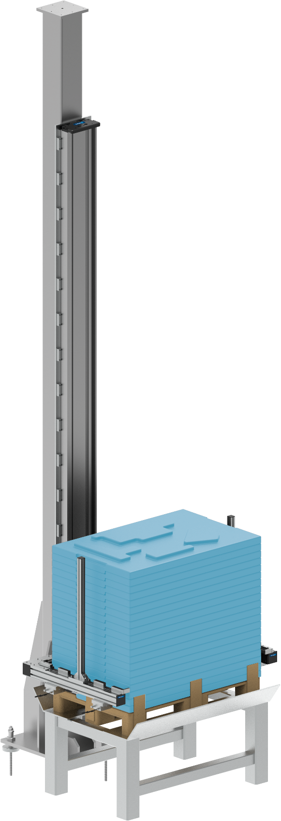
Material Lifter
Lifting trays for automated unloading
Electronic - Intralogistics
Reference project
consisting of
Linear direct axis SLD-24 heavy-duty design with working stroke 3.200 mm
Electric long-stroke gripper ELG 30
1
2
Notes:
SCHUNK ID: 1602006

Slide 5

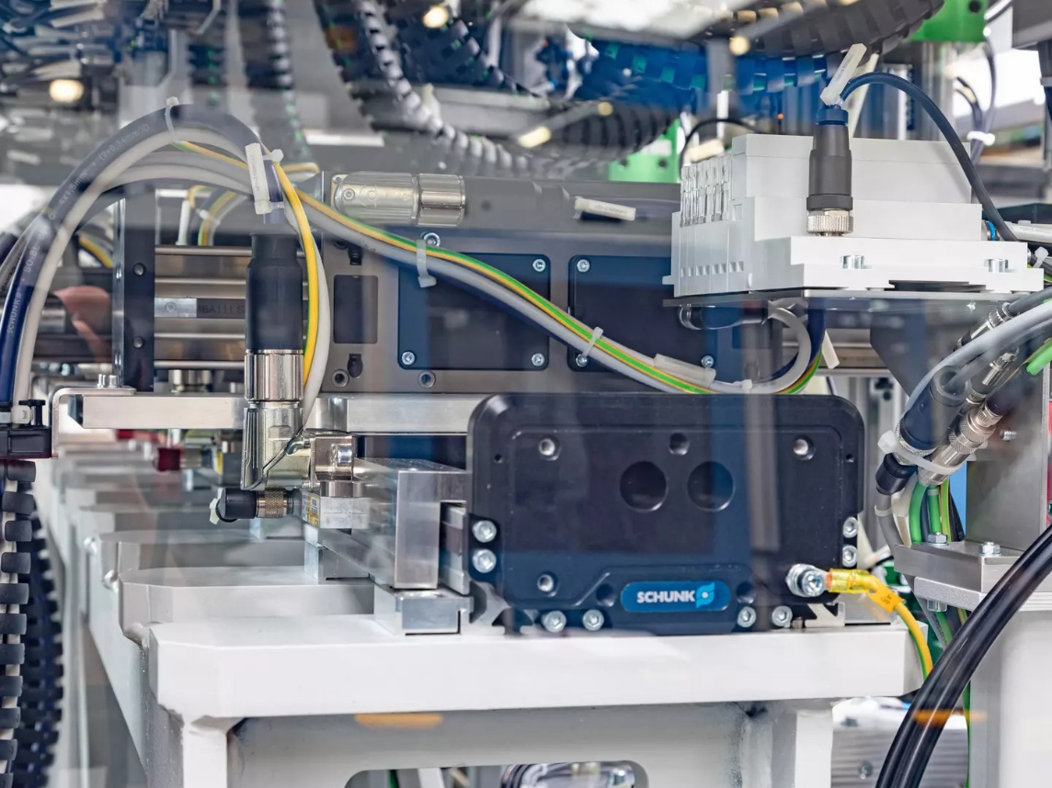
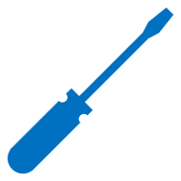
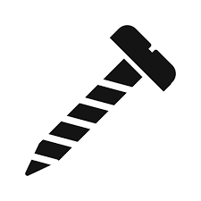




It couldn't be more compact!
Screw assembly cell with five screw units
Electronic - Assembly
Function
Five separately controlled slides enable high-precision and fast screw processes in the assembly cell. The robustness and accuracy of the SLD-axis ensures flawless screwdriving processes and avoids scrap.
Scope
  1x linear direct axis SLD 11 with five slides (x-axis)
  5x linear direct axis LDN (y-axis)
Customer benefit
  Highly compact unit integrated into existing customer line
  High load capacity of the base axis ensures precision of screwdriving operations
Discharge side view of the SLD linear direct axis installed on a steel girder.
second page available
TYPICAL PRODUCTS
TYPICAL PROCESS
REQUIREMENTS
Click here for the success story!
HIGHSPEED
STRONG
ACCURACY
Notes:
SCHUNK ID: 1554728

Slide 6
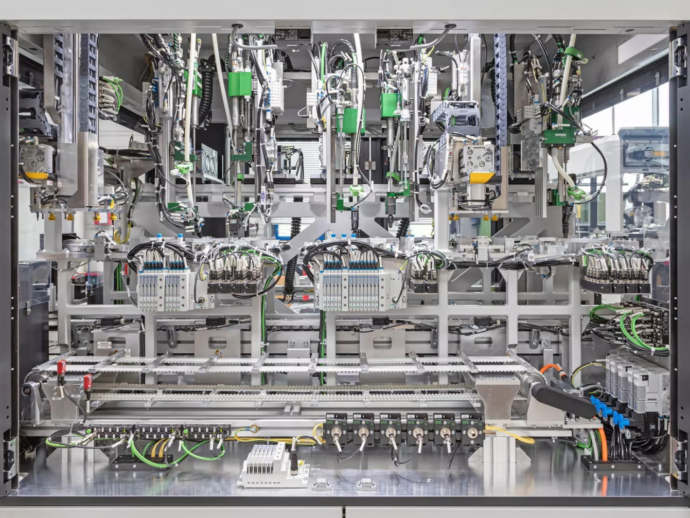
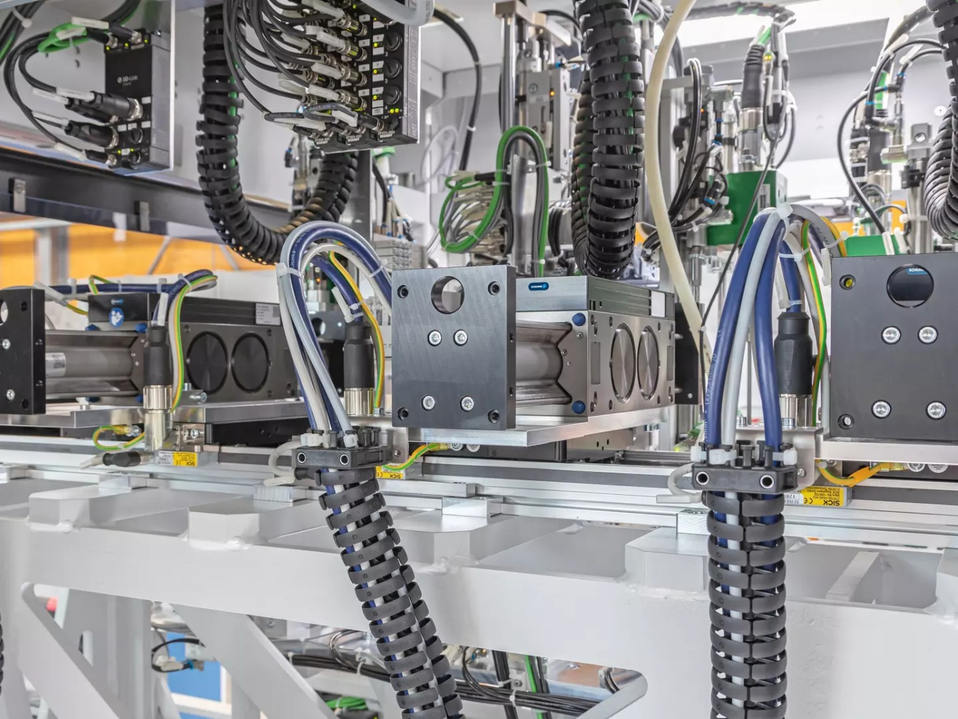
It couldn't be more compact!
Screw assembly cell with five screw units
Electronic - Assembly
Complete view of the extremely compact screwdriving assembly cell with five screwdriving units. The heart of the cell is the SLD horizontal linear direct axis with five independently movable carriages.
An LDN universal linear axis is mounted transversely on the SLD horizontal linear direct axis, on all five slides.
Click here for the success story!
Notes:
SCHUNK ID: 1554728

Slide 7
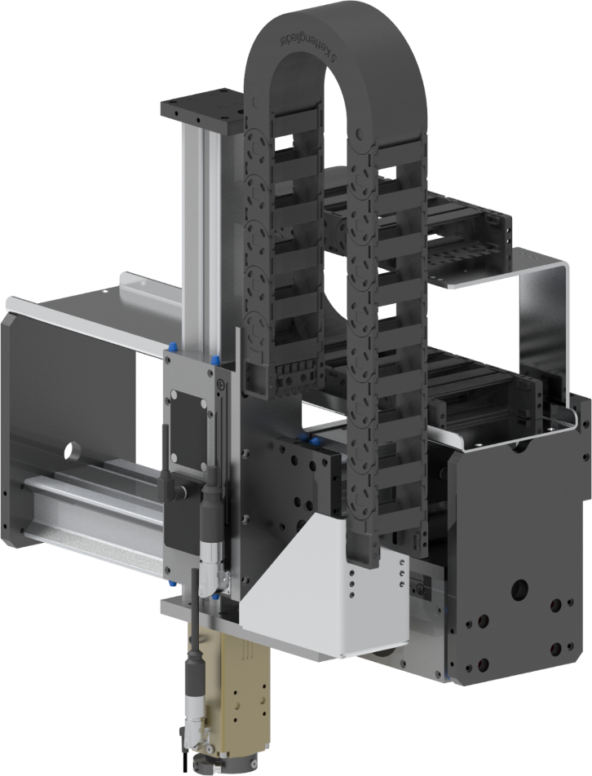

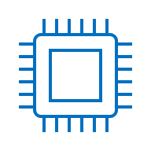
4-axes handling gantry
Handling of circuit boards
Elektronic - Small items
Expert project planning teams
Sizing, design and assembly by SCHUNK
Complete system
Installation and wiring of all components, including the mounting bracket
Axes
X-axis: LDM 200-M, stroke 300 mm
Y-axis: LDM 200-NAL, stroke 150 mm
Z-axis: LDM 100-K, stroke 50 mm
C-axis: MRDS 04 IP40 ED
Gripping solution
Interchangeable head miniature parallel gripper with center bore and gripper jaws, 3 x MV 15 valves for controlling the gripper and blowing off
TYPICAL PRODUCTS
TYPICAL PROCESS
REQUIREMENTS
HIGHSPEED
STRONG
ACCURACY
Notes:
SCHUNK ID: 400287

Slide 8
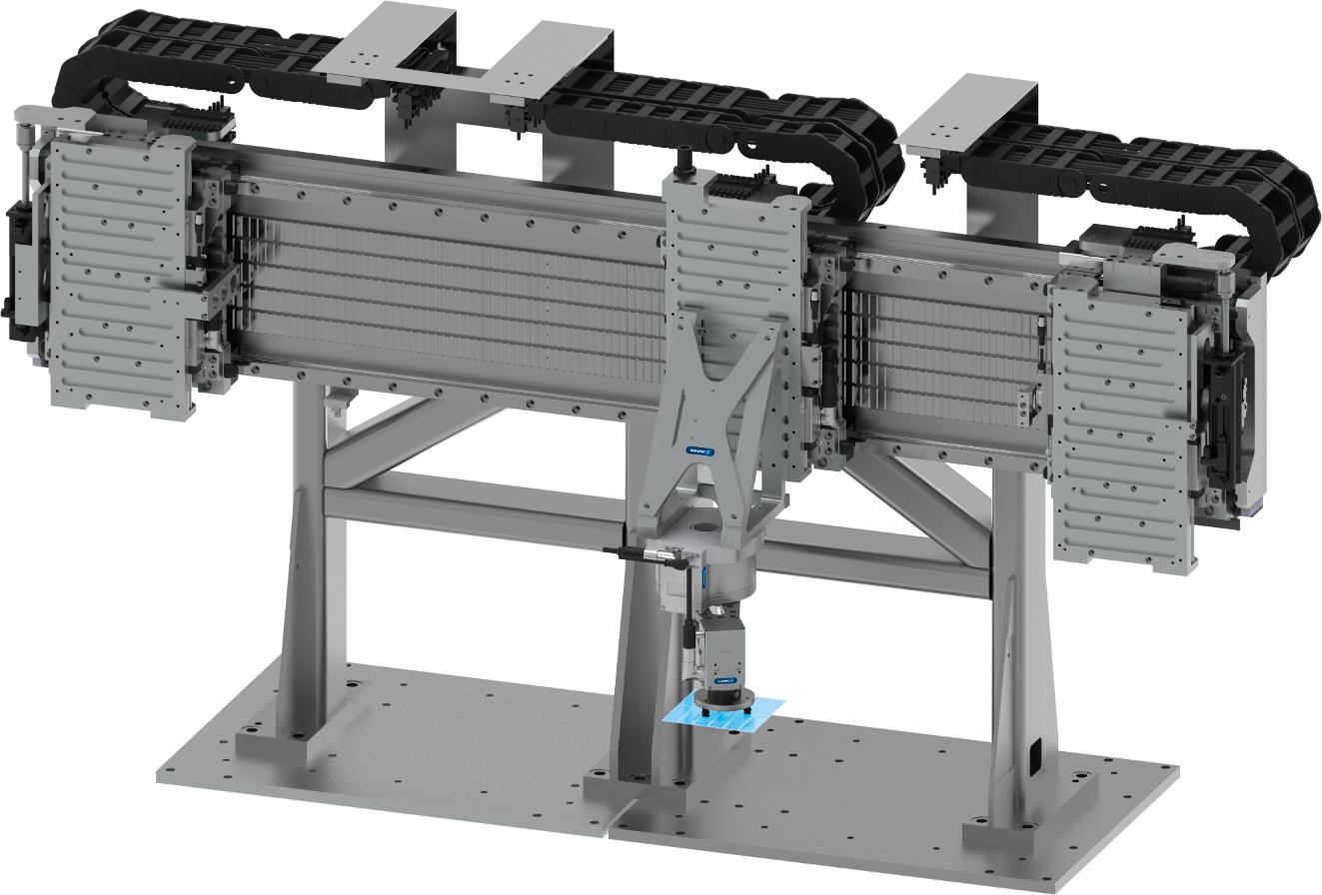



Handling gantry
Assembly for handling solar module components
Elektronik – Solar/small items
Handling gantry
Handling system with energy chains, cable routing according to customer specifications, including all power and sensor cables to the drive controller and pneumatic load compensation
Customer benefits
Ready-to-install sub-machine tailored to the overall concept. The gantry handling system is installed directly into the customer's production facility.
Scope
Base frame made of welded steel construction, profile rail guides with linear direct drive
Y-axis: LDS-UF-1000-1100, nom. force: 1000 N Z-axis: LDS-UL-0600, nom. force: 600 N
TYPICAL PRODUCTS
TYPICAL PROCESS
REQUIREMENTS
HIGHSPEED
STRONG
ACCURACY
Notes:
SCHUNK ID: 416380 / 441025 (Rendering mit Werkstück)

