Slide 1

SCHUNK Engineering
Solution Book - Aerospace
Note:
This presentation contains confidential information and is only released for non-public use by customers and suppliers.
Consultation with specialist department may be necessary.
- Remove this note before use -

Slide 2
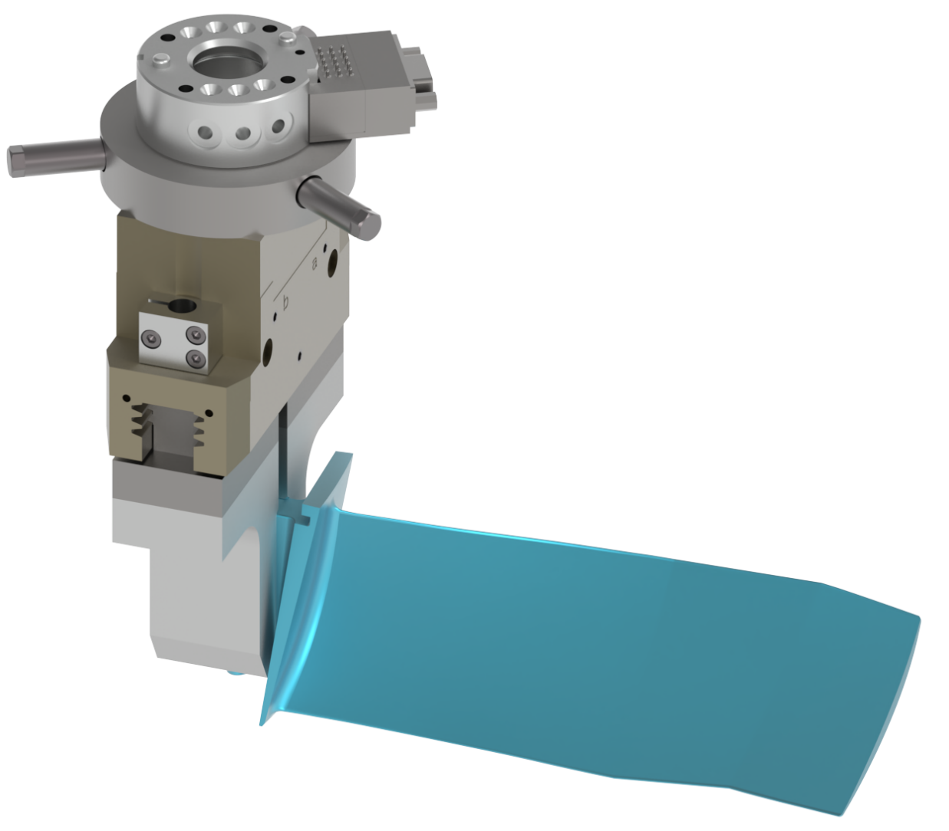
Handling of turbine blades
Loading and unloading of machine tools
Aerospace
Function
Loading and unloading of machine tools
Customer benefit
  Gripper fingers are specifically designed to fit the customer’s workpiece
  Functional example: Plastic gripper fingers that enable X-ray quality inspection of components while they are being held
Customer work piece
Turbine blades
Notes:
SCHUNK ID: 374142

Slide 3
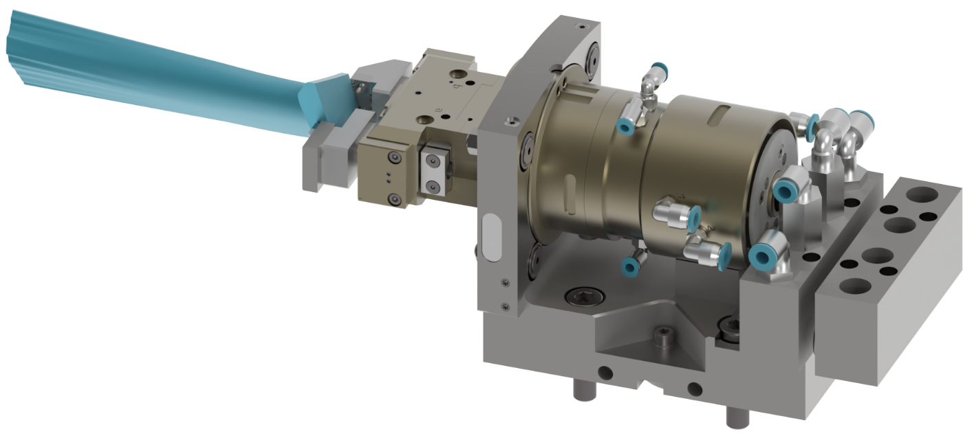
Handling of turbine blades
Deburring process
Aerospace
Function
Automatic deburring process
Customer benefit
  The customer component is held securely, with tolerance differences between the raw part and the machining tool automatically compensated
  Reduced machining time and improved quality thanks to compensation of raw part tolerances
Customer work piece
Turbine blades
Notes:
SCHUNK ID: 376087

Slide 4
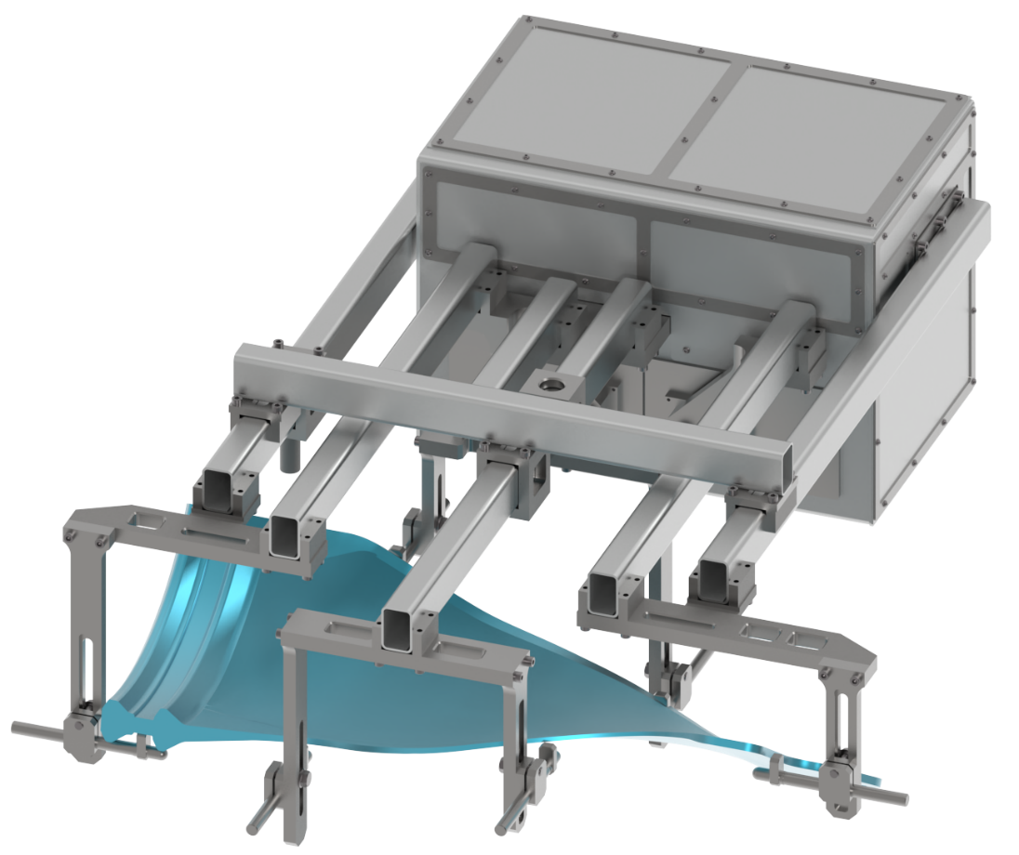
Handling of turbine blades
Repositioning turbine blades during the hardening process
Aerospace
Function
Repositioning turbine blades
during the hardening process from / to the hardening furnace
Customer benefit
  Customer component is taken out of or loaded into the hardening furnace (>1,000 °C)
  Key challenge: Ensuring thermal insulation to cope with the extreme process temperatures
Customer work piece
Turbine blades
Notes:
SCHUNK ID: 374194

