Slide 1
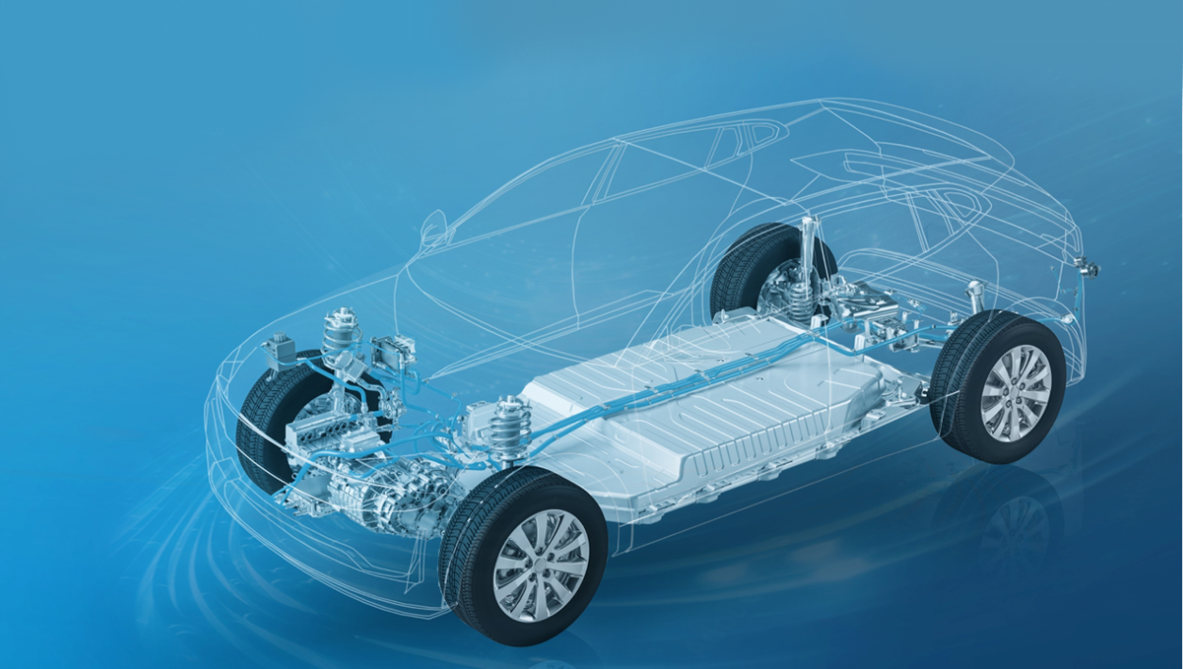

DRIVING YOUR CHANGE

Slide 2
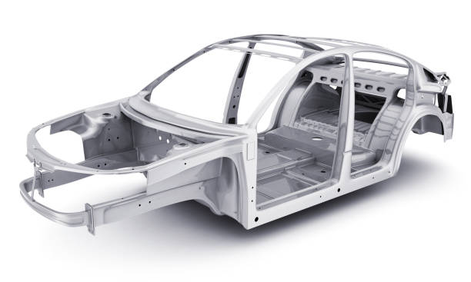
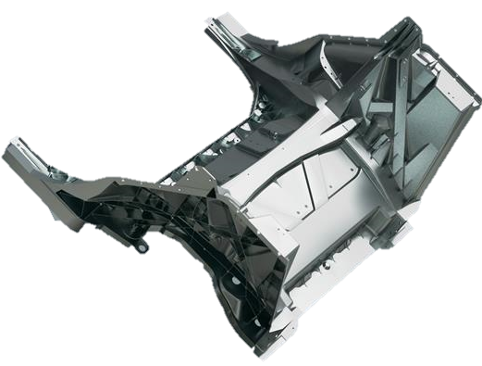
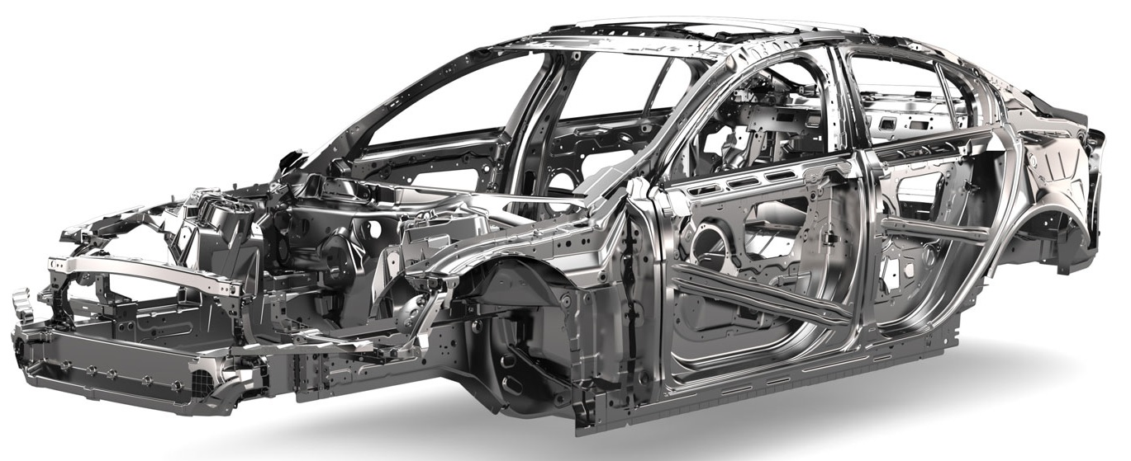
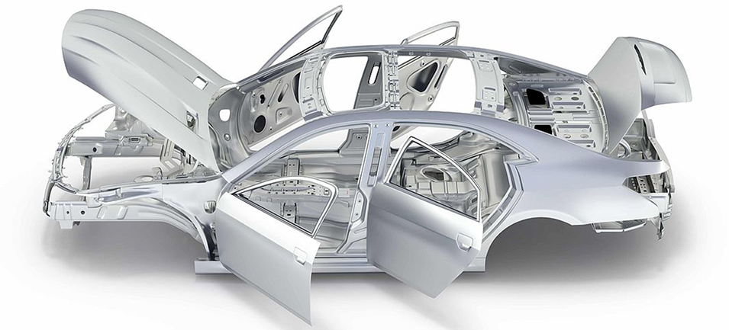
OUR FOCUS
AUTOMOTIVE
CASTING
FRAMING
ASSEMBLY

Slide 3
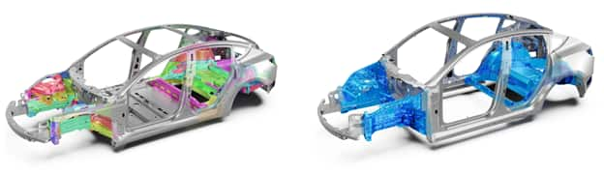
What is Gigacasting/ Megacasting/ …
Creation of big structual parts via the extrusion of molten
metal under high pressure of 6000 – 9000 tonnes
  Working on presses with over 16.000 tonnes
Main goal:
Reducing the number of parts
Elimination of manufacturing costs due to fewer welding
spots and lower amount of parts
Higher rigidity and stiffness

Slide 4
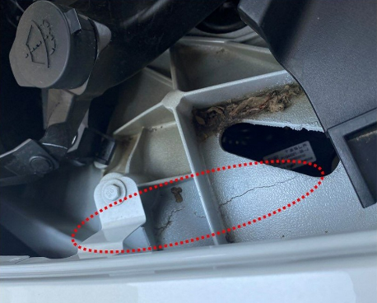
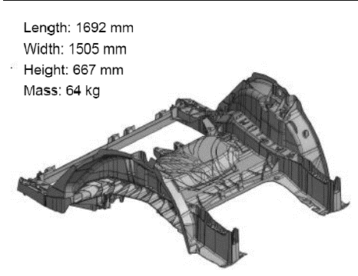
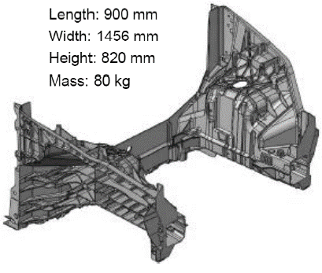
What is Gigacasting/ Megacasting/ …
Challenges:
  Quality of parts due to the extrusion of molten aluminum
  Faulty casts can cause cracks
Critical voices:
  OEM`s such as BMW are not yet adapting the technice due to quality challenges
  Repair of damage parts is very difficult if not impossible

Slide 5
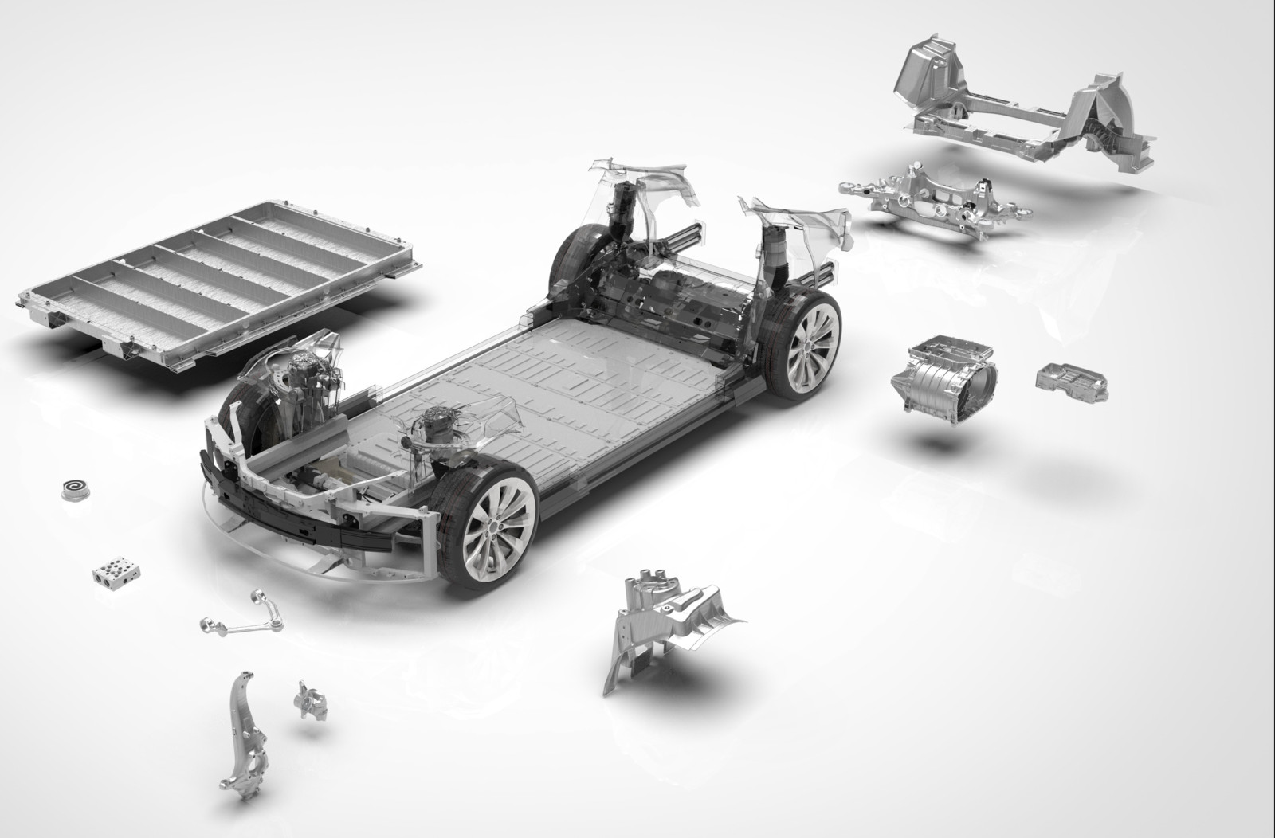
Parts for Gigacasting - EV
Car:
Rear & Front structure
Battery pack
Wishbone
Axle carreir
E-Drive:
Stator
Stator housing

Slide 6
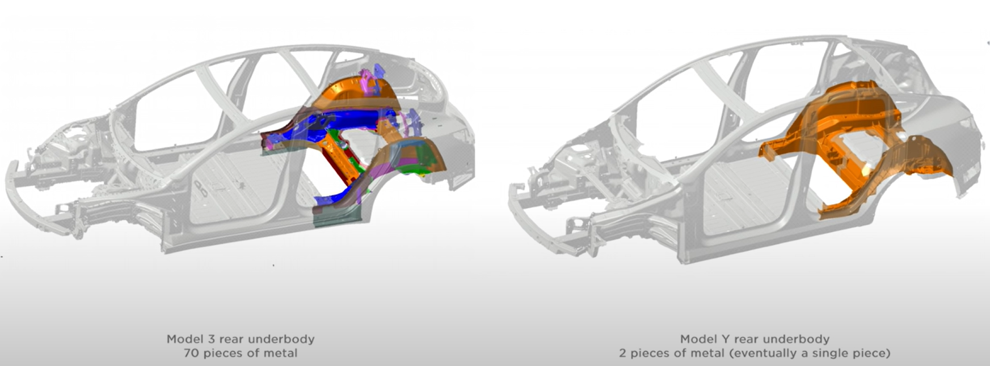
Why Giga casting – car structure
Conventional:
Rear structure is made of 70 pieces of stamped sheet metal
Sealing/ welding/ gluing is necessary to assemble final piece
Stamped parts have a spring back effect which complicates things
Gigacast:
Removing 79 parts per car
Cost reduction of 40% for rear underbody
simplfying mounting operations
Improving build quality

Slide 7
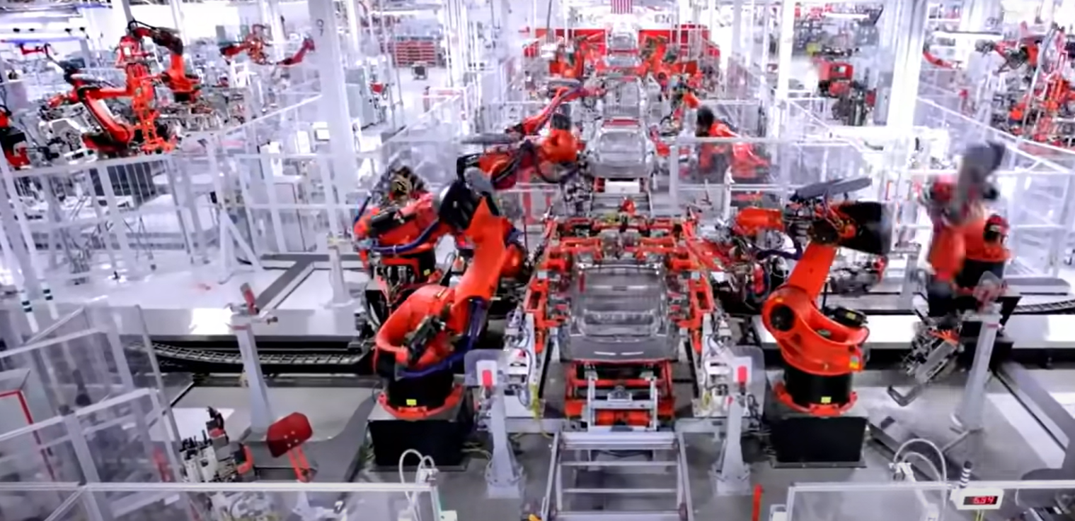
Why Giga casting – car structure
Giga casting:
Number of roboter per line can decrase by 66%
  1000 Robots -> 300 Robots
Reduced floor space due to fewer stations
  Estimation from IDRA -> 20%floor saving
New alloys were necessary to implement the Gigacasting to generate the necessary quality
Conventional Body in White lines have up to 1000 robots for gluing and welding applications

Slide 8


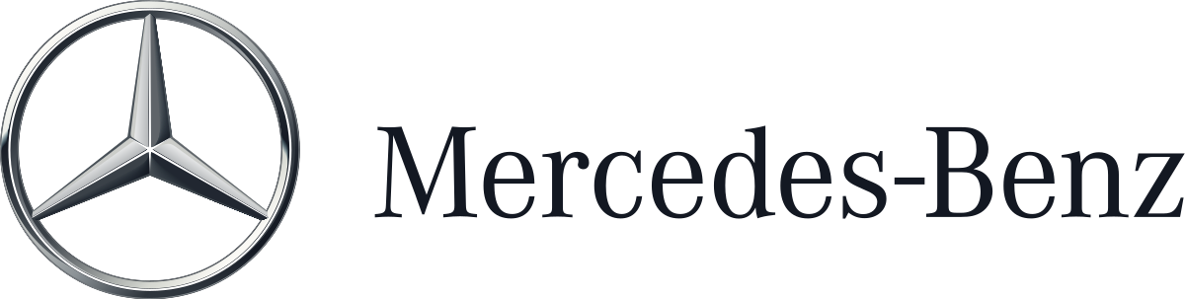















OEM investing in / using Gigacasting
EUROPE
ASIA
NORTH AMERICA

Slide 9










Machine builders Gigacasting
EUROPE
CHINA
JAPAN
Notes:
LK-Machinery: https://www.youtube.com/watch?v=qGTBCGeIwVw

Slide 10
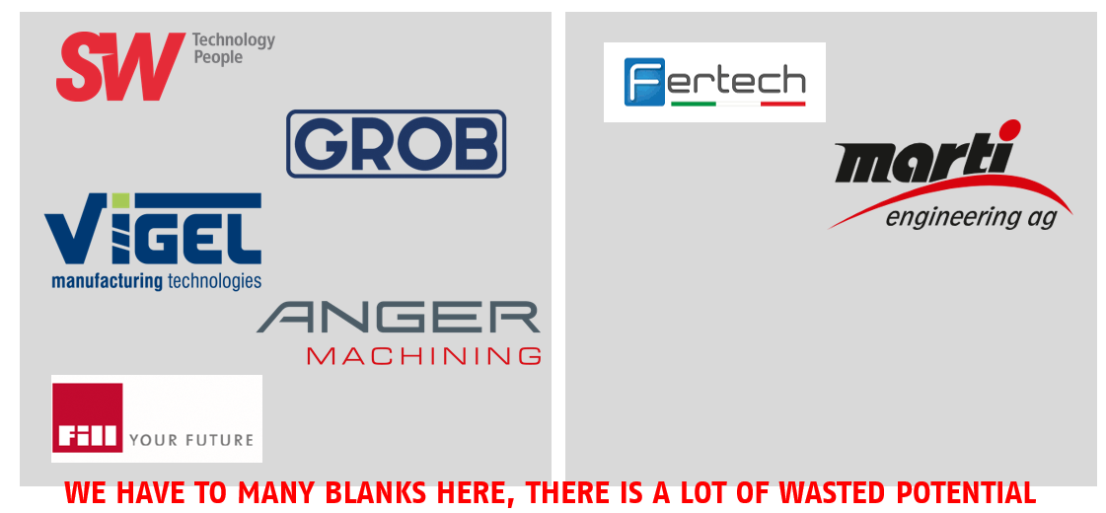
Machine builders for the machining of Mega Casting
Potential suppliers for this process step
Integrators for the unloading of Mega Casting machines
→ Integrator for unloading for IDRA
→ Integrator for unloading for BÜHLER

Slide 11
Order books of machine builders
Q1 2024
Machine builder | 5.000 T | 6.000 T | 7.000 T | 8.000 T | 9.000 T | 12.000 T | 16.000 T
IDRA |  | Tesla; Linamar; Ford |  |  | Tesla, Hyundai, Volvo
Bühler |  | Anhui Unique, IKD, Seojin System, Dongguan Econtec; Handtmann |  | Volvo; IKD | Anhui Unique
LK Machinery | Junling Mould; SPHT | Xpeng; Ruili Group; Tesla; Glovitech; Asiaway; Wencan; SPHT; Yunhai Metals | Xpeng; Wencan; Tuopu; Zeekr | Ruili Group | Ruili Group, Wencan, SPHT | Guangdong Hongtu; SPHT | Guangdong Hongtu
Haitan | Anhui Yongtai |  | Anhui Yongtai | Millison; BAIC Group (Xiaomi)
Yizumi |  |  | Changan, Yunhai Metals
Ube & Gauss |  | Ryobi
ItalPresse-Gauss | Nantong; BMW

Slide 12
Who supplies whom
OEM & Model | GIGA Press Supplier | Giga Cast Supplier | Integrated Parts | Clamping Force (Ton)
Tesla Model Y | IDRA & LK Machinery | Tesla | Rear | 6.100
Tesla Model Y RWD Berlin | IDRA | Tesla | Front & Rear | 6.100
Tesla Cybertruck | IDRA | Telsa | Front & Rear | 9.200
Xpeng G6 | LK Machinery | Xpeng | Front & Rear | 7.000
Xpeng X9 | LK Machinery | Guangdong HongTu | Front & Rear | 12.000
Zeekr 009 | LK Machinery | Zeekr | Rear | 7.200
Volvo M90 | LK Machinery | Zeekr | Rear | 7.200
Nio ET5 – ES6 | LK Machinery | Wencan | Rear | 6.000
Nio ES8 | Haitian | Millison | Rear | 8.800
Huawei AITO M9 | ? | ? | Front & Rear | 9.000
Xiaomi SU7 | Haitian | Xiaomi (BAIC Group) | Rear | 9.100
Notes:
https://haitianinter.com/de/contact/headquarters/

Slide 13
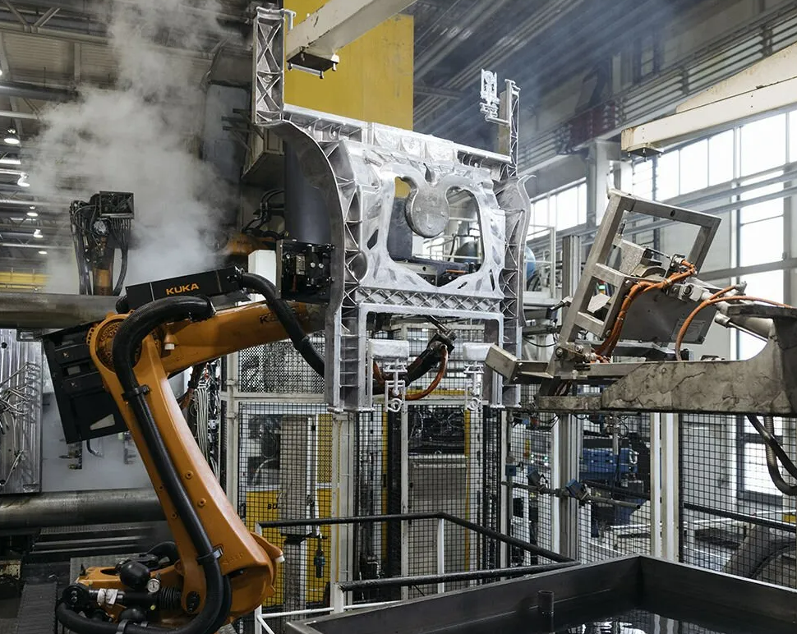
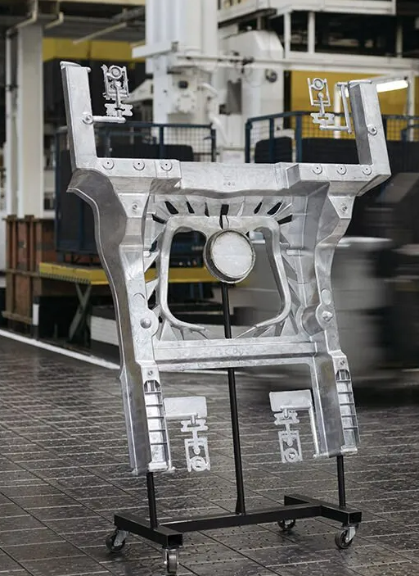
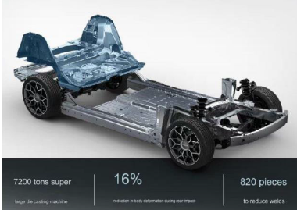
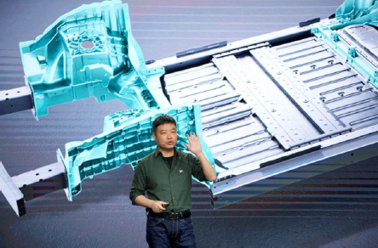
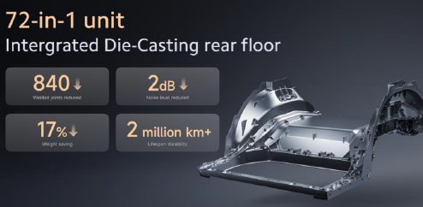
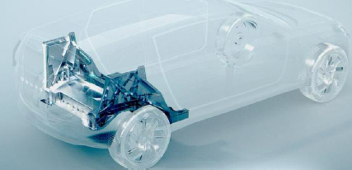
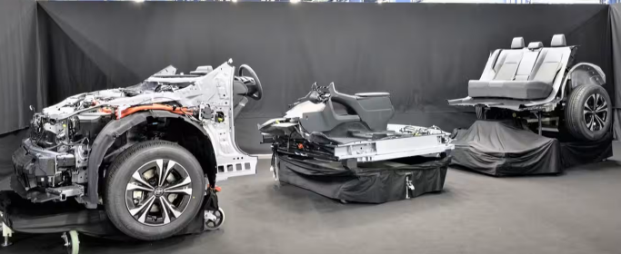
OEM`s Gigacasting
Volkswagen – Trinity, China
Zeeker – China
Xpeng – China
Xiaomi – China
Volvo – China
Toyota – Japan

Slide 14
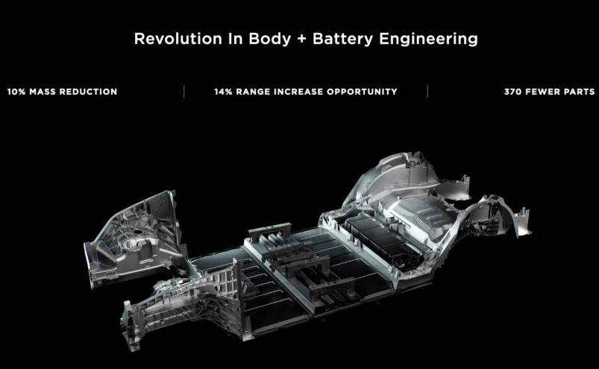
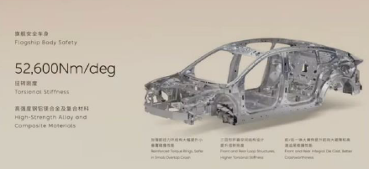
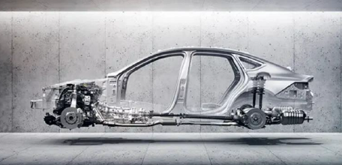
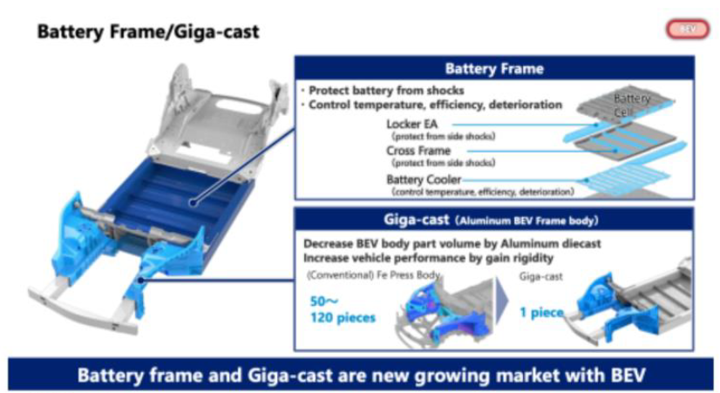
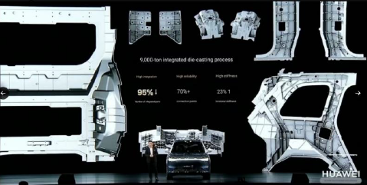
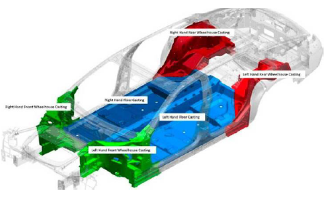
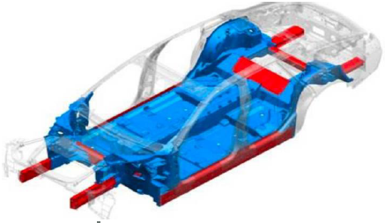
OEM`s Gigacasting
Tesla - Global
NIO – China
Hyundai – Korea
General Motors – USA
Aisin - Japan
Huawei – China
Notes:
https://www.autoevolution.com/news/mercedes-benz-vision-eqxx-will-use-body-castings-like-tesla-165817.html

Slide 15
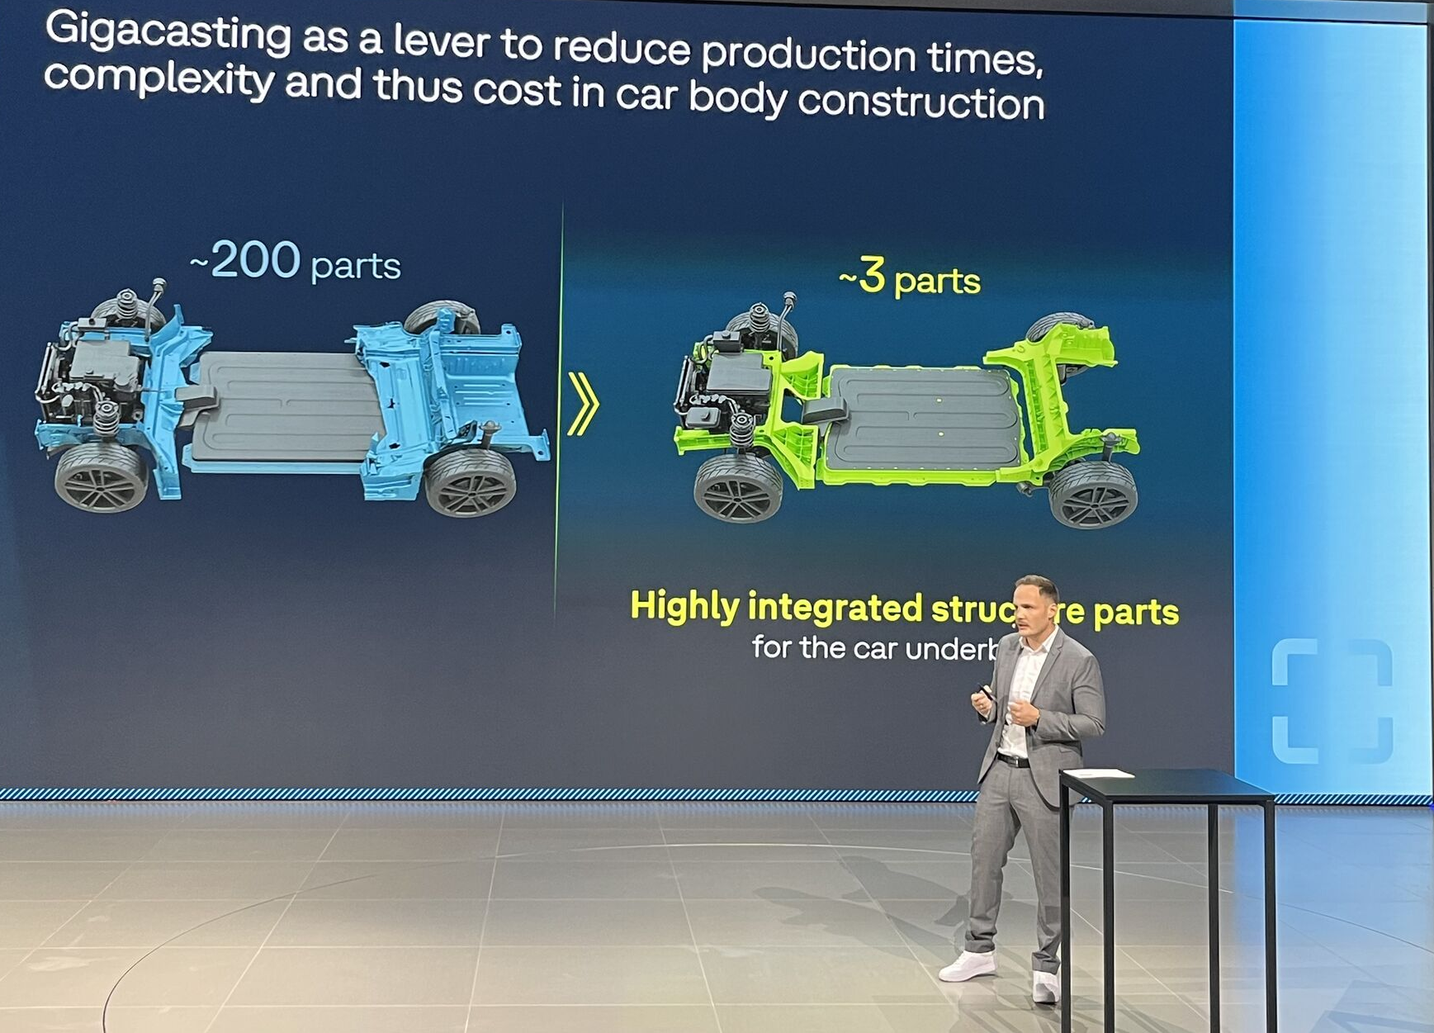
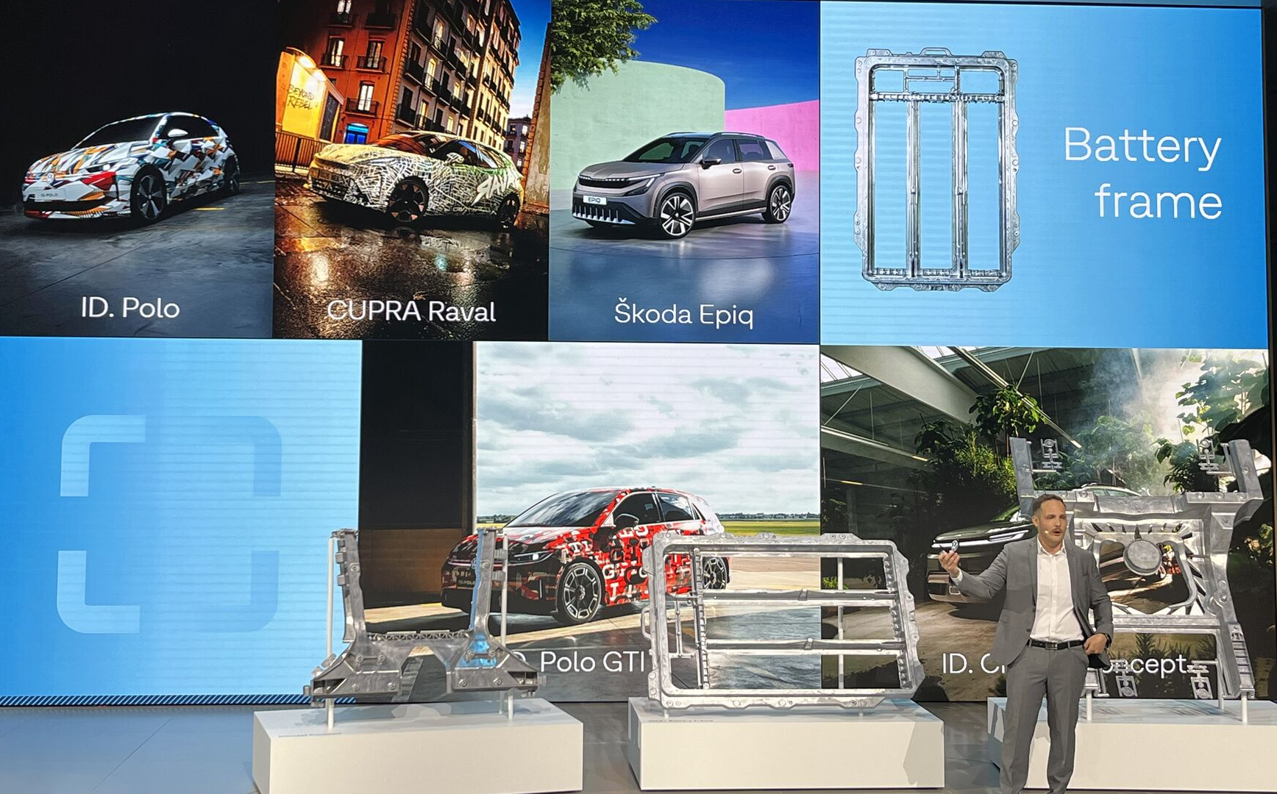
Volkswagen News – Mega Casting for new car generations

Slide 16
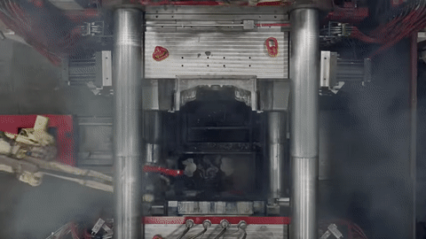
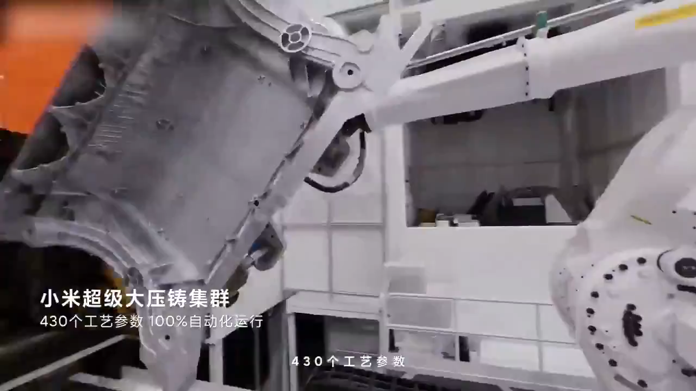
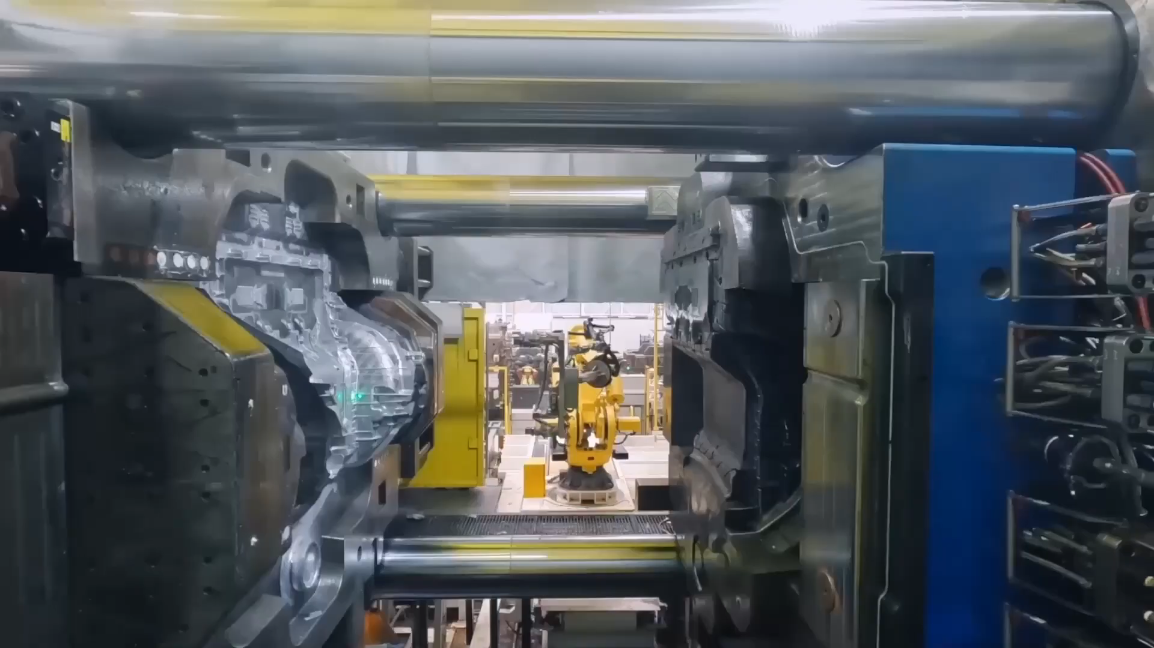
Application envirounment
Heavy workpieces 100KG or more
Workpiece temperature 250° or more
Unloading with robot
Part has to be pulled out of die casting form
Tesla
Xiaomi
XPENG

Slide 17
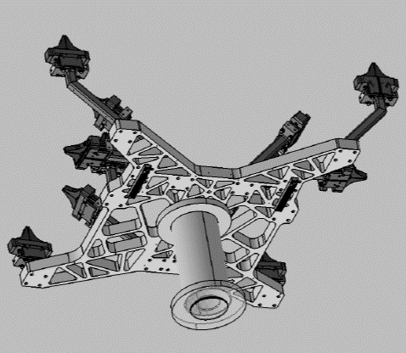
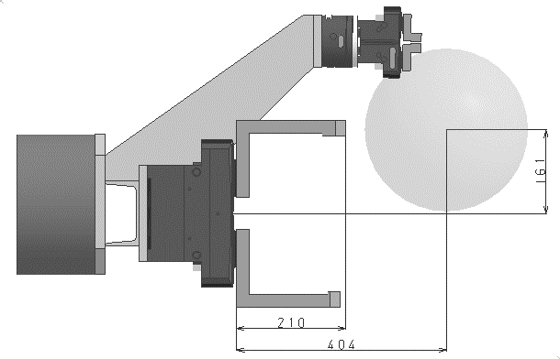
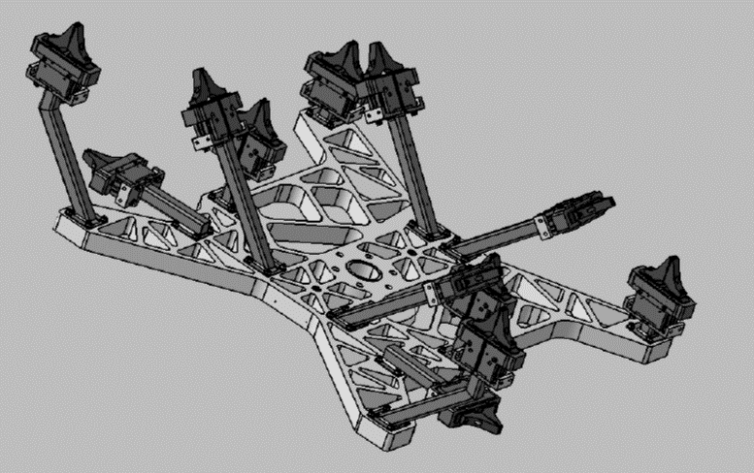
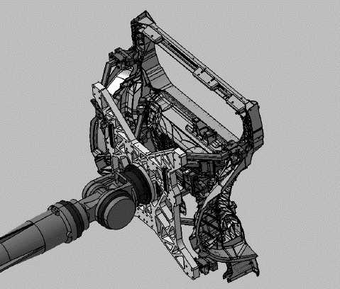
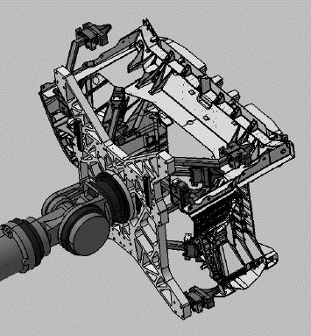
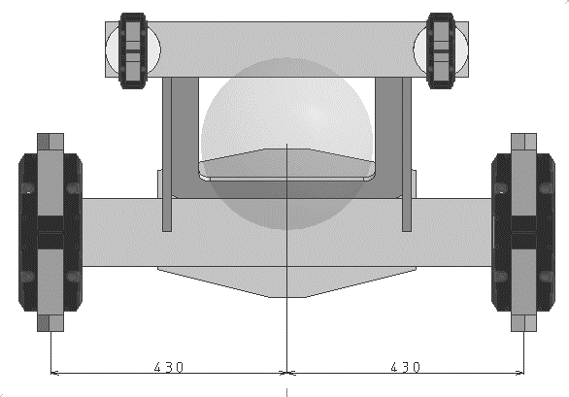
Gripper for Gigacasting
NDA – do not show

Slide 18
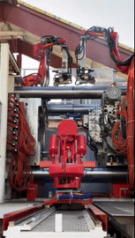
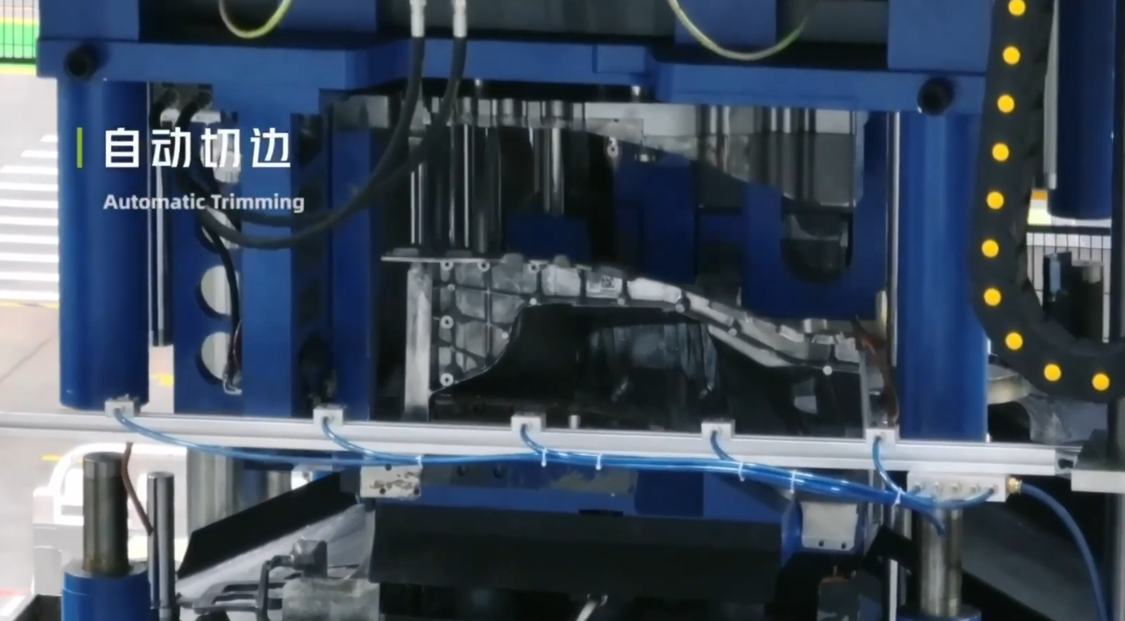
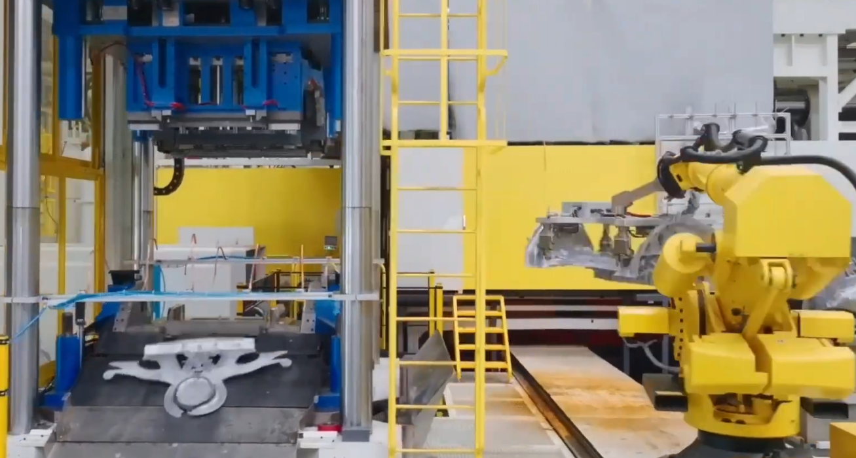
Steps after unloading?
Removing sprue of giga casting
CNC machines or other applications also possible
Laser engraving
Implementing if threads for mounting applications

Slide 19
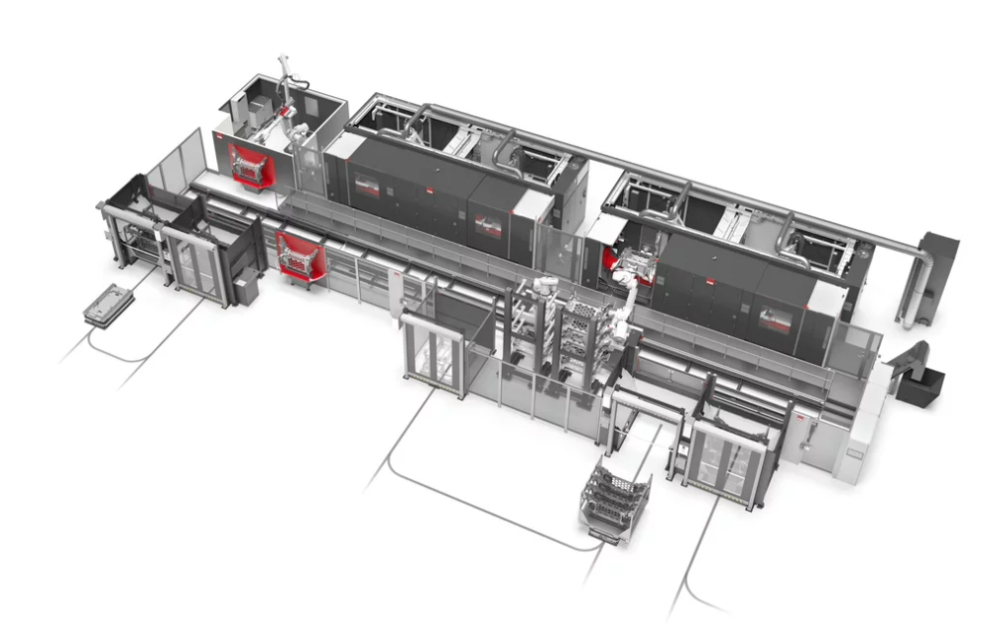
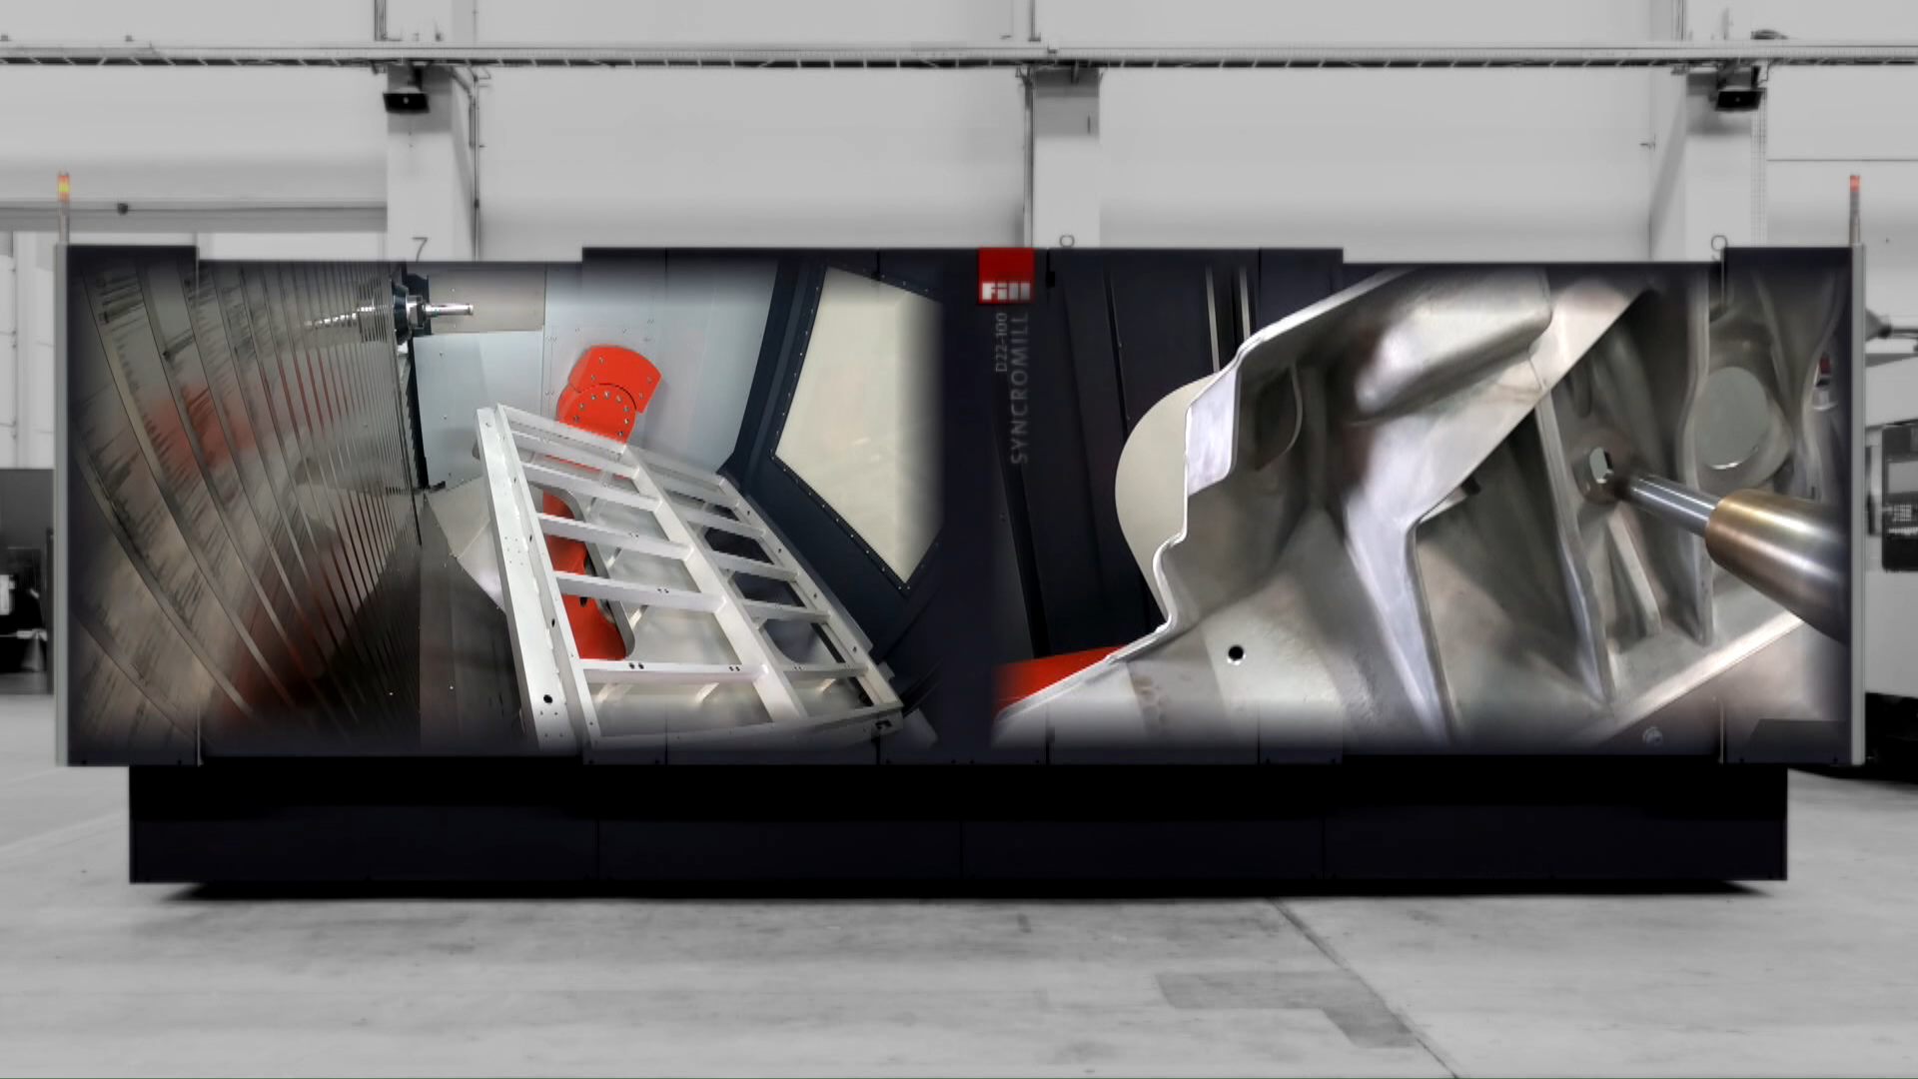
CNC machining
Possible clamping solutions for parts
CNC also of battery housings
There are different existing customers from SCHUNK
which are building/ integrating such lines

