Slide 1



Slide 2
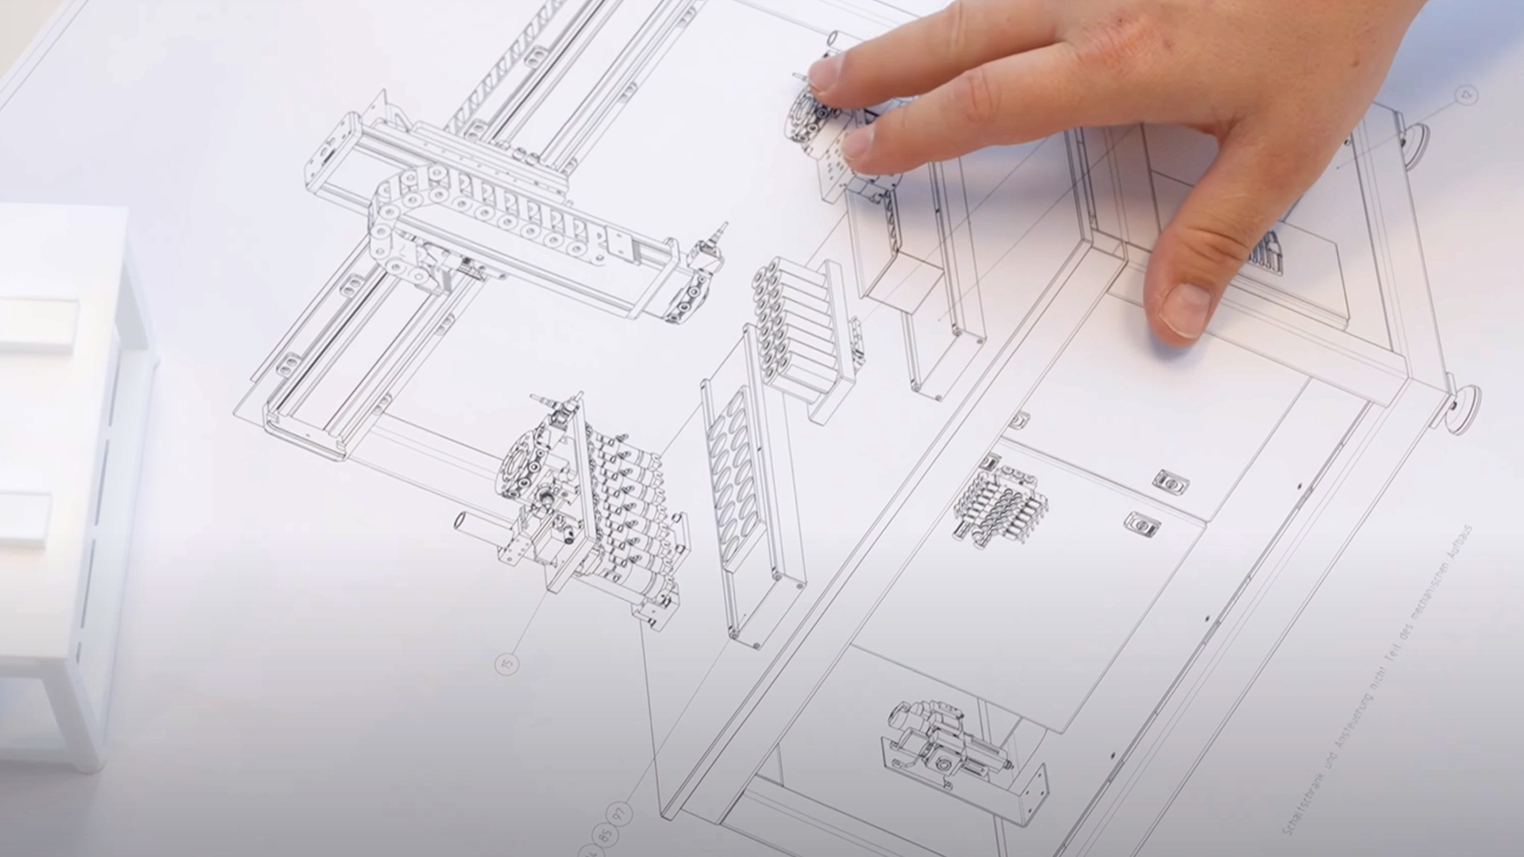



SCHUNK
Engineering
Note:
This presentation contains confidential information and is only released for non-public use by customers and suppliers.
Consultation with specialist department may be necessary.
- Remove this note before use -
SCHUNK Engineering GTAT
- Innovating Partnerships
Competence | Partnership | Speed | Trust

Slide 3
SCHUNK Engineering
  What is SCHUNK Engineering
  Your Advantages of SCHUNK Engineering
Four Steps to Project Success
  Consult
  Develop
  Build
  Support
  Project management

Slide 4





Four steps to project success
Innovating Partnerships
SCHUNK Engineering GTAT
1. Consult
Understand challenges –define the requirements
Defining your advanced requirements through consultation to develop a budget-friendly proposal.
2. Develop
Developing solutions – from idea to design
Collaborate with our expert engineers to deliver custom designed solutions that free you to focus on what you do best.
3. Build
Manufacturing and assembly – production and validation
SCHUNK’s products are built with unmatched precision and digital integration, ensuring the excellence and reliability you need.
4. Support
On-site support – delivery and aftersales
As a trusted partner, on-site support, installation, and after-sales service ensure a seamless experience.
Notes:
Discover SCHUNK Engineering - your partner for custom solutions in toolholders, workholding, gripping technology, and automation technology. With our best-in-class component portfolio and a unique process built on decades of know-how and top-tier technical expertise, we deliver fast, globally available solutions - and outstanding support during the concept development phase. From planning and production to after-sales service, we support you worldwide to meet your specific requirements. Choose SCHUNK Engineering for outstanding results in your manufacturing.
SCHUNK Engineering – Innovating Partnerships
We combine our industry expertise with innovative technologies and sustainable partnerships for your success..
Competence | Partnership | Speed | Trust
Solving problems, unlocking potential, boosting efficiency
SCHUNK Engineering is a key building block for companies focused on efficiency, quality, and innovation.
It not only enables the development of future-proof products and processes, but also makes a significant contribution to our customers’ competitiveness.

Slide 5






SCHUNK is at your side - worldwide
SCHUNK Engineering GTAT
In over 75 countries
  34 own subsidiaries
  32 sales partners
  10 production plants
  6 engineering hubs
Lauffen, DE
Hausen, DE
Mengen, DE
Querétaro, MX
Shanghai, CN
Morrisville, NC, USA
Notes:
Expandable capacity through employees from the Intecs/production facilities in USA, Mexico and China as well as external partners
18 employees in the Brackenheim-Hausen design team + Center of Competence Drive Technology in St. Georgen with three employees

Slide 6
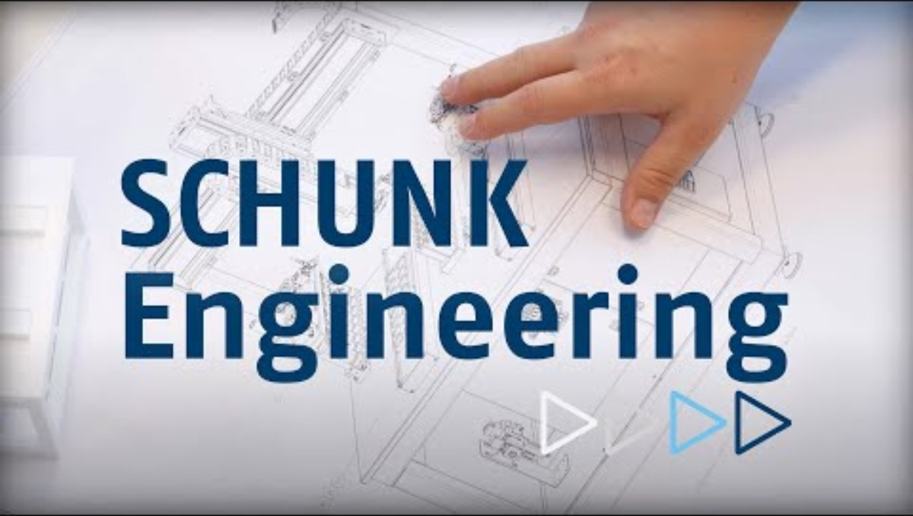

Image-Video
SCHUNK Engineering GTAT
SCHUNK Engineering – Innovating Partnerships
Link to online video.
Internet connection required.

Slide 7
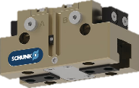
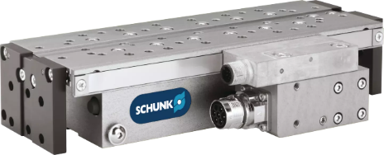
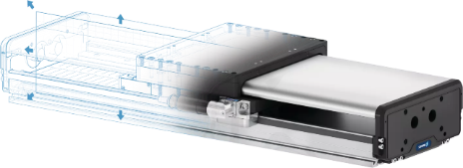
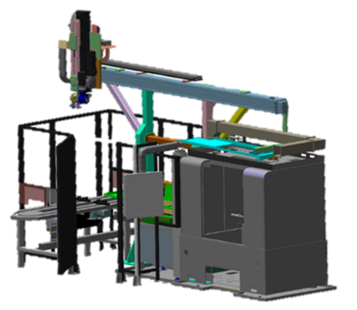
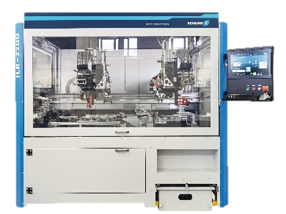
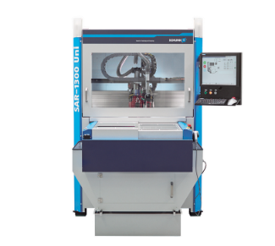
What is SCHUNK Engineering?
Four levels of partnership - SCHUNK offers more
SCHUNK Engineering GTAT
Level 1
Standard Components
Level 2
Customized Components
SCHUNK Engineering
Lot size one product customization and large-scale projects and in industrial automation
Level 3
System technology
Level 4
Machines

Slide 8
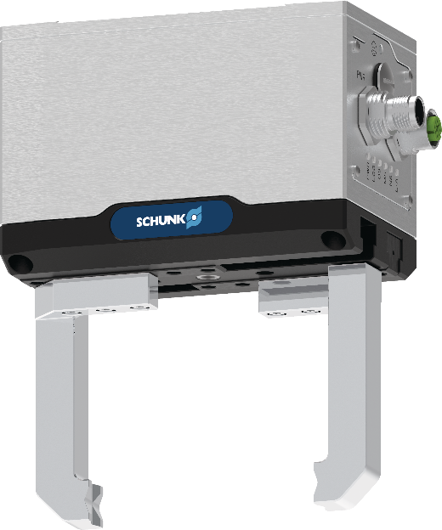
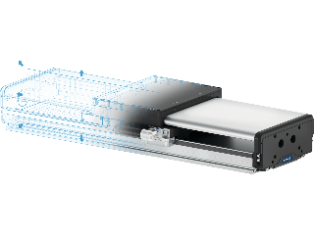
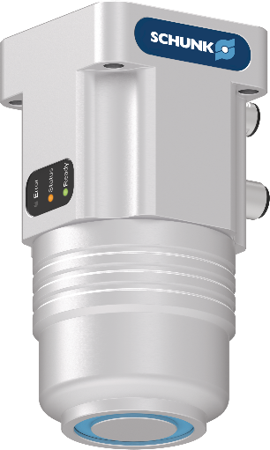
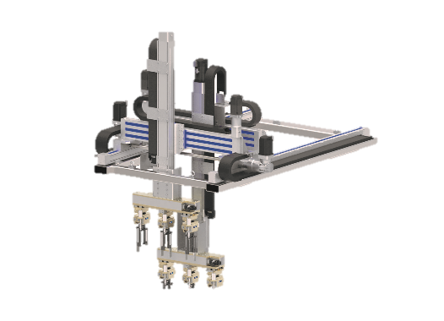
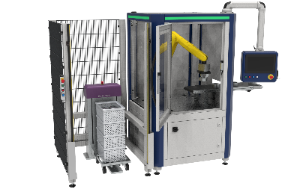
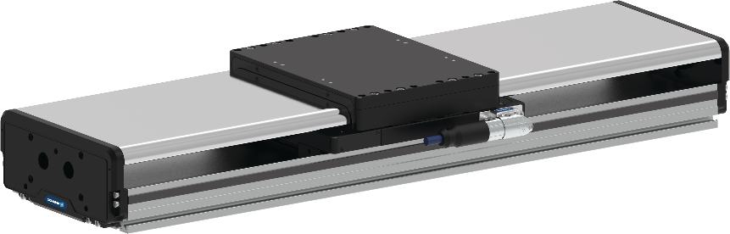
In automation, you can’t get around SCHUNK
- 4 levels of partnership
SCHUNK Engineering GTAT
Standard components Standard components, modified standard components, industry components
Level 1
Customized components Configurable products, axis systems and assemblies with a defined interface to the customer system
Level 2
System technology Axis systems and assemblies with a defined interface to the customer system, including steel construction, safety fence and control cabinet
Level 3
Machines Delivery of complete systems including control and software.
Level 4

Slide 9
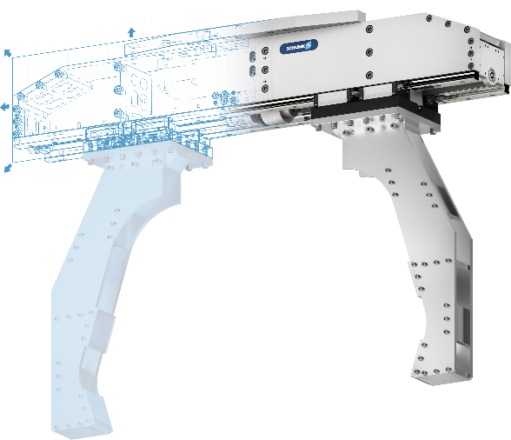
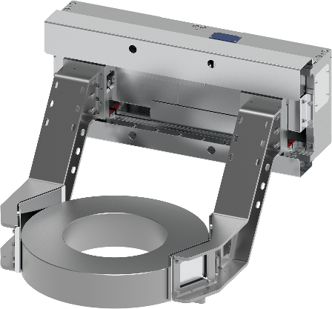
In automation, you can’t get around SCHUNK
- 4 levels of partnership
SCHUNK Engineering GTAT
Standard components Standard components, modified standard components, industry components
Level 1
Customized components Configurable products, axis systems and assemblies with a defined interface to the customer system
Level 2
System technology Axis systems and assemblies with a defined interface to the customer system, including steel construction, safety fence and control cabinet
Level 3
Machines Delivery of complete systems including control and software.
Level 4

Slide 10
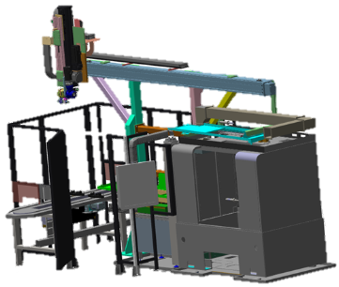
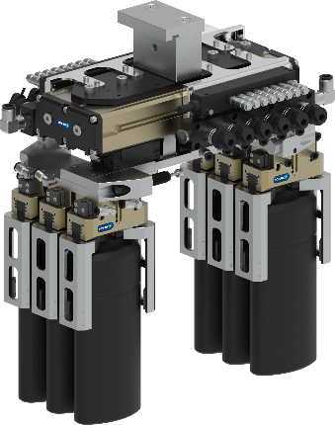
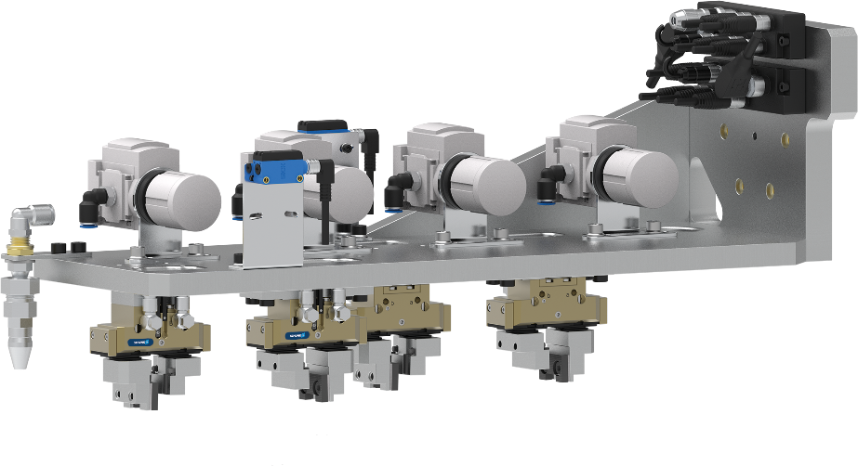
In automation, you can’t get around SCHUNK
- 4 levels of partnership
SCHUNK Engineering GTAT
Standard components Standard components, modified standard components, industry components
Level 1
Customized components Configurable products, axis systems and assemblies with a defined interface to the customer system
Level 2
System technology Axis systems and assemblies with a defined interface to the customer system, including steel construction, safety fence and control cabinet
Level 3
Machines Delivery of complete systems including control and software.
Level 4

Slide 11
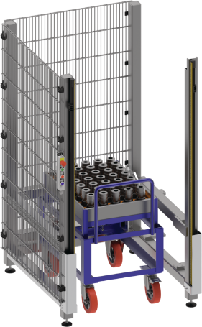
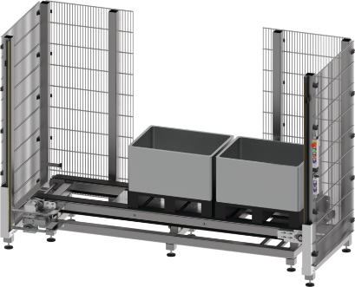
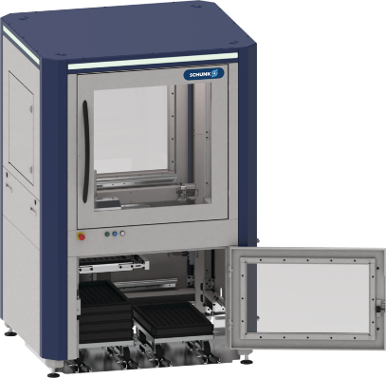
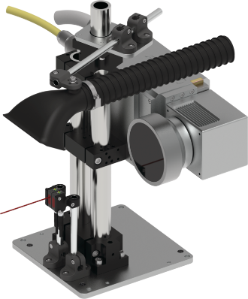
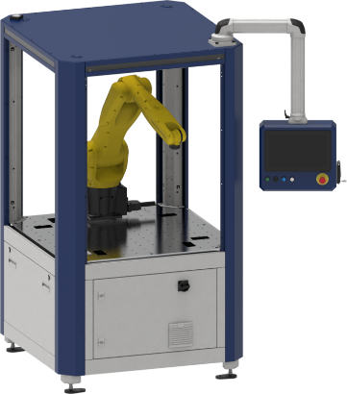
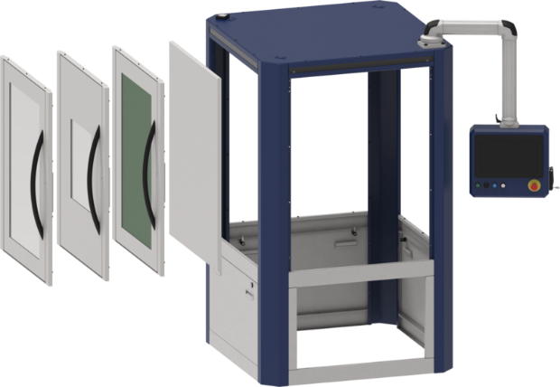
In automation, you can’t get around SCHUNK
- 4 levels of partnership
SCHUNK Engineering GTAT
Standard components Standard components, modified standard components, industry components
Level 1
Customized components Configurable products, axis systems and assemblies with a defined interface to the customer system
Level 2
System technology Axis systems and assemblies with a defined interface to the customer system, including steel construction, safety fence and control cabinet
Level 3
Machines Delivery of complete systems including control and software.
Level 4

Slide 12







SCHUNK Engineering
We combine our industry expertise with innovative technologies and sustainable partnerships for your success.
SCHUNK Engineering GTAT
The benefits at a glance
Custom-fit, not compromise:
solutions built precisely to your specifications
Get to production faster:
shorter time-to-production
Greater process stability:
consistent quality and reliable workflows
Reduced risk:
a single contact, clear accountability
What makes us different
Experienced engineering—precise, reliable, thoroughly documented
Trust by Competence, Partnership and Speed
Globally available:
34 sales locations and 6 cutting-edge engineering hubs worldwide

Slide 13
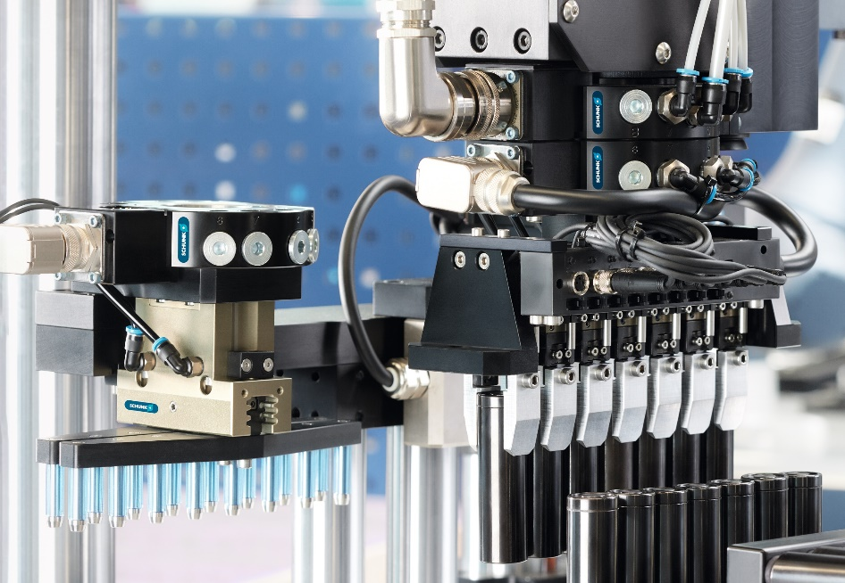

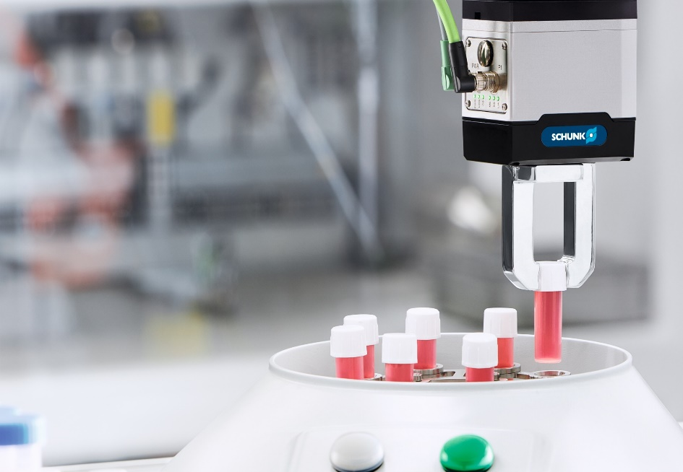
Why SCHUNK Engineering?
External influences & rapidly changing demands: Speed & adaptability are key.
SCHUNK Engineering GTAT
Skills shortage | Rising personnel costs
Shorter product life cycles
Economic dynamics | Ecological requirements
China / USA / … state subsidies
Mobility transformation
Automation
Research (mRNA, robotics, etc.)
New manufacturing processes
Phase-out of combustion engines
New legal requirements
E-mobility
Machining
Life Science
System Integrators, plant manufacturers and machine tool manufacturers are increasingly looking
for reliable project partners, especially for high investment volumes

Slide 14
SCHUNK Engineering - Positioning
SCHUNK Engineering GTAT
Internal Information
SCHUNK – Hand in hand for tomorrow
SCHUNK Engineering – Innovating Partnerships
Competence
Partnership
Speed
Trust
Content: e.g. consulting, project engineering, design, operations, supply chain, after sales

Slide 15


SCHUNK Engineering – Innovating Partnerships
We combine our industry expertise with innovative technologies and future proof partnerships for your success
SCHUNK Engineering GTAT
Competence
Years of experience
Innovation, precision and the ability to master individual challenges
Tailored to specific requirements
Trust
The key to long-term partnerships
We stand for the highest reliability and quality
Partnership
Close collaborations
Personal consulting
Develop solutions together precisely tailored to customers' requirements
Speed
Speed is the engine of progress
Dynamic processes, fast communication and efficient execution

Slide 16
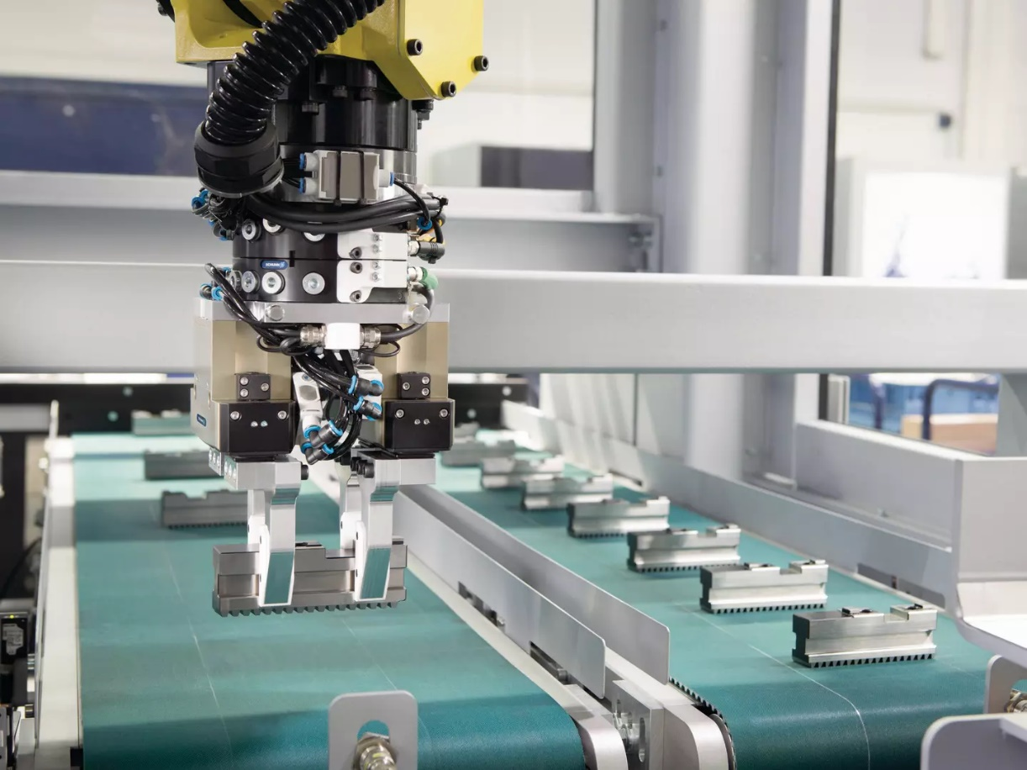
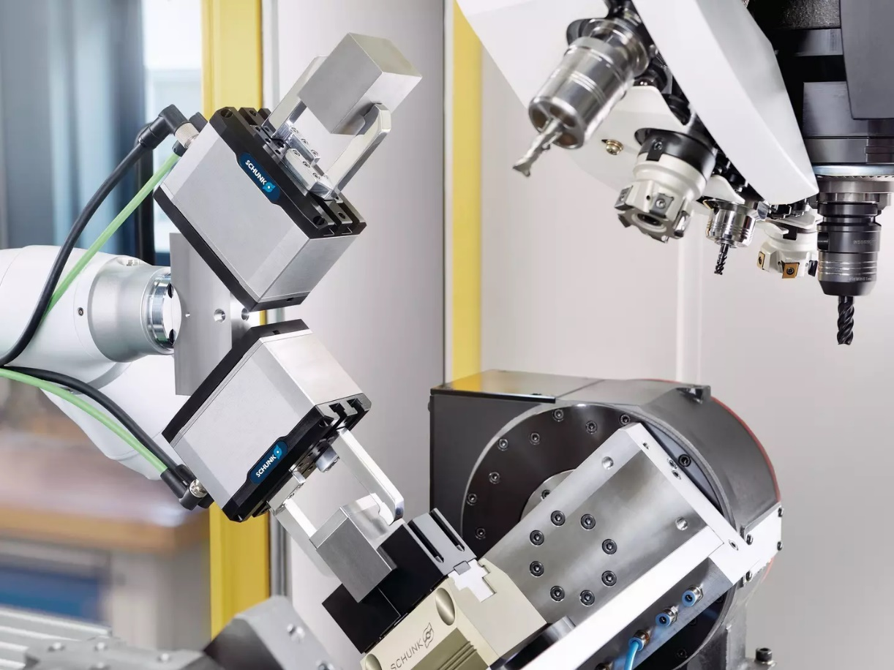
Profound know-how built up over decades
SCHUNK Engineering GTAT
Machine loading and unloading
The right automation type for your process
Handling
Reliable and efficient parts handling

Slide 17
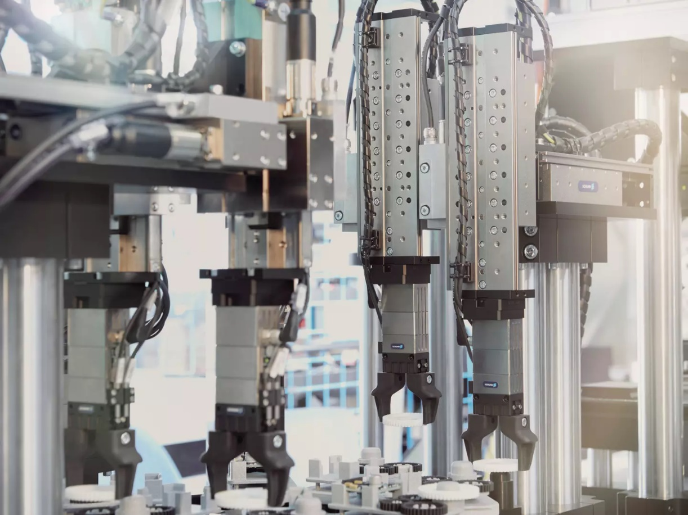
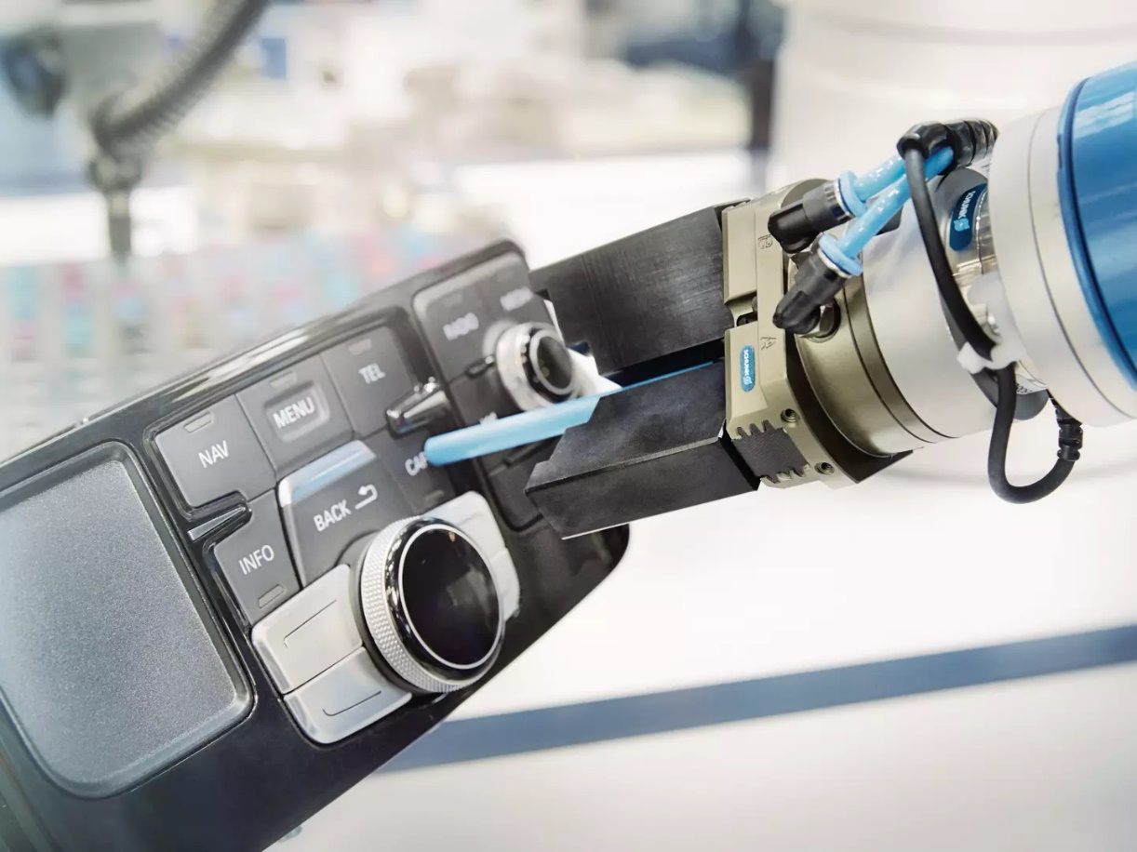
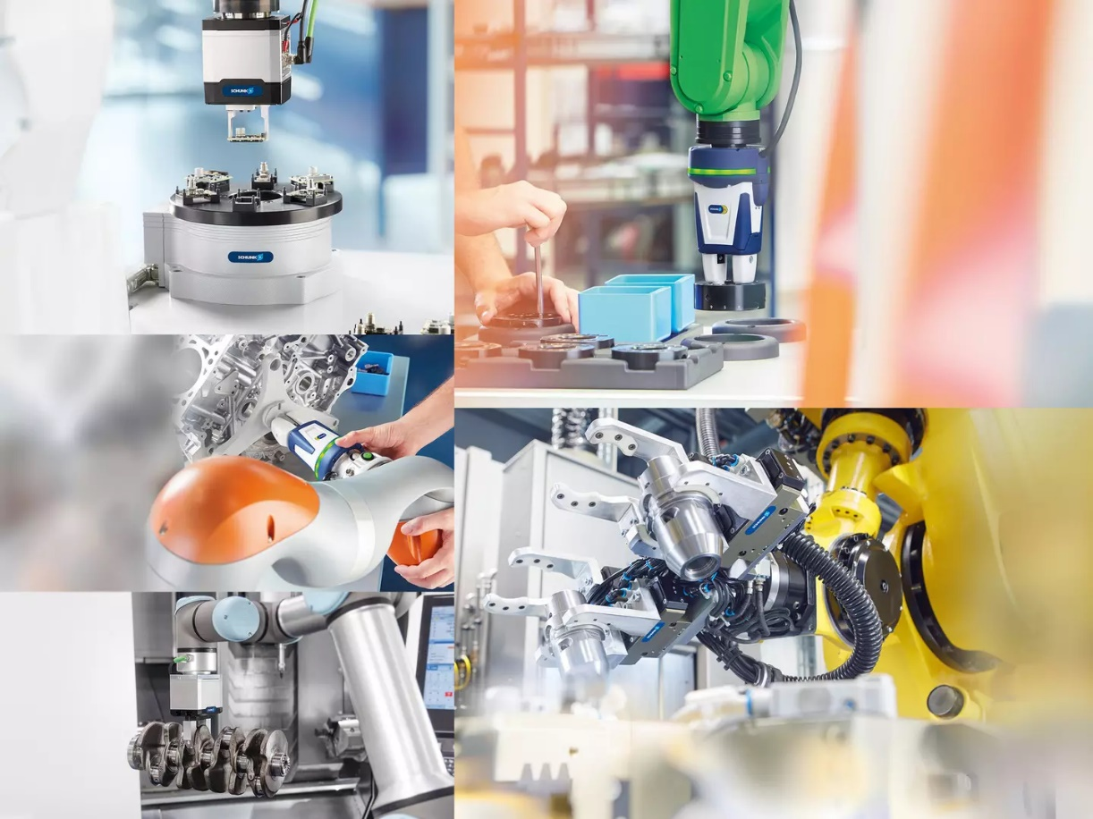
Profound know-how built up over decades
SCHUNK Engineering GTAT
Assembly
Individual assembly solutions for your application
Quality assurance
Automated quality inspection and assurance
Robots & cobots
Global production worlds in transition

Slide 18
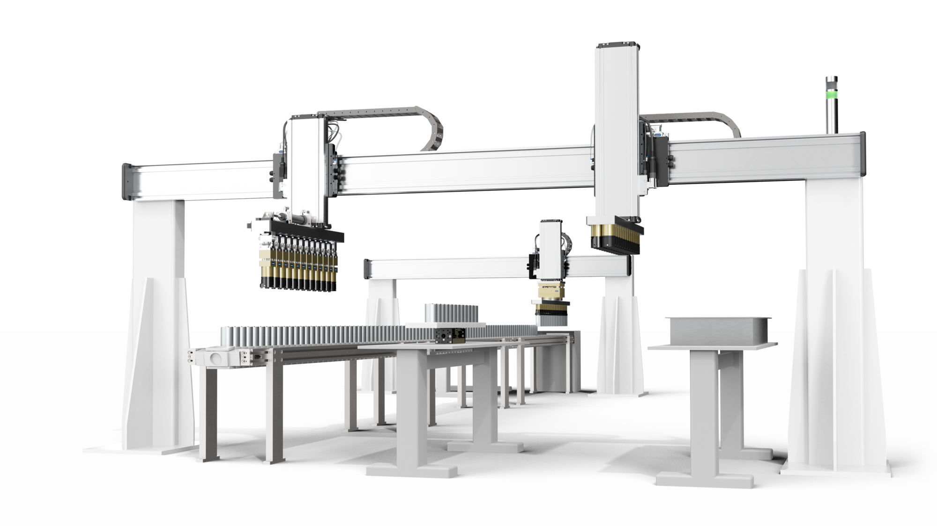
Large-scale projects and lot size one product configuration in industrial automation
SCHUNK Engineering GTAT
Pneumatics
Mechatronics
Robot accessories
Axis systems
more than 750
projects per year

Slide 19
More than 160 professionals - one goal:
Making your project a success
SCHUNK Engineering GTAT
More than 30 specialists
6 product areas
Price indication and calculation in advance
Mechanics / Electronics / Software
FEM simulation
Cycle time analysis
Support in 34 INTECs
Repair and maintenance
Ad-hoc service in the event of system downtime
Sales Engineering
Engineering Design
After-Sales-Service
Project Management
Production and Assembly
Central coordination
Industry-specific requirements management
Time and cost planning
Highest quality standards
Cleanroom assembly
Production of small series
Worldwide supplier network

Slide 20
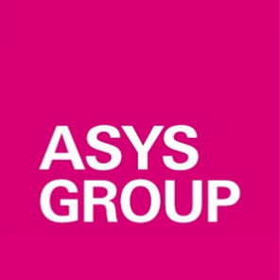
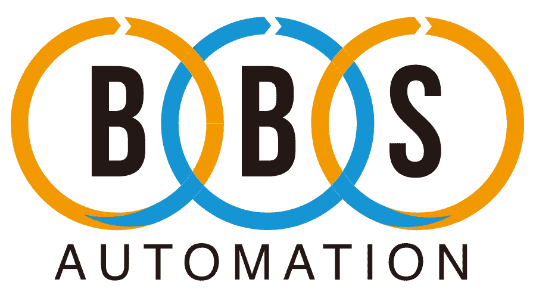












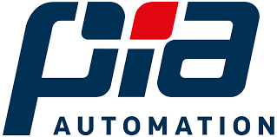



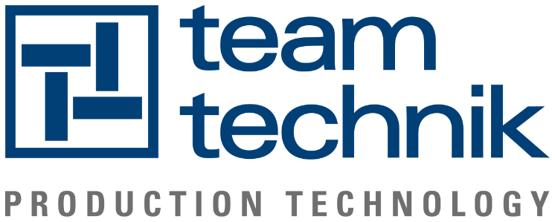
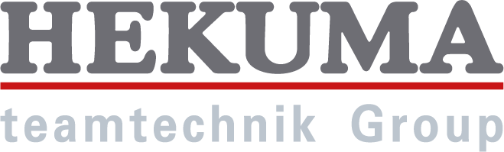
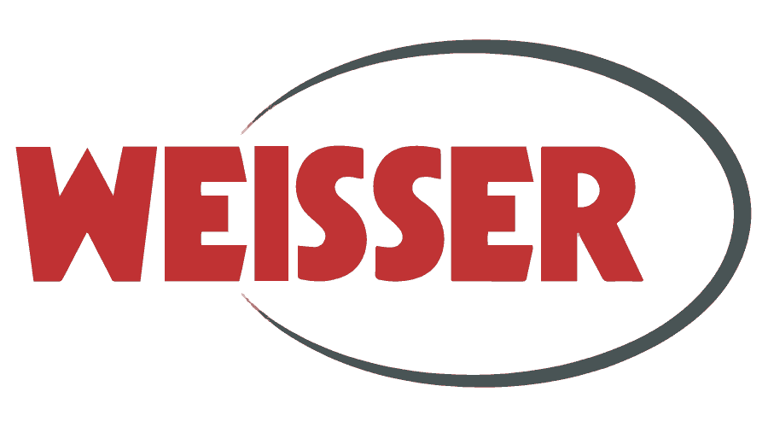
Customer references ... a selection
SCHUNK Engineering GTAT

Slide 21
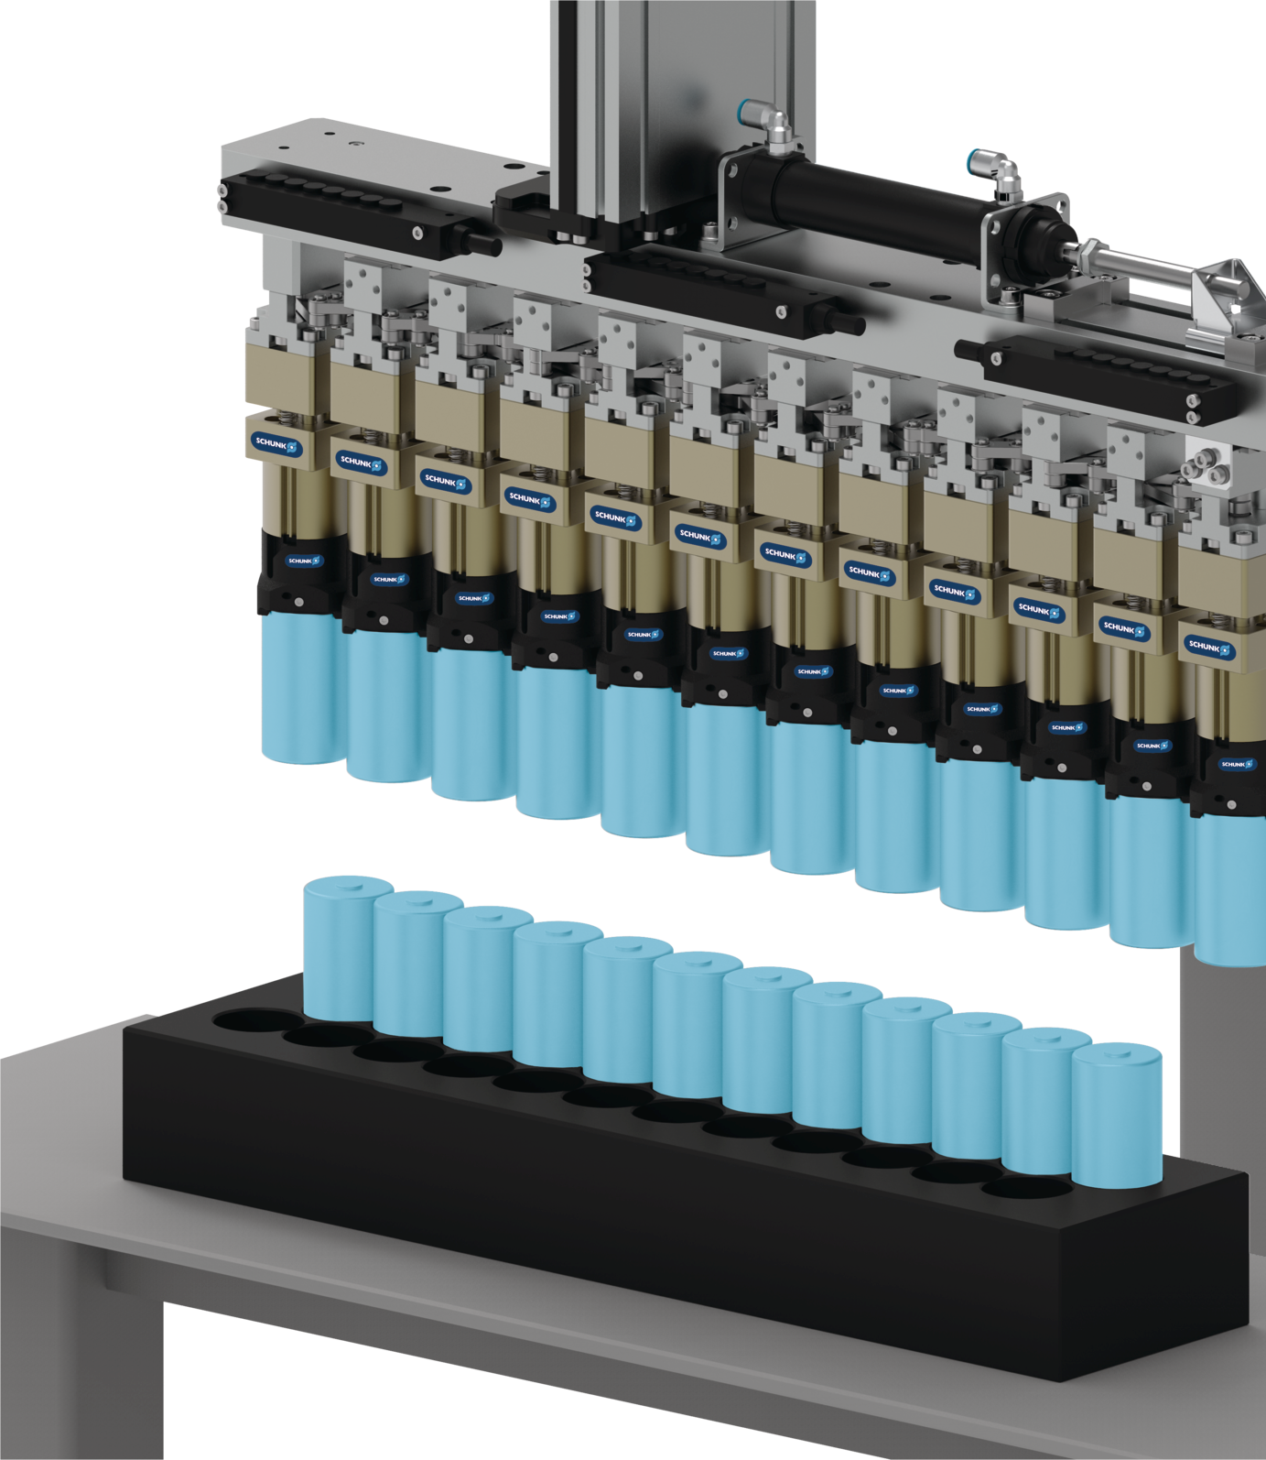
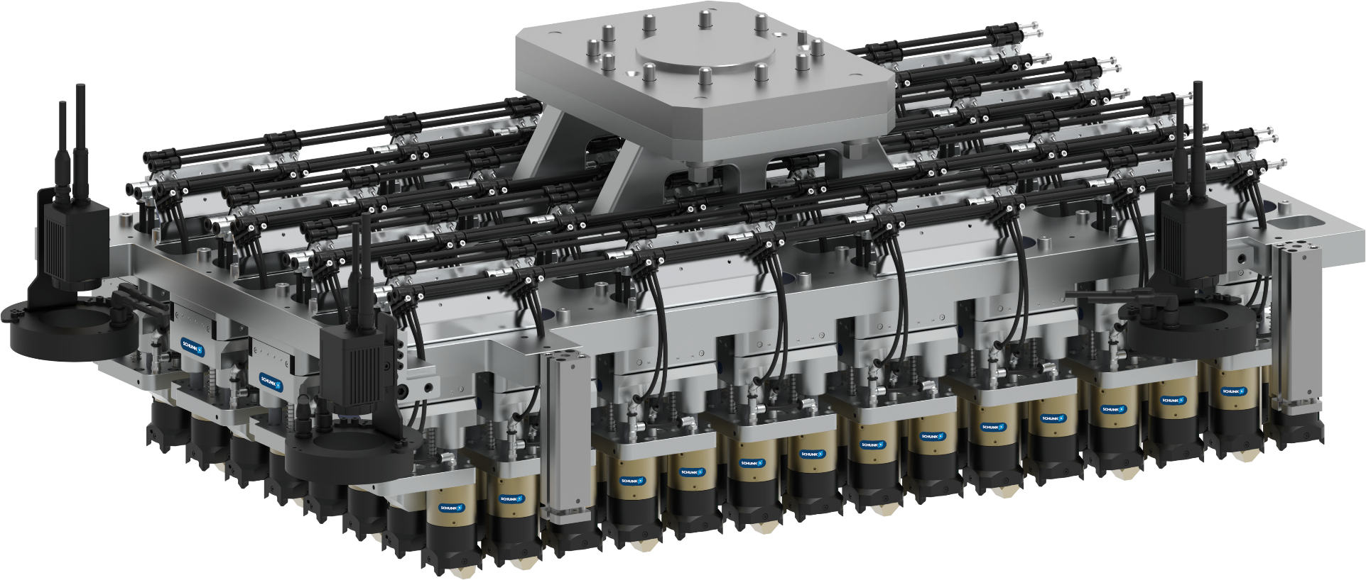
Project references
E-mobility module/pack assembly
SCHUNK Engineering GTAT
Battery production e-mobility
Transfer of 120 cylindrical battery cells simultaneously, incl. 32 compensation units
Spacer Unit
Compensation Unit
Round-Cell-Gripper

Slide 22
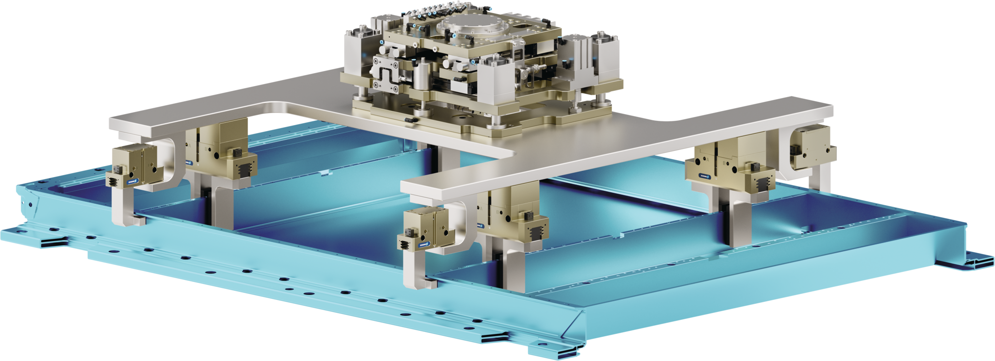
Project references
E-mobility pack assembly
SCHUNK Engineering GTAT
Compensation unit X/Y+Rotation
Gripping Structure

Slide 23
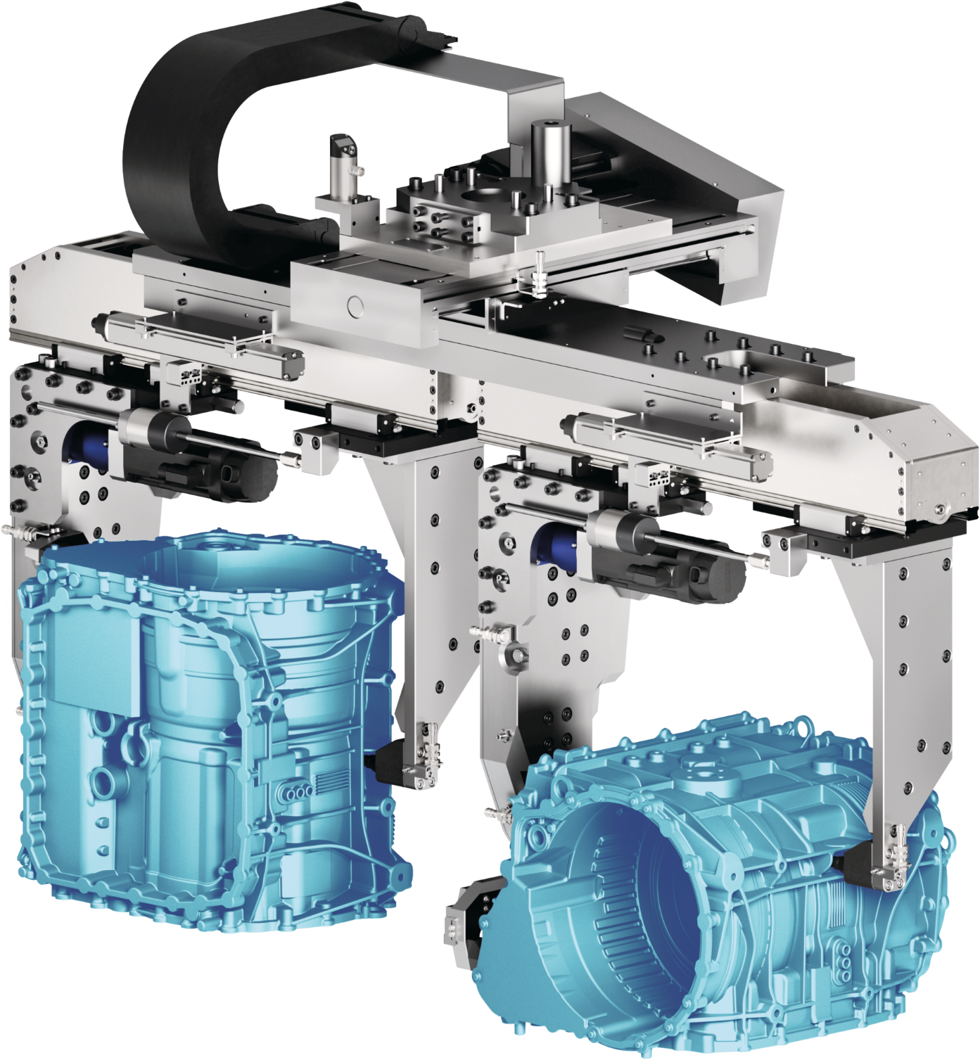
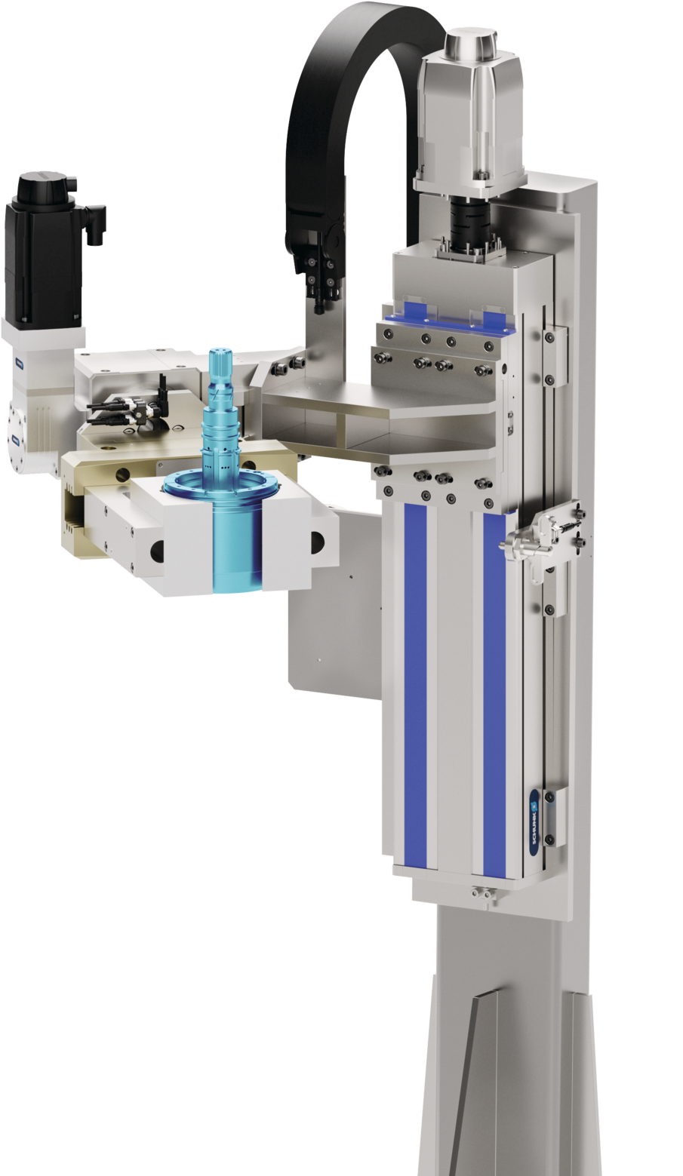
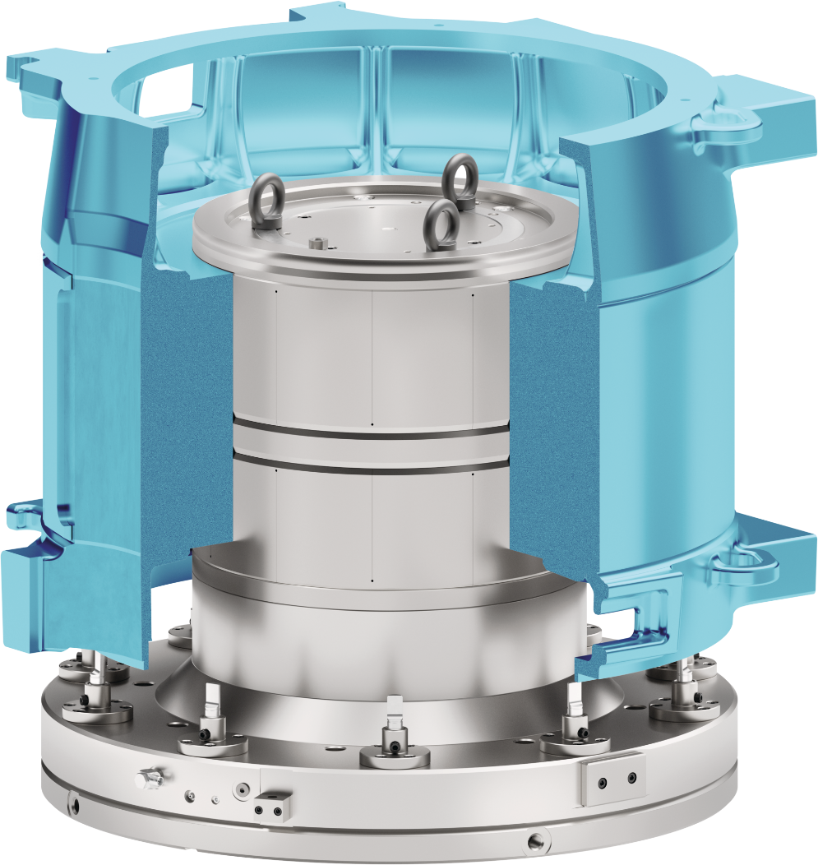
Project references
E-mobility rotor/stator production
SCHUNK Engineering GTAT

Slide 24
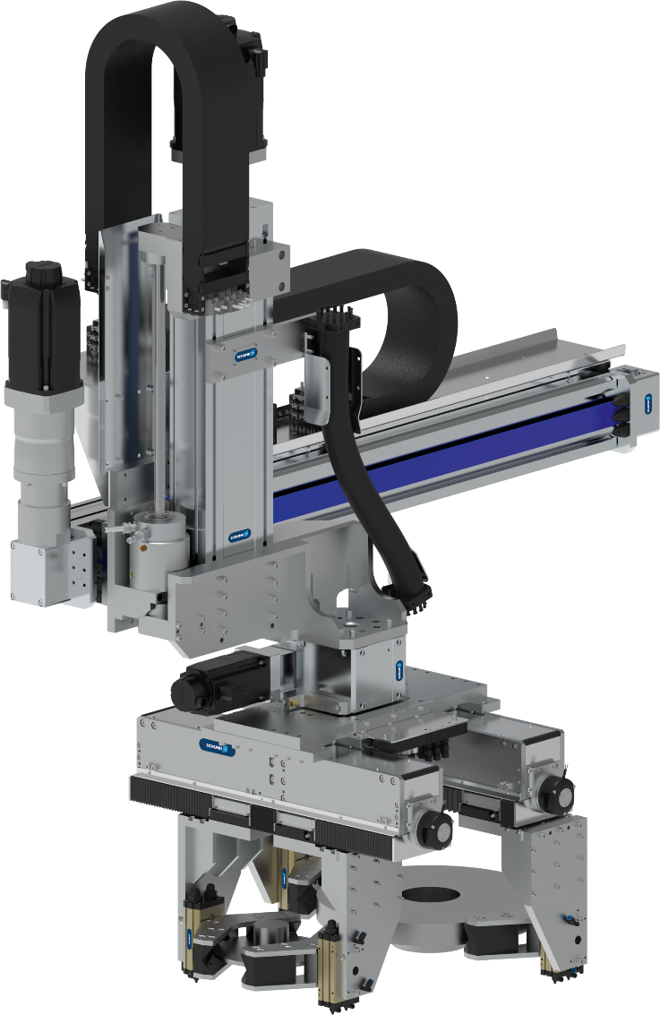
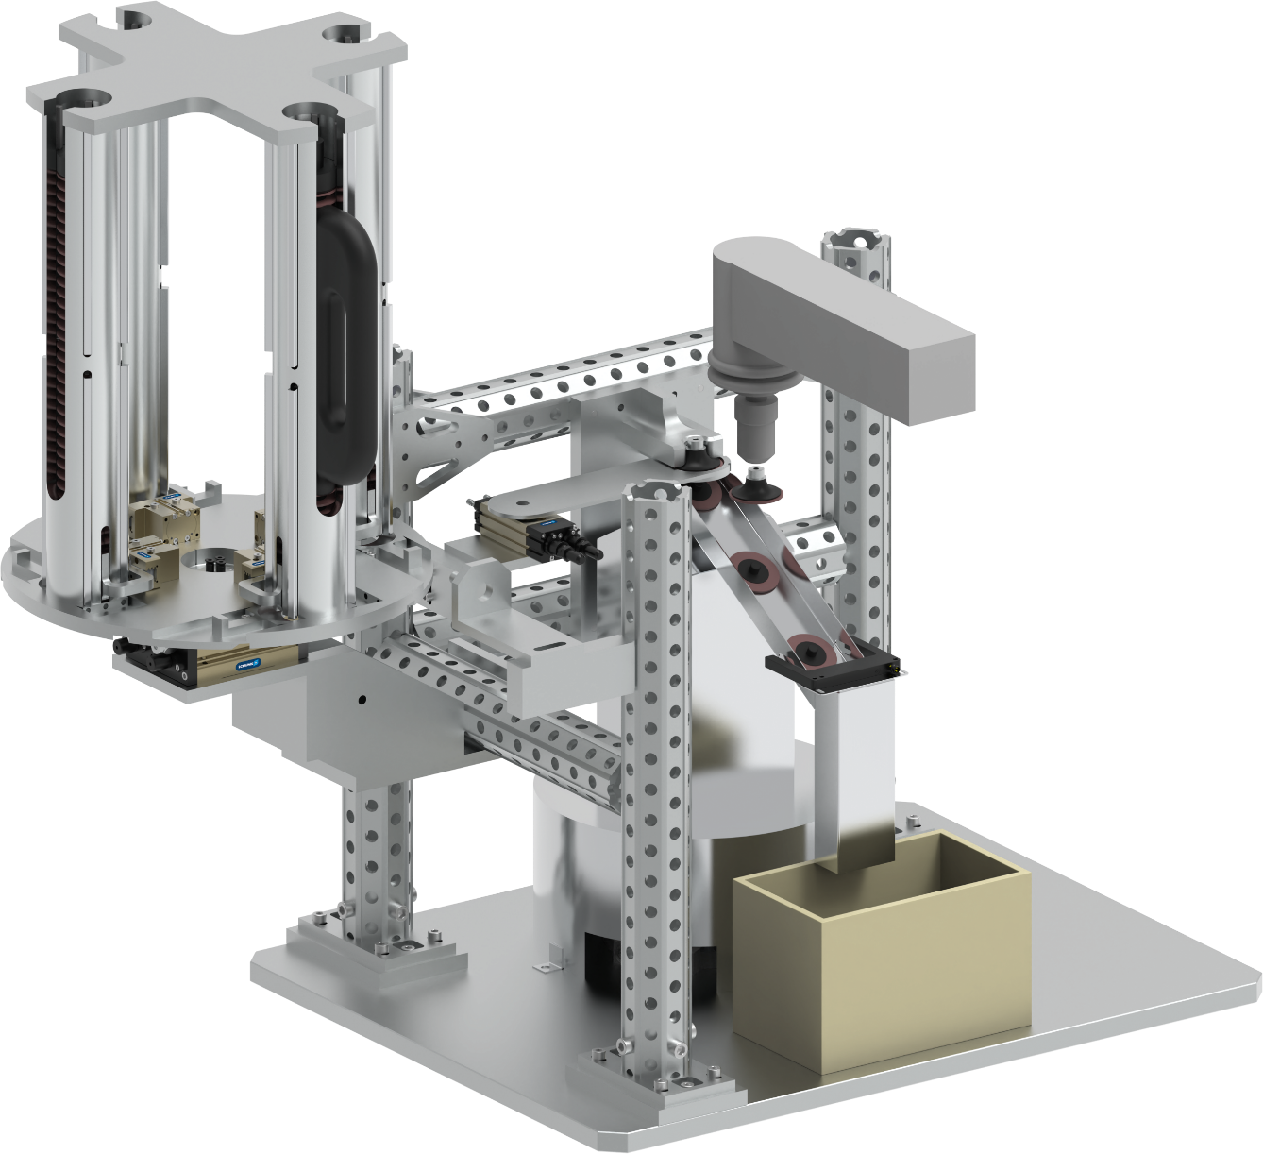
Project references
Automotive parts handling and processing
SCHUNK Engineering GTAT
ID: 1569896
Automotive - Brake disc coating
Gripping and swiveling of brake disks for coating to reduce particulate emissions during braking (EURO 7)
Handling and deburring of sheet metal parts
System for automatic grinding disc change when worn

Slide 25
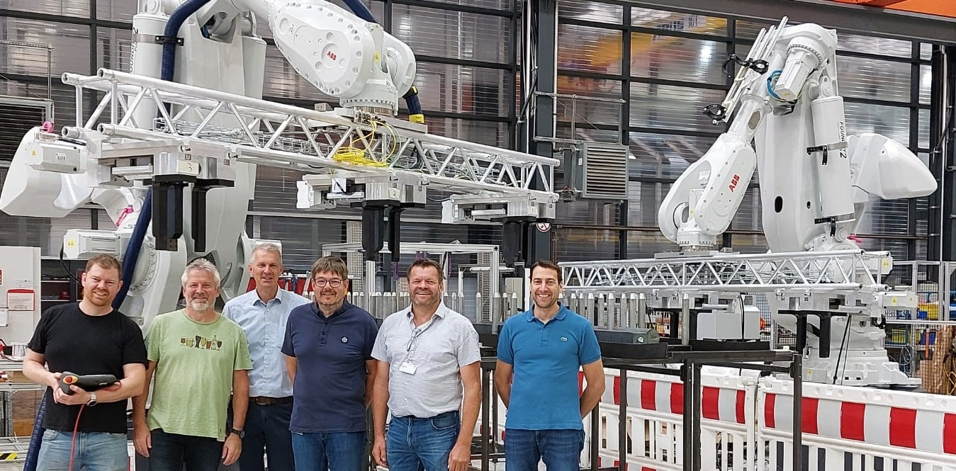


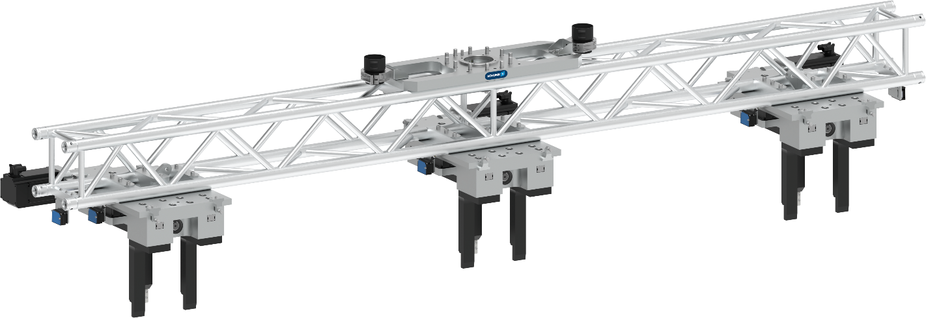
Project references
Large-scale part handling & machine tending
SCHUNK Engineering GTAT
ID: 1472620 oder 1511530 (links / rechts)
Machine tending - Lean Automation:
test specimen production for impact tests
Clamping station (right), workpiece magazine (center) and turning station (left).
Handling by gripper with shaft interface.
Handling of 4-meter steel beams weighing up to 500 kg
Handling of very long and heavy components: gripper assembles along a truss to reduce weight

Slide 26
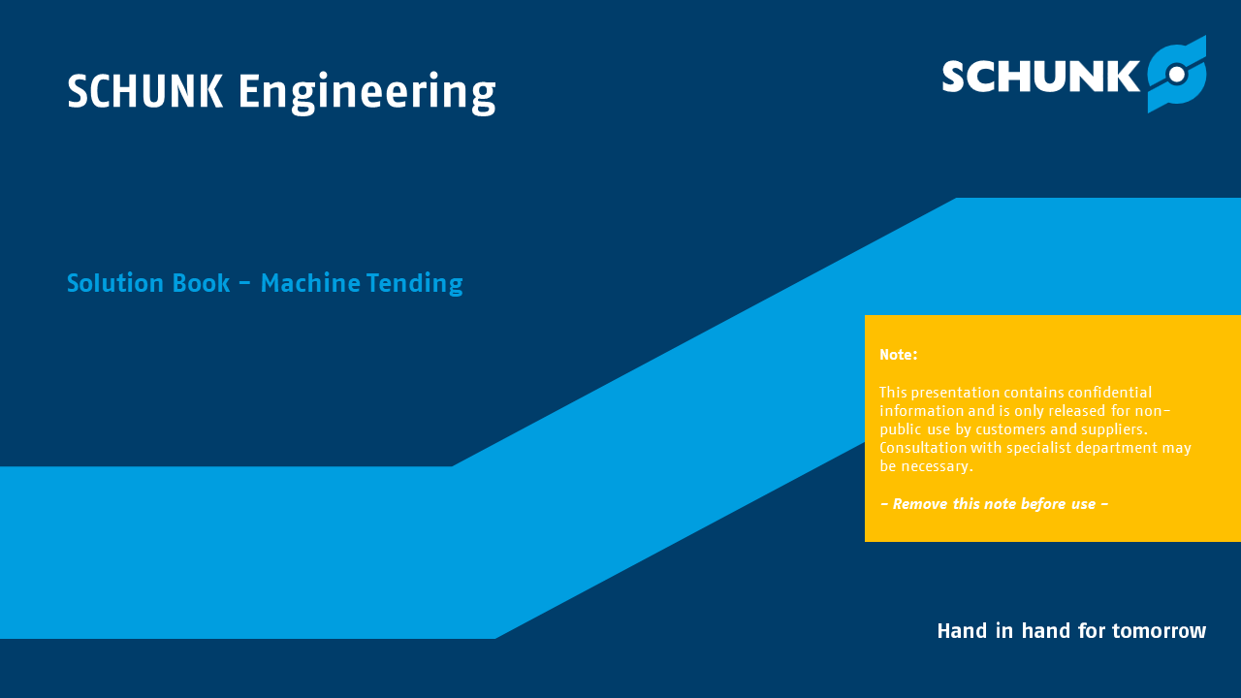









Solution Books
SCHUNK Engineering GTAT
Internal Information
Solution Books with product and application examples for GTAT can be found in the STB in the new industry tiles.
  Automotive
  Consumer Goods
  Life Science
  Logistic
  Machine Tending
  Metal Processing
  …
ppt-files available in DE/EN
exemplarily

Slide 27





Four steps to project success
One-Stop-Shop: Collaboration from consulting and requirements analysis to after-sales service
SCHUNK Engineering GTAT
Consult
Develop
Build
Support
Iterations
Consulting
Specification
First draft
Prototype, simulation, digital twin
Final design
Final approval
Manufacturing
Validation
Delivery
After-Sales- Service
Iterations
Project management

Slide 28
1. Consult
Understand challenges - define the requirements
SCHUNK Engineering GTAT
Consult
Develop
Build
Support
Iterations
Consulting
Specification
First draft
Prototype, simulation, digital twin
Final design
Final approval
Manufacturing
Validation
Delivery
After-Sales- Service
Iterations
Project management

Slide 29





What to expect
SCHUNK Engineering GTAT
In the first step – understanding challenges, we capture and prioritize requirements, analyze processes and cycle times, and clarify interfaces as well as quality and safety criteria.
The result is a structured requirements profile with a feasibility assessment and a reliable budget and timeline – the foundation for fast and secure decisions.
Your benefits
Targeted iterations, plannable budgets
Early clarity on budget, timeline, and technology
Well-founded decision templates for stakeholders
Approach and methodology
Workshops at eye level, process and cycle time analysis
Variant and risk analysis
Rough concept incl. integration scenarios and interface definition

Slide 30
2. Develop
Developing solutions – from idea to design
SCHUNK Engineering GTAT
Consult
Develop
Build
Support
Iterations
Consulting
Specification
First draft
Prototype, simulation, digital twin
Final design
Final approval
Manufacturing
Validation
Delivery
After-Sales- Service
Iterations
Project management

Slide 31





What to expect
SCHUNK Engineering GTAT
In the second step, we refine the rough concept into a robust design: variants are compared, functions simulated, interfaces clearly defined, and standards considered.
The result is release-ready models with detailed drawings, bills of materials, and a transparent decision framework for production.
Your benefits
Faster approval thanks to upfront simulation and validation
Optimal combination of standard and custom: high value with a clear budget
Minimized integration risk through clean interfaces
Approach and methodology
Co-engineering: iteration with CAD/DMU/simulation
Detailed drawings, bills of materials, variant comparison
Safety and standards compliance from the very beginning

Slide 32




































Products become solutions ...
SCHUNK Engineering GTAT
>30 Project Engineers worldwide
compliant
optimized
perfect fit
interference contour
Time-to-Market
Footprint
Design sovereignty over a tried-and-tested, extensive modular product system
sustainable
global
fast

Slide 33






We design the solution ... ... with you!
SCHUNK Engineering GTAT
Consultancy
On-site analysis
Price estimation
Accessories
Preliminary investigation

Slide 34





optional: prototype / simulation / digital twin
SCHUNK Engineering GTAT
Support of the solution design by:
Simulation
Prototypes
Digital twins
Hardware-in-the-Loop (HIL) /
Software-in-the-Loop (SIL)
Obtaining important findings in the early project phase
  Safeguarding
  Speed
Magnetic field simulation
Topology optimization
Notes:
Optional service within a project

Slide 35











Final design
SCHUNK Engineering GTAT
AI-supported design in the range of solution finding and specifications
Consideration of industry- and country-specific laws, standards and regulations
Risk assessment and declaration of incorporation
High-end 3D CAD systems for all conceivable requirements
Worldwide design standards and solution databases
Brackenheim-Hausen
St. Georgen

Slide 36
Final approval
SCHUNK Engineering GTAT
Central milestone for the technical release of the scope of delivery
  All features and elements must meet the customer's requirements and fulfill the function
Extensive data set for testing and release is made available to the customer by SCHUNK
  .step model
  drawing
  technical data
  dimensions
  centers of gravity
  etc.
Contract amendment to include the technically measurable details
+
Customer

Slide 37
Lead time
SCHUNK Engineering GTAT
Check the non-binding target price
Checking the offer
Checking the approval drawing
Customer
Feedback
Order
Release
SCHUNK
Preparation of an orderable offer
Order confirmation and design
Production and delivery
depending on effort
6 to 12 weeks
At any time: Support for questions or change requests

Slide 38
3. Build
Manufacturing and assembly - production and validation
SCHUNK Engineering GTAT
Consult
Develop
Build
Support
Iterations
Consulting
Specification
First draft
Prototype, simulation, digital twin
Final design
Final approval
Manufacturing
Validation
Delivery
After-Sales- Service
Iterations
Project management

Slide 39




What to expect
SCHUNK Engineering GTAT
In the third step, the design is turned into precisely manufactured and assembled modules — following standardized, reproducible processes. We ensure quality through defined test concepts and complete documentation. Our digital process chain and global plants deliver reproducible quality—on schedule and transparent.
Your benefits
Stable start of series production thanks to tested assemblies
Documented quality assurance with full traceability
Schedule reliability through digital planning and scalable capacities
Approach and methodology
Precision machining, takt-based and variant assembly
Validation/acceptance according to specification
Global availability, uniform standards

Slide 40

Production and Validation
SCHUNK Engineering GTAT
Manufacturing expertise
High investment rate in own machinery
Milling / turning (also combined)
Grinding (flat/round)
SLS and FDM printing
Production with an end-to-end digital process chain
Hall 4, Brackenheim-Hausen:
plant-in-plant concept dedicated to SCHUNK Engineering
Notes:
Hausen: 16 machines and 28 employees exclusively for SCHUNK Engineering
Access to certified supplier network for drawing parts
Wide range of professional partners for heat treatment, surface finishing and surface treatment

Slide 41

Production and Validation
SCHUNK Engineering GTAT
Assembly expertise
Team with years of experience in setting up complex customer solutions - can also be deployed on construction sites to provide support
Operational Excellence / customer-benefit
SCHUNK value-creation system
  Efficiency enhancement in production
  Integration of intelligent tools, automation technology, and digital networking
  Flexible production and rapid adaptation to changing requirements
SCHUNK Engineering: Hall 4, Brackenheim-Hausen
Notes:
Hausen: 26 employees who optimize all company processes in the value chain at SCHUNK daily

Slide 42




SCHUNK Electronic Solutions -
Center of Competence for Direct Drives
SCHUNK Engineering GTAT
+
+ …
SCHUNK Electronic Solutions GmbH, St. Georgen
From motor development and motor manufacturing to the fully assembled and tested linear direct multi-axis system—ready to install, fully wired and tubed!
Highest vertical integration
Your advantages: Quality, speed, expertise and innovation, availability, sustainability, service, and support

Slide 43

Validation
Exemplarily: Linear Direct Axes
SCHUNK Engineering GTAT
In-House:
Linear and rotary drive test bench
Endurance test room for approx. 24 systems
Drive laboratory for verification of all characteristics
EMC and environmental tests in accredited laboratories
Specific customer tests upon agreement
Linear axis test bench
Endurance test

Slide 44




CoLabs validate applications worldwide
SCHUNK Engineering GTAT
15
locations around the world
Over 275
visits and workshops
Feasibility test and documentation by application experts
Live demonstration and customer training
Over 1950
validated applications

Slide 45
4. Support
On-site support – delivery and after sales
SCHUNK Engineering GTAT
Consult
Develop
Build
Support
Iterations
Consulting
Specification
First draft
Prototype, simulation, digital twin
Final design
Final approval
Manufacturing
Validation
Delivery
After-Sales- Service
Iterations
Project management

Slide 46




What to expect
SCHUNK Engineering GTAT
In the fourth step, after delivery comes stable operations: following commissioning, the solution is handed over in an orderly manner, supported by defined support structures, and maintained proactively.
Targeted measures ensure availability and performance throughout the entire lifecycle.
Your benefits
Short ramp-up: productive faster
Higher OEE through preventive maintenance and rapid support
Investment protection thanks to modernizations and retrofits
Approach and methodology
Commissioning, training, and spare parts planned in advance
Remote and on-site service, preventive and predictive maintenance
Continuous improvements

Slide 47


Delivery and handover of the finished product
SCHUNK Engineering GTAT
Supply Chain and logistic
Organization consistently follows the product development chain to achieve maximum customer benefits
Defined escalation processes with maximum transparency
  For priority projects: daily reporting to the customer if required
Competent and flexible supplier network organized according to areas of expertise to be able to respond to all requirements
Commissioning support possible:
  Parameterization of the drive system
  Definition of motion profiles

Slide 48





After-Sales-Service GTAT
SCHUNK Engineering GTAT
Your contact person for your requests about SCHUNK products
Regular maintenance and repairs by our qualified service technicians increase and ensure the long-term availability of your SCHUNK product. Unplanned downtimes can thus be reduced to a minimum.
Our services:
  Commissioning support via remote support
  Repairs at the customer’s location and at the SCHUNK
  Inspection including functional check
  Early detection of faults and damage
  Execution of work according to detailed maintenance plan

Slide 49

How we handle your projects
One-Stop-Shop: Collaboration from consulting and requirements analysis to after-sales service
SCHUNK Engineering GTAT
Project management

Slide 50

State-of-the-art Project Management
SCHUNK Engineering GTAT
Use of SCHUNK Engineering project managers for:
particularly tight deadlines
coordination across several (customer) locations
high technical complexity
Efficiency
  Structured processes for on-time delivery
Customized Solutions
  Tailored projects for specific requirements
Transparency
  Regular updates on project progress
Quality
  High standards through continuous monitoring
Partnership
  Successful and sustainable collaboration

Slide 51
State-of-the-art Project Management
SCHUNK Engineering GTAT
CFO / COO
Business Unit GTAT
SCHUNK Engineering GTAT
Project Engineering
Project Management
Design
Supply Chain Management
Project Management
Germany
Project Design
Germany
USA
Mexico
China
USA
Mexico
China
Italy
+external
Notes:
Globally standardized processes and guidelines
Global network in the Engineering Hubs and beyond

