Slide 1
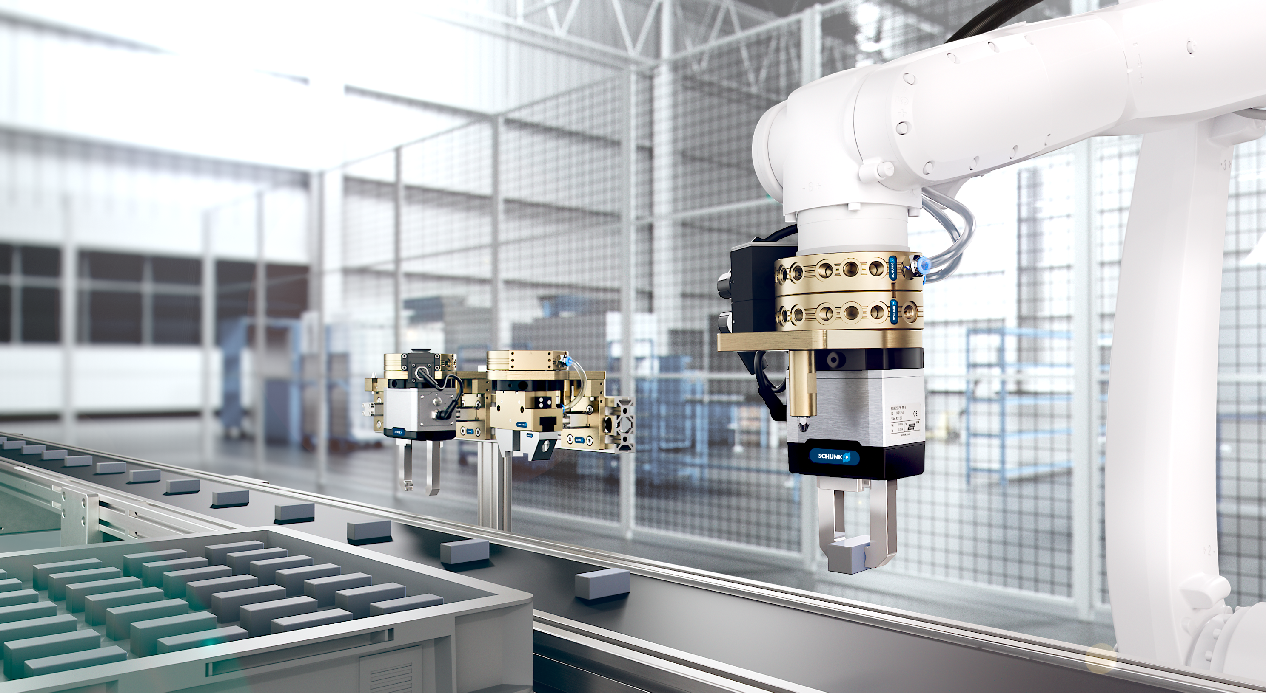

Product Presentation CPS
Version english 01.06.2025

Slide 2
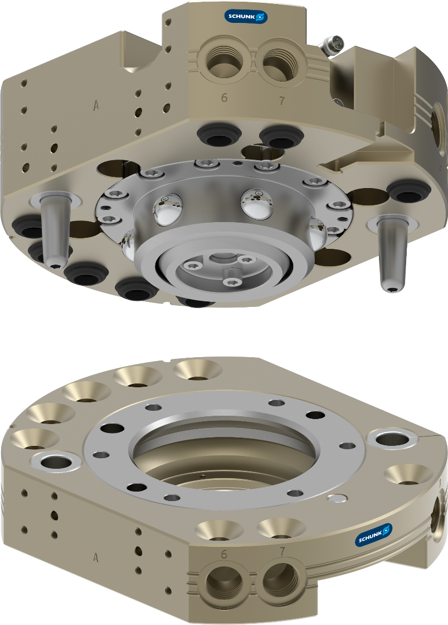
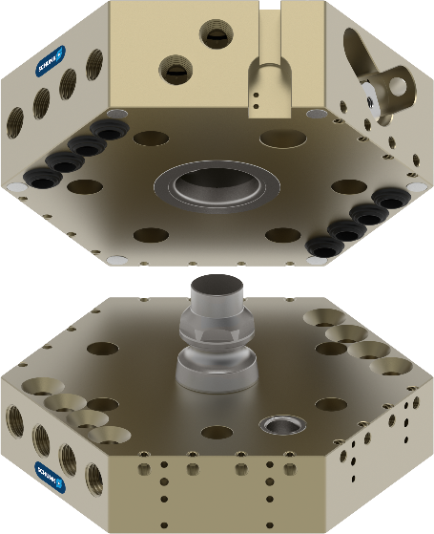
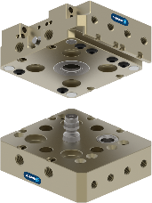
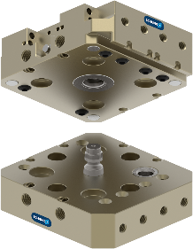
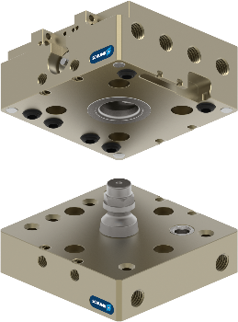
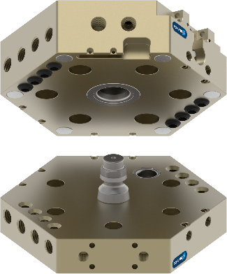
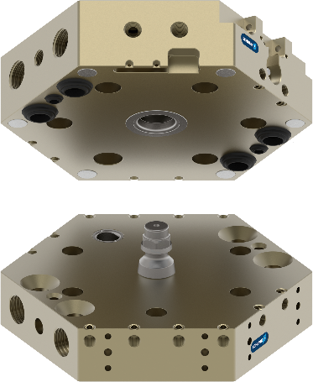
CPS
Made in Germany
Automatic Tool Changer CPS

Slide 3
CPS
Made in Germany
Automatic Tool Changer CPS
  Proven ball-locking mechanism
    Robust technology on the market for more than 30 years
    Locking mechanism made of stainless steel
    Housing made of anodized, high-strength aluminum
    Integrated spring to minimize gap in case of loss of air pressure between master and tool
  Comprehensive accessory portfolio
    Extensive portfolio of optional media modules for all kind of applications
    Wide range of other accessories like storage, sensors etc.
    CTS storage magazine available for each size
  Mix and Match
    With existing SCHUNK SWS tool changers

Slide 4
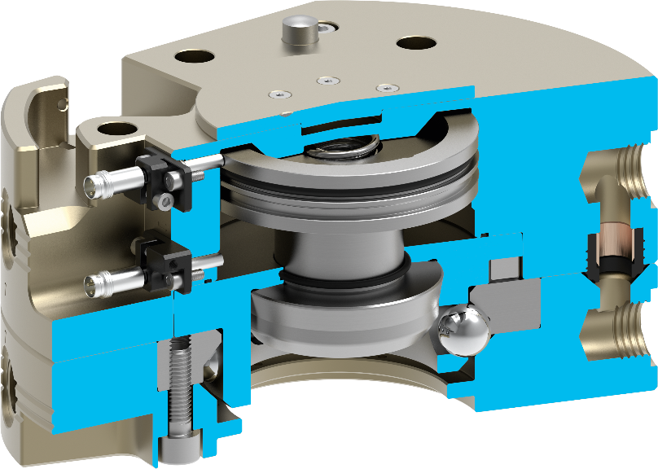
CPS
Advantages
Automatic Tool Changer CPS
Integrated spring
Gap minimization in case of compressed air drop between master and tool
Functional parts made of stainless steel, greased with H1 grease
Prepared for applications also in other environments
Ball-locking mechanism
No contact necessary before locking the Changer
Serialization
Fast and easy tracking
Self-retaining locking mechanism
Tool remains coupled in case of loss of air
Housing made of high-strength, hard-anodized aluminum
Long lifetime under high loads
Prepared option for monitoring
Monitoring of locked and unlocked conditions and tool presence
Mounting pattern tool side
End effector can be assembled from both sides, maximum flexibility
Integrated pneumatic channels
For air and vacuum feed-through

Slide 5
CPS
Product family with 18 sizes
Automatic Tool Changer CPS
Playload | Size | Preferred product | General data Weight coupled Max. dyn. moment (Mxy/Mz) Amount of screw-on surfaces | Advantages of the preferred product | General data Repeat accuracy Operating pressure Grease
<16kg | CPS 001 CPS 007 CPS 011 | CPS 007 | 0,05 kg … 0,42 kg 2/6 Nm … 35/50 Nm 1x optional modules | Integrated sensors for lock/unlock ISO flange pattern robot side Additional pneumatic ports | 0,015mm 4,5 … 6,9 bar H1 Grease
<35kg | CPS 020 CPS 021 CPS 029 | CPS 021 CPS 029 | 0,86 kg … 1,66 kg 100/80 Nm … 120/150 Nm Up to 3 optional modules | Larger pneumatic ports in the housing G 1/8" instead of M5) Additional flats for modules | 0,015mm 4,5 … 6,9 bar H1 Grease
<50kg | CPS 040 CPS 041 CPS 046 | CPS 040 | 1,87 kg … 2,98 kg 350/350 Nm … 350/400 Nm Up to 5 optional modules | Integrated sensors for lock/unlock | 0,015mm 4,5 … 6,9 bar H1 Grease
<100kg | CPS 060 CPS 071 CPS 076 | CPS 076 | 2,00 kg … 3,68 kg 500/400 Nm … 800/1.800 Nm Up to 2 optional modules | Integrated sensors for lock/unlock Tool presence montoring prepared ISO flange pattern robot side | 0,015mm 4,5 … 6,9 bar H1 Grease
<300 kg | CPS 110 CPS 160 CPS 210 | CPS 110 CPS 160 CPS 210 | 6,60 kg … 9,30 kg 1.000/1.800 Nm … 3.500/1.800 Nm Up to 4 optional modules | Integrated sensors for lock/unlock Tool presence monitoring prepared ISO flange pattern robot side | 0,015mm 4,5 … 6,9 bar H1 Grease
<700 kg | CPS 310 CPS 510 | CPS 310 CPS 510 | 20,00 kg … 28,00 kg 5.000/4.500 Nm … 10.000/4.500 Nm Up to 6 optional modules | Integrated sensors for lock/unlock Tool presence monitoring prepared ISO flange pattern robot side | 0,015mm 4,5 … 6,9 bar H1 Grease

Slide 6
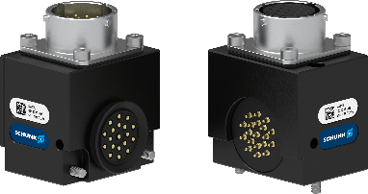
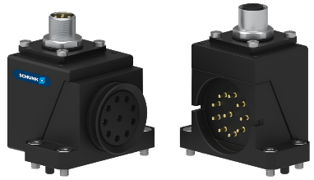
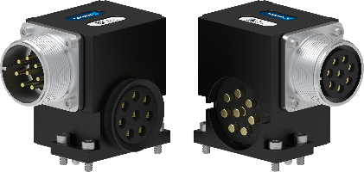
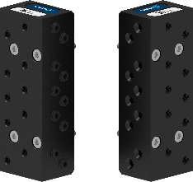
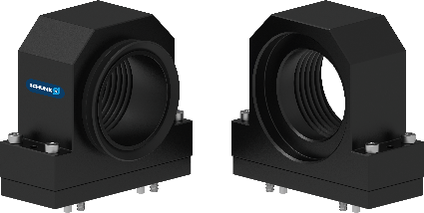
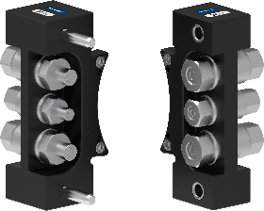
COS
Option modules for all kind of applications
Automatic Tool Changer CPS
SIGNAL | COMMUNICATION | POWER | PNEUMATIC | VACUUM | HYDRAULIC / FLUID
> 200 variants
Max. 48 VAC / 5 A | EtherNet | Up to 500 VAC / 45 A | NBR form sealings | NBR lip sealings | Up to 150 bar
Digital signals | EtherNet/IP |  | M5, G 1/8“, G 1/4“, G 3/8“, G ½“ | G ¾“, G 1,1/2“, G 2“ | Up to 8 bar
 | ProfiNet

Slide 7
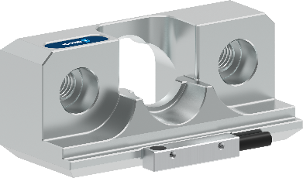
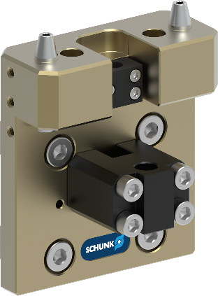
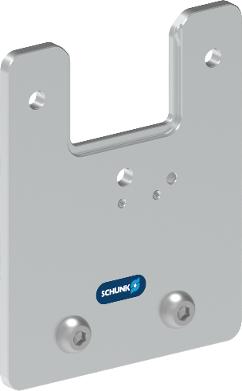
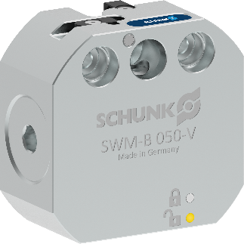
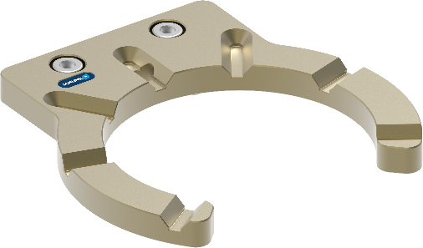
CTS
Large portfolio of accessories
Automatic Tool Changer CPS
CTS B passive
(without locking)
CTS P
Pin & Bushing
CTS T
Storage tray
CTS B aktive
(with locking)
CTS C
Bolt storage
Notes:
Focused to the existing Systems
Wording from SWM to CTS
CTS P: 1:1 replacement
CTS C: 1:1 replacement
CTS T: 1:1 replaement

