Slide 1


Product Presentation CPB
Version english 01.06.2025

Slide 2
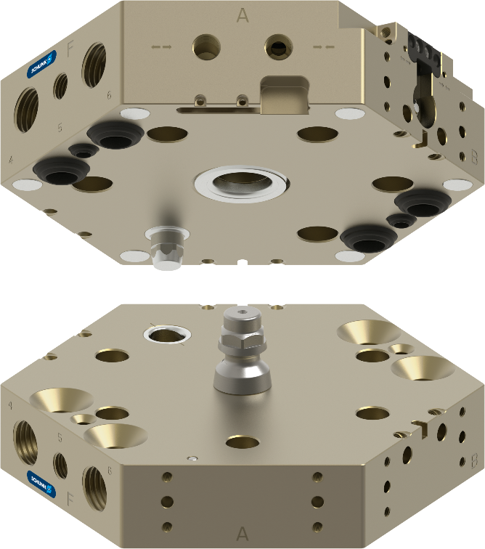
CPB
Developed and manufactured in Germany
Automatic Tool Changer CPB
Continuous series with 7 sizes (040 to 160), proven SCHUNK bolt-locking mechanism
Payload up to 300 kg, up to 3,000 Nm Mxy moment payload
New developed series of optional modules, can be screwed directly into changer CPB

Slide 3
CPB
Go beyond
Automatic Tool Changer CPB
Robust, bolt-locking mechanism
  Proven technology in stationary workholding systems for over 20 years
  Internal locking mechanism made of vacuum-hardened stainless steel
  Housing made of anodized, high-strength aluminum
  Integrated spring to minimize gap in case of loss of air between master and tool
More flexibility
  Integrated sensors for monitoring lock/unlock conditions and tool presence
  Newly developed optional modules with universal bolt interface for various media
  Additional integrated pneumatic feed-throughs
  More screw-on surfaces for feed-through modules due the rectangular or hexagonal design
Easy to use
  Integrated ISO flange pattern master and tool side
  Integrated feed-throughs on the adapter can be used radial or axial
  On the adapter side, end effectors can be bolted either onto the quick-change adapter (bolt-up) or through it (bolt-down)

Slide 4

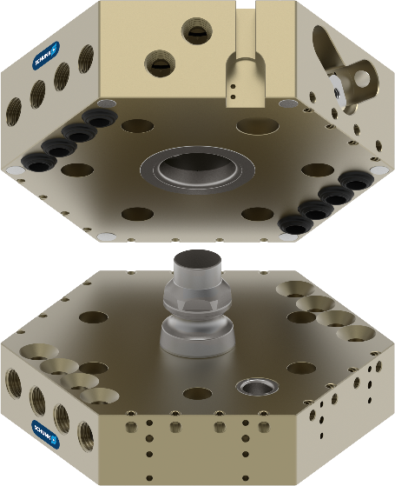
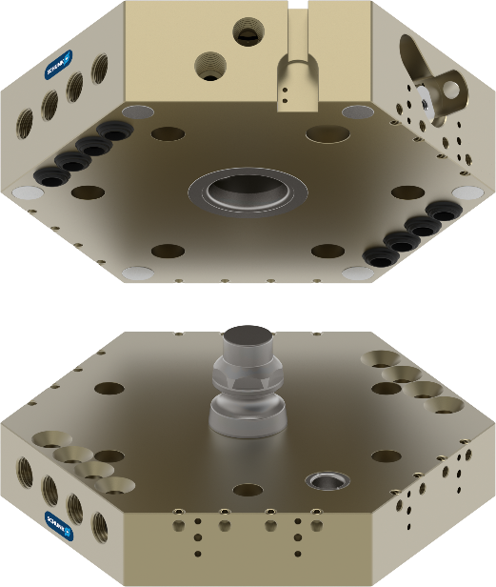
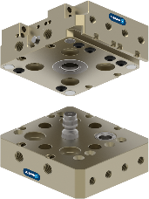
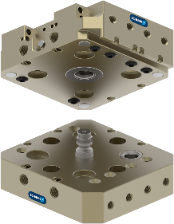
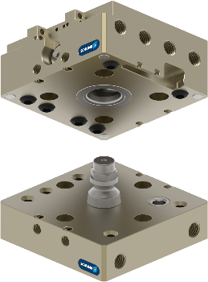
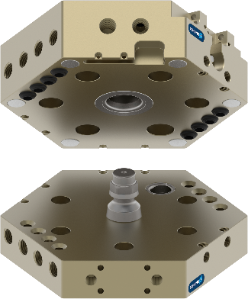
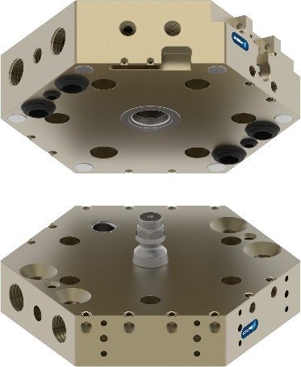
CPB
From the Machine Table to the Robot
Automatic Tool Changer CPB
Size | Payload | Weight when coupled | Max. dynamic moment M_{X} / M_{Z} | Sensors inductive for lock/unlock prepared | Sensors inductive for tool presence prepared | Repeat accuracy | Operating pressure | Amount of mounting surfaces for optional modules
 | [kg] | [kg] | [Nm] |  |  | [mm] | [bar]
CPB 040 | 20 | 0,41 | 100 / 100 |  |  | 0,015 | 4,5-7 | 2
CPB 050 | 35 | 0,57 | 125 / 125 |  |  |  |  | 2
 |  |  |  |  |  |  |  | 2
CPB 063 | 50 | 1,23 | 350 / 350
 |  |  |  |  |  |  |  | 3
CPB 080 | 85 | 1,92 | 500 / 500
 |  |  |  |  |  |  |  | 3
CPB 100 | 100 | 3,03 | 800 / 600
 |  |  |  |  |  |  |  | 3*
CPB 125 | 200 | 7,22 | 2.000 / 1.000
CPB 160 | 300 | 10,56 | 3.000 / 1.500 |  |  |  |  | 3*
*doppeltes Anschraubbild, Anschraubbild J (bsp. für COS R19 Optionsmodul) vorbereitet.

Slide 5
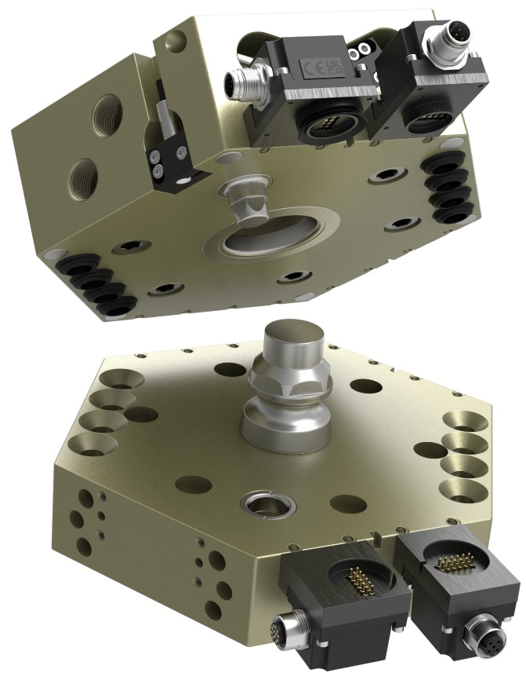
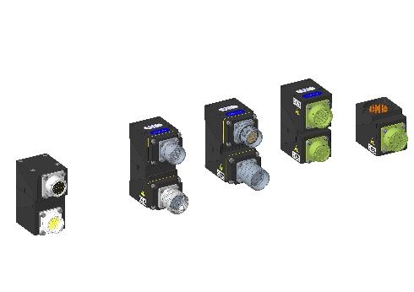
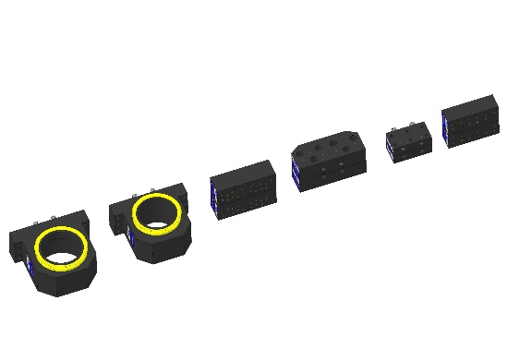
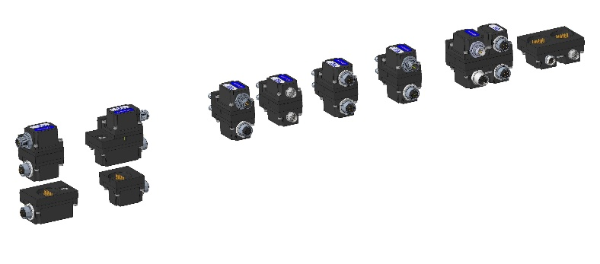
COB
Optional Modules for Media feed-through
Automatic Tool Changer CPB
SIGNAL | COMMUNICATION | POWER | PNEUMATIC | VACUUM
> 50 variants
COB S12R/L plus tool coding | COB CB2 | COB CB2 | COB A6M5 | COB V1A
COB P4 | COB CB1 | COB CB3 | COB A618A | COB V2A
COB S8 plus tool coding | COB CIO1 |  | COB A10M5
 | COB CB3
 | COB CB4
 | COB CB6
All optional modules with serialization via DMC code

Slide 6
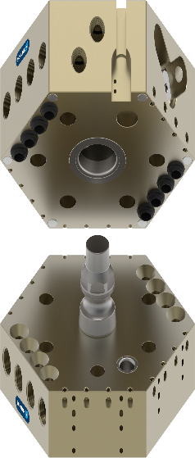

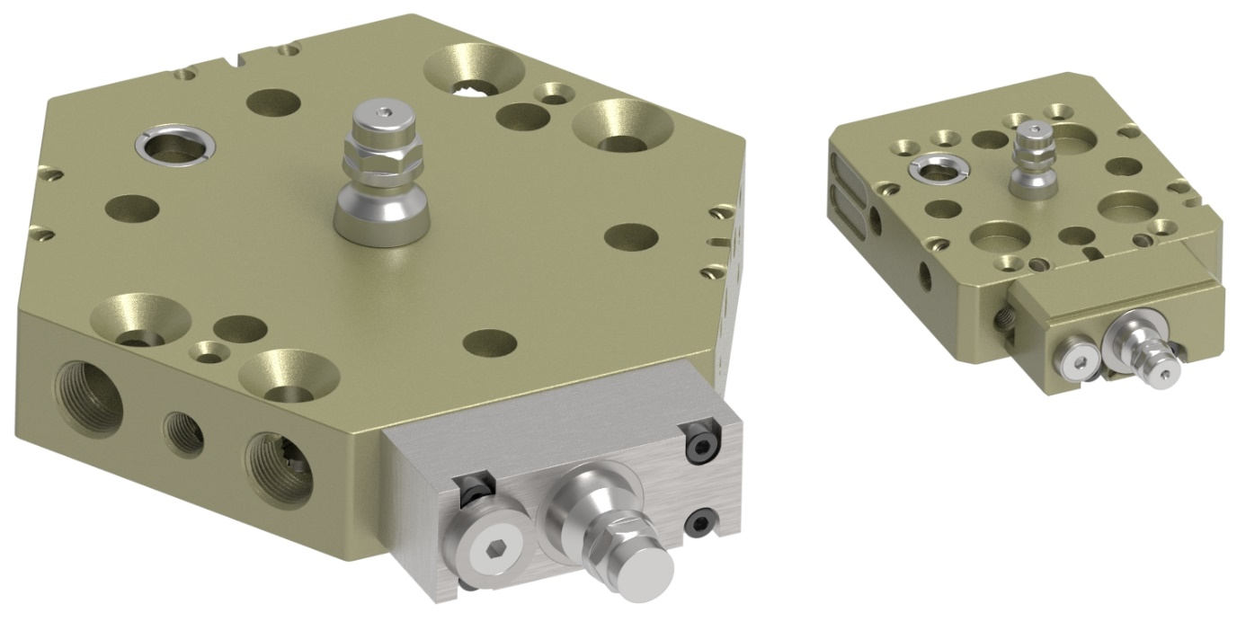

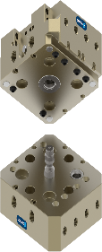


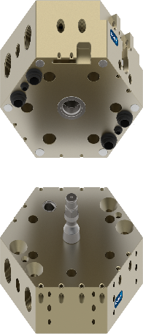
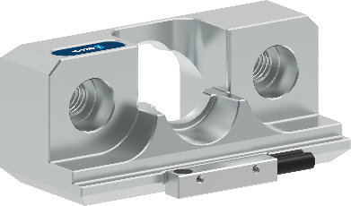
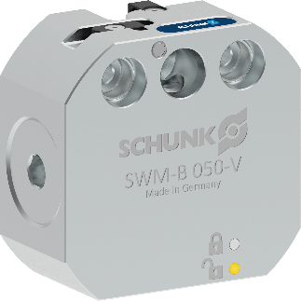
CTS B
Bolt Storage
Automatic Tool Changer CPB
2 sizes 050 and 085, each available in active (with locking) and passive version (without locking)
Further sizes available from the end of 2025 (up to 250 kg payload)
Screw-on surface “A” prepard on all CPB adapters for mounting the support bolt
CTS B passive
CTS B aktive

