Slide 1
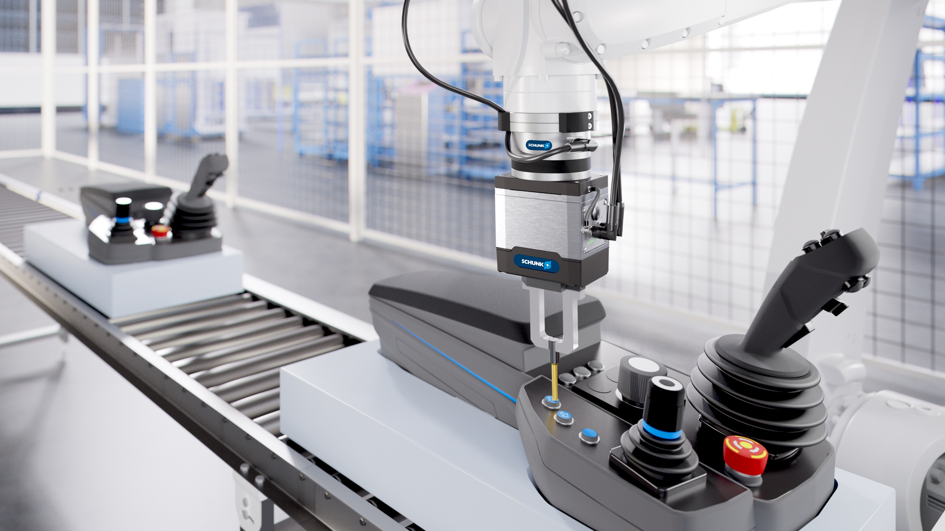

Product Presentation
FTS
Version english 01.06.2025

Slide 2
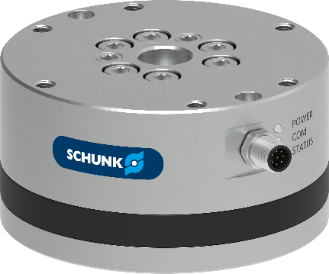
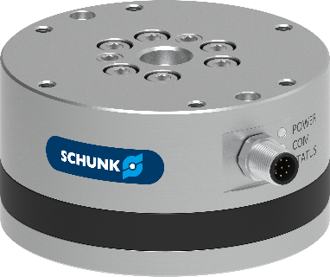
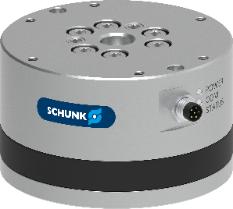
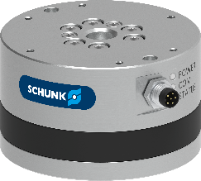
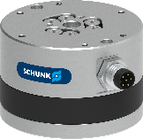
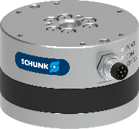
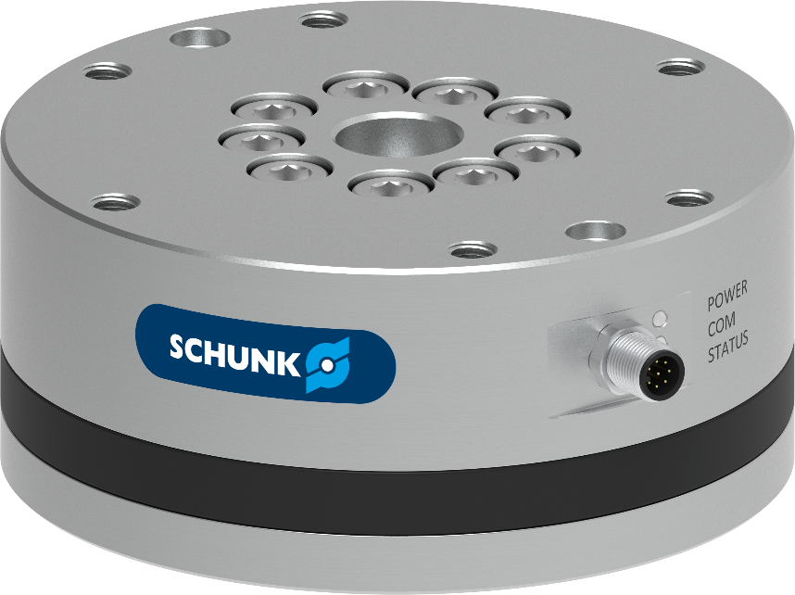
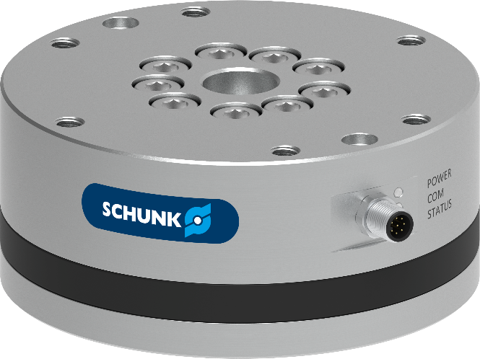

FTS
Developed and manufactured in Germany
Force-Torque-Sensors FTS
FTS 047
FTS 056
FTS 070
FTS 085
FTS 105
FTS 125
FTS 160
FTS 200
FTS 250

Slide 3

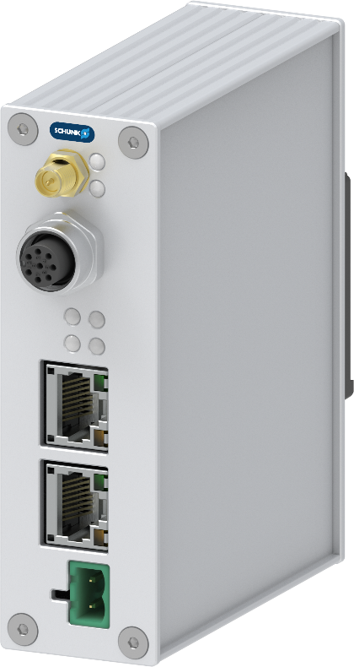




Communication Interfaces
Force-Torque-Sensors FTS
Ethernet TCP/UDP
EtherNet & Ethernet/IP
EtherCAT
ProfiNET

Slide 4
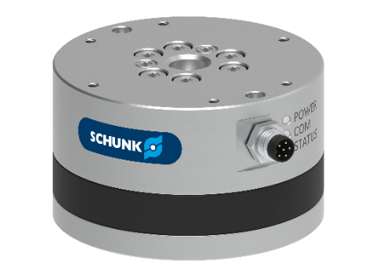
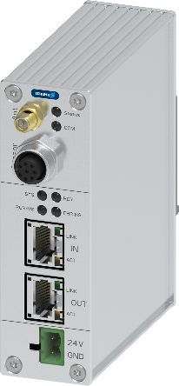
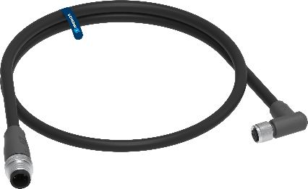
Product Description
Force-Torque-Sensors FTS
FTS | 056 | 600 | 11
Series Force Torque Sensor | Size Outer Diameter Ø56mm | Measurement Range Fz 600 N | Measurement Range Mxyz 11 Nm
FTS | IFB | PN
Series Force Torque Sensor | Interface Face Box | PN ProfiNet EI Ethernet/IP EC EtherCAT EN Ethernet | - IP67 (optional)
FTS | C | M8 | M12 | 10
Series Force Torque Sensor | Cable | M8 Size 047 - 085 M12 Size 105 - 250 | M12 Interface Box | 10 m Cable length

Slide 5


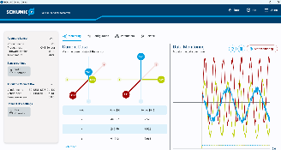
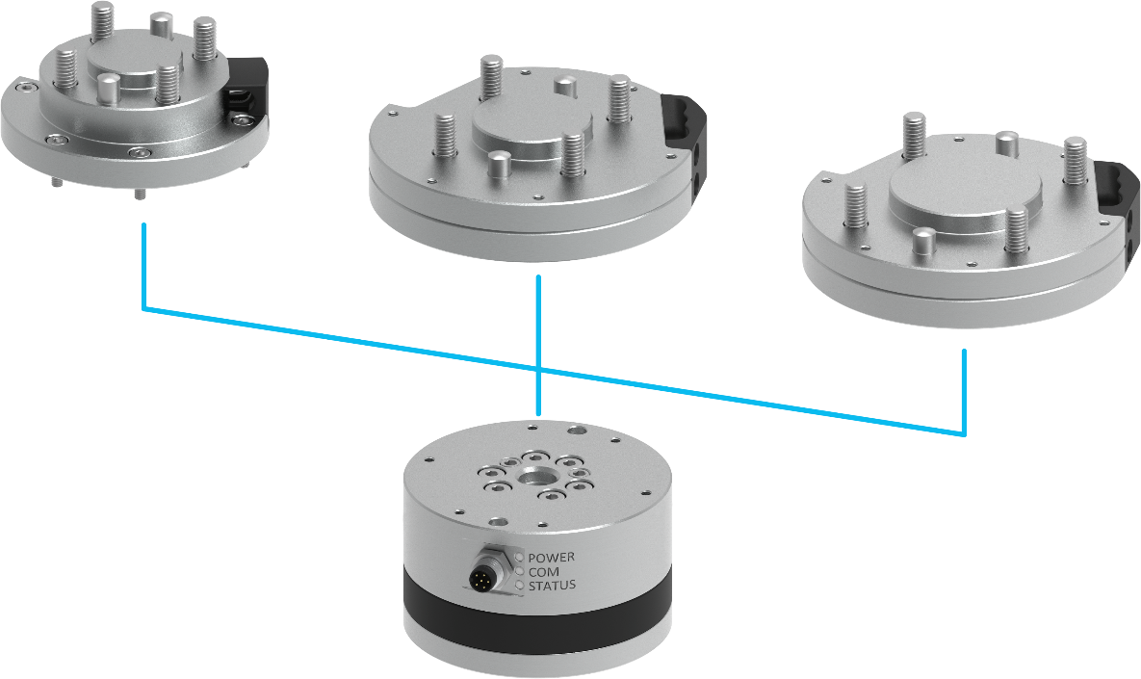


Portfolio overview
Force-Torque-Sensors FTS
ISO adapter
3 sizes for each FTS Sensor
Control Center
Robot Control
SPS/PLC
Interface-Box
1 for all Interfaces
2 Variants (IP)
Cable
5 lenghts
2 variants
Sensor
9 Sizes

Slide 6
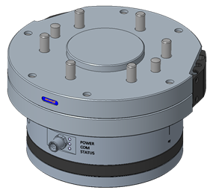
Sizes and Interface plates
Force-Torque-Sensors FTS
Size | Diameter | Measurement Range |  |  | Tool Side | Robot Side Interface Plate Options
 | Ø | Fx/Fy | Fz | Mx/My/Mz |  | S (small) | M (medium) | L (large)
FTS 047 | 47 mm | 125 N | 300 N | 4,5 Nm | ISO 31,5 | ISO 25 | ISO 31,5 | ISO 40
FTS 056 | 56 mm | 250 N | 600 N | 11 Nm | ISO 40 | ISO 31,5 | ISO 40 | ISO 50
FTS 070 | 70 mm | 500 N | 1200 N | 28 Nm | ISO 50 | ISO 31,5 + ISO 40 | ISO 50 | ISO 63
FTS 085 | 85 mm | 1000 N | 2400 N | 70 Nm | ISO 63 | ISO 50 | ISO 63 | ISO 80
FTS 105 | 105 mm | 2000 N | 4800 N | 175 Nm | ISO 80 | ISO 63 | ISO 80 | ISO 100
FTS 125 | 125 mm | 3200 N | 7800 N | 350 Nm | ISO 100 | ISO 80 | ISO 100 | ISO 125
FTS 160 | 160 mm | 5000 N | 12500 N | 700 Nm | ISO 125 | ISO 100 | ISO 125 | ISO 160
FTS 200 | 200 mm | 10000 N | 20000 N | 1400 Nm | ISO 160 | ISO 125 | ISO 160 | ISO 200
FTS 250 | 250 mm | 16000 N | 32000 N | 2800 Nm | ISO 200 | ISO 160 | ISO 200 | ISO 250

Slide 7
Advantages and benefits
Force-Torque-Sensors FTS
Standard IP67 for all FTS sizes
LED´s for Power, Communication & Sensor Status integrated in all FTS sizes (with exception size FTS 047)
All FTS sizes with digital signal output, sensor is independent of cable and Interface Box.
The Interface Box has In and Out connections and can therefore be easily integrated into existing network topologies.
Product configuration: SCHUNK Control Center allows easy setup and easy data logging.

