Slide 1
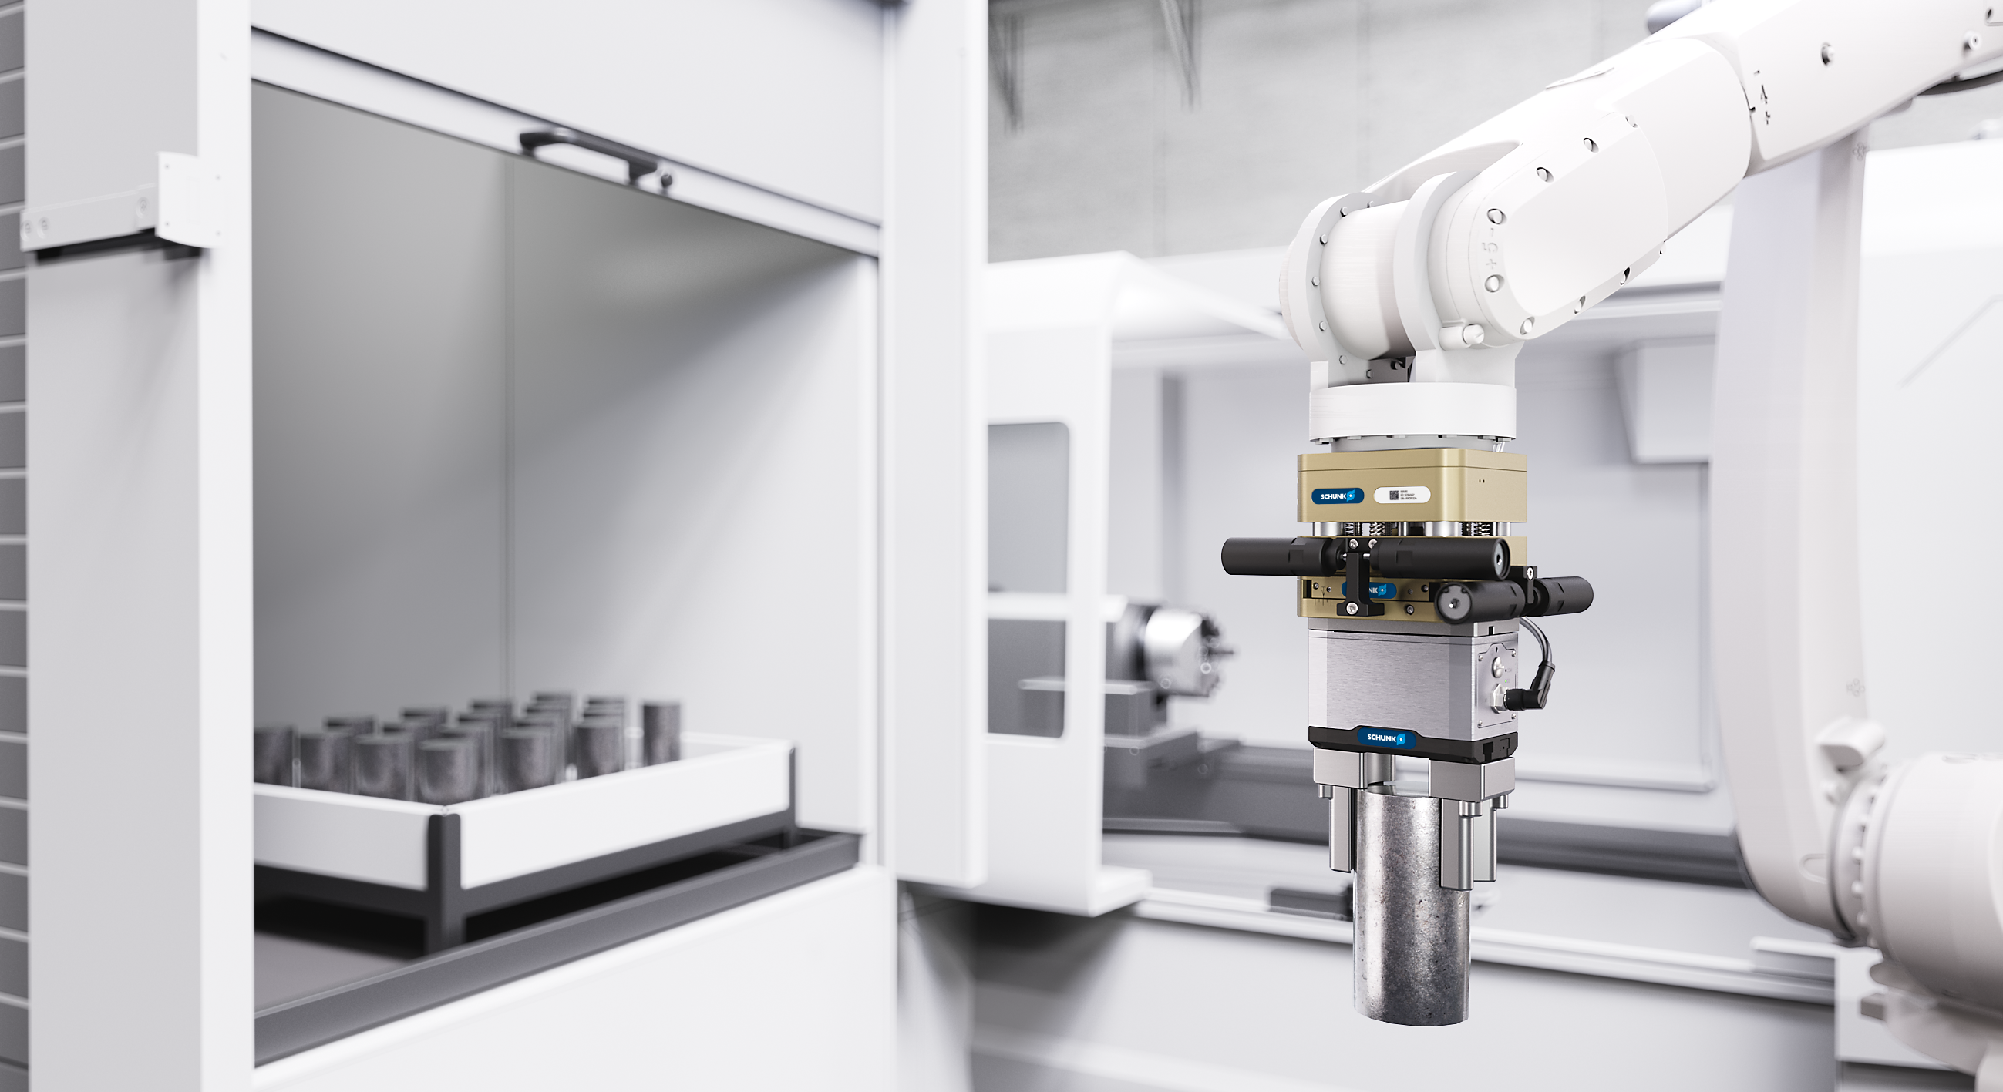

Product Presentation
AGM
Version english 10.12.2025

Slide 2
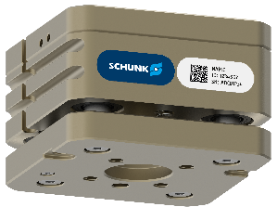
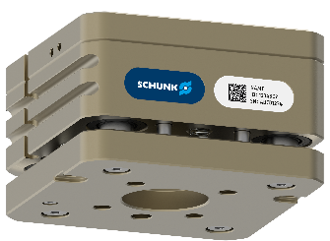
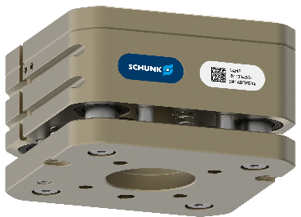
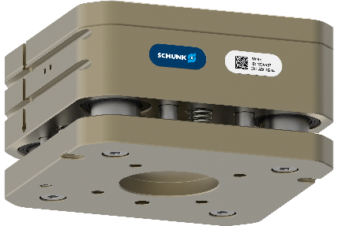
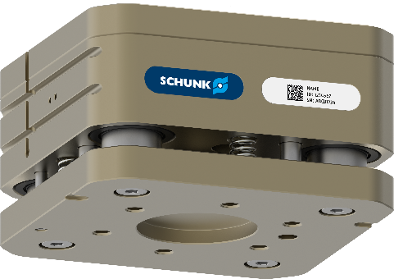
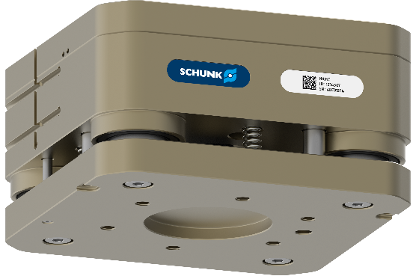
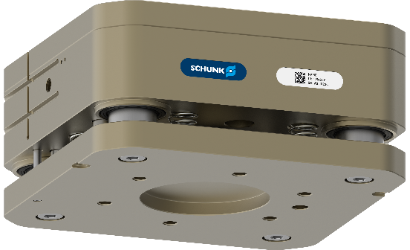
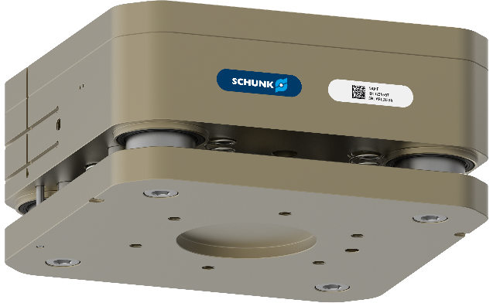


AGM-Z
Mastering tolerances and increasing reliability
Modular Compensation units AGM
AGM-Z 031
AGM-Z 040
AGM-Z 050
AGM-Z 063
AGM-Z 080
AGM-Z 100
AGM-Z 125
AGM-Z 160
AGM-Z 160L
AGM-Z 200
Notes:
Folie fertig

Slide 3

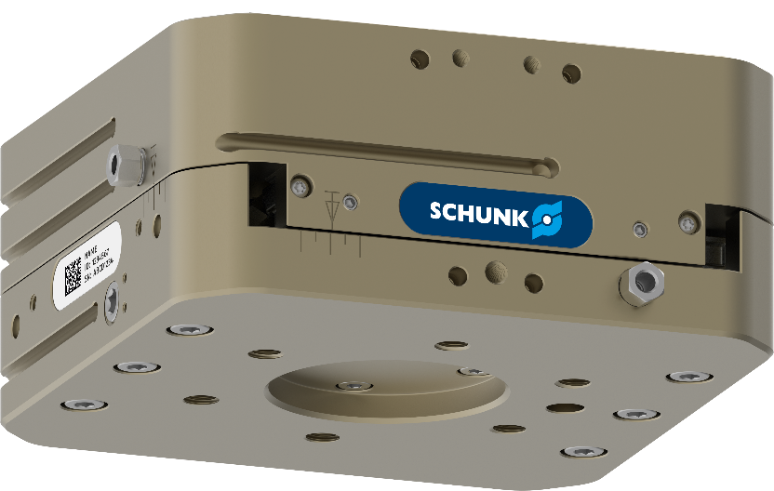
AGM
Product family
Modular Compensation units AGM
Broad load capacity range
With the AGM units, loads ranging from a few grams to over 500 kg can be handled
No compromises on the interfering contour
The AGM product family offers the perfect unit for a wide range of applications with 23 sizes
Easy to assemble
The integrated, continuous ISO interface on both the robot and tool sides, from ISO 31,5 to ISO 200, is compatible with most robot types
Always the right compensation behaviour
The wide portfolio enables compensation in XY-, Z-, W-, XYZ-, WZ-direction

Slide 4


AGM-Z
Technical data
Modular Compensation units AGM
Size | Recommended handling weight, vertical | Recommended handling weight, horizontal | Compensation in Z | Net Weight | Monitoring prepared | Standard adapter plates | Modularity: WZ | Modularity: XYZ
 | [kg] | [kg] | [mm] | [kg]
AGM-Z 031 | 4 | 4 | 4 | 0,5 | inductive or magnetic
AGM-Z 040 | 8 | 5,7 | 4 | 0,7
AGM-Z 050 | 12 | 12 | 6 | 1,0
AGM-Z 063 | 24 | 18 | 8 | 1,9
AGM-Z 080 | 45 | 32,5 | 10 | 3,6
AGM-Z 100 | 85 | 74 | 15 | 6,0
AGM-Z 125 | 135 | 107 | 15 | 9,7
AGM-Z 160 | 230 | 150 | 15 | 19,3
AGM-Z 160L | 290 | 230 | 20 | 25,2
AGM-Z 200 | 500* | 360* | 20* | 37,8*
* Technical Data under reservation

Slide 5










AGM-XY
Mastering tolerances and increasing reliability
Modular Compensation units AGM
AGM-XY 031
AGM-XY 040
AGM-XY 050
AGM-XY 063
AGM-XY 080
AGM-XY 100
AGM-XY 125
AGM-XY 160
AGM-XY 160L
AGM-XY 200
Notes:
Ausgleichseinheiten „nur größer“ gezogen, da noch kein BG Rendering verfügbar

Slide 6

AGM-XY
Technical data
Modular Compensation units AGM
Size | Recommended handling weight, vertical | Recommended handling weight, horizontal | Compensation in XY | Net Weight | Monitoring prepared | Adjustable Stroke limitation | Standard adapter plates | Weight compensation | Modularity: XYZ
 | [kg] | [kg] | [mm] | [kg]
AGM-XY 031 | 4,7 | 2,4 | ± 2 | 0,5 | inductive or magnetic | Abfrage vorbereitet |  | via spring and air cartridge
AGM-XY 040 | 9,5 | 5,7 | ± 3 | 0,8
AGM-XY 050 | 18 | 9 | ± 4 | 1
AGM-XY 063 | 32,5 | 17 | ± 5 | 2
AGM-XY 080 | 68 | 25 | ± 7 | 3,6
AGM-XY 100 | 130 | 60 | ± 9 | 5,8
AGM-XY 125 | 190 | 90 | ± 10 | 10,9
AGM-XY 160 | 250 | 130 | ± 12 | 21,8
AGM-XY 160L | 350 | 180 | ± 15 | 31,7
AGM-XY 200 | 520* | 350* | ± 15* | 41,8*
* Technical Data under reservation

Slide 7
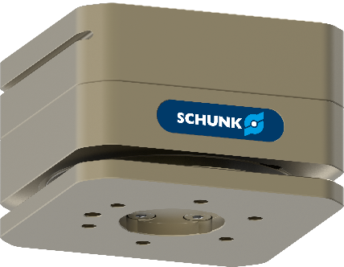


AGM-W
Mastering tolerances and increasing reliability
Modular Compensation units AGM
Size | Recommended handling weight, vertical | Recommended handling weight, horizontal | Compensation angular | Net Weight | Monitoring prepared | Standard adapter plates | Adjustable weight compensation | Modularity: WZ
 | [kg] | [kg] | [°] | [kg]
AGM-W 050 | 8 | 5,5 | ± 5 | 1,2 | inductive or magnetic |  | via control piston
AGM-W 063 | 16 | 11 | ± 5 | 1,9
AGM-W 080 | 32 | 22 | ± 5 | 3,2
AGM-W 050
AGM-W 063
AGM-W 080
Notes:
Folie fertig

Slide 8
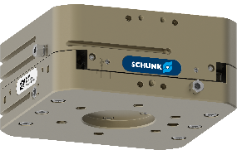

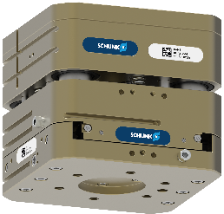
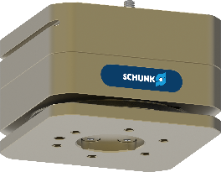
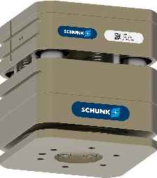
AGM
Combination options thanks to modular series
Modular Compensation units AGM
AGM-XY
AGM-Z
AGM-XYZ
+
=
Advantages:
Lower installation height
Lower weight
compared to the combination of single components
AGM-W
AGM-Z
AGM-WZ
+
=

Slide 9
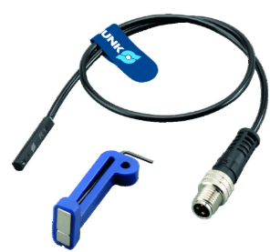
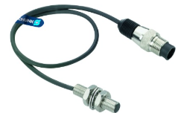
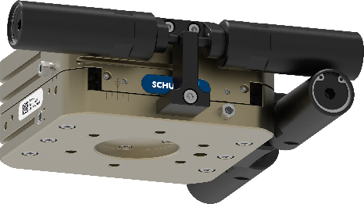
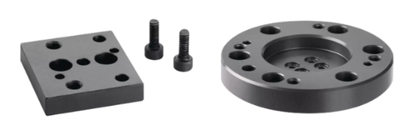
AGM
Offers more…
Modular Compensation units AGM
Most comprehensive range of sensors
Numerous magnetic and inductive monitoring options
optionally available for all sizes
Effective weight compensation in horizontal applications
thanks to patented spring and air cartridges for AGM-XY and AGM-XYZ
Standardized adapter plates
In addition to the integrated ISO interface, one adapter plate per size is available for a smaller and one for a larger ISO interface

