Slide 1

SCHUNK Engineering
Solution Book - Consumer Goods
Note:
This presentation contains confidential information and is only released for non-public use by customers and suppliers.
Consultation with specialist department may be necessary.
- Remove this note before use -

Slide 2




Material Lifter
Lifting trays for automated unloading
Consumer Goods - Intralogistics
Function
Lifting trays layer by layer for automated unloading.
Customer benefits
Compact and space saving:
Using the z-axis vs. x/y-axis saves valuable installation / floor area
Flexibility - virtually universal:
The Material Lifter with configurable axis and gripper can be adapted to many applications in terms of size, load, speed, …
Expert project planning team
Sizing, design and assembly by SCHUNK
+
additional slides available

Slide 3






Material Lifter
Lifting trays for automated unloading
Consumer Goods - Intralogistics
Cover handling
Saves
Floorspace
Pure
Flexibility

Slide 4

Material Lifter
Lifting trays for automated unloading
Consumer Goods - Intralogistics
Reference project
consisting of
Linear direct axis SLD-24 heavy-duty design with working stroke 3.200 mm
Electric long-stroke gripper ELG 30
1
2
Notes:
SCHUNK ID: 1602006

Slide 5

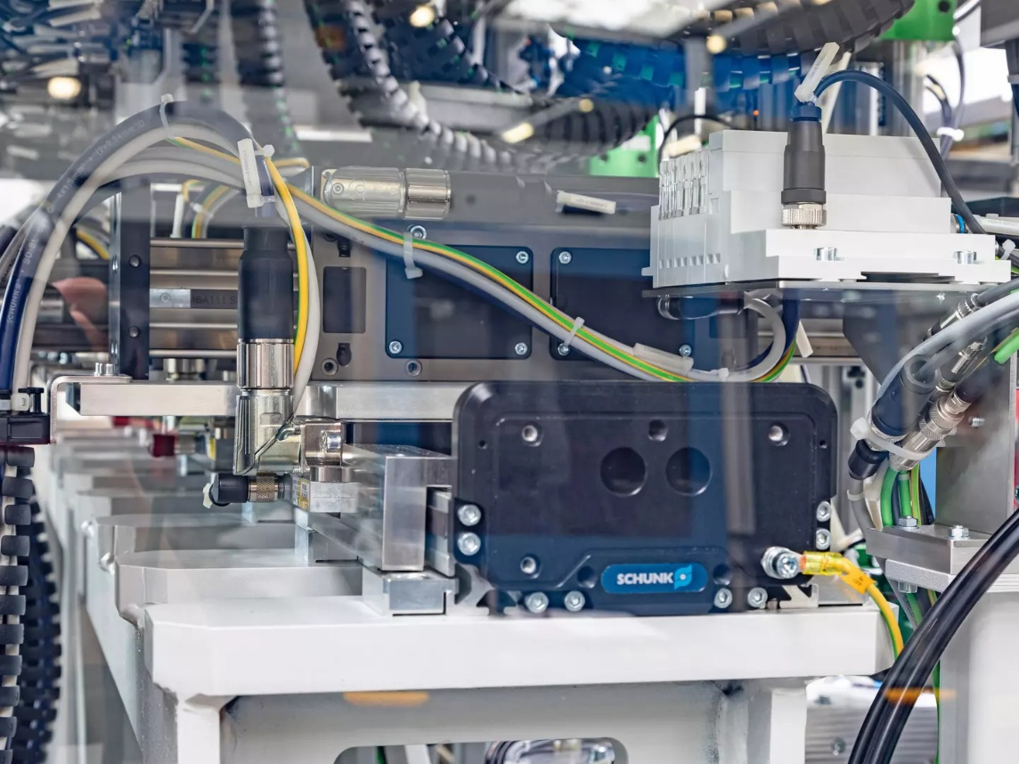






It couldn't be more compact!
Screw assembly cell with five screw units
Consumer Goods - Assembly
Function
Five separately controlled slides enable high-precision and fast screw processes in the assembly cell. The robustness and accuracy of the SLD-axis ensures flawless screwdriving processes and avoids scrap.
Scope
  1x linear direct axis SLD 11 with five slides (x-axis)
  5x linear direct axis LDN (y-axis)
Customer benefit
  Highly compact unit integrated into existing customer line
  High load capacity of the base axis ensures precision of screwdriving operations
Discharge side view of the SLD linear direct axis installed on a steel girder.
second page available
TYPICAL PRODUCTS
TYPICAL PROCESS
REQUIREMENTS
Click here for the success story!
HIGHSPEED
STRONG
ACCURACY
Notes:
SCHUNK ID: 1554728

Slide 6
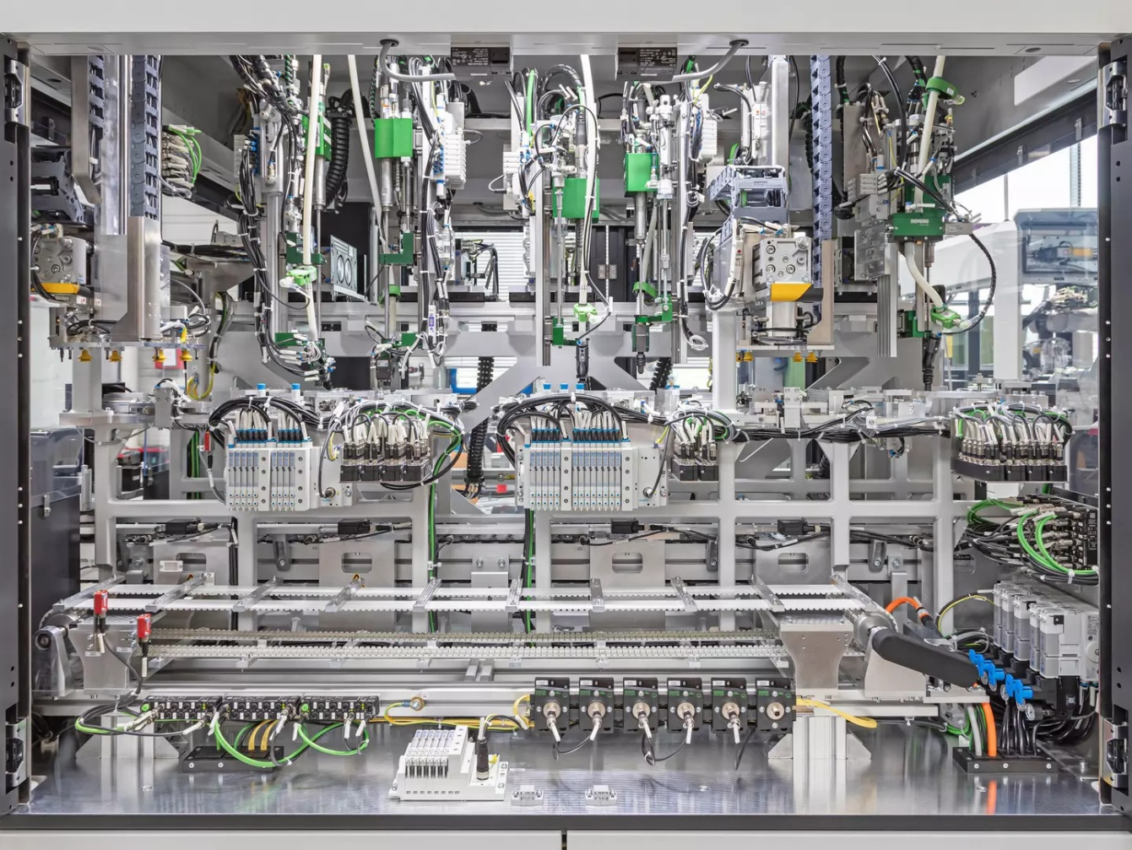
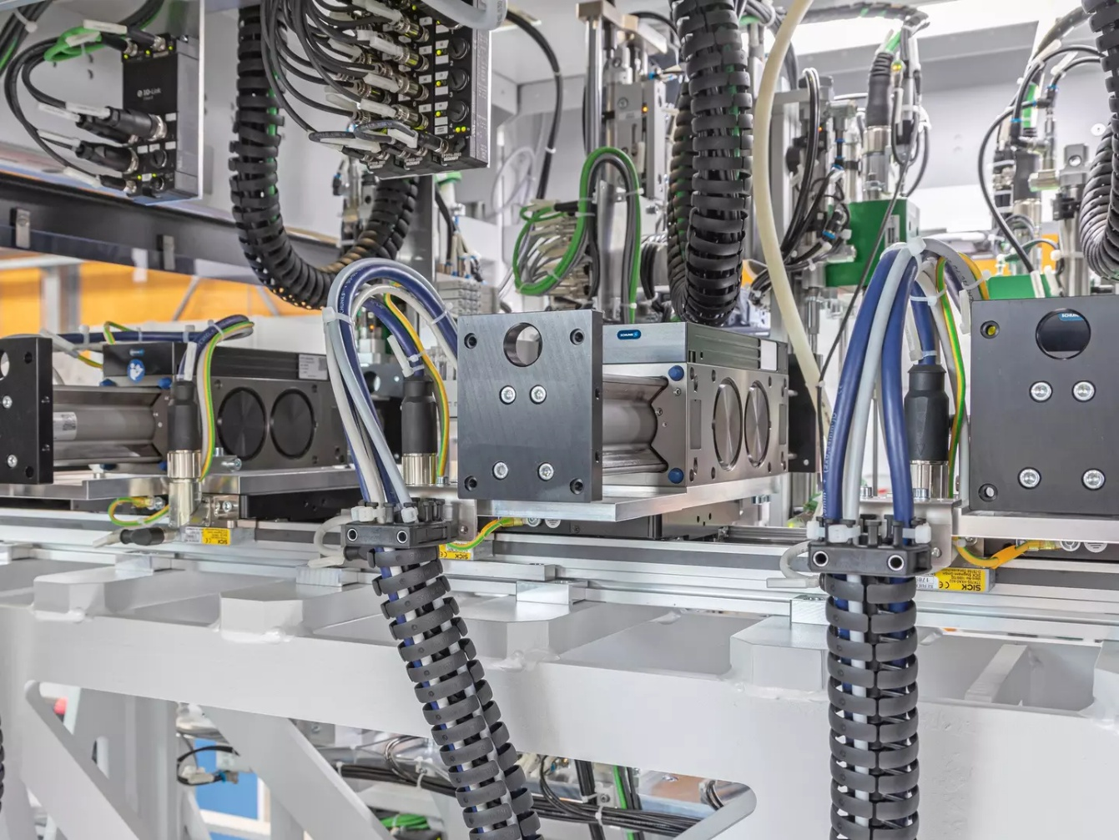
It couldn't be more compact!
Screw assembly cell with five screw units
Consumer Goods - Assembly
Complete view of the extremely compact screwdriving assembly cell with five screwdriving units. The heart of the cell is the SLD horizontal linear direct axis with five independently movable carriages.
An LDN universal linear axis is mounted transversely on the SLD horizontal linear direct axis, on all five slides.
Click here for the success story!
Notes:
SCHUNK ID: 1554728

Slide 7
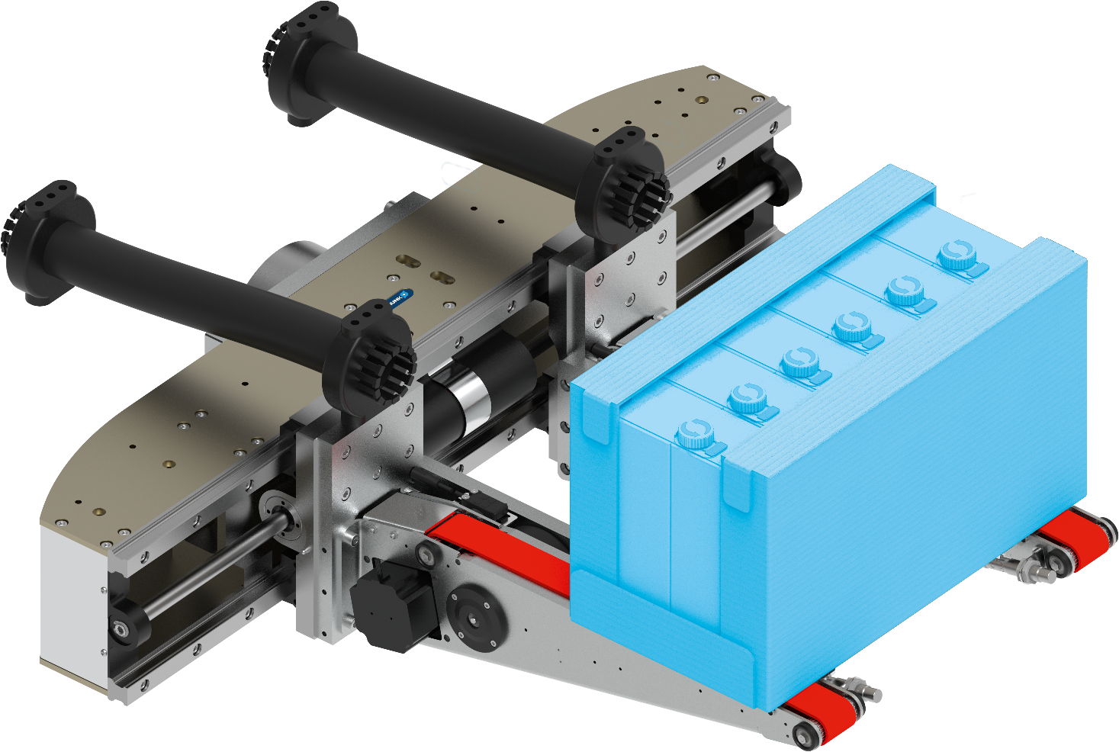





Roll-up gripper
Handling of various products (Tetra-Pack trays and similar)
Consumer Goods
Customized gripper unit
consisting of electric long-stroke gripper LEG and customized fingers. Attached to robots with 60 kg load capacity.
Long-stroke
235 mm stroke per finger
Gripper finger with roll-up function
Long-stroke gripper
LEG 760-2
Reliability
Use of proven SCHUNK-technology
TYPICAL PRODUCTS
TYPICAL PROCESS
REQUIREMENTS
RELIABILITY
STRONG
ACCURACY
Notes:
SCHUNK ID: 1314255

Slide 8
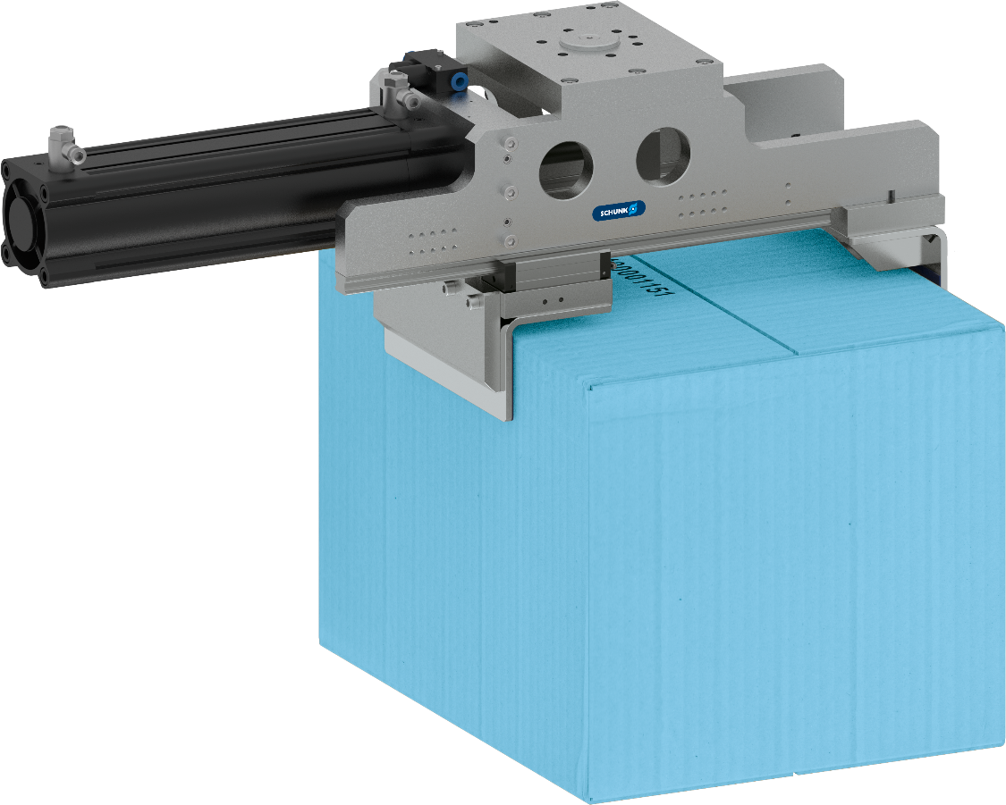
Gripper
Handling of cardboard boxes
Consumer Goods
Customized gripping unit
with fixed jaw and pneumatic drive cylinder
Stroke
250 mm
Gripper weight
approx. 26 kg
TYPICAL PRODUCTS
TYPICAL PROCESS
REQUIREMENTS
RELIABILITY
STRONG
ACCURACY
Notes:
SCHUNK ID: 30085203

Slide 9
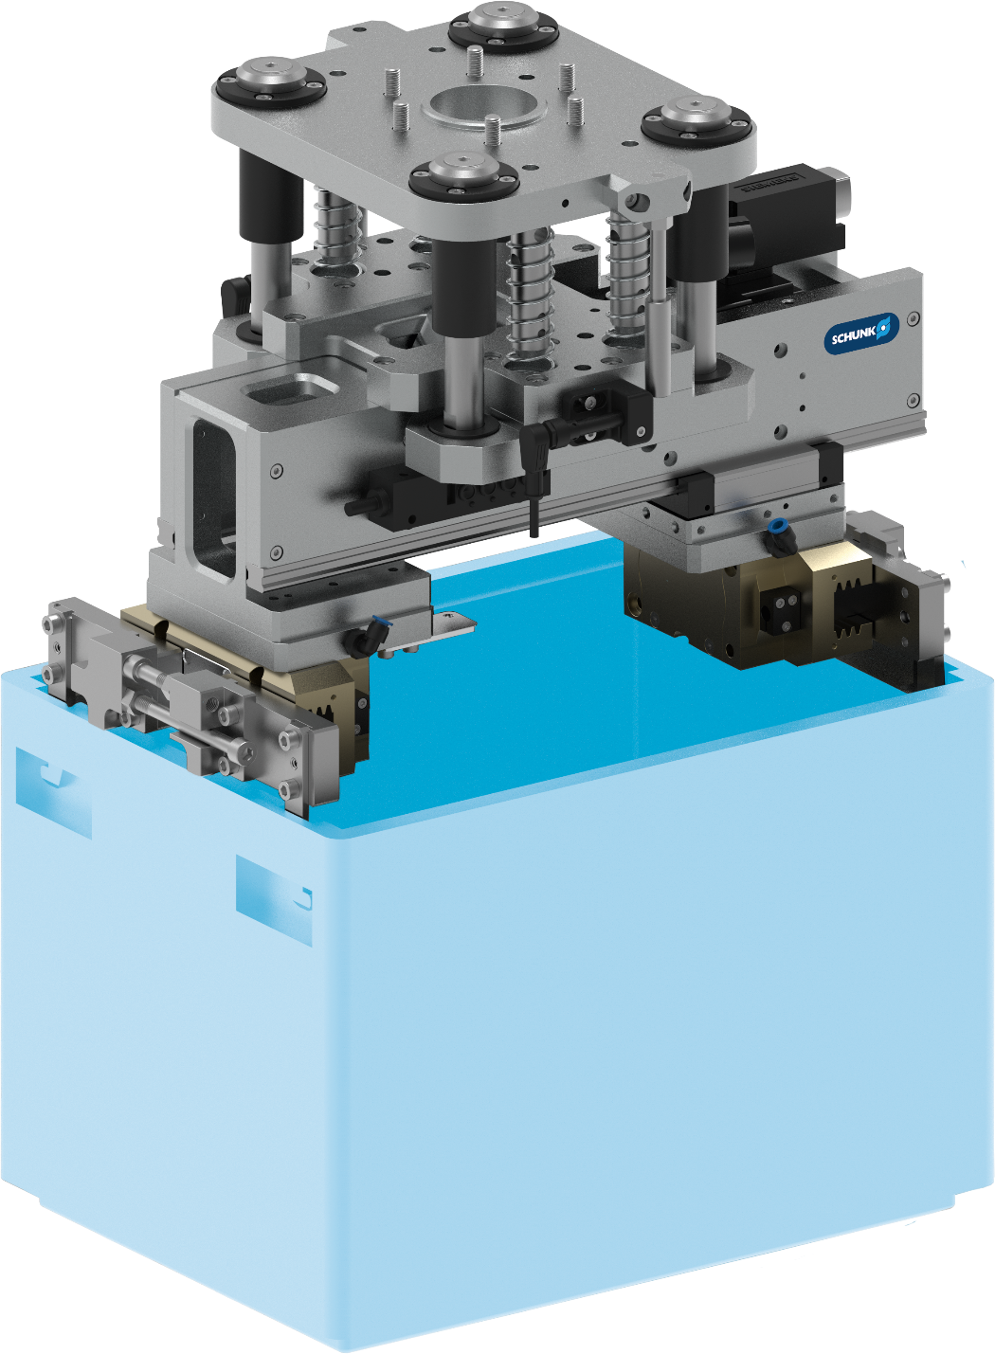
Euro container (KLT) gripper
Handling of containers
Consumer Goods
Customized gripping unit
consisting of electric long-stroke gripper LEG and 2-finger parallel gripper PGN-plus 125 with customized fingers
Z-Compensation unit
stroke 50 mm
Long-stroke gripper
LEG 400
Gripper weight
approx. 23 kg
TYPICAL PRODUCTS
TYPICAL PROCESS
REQUIREMENTS
RELIABILITY
STRONG
ACCURACY
Notes:
SCHUNK ID: 1320105

Slide 10
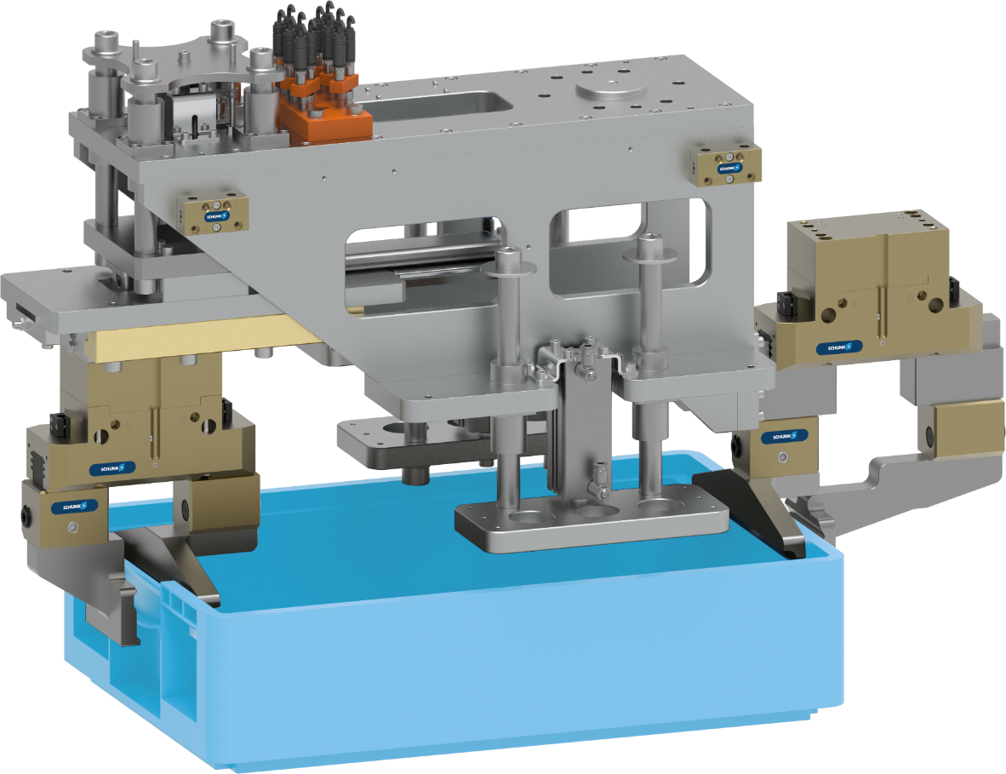
Euro container (KLT) gripper
Handling of containers
Consumer Goods
Customized gripping unit
consisting of 2 pieces of PGN-plus 160-AS parallel grippers with customized fingers
Pneumatic Z-X adjustment unit
for a gripper to adapt to the different container sizes
Pneumatic parallel gripper
PGN-plus 160-AS
2x pneumatic pressure unit
for fixing the workpieces in the gripped state
Gripper weight
approx. 60 kg
TYPICAL PRODUCTS
TYPICAL PROCESS
REQUIREMENTS
RELIABILITY
STRONG
ACCURACY
Notes:
SCHUNK ID: 1316816

Slide 11

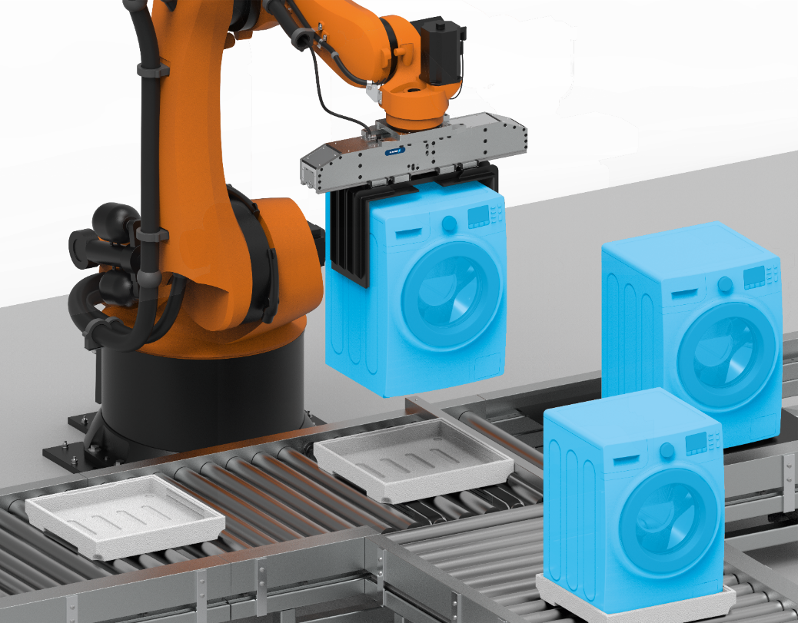

Gripping unit ELG
Handling of lashing machines
Consumer Goods - Packaging
Short project lead time
Sizing, design and assembly by SCHUNK
ELG gripper configuration
Customizable long-stroke gripper
Customized interface
for mounting on your robot or linear gantry with tolerance compensation
Gripping unit
Gripper for handling large, heavy workpieces
Solution
ELG long-stroke gripper, gripper fingers with anti-slip coating
TYPICAL PRODUCTS
TYPICAL PROCESS
REQUIREMENS
RELIABILITY
STRONG
ACCURACY
Notes:
SCHUNK ID: 1490001 - Anwendungsbeispiel (Projektierung Timo Kurzenberger)

Slide 12
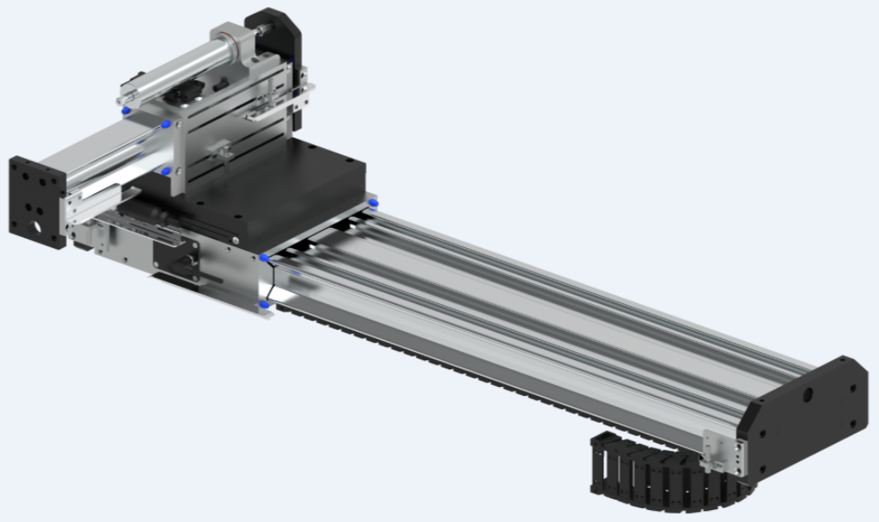


2-axis system
Handling of contact lens trays
Consumer Goods
Expert project planning team
Sizing, design and assembly by SCHUNK
Linear axes LDT / LDN
Linear axes type LDT and LDN
Dynamic
Linear axes with direct drive ensure high dynamics and minimum cycle times
High availability
High system availability due to maximum reduction of wear parts
TYPICAL PRODUCTS
TYPICAL PROCESS
REQUIREMENTS
HIGHSPEED
RELIABILITY
ACCURACY
Notes:
SCHUNK ID: 1341187

Slide 13
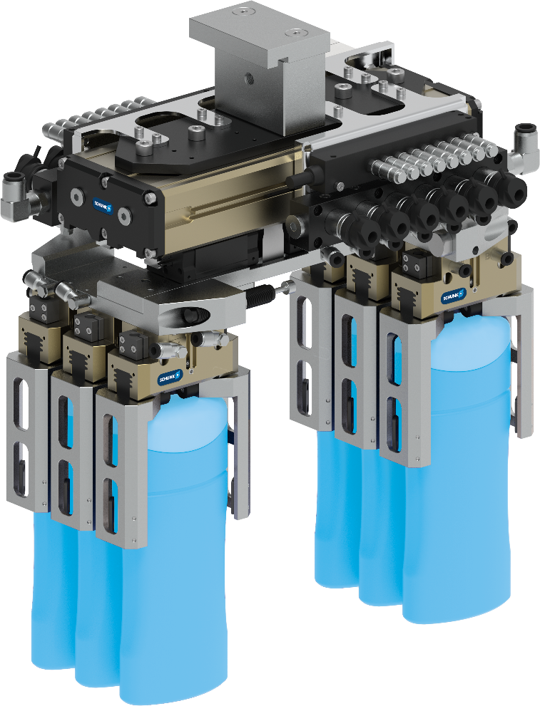



Gripping unit PHL, 6x PGN-plus
Handling of shampoo bottles
Consumer Goods – Packaging
Expert project planning team
Sizing, design and assembly by SCHUNK
Long-stroke gripper PHL-W
Moving together and moving apart
6x gipper PGN-plus
Gripping of six shampoo bottles simultaneously
Micro valves
Fast cycle times and compact design
Rotary actuator SRU-plus
Reorientation of the component by 90°
TYPICAL PRODUCTS
TYPICAL PROCESS
REQUIREMENTS
POWERFUL
SENSITIVE
ACCURACY
Notes:
SCHUNK ID: 1314005

Slide 14
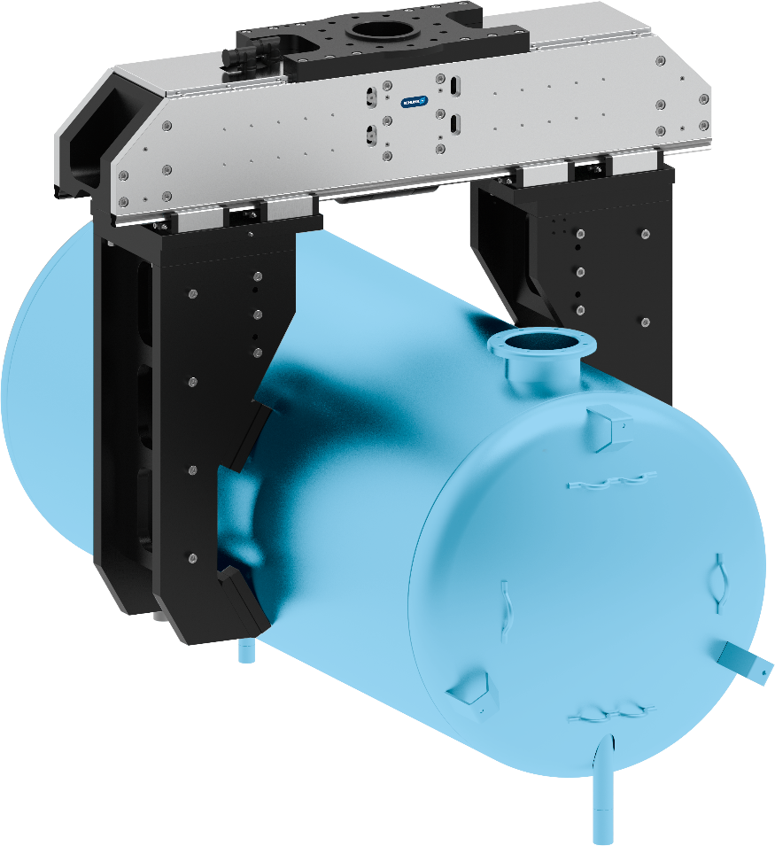


Gripping unit ELG
Transport of hot water boilers within a test sequence
Consumer Goods - Testing machines
Customized gripping unit
consisting of customized LEG and customized fingers
High gripping force
12.000 N
Frictional gripping
  Workpiece weight up to 160 kg
  Interchangeable clamping inserts with high friction coefficient
Long-stroke gripper
for workpiece diameter 443-650 mm
Reliability
Use of proven SCHUNK technology
TYPICAL PRODUCTS
TYPICAL PROCESS
REQUIREMENTS
RELIABILITY
STRONG
ACCURACY
Notes:
SCHUNK ID: 30078862

Slide 15
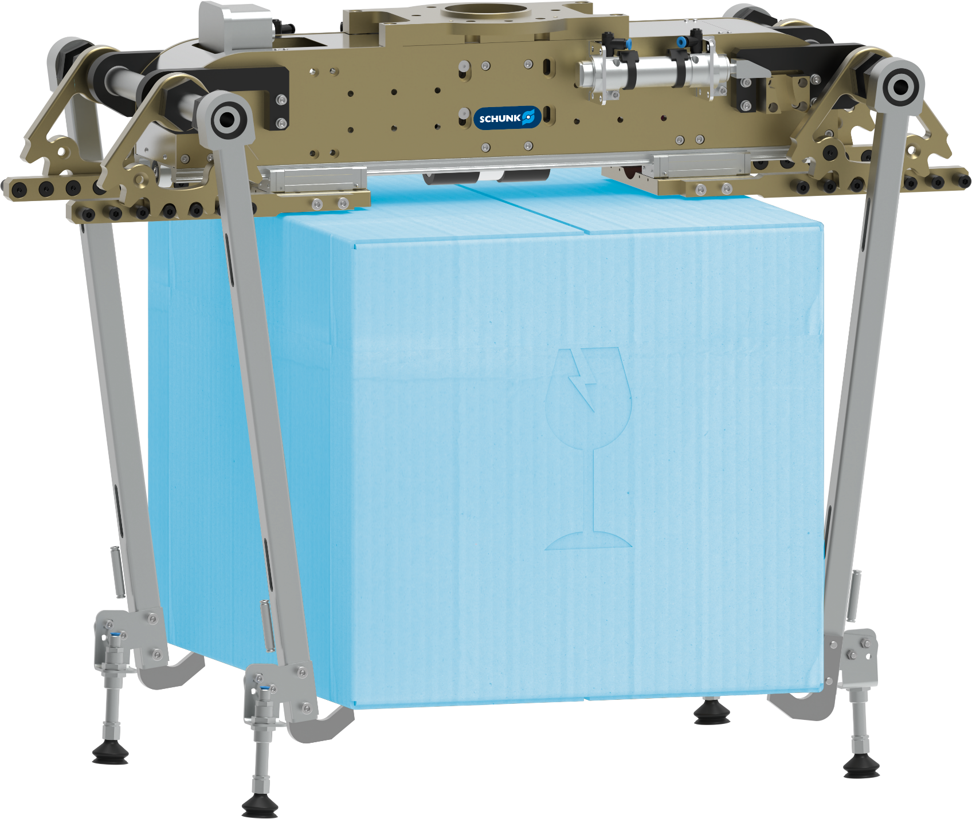
Electric long-stroke gripper
Handling cartons and cardboard inserts/dividers
Consumer Goods - Intralogistics
Function
Electric long-stroke gripper with smooth-running double profile rail guide and adaptable servo motor
Customer benefit
  For flexible and highly dynamic handling of different carton sizes
  High torque capacity thanks to double profile rail guide, suitable for use with long gripper fingers
  Very narrow design for minimal interference contours
  Adaptable drive motor for flexible control and easy integration into existing control concepts
Customer work piece
Cardboard boxes of various sizes and cardboard inserts/dividers
Scope
LEG 760 long-stroke gripper with customized fingers, 230 mm stroke per jaw
Notes:
SCHUNK ID: 30057990

Slide 16
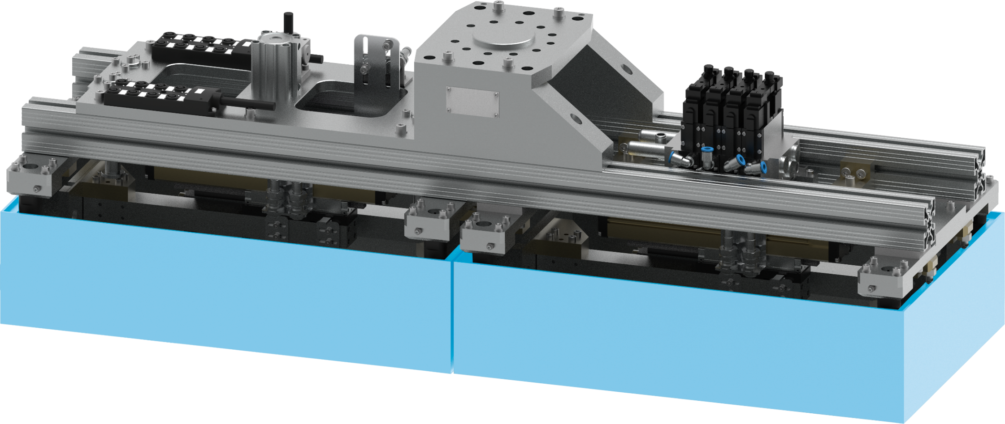
KLT-Gripper
Handling of small load container boxes (KLT), boxes
Consumer Goods - Intralogistics
Function
Handling of one or two KLT containers, as required, by two parallel-mounted PHL-W-32 long-stroke grippers with large jaw stroke
Customer benefit
  Double piston rack and pinion principle for centric clamping
  High torque absorption
  Energy supply via tubeless direct connection possible for flexible pressure supply in many automation solutions
Customer work piece
Small load container boxes (KLT), boxes
Scope
2x PHL-W-32 long-stroke grippers with customer-specific fingers, 40 mm stroke per jaw
TYPICAL PRODUCTS
TYPICAL PROCESS
REQUIREMENTS
RELIABILITY
STRONG
ACCURACY
Notes:
SCHUNK ID: 30083528

