Slide 1

SCHUNK Engineering
Solution Book - Metal Processing
Note:
This presentation contains confidential information and is only released for non-public use by customers and suppliers.
Consultation with specialist department may be necessary.
- Remove this note before use -

Slide 2
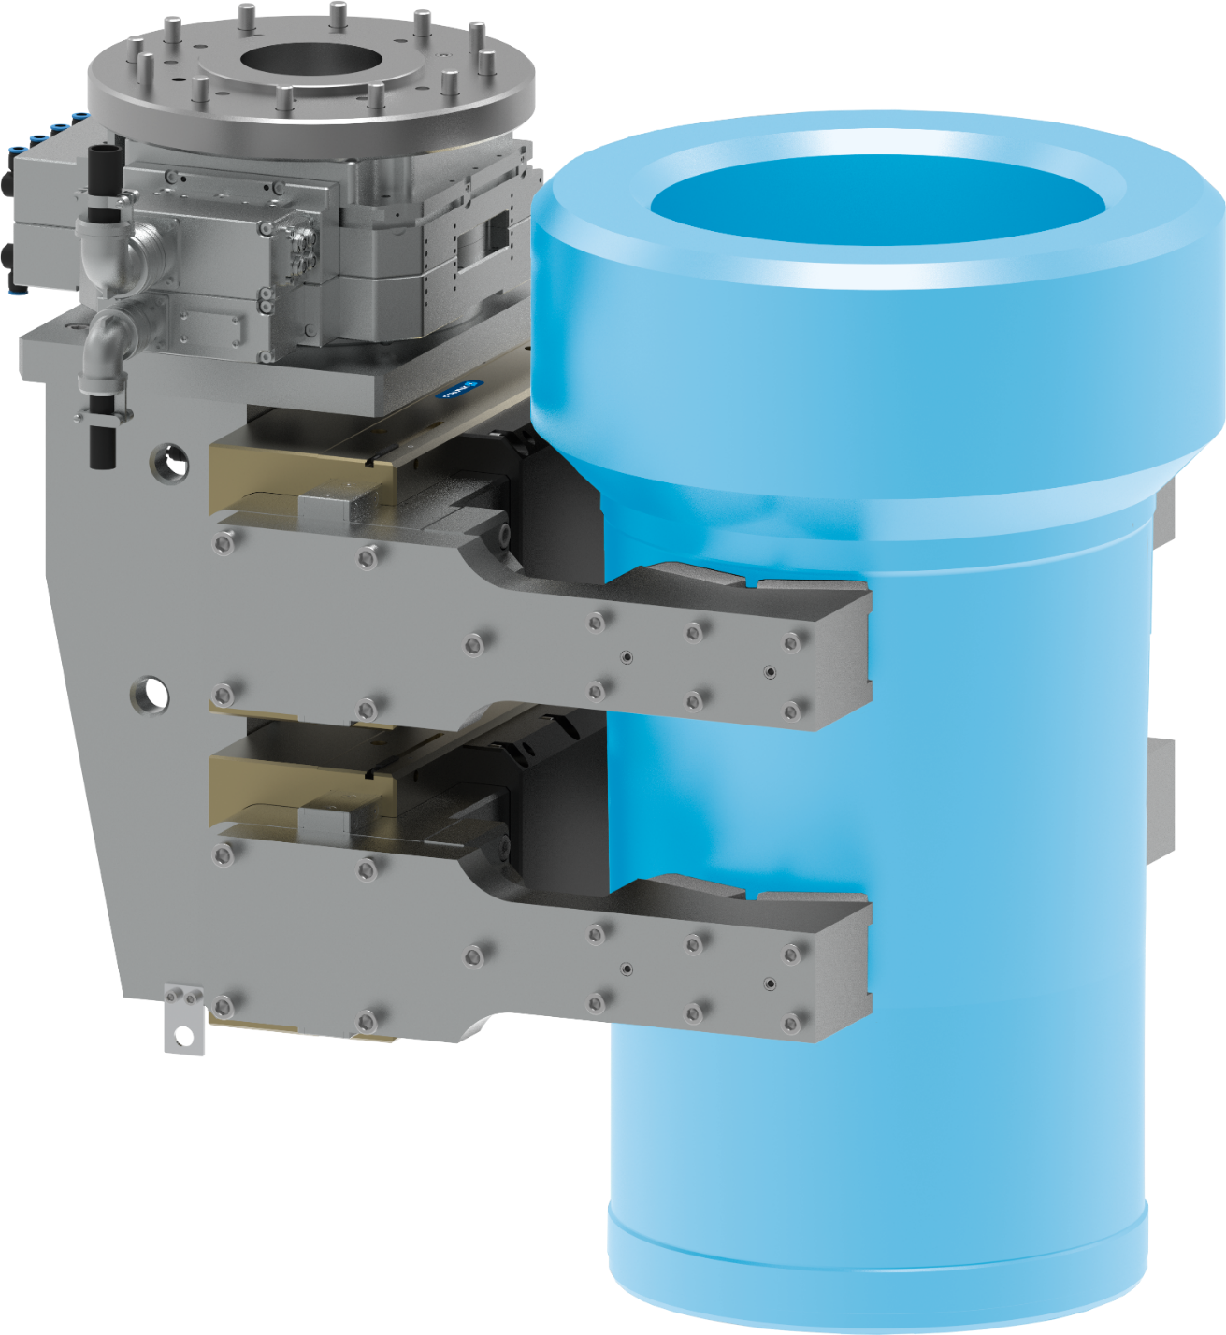








Gripping unit
Handling of cylinder liners for marine engines
Metal Processing
Function
Loading and unloading a lathe with very heavy cylinder liners (350 kg)
Customer benefit
  High flexibility with a wide range of components
  High scalability
  Handling of heavy components >350 kg
  Easy and quick replacement of wear parts
Customized attachment jaws
with interchangeable clamping inserts
Expert project planning team
Sizing, design and assembly by SCHUNK
second page available
TYPICAL PRODUCTS
TYPICAL PROCESS
REQUIREMENTS
RELIABILITY
STRONG
ACCURACY
Notes:
SCHUNK ID: 1579207

Slide 3

Gripping unit
Handling of cylinder liners for marine engines
Metal Processing
1 x heavy duty tool changing system
SWS-L-510
distributor
valves
Adapter plate
Customized attachment jaws
with interchangeable clamping inserts
2 x parallel gripper
SPG 100-SDV-P with pressure maintenance valve
Notes:
SCHUNK ID: 1579207

Slide 4
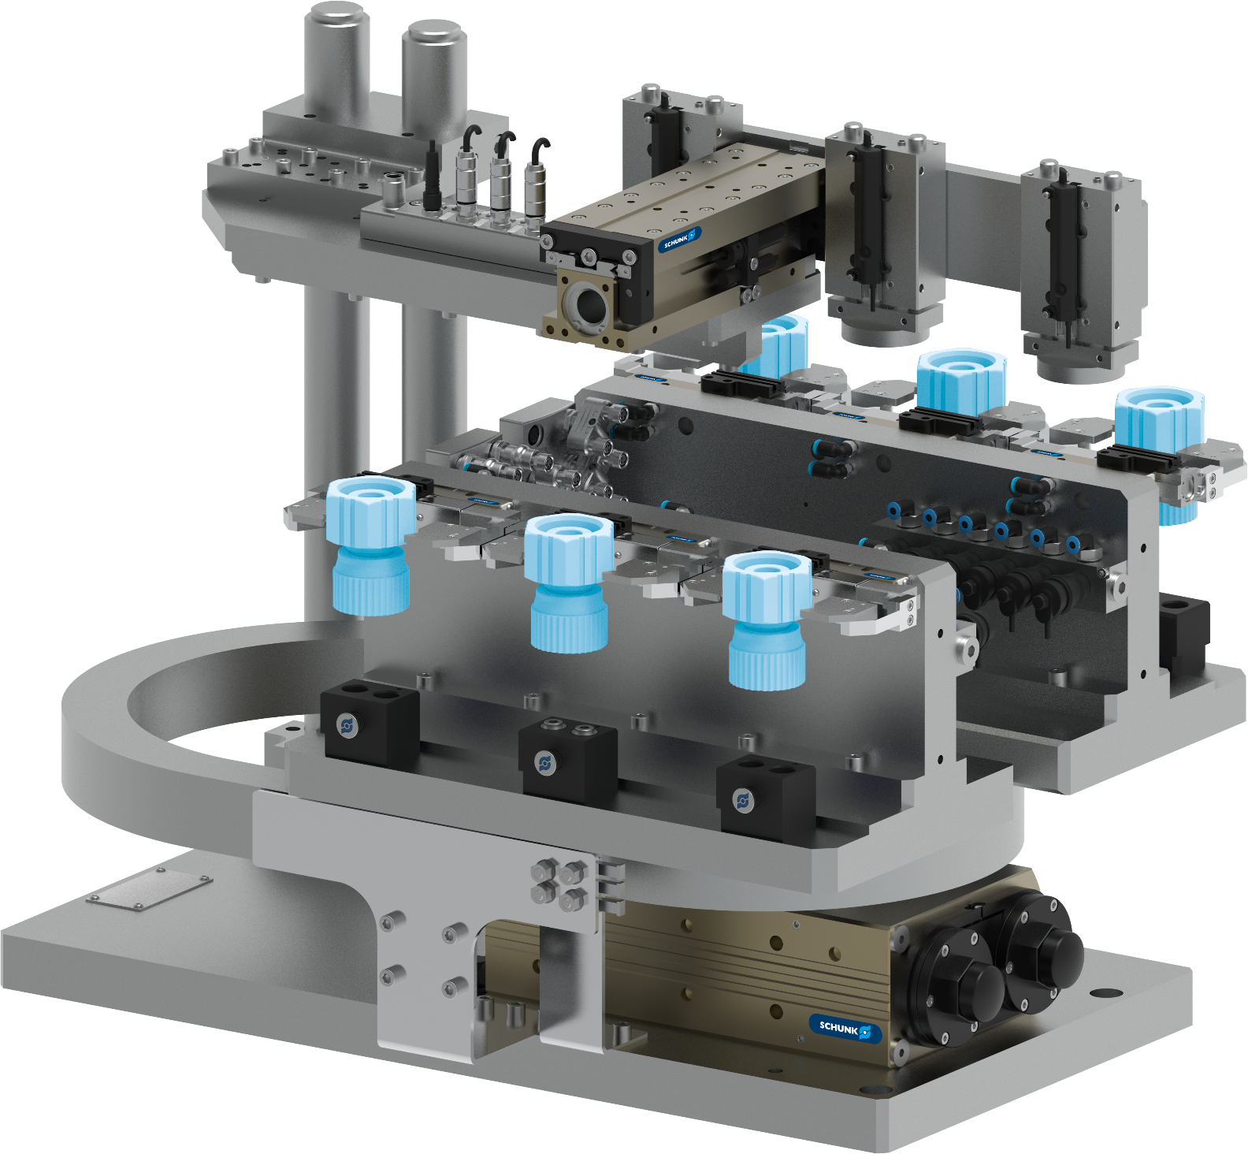




6-fold gripping swivel unit
Gripping of small items / bulk material
Metal Processing
Function
Loading, unloading, and crimping process for small parts. The customer-side counterpart for centering is changed using a quick-change system.
Customer benefit
  Quick changeover
  Maximum parallelization
  Integrated media feed-through
  High scalability
Expert project planning team
Sizing, design and assembly by SCHUNK
second page available
TYPICAL PRODUCTS
TYPICAL PROCESS
REQUIREMENTS
HIGHSPEED
RELIABILITY
ACCURACY
Notes:
SCHUNK ID: 1502263

Slide 5

6-fold gripping swivel unit
Gripping of small items / bulk material
Metal Processing
Adapter plates, sensor distributor, valves, magnetic switch, energy chain
6 x 2-finger
parallel gripper
KGG 60-40
6 x jaw quick-change system BSWS - customer-side counterpart for centering not shown
1 x swivel unit
SRU-plus 50
Notes:
SCHUNK ID: 1502263

Slide 6
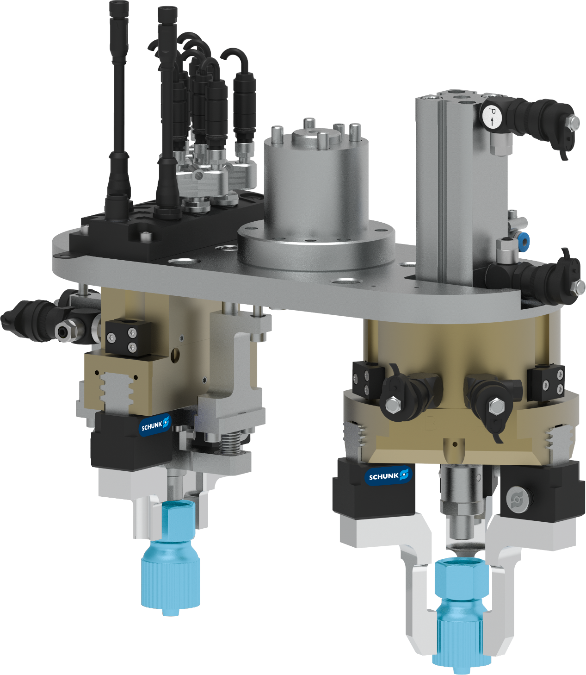
Double-Gripper unit
Gripping of small items / bulk material
Metal Processing
Function
Crimping of gripped parts with counterpart via pressing device
Customer benefit
  Compact design
  handling of high variety of parts variants
  Short setup times
  Short cycle times
Attachment to robot flange
via adapter plate
Expert project planning team
Sizing, design and assembly by SCHUNK
second page available
TYPICAL PRODUCTS
TYPICAL PROCESS
REQUIREMENTS
HIGHSPEED
RELIABILITY
ACCURACY
Notes:
SCHUNK ID: 1502264

Slide 7

Double-Gripper unit
Gripping of small items / bulk material
Metal Processing
Adapter, magnetic switch,
valve, distributor
Attachment to robot flange
via adapter plate
1 x parallel gripper
PGN-plus-P 80
1 x 3-finger centric gripper
PZB-plus 100
5 x jaw quick-change system
BSWS-BM 80
pressing device
Notes:
SCHUNK ID: 1502264

Slide 8
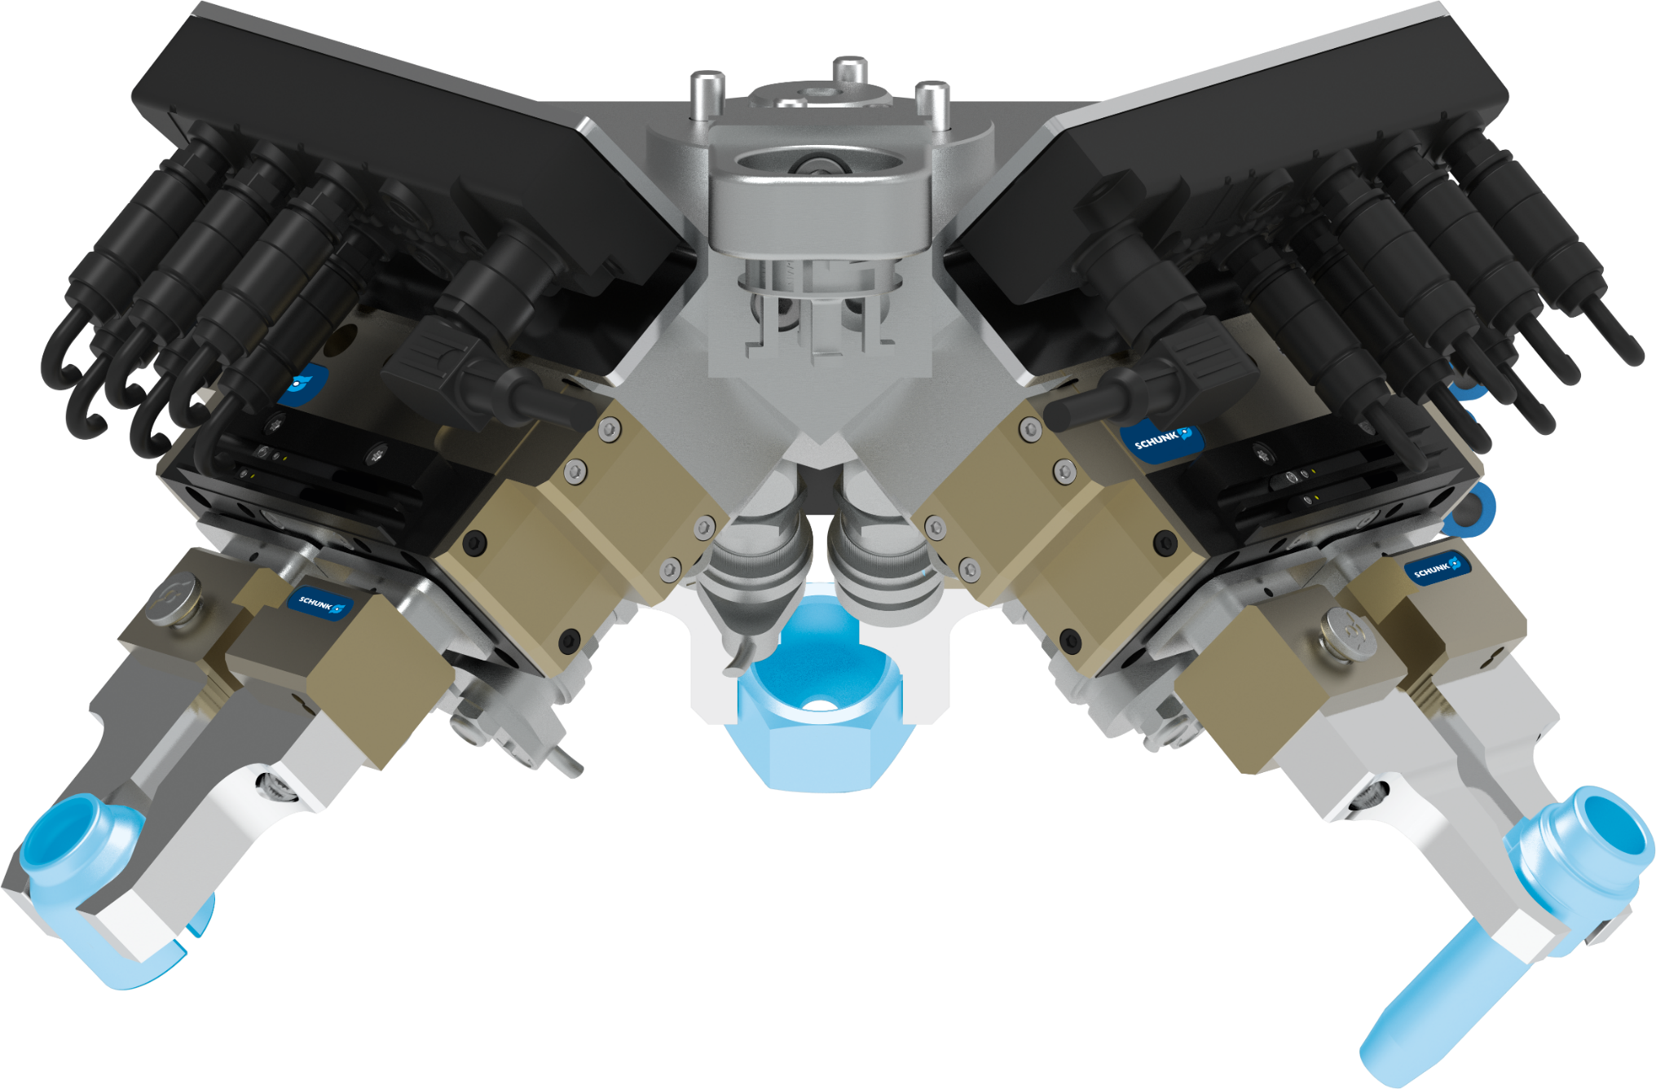
3-fold gripper unit
Gripping of small items / bulk material
Metal Processing
Function
Gripping three different small metal parts as bulk goods via customer camera system.
Customer benefit
  Compact multiple gripper solution
  Handling of high variety of parts variants
  Short setup times
  Short cycle times
Attachment to robot flange
via adapter plate
Expert project planning team
Sizing, design and assembly by SCHUNK
second page available
TYPICAL PRODUCTS
TYPICAL PROCESS
REQUIREMENTS
HIGHSPEED
RELIABILITY
ACCURACY
Notes:
SCHUNK ID: 1502261

Slide 9
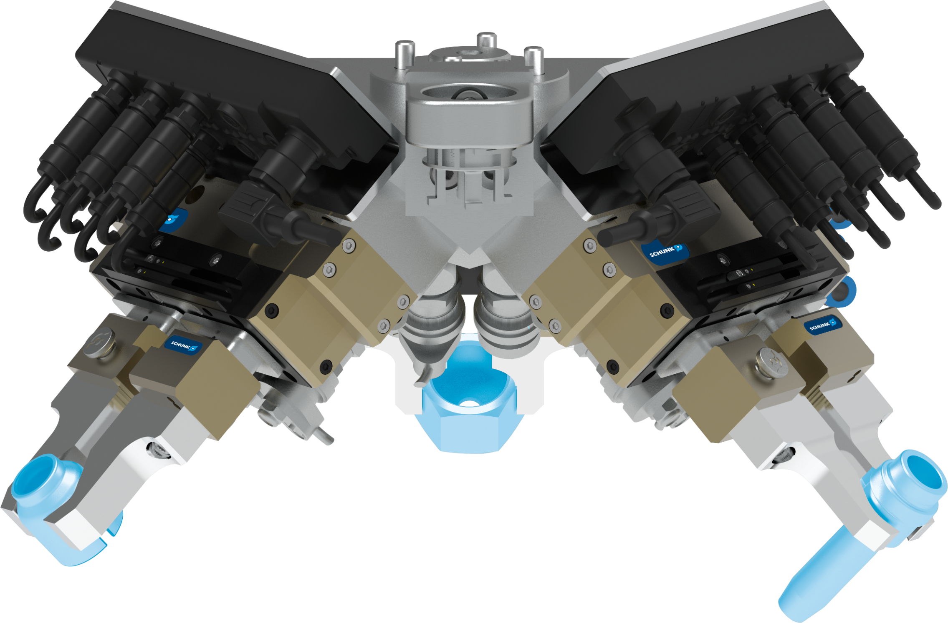
3-fold gripper unit
Gripping of small items / bulk material
Metal Processing
Exemplary representation of one gripper:
distributor
valves
2-finger parallel gripper PGL-plus-P 10-AS
second gripper
magnetic switch
jaw quick-change system
BSWS-BM 64
various attachment jaws
third gripper
Notes:
SCHUNK ID: 1502261

Slide 10
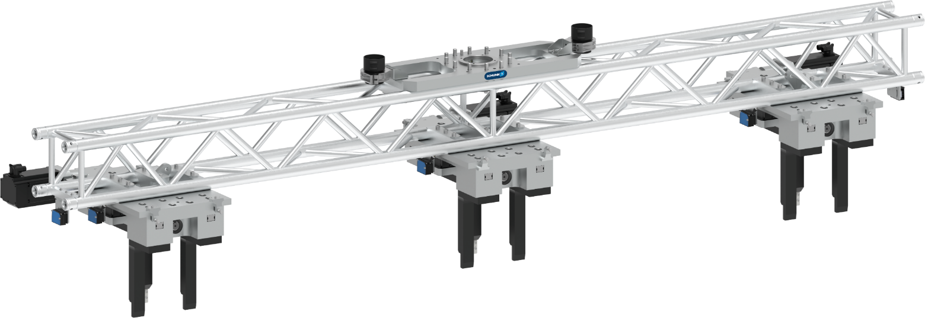

Gripper assemblies along a truss
Handling of 4-meter steel beams weighing up to 500 kg
Metal Processing
Function
Handling of very long and heavy components: gripper assemblies along a truss to reduce weight
Scope
  Crossbeam construction with flange connection for robots
  3x reinforced special grippers for workpiece weights up to 500 kg
  3x angular gears for customer-specific attachment of a servo motor
  3x fixed and movable attachment jaws each
Expert project planning team
Sizing, design and assembly by SCHUNK
second page available
TYPICAL PRODUCTS
TYPICAL PROCESS
REQUIREMENTS
RELIABILITY
STRONG
ACCURACY
Notes:
SCHUNK ID: 1472620 (l) /1511530 (r)

Slide 11
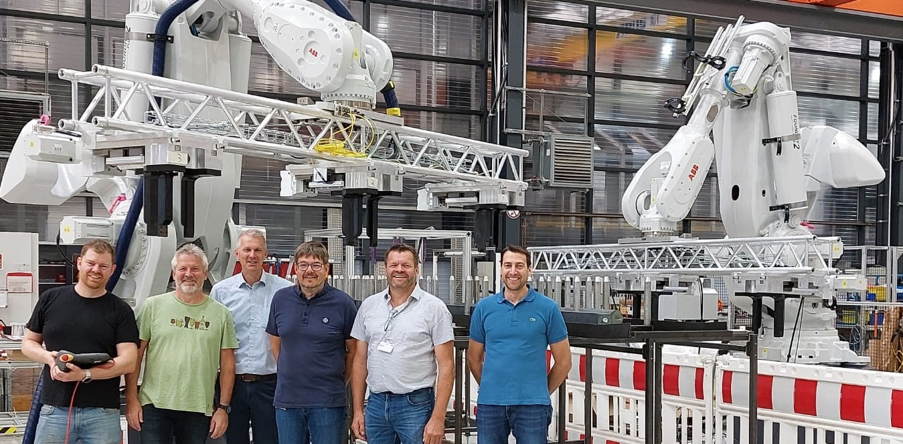
Gripper assemblies along a truss
Handling of 4-meter steel beams weighing up to 500 kg
Metal Processing

Slide 12


Electric 3-finger centric gripper with large stroke
Handling of large rotationally symmetrical components
Metal Processing - Machine tool
Scope
  Sheet metal housing
  Wiper
  Accessible lubrication adapter
  Passive pressure unit
  Angular gearbox
Servo-electric drive
Servomotor adaptable by the customer
Robust guidance
Recirculating ball bearing
Large stroke / high gripping force
TYPICAL PRODUCTS
TYPICAL PROCESS
REQUIREMENTS
STRONG
Notes:
SCHUNK ID: 1562643 / ausschließlich ENTWURF-Status

Slide 13



2-finger gripper swivel modules
Handling of rotor shafts and drive shafts
Metal Processing
Function and benefits
Machine tending of a turning machine: handling of rotor and drive shafts OP1 + OP2
Scope - each module consisting of:
  1x rotary module SRU-plus 50
  1x rotary module SRH-plus-D 40
  2 x sealed 2-finger parallel gripper
  DPG-plus 100 (IP67)
  adapter plates with internal air feed-through for space saving design
  8 x magnetic sensors
Customized top jaws
gas nitrocarburized & oxidized steel inserts
Expert project planning teams
Sizing, design and assembly by SCHUNK
second page available
TYPICAL PRODUCTS
TYPICAL PROCESS
REQUIREMENTS
RELIABILITY
STRONG
WET
Notes:
SCHUNK ID: 1571789 / 1571786

Slide 14


2-finger gripper swivel modules
Handling of rotor shafts and drive shafts
Metal Processing
The gripper swivel modules are operated on a gantry system between central storage and turning machine → gantry systems also scope of SCHUNK Engineering
1x rotary module SRU-plus 50
1x rotary module SRH-plus-D 40
adapter plates with internal air feed-through for space saving design
2 x sealed 2-finger parallel gripper
DPG-plus 100 (IP67) with customized to jaws
Notes:
SCHUNK ID: 1571789 / 1571786

Slide 15
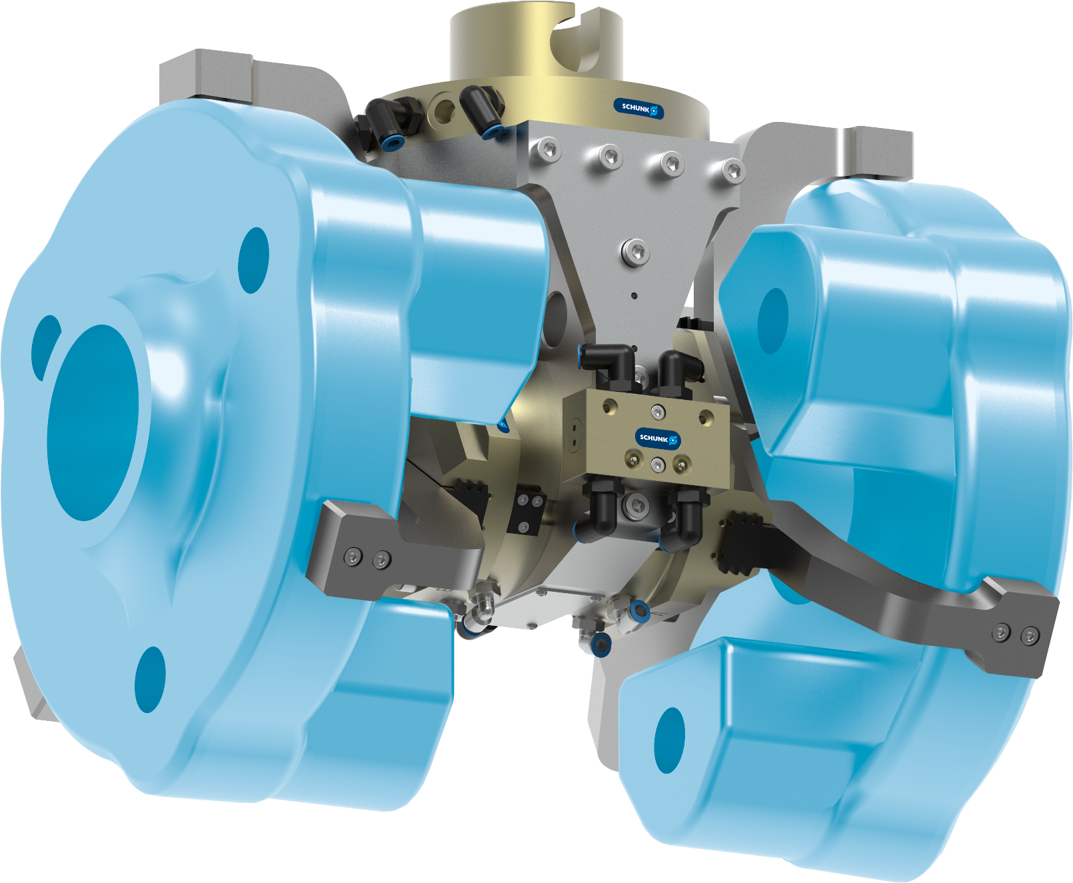
3-finger double gripper + quick-change system
Light-weight design with maximum gripping force
Metal Processing
Function and benefits
3-finger double gripper with manual quick-change system as end-of-arm on a robot. Reduction of gripper weight to allow heaver workpiece but carry over the existing robot.
Scope
  2x 3-finger centric gripper PZN-plus 125-2
  quick change system SHS-125
  light-weight adapter plate
  Pressure maintenance valve SDV-P
Customized top jaws
with peaky inserts for higher friction
Expert project planning teams
Sizing, design and assembly by SCHUNK
second page available
TYPICAL PRODUCTS
TYPICAL PROCESS
REQUIREMENTS
RELIABILITY
STRONG
ACCURACY
Notes:
SCHUNK ID: 1566116

Slide 16

3-finger double gripper + quick-change system
Light-weight design with maximum gripping force
Metal Processing
manual quick change system
SHS-125
light-weight adapter plate
Pressure maintenance valve SDV-P
2x 3-finger centric gripper
PZN-plus 125-2
with customized top jaws: peaky inserts for higher friction
Notes:
SCHUNK ID: 1566116

Slide 17


Heavy-duty handling
Handling an engine block weighing approx. 350 kg for trucks
Metal Processing - Machine tool
Function and customer benefits
Transferring the unmachined casting part to the machine tool. Multiple tolerance compensation enables clamping on raw clamping contours with component tolerances of several millimeters.
Scope
  C-axis
  x-y-z compensation unit
  2-finger parallel gripper
  Swivel finger with tolerance compensation
  Adapter plates and other accessories
Expert project planning team
Sizing, design and assembly by SCHUNK
second page available
TYPICAL PRODUCTS
TYPICAL PROCESS
REQUIREMENTS
RELIABILITY
STRONG
ACCURACY
Notes:
SCHUNK ID: 1535228

Slide 18

Heavy-duty handling
Handling an engine block weighing approx. 350 kg for trucks
Metal Processing - Machine tool
C-axis
Others:
Adapter plates
Sensors, Gear unit
Blow nozzles for cleaning the gripper pins incl. tubing
x-y-z compensation unit
2-finger parallel gripper
Swivel finger with tolerance compensation
Notes:
SCHUNK ID: 1535228

Slide 19
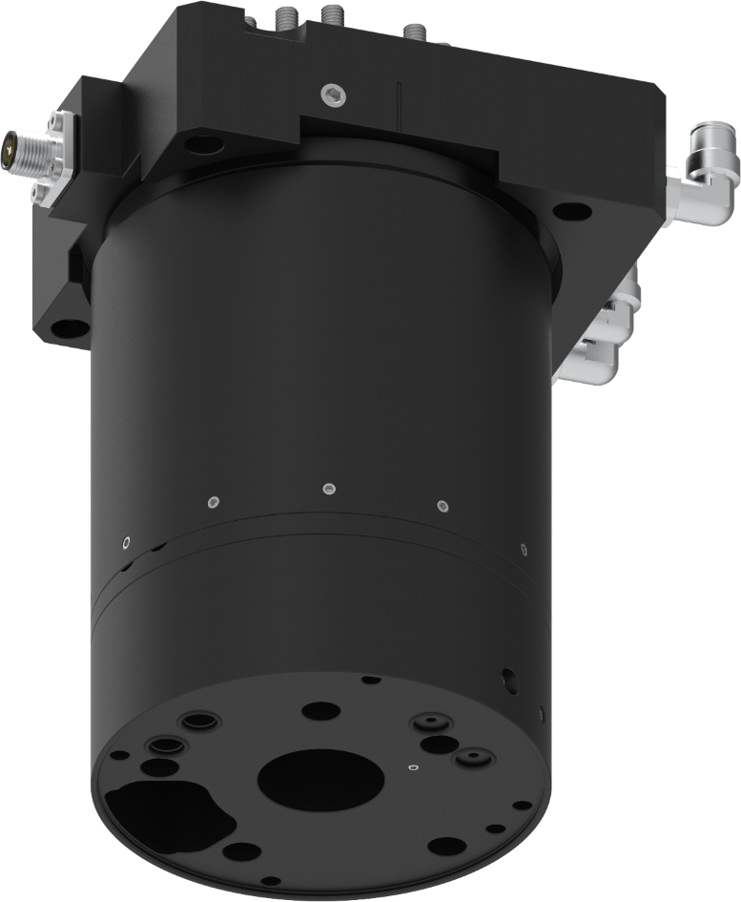

Rotary feed-through DDF-060
Loading and unloading sheet metal processing machines
Metal Processing - Sheet metal processing
DDF-060
Rotary feed-through
Pneumatic feed-trough
  1 x pneumatic G1/4 inch 4-10 bar
  1 x pneumatic G1/8 inch 4-10 bar
  1 x Vacuum G1/4 inch
Electrical feed-through
4 x ASI+/-, AUX+/-, connector M12 4-pin
Mounting hole pattern
possible according to customer specifications
Short project lead time
Sizing, design and assembly by SCHUNK
TYPICAL PRODUCTS
TYPICAL PROCESS
REQUIREMENTS
RELIABILITY
STRONG
ACCURACY
Notes:
SCHUNK ID: 1401942

Slide 20
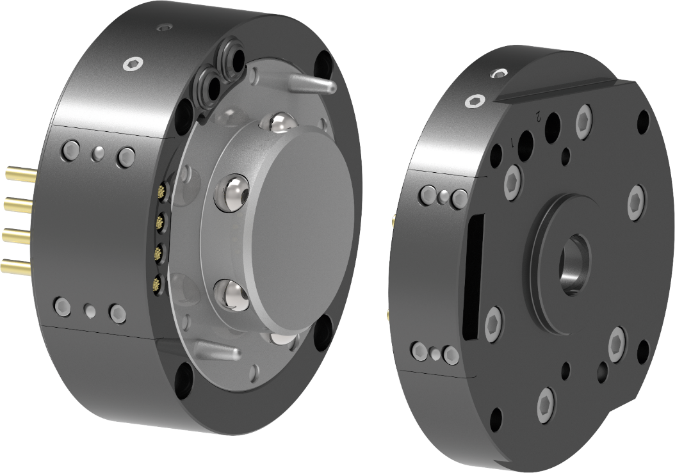

Quick-change system
Loading and unloading sheet metal processing machines
Metal Processing - Sheet metal processing
SWS-060-T
Quick-change system,
Payload up to 75 kg, Mxy up to 197 Nm
Feed-through of of pneumatic / vacuum and electrics
2 x G18“ pneumatic / vacuum
4 pins für ASi-bus
Mounting hole pattern
possible according to customer specifications
Short project lead time
Sizing, design and assembly by SCHUNK
TYPICAL PRODUCTS
TYPICAL PROCESS
REQUIREMENTS
RELIABILITY
STRONG
ACCURACY
Notes:
SCHUNK ID: 30021712/30021713

Slide 21
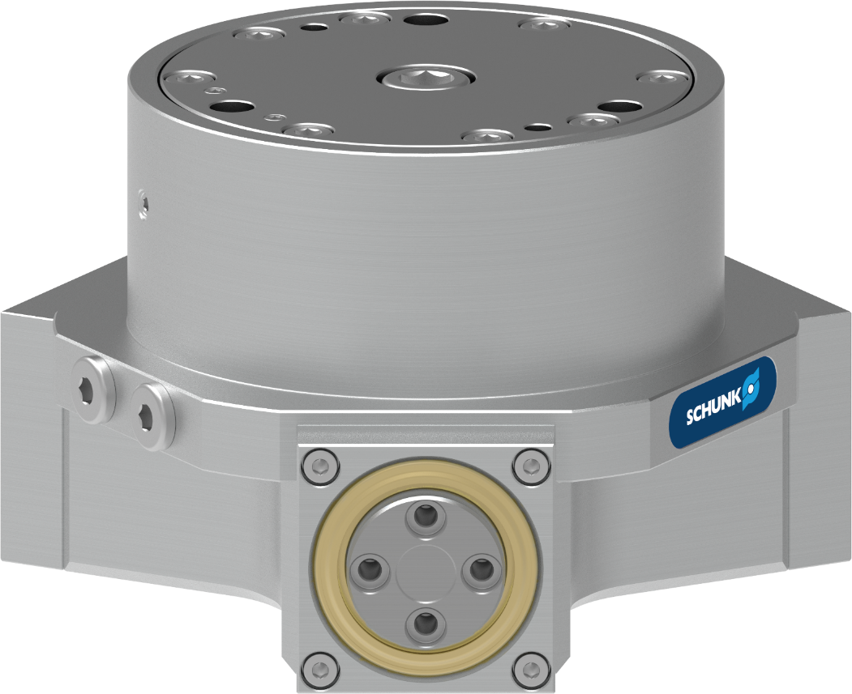

3-finger centric gripper
Handling of parts within the cleaning machine
Metal Processing - Cleaning
Tight 3-finger centric gripper
Material: stainless steel and seawater-resistant aluminum
Chemically and thermally resistant double seal
with robust scraper
Screw-on pattern top jaws
corresponding DPZ-plus 80
One contact person
for the entire system including construction and assembly
TYPICAL PRODUCTS
TYPICAL PROCESS
REQUIREMENTS
RELIABILITY
STRONG
ACCURACY
Notes:
SCHUNK ID: 1336370

Slide 22
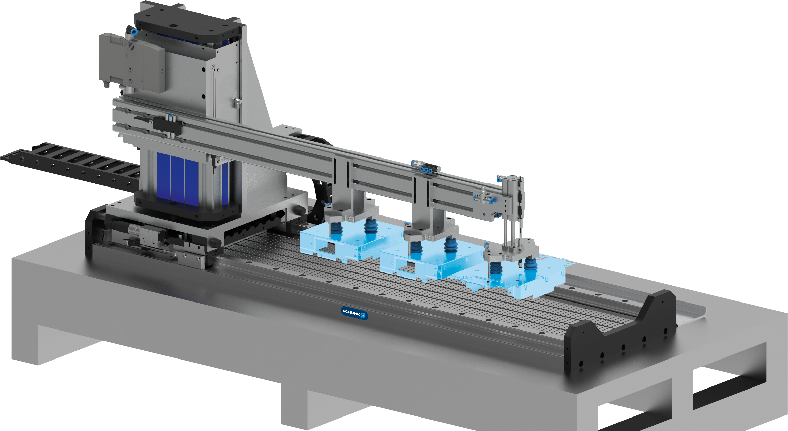




2-axes Linear Unit
Transferring electronic housings in progressive tools
Metal Processing - Sheet metal processing
Application
Handling for a progressive die. Housings for car radios are manufactured. Three parts have to be gripped at the same time in the press cycle and transported to the next tool stage.
Axes
X-axis: LDF-UF-1000-1050-1460
Z-axis: LDT-EL-0600-0100-0460
Scope of delivery
Power and encoder cable, compact ejector with vacuum gripper, mounting bracket for Z-axis, 3x pneumatic Z-axes and energy chain
TYPICAL PRODUCTS
TYPICAL PROCESS
REQUIREMENTS
HIGHSPEED
RELIABILITY
ACCURACY
Notes:
SCHUNK ID: 394057 (SES)

Slide 23
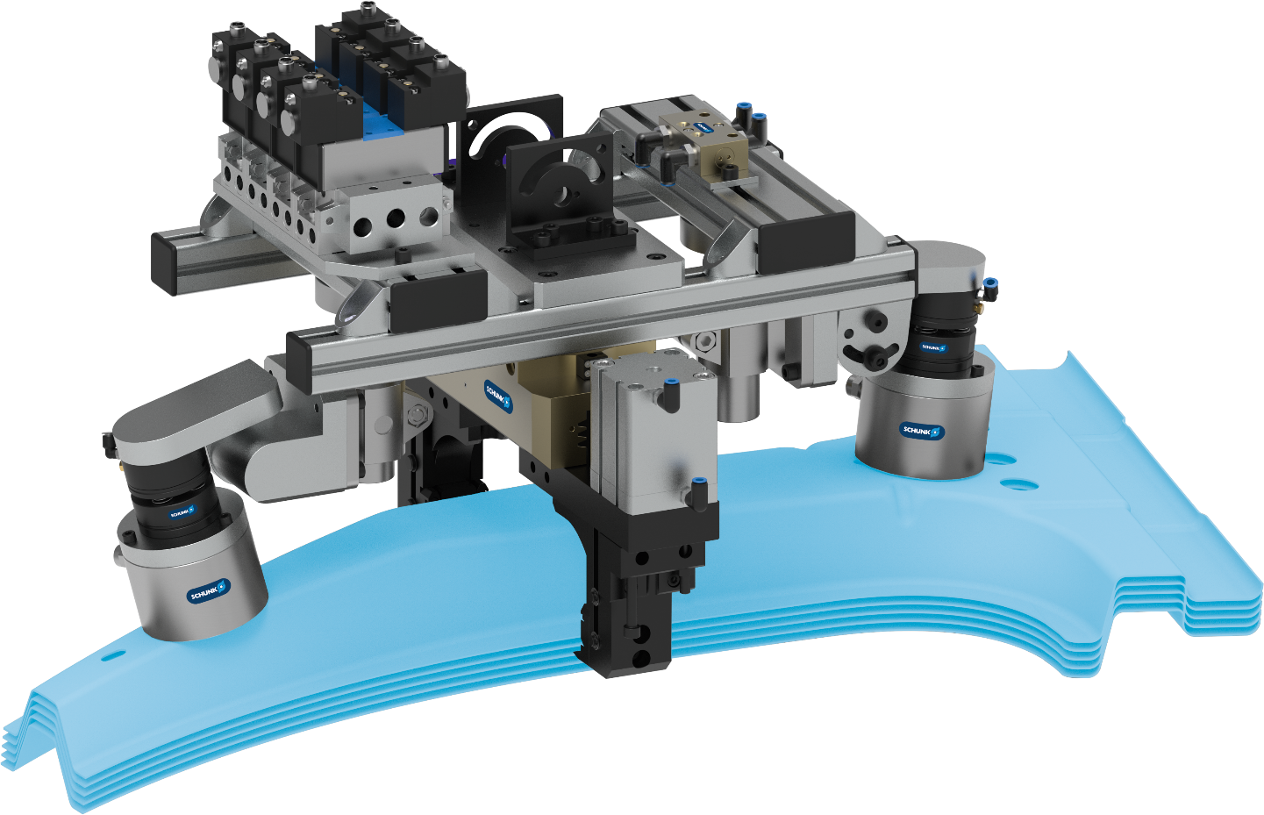



Gripping unit PGN-plus, EGM
Separation and loading and unloading of B-pillars
Metal Processing - Sheet metal processing
Expert project planning team
Sizing, design and assembly by SCHUNK
Parallel gripper PGN-plus
Customized gripper fingers with integrated spreading function
Magnetic gripper EGM
Floating bearing for flexible workpiece mounting
Compensation unit AGE-U
Compensation direction X, Y, Z, angle
TYPICAL PRODUCTS
TYPICAL PROCESS
REQUIREMENTS
RELIABILITY
STRONG
ACCURACY
Notes:
SCHUNK ID: 1347859

Slide 24
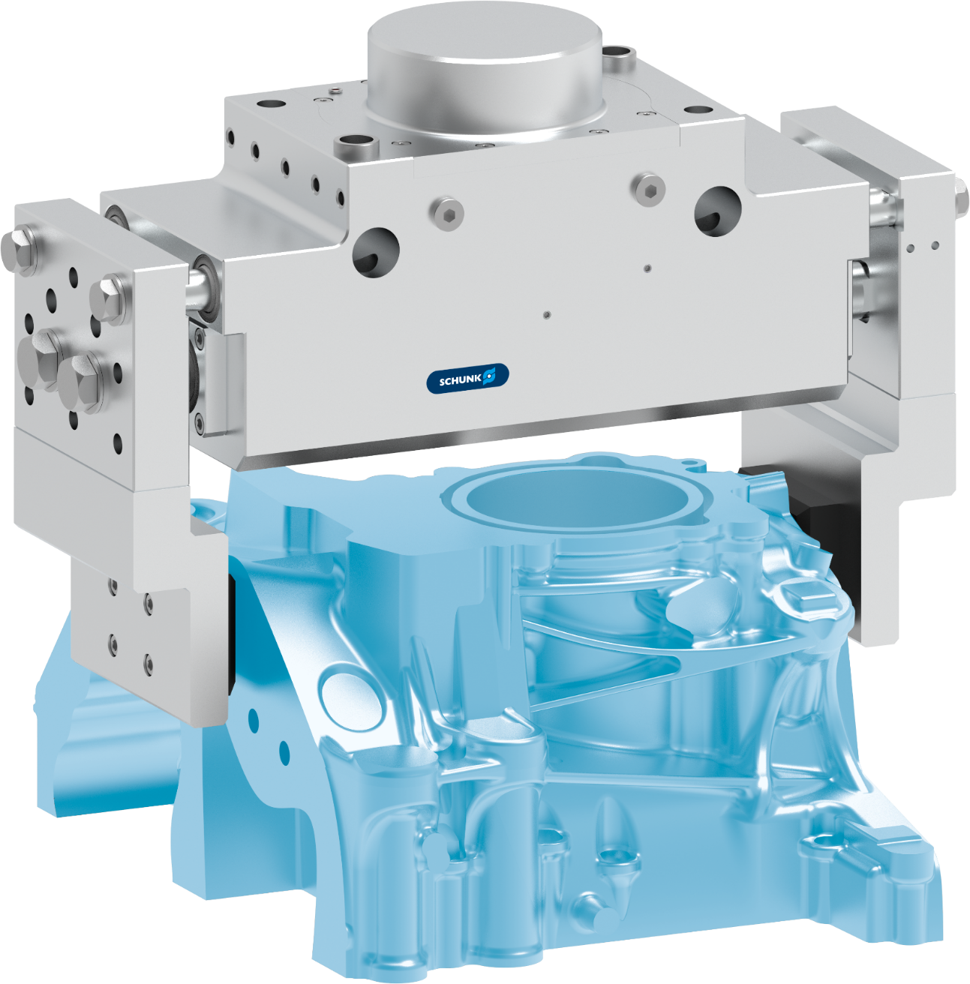
Tight 2-finger parallel gripper
Handling of parts within the cleaning machine
Metal Processing - Cleaning
Tight 2-finger parallel gripper
Material: stainless steel and seawater-resistant aluminum
Chemically and thermally resistant double seal
with robust scraper
Monitoring with pressure switch
through mechanically actuated valves
One contact person
for the entire system including construction and assembly
TYPICAL PRODUCTS
TYPICAL PROCESS
REQUIREMENTS
RELIABILITY
STRONG
ACCURACY
Notes:
SCHUNK ID: 1376342

Slide 25
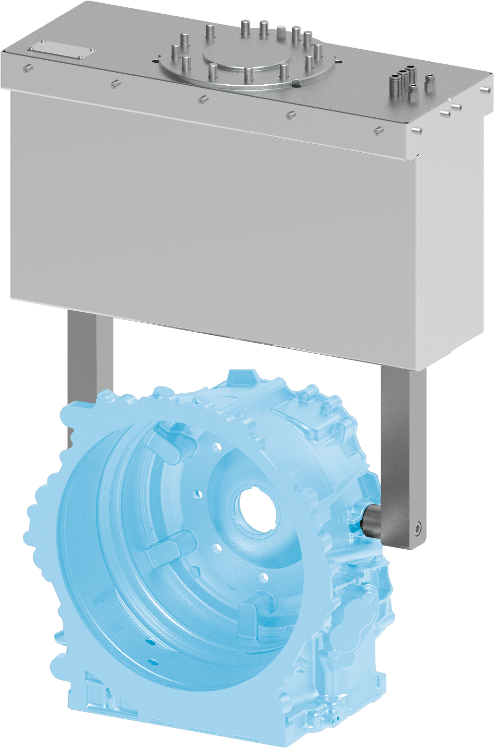
Gripping unit DPG-plus
Use in high-pressure water jet cleaning system
Metal Processing - Cleaning machines
Tight gripper DPG-plus HD
with Viton sealings and integrated sensors
Special gripper fingers and cover
made of stainless steel with pressure mechanism in the gripper finger
Use in high-pressure cleaning system
Water jet pressure 750 bar
Expert project planning teams
Sizing, design and assembly by SCHUNK
TYPICAL PRODUCTS
TYPICAL PROCESS
REQUIREMENTS
RELIABILITY
STRONG
WET
Notes:
SCHUNK ID: 1490313

Slide 26
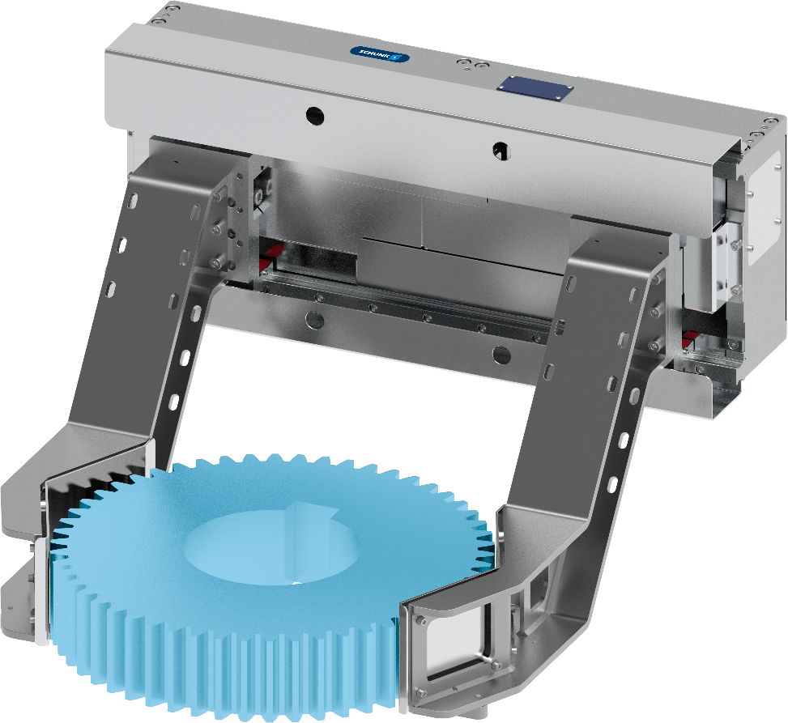


Long-stroke Gripper MGHG heat-protected
Loading/unloading of hot gears
Metal Processing – Hardening - High temperature
Handling hot workpieces
Workpiece temperature >1000° C
Different workpiece diameters
Gripping diameter 200-600 mm
High gripping force / heavy workpieces
Workpiece weight 70 kg, positive gripping
Dynamics
Integrated position measuring system also for servopneumatics
Expert project planning teams
Sizing, design and assembly by SCHUNK
TYPICAL PRODUCTS
TYPICAL PROCESS
REQUIREMENTS
STRONG
HOT
RELIABILITY
Notes:
SCHUNK ID: 1386683

Slide 27
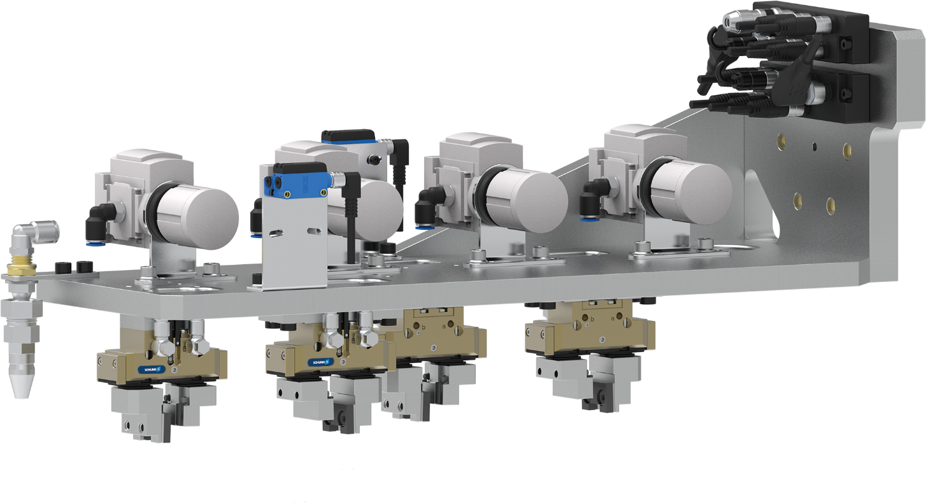

Double gripper unit for sand cores
Unloading a sand core shooter
Metal Processing - Sand core production - High temperature
2-fold gripping unit as a complete solution
with standard gripper PGN-plus 50-1
Dust-protected gripper
Dust protection version SD
Gentle gripping
with with rubber clamping inserts and pressure regulator
Integrated blow-out function
to clean the tool
Plug and Play
with valve technology and electrical distributor, completely wired and hosed
TYPICAL PRODUCTS
TYPICAL PROCESS
REQUIREMENTS
Notes:
SCHUNK ID: 1416753

Slide 28
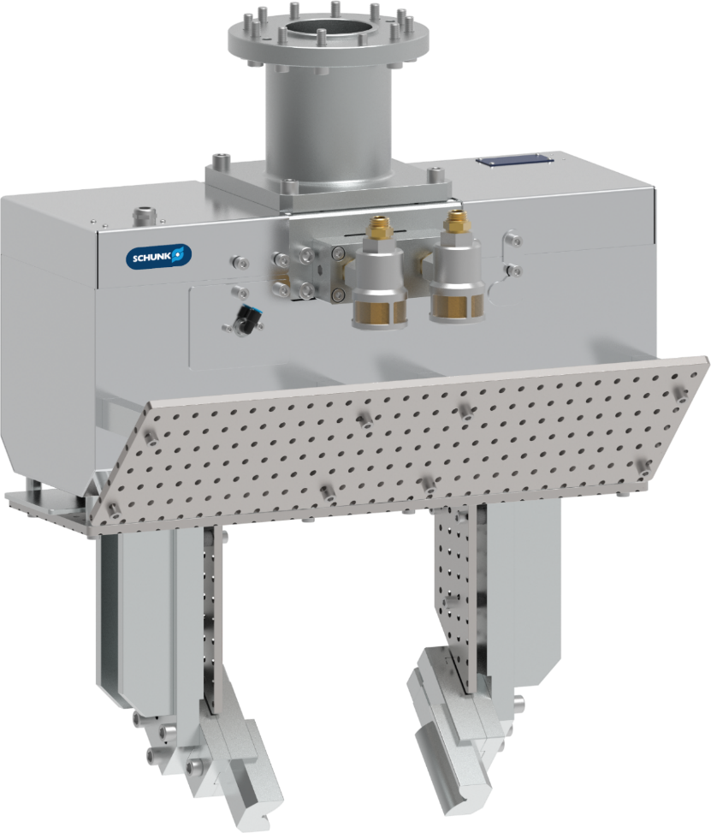
Gripping unit SPG 100 & heat protection
Removal of red-hot saw cuttings from the oven
Metal Processing - High temperature
Gripping unit SPG 100
Workpiece weight 50 kg,
Workpiece temperature >1000° C
Heat protection
with sheet metal housing, heat shield, ceramic insulation, high-temperature grease, high-temperature seals
Optimized opening/closing times
with quick venting valves, special damping elements
Customized top jaws
Form-fit prismatic with insulation
Short project lead time
Sizing, design and assembly by SCHUNK
TYPICAL PRODUCTS
TYPICAL PROCESS
REQUIREMENTS
STRONG
HOT
RELIABILITY
Notes:
SCHUNK ID: 30087158

Slide 29
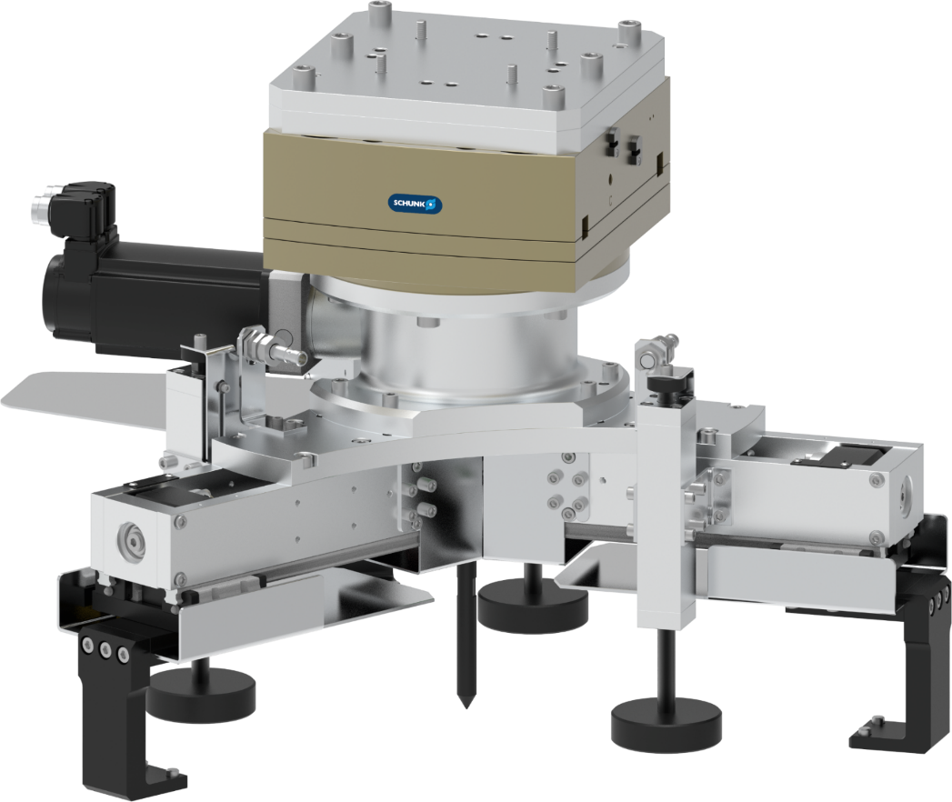
Servo-electric 3-finger centric gripper with compensation unit
Loading/unloading of ring gears from a hardening press
Metal Processing - Hardening - High temperature
Servo-electric 3-finger centric gripper
with gearbox, bevel gears, spindle
Heat protection
with radiant heat plate, thermal insulation
Customized top jaws
with ceramic coating
X-/compensation unit
as tolerance compensation during loading
Pressure unit
with “workpiece present” monitoring
Customized interface
for mounting on robots
TYPICAL PRODUCTS
TYPICAL PROCESS
REQUIREMENTS
RELIABILITY
STRONG
ACCURACY
Notes:
SCHUNK ID: 30082733

Slide 30
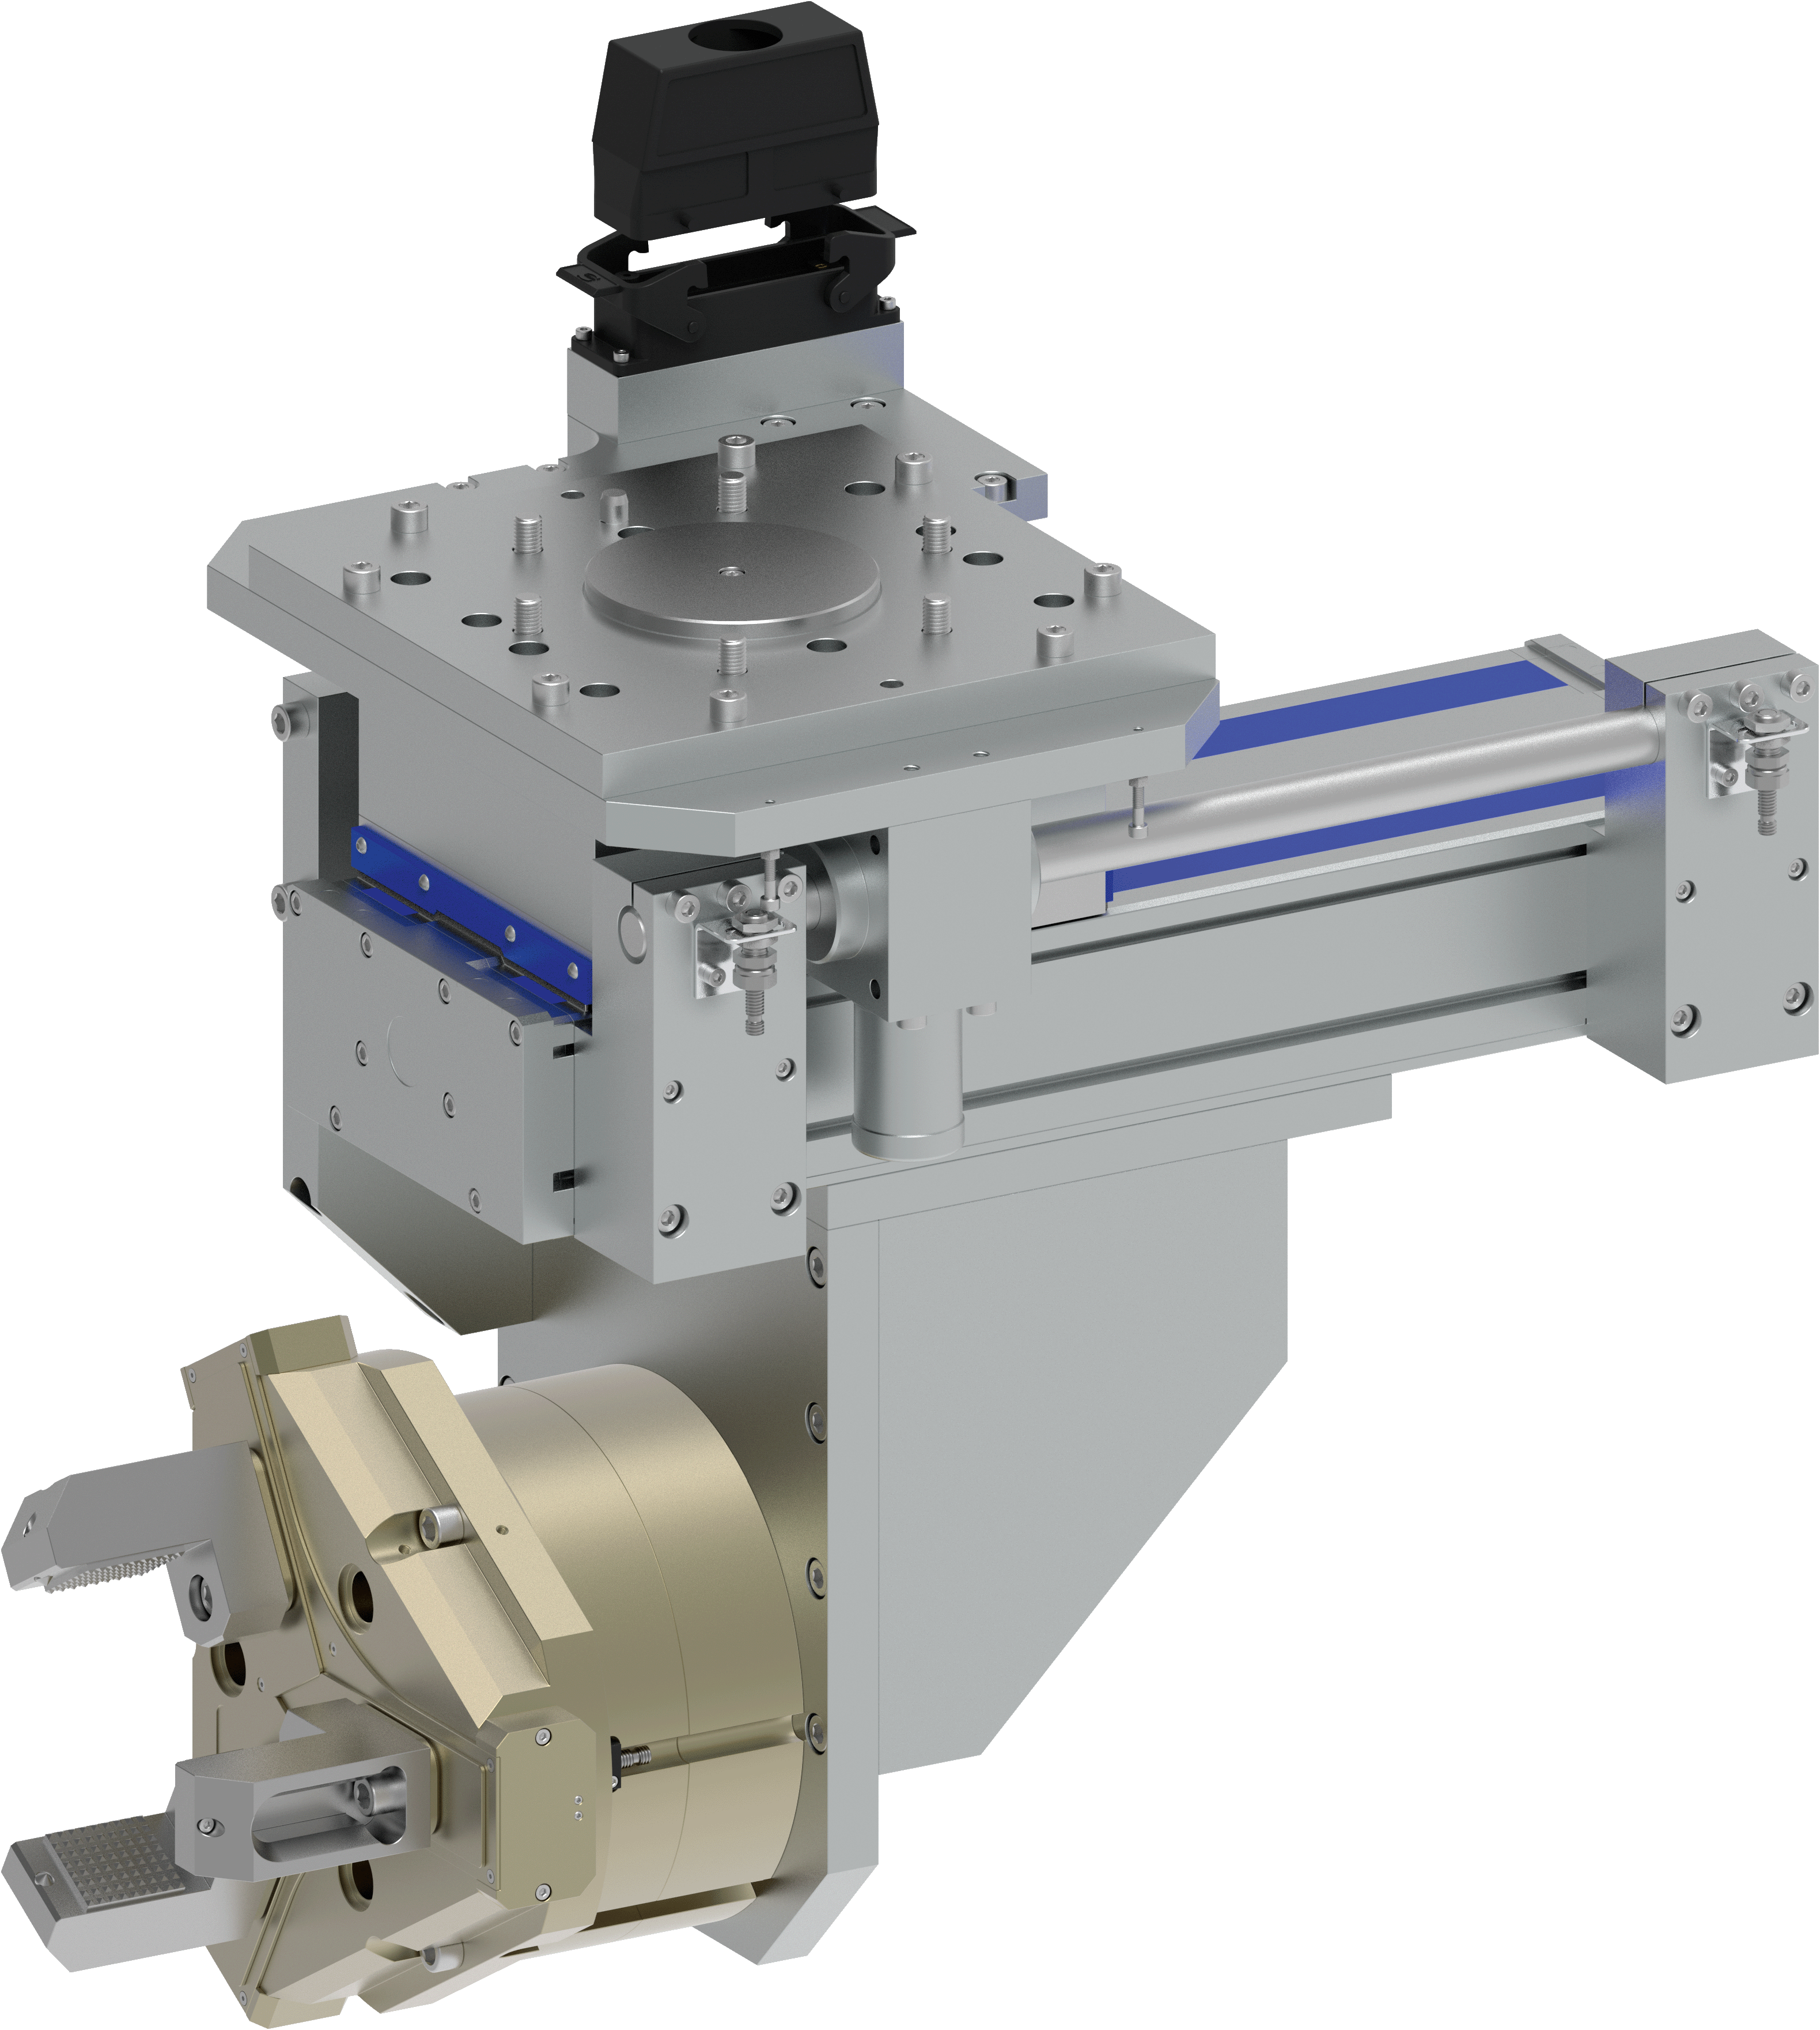
Linear gripper unit
Unloading housings from a die casting machine
Metal Processing - Die casting machines - High temperature
Complete functional module
through combination of standard components
Traversing axis
Pneumatic with clamping
Standard 3-finger centric gripper
PZ-plus
with dust cover, high temperature sealings, high temperature grease
Customized interface
for attachment to your robot incl. attachment option for energy hose
Customized top jaws
with claw clamping inserts for gripping the sprue
TYPICAL PRODUCTS
TYPICAL PROCESS
REQUIREMENTS
RELIABILITY
STRONG
ACCURACY
Notes:
SCHUNK ID: 30049061

Slide 31
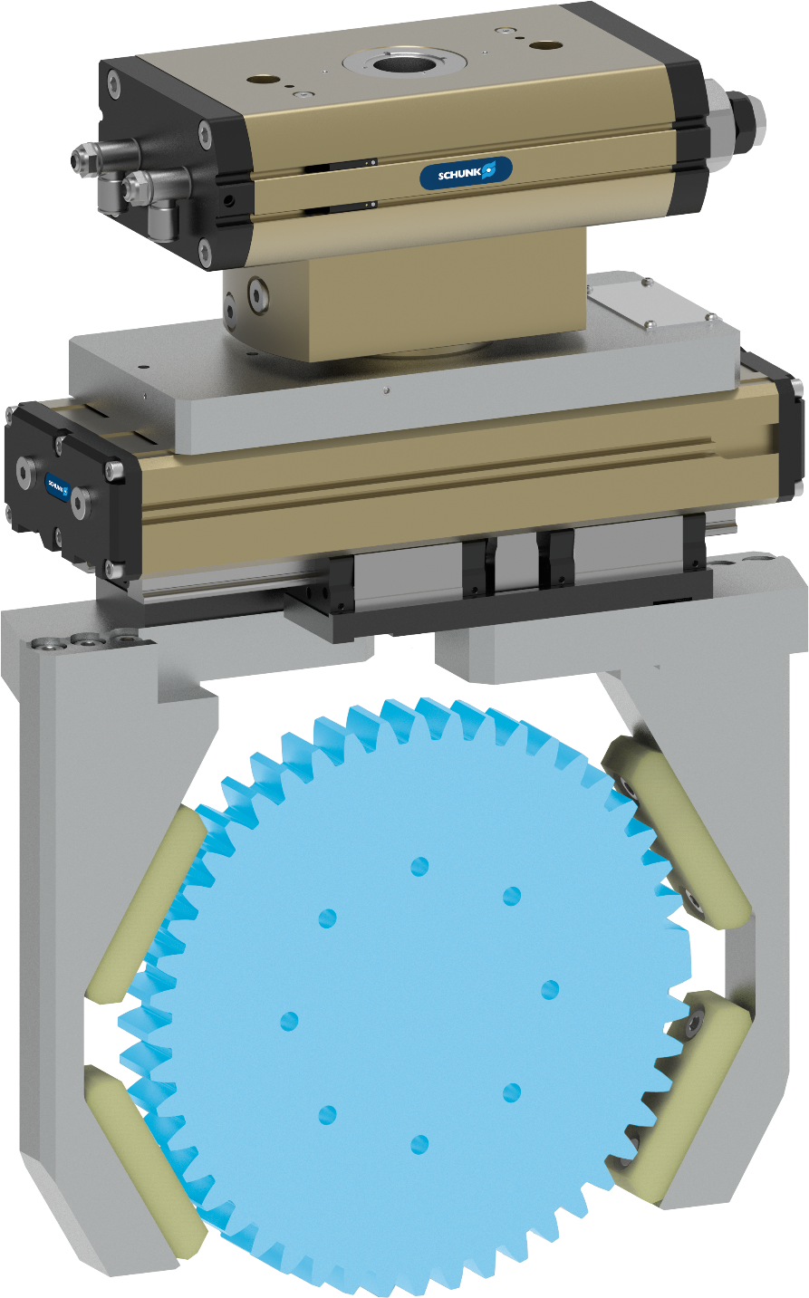
Swivel-Gripper Unit
Turning gears during the hardening process
Metal Processing - Hardening - High temperature
Complete functional module
through combination of standard components
Pneumatic swivel unit SRM
with air feed-through, proximity switch
2-finger Parallel gripper PHL
with proximity switch
Customized top jaws
interchangeable QUENTES clamping inserts
Gripping force maintenance
pressure maintenance valve
TYPICAL PRODUCTS
TYPICAL PROCESS
REQUIREMENTS
RELIABILITY
STRONG
ACCURACY
Notes:
SCHUNK ID: 1474362

Slide 32
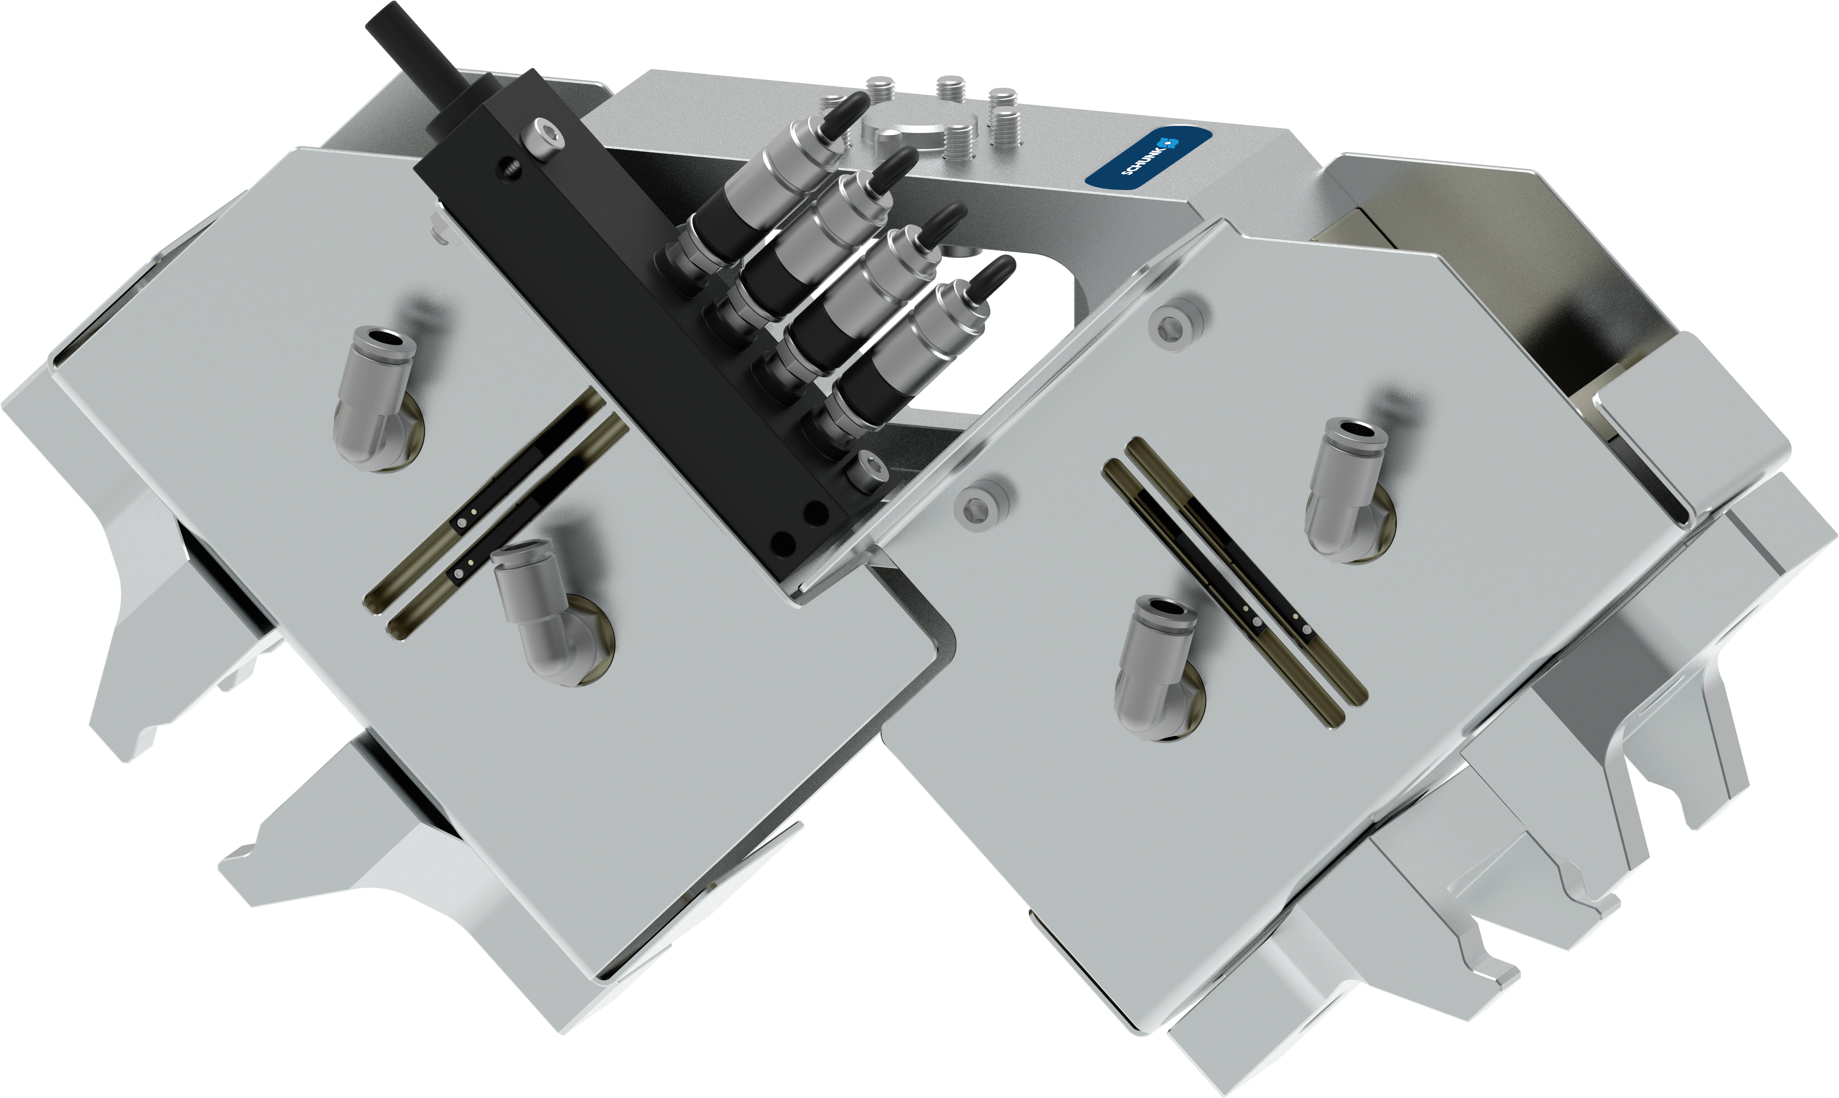
Double gripping unit
Loading/unloading valves into/from a welding machine
Metal Processing - Welding - High temperature
Double gripping unit
2x PGN-plus 100 with proximity switch
Heat protection version
High-temperature sealings, high-temperature grease, heat radiation plates, shielded sensors
Heat-resistant top jaws
Material: Stainless steel
Electrical distributor
Complete electrical installation with electrical diagram
Customized interface
for robot mounting
TYPICAL PRODUCTS
TYPICAL PROCESS
REQUIREMENTS
STRONG
HOT
RELIABILITY
Notes:
SCHUNK ID: 1400648

Slide 33
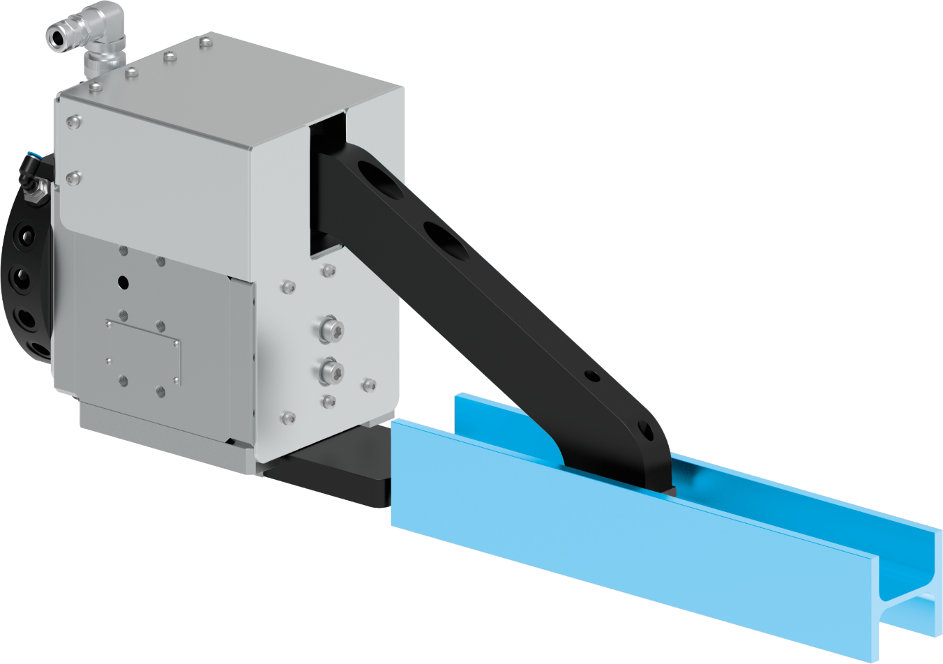
Gripping unit PGN-plus-P with heat protection - Handling of test specimens
Metal Processing - Forming technology - High temperature
Including change system
SWA-110-R19VL-PG3 and storage module
Gripper PGN-plus-P 240-2-AS-SD
Fixed jaw due to connection to a base jaw, housing moves
Heat protection
Radiant heat plates, Viton sealings
Top jaw
with one-sided pendulum, toothed carbide clamping inserts
Expert project planning teams
Sizing, design and assembly by SCHUNK
TYPICAL PRODUCTS
TYPICAL PROCESS
REQUIREMENTS
STRONG
HOT
RELIABILITY
Notes:
SCHUNK ID: 1423242, 1423244

Slide 34
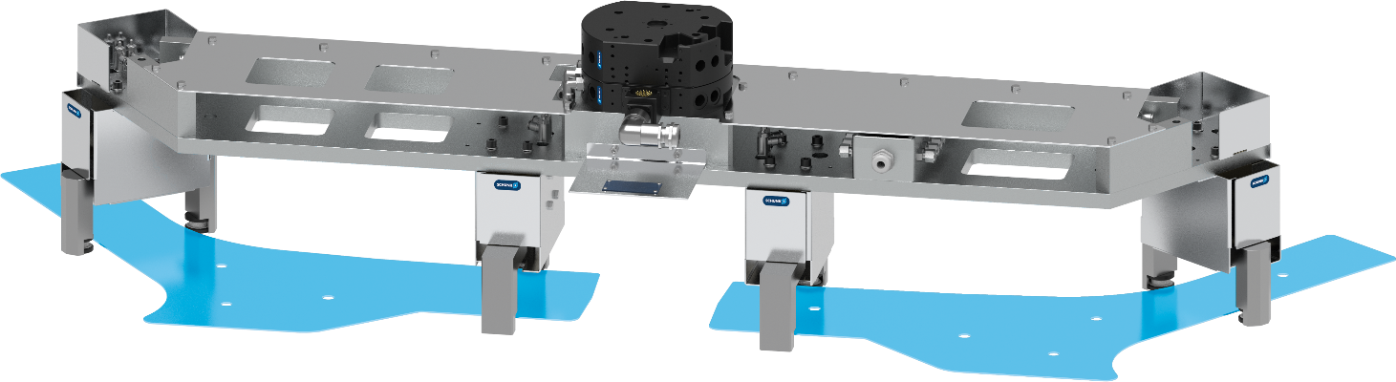
Gripping unit for pipes A-pillar
Loading/unloading of hydroforming presses
Metal Processing - Forming technology - High temperature
Complete assembly
with pneumatic 2-finger parallel grippers
Heat protection
with radiant heat panel, thermal insulation
Customized top jaws
with ceramic clamping inserts
Quick-change system
with media feed-through
Complete with installation
Hoses and cables covered with fire protection
Customized interface
for mounting on robots
TYPICAL PRODUCTS
TYPICAL PROCESS
REQUIREMENTS
RELIABILITY
STRONG
ACCURACY
Notes:
SCHUNK ID: 30086493

