Slide 1

SCHUNK Engineering
Solution Book - Automotive
Note:
This presentation contains confidential information and is only released for non-public use by customers and suppliers.
Consultation with specialist department may be necessary.
- Remove this note before use -

Slide 2




Material Lifter
Lifting trays for automated unloading
Automotive - Intralogistics
Function
Lifting trays layer by layer for automated unloading.
Customer benefits
Compact and space saving:
Using the z-axis vs. x/y-axis saves valuable installation / floor area
Flexibility - virtually universal:
The Material Lifter with configurable axis and gripper can be adapted to many applications in terms of size, load, speed, …
Expert project planning team
Sizing, design and assembly by SCHUNK
+
additional slides available

Slide 3






Material Lifter
Lifting trays for automated unloading
Automotive - Intralogistics
Cover handling
Saves
Floorspace
Pure
Flexibility

Slide 4

Material Lifter
Lifting trays for automated unloading
Automotive - Intralogistics
Reference project
consisting of
Linear direct axis SLD-24 heavy-duty design with working stroke 3.200 mm
Electric long-stroke gripper ELG 30
1
2
Notes:
SCHUNK ID: 1602006

Slide 5

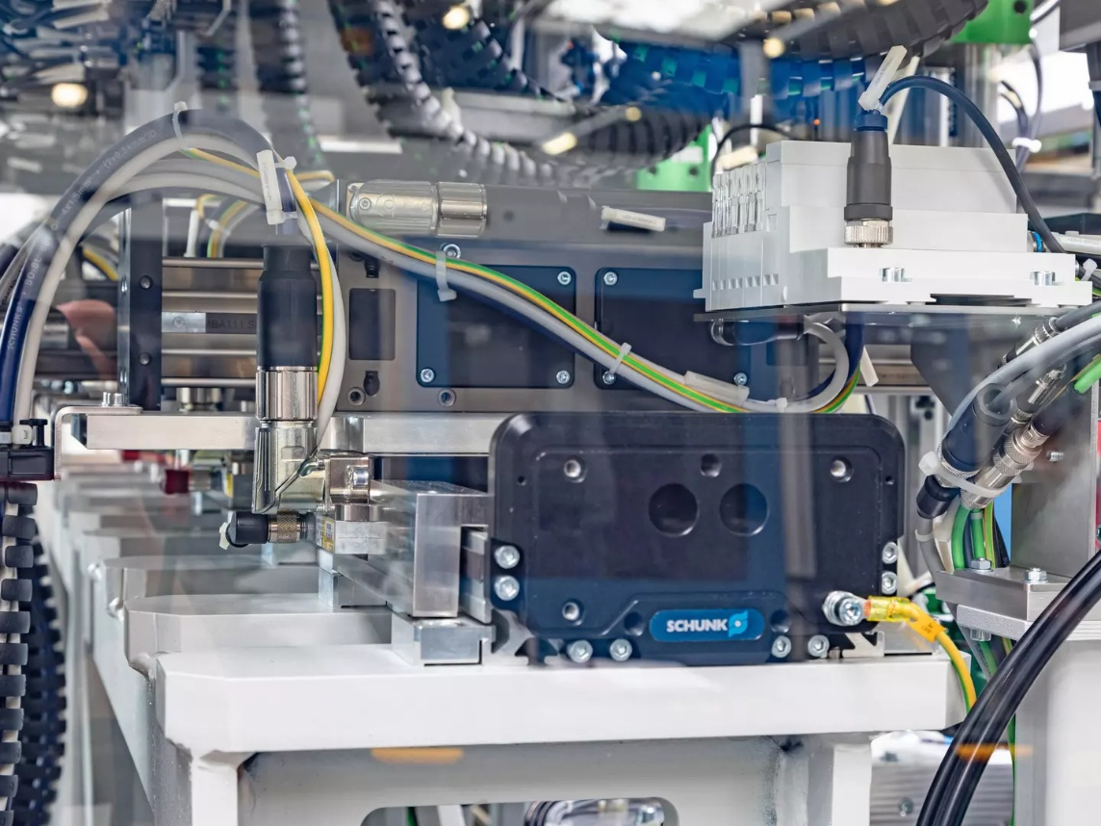

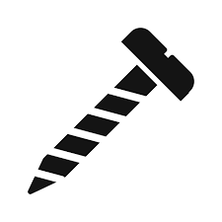




It couldn't be more compact!
Screw assembly cell with five screw units
Automotive - Assembly
Function
Five separately controlled slides enable high-precision and fast screw processes in the assembly cell. The robustness and accuracy of the SLD-axis ensures flawless screwdriving processes and avoids scrap.
Scope
  1x linear direct axis SLD 11 with five slides (x-axis)
  5x linear direct axis LDN (y-axis)
Customer benefit
  Highly compact unit integrated into existing customer line
  High load capacity of the base axis ensures precision of screwdriving operations
Discharge side view of the SLD linear direct axis installed on a steel girder.
second page available
TYPICAL PRODUCTS
TYPICAL PROCESS
REQUIREMENTS
Click here for the success story!
HIGHSPEED
STRONG
ACCURACY
Notes:
SCHUNK ID: 1554728

Slide 6
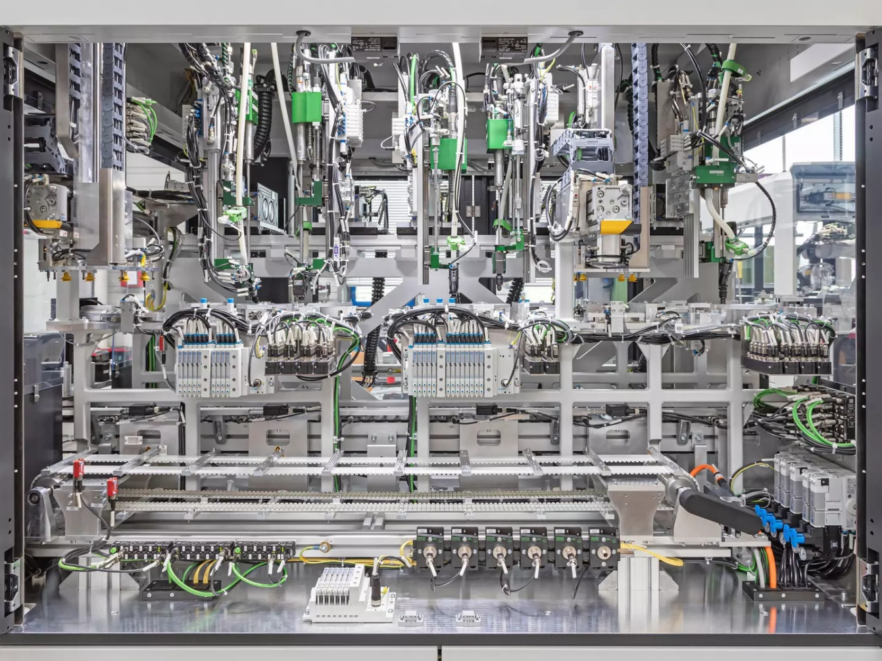
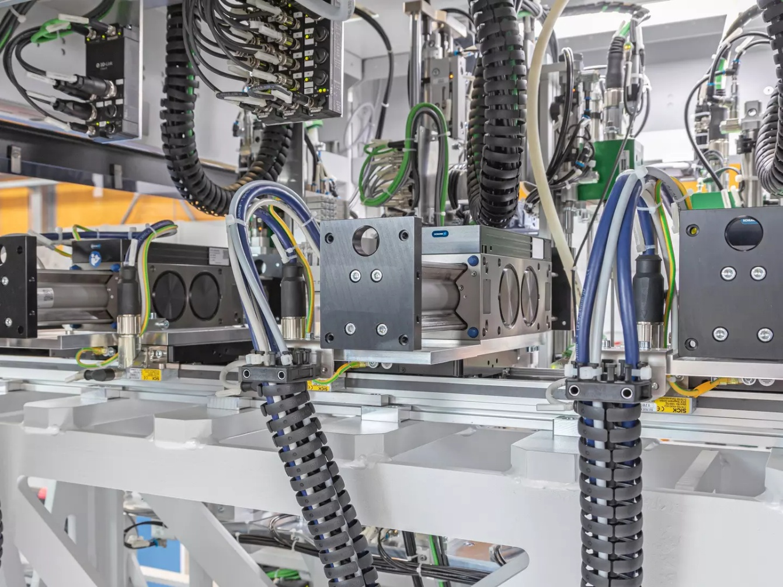
It couldn't be more compact!
Screw assembly cell with five screw units
Automotive - Assembly
Complete view of the extremely compact screwdriving assembly cell with five screwdriving units. The heart of the cell is the SLD horizontal linear direct axis with five independently movable carriages.
An LDN universal linear axis is mounted transversely on the SLD horizontal linear direct axis, on all five slides.
Click here for the success story!
Notes:
SCHUNK ID: 1554728

Slide 7





Electric 3-finger centric gripper with large stroke
Handling of large rotationally symmetrical components
Automotive - Assembly technology
Scope
  Sheet metal housing
  Wiper
  Accessible lubrication adapter
  Passive pressure unit
  Angular gearbox
Servo-electric drive
Servomotor adaptable by the customer
Robust guidance
Recirculating ball bearing
Large stroke / high gripping force
TYPICAL PRODUCTS
TYPICAL PROCESS
REQUIREMENTS
STRONG
Notes:
SCHUNK ID: 1562643 / ausschließlich ENTWURF-Status

Slide 8




2-finger gripper swivel modules
Handling of rotor shafts and drive shafts
Automotive - Metal Processing
Function and benefits
Machine tending of a turning machine: handling of rotor and drive shafts OP1 + OP2
Scope - each module consisting of:
  1x rotary module SRU-plus 50
  1x rotary module SRH-plus-D 40
  2 x sealed 2-finger parallel gripper
  DPG-plus 100 (IP67)
  adapter plates with internal air feed-through for space saving design
  8 x magnetic sensors
Customized top jaws
gas nitrocarburized & oxidized steel inserts
Expert project planning teams
Sizing, design and assembly by SCHUNK
second page available
TYPICAL PRODUCTS
TYPICAL PROCESS
REQUIREMENTS
RELIABILITY
STRONG
WET
Notes:
SCHUNK ID: 1571789 / 1571786

Slide 9


2-finger gripper swivel modules
Handling of rotor shafts and drive shafts
Automotive - Metal Processing
The gripper swivel modules are operated on a gantry system between central storage and turning machine → gantry systems also scope of SCHUNK Engineering
1x rotary module SRU-plus 50
1x rotary module SRH-plus-D 40
adapter plates with internal air feed-through for space saving design
2 x sealed 2-finger parallel gripper
DPG-plus 100 (IP67) with customized to jaws
Notes:
SCHUNK ID: 1571789 / 1571786

Slide 10


3-finger double gripper + quick-change system
Light-weight design with maximum gripping force
Automotive - Metal Processing
Function and benefits
3-finger double gripper with manual quick-change system as end-of-arm on a robot. Reduction of gripper weight to allow heaver workpiece but carry over the existing robot.
Scope
  2x 3-finger centric gripper PZN-plus 125-2
  quick change system SHS-125
  light-weight adapter plate
  Pressure maintenance valve SDV-P
Customized top jaws
with peaky inserts for higher friction
Expert project planning teams
Sizing, design and assembly by SCHUNK
second page available
TYPICAL PRODUCTS
TYPICAL PROCESS
REQUIREMENTS
RELIABILITY
STRONG
ACCURACY
Notes:
SCHUNK ID: 1566116

Slide 11

3-finger double gripper + quick-change system
Light-weight design with maximum gripping force
Automotive - Metal Processing
manual quick change system
SHS-125
light-weight adapter plate
Pressure maintenance valve SDV-P
2x 3-finger centric gripper
PZN-plus 125-2
with customized top jaws: peaky inserts for higher friction
Notes:
SCHUNK ID: 1566116

Slide 12


Heavy-duty handling
Handling an engine block weighing approx. 350 kg for trucks
Automotive – Metal processing
Function and customer benefits
Transferring the unmachined casting part to the machine tool. Multiple tolerance compensation enables clamping on raw clamping contours with component tolerances of several millimeters.
Scope
  C-axis
  x-y-z compensation unit
  2-finger parallel gripper
  Swivel finger with tolerance compensation
  Adapter plates and other accessories
Expert project planning team
Sizing, design and assembly by SCHUNK
second page available
TYPICAL PRODUCTS
TYPICAL PROCESS
REQUIREMENTS
RELIABILITY
STRONG
ACCURACY
Notes:
SCHUNK ID: 1535228

Slide 13

Heavy-duty handling
Handling an engine block weighing approx. 350 kg for trucks
Automotive – Metal processing
C-axis
Others:
Adapter plates
Sensors, Gear unit
Blow nozzles for cleaning the gripper pins incl. tubing
x-y-z compensation unit
2-finger parallel gripper
Swivel finger with tolerance compensation
Notes:
SCHUNK ID: 1535228

Slide 14
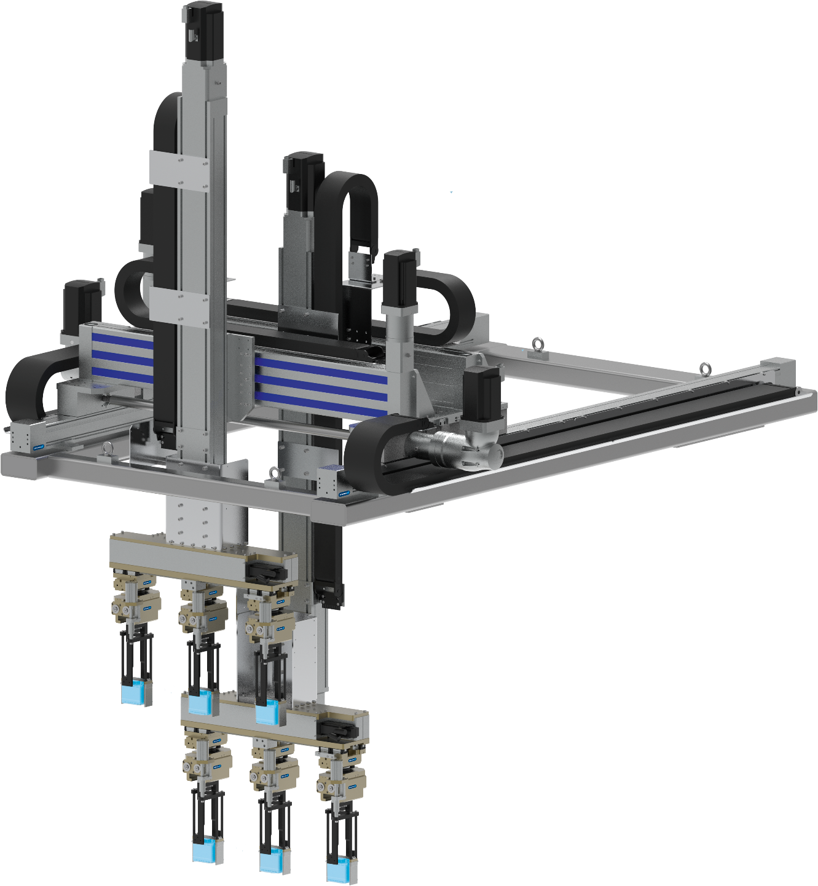


Multi-axis system with special gripper unit
Handling of AGM cells
Automotive – Assembly technology
Application
several workpieces are picked up from the belt, swiveled and placed in different containers with a different gauge.
Components
  Linear axes type B110-ASS / D240-ZSS /
  B180-SSS
  3-fold Gripping unit with swivel module type SRU 40 and linear adjustment
Workpiece
Battery cell packs
Scope of delivery
Complete multi-axis system with special gripper, incl. servomotors, wired and hosed
TYPICAL PRODUCTS
TYPICAL PROCESS
REQUIREMENTS
HIGHSPEED
RELIABILITY
ACCURACY
Notes:
SCHUNK ID: 30045320

Slide 15
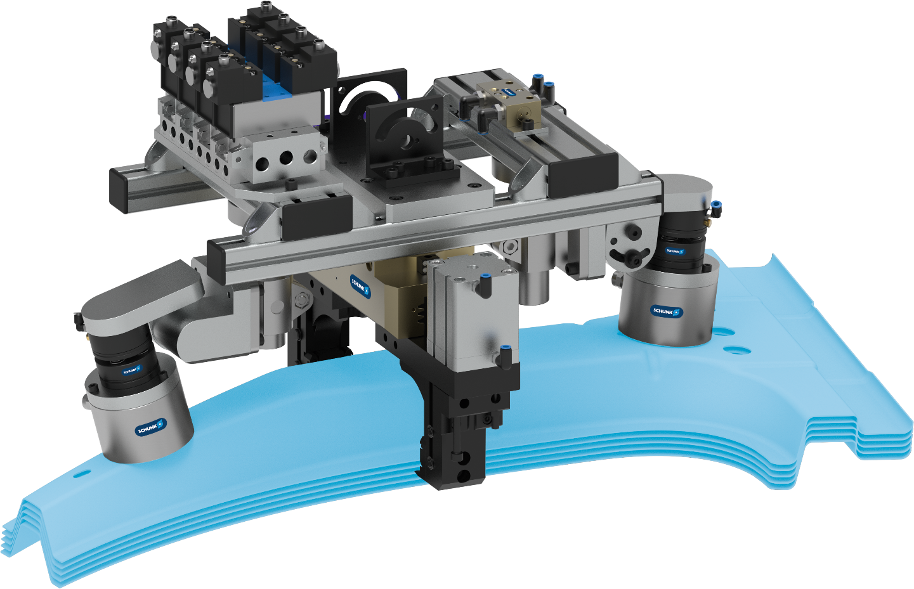




Gripping unit PGN-plus, EGM
Separation and loading and unloading of B-pillars
Automotive - Sheet metal processing
Expert project planning team
Sizing, design and assembly by SCHUNK
Parallel gripper PGN-plus
Customized gripper fingers with integrated spreading function
Magnetic gripper EGM
Floating bearing for flexible workpiece mounting
Compensation unit AGE-U
Compensation direction X, Y, Z, angle
TYPICAL PRODUCTS
TYPICAL PROCESS
REQUIREMENTS
RELIABILITY
STRONG
ACCURACY
Notes:
SCHUNK ID: 1347859

Slide 16
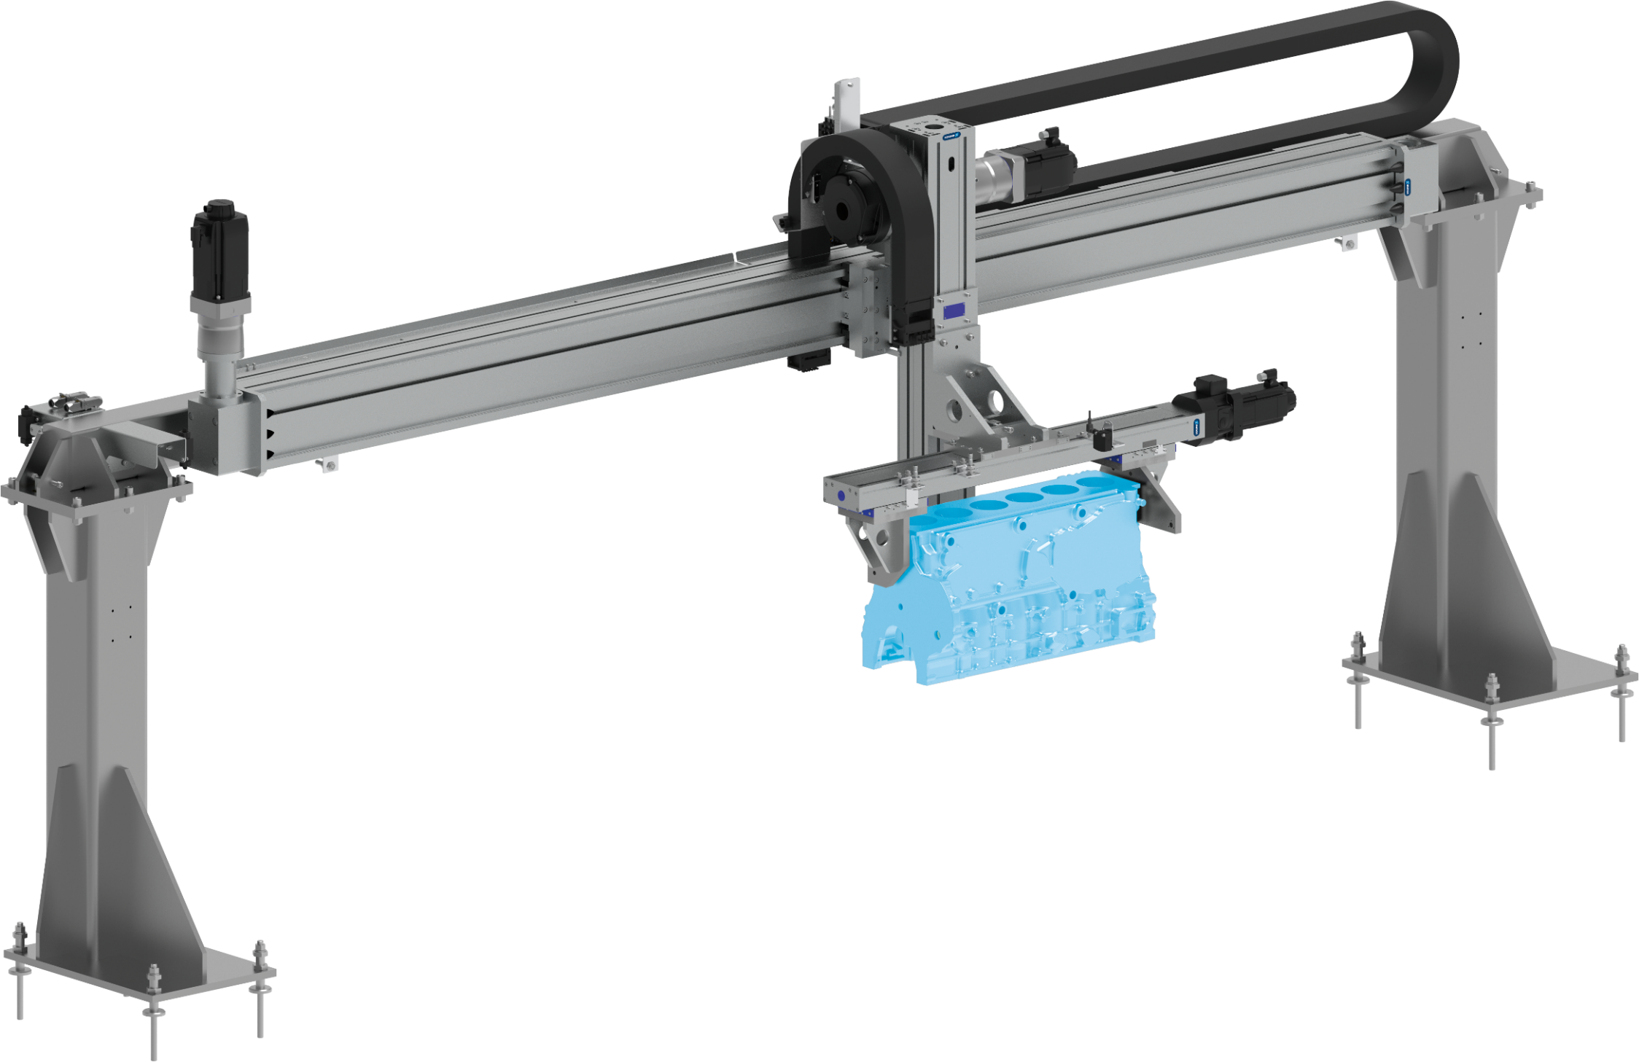


2-axis system with long-stroke gripper
Relocating engine blocks
Automotive - Assembly
Line gantry with gripper unit
for pick & place task
Components
- Linear axes type G 220-ZSS / G 160-ASH
- Gripping unit type D 145-C-SSS-L/R
(long-stroke gripper up to 200 mm stoke/jaw)
Workpiece
Large-volume, medium-weight components
Scope of delivery
Complete axis system incl. gearbox
TYPICAL PRODUCTS
TYPICAL PROCESS
REQUIREMENTS
HIGHSPEED
RELIABILITY
ACCURACY
Notes:
SCHUNK ID: 1404609

Slide 17
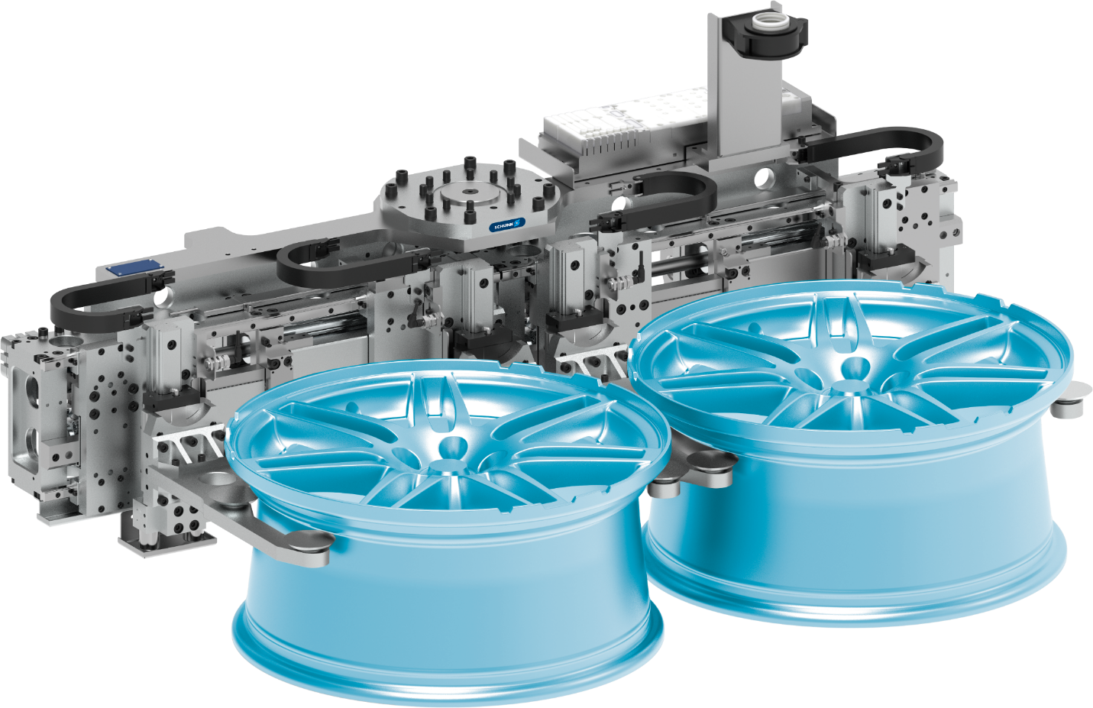

Double gripping unit
Moving rims in the paint shop
Automotive – Rims / wheels
Pneumatic double gripping unit
for handling of aluminum rims - radial gripping
Long-stroke gripper with stroke measuring system
Workpieces : 14-24 inches
Customized top jaws
with integrated collision protection
Gentle gripping
Plastic clamping inserts
Plug and Play
with bus valve terminal and bus distributor, fully wired and hosed
TYPICAL PRODUCTS
TYPICAL PROCESS
REQUIREMENTS
RELIABILITY
STRONG
ACCURACY
Notes:
SCHUNK ID: 30089390

Slide 18
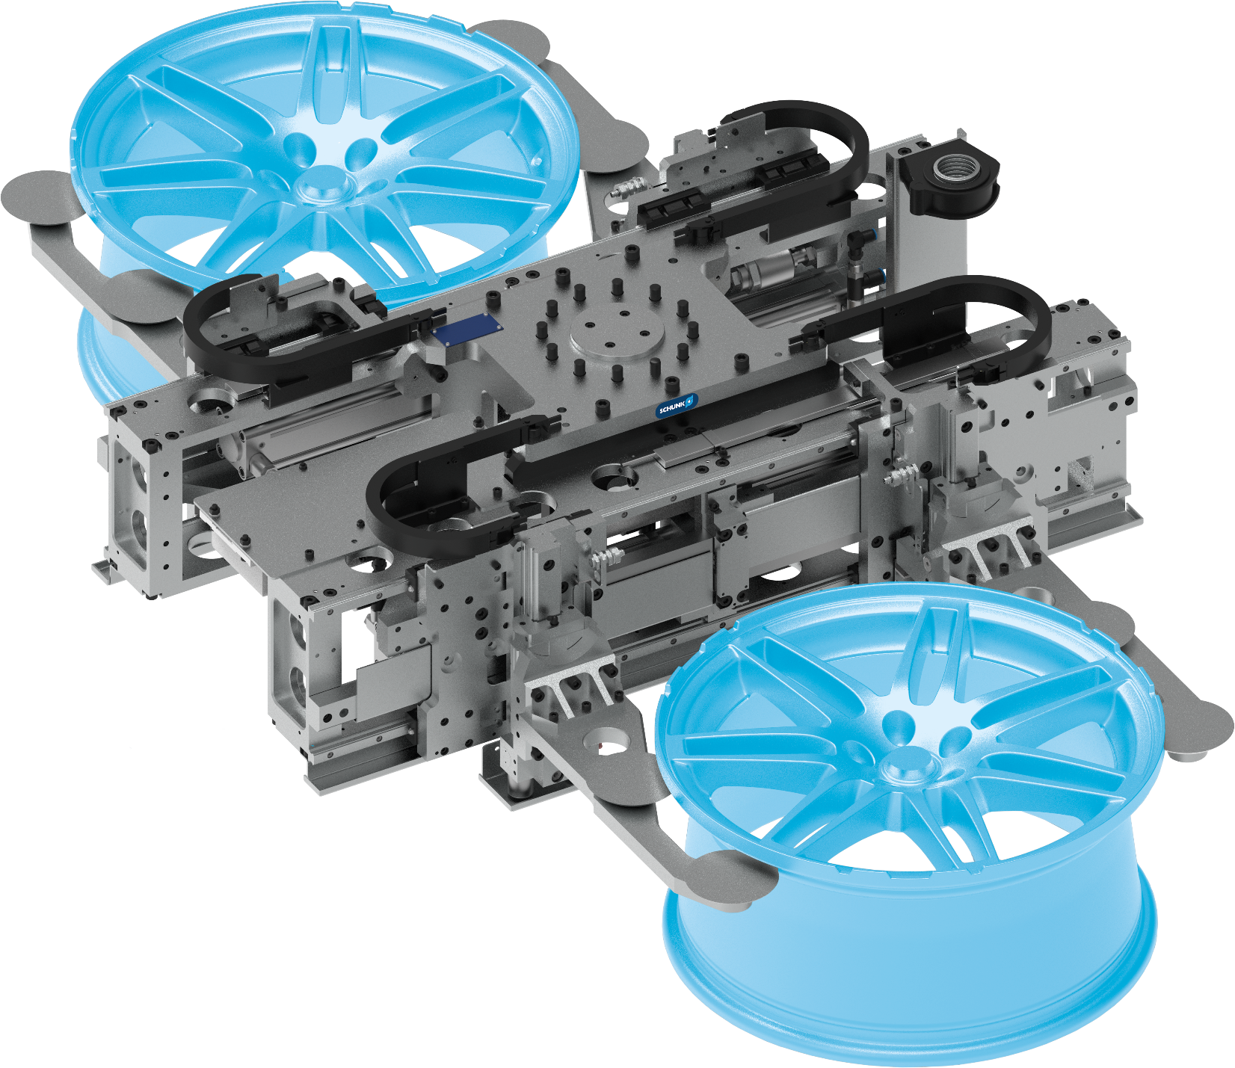
Double gripping unit
Moving rims in the paint shop
Automotive – Rims / wheels
Pneumatic double gripping unit
for handling of aluminum rims - radial gripping
Long-stroke gripper with stroke measuring system
Workpieces : 14-24 inches
Customized top jaws
with integrated collision protection
Gentle gripping
Plastic clamping inserts
Plug and Play
with bus valve terminal and bus distributor, fully wired and hosed
TYPICAL PRODUCTS
TYPICAL PROCESS
REQUIREMENTS
RELIABILITY
STRONG
ACCURACY
Notes:
SCHUNK ID: 30085645

Slide 19
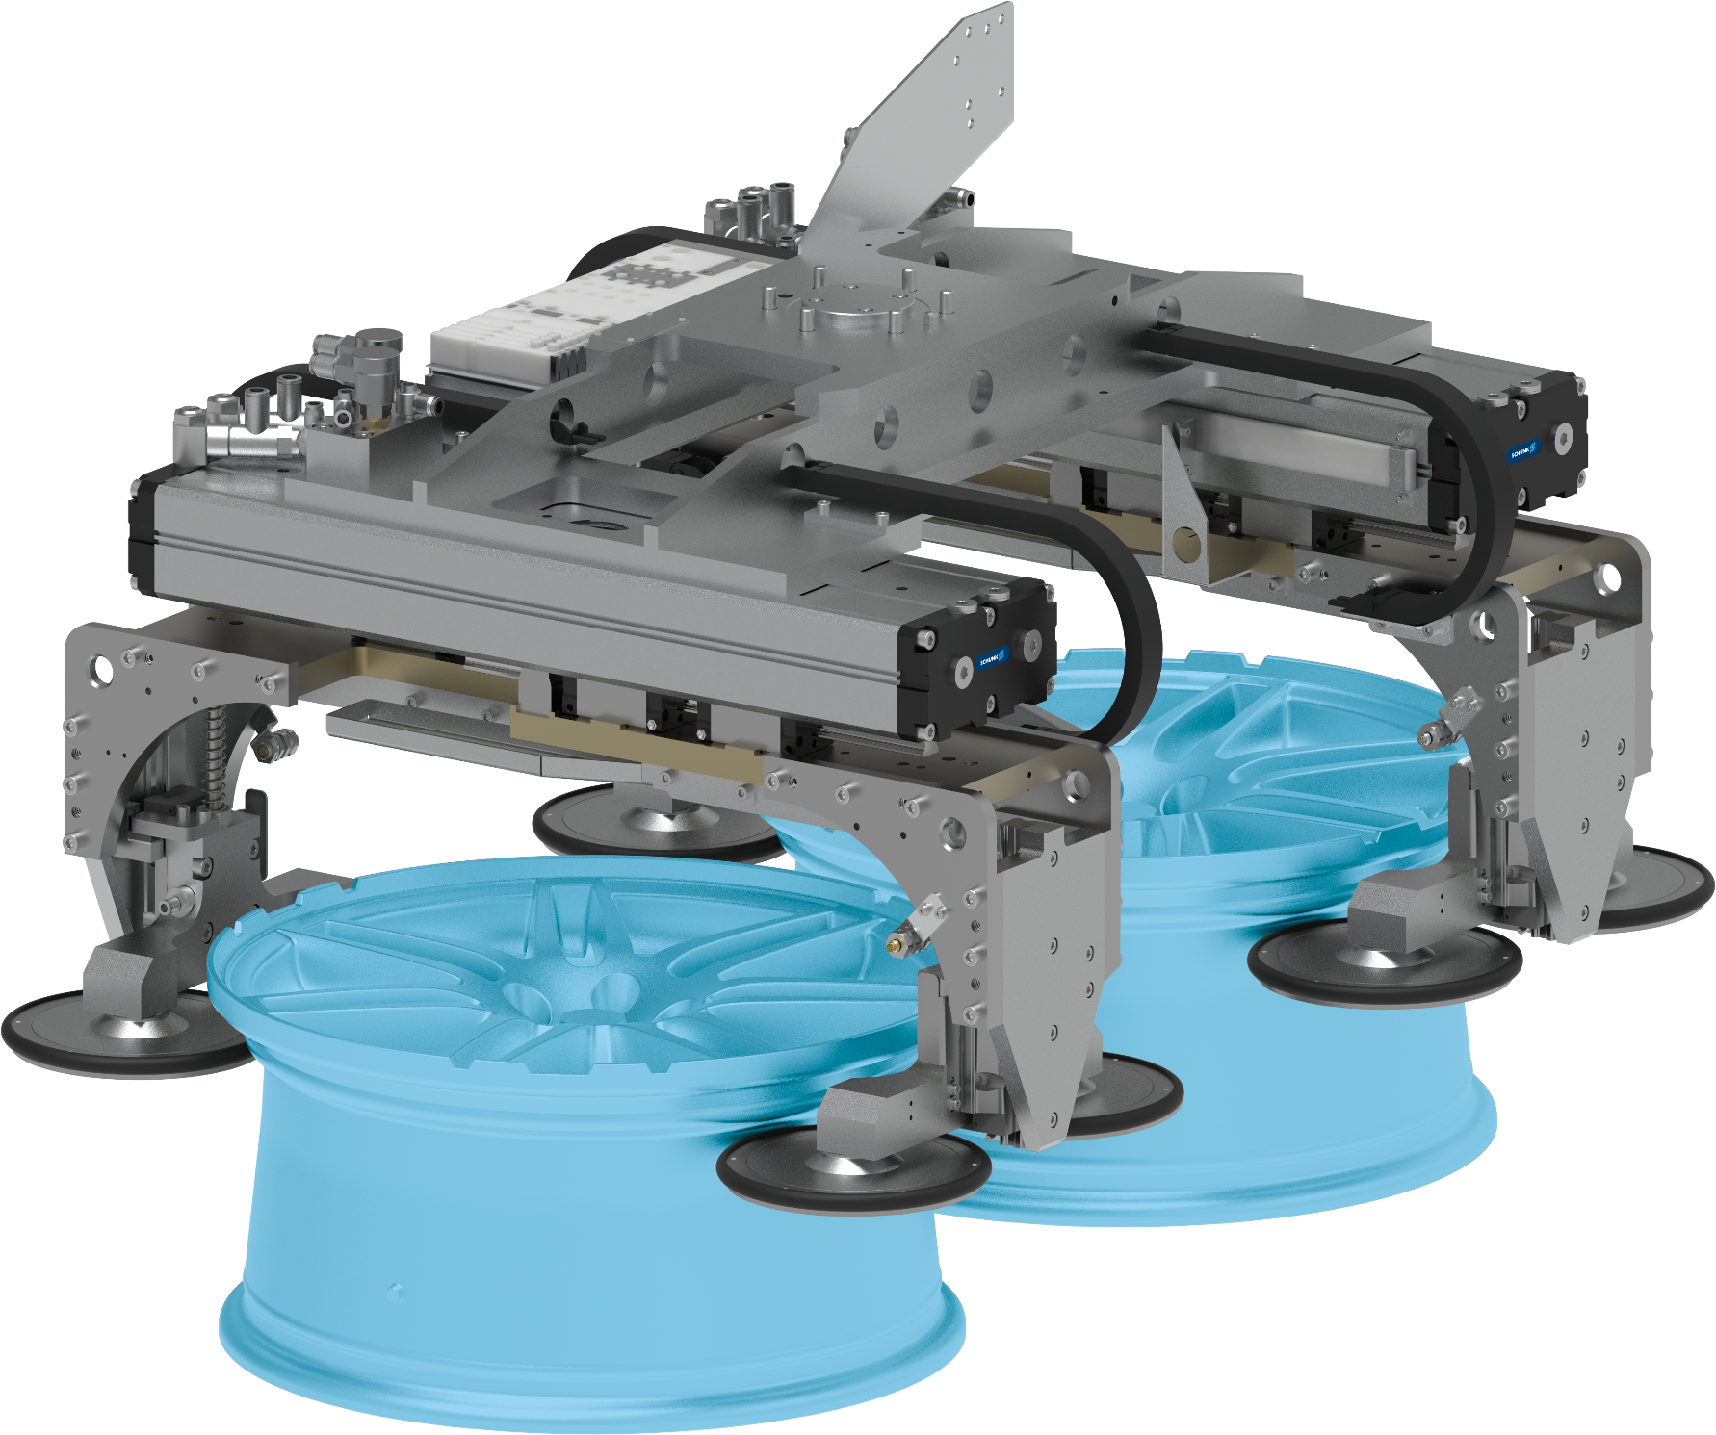
Double gripping unit
Moving rims in the paint shop
Automotive – Rims / wheels
Pneumatic double gripping unit
for handling of aluminum rims - axial gripping
Long-stroke gripper with stroke measuring system
Workpieces : 14-24 inches
Customized top jaws
with integrated collision protection
Gentle gripping
Plastic clamping inserts
Plug and Play
with bus valve terminal and bus distributor, fully wired and hosed
TYPICAL PRODUCTS
TYPICAL PROCESS
REQUIREMENTS
RELIABILITY
STRONG
ACCURACY
Notes:
SCHUNK ID: 30083459

Slide 20
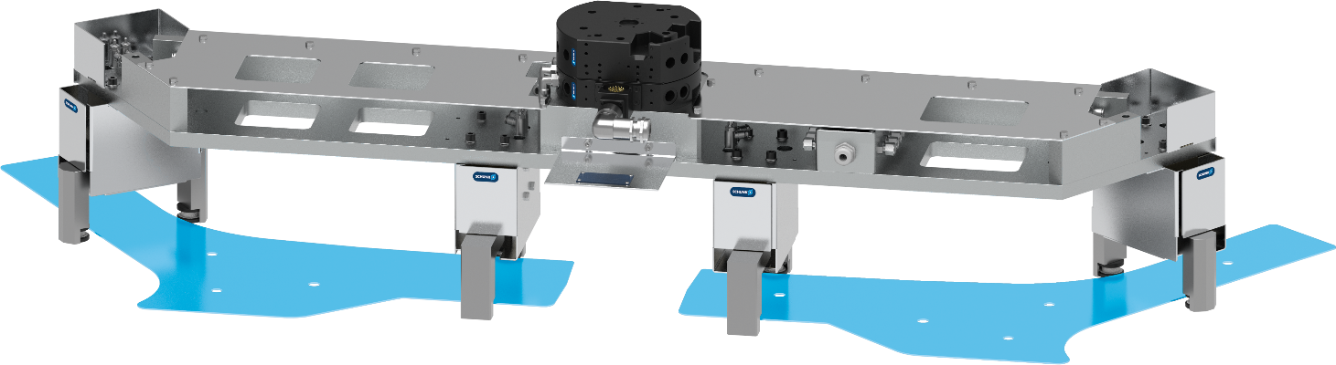
Gripping unit for pipes A-pillar
Loading/unloading of hydroforming presses
Automotive - Forming technology - High temperature
Complete assembly
with pneumatic 2-finger parallel grippers
Heat protection
with radiant heat panel, thermal insulation
Customized top jaws
with ceramic clamping inserts
Quick-change system
with media feed-through
Complete with installation
Hoses and cables covered with fire protection
Customized interface
for mounting on robots
TYPICAL PRODUCTS
TYPICAL PROCESS
REQUIREMENTS
RELIABILITY
STRONG
ACCURACY
Notes:
SCHUNK ID: 30086493

Slide 21
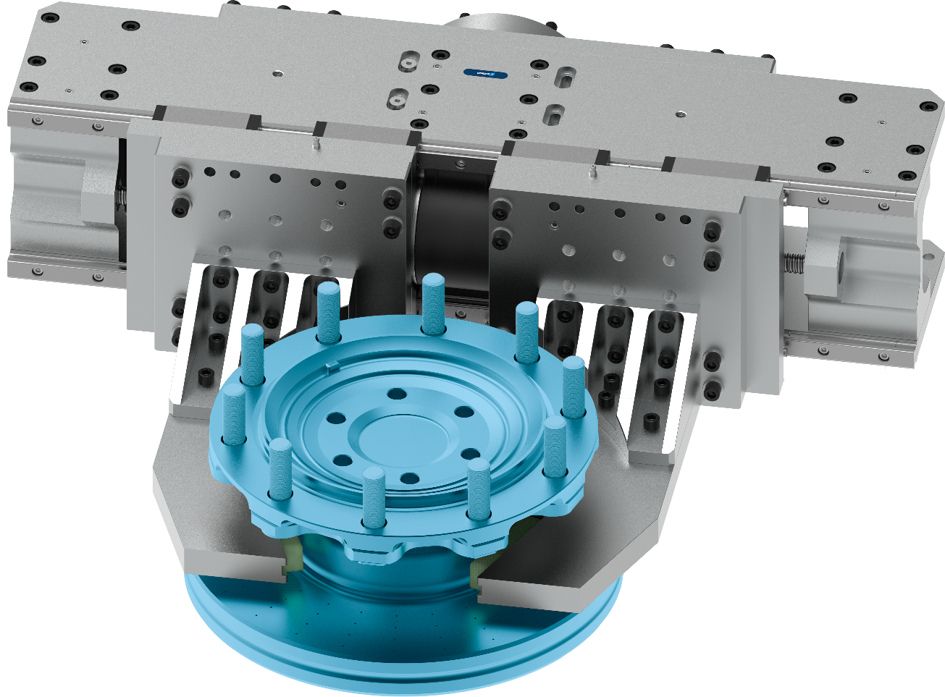
Gripping unit ‘ELG’
Handling of truck brake discs during assembly
Automotive - Assembly
Heavy-duty gripper unit
truck brake discs 80kg
Customized top jaws
form-fit gripping with interchangeable plastic clamping inserts
Servo-electric drive
Ball screw
Adaptable servo motor
Robust guidance
Recirculating ball bearing guide
Long-stroke / high gripping force
TYPICAL PRODUCTS
TYPICAL PROCESS
REQUIREMENTS
RELIABILITY
STRONG
ACCURACY
Notes:
SCHUNK ID: 1316727

Slide 22
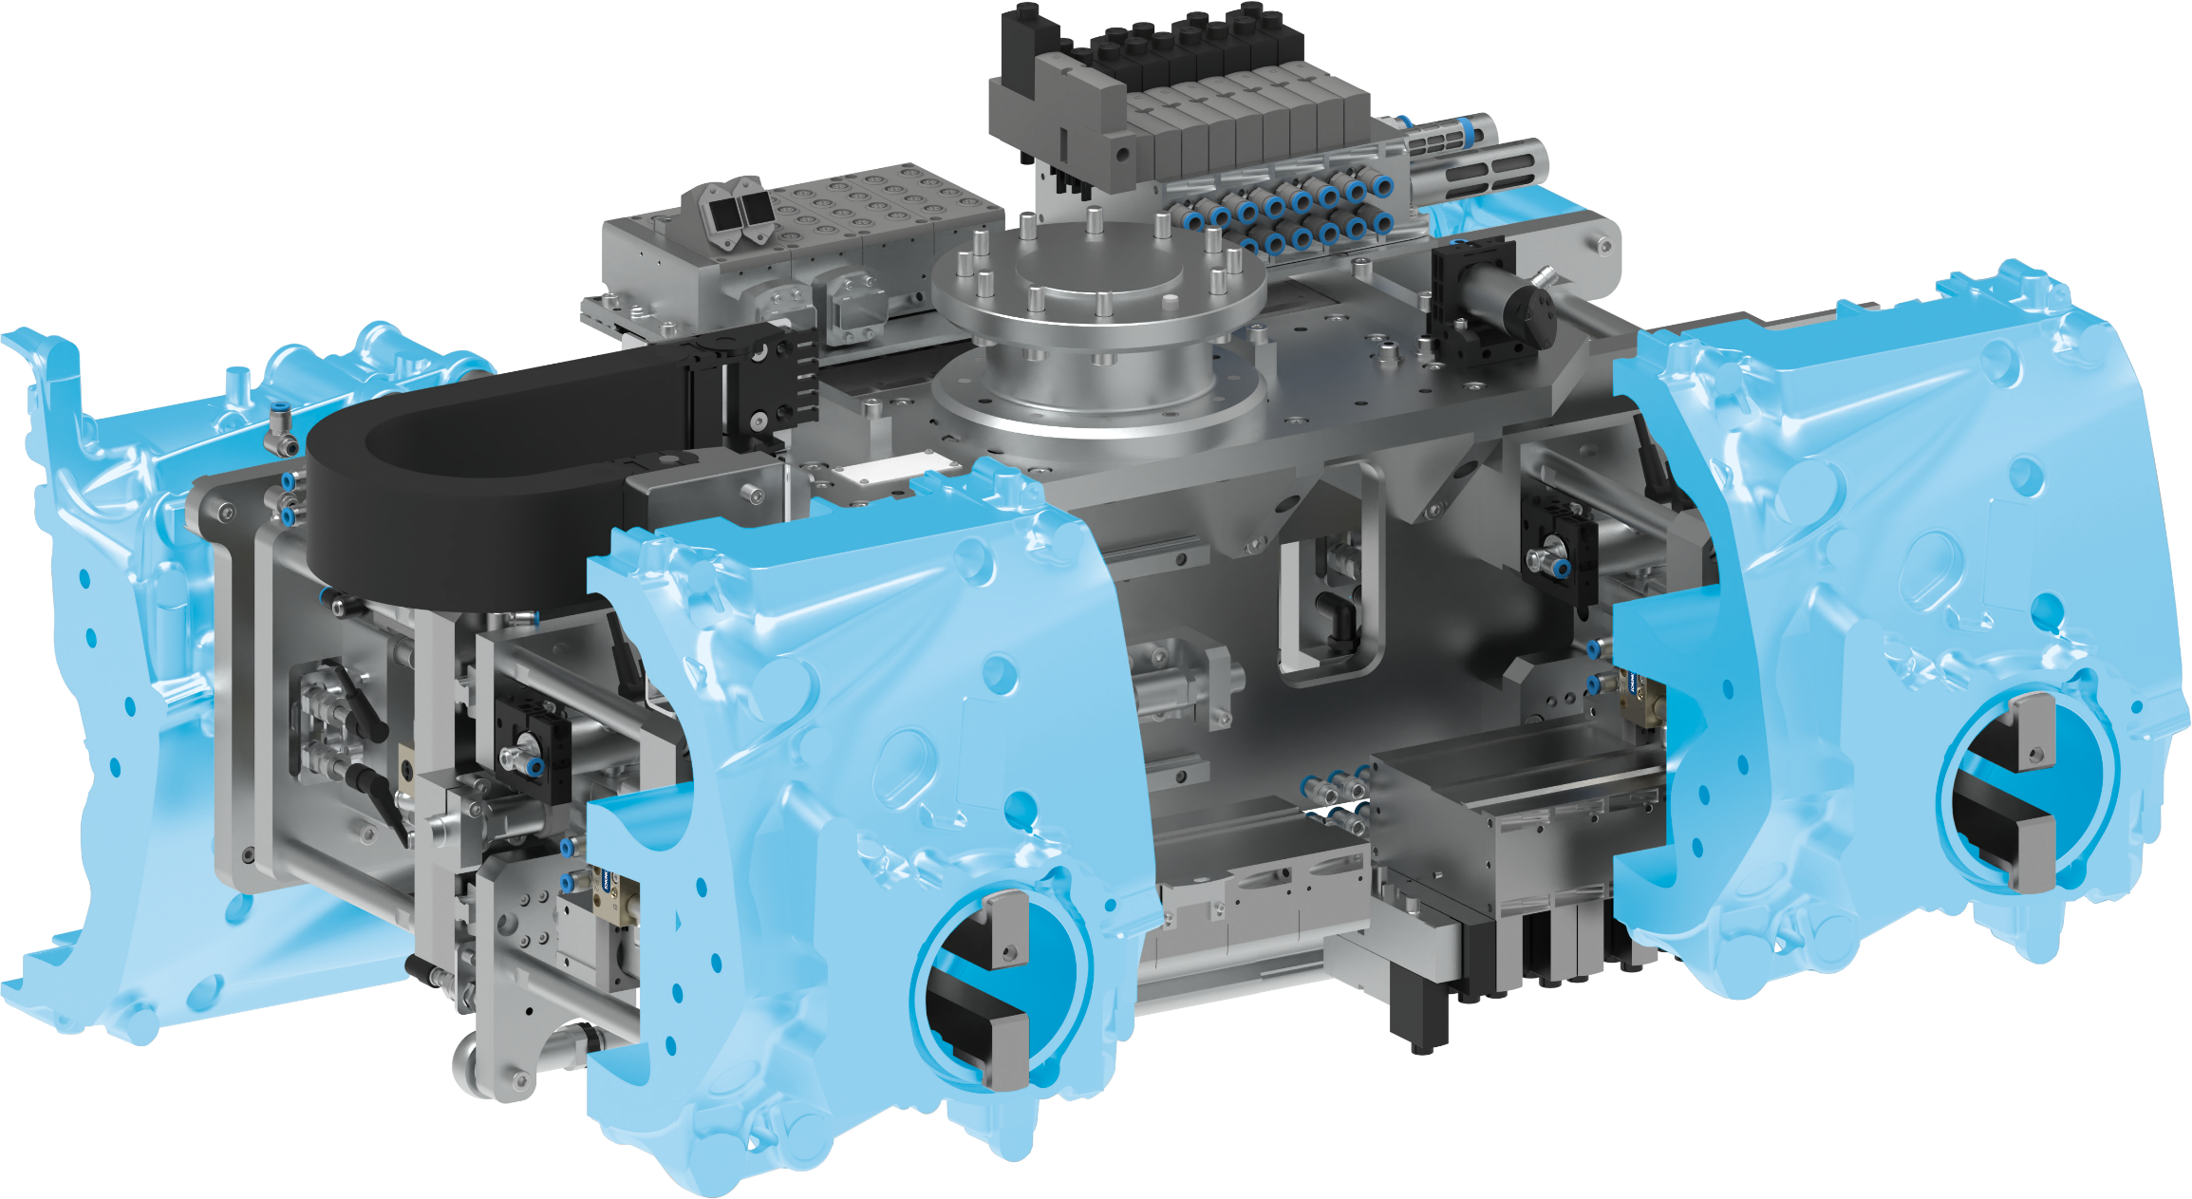
4-fold gripper unit
Loading/unloading motorcycle crankcases
Automotive – Metal processing
Customized gripping unit
pneumatic
Form-fit gripping
with rear grip and clamping via pneumatic cylinder and movable gripper against stationary support
One-sided gauge adjustment
for different pick-up/drop-off positions
Complete project management
Sizing, design and assembly by SCHUNK
Plug and Play
with valve technology and electrical distributor, fully wired and hosed
TYPICAL PRODUCTS
TYPICAL PROCESS
REQUIREMENTS
RELIABILITY
STRONG
ACCURACY
Notes:
SCHUNK ID: 1427405

Slide 23
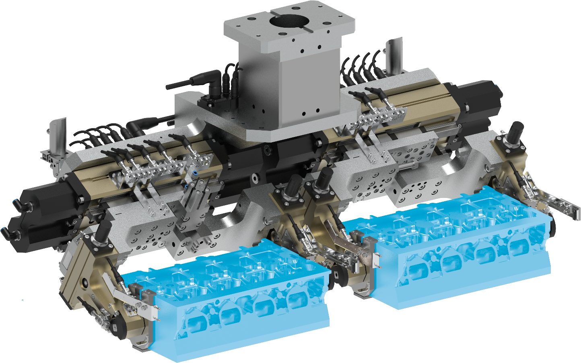
2-fold rotary-gripping unit
Loading/unloading of cylinder heads
Automotive – Metal processing
Customized rotary-gripping unit
pneumatic
Customized interface
for mounting on linear gantry
2x gripper PHL-W 63-160-S
4-position monitoring with proximity switch M8
4x rotary finger GFS 40-180
with clamping and monitoring with proximity switch M8
Workpiece detection
with light barrier
Plug and Play
with valve technology and electrical distributor, completely wired and hosed
TYPICAL PRODUCTS
TYPICAL PROCESS
REQUIREMENTS
RELIABILITY
STRONG
ACCURACY
Notes:
SCHUNK ID: 1427053

Slide 24
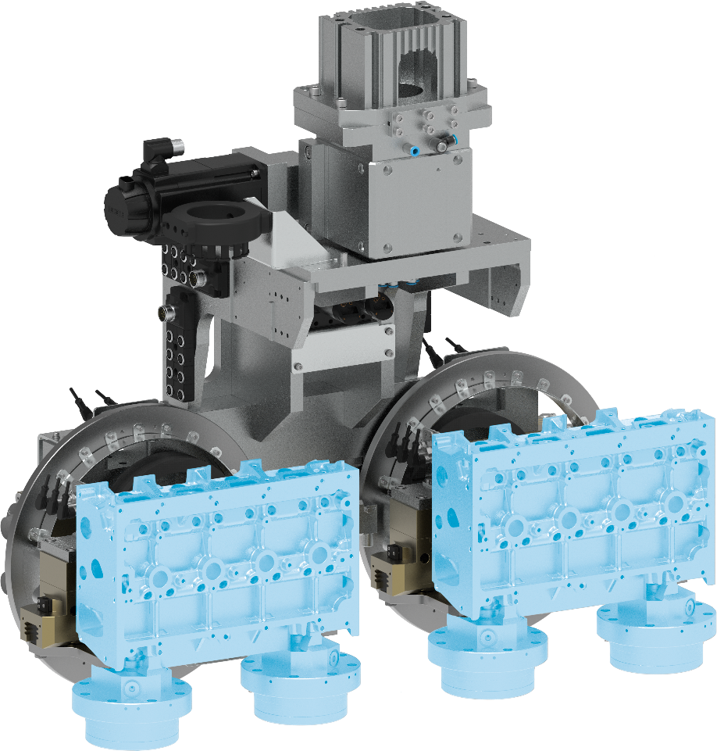
2-fold rotary-gripping unit
Loading/unloading of cylinder heads
Automotive – Metal processing
Customized rotary-gripping unit
ready to install to customer portal
Rotation with ERM 160
as C-axis
Swiveling with SRU-plus
with external clamping via ring element
Gripping at 2x quick-change clamping pins
mounted to workppiece
Plug and Play
with valve technology and electrical distributor, completely wired and hosed
Complete project management
Sizing, design and assembly by SCHUNK
TYPICAL PRODUCTS
TYPICAL PROCESS
REQUIREMENTS
RELIABILITY
STRONG
ACCURACY
Notes:
SCHUNK ID: 1427056

Slide 25
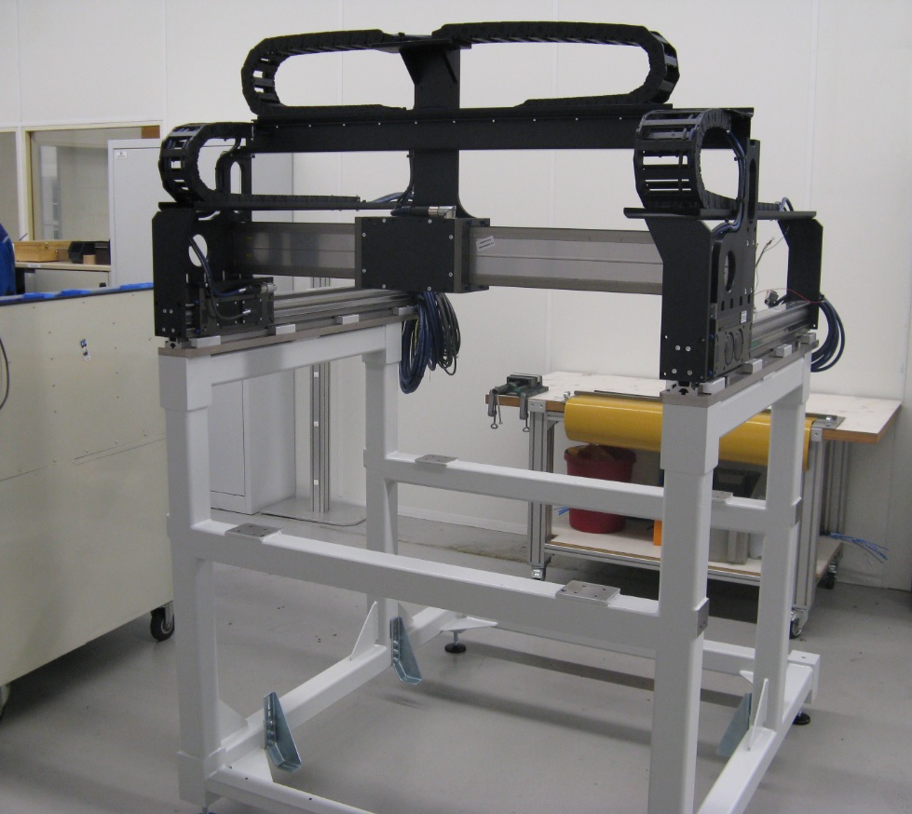



Gantry handling
Dosing/dispensing
Automotive - Dosing units
Painted welded steel frame
X1-axis: Linear axis LDN-UL-0200-100
(left, with 7,5 m cable)
X2-axis: Linear axis LDN-UL-0200-100
(right, with 5 m cable)
Y-axis: Linear axis LDM-EL-0400-100
(with 10 m cable)
TYPICAL PRODUCTS
TYPICAL PROCESS
REQUIREMENTS
HIGHSPEED
STRONG
ACCURACY
Notes:
SCHUNK ID: 1452210 (SES 415211)

Slide 26
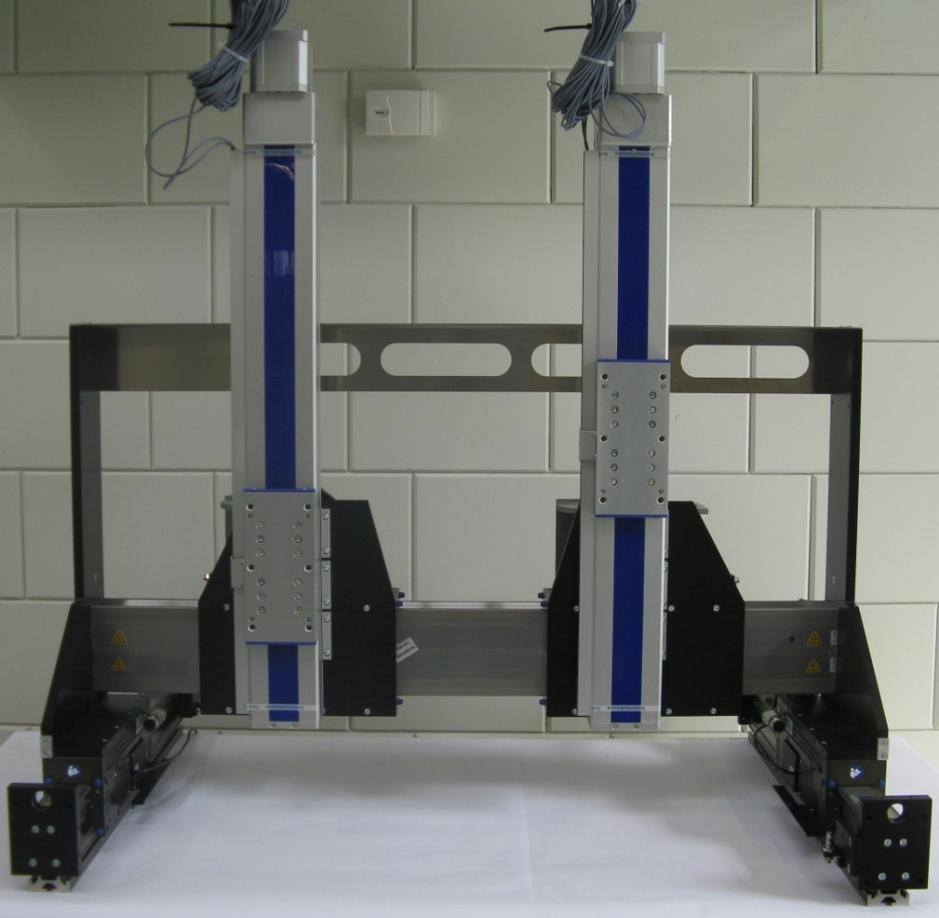
Gantry system
Dosing/dispensing
Automotive - Dosing units
Complete project management
Sizing, design and assembly by SCHUNK
Gantry system
  Y-axes: LDN-UL-200-0300,
  rated force 200 N
  X-axis: LDM-EL-0400-2 (Hub 500),
  rated force 400 N
  Z-axes: HSB-Beta-100D-SSS
Customer benefits
Compact design, ready-to-install sub-system
TYPICAL PRODUCTS
TYPICAL PROCESS
REQUIREMENTS
HIGHSPEED
STRONG
ACCURACY
Notes:
SCHUNK ID: 1356442 (SES: 399561)

Slide 27
Gantry system
Dosing/dispensing
Automotive - Dosing units
Special feature :
Design of the energy chain within the installation frame. Use of the primary part on the right up to the end plate without the energy chain hitting the frame. Completely assembled including bridge, axes, energy chains and cabling.
Portal
X1-axis: linear axis LDN-UL-0200,
stroke 385 mm
X2-axis: linear axis LDN-UL-0200,
stroke 385 mm
Y-axis: linear axis LDM-EL-0400-2,
stroke 354 mm
TYPICAL PRODUCTS
TYPICAL PROCESS
REQUIREMENTS
HIGHSPEED
STRONG
ACCURACY
Notes:
SCHUNK ID: 30701340 (SES 371064)

Slide 28
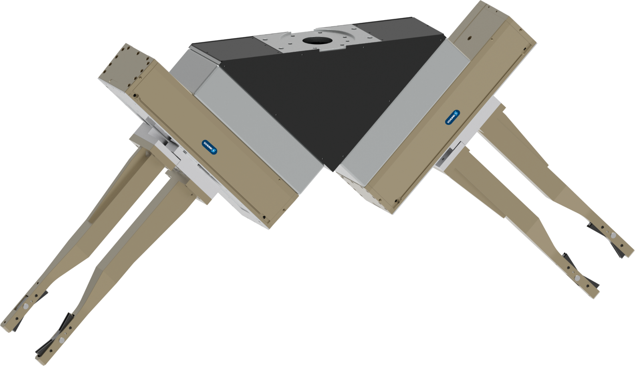
Double gripping unit
Be-/Entladen eines Dreh-/Fräszentrum
Automotive – Rims / wheels
Pneumatic double gripping unit
for handling of aluminum rims
Leight-weight design
Adapter as truss construction
Long-stroke gripper
Workpieces : 14-24 inches
Customized top jaws
with friction-enhancing clamping inserts
Customer-specific interface
for attachment to your robot
Complete project management
Sizing, design and assembly by SCHUNK
TYPICAL PRODUCTS
TYPICAL PROCESS
REQUIREMENTS
RELIABILITY
STRONG
ACCURACY
Notes:
SCHUNK ID: 30035374, 30036488

Slide 29
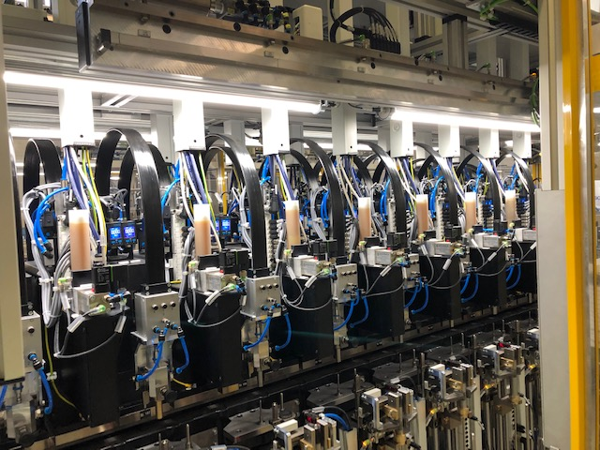
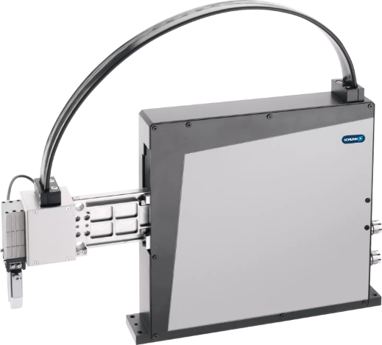


Pick and Place unit PPU-E
Feeding of discs
Automotive - Small items
Application
Feeding and loading in an assembly line
Added value
Fast and precise feeding of different parts in the tightest of spaces
Customer benefit
Fast and precise, small installation space, high availability, durable and low maintenance
Special feature
Central lubrication system
TYPICAL PRODUCTS
TYPICAL PROCESS
REQUIREMENTS
HIGHSPEED
RELIABILITY
ACCURACY
Notes:
SCHUNK ID: 1375286 (SES 398417) // SES 39801

Slide 30
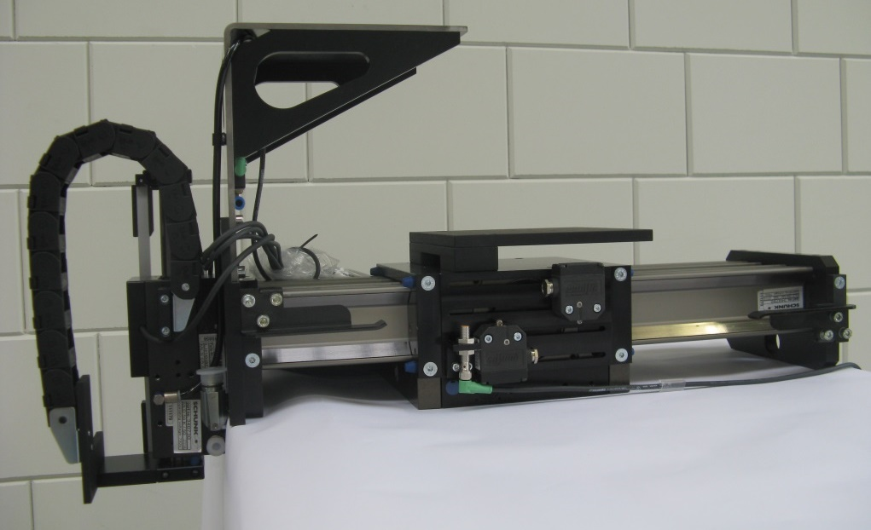

2-axes linear unit
Pick and Place of small items
Automotive - Assembly
Handling for loading and unloading
  X-axis: Linear axis LDM-ES-0200-0300
  Z-axis: Linear axis LDH-ES-0050-0100
Customer benefit
  Highly dynamic pick & place system
  Very compact design, optimized for the customer's installation situation
TYPICAL PRODUCTS
TYPICAL PROCESS
REQUIREMENTS
HIGHSPEED
STRONG
ACCURACY
Notes:
SCHUNK ID: 416317

Slide 31
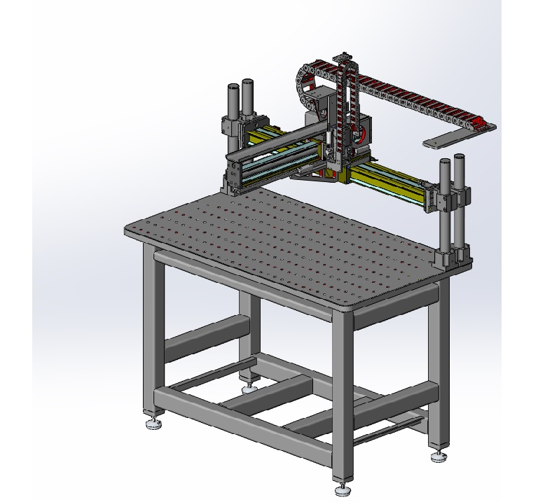

Configurable linear axes
Sub-system for various applications
Automotive - Assembly
Complete project management
Sizing, design and assembly by SCHUNK
Base frame
Welded steel construction with perforated plate and SCHUNK modular assembly automation (Pillar assembly system)
Axes
LDN-EL 0100, LBN-US-0100
Special features
Stroke and motors are variable,
LDx modular system
TYPICAL PRODUCTS
TYPICAL PROCESS
REQUIREMENTS
HIGHSPEED
STRONG
ACCURACY
Notes:
SCHUNK ID: 253125

