Slide 1

SCHUNK Engineering
Solution Book - Machine Tending
Note:
This presentation contains confidential information and is only released for non-public use by customers and suppliers.
Consultation with specialist department may be necessary.
- Remove this note before use -

Slide 2
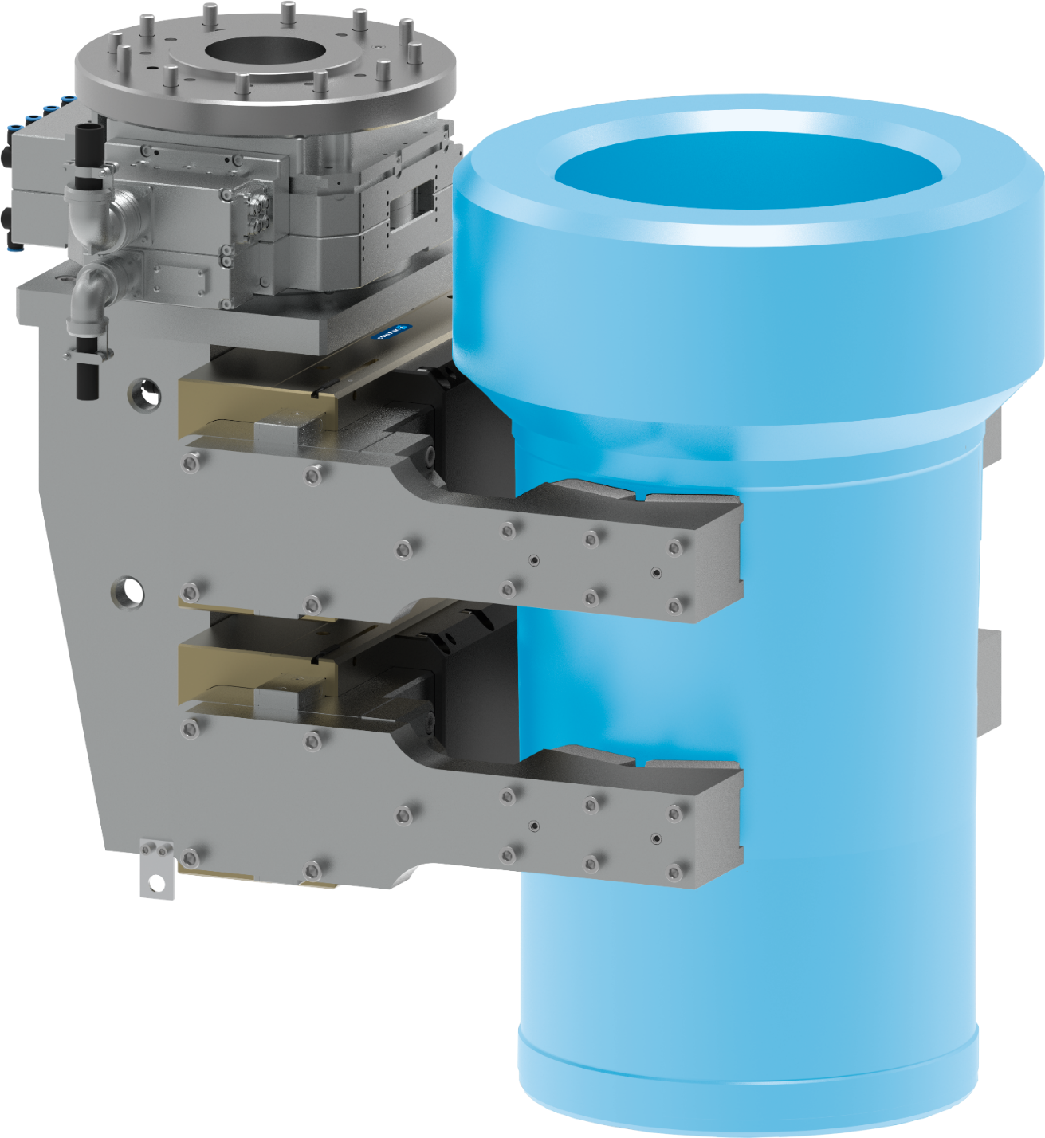








Gripping unit
Handling of cylinder liners for marine engines
Machine Tending
Function
Loading and unloading a lathe with very heavy cylinder liners (350 kg)
Customer benefit
  High flexibility with a wide range of components
  High scalability
  Handling of heavy components >350 kg
  Easy and quick replacement of wear parts
Customized attachment jaws
with interchangeable clamping inserts
Expert project planning team
Sizing, design and assembly by SCHUNK
second page available
TYPICAL PRODUCTS
TYPICAL PROCESS
REQUIREMENTS
RELIABILITY
STRONG
ACCURACY
Notes:
SCHUNK ID: 1579207

Slide 3

Gripping unit
Handling of cylinder liners for marine engines
Machine Tending
1 x heavy duty tool changing system
SWS-L-510
distributor
valves
Adapter plate
Customized attachment jaws
with interchangeable clamping inserts
2 x parallel gripper
SPG 100-SDV-P with pressure maintenance valve
Notes:
SCHUNK ID: 1579207

Slide 4
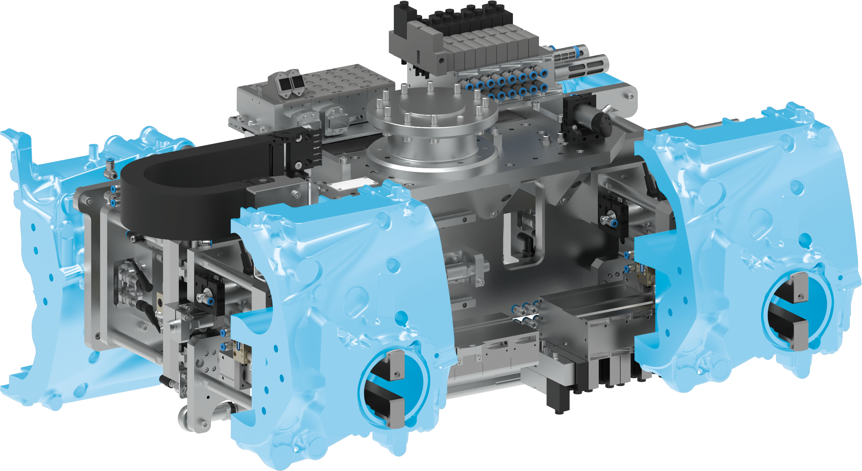


4-fold gripper unit
Loading/unloading motorcycle crankcases
Machine Tending
Customized gripping unit
pneumatic
Form-fit gripping
with rear grip and clamping via pneumatic cylinder and movable gripper against stationary support
One-sided gauge adjustment
for different pick-up/drop-off positions
Complete project management
Sizing, design and assembly by SCHUNK
Plug and Play
with valve technology and electrical distributor, fully wired and hosed
TYPICAL PRODUCTS
TYPICAL PROCESS
REQUIREMENTS
RELIABILITY
STRONG
ACCURACY
Notes:
SCHUNK ID: 1427405

Slide 5
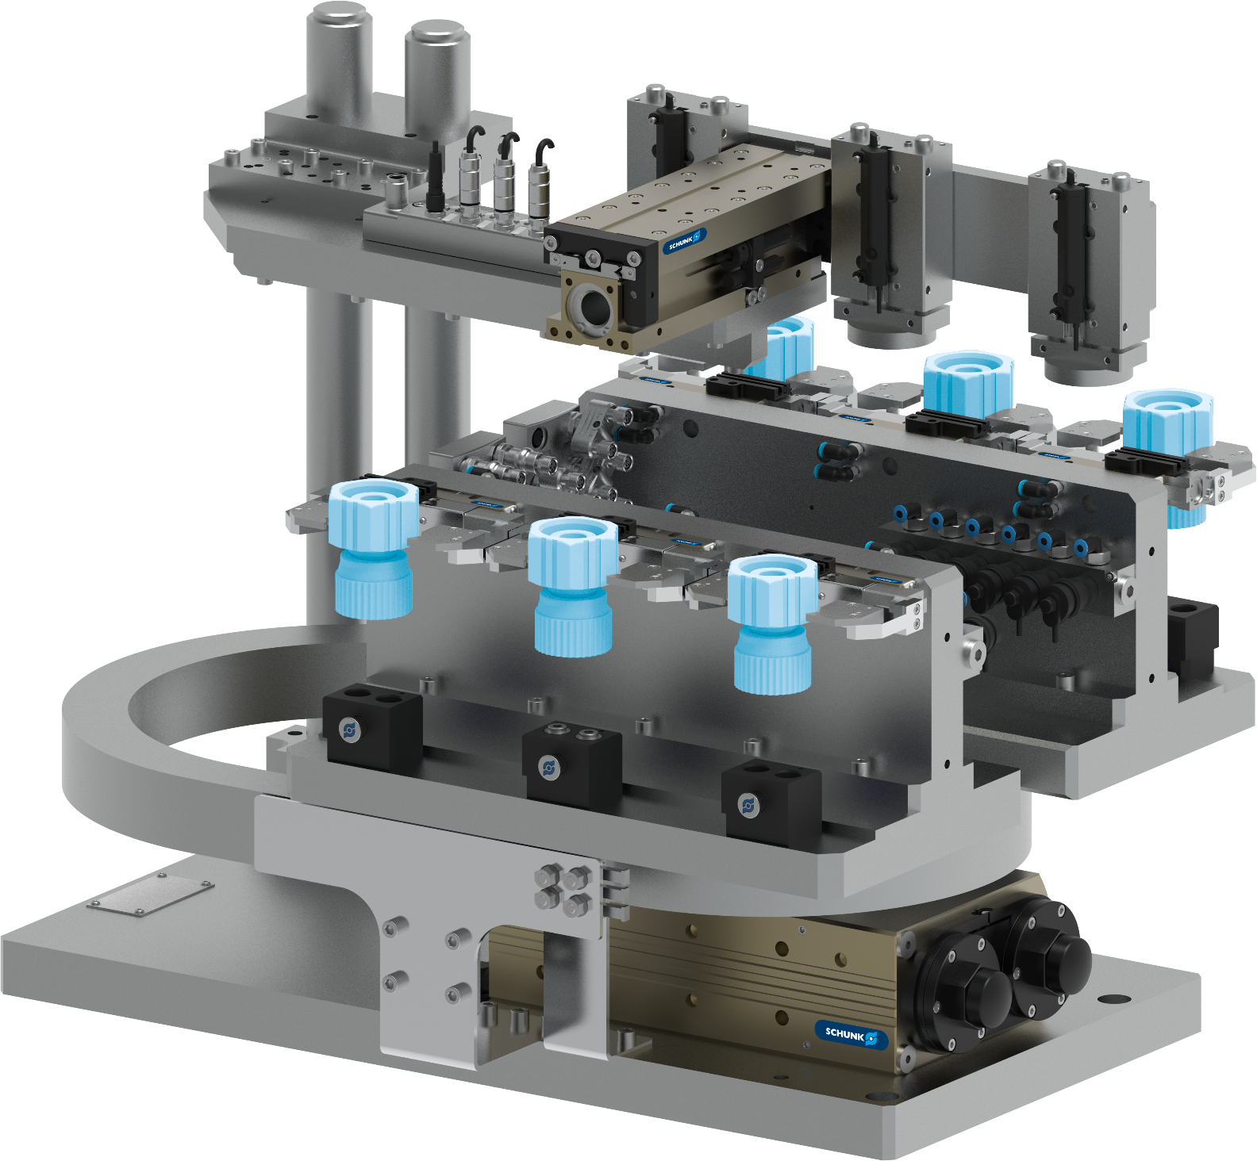
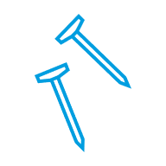



6-fold gripping swivel unit
Gripping of small items / bulk material
Machine Tending
Function
Loading, unloading, and crimping process for small parts. The customer-side counterpart for centering is changed using a quick-change system.
Customer benefit
  Quick changeover
  Maximum parallelization
  Integrated media feed-through
  High scalability
Expert project planning team
Sizing, design and assembly by SCHUNK
second page available
TYPICAL PRODUCTS
TYPICAL PROCESS
REQUIREMENTS
HIGHSPEED
RELIABILITY
ACCURACY
Notes:
SCHUNK ID: 1502263

Slide 6

6-fold gripping swivel unit
Gripping of small items / bulk material
Machine Tending
Adapter plates, sensor distributor, valves, magnetic switch, energy chain
6 x 2-finger
parallel gripper
KGG 60-40
6 x jaw quick-change system BSWS - customer-side counterpart for centering not shown
1 x swivel unit
SRU-plus 50
Notes:
SCHUNK ID: 1502263

Slide 7
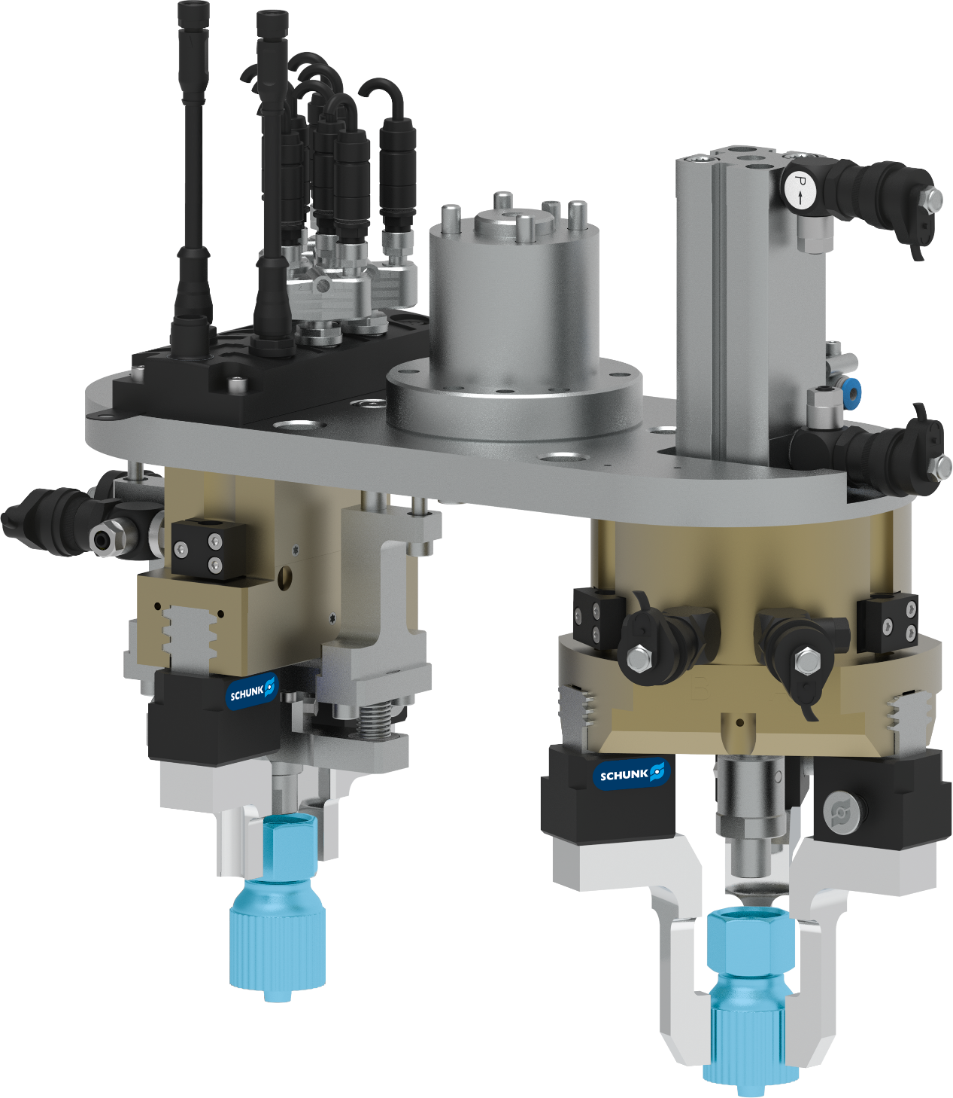
Double-Gripper unit
Gripping of small items / bulk material
Machine Tending
Function
Crimping of gripped parts with counterpart via pressing device
Customer benefit
  Compact design
  handling of high variety of parts variants
  Short setup times
  Short cycle times
Attachment to robot flange
via adapter plate
Expert project planning team
Sizing, design and assembly by SCHUNK
second page available
TYPICAL PRODUCTS
TYPICAL PROCESS
REQUIREMENTS
HIGHSPEED
RELIABILITY
ACCURACY
Notes:
SCHUNK ID: 1502264

Slide 8

Double-Gripper unit
Gripping of small items / bulk material
Machine Tending
Adapter, magnetic switch,
valve, distributor
Attachment to robot flange
via adapter plate
1 x parallel gripper
PGN-plus-P 80
1 x 3-finger centric gripper
PZB-plus 100
5 x jaw quick-change system
BSWS-BM 80
pressing device
Notes:
SCHUNK ID: 1502264

Slide 9
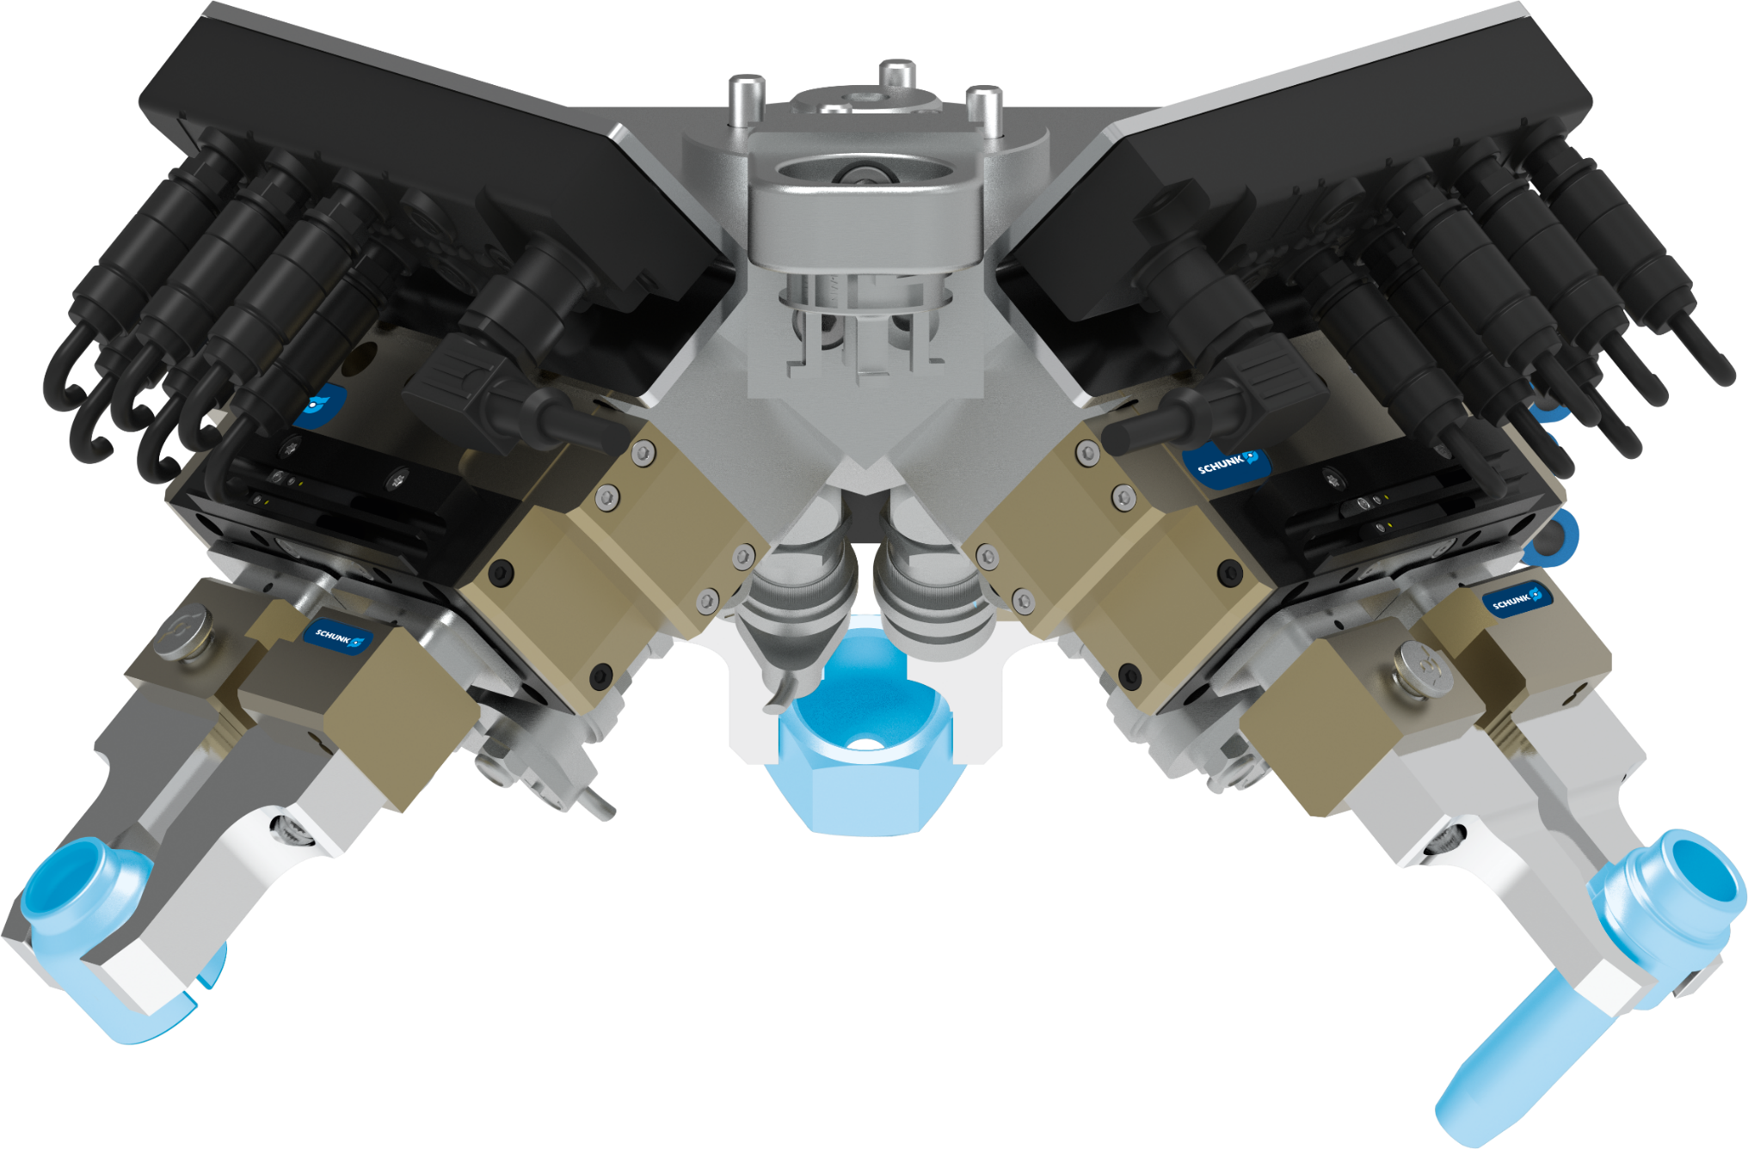
3-fold gripper unit
Gripping of small items / bulk material
Machine Tending
Function
Gripping three different small metal parts as bulk goods via customer camera system.
Customer benefit
  Compact multiple gripper solution
  Handling of high variety of parts variants
  Short setup times
  Short cycle times
Attachment to robot flange
via adapter plate
Expert project planning team
Sizing, design and assembly by SCHUNK
second page available
TYPICAL PRODUCTS
TYPICAL PROCESS
REQUIREMENTS
HIGHSPEED
RELIABILITY
ACCURACY
Notes:
SCHUNK ID: 1502261

Slide 10
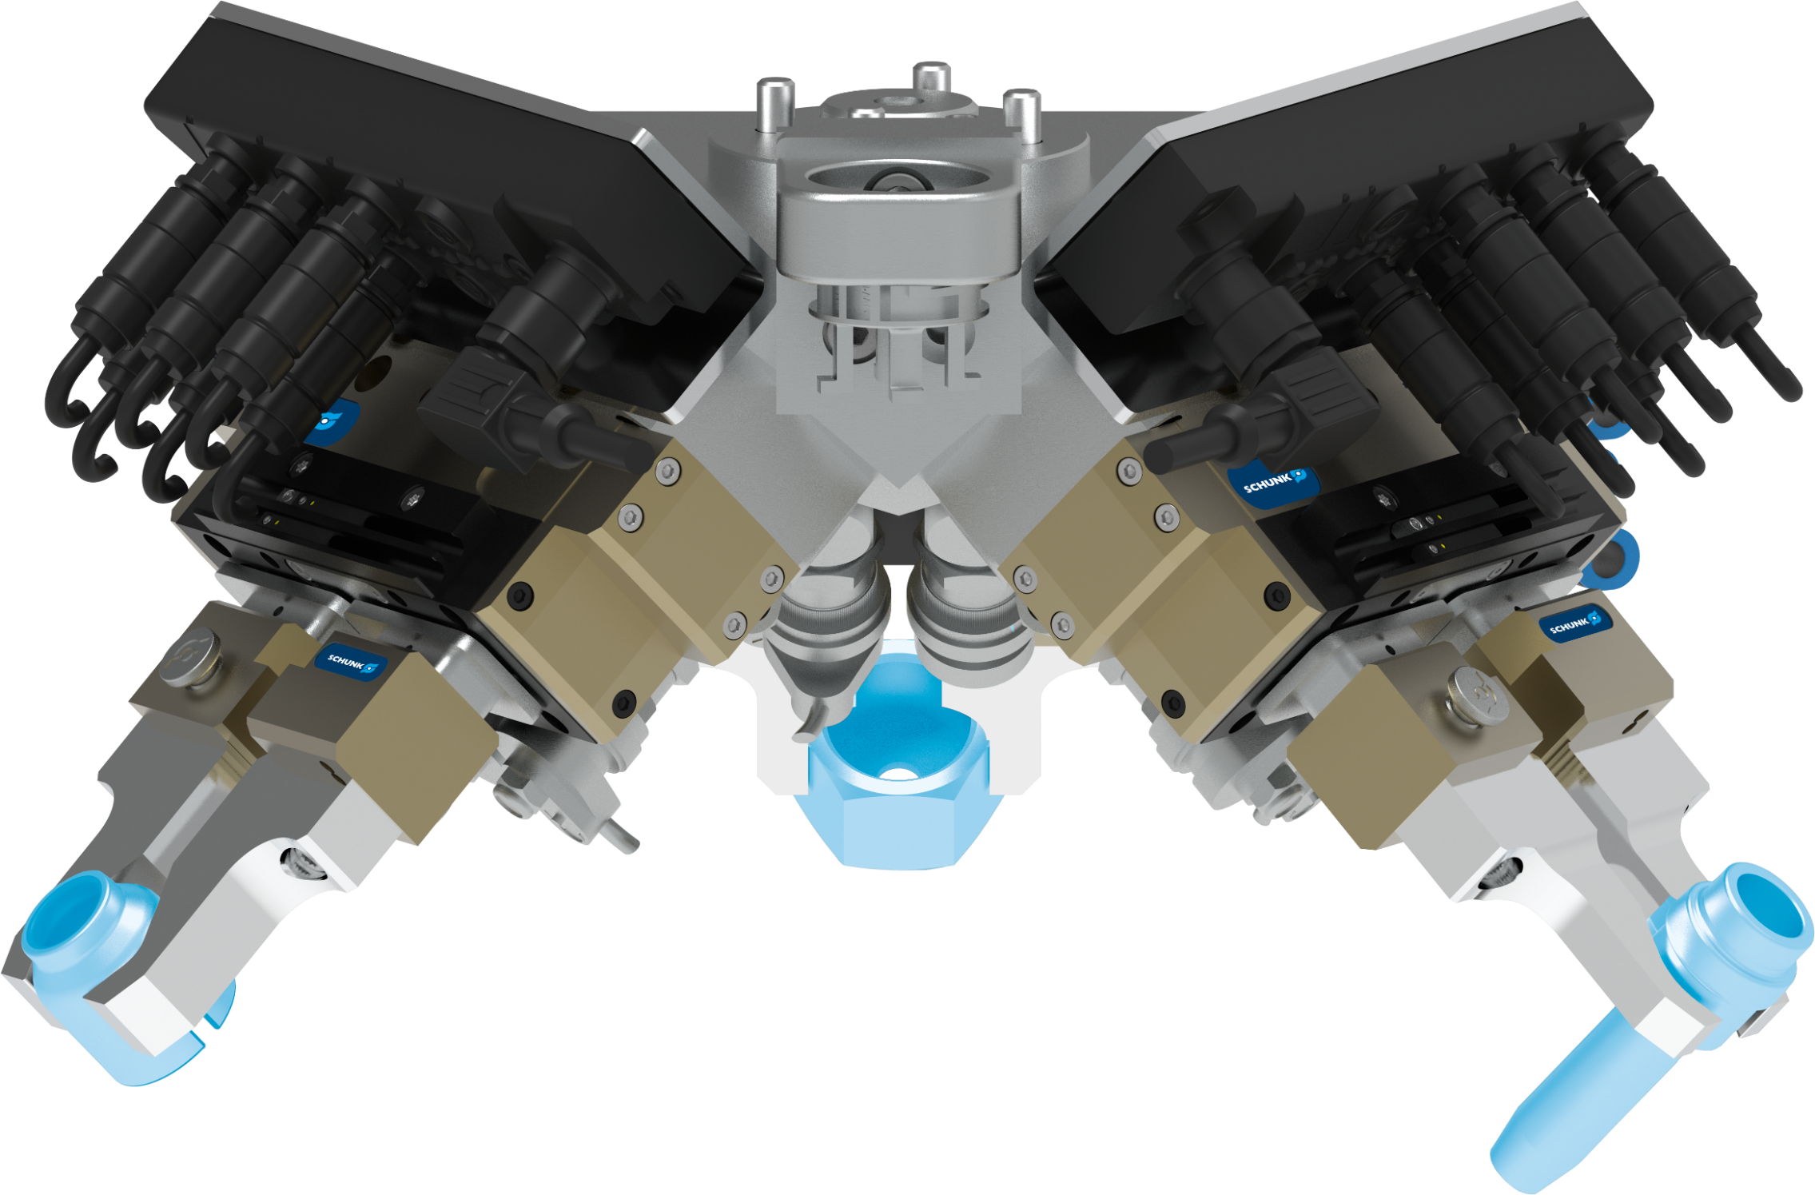
3-fold gripper unit
Gripping of small items / bulk material
Machine Tending
Exemplary representation of one gripper:
distributor
valves
2-finger parallel gripper PGL-plus-P 10-AS
second gripper
magnetic switch
jaw quick-change system
BSWS-BM 64
various attachment jaws
third gripper
Notes:
SCHUNK ID: 1502261

Slide 11


Electric 3-finger centric gripper with large stroke
Handling of large rotationally symmetrical components
Machine Tending - Lathe
Scope
  Sheet metal housing
  Wiper
  Accessible lubrication adapter
  Passive pressure unit
  Angular gearbox
Servo-electric drive
Servomotor adaptable by the customer
Robust guidance
Recirculating ball bearing
Large stroke / high gripping force
TYPICAL PRODUCTS
TYPICAL PROCESS
REQUIREMENTS
STRONG
Notes:
SCHUNK ID: 1562643 / ausschließlich ENTWURF-Status

Slide 12



2-finger gripper swivel modules
Handling of rotor shafts and drive shafts
Machine Tending - Metal Processing
Function and benefits
Machine tending of a turning machine: handling of rotor and drive shafts OP1 + OP2
Scope - each module consisting of:
  1x rotary module SRU-plus 50
  1x rotary module SRH-plus-D 40
  2 x sealed 2-finger parallel gripper
  DPG-plus 100 (IP67)
  adapter plates with internal air feed-through for space saving design
  8 x magnetic sensors
Customized top jaws
gas nitrocarburized & oxidized steel inserts
Expert project planning teams
Sizing, design and assembly by SCHUNK
second page available
TYPICAL PRODUCTS
TYPICAL PROCESS
REQUIREMENTS
RELIABILITY
STRONG
WET
Notes:
SCHUNK ID: 1571789 / 1571786

Slide 13


2-finger gripper swivel modules
Handling of rotor shafts and drive shafts
Machine Tending - Metal Processing
The gripper swivel modules are operated on a gantry system between central storage and turning machine → gantry systems also scope of SCHUNK Engineering
1x rotary module SRU-plus 50
1x rotary module SRH-plus-D 40
adapter plates with internal air feed-through for space saving design
2 x sealed 2-finger parallel gripper
DPG-plus 100 (IP67) with customized to jaws
Notes:
SCHUNK ID: 1571789 / 1571786

Slide 14
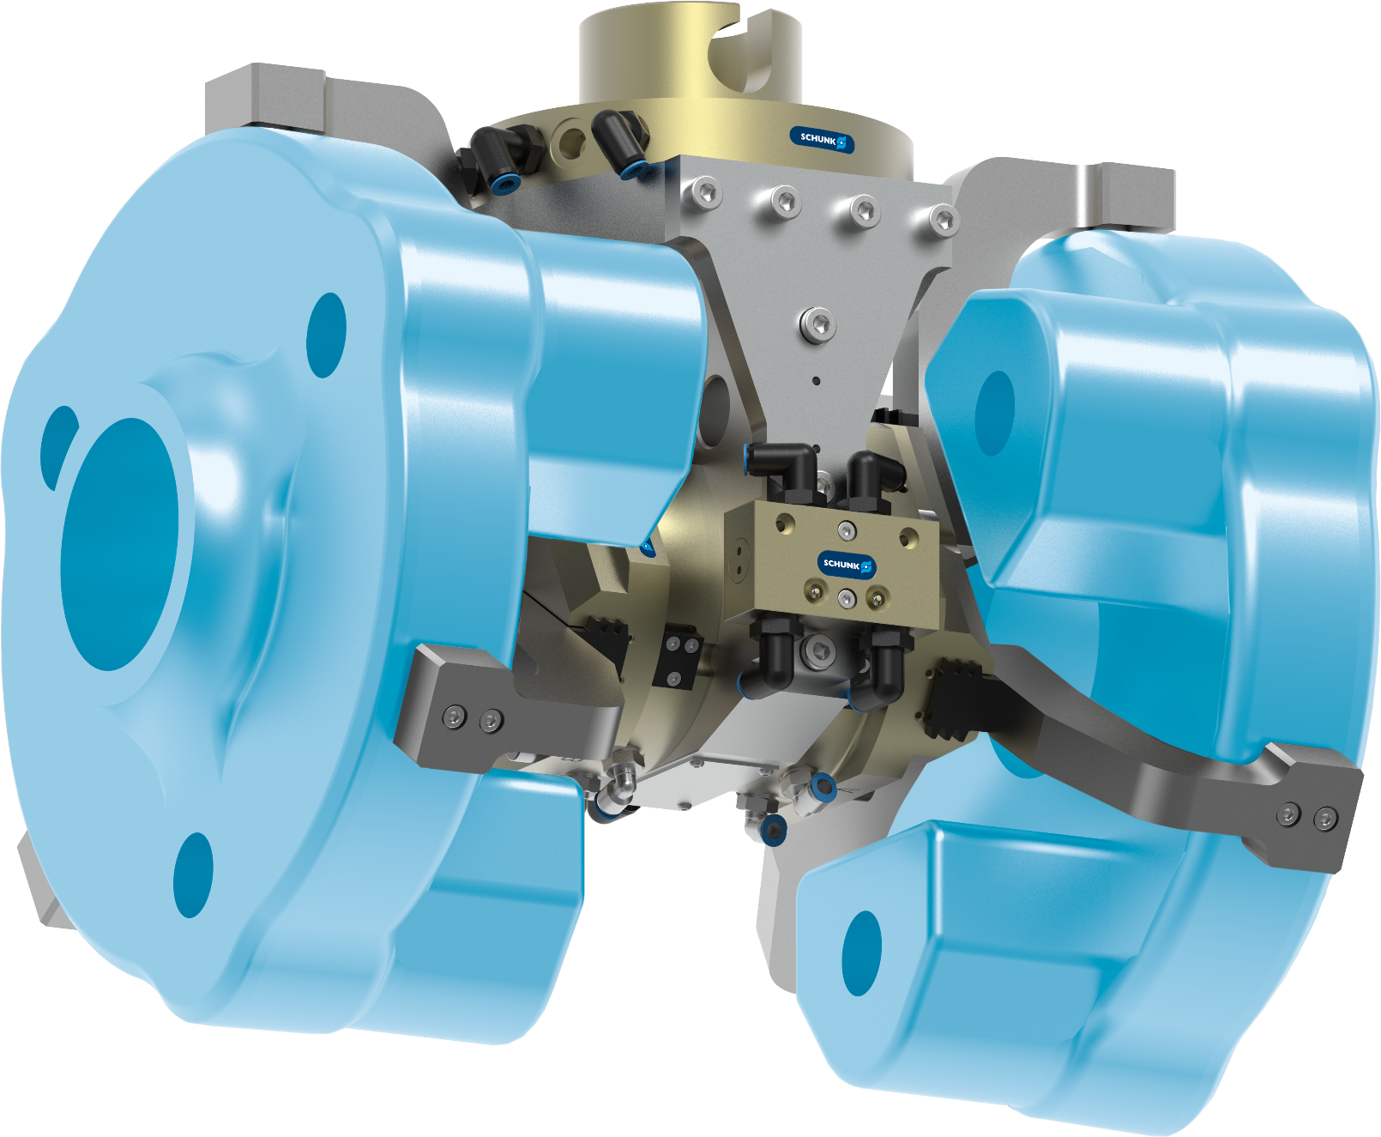
3-finger double gripper + quick-change system
Light-weight design with maximum gripping force
Machine Tending - Metal Processing
Function and benefits
3-finger double gripper with manual quick-change system as end-of-arm on a robot. Reduction of gripper weight to allow heaver workpiece but carry over the existing robot.
Scope
  2x 3-finger centric gripper PZN-plus 125-2
  quick change system SHS-125
  light-weight adapter plate
  Pressure maintenance valve SDV-P
Customized top jaws
with peaky inserts for higher friction
Expert project planning teams
Sizing, design and assembly by SCHUNK
second page available
TYPICAL PRODUCTS
TYPICAL PROCESS
REQUIREMENTS
RELIABILITY
STRONG
ACCURACY
Notes:
SCHUNK ID: 1566116

Slide 15

3-finger double gripper + quick-change system
Light-weight design with maximum gripping force
Machine Tending - Metal Processing
manual quick change system
SHS-125
light-weight adapter plate
Pressure maintenance valve SDV-P
2x 3-finger centric gripper
PZN-plus 125-2
with customized top jaws: peaky inserts for higher friction
Notes:
SCHUNK ID: 1566116

Slide 16


Heavy-duty handling
Handling an engine block weighing approx. 350 kg for trucks
Machine Tending - Metal processing
Function and customer benefits
Transferring the unmachined casting part to the machine tool. Multiple tolerance compensation enables clamping on raw clamping contours with component tolerances of several millimeters.
Scope
  C-axis
  x-y-z compensation unit
  2-finger parallel gripper
  Swivel finger with tolerance compensation
  Adapter plates and other accessories
Expert project planning team
Sizing, design and assembly by SCHUNK
second page available
TYPICAL PRODUCTS
TYPICAL PROCESS
REQUIREMENTS
RELIABILITY
STRONG
ACCURACY
Notes:
SCHUNK ID: 1535228

Slide 17

Heavy-duty handling
Handling an engine block weighing approx. 350 kg for trucks
Machine Tending - Metal processing
C-axis
Others:
Adapter plates
Sensors, Gear unit
Blow nozzles for cleaning the gripper pins incl. tubing
x-y-z compensation unit
2-finger parallel gripper
Swivel finger with tolerance compensation
Notes:
SCHUNK ID: 1535228

Slide 18
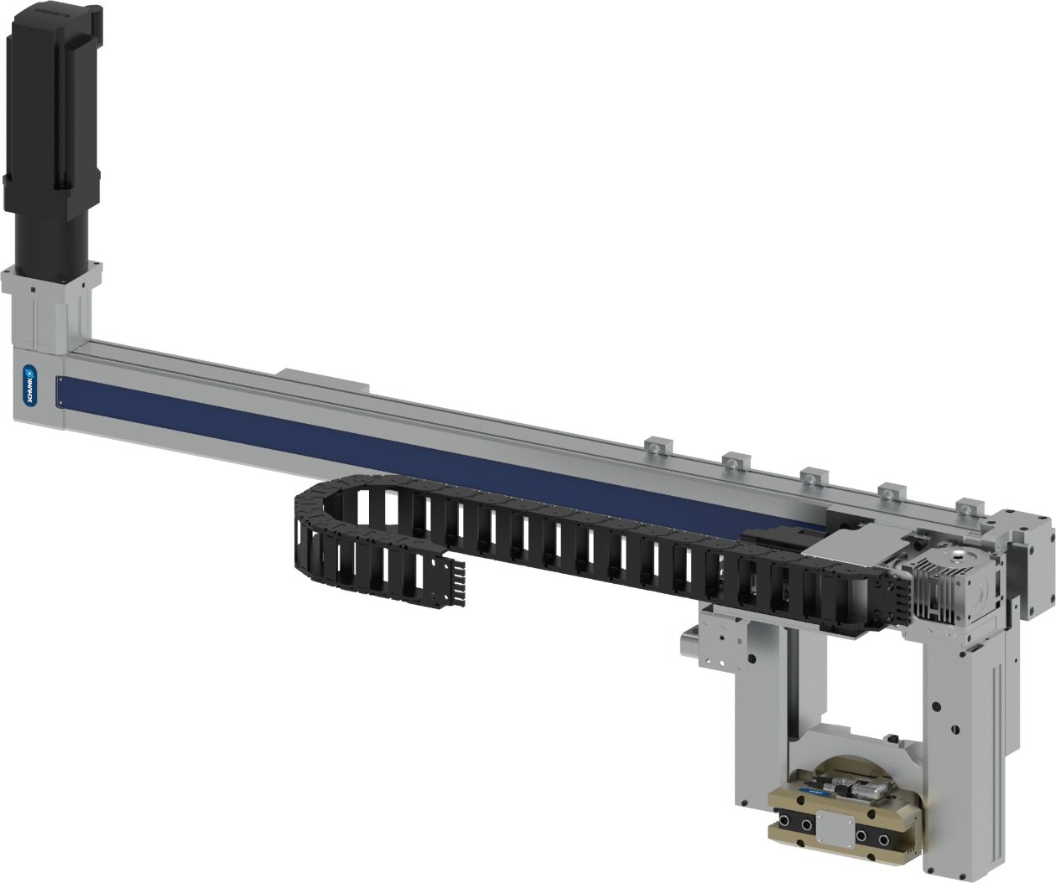


2-axis system with swivel/gripper unit
Loading and unloading of turned parts
Machine Tending – Turning / milling
Loading and unloading system according to customer specifications
Special solution for limited space
Components
  Linear axis horizontal type B 100-D-ZSS
  Linear axis vertical ‘special’
  Swivel axis pneum. type SRU-plus 35
  Double gripping unit type PGN-plus 160 with BSWS
Workpieces
Turned parts
Scope of delivery
Complete axis system incl. gearbox
TYPICAL PRODUCTS
TYPICAL PROCESS
REQUIREMENTS
HIGHSPEED
RELIABILITY
ACCURACY
Notes:
SCHUNK ID: 30503164

Slide 19
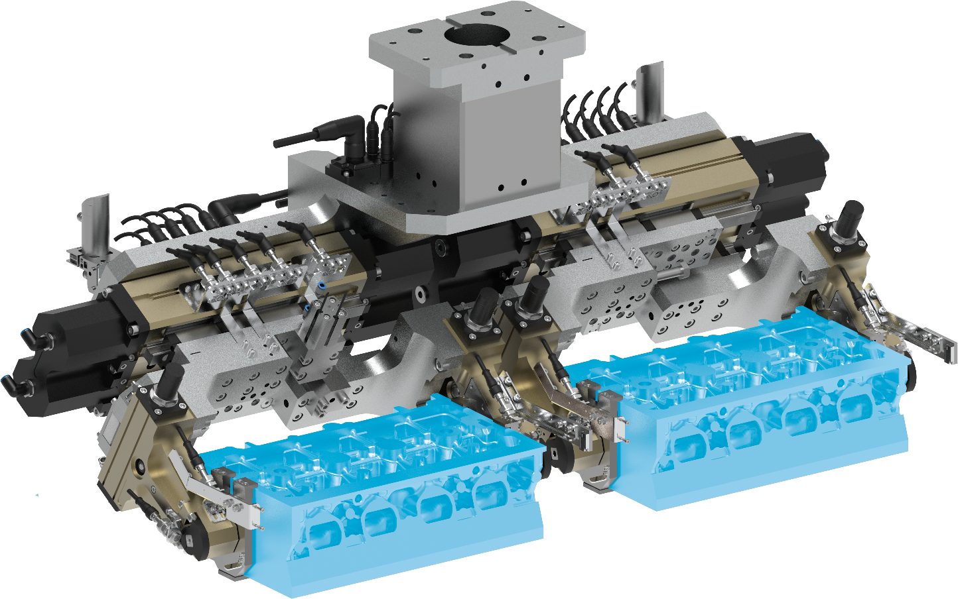
2-fold rotary-gripping unit
Loading/unloading of cylinder heads
Machine Tending – Metal processing
Customized rotary-gripping unit
pneumatic
Customized interface
for mounting on linear gantry
2x gripper PHL-W 63-160-S
4-position monitoring with proximity switch M8
4x rotary finger GFS 40-180
with clamping and monitoring with proximity switch M8
Workpiece detection
with light barrier
Plug and Play
with valve technology and electrical distributor, completely wired and hosed
TYPICAL PRODUCTS
TYPICAL PROCESS
REQUIREMENTS
RELIABILITY
STRONG
ACCURACY
Notes:
SCHUNK ID: 1427053

Slide 20
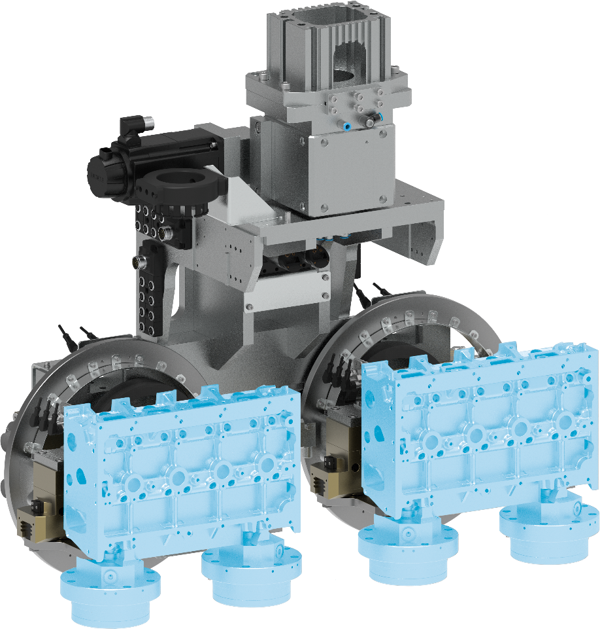
2-fold rotary-gripping unit
Loading/unloading of cylinder heads
Machine Tending – Metal processing
Customized rotary-gripping unit
ready to install to customer portal
Rotation with ERM 160
as C-axis
Swiveling with SRU-plus
with external clamping via ring element
Gripping at 2x quick-change clamping pins
mounted to workppiece
Plug and Play
with valve technology and electrical distributor, completely wired and hosed
Complete project management
Sizing, design and assembly by SCHUNK
TYPICAL PRODUCTS
TYPICAL PROCESS
REQUIREMENTS
RELIABILITY
STRONG
ACCURACY
Notes:
SCHUNK ID: 1427056

Slide 21
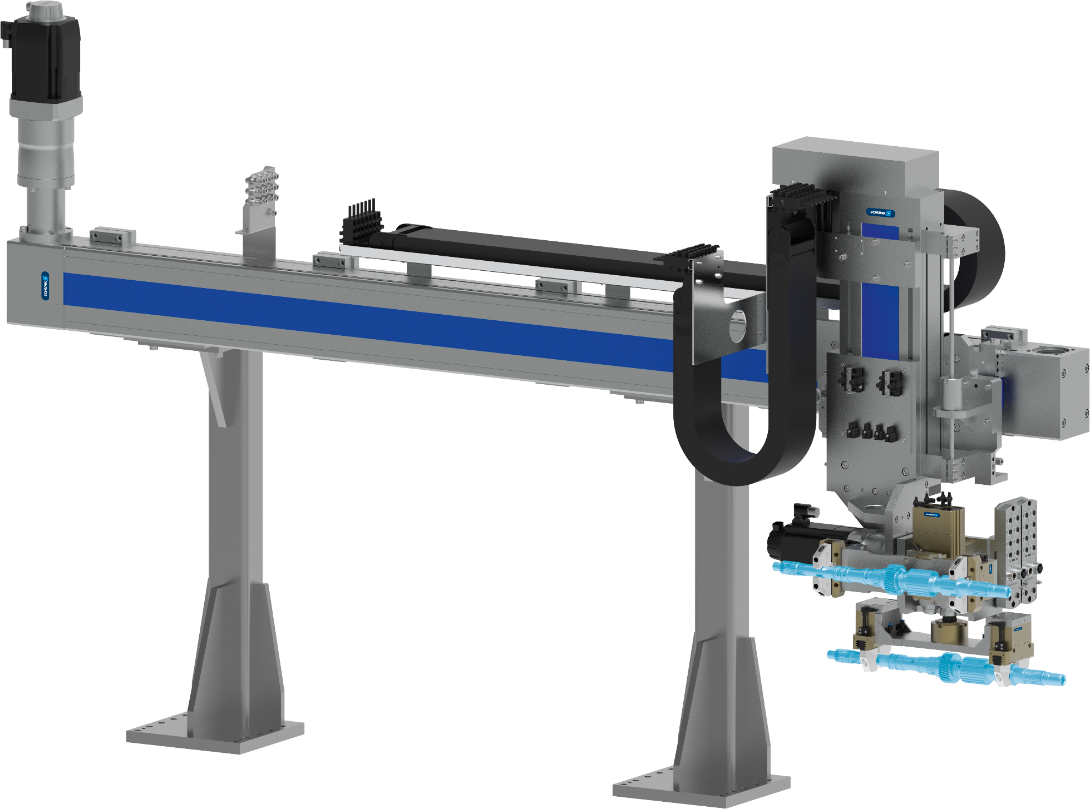
2-axis system with swivel/gripper unit
Loading and unloading of drive shafts
Machine Tending - Gear cutting machines
Loading and unloading system according to customer specifications
Robust design with special solution for swivel unit
Components
  Linear axis type B 180-C-ZSS / D 200-SSS
  Swivel axis electr. with gearbox type TK+025
  Swivel axis pneum. type SRU-plus D35
  Overload protection OPR-081
  4-fold gripping unit type PGN-plus 100 with BSWS
Workpieces
drive shafts
Scope of delivery
Complete axis system incl. motors and steel construction
TYPICAL PRODUCTS
TYPICAL PROCESS
REQUIREMENTS
HIGHSPEED
RELIABILITY
ACCURACY
Notes:
SCHUNK ID: 30079650

Slide 22
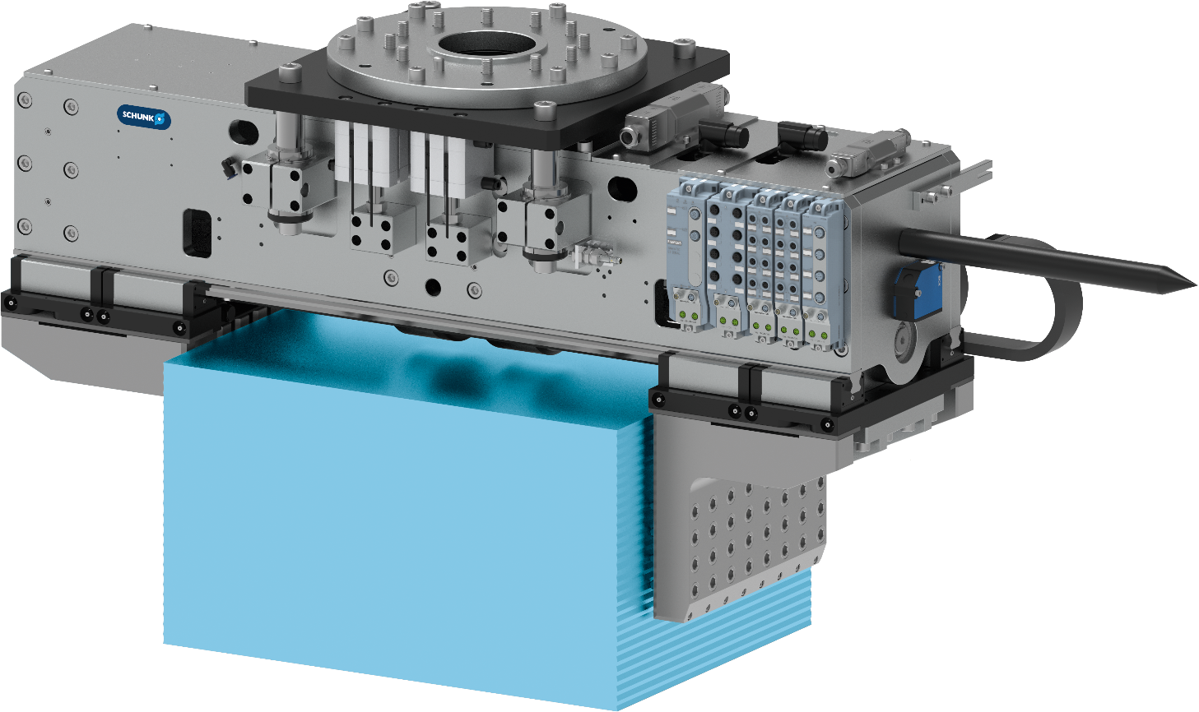


Gripper unit ELG
Loading/unloading raw material into/from a sawing machine
Machine Tending - Sawing machines
Heavy-duty gripper unit
for workpiece weights up to 200 kg
Customized collision protection
Pneumatically lockable
Pallet change system
NSR-A 160
Top jaws for uneven workpieces
due to integrated, spring-loaded, toothed clamping elements
Robot adjustment tip
Attachment integrated in gripper unit
TYPICAL PRODUCTS
TYPICAL PROCESS
REQUIREMENTS
Notes:
SCHUNK ID: 1423248

Slide 23
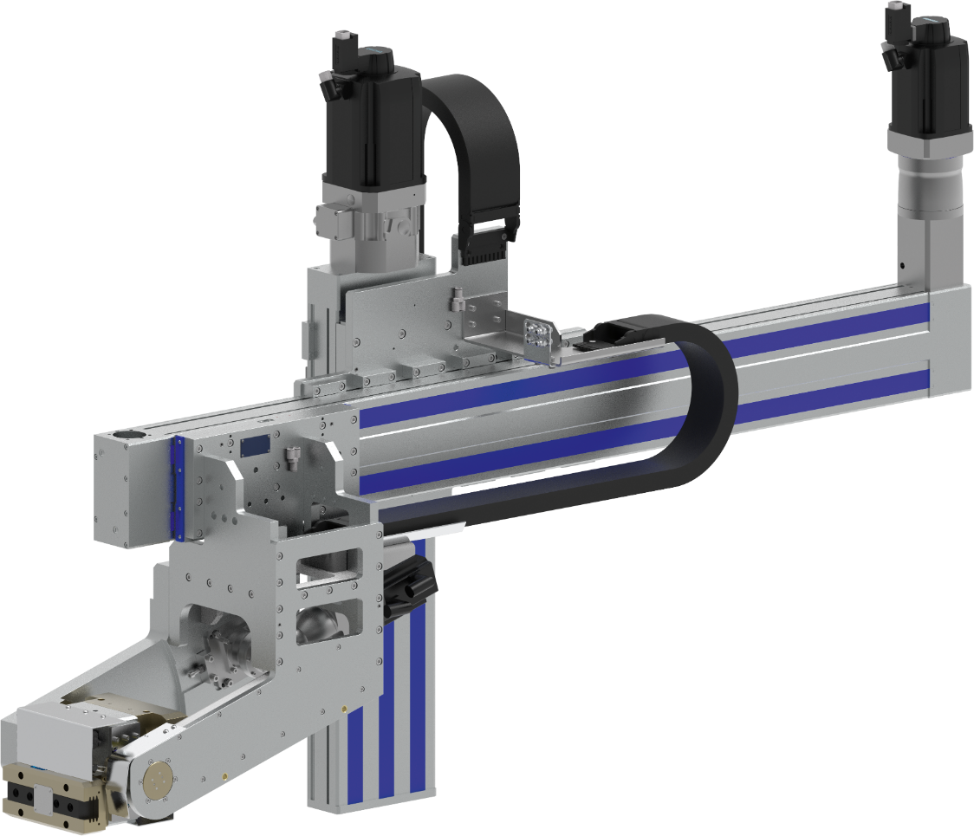

2-axis system with swivel/gripper unit
Loading and unloading of gear wheels
Machine Tending - Gear cutting machines
Loading and unloading system according to customer specifications
Robust design with special solution for swivel unit
Components
  Linear axis type D 240-SSS / D 200-ZSS
  Swivel axis electr. ‘special‘ with belt drive
  Rotary feed-through DDF-2-40
  Double gripping unit tpe PGN-plus 125
Workpieces
Gear wheels
Scope of delivery
Complete axis system incl. gearbox and servomotors
TYPICAL PRODUCTS
TYPICAL PROCESS
REQUIREMENTS
HIGHSPEED
RELIABILITY
ACCURACY
Notes:
SCHUNK ID: 30082510

Slide 24
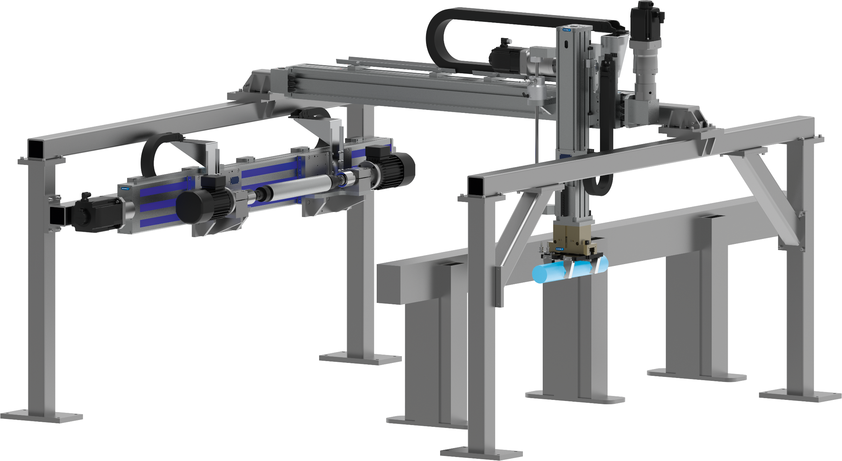
2-axis system with deburring spindle + gripper - Unloading and deburring
Machine Tending - Sawing machines
Multi-axis system with gripper unit
Task: Unloading a sawing machine with subsequent deburring of the workpieces
Added value
Two tasks are automated in one handling operation. The removal of profile sections including deburring.
Workpieces
Sectional steels, weight range up to 50 kg
Wide range of parts
Part diameter 20–103 mm
TYPICAL PRODUCTS
TYPICAL PROCESS
REQUIREMENTS
HIGHSPEED
RELIABILITY
ACCURACY
Notes:
SCHUNK ID: 1416474

Slide 25
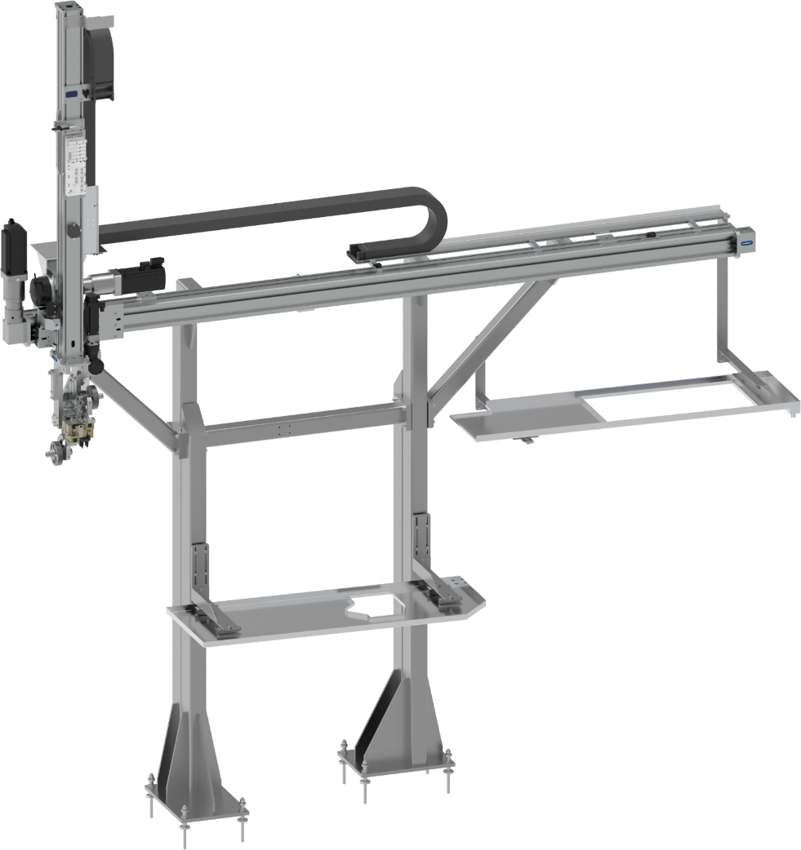
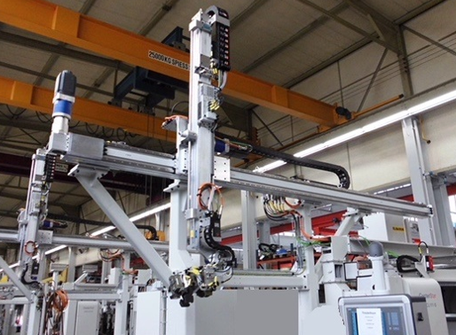
2-axis system with swivel/gripper unit
Loading and unloading of drive shafts
Machine Tending - Grinding machine
Loading and unloading system incl. swivel/gripper unit
Robust design for difficult environments
Components
  Linear axis type G-160 / G-120
  Swivel axis electr. with gearbox type TK+025
  Swivel axis pneum. type SRU-plus 40
  Double gripping unit type PGN-plus 125
Workpieces
Drive shafts with splines
Scope of delivery
Complete axis system incl. drives and steel construction
TYPICAL PRODUCTS
TYPICAL PROCESS
REQUIREMENTS
HIGHSPEED
RELIABILITY
ACCURACY
Notes:
SCHUNK ID: 1341213

Slide 26
2-axis system with swivel/gripper unit
Loading and unloading of gear wheels
Machine Tending - Gear cutting machines
Loading and unloading system according to customer specifications
Robust design with special solution for swivel unit
Components
  Linear axes type D 200-SSS / 2x B 80-C
  Swivel axis pneum. type SRU-plus 40
  Double gripping unit type PGN-plus 125 with BSWS
  Analog position sensor for part detection
Workpieces
Gear wheels
Scope of delivery
Complete axis system incl. servomotors
TYPICAL PRODUCTS
TYPICAL PROCESS
REQUIREMENTS
HIGHSPEED
RELIABILITY
ACCURACY
Notes:
SCHUNK ID: 30077329

Slide 27
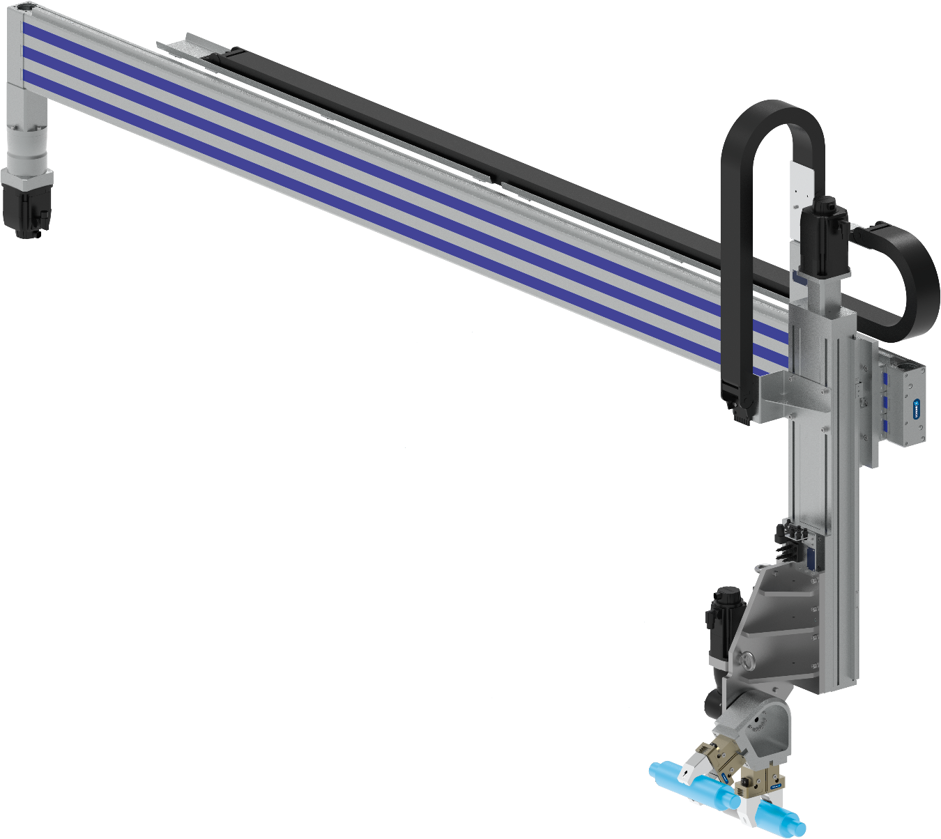
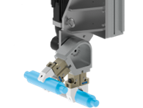

2-axis system with swivel/gripper unit
Loading and unloading of shafts and bearing rings
Machine Tending - Grinding machine
Loading and unloading system according to customer specifications
Robust design with special solution for swivel unit
Components
Linear axes type D 240-ZSS / D 200-SSS
Swivel axis electr. with gearbox type NP+035
Double gripping unit type PGN-plus 125
  Analog position sensor for part detection
Workpieces
shafts and bearing rings
Scope of delivery
Complete axis system incl. servomotors
TYPICAL PRODUCTS
TYPICAL PROCESS
REQUIREMENTS
HIGHSPEED
RELIABILITY
ACCURACY
Notes:
SCHUNK ID: 1463927

Slide 28
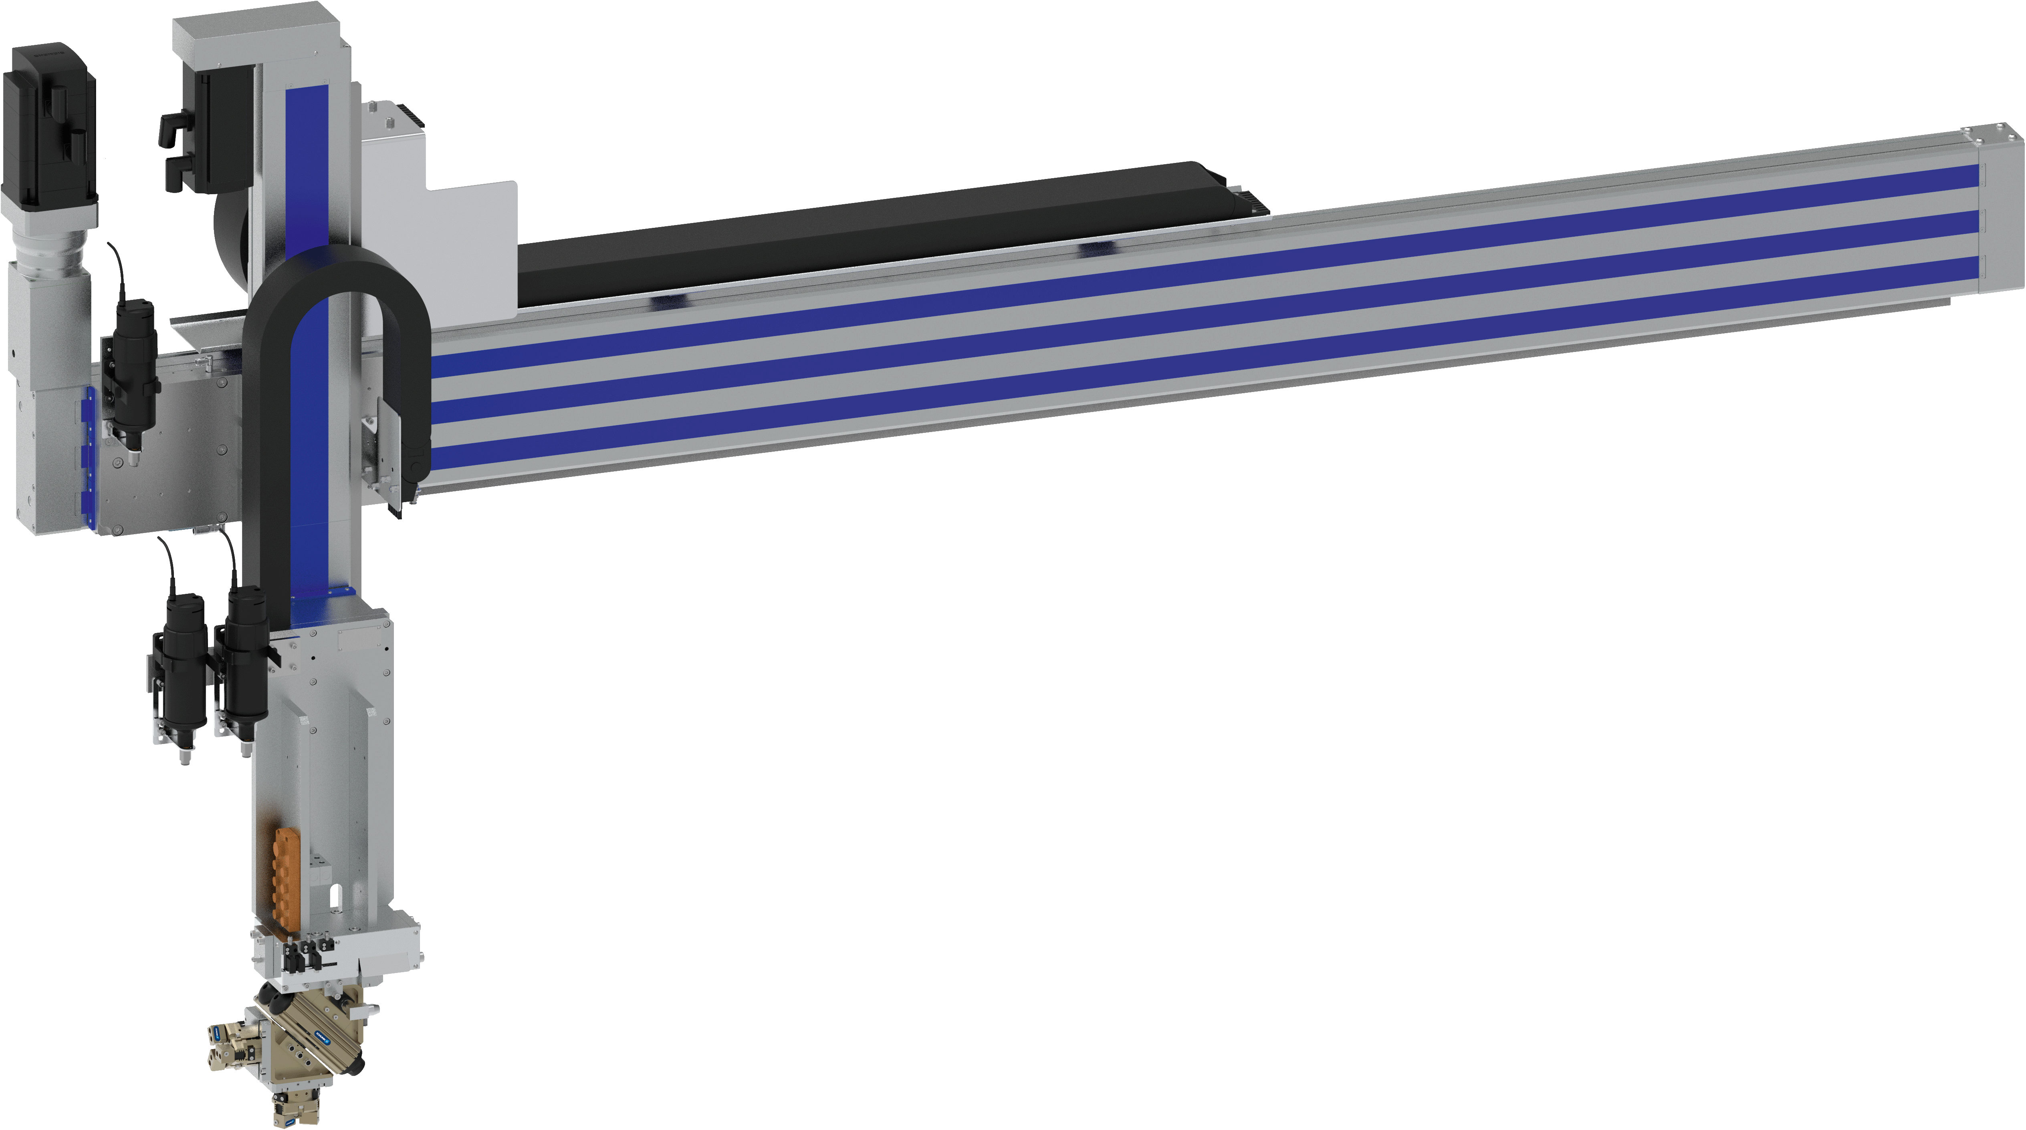
2-axis system with swivel/gripper unit
Loading and unloading of gear wheels
Machine Tending - Grinding machine
Loading and unloading system according to customer specifications
Robust design with modular EOA tooling
Components
  Linear axes type D 240-C-ZSS / D 145-SSS
  Swivel head pneum. type SRH-plus 25
  Special Pressure unit ADE-01
  2x gripper type PZB-plus 64 with workpiece cleaning
Workpieces
gear wheels
Scope of delivery
Complete axis system incl. servomotors
TYPICAL PRODUCTS
TYPICAL PROCESS
REQUIREMENTS
HIGHSPEED
RELIABILITY
ACCURACY
Notes:
SCHUNK ID: 1474865

