Slide 1

SCHUNK Engineering
Solution Book - Life Science
Note:
This presentation contains confidential information and is only released for non-public use by customers and suppliers.
Consultation with specialist department may be necessary.
- Remove this note before use -

Slide 2
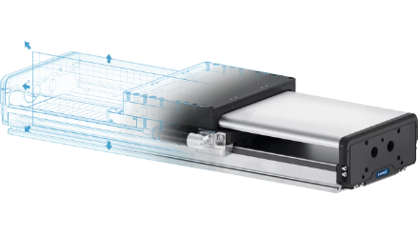
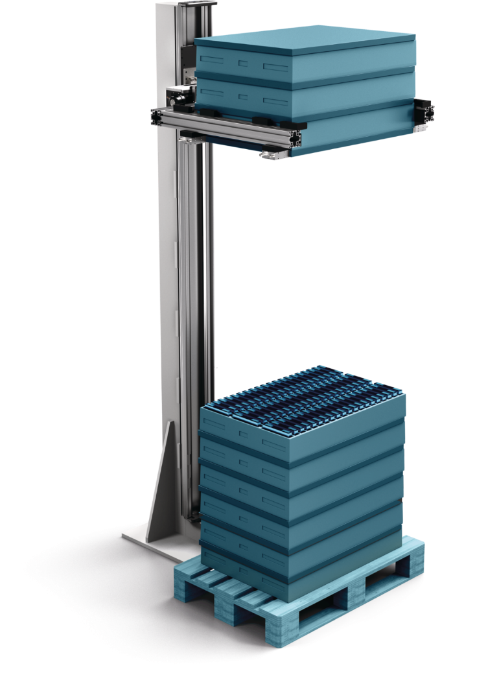
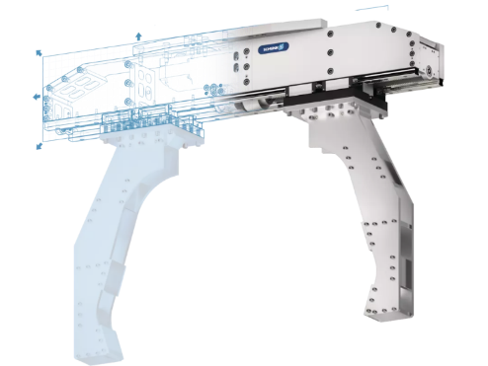

Material Lifter
Lifting trays for automated unloading
Life Science - Intralogistics
Function
Lifting trays layer by layer for automated unloading.
Customer benefits
Compact and space saving:
Using the z-axis vs. x/y-axis saves valuable installation / floor area
Flexibility - virtually universal:
The Material Lifter with configurable axis and gripper can be adapted to many applications in terms of size, load, speed, …
Expert project planning team
Sizing, design and assembly by SCHUNK
+
additional slides available

Slide 3
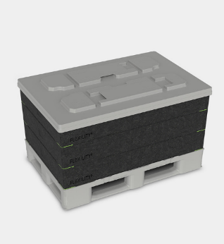
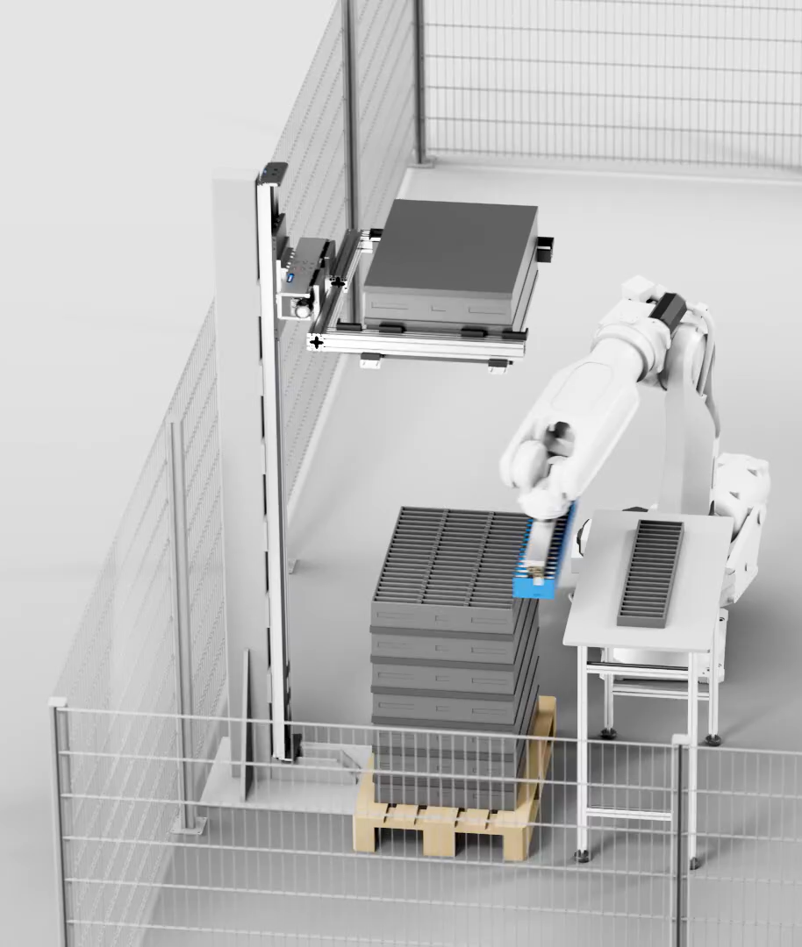
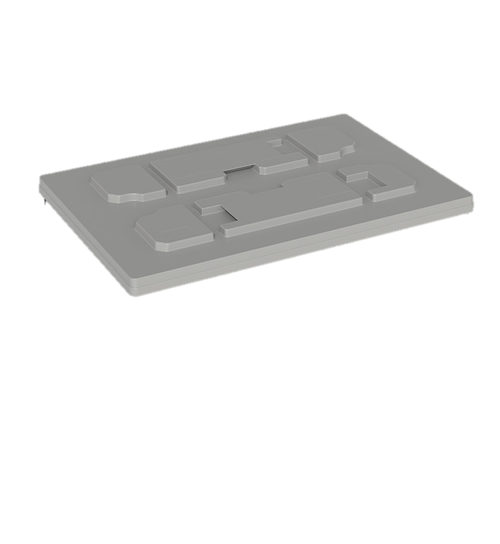
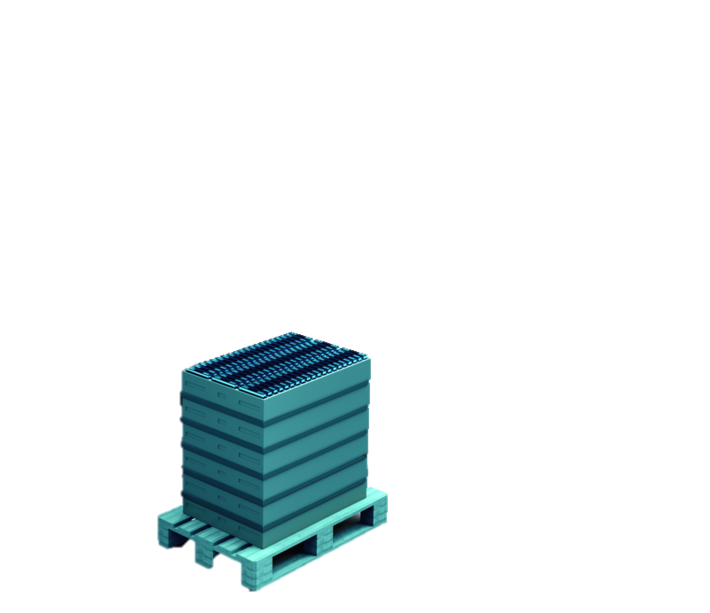
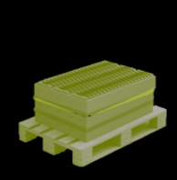
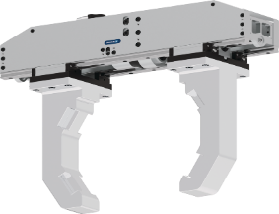
Material Lifter
Lifting trays for automated unloading
Life Science - Intralogistics
Cover handling
Saves
Floorspace
Pure
Flexibility

Slide 4
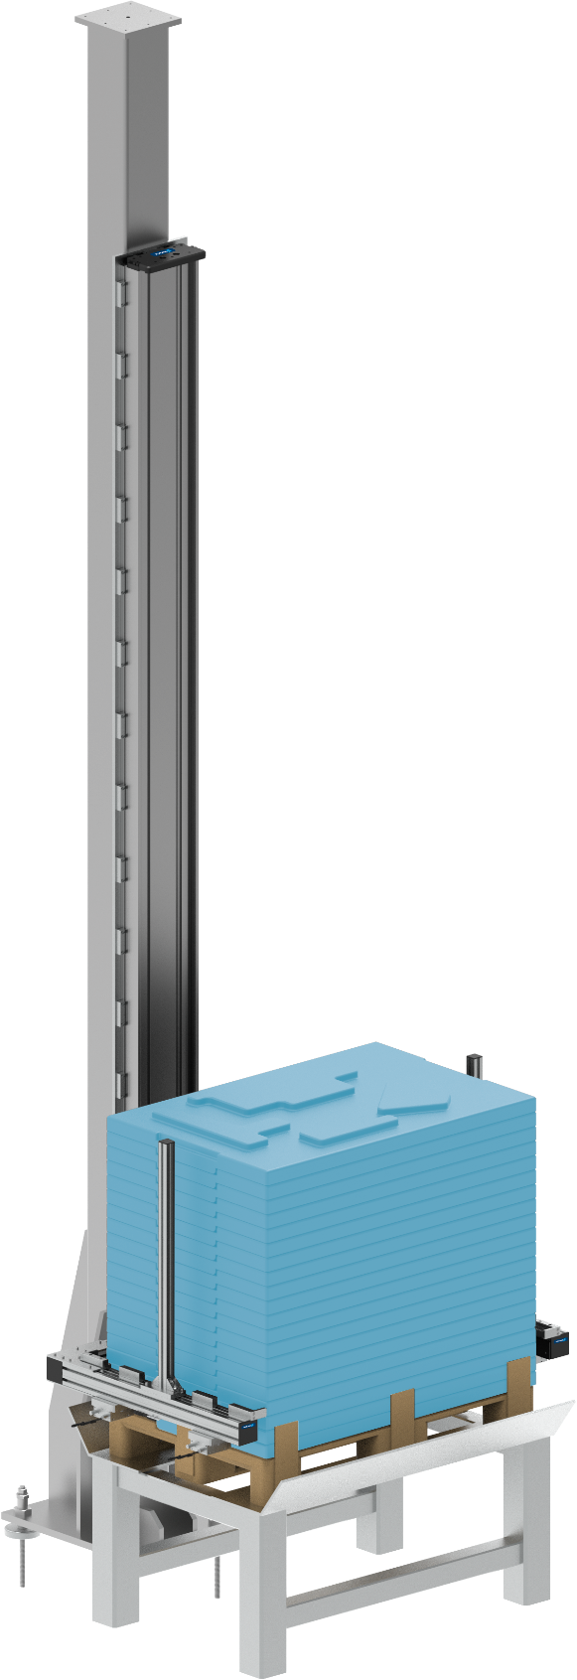
Material Lifter
Lifting trays for automated unloading
Life Science - Intralogistics
Reference project
consisting of
Linear direct axis SLD-24 heavy-duty design with working stroke 3.200 mm
Electric long-stroke gripper ELG 30
1
2
Notes:
SCHUNK ID: 1602006

Slide 5

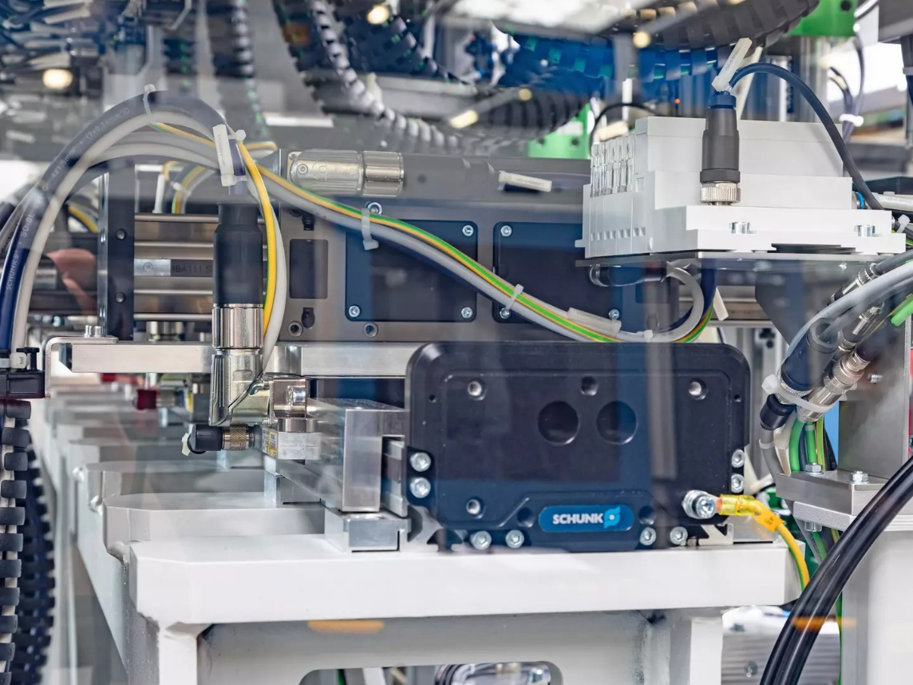






It couldn't be more compact!
Screw assembly cell with five screw units
Life Science - Assembly
Function
Five separately controlled slides enable high-precision and fast screw processes in the assembly cell. The robustness and accuracy of the SLD-axis ensures flawless screwdriving processes and avoids scrap.
Scope
  1x linear direct axis SLD 11 with five slides (x-axis)
  5x linear direct axis LDN (y-axis)
Customer benefit
  Highly compact unit integrated into existing customer line
  High load capacity of the base axis ensures precision of screwdriving operations
Discharge side view of the SLD linear direct axis installed on a steel girder.
second page available
TYPICAL PRODUCTS
TYPICAL PROCESS
REQUIREMENTS
Click here for the success story!
HIGHSPEED
STRONG
ACCURACY
Notes:
SCHUNK ID: 1554728

Slide 6
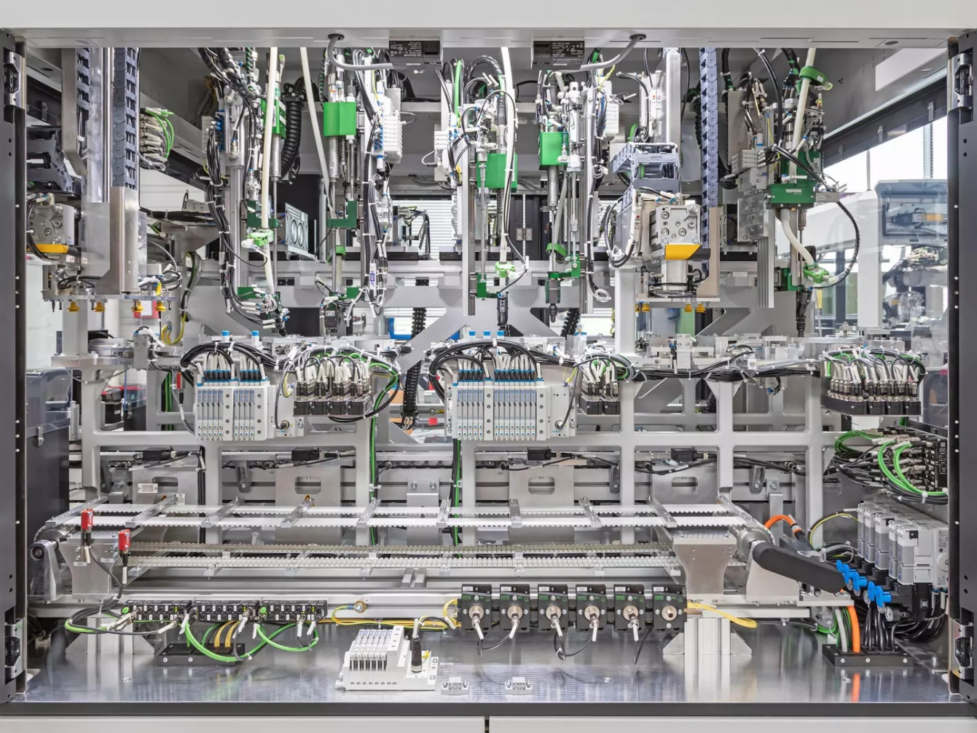
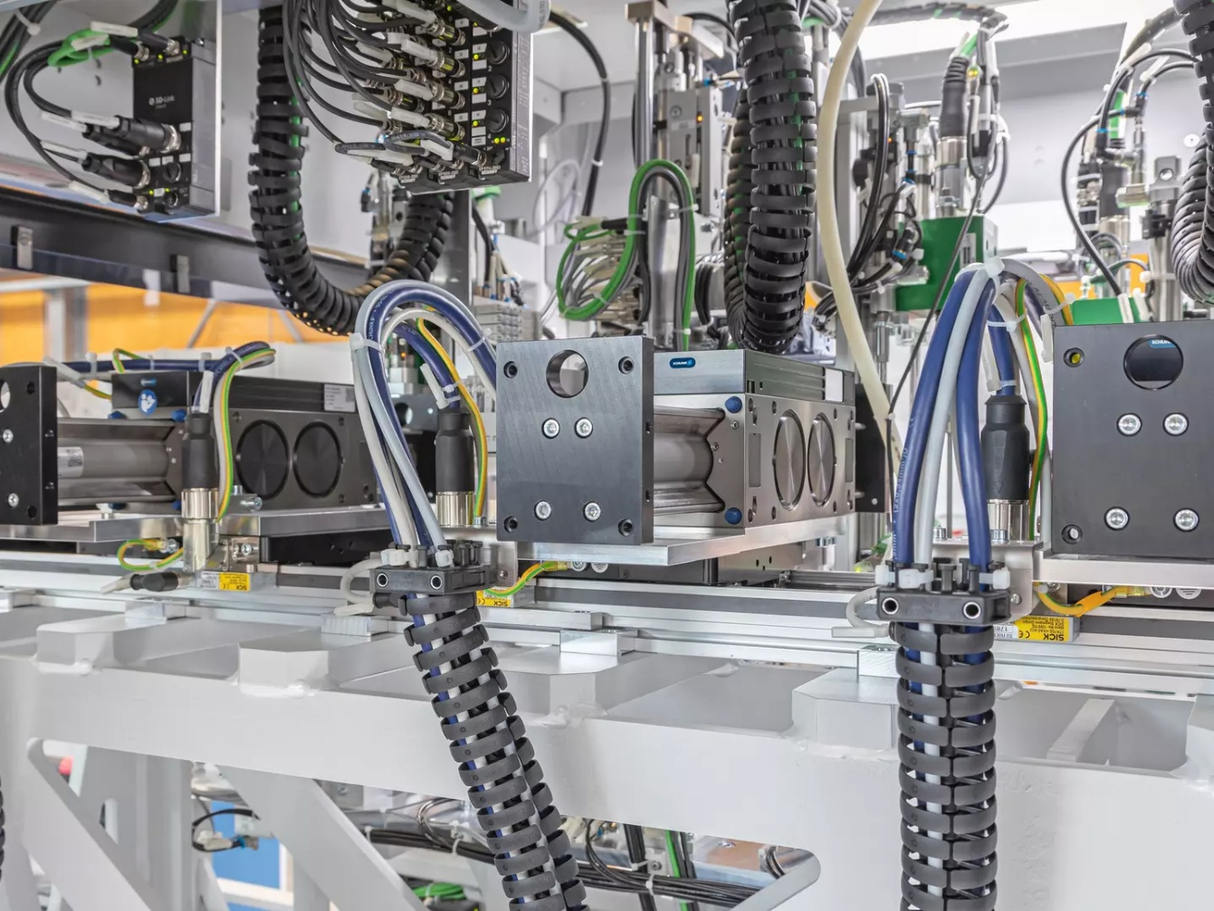
It couldn't be more compact!
Screw assembly cell with five screw units
Life Science - Assembly
Complete view of the extremely compact screwdriving assembly cell with five screwdriving units. The heart of the cell is the SLD horizontal linear direct axis with five independently movable carriages.
An LDN universal linear axis is mounted transversely on the SLD horizontal linear direct axis, on all five slides.
Click here for the success story!
Notes:
SCHUNK ID: 1554728

Slide 7
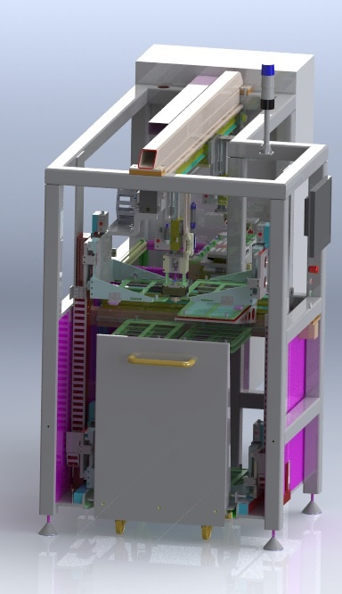
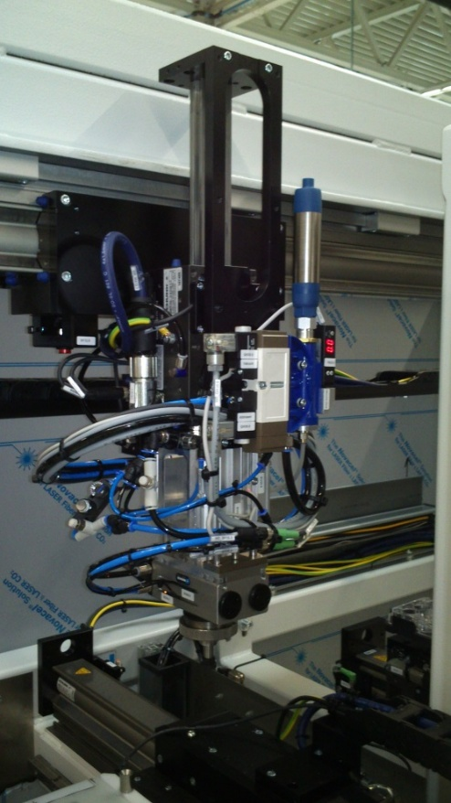

Axis System
Handling of test specimens
Life Science - Assembly
Complete project management
Sizing, design and assembly by SCHUNK
Cycle axis
Y1-axis: LDN-UL-0200-0600
Gantry
  X-axis: LDN-U-2-200-100-1805,
  rated force 200 N
  Z-axis: LDK-US-100-100,
  rated force 100 N
Swivel table
LDN-US-0100-100
TYPICAL PRODUCTS
TYPICAL PROCESS
REQUIREMENTS
HIGHSPEED
STRONG
ACCURACY
Notes:
SCHUNK ID: 374100

Slide 8
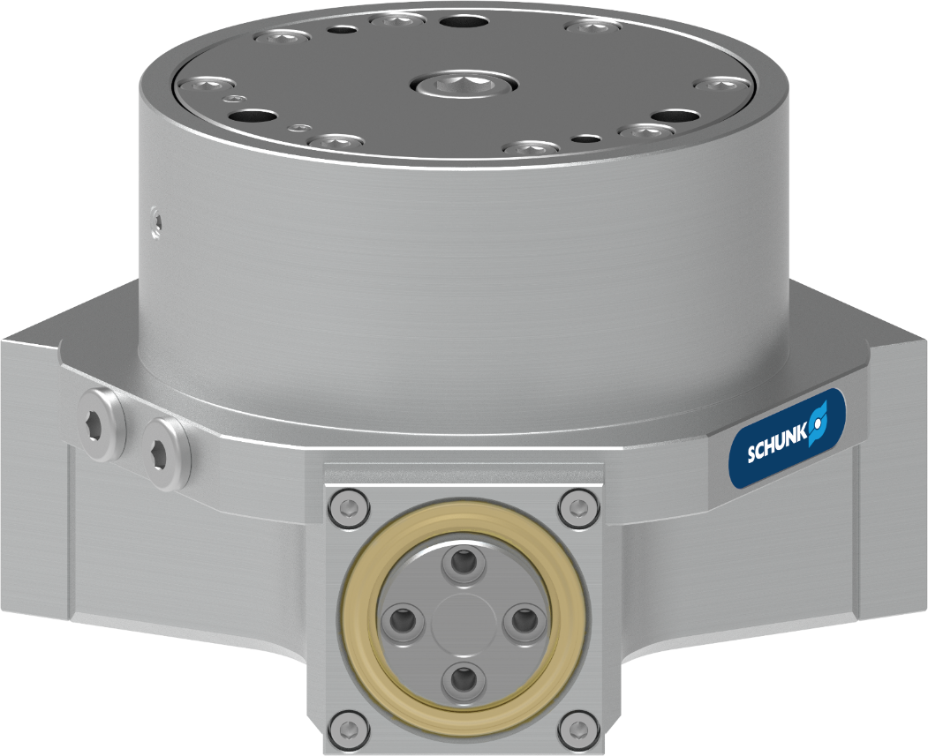



3-finger centric gripper
Handling of parts within the cleaning machine
Life Science - Cleaning
Tight 3-finger centric gripper
Material: stainless steel and seawater-resistant aluminum
Chemically and thermally resistant double seal
with robust scraper
Screw-on pattern top jaws
corresponding DPZ-plus 80
One contact person
for the entire system including construction and assembly
TYPICAL PRODUCTS
TYPICAL PROCESS
REQUIREMENTS
RELIABILITY
STRONG
ACCURACY
Notes:
SCHUNK ID: 1336370

Slide 9
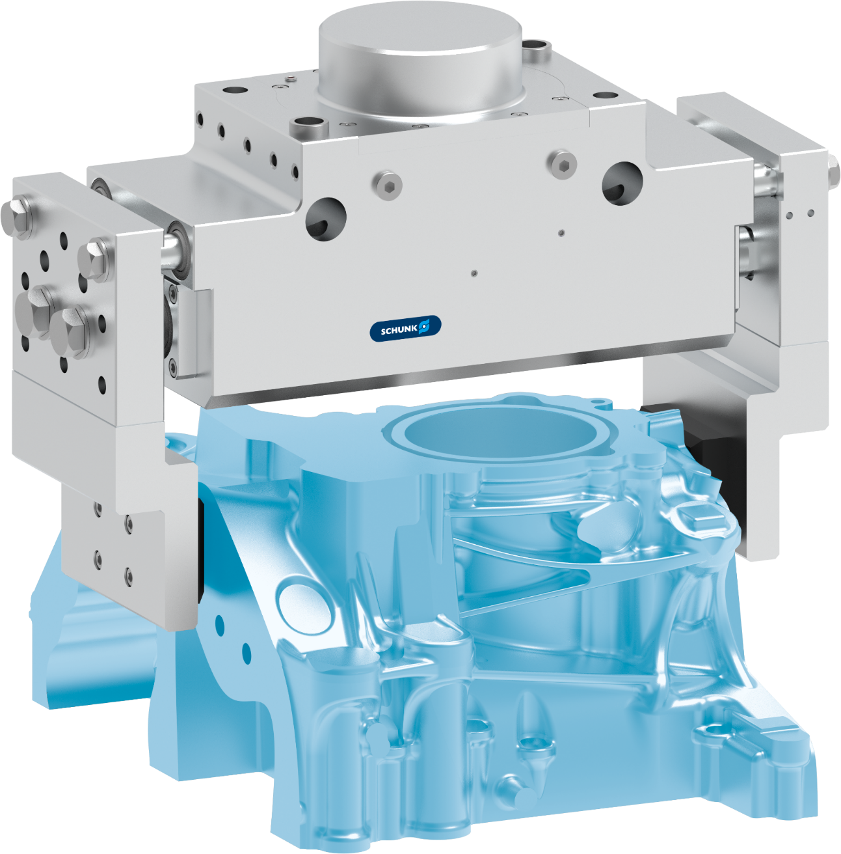

Tight 2-finger parallel gripper
Handling of parts within the cleaning machine
Life Science - Cleaning
Tight 2-finger parallel gripper
Material: stainless steel and seawater-resistant aluminum
Chemically and thermally resistant double seal
with robust scraper
Monitoring with pressure switch
through mechanically actuated valves
One contact person
for the entire system including construction and assembly
TYPICAL PRODUCTS
TYPICAL PROCESS
REQUIREMENTS
RELIABILITY
STRONG
ACCURACY
Notes:
SCHUNK ID: 1376342

Slide 10
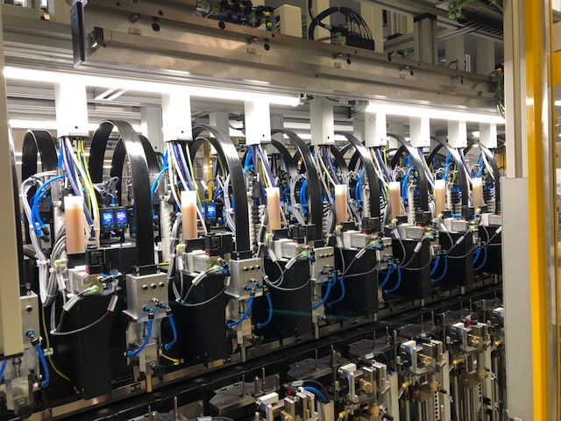
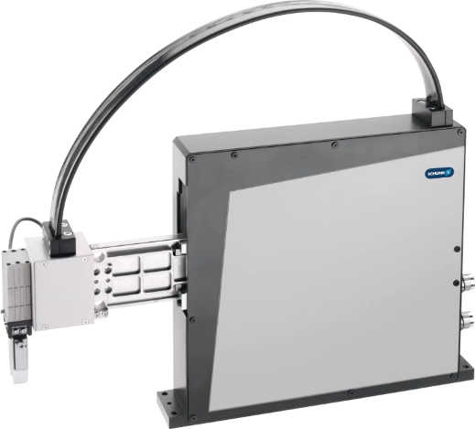



Pick and Place unit PPU-E
Feeding of discs
Life Science - Small items
Application
Feeding and loading in an assembly line
Added value
Fast and precise feeding of different parts in the tightest of spaces
Customer benefit
Fast and precise, small installation space, high availability, durable and low maintenance
Special feature
Central lubrication system
TYPICAL PRODUCTS
TYPICAL PROCESS
REQUIREMENTS
HIGHSPEED
RELIABILITY
ACCURACY
Notes:
SCHUNK ID: 1375286 (SES 398417) // SES 39801

Slide 11
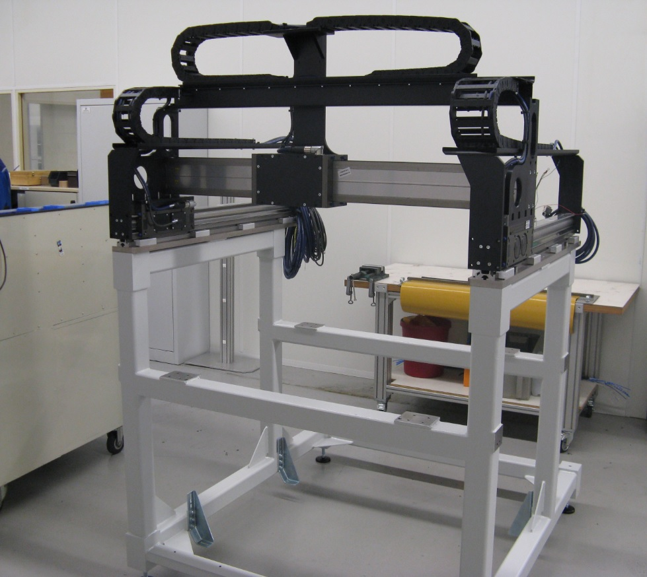


Gantry handling
Dosing/dispensing
Life Science - Dosing units
Painted welded steel frame
X1-axis: Linear axis LDN-UL-0200-100
(left, with 7,5 m cable)
X2-axis: Linear axis LDN-UL-0200-100
(right, with 5 m cable)
Y-axis: Linear axis LDM-EL-0400-100
(with 10 m cable)
TYPICAL PRODUCTS
TYPICAL PROCESS
REQUIREMENTS
HIGHSPEED
STRONG
ACCURACY
Notes:
SCHUNK ID: 1452210 (SES 415211)

Slide 12
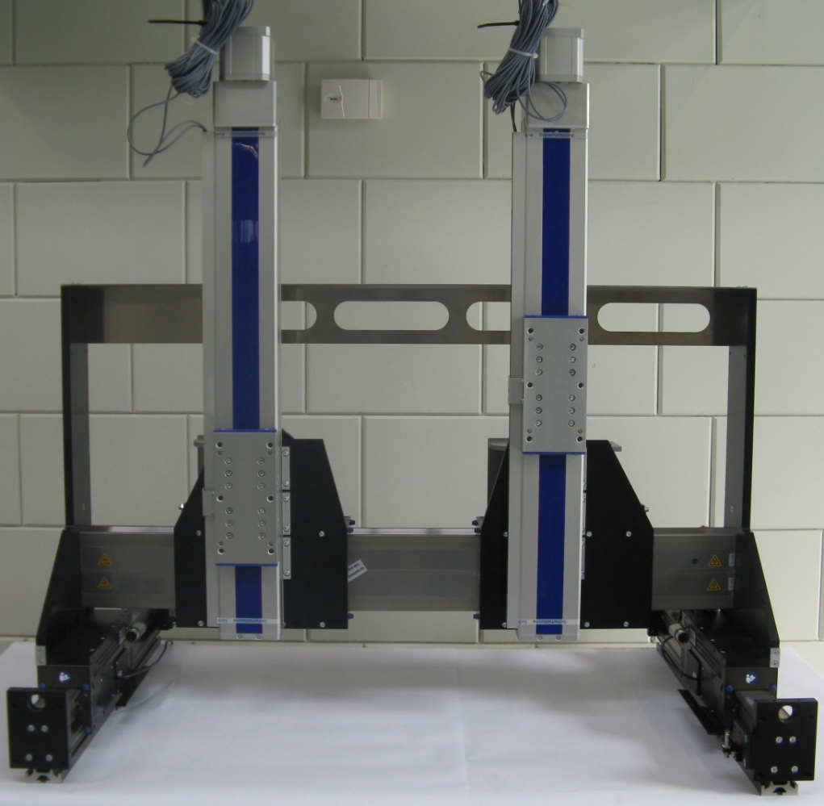
Gantry system
Dosing/dispensing
Life Science - Dosing units
Complete project management
Sizing, design and assembly by SCHUNK
Gantry system
  Y-axes: LDN-UL-200-0300,
  rated force 200 N
  X-axis: LDM-EL-0400-2 (Hub 500),
  rated force 400 N
  Z-axes: HSB-Beta-100D-SSS
Customer benefits
Compact design, ready-to-install sub-system
TYPICAL PRODUCTS
TYPICAL PROCESS
REQUIREMENTS
HIGHSPEED
STRONG
ACCURACY
Notes:
SCHUNK ID: 1356442 (SES: 399561)

Slide 13
Gantry system
Dosing/dispensing
Life Science - Dosing units
Special feature :
Design of the energy chain within the installation frame. Use of the primary part on the right up to the end plate without the energy chain hitting the frame. Completely assembled including bridge, axes, energy chains and cabling.
Portal
X1-axis: linear axis LDN-UL-0200,
stroke 385 mm
X2-axis: linear axis LDN-UL-0200,
stroke 385 mm
Y-axis: linear axis LDM-EL-0400-2,
stroke 354 mm
TYPICAL PRODUCTS
TYPICAL PROCESS
REQUIREMENTS
HIGHSPEED
STRONG
ACCURACY
Notes:
SCHUNK ID: 30701340 (SES 371064)

Slide 14
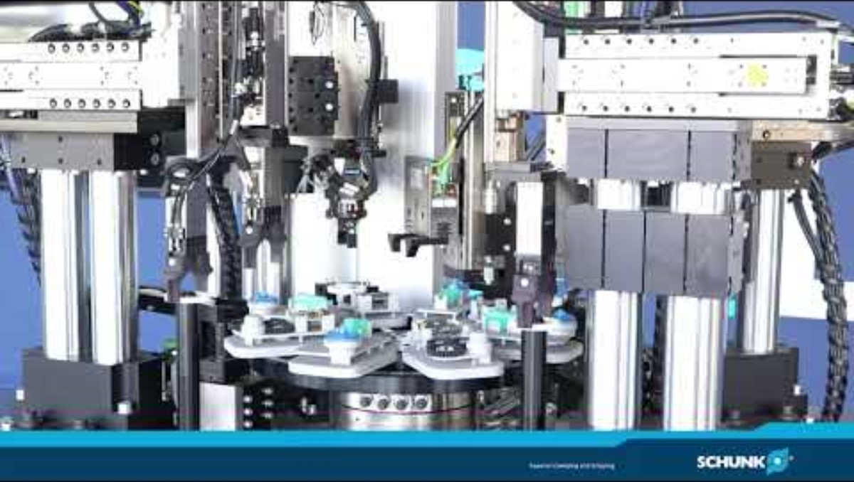
Insights into the CoLab: SCHUNK Life Science - Assembly automation
Life Science

Slide 15
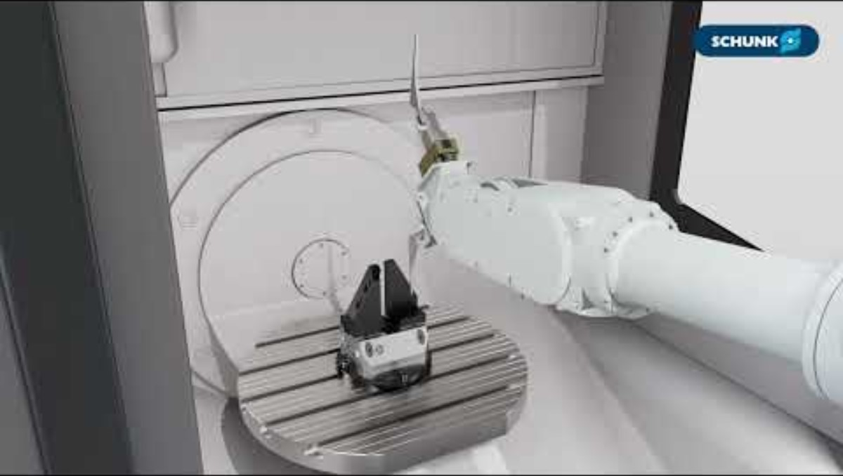
Life Science MedTech: Machining of hip stem implants
Life Science
Robustness
Process reliability
Advanced sensor technology
Further information: Life-science partner ➠ With many years of expertise | SCHUNK

Slide 16
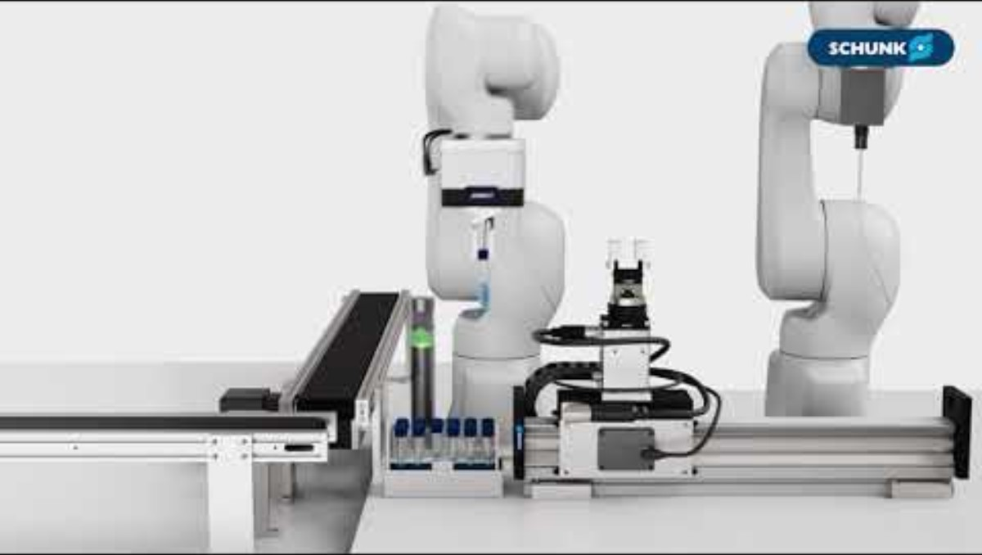
Life Science LabAutomation: Handling of laboratory samples
Life Science
Flexibility
Sensitive gripping
Laboratory grade lubricants
Further information: Life-science partner ➠ With many years of expertise | SCHUNK

Slide 17
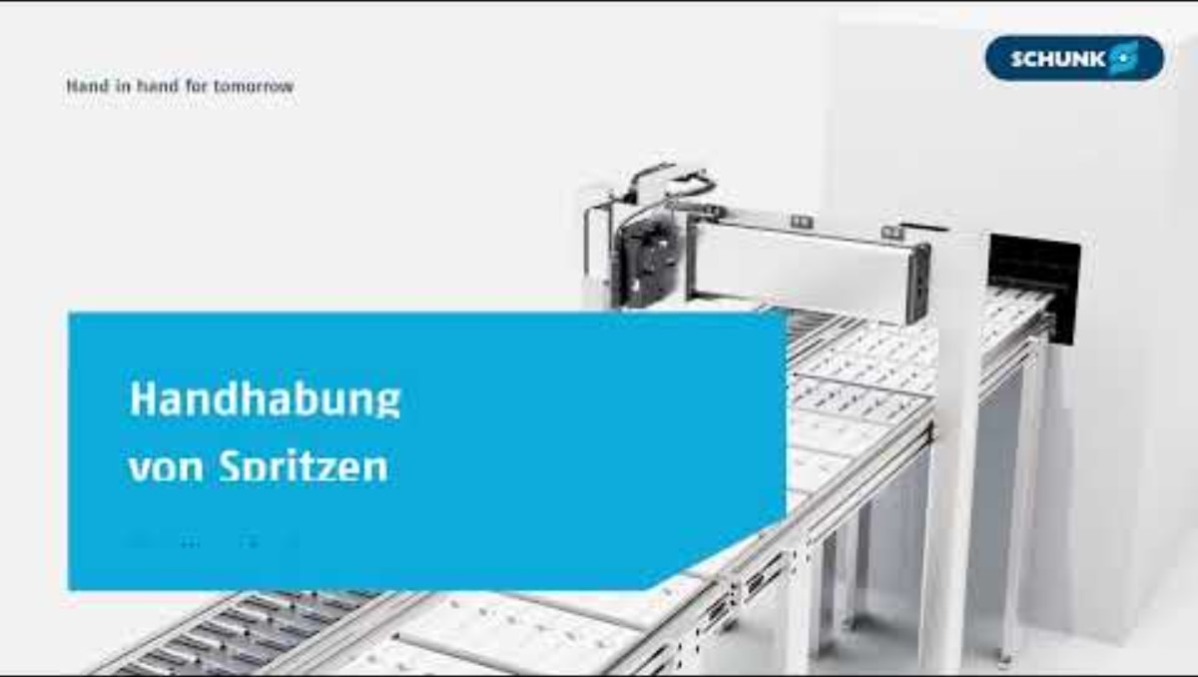
Life Science Pharma: Handling of syringes
Life Science
Hygienic Design
Cleanroom certification
Safety in contact with pharmaceutical products
Further information: Life-science partner ➠ With many years of expertise | SCHUNK

