Slide 1

SCHUNK Engineering
Business area
Special clamping technology

Slide 2
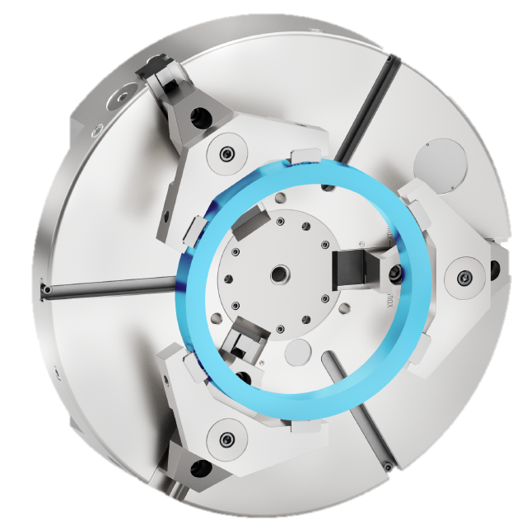
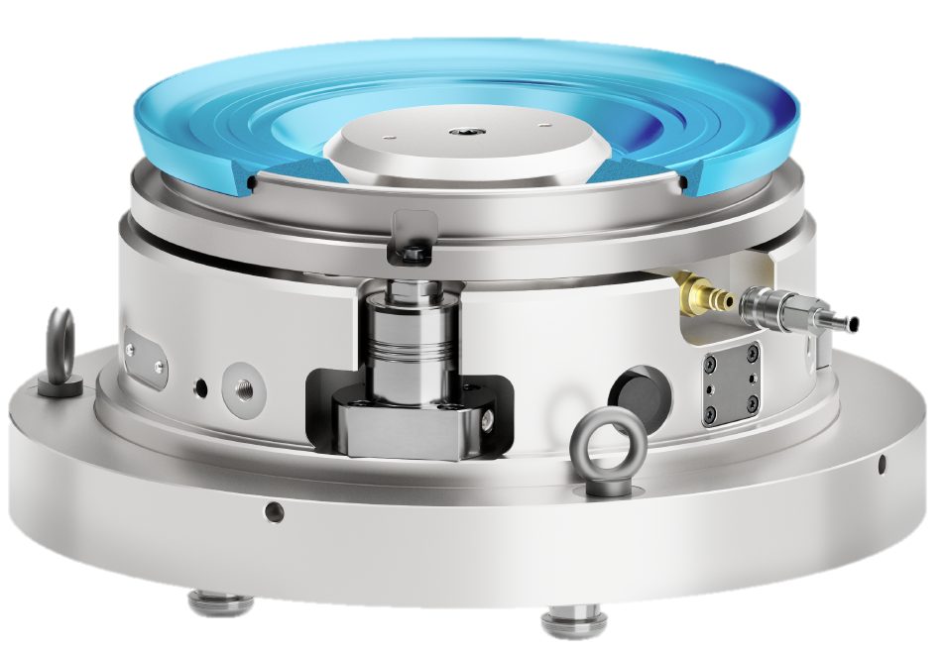

SCHUNK Engineering: customer-specific large-scale projects and product configurations
SCHUNK Engineering - Pitchdeck
Mechanically
Hydraulic
Pneumatic
Hybrid
Over 200
projects per year

Slide 3





Your success factors:
Professional project management and highest level of technological expertise
SCHUNK Engineering - Pitchdeck
eMobility
LifeScience
Aerospace
Automotive
Optics
Machine Tools

Slide 4

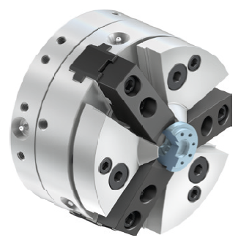
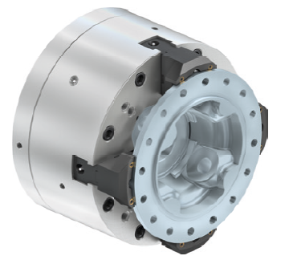
4 Levels of partnership - SCHUNK offers more
SCHUNK Engineering - Special clamping technology
Level 1
Standard Components
Level 2
Customized Components
SCHUNK Engineering
Level 3
Large Scale Projects
Level 4
Machines

Slide 5
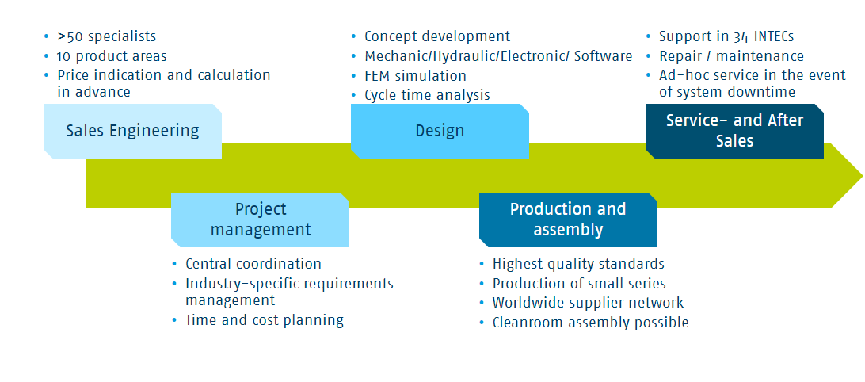

40 profefssionals – one goal:
Making your project a success
SCHUNK Engineering - Pitchdeck
Team of specialists
2 prduct areas

Slide 6
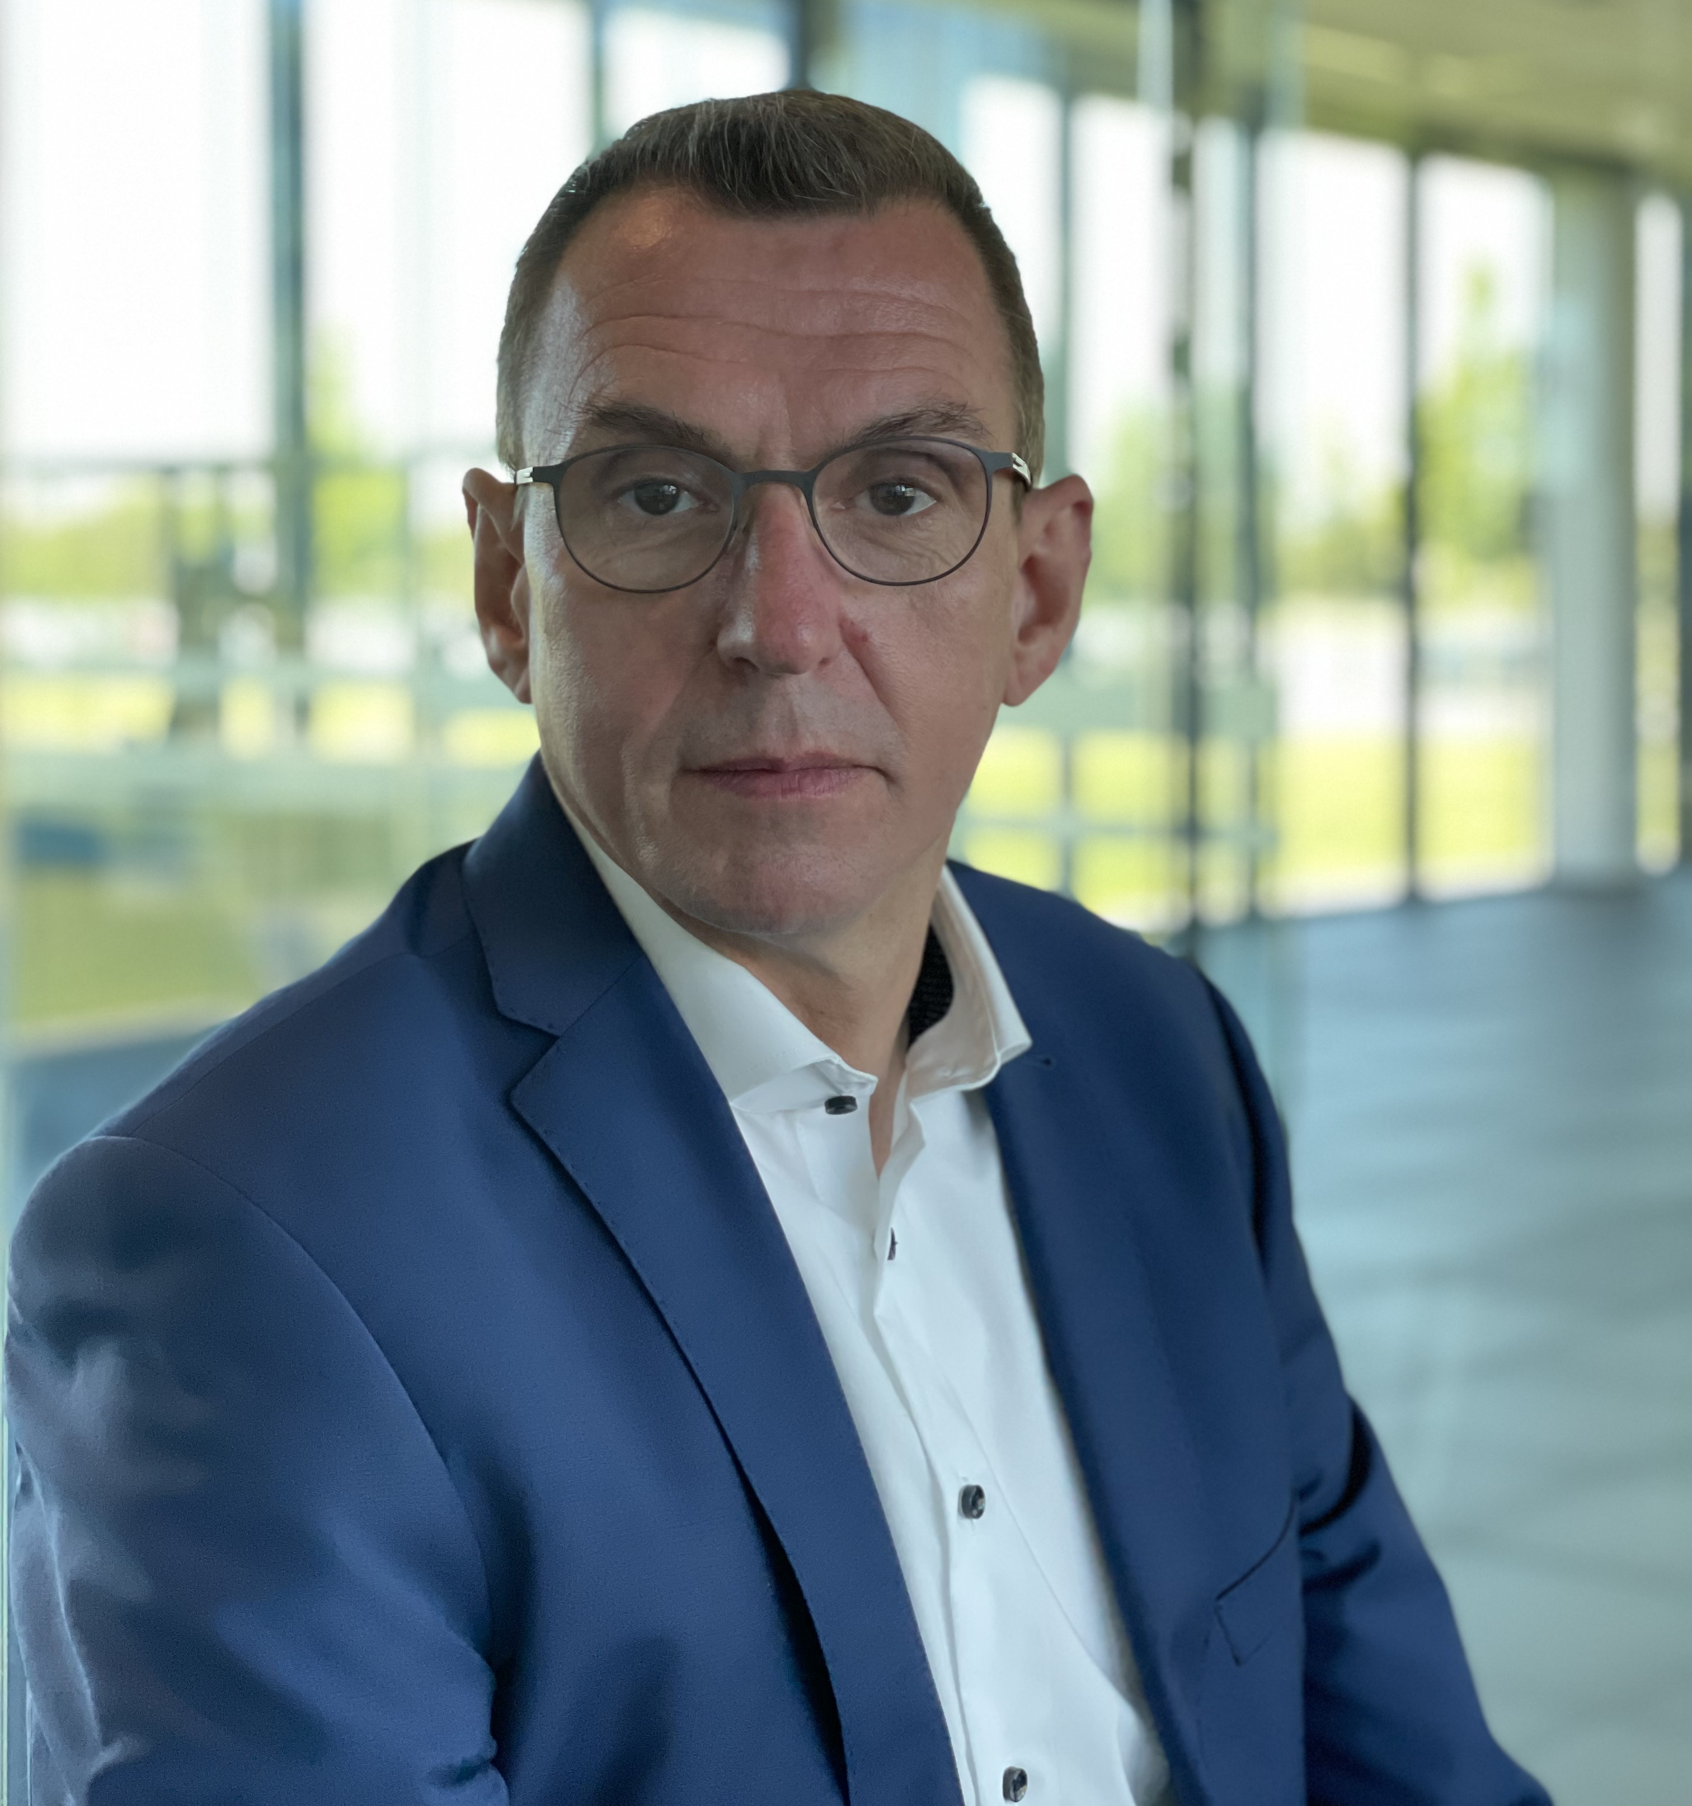
Sales management
SCHUNK Engineering - Pitchdeck
Markus Michelberger
+49-7572-7614-1034
+markus.michelberger@de.schunk.com

Slide 7
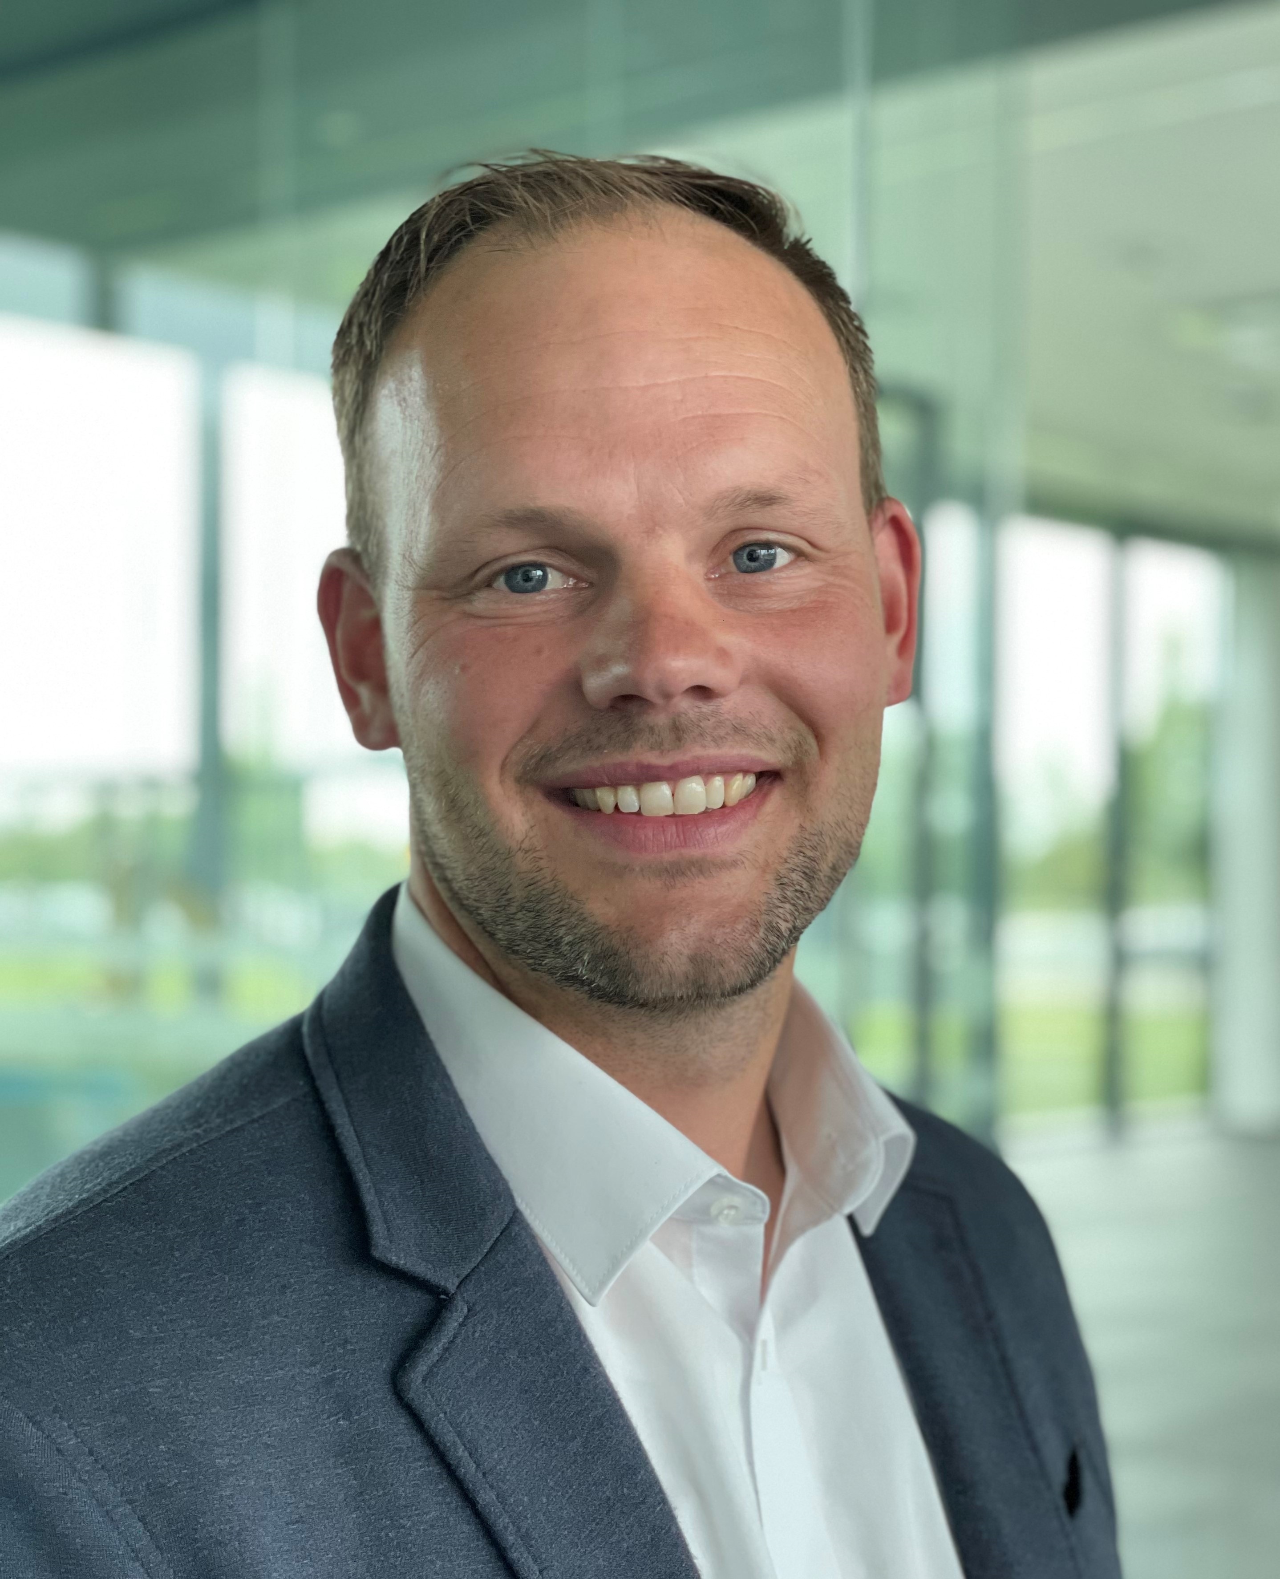
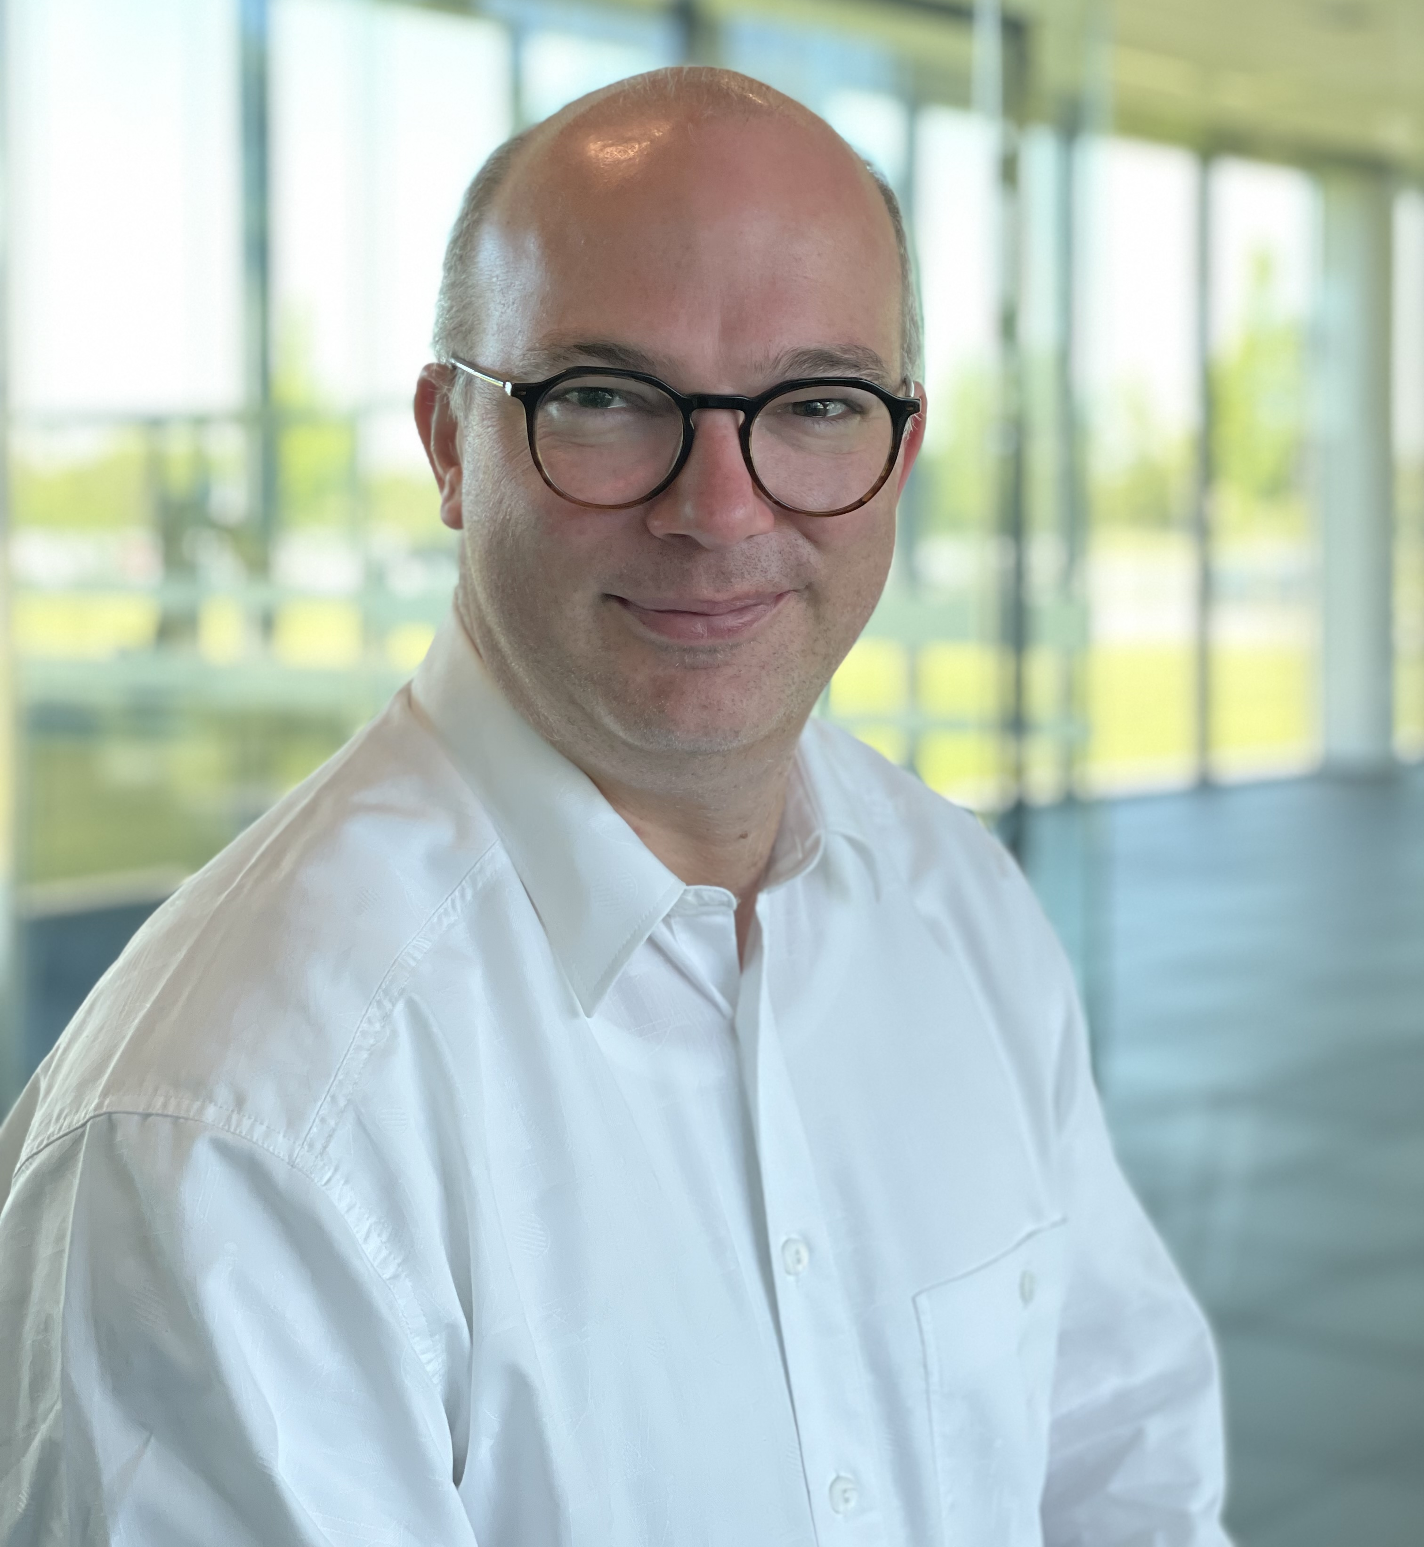
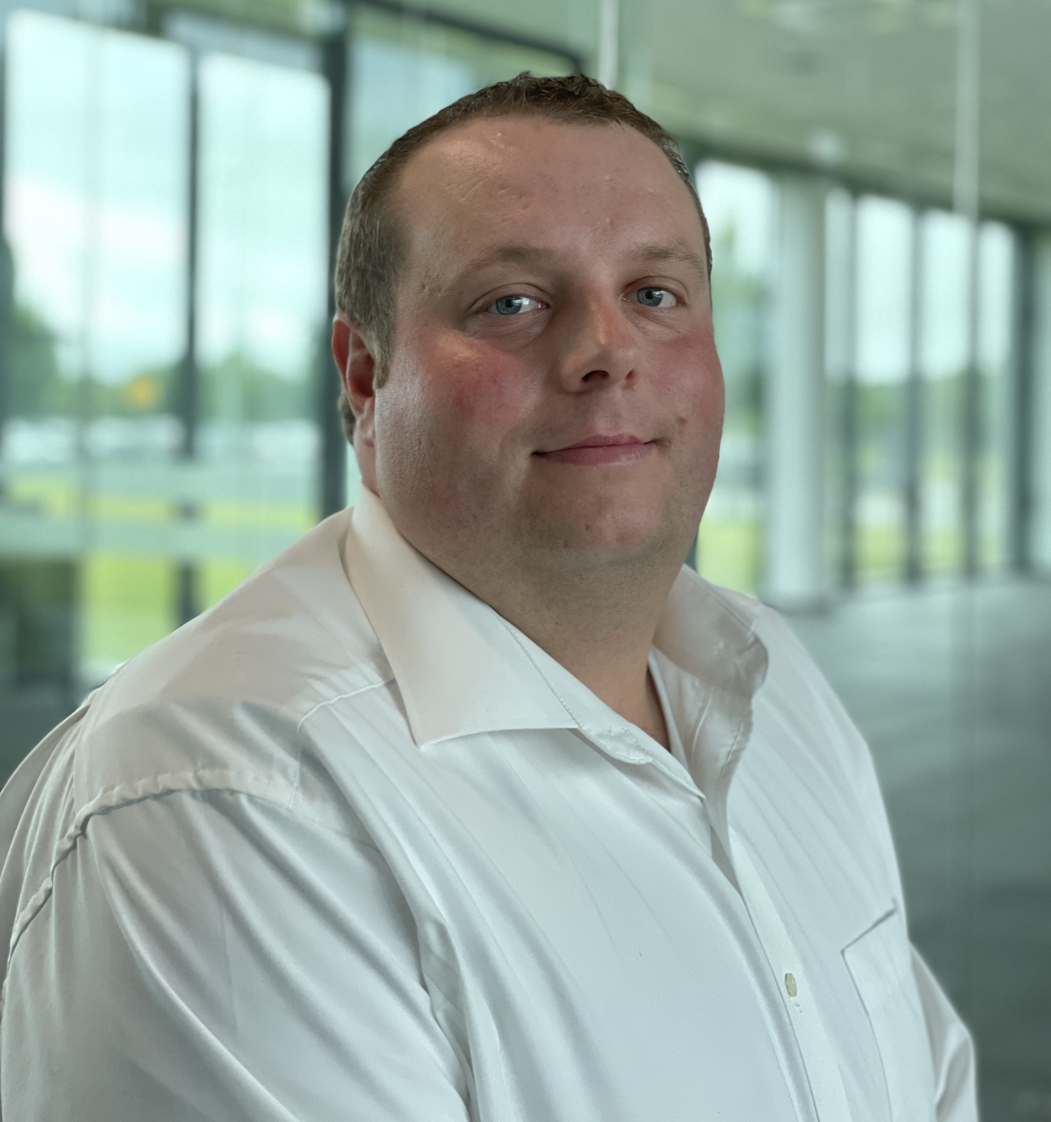
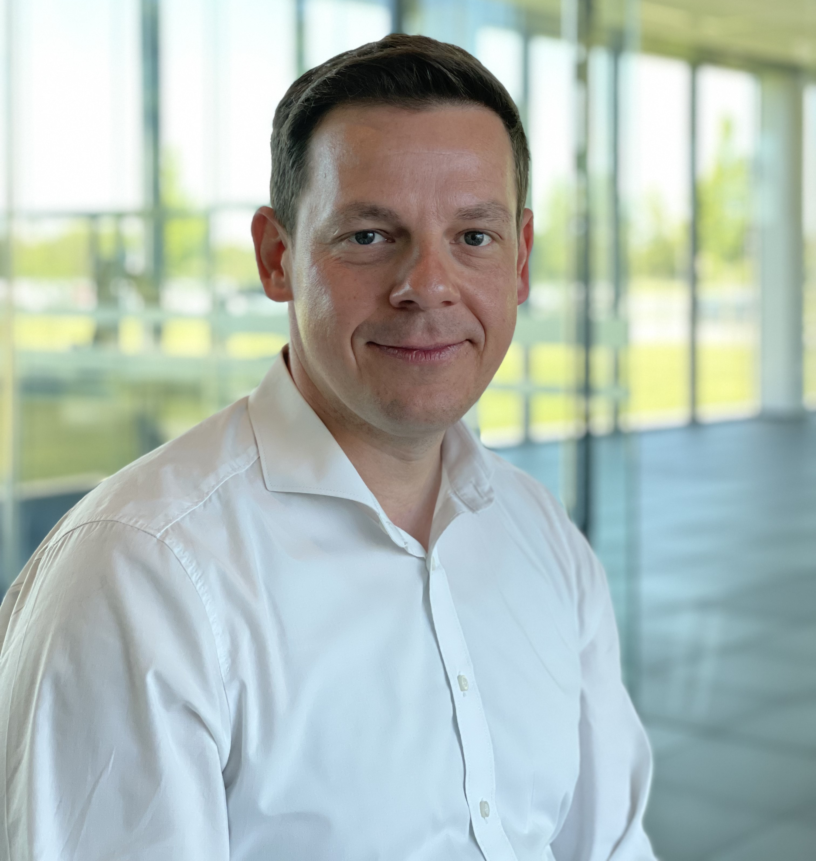
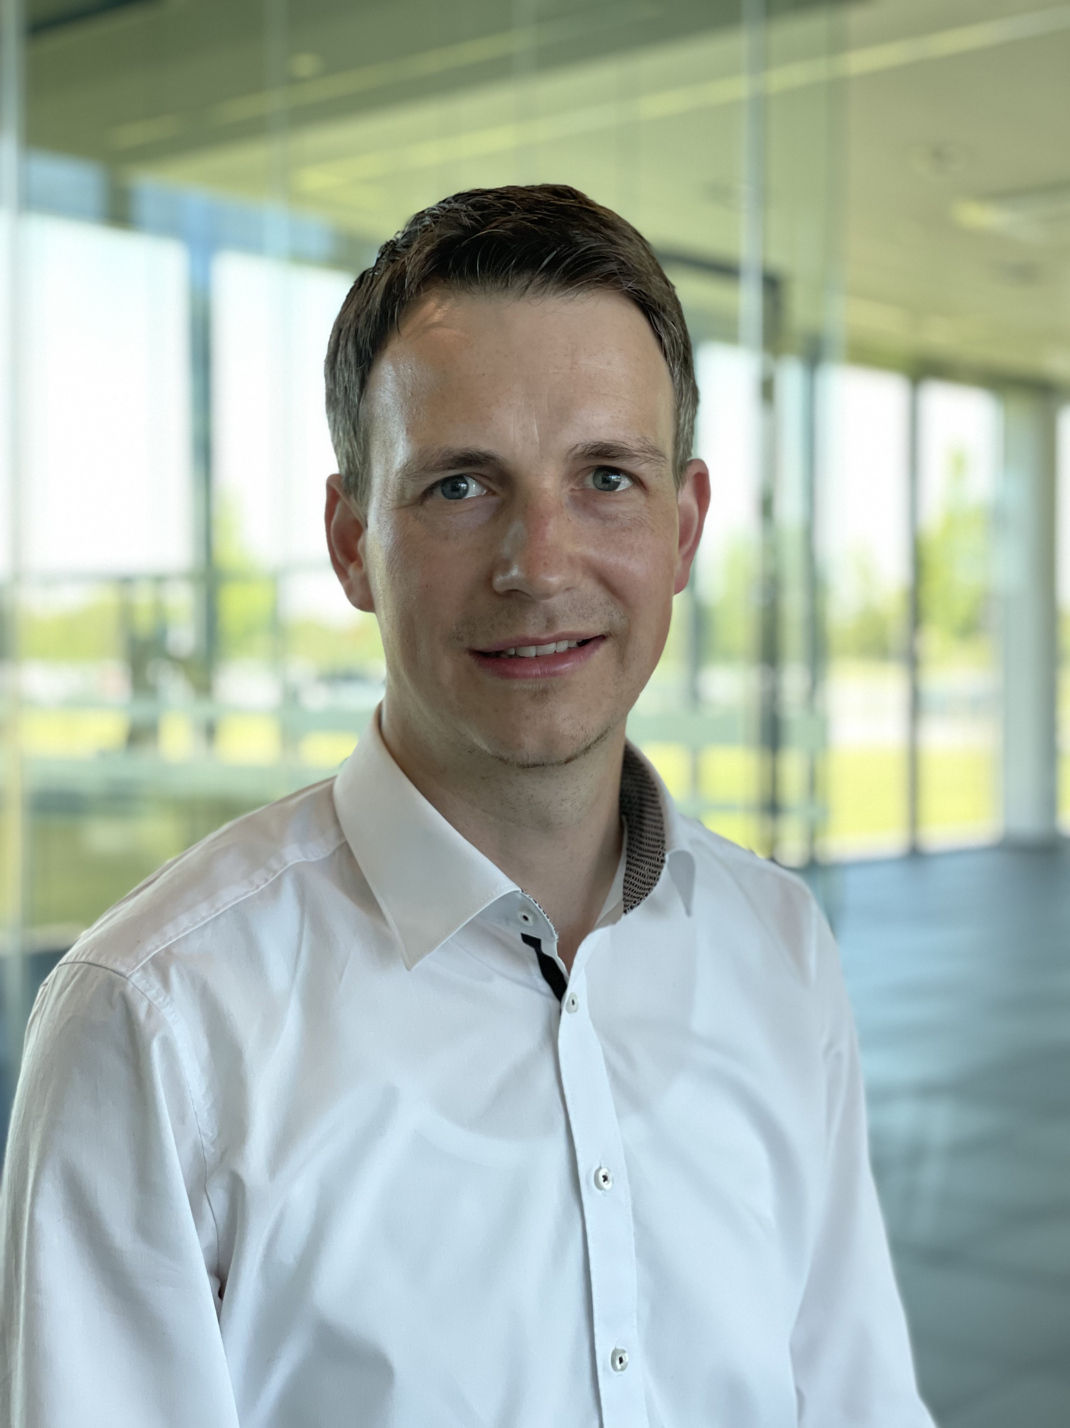
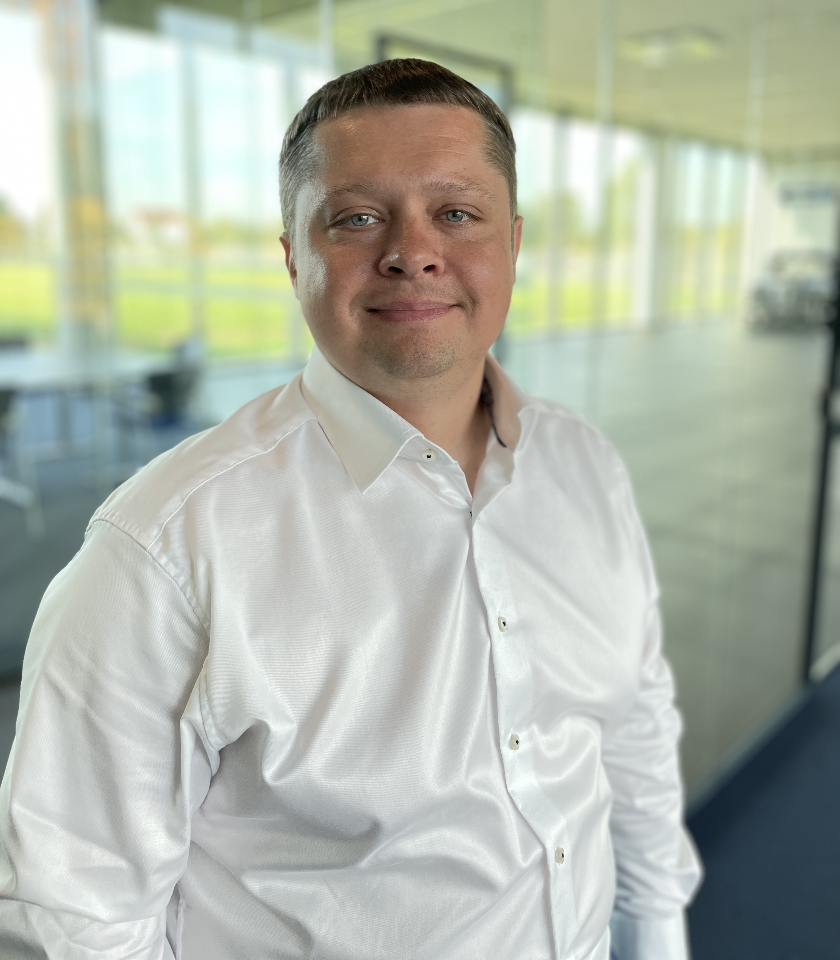
Team Product distribution
Lathe Chucks
SCHUNK Engineering - Pitchdeck
Andreas Holstein
Teamleitung
+49-7572-7614-1037
andreas.holstein@de.schunk.com
Josef Bischofberger
+49-7572-7614-1038
josef.bischofberger@de.schunk.com
Julian Jäggle
+49-7572-7614-1242
julian.jaeggle@de.schunk.com
Michael Göttle
+49-7572-7614-1094
michael.goettle@de.schunk.com
Dominikus Holstein
+49-7572-7614-1131
dominikus.holstein@de.schunk.com
Aleksei Kochurov
+49-7572-7614-1176
aleksei.kochurov@de.schunk.com

Slide 8
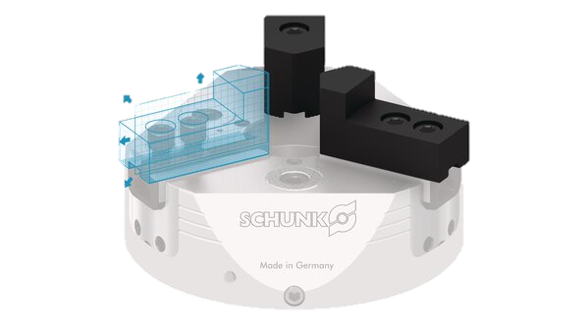



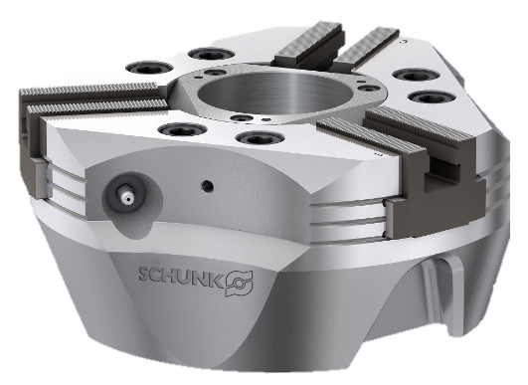
Individual products and systems from batch size 1 at the most attractive price and delivery time
SCHUNK Engineering - Konfigurierbare Produkte
schunk.com
Jaws, tools and more

Slide 9
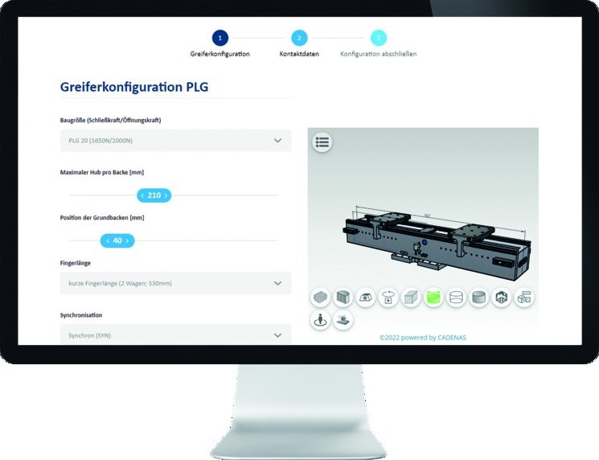
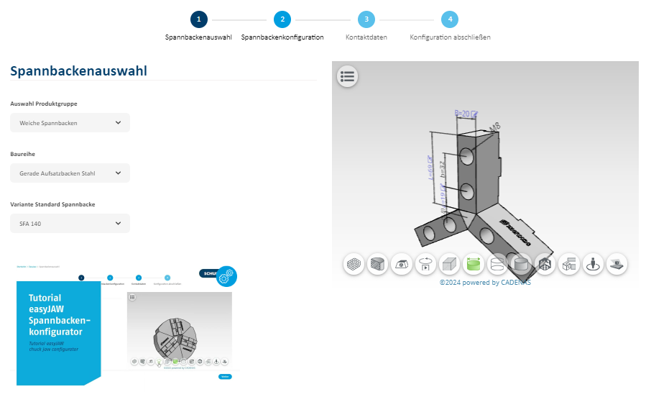
Why Configuration?
SCHUNK Engineering - Konfiguratoren bei SCHUNK
Web-based & license-free online tool
→ No CAD program required
No devolopment knowlede required
→ Resource-saving
Product- &
CAD-Data
SCHUNK Experte knowledge
→ Risk reduction
Exclusion of incorrect/impossible configurations
Fast and easy
Price and delivery time

Slide 10
Custom components
SCHUNK Engineering

Slide 11
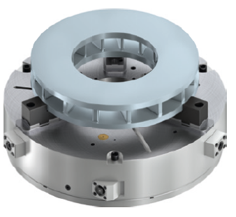

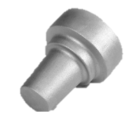

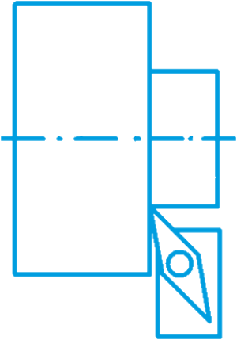



ROTA-S plus
Sealed 3-jaw-Manual-Chuck
SCHUNK Engineering
Requirement
in case of increased contamination (grinding application), a sealed chuck is necessary.
SCHUNK-Solution
ROTA-S plus in a sealed version for process-reliable clamping even with increased contamination.
Application
Use on grinding machines; Suitable for casting processing; Use under heavy pollution.
Advantage
Processreliable clamping even with increased contamination.
Typical Application
Typical Machining
Requirement
Guss Machining
Turning
HIGH
FLEXIBILITY
Contamination
Notes:
Ansprechpartner: Gunter Praxmarer

Slide 12
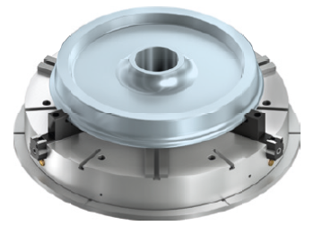


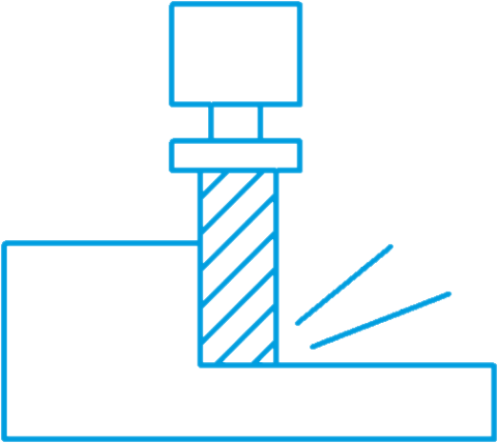

ROTA-S plus
3-Jaw Manual Chuck with individual jaw adjustment
SCHUNK Engineering
Requirement
The inaccurate clamping surface does not to the diameter to be machined.
SCHUNK-Solution
ROTA-S plus with individual jaw adjustment enables additional alignment of the workpieces.
Application
Clamping of irregularly shaped workpieces ; Clamping asymmetrical workpieces.
Advantage
Additional individual jaw adjustment allows the workpiece to be aligned.
Typical Application
Typical Machining
Requirement
Single-Jaw-Adjustment
MILLING
Turning
HIGH
FLEXIBILITY
Schmutz
Notes:
Ansprechpartner: Gunter Praxmarer

Slide 13
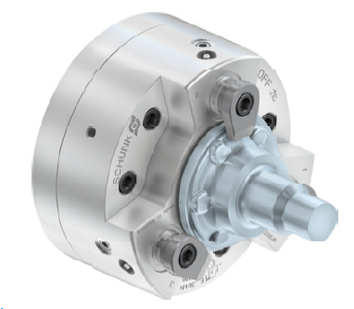




ROTA DFF
Lathe Chuck for axial workpiece clamping
SCHUNK Engineering
Requirement
The contour of the workpiece does not allow radial tension - or radial deformation is not permitted.
SCHUNK-Solution
ROTA DFF-lathe chuck for axial workpiece clamping.
Application
Clamping of workpieces without radially deformation.
Advantage
No radial deformation and plane-parallel tension of the workpieces.
Typical Application
Typical Machining
Requirement
COMPLEX GEOMETRY
Turning
INDIVIDUAL SOLUTION
Strong
Notes:
Ansprechpartner: Gunter Praxmarer

Slide 14
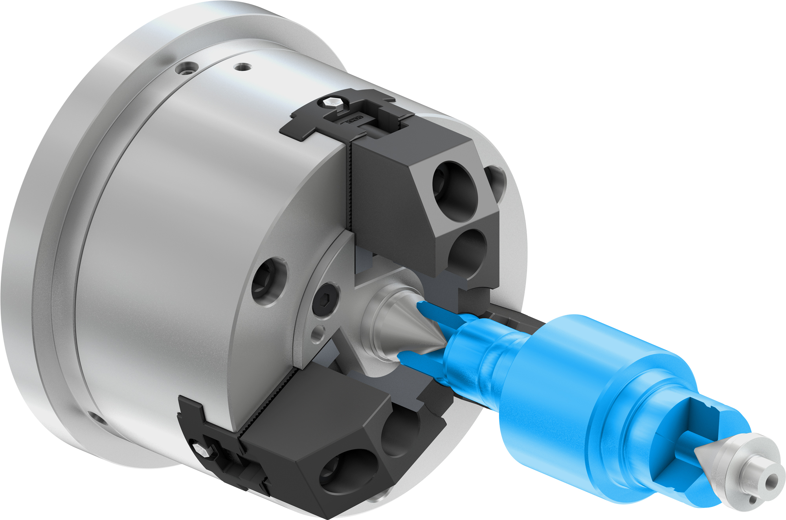




ROTA HSA
Compensating Chuck for clamping workpieces between sharps
SCHUNK Engineering
Requirement
The workpiece reference is in the axis of rotation of the workpiece. Outer diameter does not run towards the axis of rotation.
SCHUNK-Solution
Workpiece is picked up between the centers (chuck and tailstock).
Application
Clamping of shafts whre the reference is the center hole.
Advantage
To transmit torque, the outer diameter is clamped „compensating“
Typical Application
Typical Machining
Requirement
Compensation Clamping
SHAFTS
Turning
INDIVIDUAL SOLUTION
HIGH
PRECISION
Notes:
Ansprechpartner: Gunter Praxmarer

Slide 15
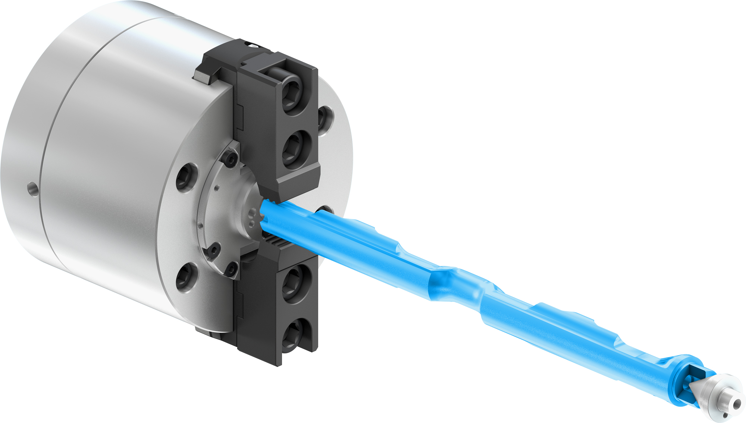


ROTA HSA-NZ
Compensating Chuck for clamping workpieces between sharps
SCHUNK Engineering
Requirement
The workpiece reference is in the axis of rotation of the workpiece. Outer diameter does not run towards the axis of rotation. The diameter to be machined requires good parallelism to the clamping diameter and the contact surface.
SCHUNK-Solution
Workpiece clamping between centers. Base jaw guides arranged at an angle to prevent the workpieces from lifting off.
Application
Centering on reference diameter of shaft-like components.
Advantage
No lifting of the workpiece thanks to inclined base jaw guides.
TYPICAL Application
Typical Machining
Requirement
Compensating Clamping
SHAFTS
Turning
INDIVIDUAL SOLUTION
HIGH
PRECISION
Notes:
Ansprechpartner: Gunter Praxmarer

Slide 16
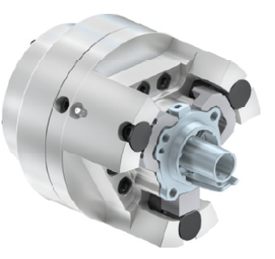


ROTA Axial clamping chuck
Active pull-down
SCHUNK Engineering
Requirement
The diameter to be machined requires a high degree of perpendicularity to the contact surface.
SCHUNK-Solution
Axial chuck with active pull-down.
Application
Clamping of workpieces with the highest requirements for plane parallelism.
Advantage
Workpiece is clamped radially and actively pulled axially against the contact surface.
Typical Application
Typical Machining
Requirement
Cast iron
Turning
INDIVIDUAL SOLUTION
Notes:
Ansprechpartner: Gunter Praxmarer

Slide 17
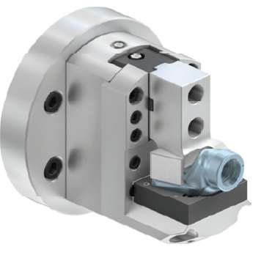

ROTA Consol Chuck
Consol Chuck with one fixed jaw
SCHUNK Engineering
Requirement
The diameter to be machined should be clamped parallel to the reference surface.
SCHUNK-Solution
Consol chuck with a fixed jaw for workpieces that need to be clamped firmly to a reference surface.
Application
Turning of components with a flat surface as a reference.
Advantage
The workpiece is clamped with the movable jaw against the fixed jaw.
Typical Application
Typical Machining
Requirement
Complex Geometry
Turning
INDIVIDUAL SOLUTION
LARGE CLAMPING RANGE
MILLING
Notes:
Ansprechpartner: Gunter Praxmarer

Slide 18
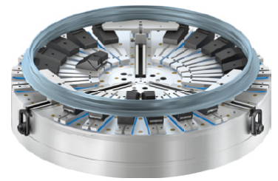

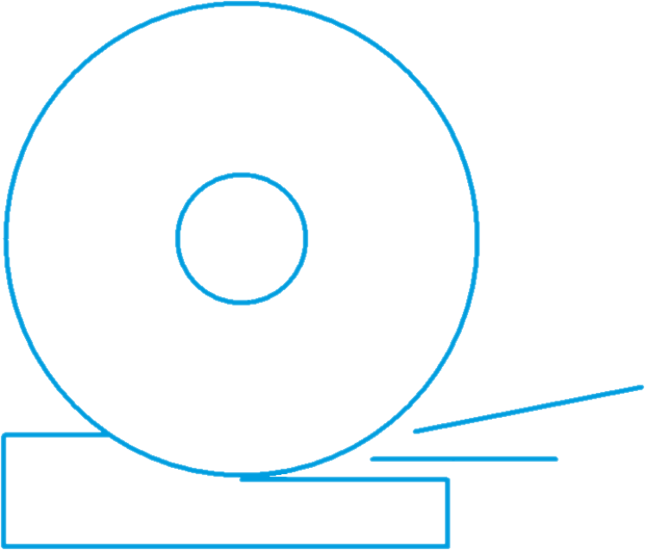
ROTA NCM
Hybrid Chuck for thin walled workpieces
SCHUNK Engineering
Requirement
The diameter to be machined should have a very good concentricity with the clamping diameter and the contact surface.
SCHUNK-Solution
Hybrid chuck for the low-preforming clamping of rings and disks.
Application
Suitalbe for grinding and turning applications; Fully automated
Advantage
Werkpiece is centered with the centering chuck and axially clamped with the magnetic clamping plate.
Typical Application
Typical Machining
Requirement
THIN-WALLED
Turning
INDIVIDUAL SOLUTION
HIGH
PRECISION
GRINDING
Notes:
Ansprechpartner: Gunter Praxmarer

Slide 19
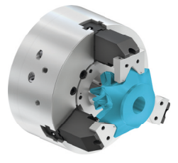

ROTA HSH
Lever Chuck with very large jaw stroke
SCHUNK Engineering
Requirement
In order to be able to clamp the clamping diameter, it is necessary to move over an interfering contour of the workpiece.
SCHUNK-Solution
Lever chuck with very large jaw stroke.
Application
Universally applicable.
Advantage
Due to the lever mechanism, lever chucks allow a very large jaw stroke compared to the cylinder stroke.
Typical Application
Typical Machining
Requirement
COMPLEX GEOMETRY
Turning
INDIVIDUAL SOLUTION
LARGE CLAMPING RANGE
GRINDING
Notes:
Ansprechpartner: Gunter Praxmarer

Slide 20


ROTA 2+2
2+2 Jaw Chuck compared centric clamping
SCHUNK Engineering
Requirement
The bore hole to be machined should be in the exact position of the clamping point and a further reference diamter.
SCHUNK-Solution
2+2 compensating chuck, with 2-jaw pairs that clamp centrically to balance dach other.
Application
Clamping of cylindrical, rectangular and irregular workpieces.
Advantage
The workpiece is clamped radially centrically and the compensation prevents overdetermination.
Typical Application
Typical Machining
Requirement
Compensating Clamping
Turning
INDIVIDUAL SOLUTION
LARGE CLAMPING RANGE
GRINDING
Notes:
Ansprechpartner: Gunter Praxmarer

Slide 21

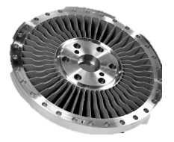
ROTA Pull-down Chuck
3-Jaw Chuck with active pull-down
SCHUNK Engineering
Requirement
The diameter to be machined requires good parallelism to the clamping diameter and the contact surface.
SCHUNK-Solution
pull-down chuck with radial tension and active pull-down.
Application
Clamping of workpieces with the highest requirement for plane parallelism.
Advantage
The workpiece is clamped radially and as soon as the jaws are in contact with the workpiece, the workpiece is additionally pulled against the stop surface.
Typical Application
Typical Machining
Requirement
COMPLEX GEOMETRY
Turning
INDIVIDUAL SOLUTION
HIGH
PRECISION
GRINDING
Notes:
Ansprechpartner: Gunter Praxmarer

