Slide 1

SCHUNK Engineering
Business unit
Special clamping technology
Note:
This presentation contains confidential information and is only released for non-public use by customers and suppliers.
Consultation with specialist department may be necessary.
- Remove this note before use -

Slide 2
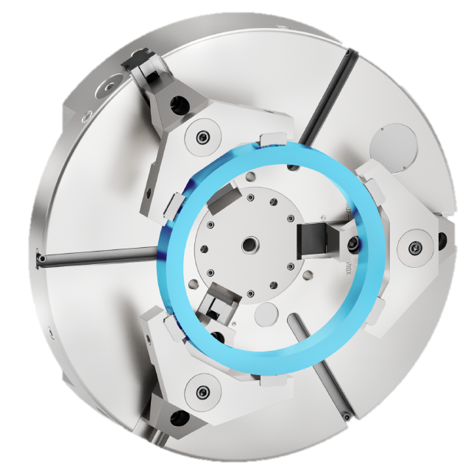
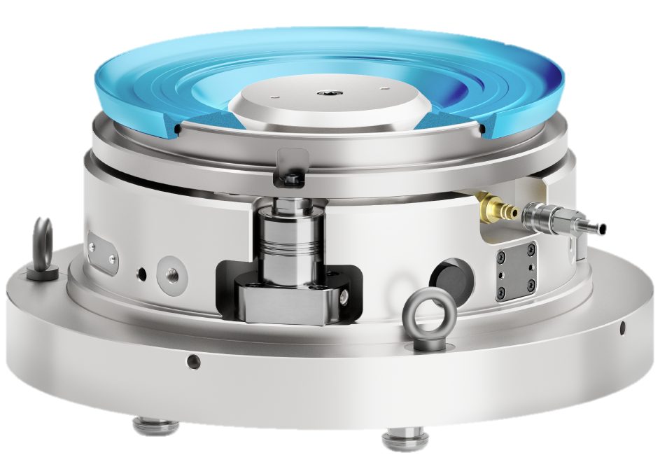

SCHUNK Engineering:
Customized large-scale projects and product configurators
SCHUNK Engineering - Pitchdeck
Mechanic clamping technology
Hydraulic clamping technology
Hybrid clamping technology
over 300
projects per year

Slide 3


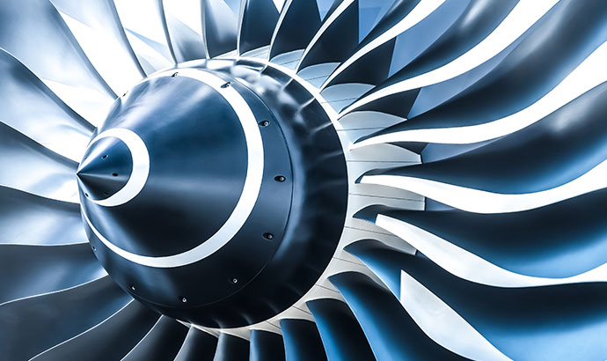


Your success factors:
Professional project management and the highest level of technological expertise
SCHUNK Engineering - Pitchdeck
eMobility
LifeScience
Aerospace
Automotive
Optics
Tool Machines

Slide 4
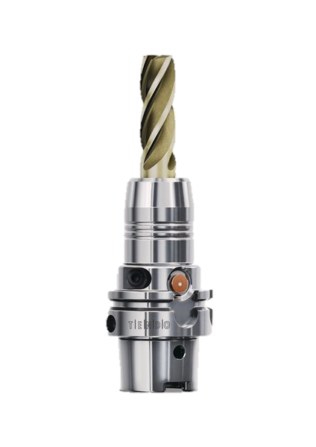
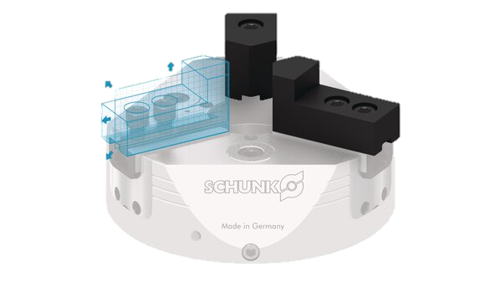
4 Levels of partnership - SCHUNK offers more
SCHUNK Engineering Special clamping technology
Level 1
Standard Components
Level 2
Customized Components
SCHUNK Engineering
Level 3
Large Scale Projects
Level 4
Machines

Slide 5
52 employees - one goal:
Making your project a success
SCHUNK Engineering - Pitchdeck
10 specialists
2 product areas
Price indication and calculation in advance
Support in 34 INTECs
Repair-/Maintenance
Ad-hoc service during
production downtime
Concept development
mechanic/hydraulic
FEM-simulation
Engineering Sales
Design
Service- und After Sales
Project management
Production and assembling
Central coordination
Industry-specific requirements management
Time/cost/schedule planning
Highest quality standards
Production of small series
Worldwide supplier network

Slide 6
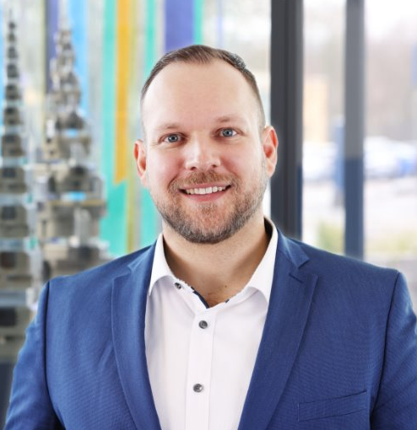
Team Lead Technical Sales Engineering
Clamping Technology
SCHUNK Engineering - Pitchdeck
Thomas Marschollek
+49-7133-103-2600
+49-160-2251271
thomas.marschollek@de.schunk.com

Slide 7
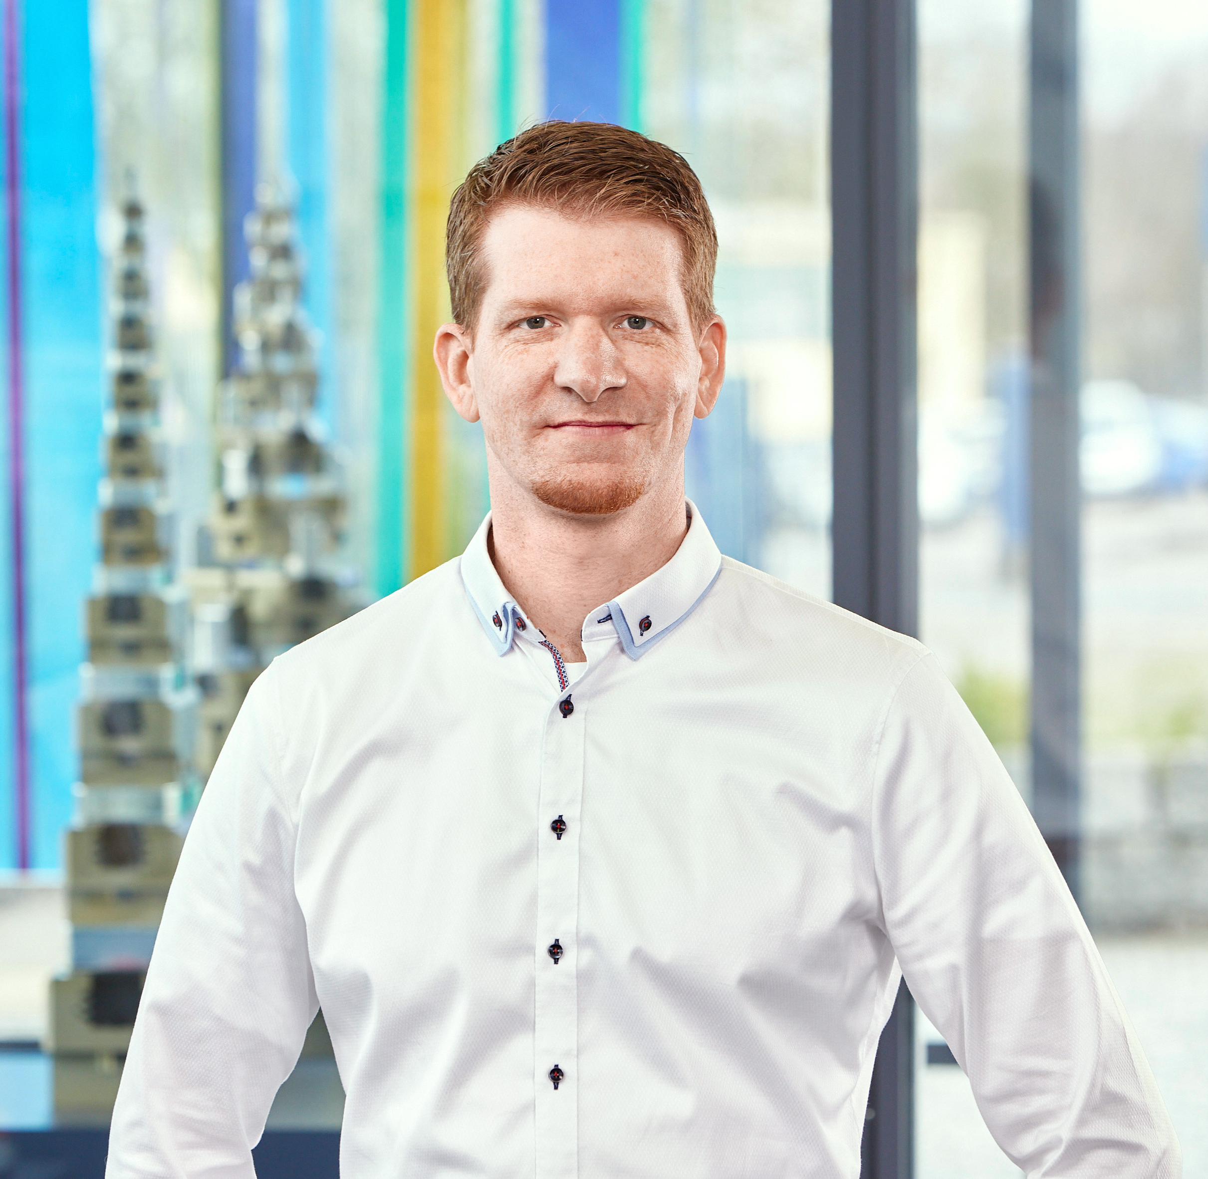
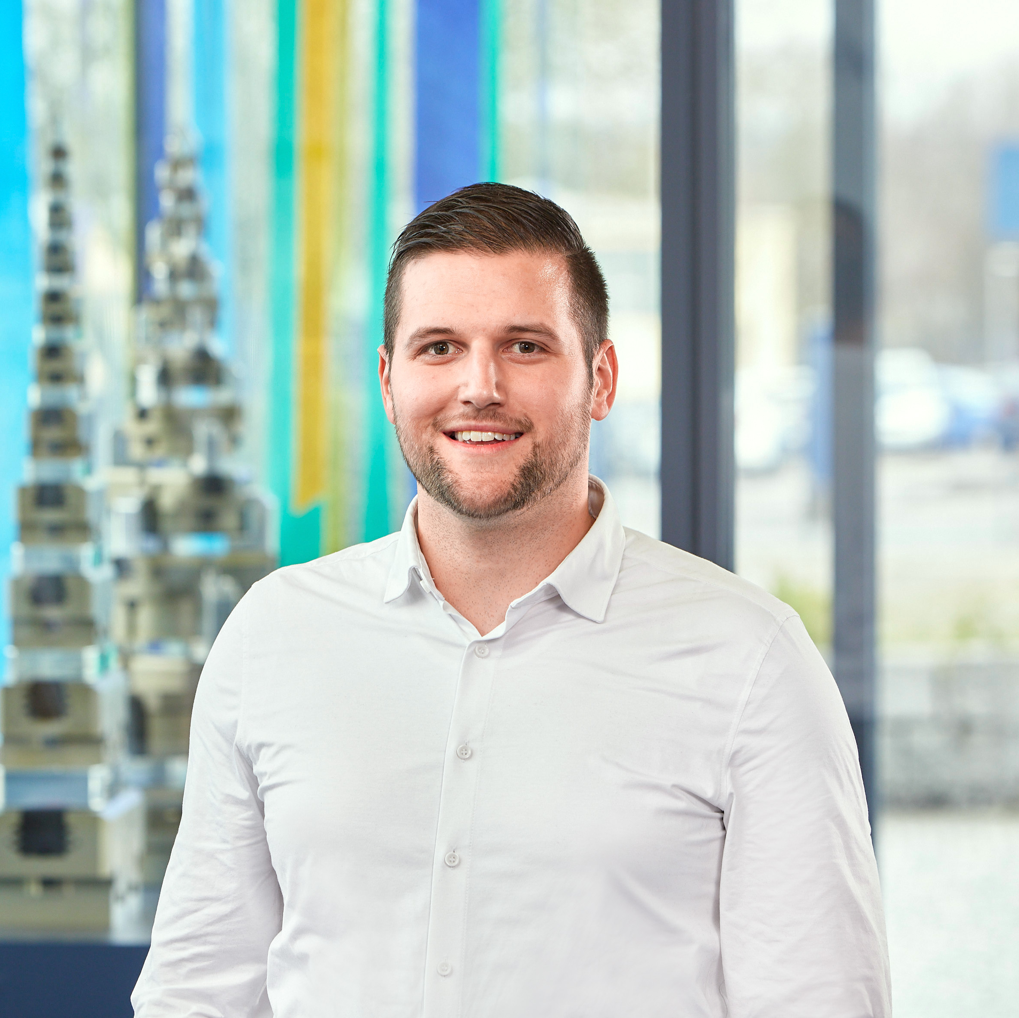
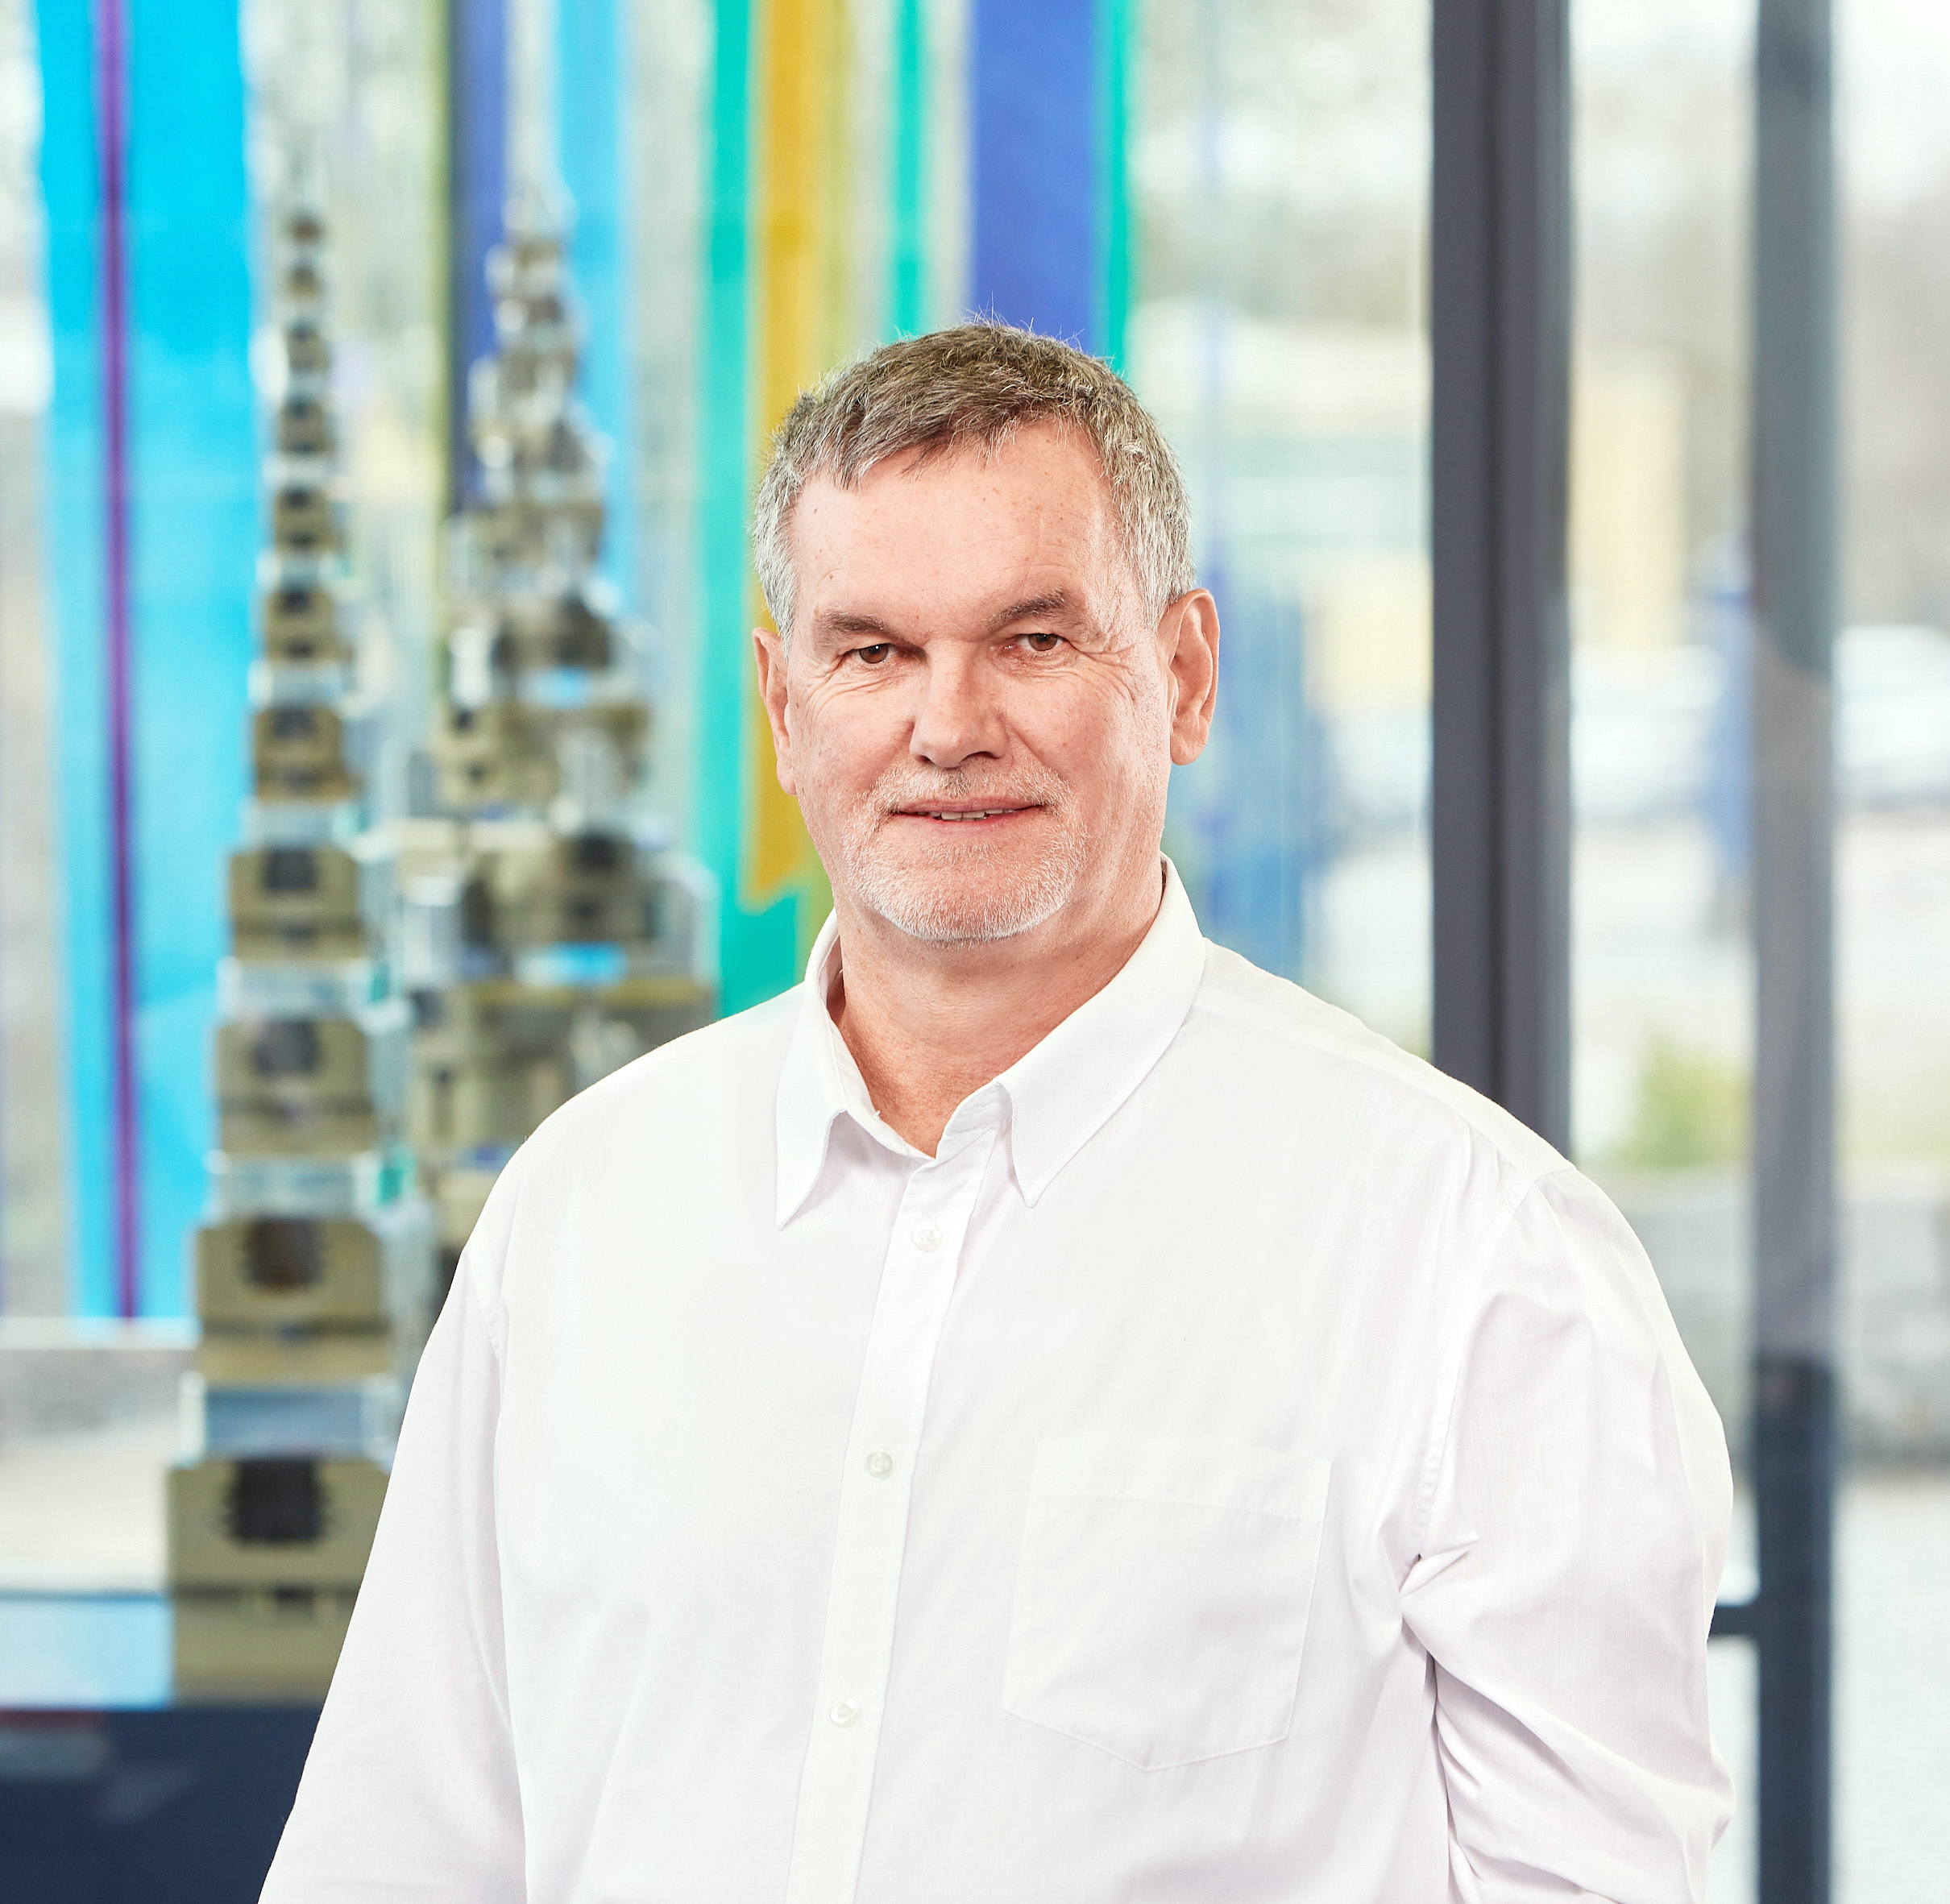
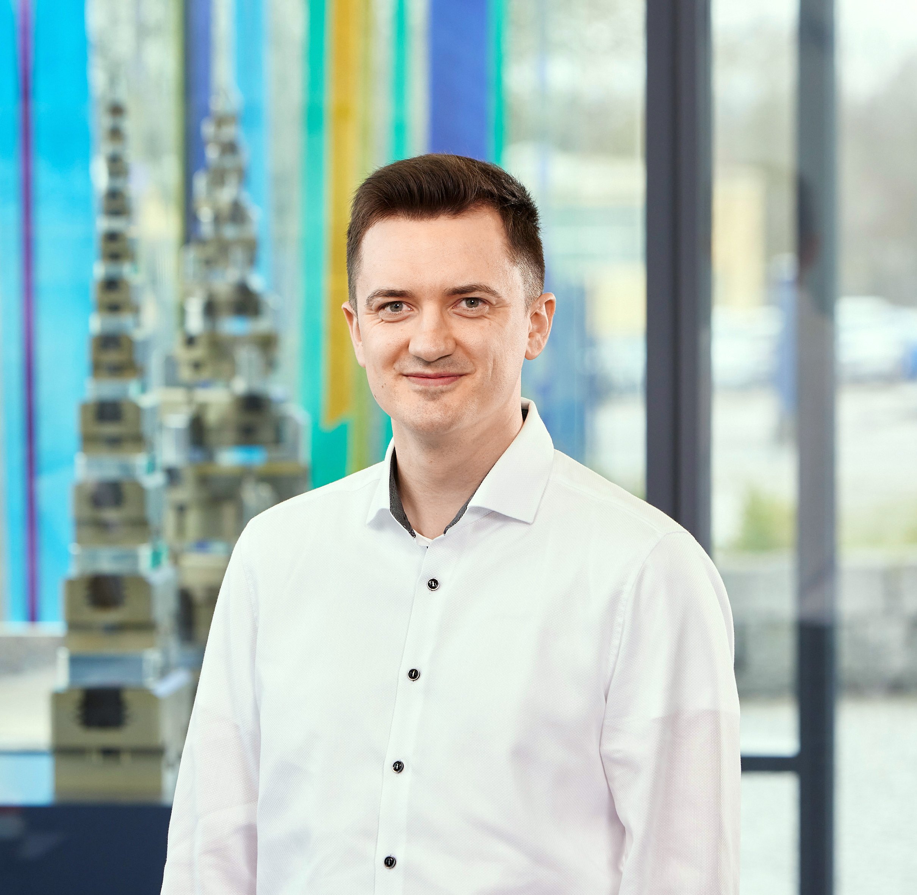
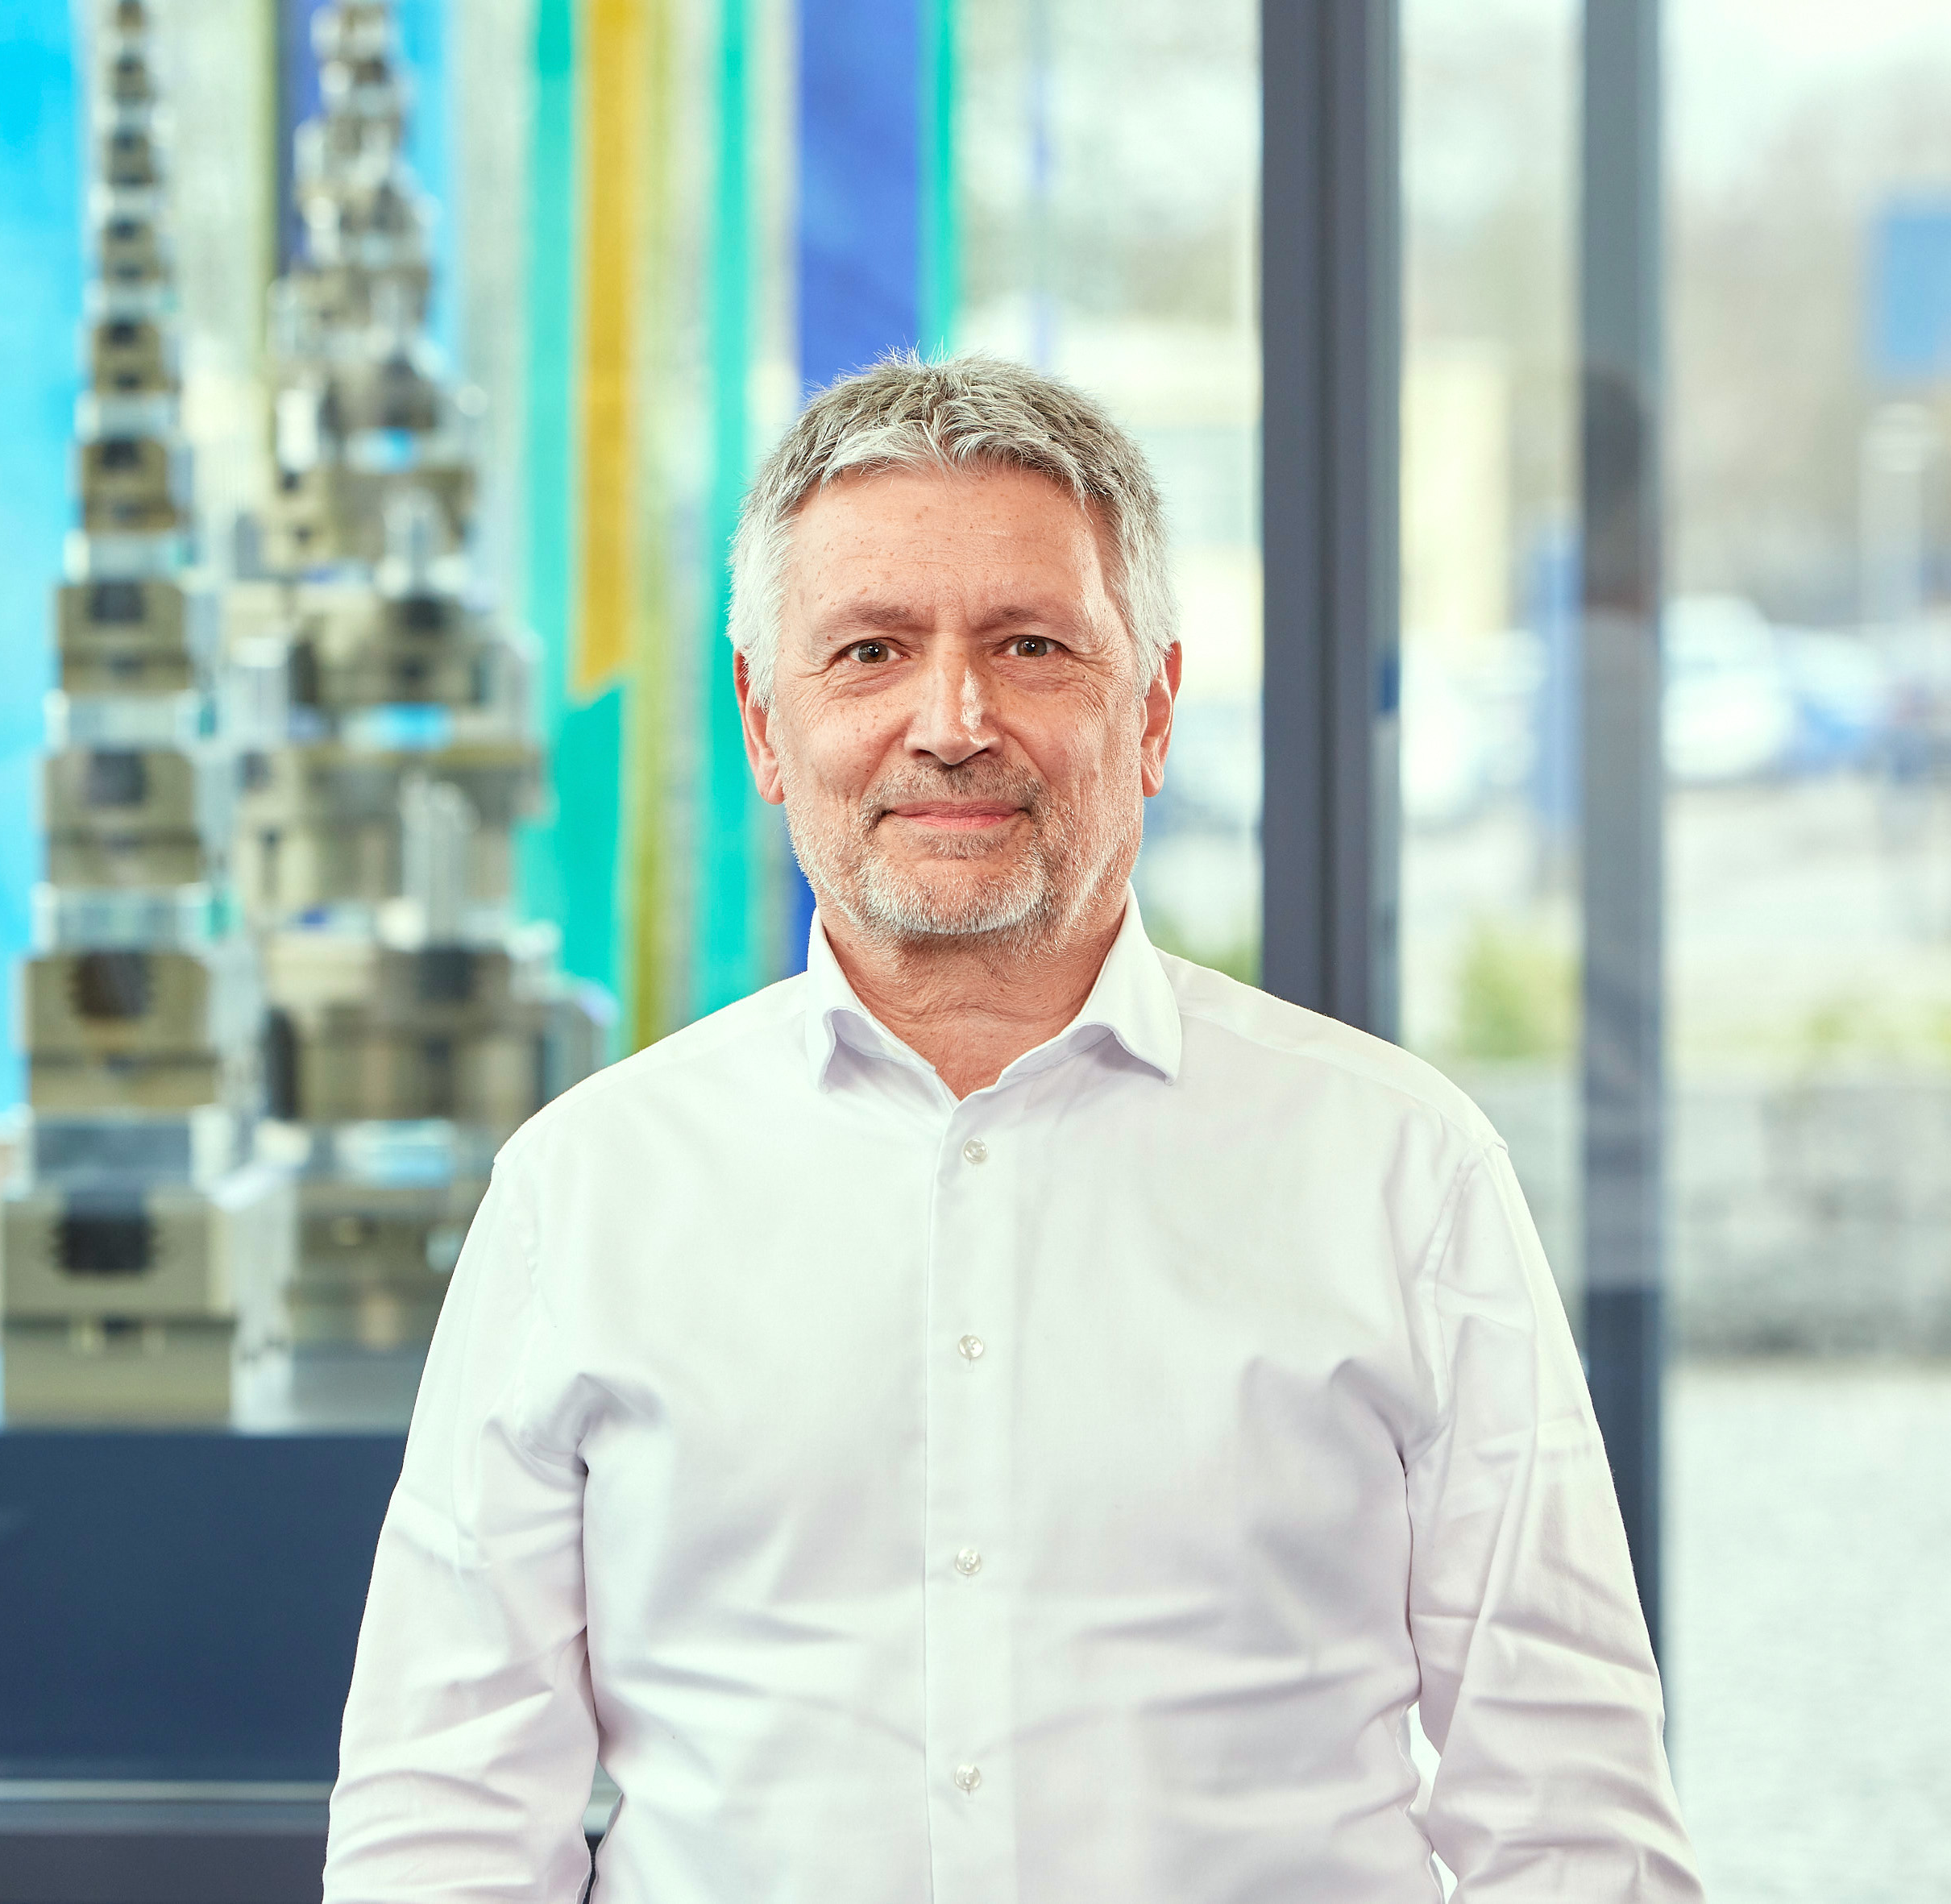
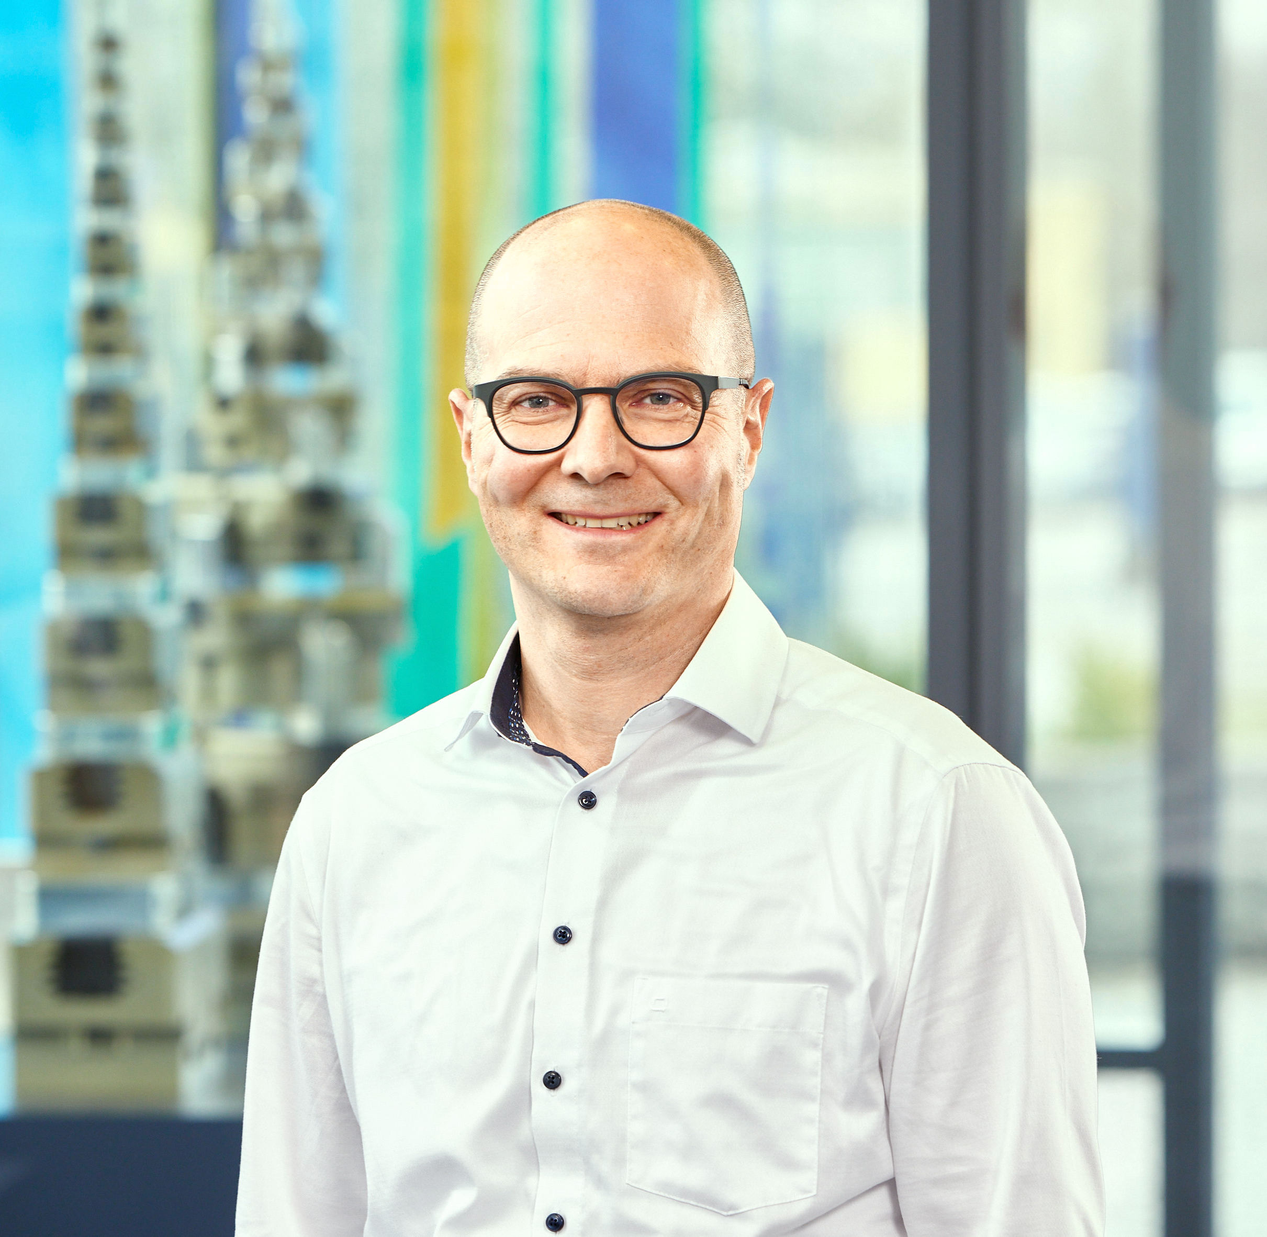
Team Technical Sales Hydraulic Expansion Technology Clamping Technology
SCHUNK Engineering - Pitchdeck
Gunter Praxmarer
+49-7133-103-2780/-2836
+49-171-9794454
gunter.praxmarer@de.schunk.com
Magnus Deyhle
+49-7133-103-3298
magnus.deyhle@de.schunk.com
Klaus Fein
+49-7133-103-2520/-2518
klaus.fein@de.schunk.com
Thomas Siemens
+49-7133-103-3041
thomas.siemens@de.schunk.com
Thomas Schinagel
+49-7133-103-2400
+49-151-12001478
thomas.schinagel@de.schunk.com
Norman Rost
+49-7133-103-2472
norman.rost@de.schunk.com

Slide 8
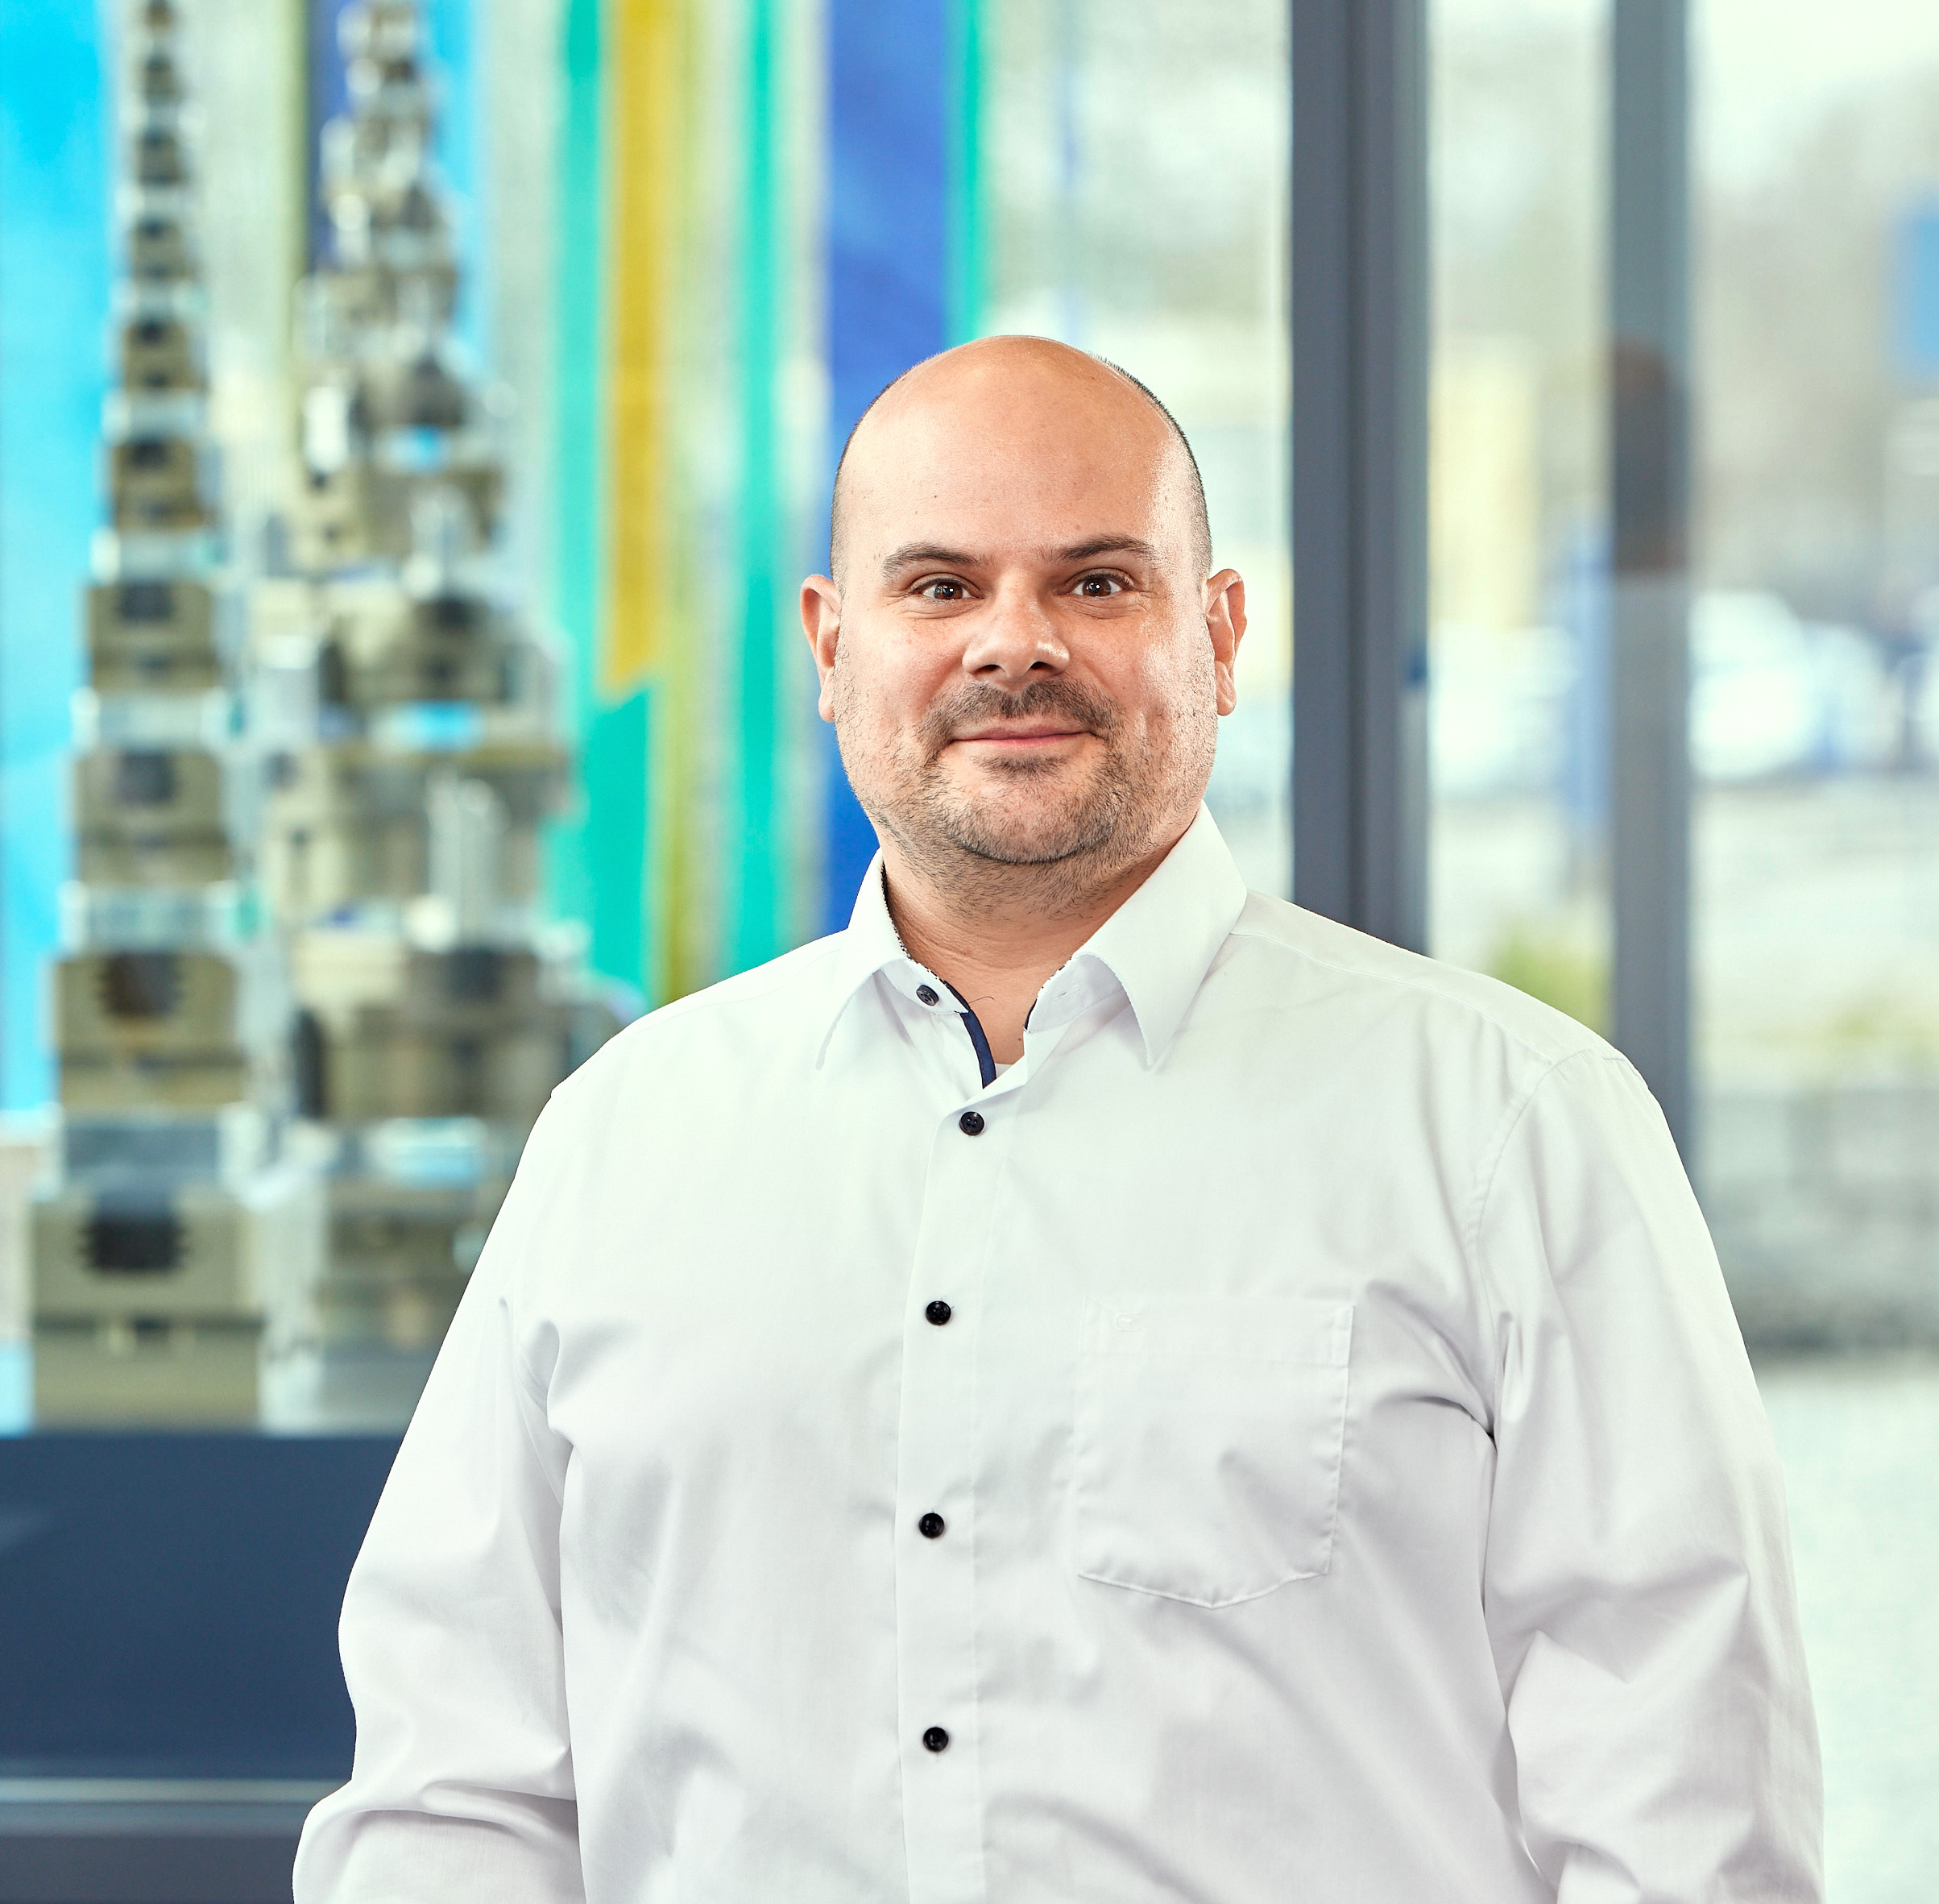
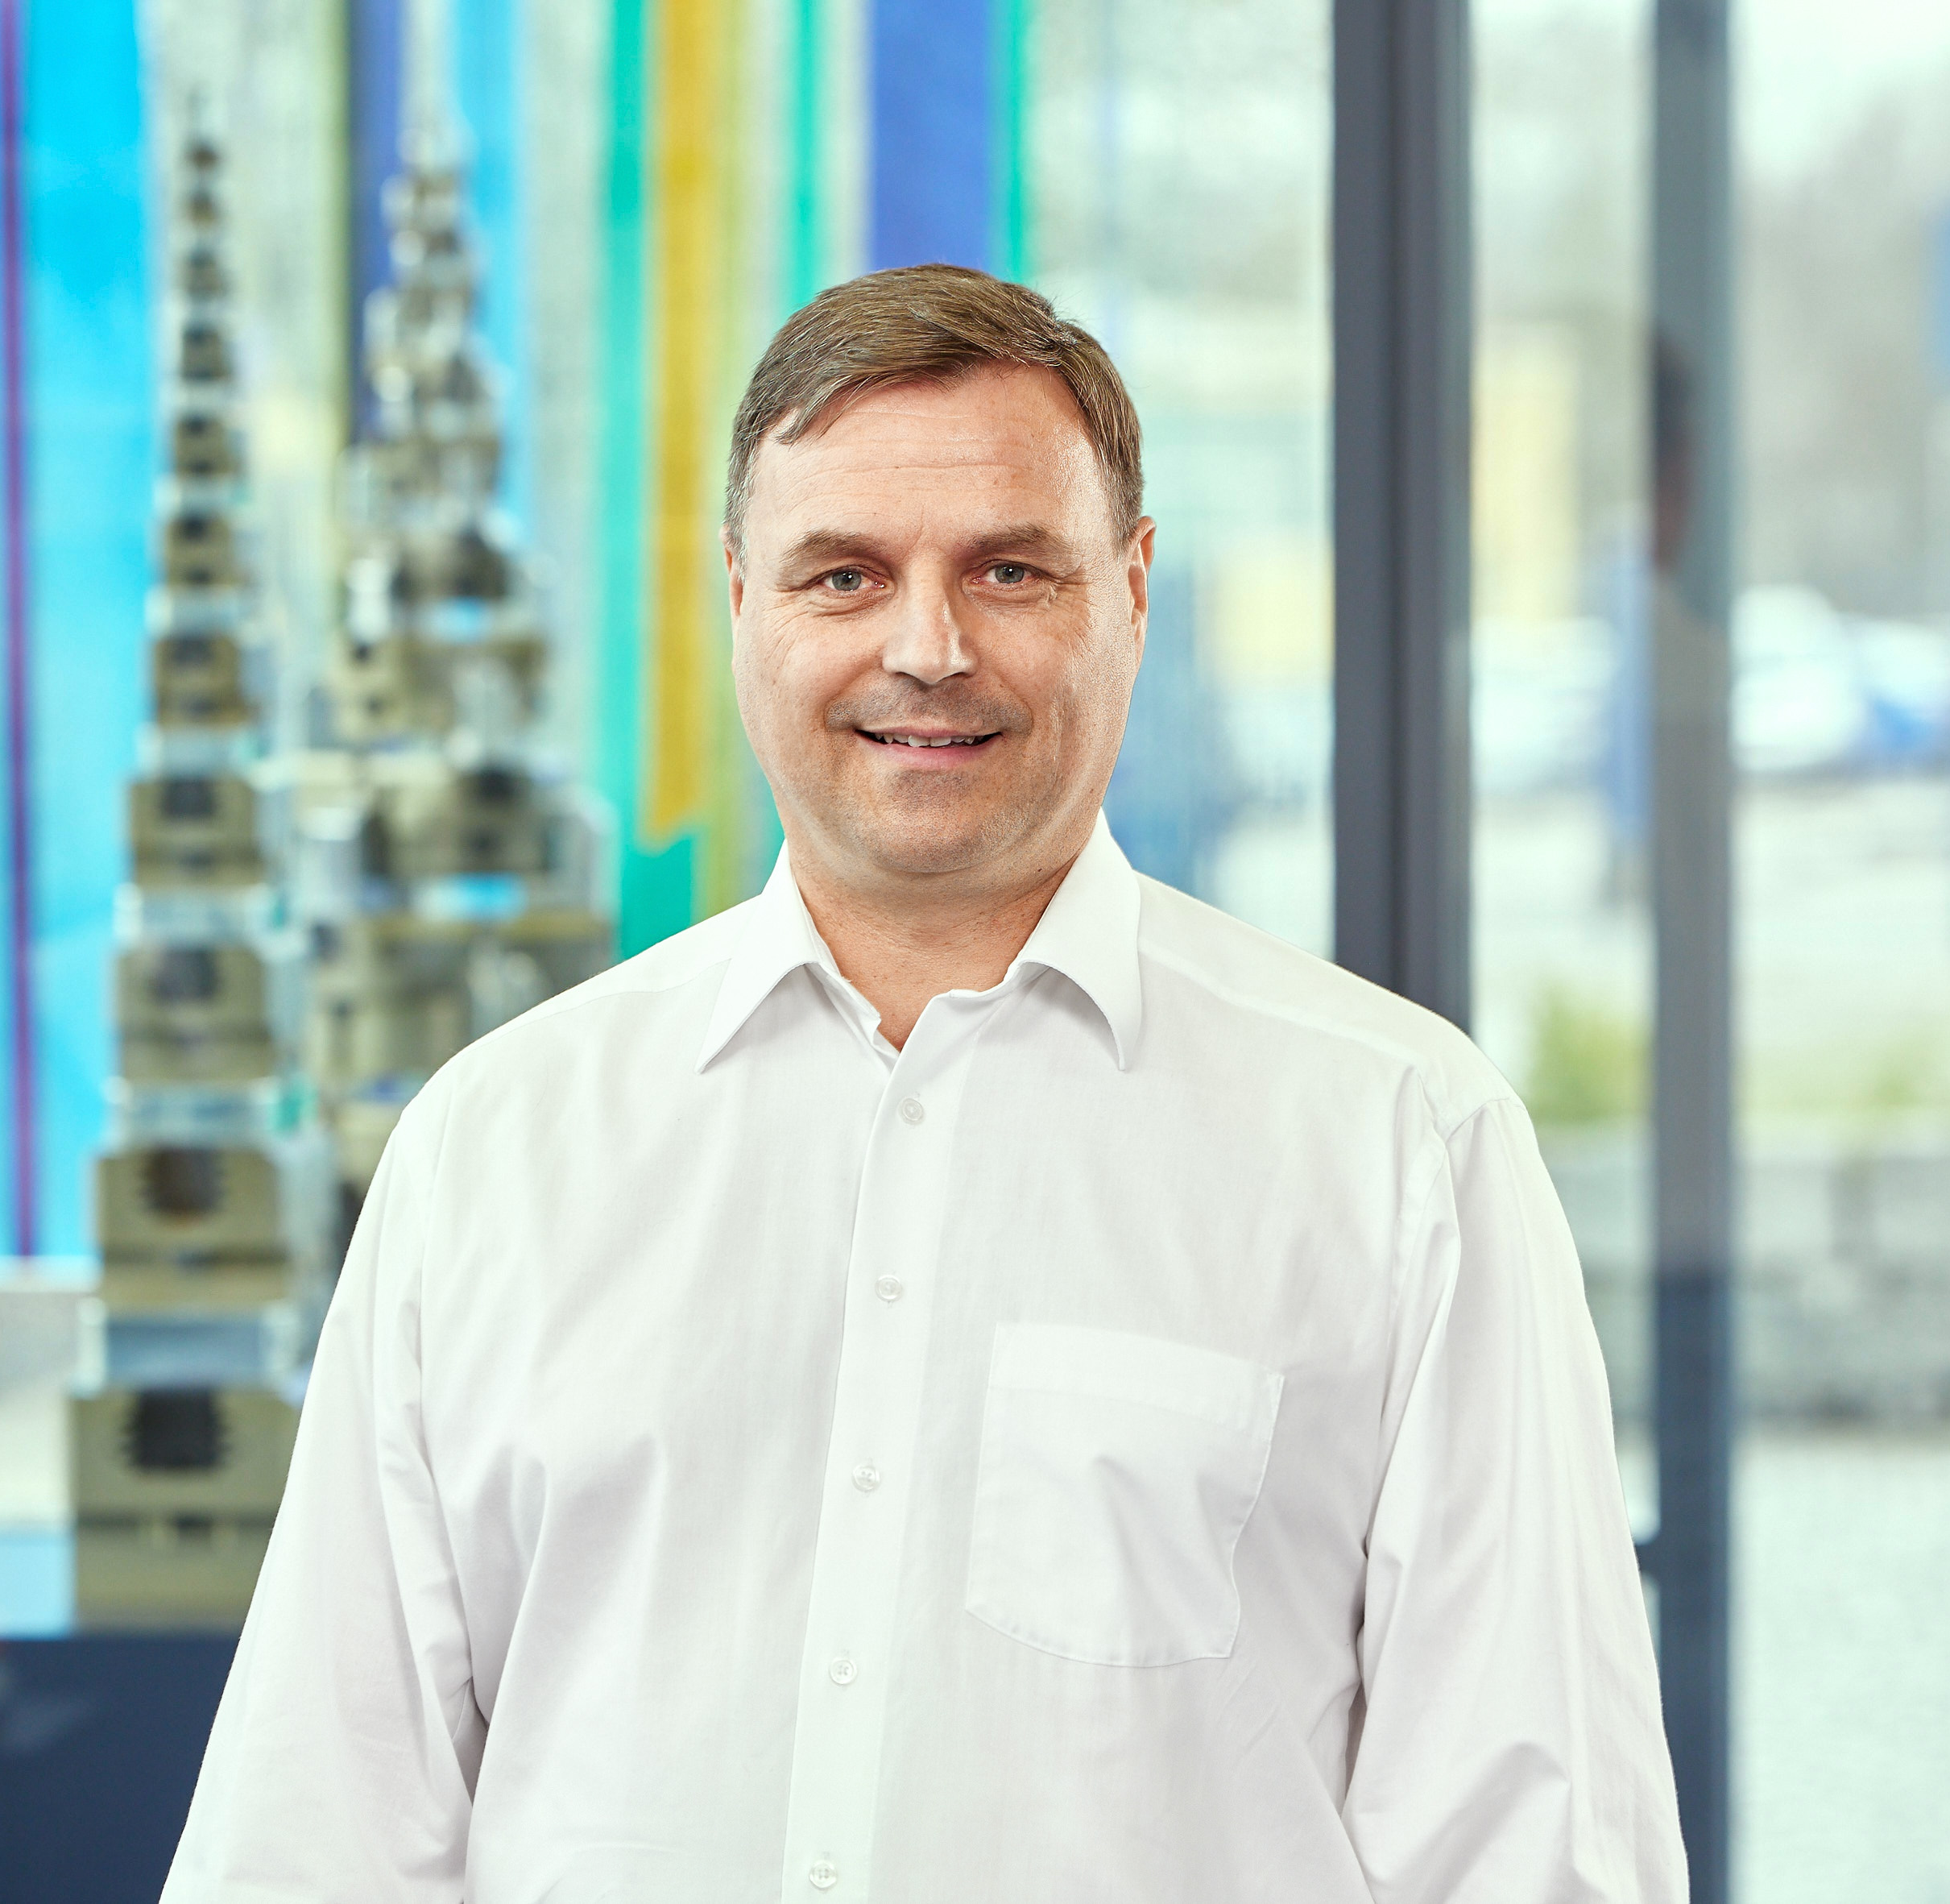
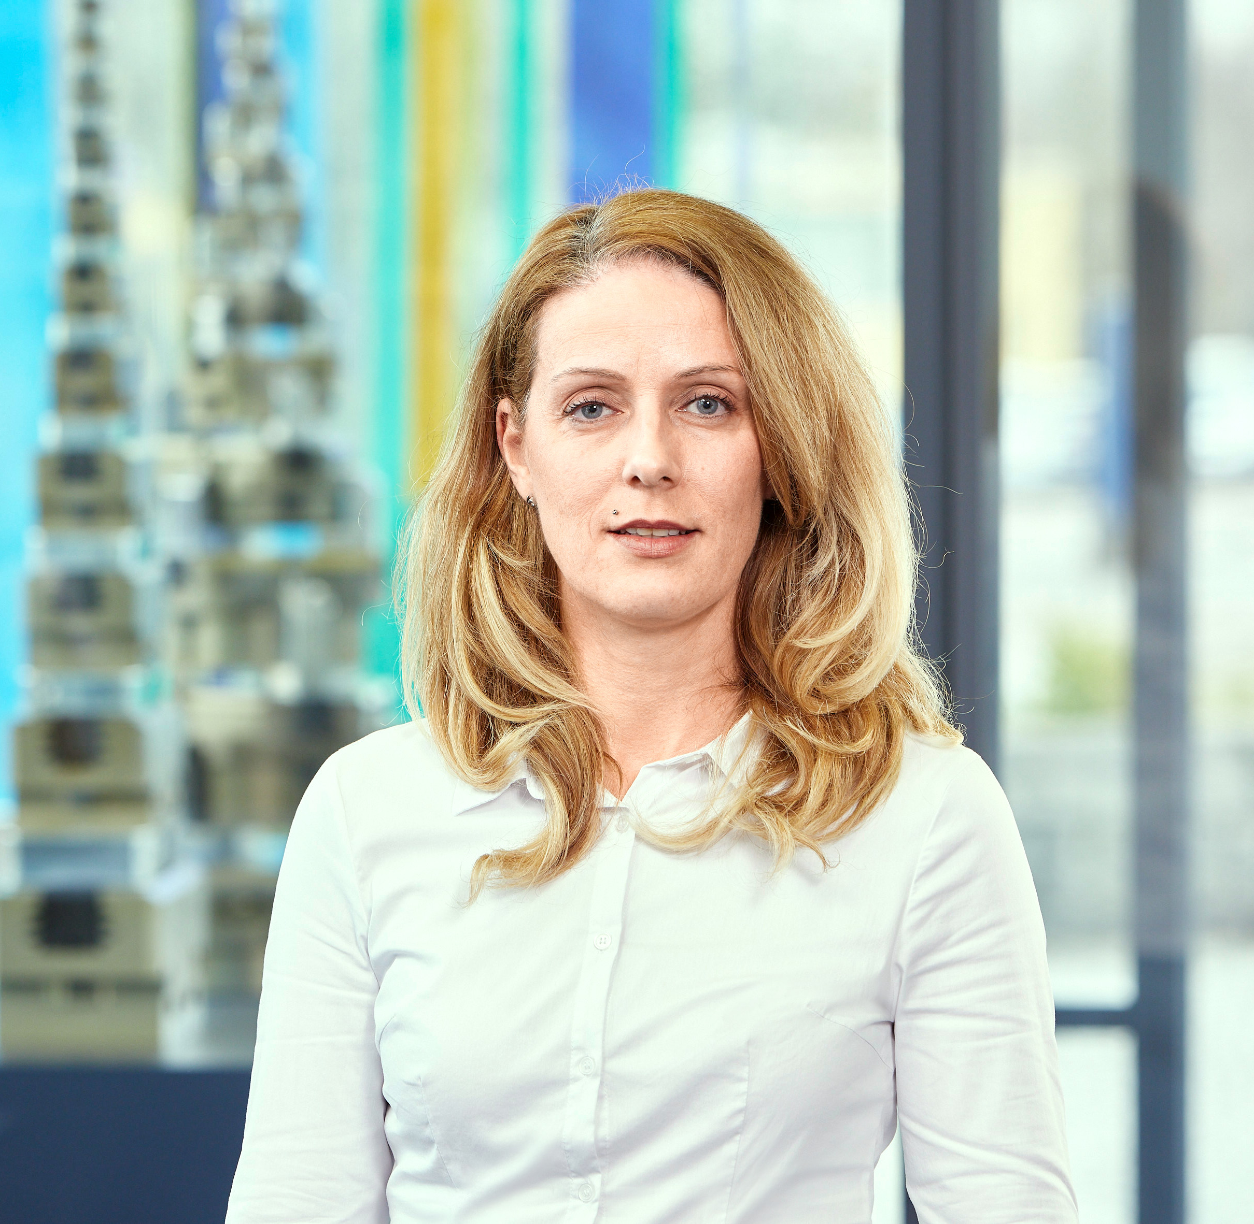
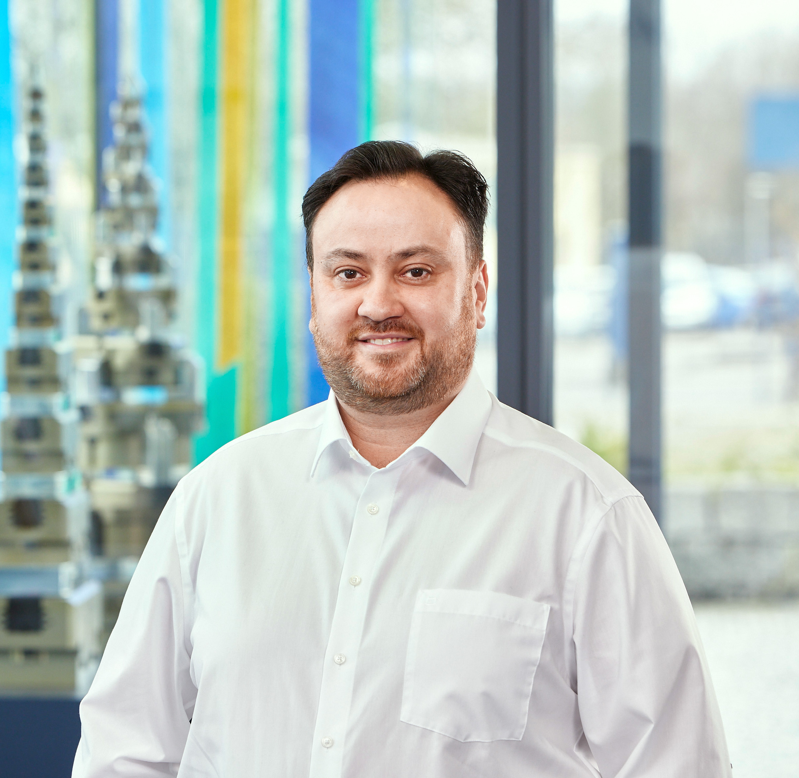
Team Technical Sales Chuck Jaws
Clamping Technology
SCHUNK Engineering - Pitchdeck
Fabian Eißele
+49-7133-103-2951
+49-160-93146561
fabian.eissele@de.schunk.com
Markus Wimmer
+49-7133-103-2161
markus.wimmer@de.schunk.com
Isabel Conzatti
+49-7133-103-2031
+49-151-46265580
isabel.conzatti@de.schunk.com
Mustafa Benali
+49-7133-103-2224
mustafa.benali@de.schunk.com

Slide 9

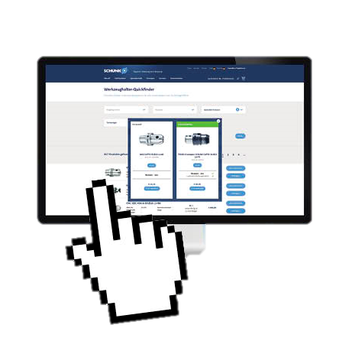
Customized products and systems from batch size 1 at the most attractive price and delivery time
SCHUNK Engineering - Konfigurierbare Produkte
schunk.com

Slide 10
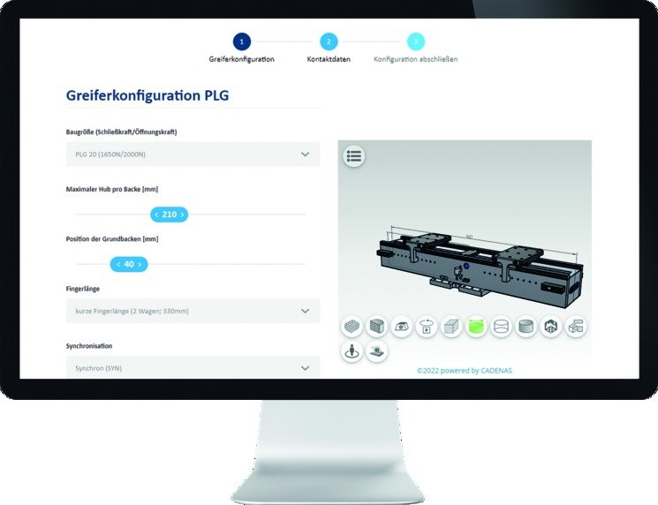
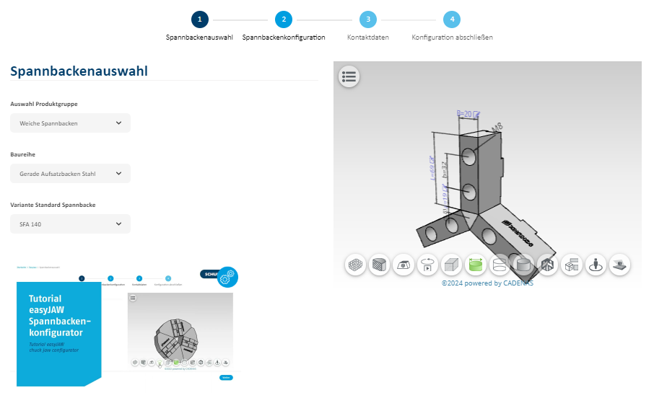
Why configuration?
SCHUNK Engineering - configurators at SCHUNK
Web-based & license-free online tool→ No CAD program required
No development knowledge required→ Saving resources
Product & CAD data
SCHUNK expert knowledge→
Risk reduction
Exclusion of incorrect/impossible configurations
Fast and easy
Price and delivery time

Slide 11
EasyJAW
SCHUNK Engineering – configurable products
Customized solutions
Dimensions are determined by the customer.
Large range of variants
different geometry models to choose from.
Jaw materials definable
differenz jaw materials for every application.
License-free and browser-based web tool
can be used without your own CAD program.
Immediate display of price and delivery time
enables the shortest possible inquiry and ordering processes.
Reduced construction costs
Quick and easy design of individual jaws via web tool.
SCHUNK Know-how
reduces your effort and risk.
CAD data available at the touch of a button
Jaws can be integrated immediately in the CAD system design.
Notes:
Ansprechpartner: Isabell Conzatti

Slide 12
Customized components
SCHUNK Engineering

Slide 13
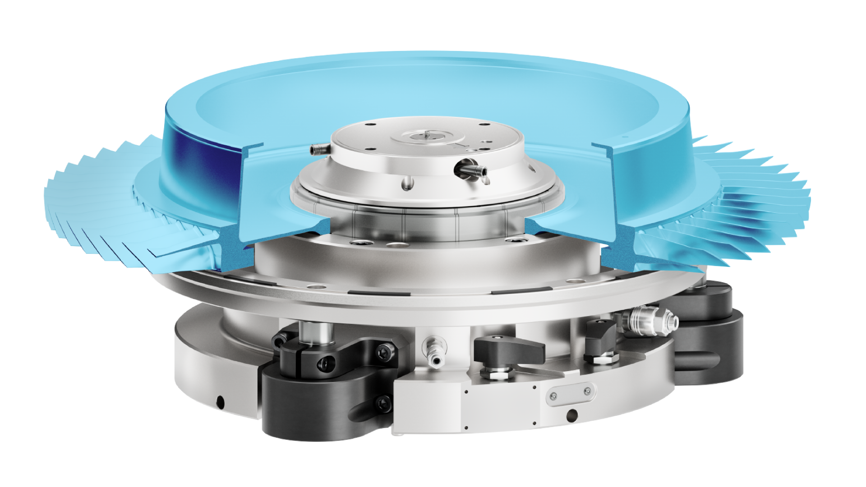


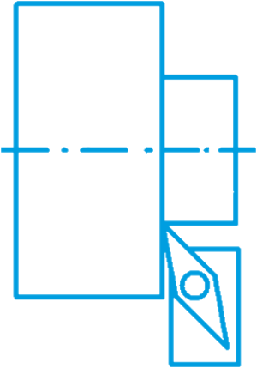

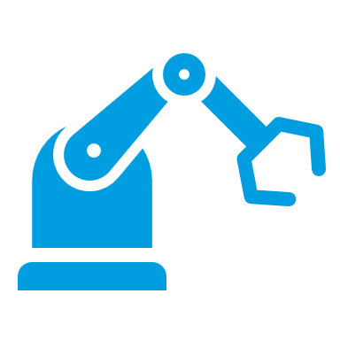

Hydraulic expansion arbor
Clamping of turbine rotors
SCHUNK Engineering
Axial runout accuracy
Axial runout accuracy of < 0,005 mm
Safety bolt
Indicates secure clamping
Machine connection
pneumatic actuation
Vibration damping can be switched off
Competent project planning team
Design, construction and assembly by SCHUNK
Solution expertise from a single source
Automation and clamping technology
TYPICAL PRODUCTS
TYPICAL PROCESS
REQUIREMENTS
COMPLEX GEOMETRY
Aerospace
INDIVIDUAL SOLUTION
AUTOMATION
HIGH
PRECISION
SCHUNK ID
1451126
TURNING
Notes:
Ansprechpartner: Gunter Praxmarer

Slide 14
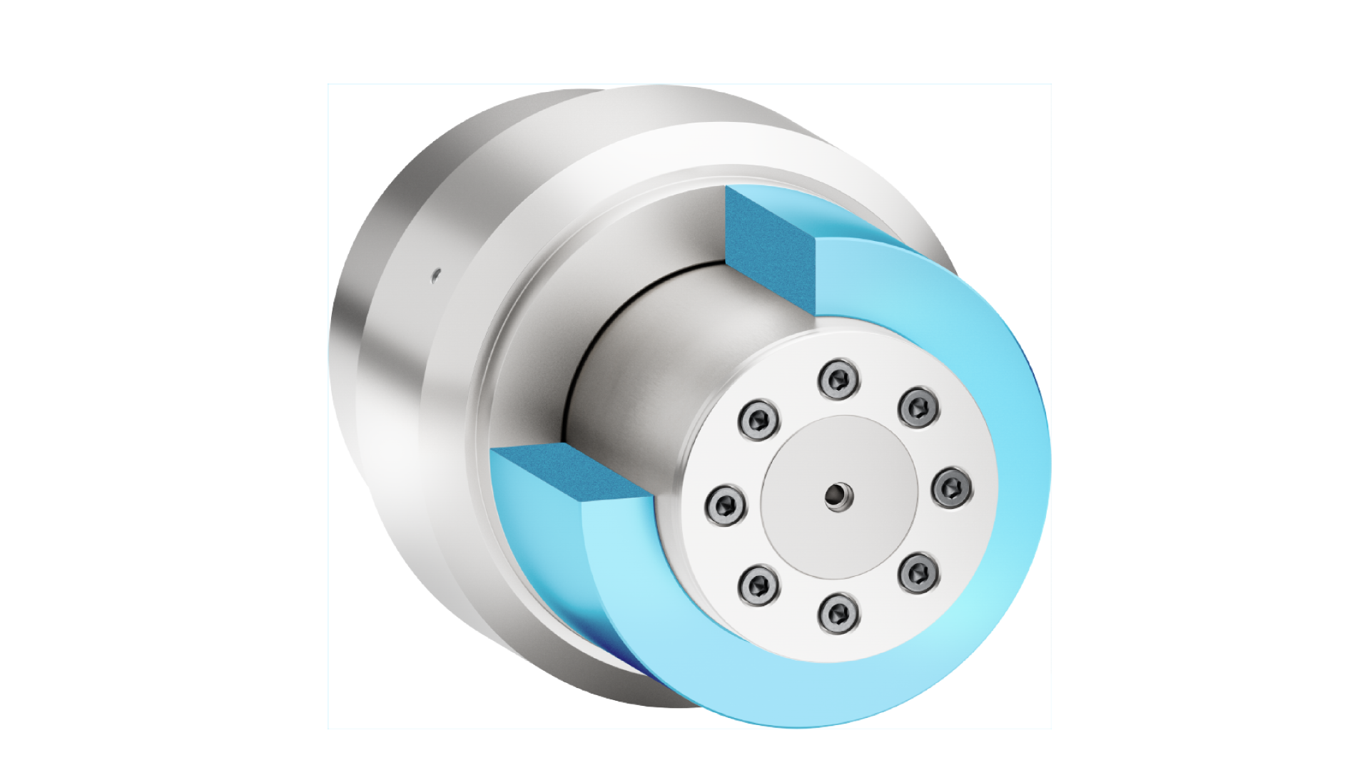


Hydraulic expansion arbor with pendelum end stop Pendelanschlag
Clamping of rotator stacks
SCHUNK Engineering
Clamping with hydraulic pressure
Pressure-operated by machine piston
Runout accuracy
Runout accuracy of < 0,005 mm
Compensation of axial runout faults
Axial runout faults on the plane surface are compensated by the pendulum stop
Competent project planning team
Design, construction and assembly by SCHUNK
Solution expertise from a single source
Automation and clamping technology
TYPICAL PRODUCTS
TYPICAL PROCESS
REQUIREMENTS
THIN-WALLED
Automotive
HIGH
FLEXIBILITY
HIGH
PRECISION
LARGE CLAMPING RANGE
SCHUNK ID
1499288
TURNING
Notes:
Ansprechpartner: Norman Rost

Slide 15
Hydraulic clamping chuck
Clamping of rotary workpieces
SCHUNK Engineering
Runout accuracy
Runout accuracy of < 0,005 mm
Up to 5 kN clamping force
Up to 80 Nm of torque can be transmitted
High process reliability
Due to vibration damping
Competent project planning team
Design, construction and assembly by SCHUNK
Solution expertise from a single source
Automation and clamping technology
TYPICAL PRODUCTS
TYPICAL PROCESS
REQUIREMENTS
COMPLEX GEOMETRY
Aerospace
INDIVIDUAL SOLUTION
HIGH
PRECISION
SCHUNK ID
1411588
TURNING
Notes:
Ansprechpartner: Gunter Praxmarer

Slide 16
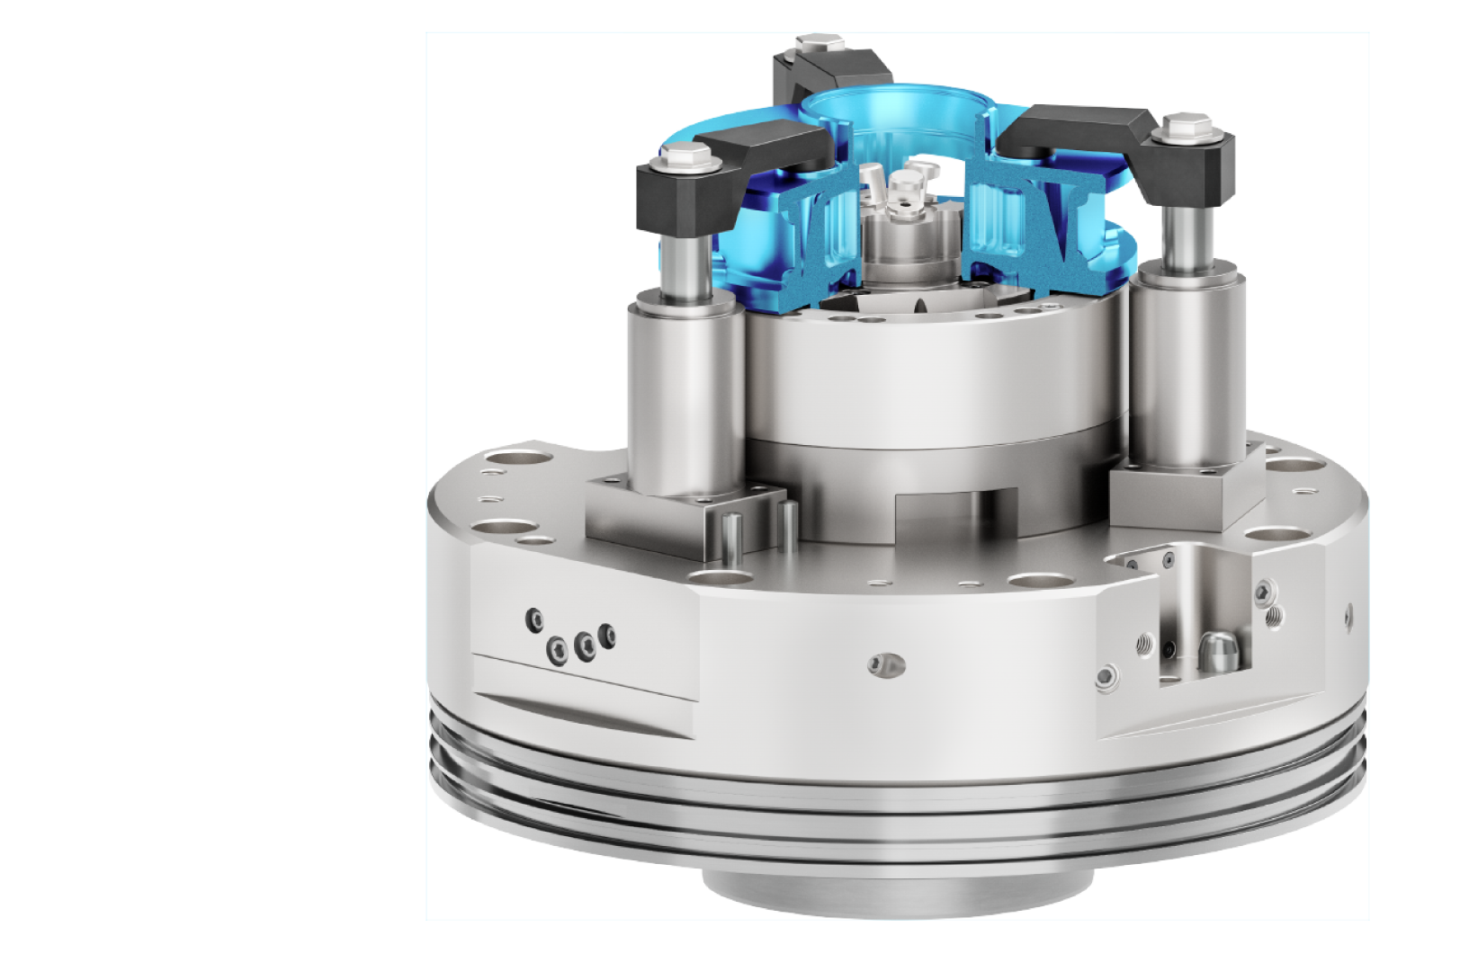

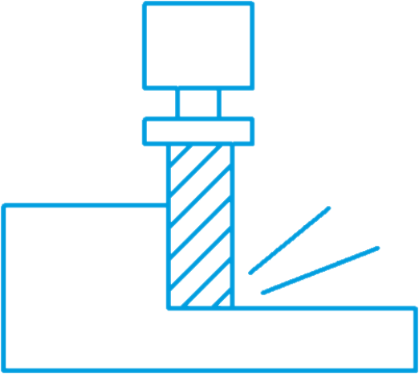

Hydraulic clamping device
Clamping of planetary gear carriers
SCHUNK Engineering
Runout accuracy
runout accuracy of < 0,008 mm
Flushing function through coolant nozzles
Machine connection
Machine connection designed precisely to customer requirements
Competent project planning team
Design, construction and assembly by SCHUNK
Solution expertise from a single source
Automation and clamping technology
TYPICAL PRODUCTS
TYPICAL PROCESS
REQUIREMENTS
COMPLEX GEOMETRY
GEARS
INDIVIDUAL SOLUTION
DIRT
RESISTANT
AUTOMATION
SCHUNK ID
1502804
MILLING
Notes:
Ansprechpartner: Norman Rost

Slide 17
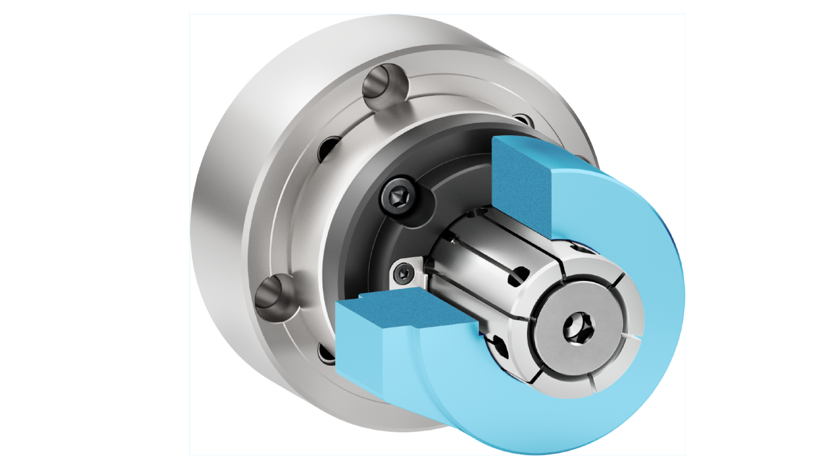


Mechanical clamping arbor
Inside clamping of rotary workpieces
SCHUNK Engineering
Runout accuracy
Runout accuracy of < 0,01 mm
Machine connection
Short taper size 6
Worpiece end stop with radial orientation
Competent project planning team
Design, construction and assembly by SCHUNK
Solution expertise from a single source
Automation and clamping technology
TYPICAL PRODUCTS
TYPICAL PROCESS
REQUIREMENTS
OUT OF ROUND PARTS
SHAFTS
QUICK CLAMPING CYCLES
HIGH
FLEXIBILITY
LARGE CLAMPING RANGE
SCHUNK ID
20064740
TURNING
Notes:
Ansprechpartner: Magnus Deyhle

Slide 18
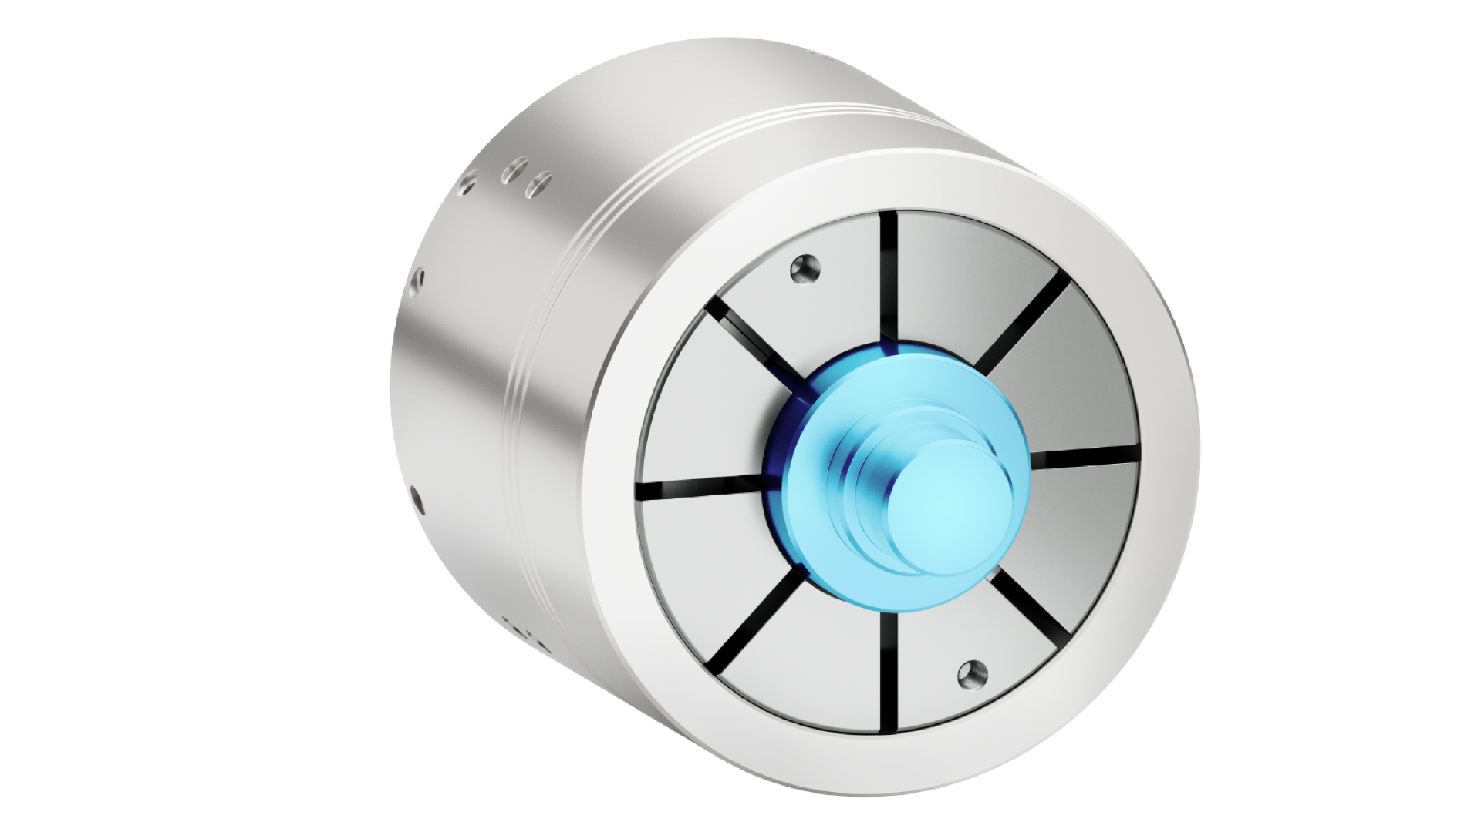
Mechanical clamping chuck
Outer clamping of rotary workpieces
SCHUNK Engineering
Runout accuracy
Runout accuracy of < 0,02 mm
Interface to base chuck size 66
Clamping bushings interchangeable
flexible clamping diameter
Competent project planning team
Design, construction and assembly by SCHUNK
Solution expertise from a single source
Automation and clamping technology
TYPICAL PRODUCTS
TYPICAL PROCESS
REQUIREMENTS
OUT OF ROUND PARTS
SHAFTS
QUICK CLAMPING CYCLES
HIGH
FLEXIBILITY
LARGE CLAMPING RANGE
SCHUNK ID
1516118
TURNING
Notes:
Ansprechpartner: Gunter Praxmarer

Slide 19
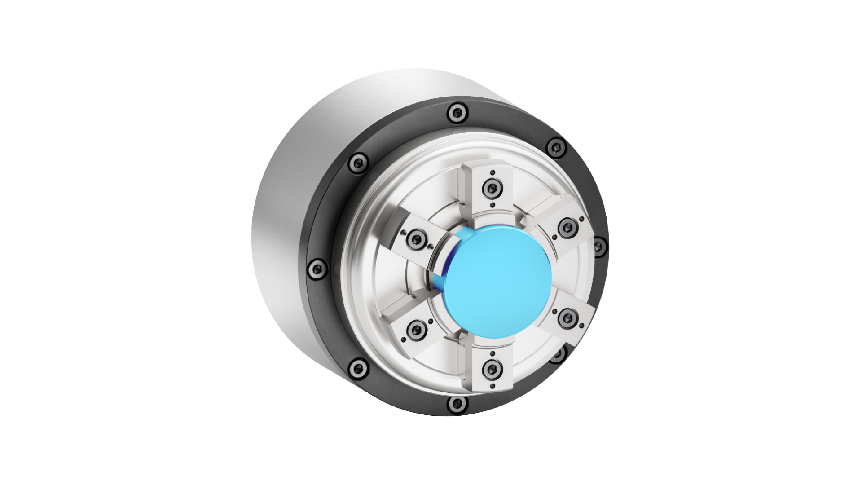

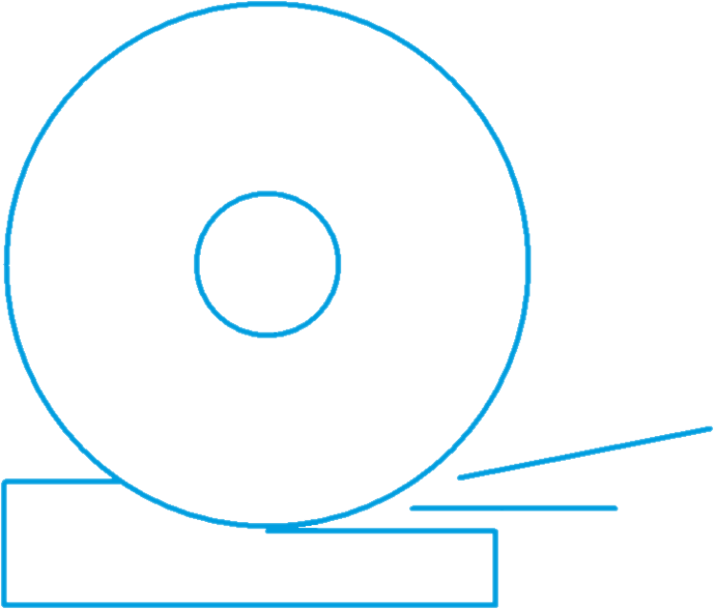

Membran chuck for outer clamping
High precision clamping of short workpieces
SCHUNK Engineering
Runout accuracy
Runout accuracy of < 0,005 mm
Clamping due deformation of the membrane
No dirt-sensitive external mechanics/parts
Interface can be designed flexible
Machine connection directly onto spindle or Schunk base chuck
Interchangeable jaws
Competent project planning team
Design, construction and assembly by SCHUNK
TYPICAL PRODUCTS
TYPICAL PROCESS
REQUIREMENTS
OPTICS
GEARS
HIGH
FLEXIBILITY
LOW MAINTAINANCE
DIRT
RESISTANT
SCHUNK ID
1489117
GRINDING
Notes:
Ansprechpartner: Norman Rost

Slide 20
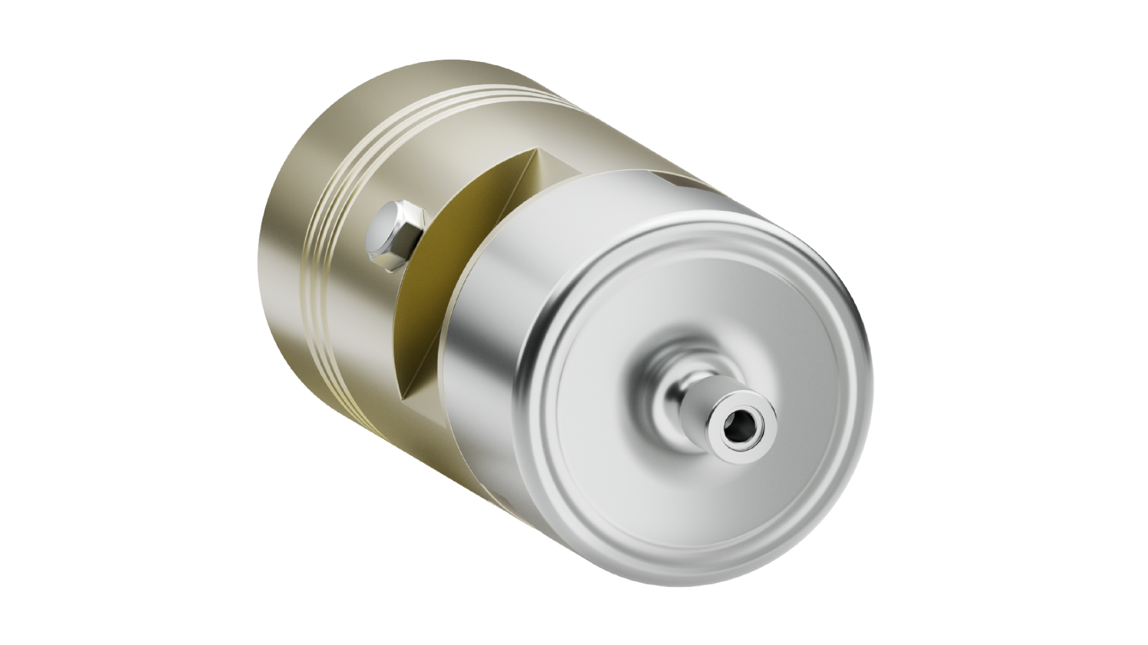

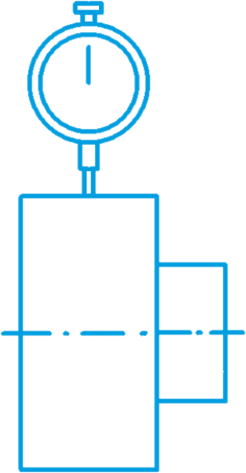
Micro-adjustment fixture for glue joint scraper
SCHUNK Engineering
μm-precise axial adjustment
High-precision length adjustment thanks to hydraulic pressure-controlled expansion technology
Runout accuracy
runout accuracy of < 0,005 mm
Machine connection
Machine connection designed precisely to customer requirements
Competent project planning team
Design, construction and assembly by SCHUNK
Solution expertise from a single source
Automation and clamping technology
TYPICAL PRODUCTS
TYPICAL PROCESS
REQUIREMENTS
Furniture
INDIVIDUAL SOLUTION
AUTOMATION
DIRT
RESISTANT
SCHUNK ID
20057150
MEASURING
Notes:
Ansprechpartner: Norman Rost, zweiter Prozess??

Slide 21
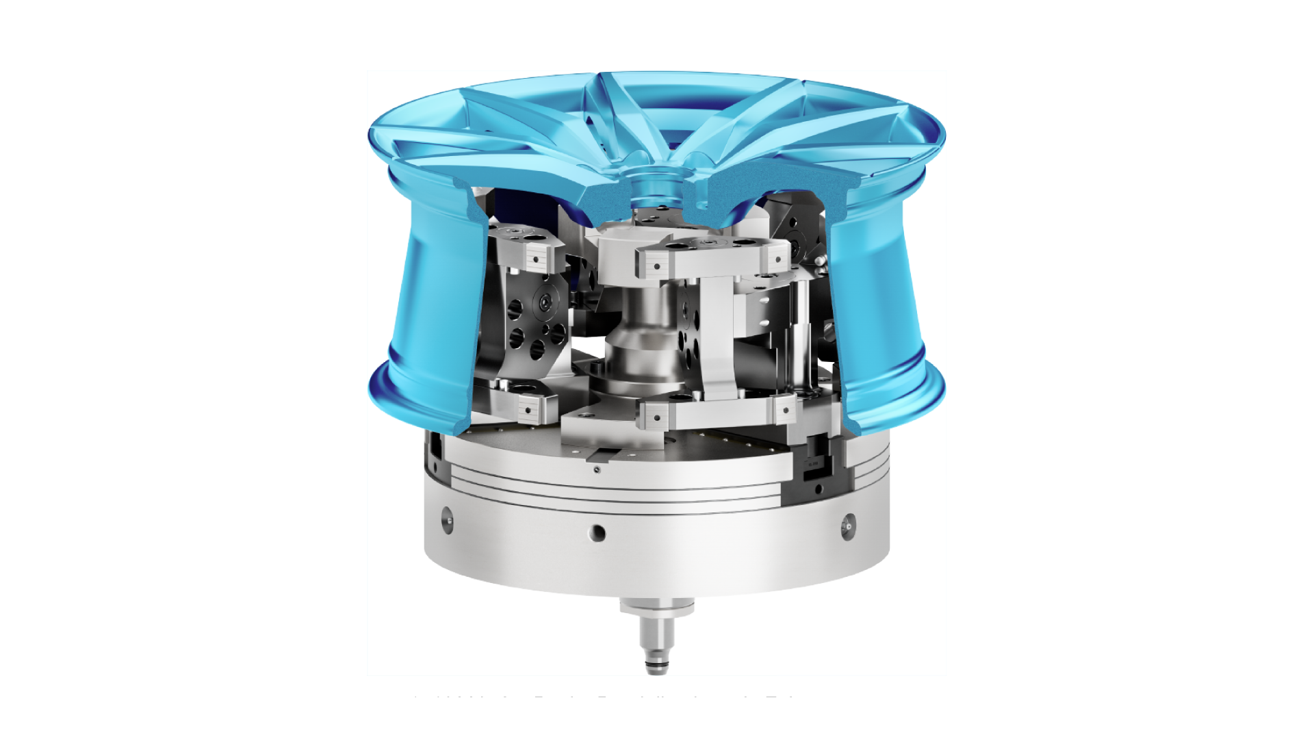

Hard pendulum jaws for inner clamping
Clamping of car rims for turning operations
SCHUNK Engineering
Low component deformation
Out-of-roundness of <0.05mm due to clamping at 24 clamping points
End stop with pendulum effect
Compensation of axial run-out faults
Machine connection
Fitting to SCHUNK ROTA NCO 400
Competent project planning team
Design, construction and assembly by SCHUNK
Solution expertise from a single source
Automation and clamping technology
TYPICAL PRODUCTS
TYPICAL PROCESS
REQUIREMENTS
THIN-WALLED
COMPLEX GEOMETRY
INDIVIDUAL SOLUTION
HIGH
PRECISION
LOW WEAR
AND TEAR
SCHUNK ID
1510863
TURNING
Notes:
Ansprechpartner: Markus Wimmer

Slide 22
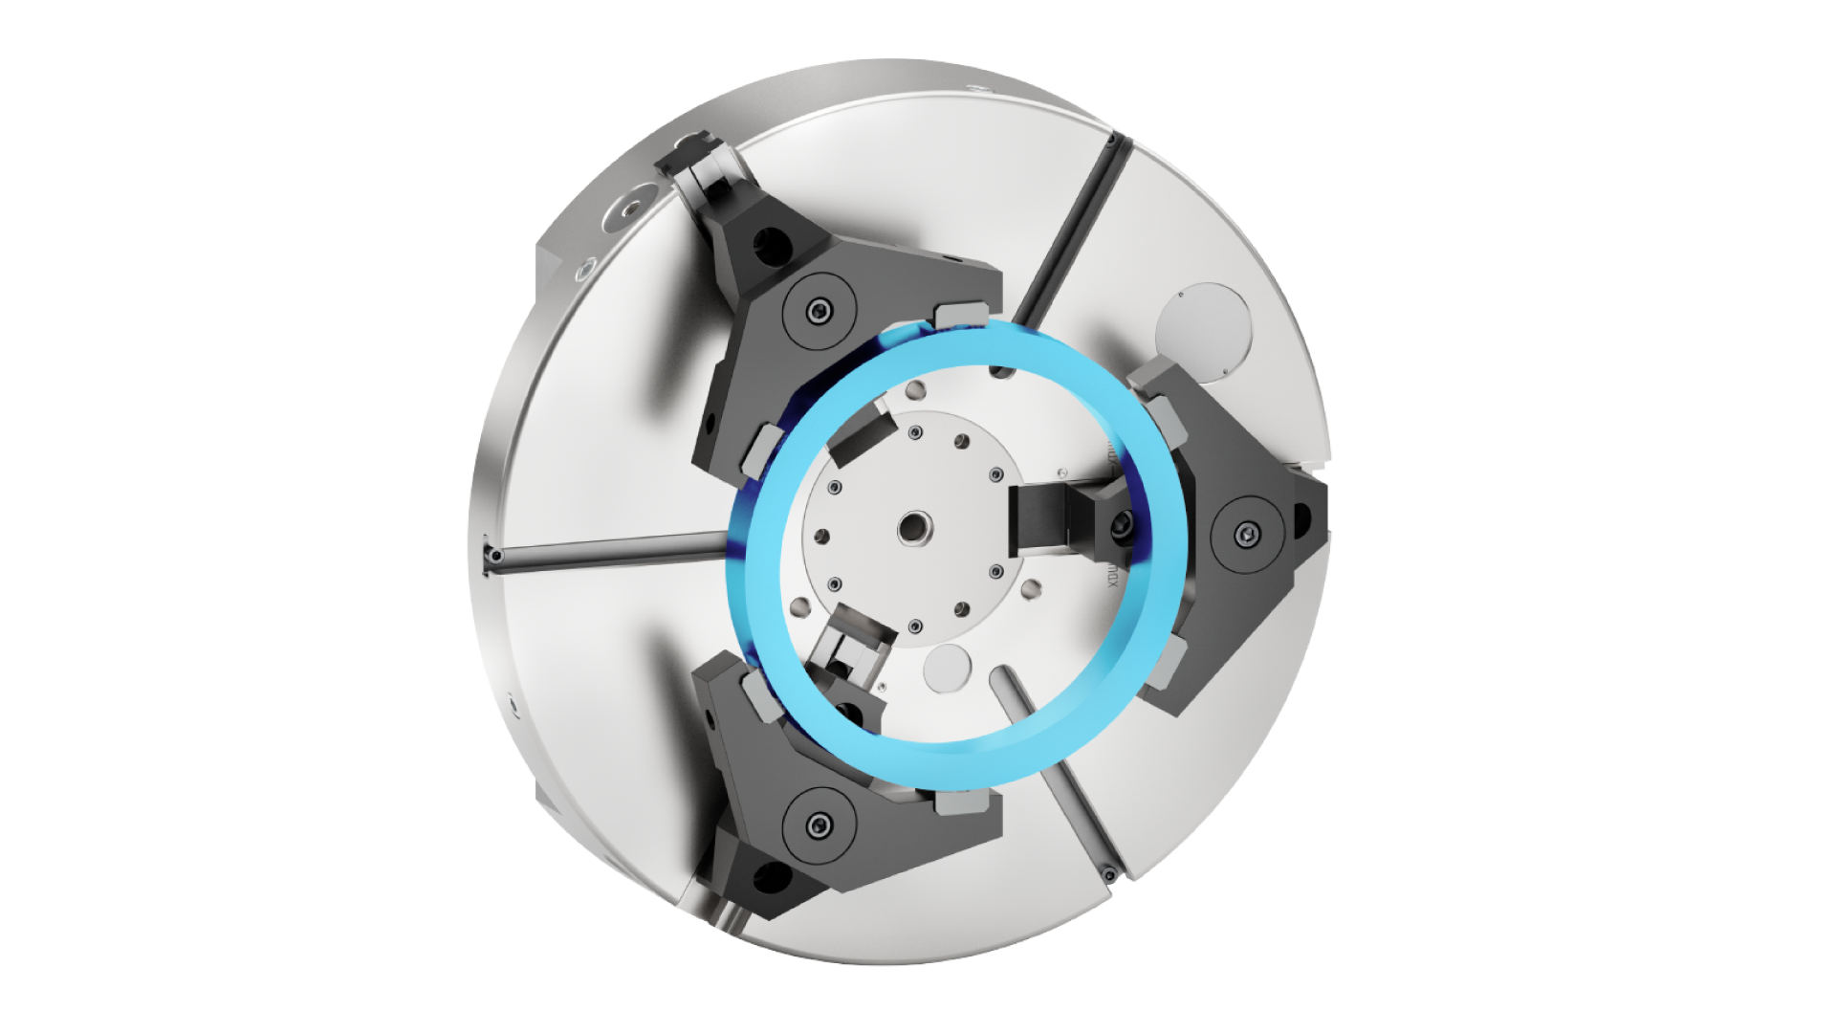

Pendulum jaws and workpiece end stop
Clamping of sliding sleeves
SCHUNK Engineering
End stop with pendulum effect
Compensation of axial run-out faults
Perfect for thin-walled worpieces
Significant reduction of material deformation due to evenly distributed clamping points
Integrated air sensing
Bores for air sensing in end stop
Long service life of the jaws
With interchangeable clamping inserts
Competent project planning team
Design, construction and assembly by SCHUNK
TYPICAL PRODUCTS
TYPICAL PROCESS
REQUIREMENTS
THIN-WALLED
SHAFTS
GENTLE CLAMPING
LOW WEAR
AND TEAR
AUTOMATION
SCHUNK ID
1525640
TURNING
Notes:
Ansprechpartner: Markus Wimmer

Slide 23
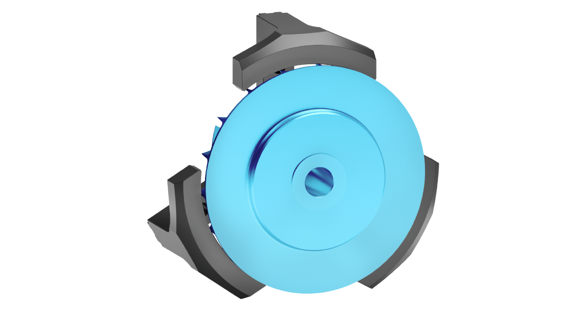
Segmented aluminum jaws for outer clamping
Clamping of compressor wheels
SCHUNK Engineering
Jaw material Aluminum
Few clamping marks on the workpiece and reduced centrifugal forces
Reduced workpiece deformation
Due to clamping force transmission over large enclosing surfaces
High runout accuracy
When turning out the clamping surfaces on the chuck used later
Competent project planning team
Design, construction and assembly by SCHUNK
Solution expertise from a single source
Automation and clamping technology
TYPICAL PRODUCTS
TYPICAL PROCESS
REQUIREMENTS
COMPLEX GEOMETRY
THIN-WALLED
GENTLE CLAMPING
HIGH
PRECISION
INDIVIDUAL SOLUTION
SCHUNK ID
1571363
TURNING
Notes:
Ansprechpartner: Fabian Eißele

Slide 24
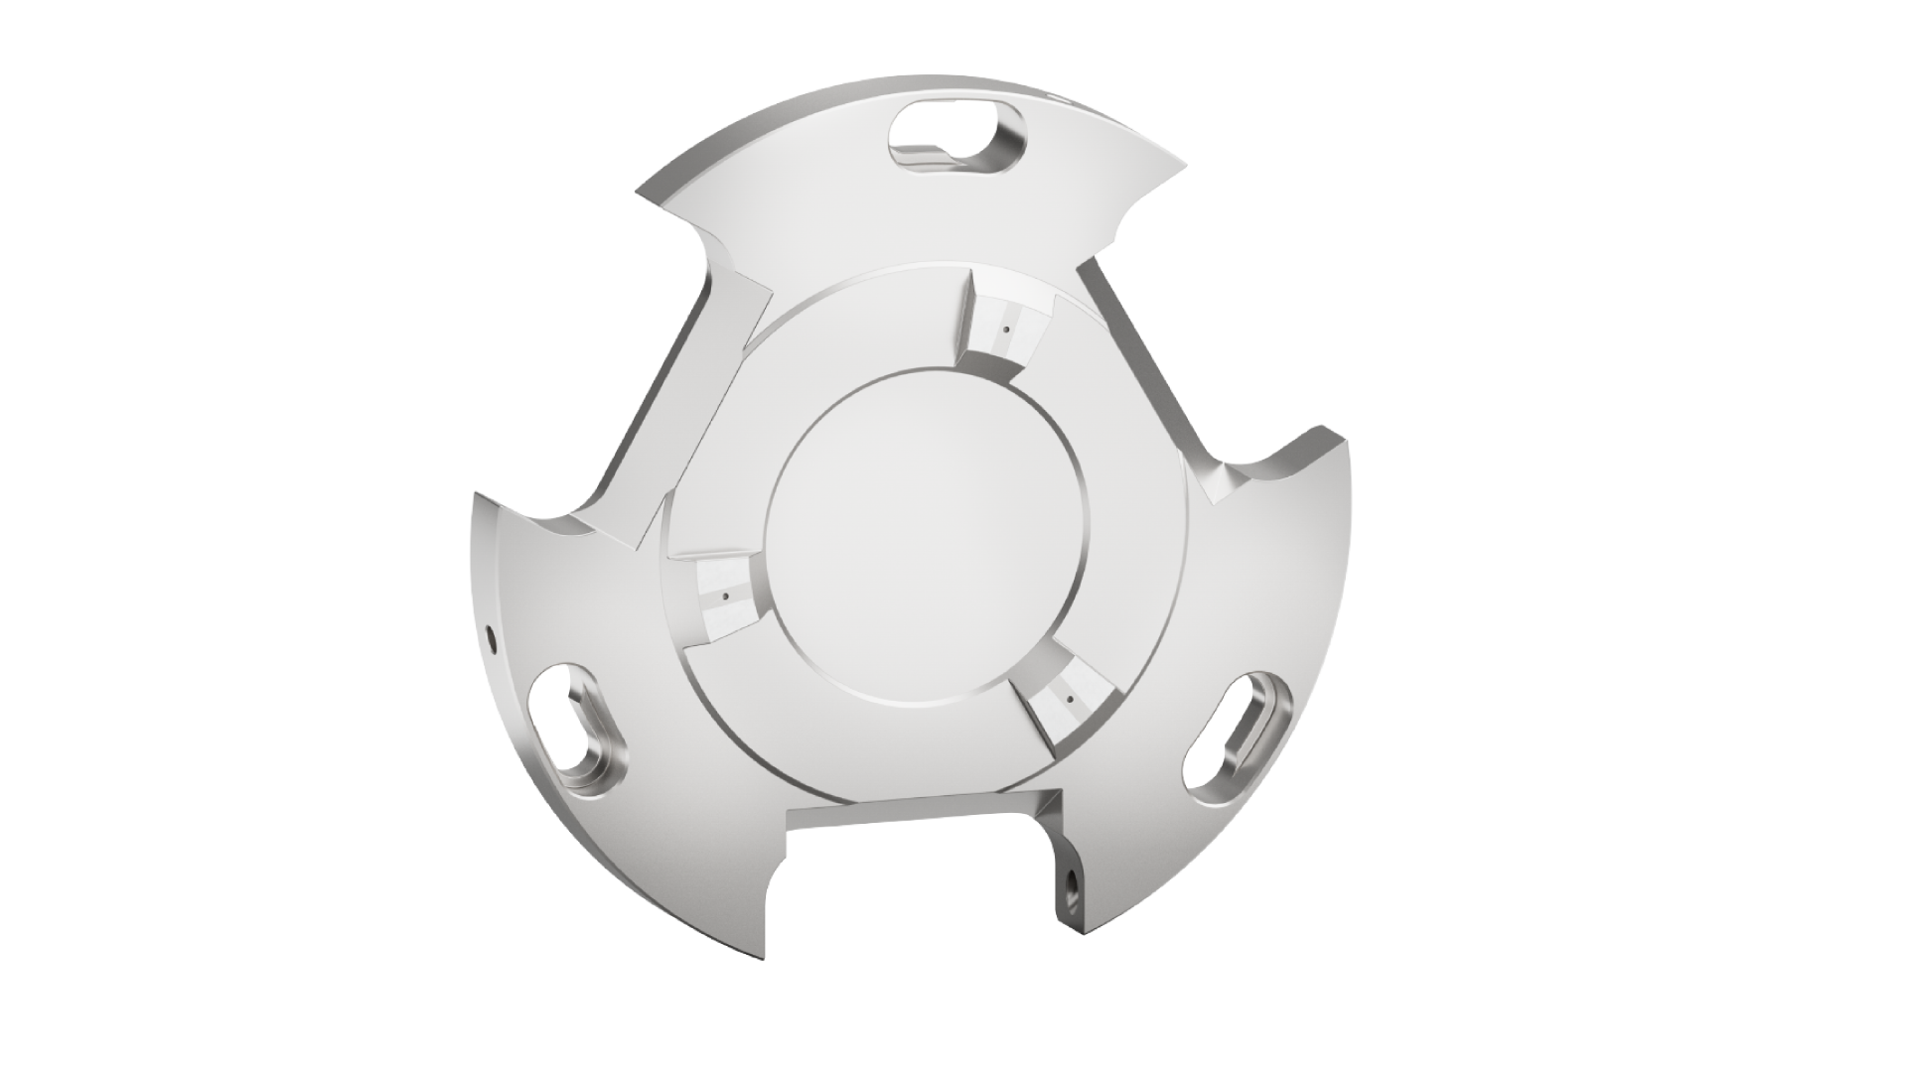
Workpiece end stop ring
For axial locating of Workpieces in the chuck
SCHUNK Engineering
Integrated air sensing
Bores for air sensing in end stop
Quick installation and removal
Due bajonett system
Machine connection
Available for all common chuck manufacturers
Competent project planning team
Design, construction and assembly by SCHUNK
Solution expertise from a single source
Automation and clamping technology
TYPICAL PRODUCTS
TYPICAL PROCESS
REQUIREMENTS
SHAFTS
HIGH
FLEXIBILITY
INDIVIDUAL SOLUTION
AUTOMATION
SCHUNK ID
1529992
TURNING
Notes:
Ansprechpartner: Markus Wimmer

Slide 25
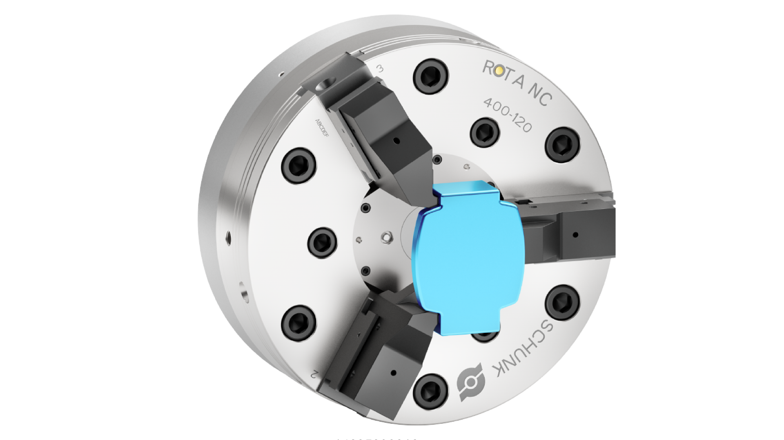

Qucik change jaws for outer clamping
Clamping of housing parts
SCHUNK Engineering
High flexibility
Quick, tool-free change of the quick-change jaws
Customized jaw conture
Reliable, form fitting clamping with balance compensation, even for more complex workpieces with three jaws
Solution expertise from a single source
Processes can be optimally automated with customized clamping jaws and gripper fingers from SCHUNK
Competent project planning team
Design, construction and assembly by SCHUNK
TYPICAL PRODUCTS
TYPICAL PROCESS
REQUIREMENTS
MACHINE HOUSINGS
COMPLEX GEOMETRY
HIGH
FLEXIBILITY
INDIVIDUAL SOLUTION
AUTOMATION
SCHUNK ID
1463509
TURNING
Notes:
Ansprechpartner: Markus Wimmer

Slide 26
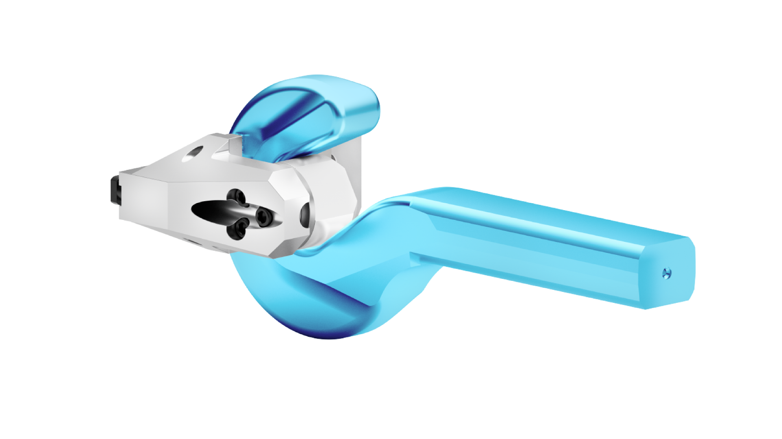
Customized application
Clamping of crane hooks
SCHUNK Engineering
Individual solutions
Special solutions can also be found for components with more complex geometries.
Interchangeable clamping inserts
If the clamping points are worn, only the inserts need to be replaced
End stop in axial direction
Competent project planning team
Design, construction and assembly by SCHUNK
Solution expertise from a single source
Automation and clamping technology
TYPICAL PRODUCTS
TYPICAL PROCESS
REQUIREMENTS
COMPLEX GEOMETRY
HIGH
PRECISION
INDIVIDUAL SOLUTION
LOW WEAR
AND TEAR
SCHUNK ID
10027797/135019
TURNING
Notes:
Ansprechpartner: Markus Wimmer

Slide 27
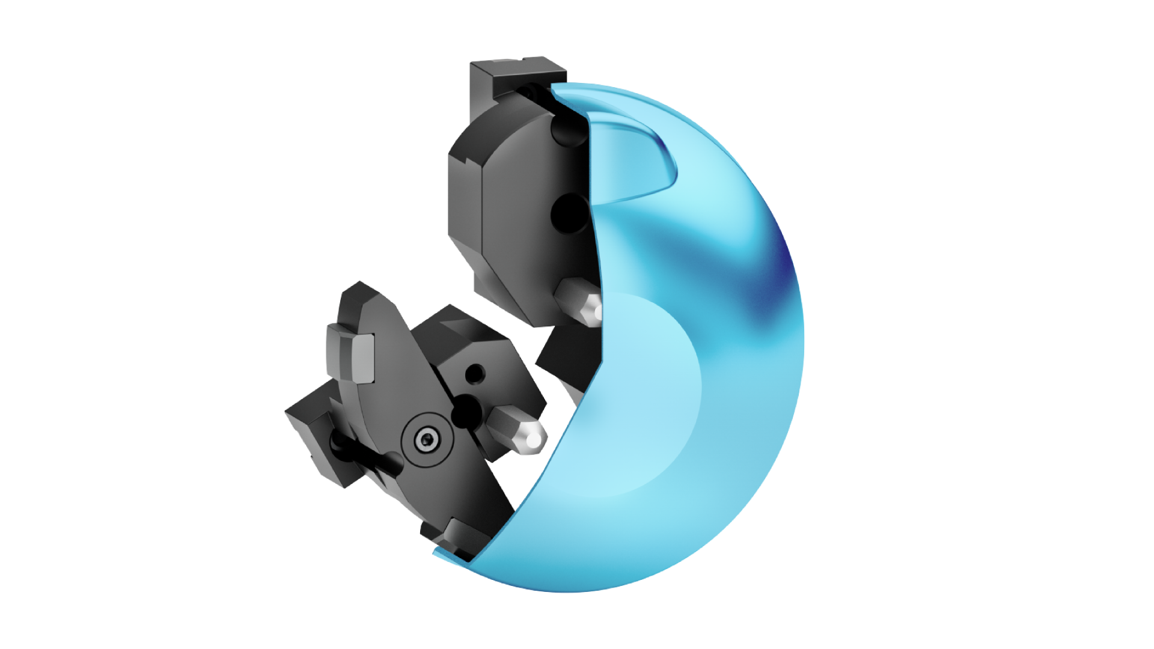
Special jaws for inside clamping
For clamping a housing cover
SCHUNK Engineering
Individual solutions
Irregular shapes can also be clamped on lathe chucks
Perfect for thin-walled worpieces
Significant reduction of material deformation due to evenly distributed clamping points
No reclamping necessary
All external surfaces can be processed using internal clamping
Competent project planning team
Design, construction and assembly by SCHUNK
TYPICAL PRODUCTS
TYPICAL PROCESS
REQUIREMENTS
COMPLEX GEOMETRY
MACHINE HOUSINGS
INDIVIDUAL SOLUTION
GENTLE CLAMPING
HIGH
PRECISION
SCHUNK ID
1532038
TURNING
Notes:
Ansprechpartner: Markus Wimmer

