Slide 1

SCHUNK Engineering
Business unit
Gripping technology and
automation technology
(GTAT)
Note:
This presentation contains confidential information and is only released for non-public use by customers and suppliers.
Consultation with specialist department may be necessary.
- Remove this note before use -

Slide 2
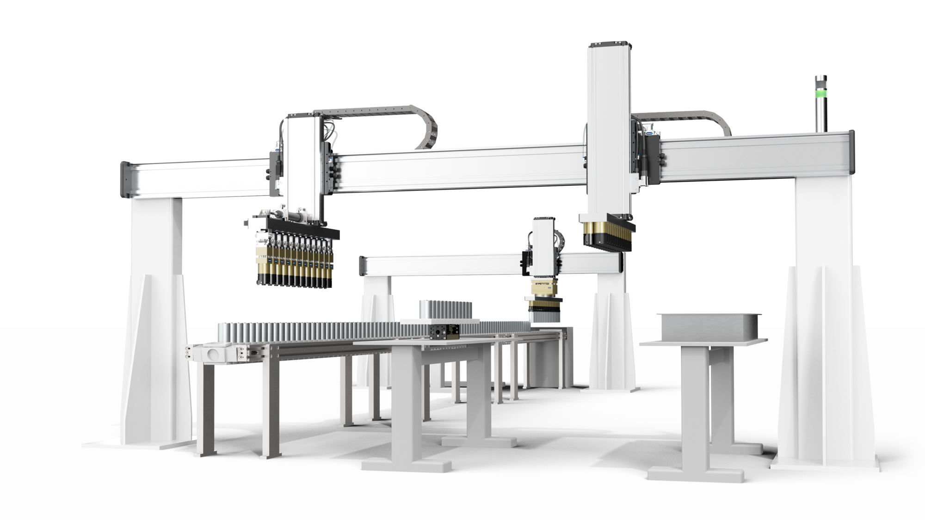
Large-scale projects and lot size one product configuration in industrial automation
SCHUNK Engineering GTAT
Pneumatics
Mechatronics
Robot accessories
Axis systems
more than 750
projects per year

Slide 3


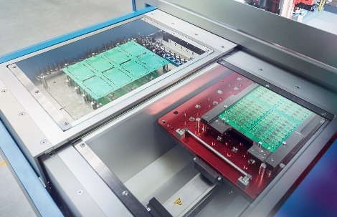
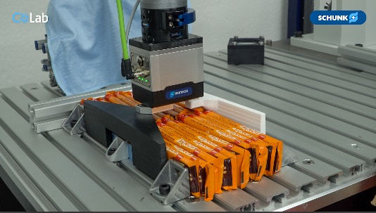

Outstanding project management and highest technology competence
SCHUNK Engineering GTAT
eMobility
Life Science
Electronic
Automotive
Logistic
Metal Processing

Slide 4
Outstanding project management and highest technology competence
SCHUNK Engineering GTAT
Products and technology
Assembly and handling such as gripping, swiveling, changing, linear moving, compensating, machining, monitoring, measuring and much more.
Decades of expertise in the areas:
Pneumatics
Mechatronics
Robot accessories
Axis systems
Services
Complete project management from inquiry to delivery as well as service and after-sales
  Design
  Assembly incl. hose system / cabling
  Approval / test
  documentation
  Commissioning
  ... and much more

Slide 5
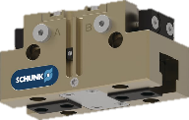
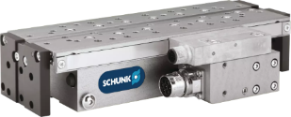
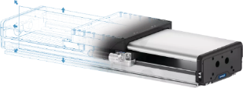
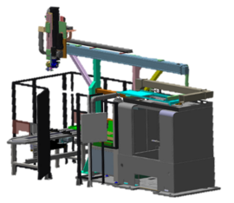
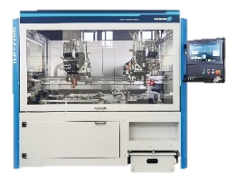
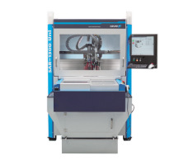
4 Levels of partnership - SCHUNK offers more
SCHUNK Engineering
Level 1
Standard Components
Level 2
Customized Components
SCHUNK Engineering
Level 3
Large Scale Projects
Level 4
Machines

Slide 6
More then 160 professionals - one goal:
Making your project a success
SCHUNK Engineering GTAT
>30 specialists
6 product areas
Price indication and calculation in advance
Mechanics / Electronics / Software
FEM simulation
Cycle time analysis
Support in 34 INTECs
Repair / maintenance
Ad-hoc service in the event of system downtime
Sales Engineering
Design
After-Sales-Service
Project management
Production and assembly
Central coordination
Industry-specific requirements management
Time and cost planning
Highest quality standards
Cleanroom assembly
Production of small series
Worldwide supplier network

Slide 7
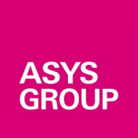
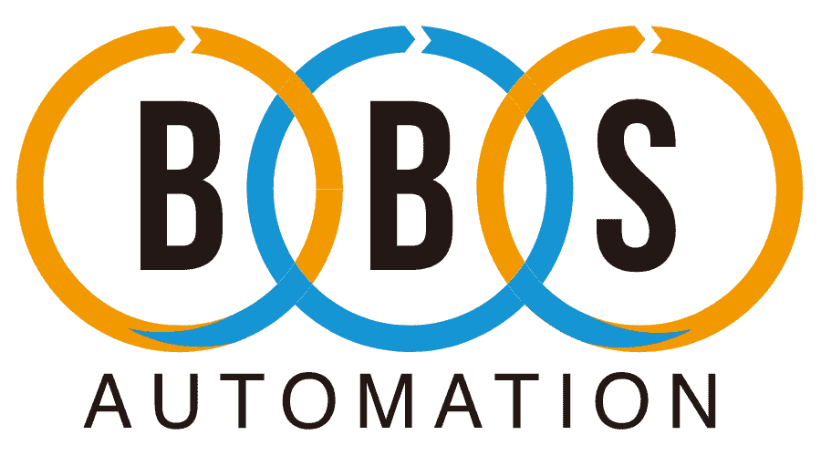












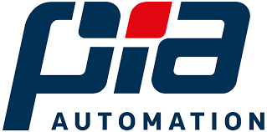






Customer references ... a selection
SCHUNK Engineering GTAT

Slide 8

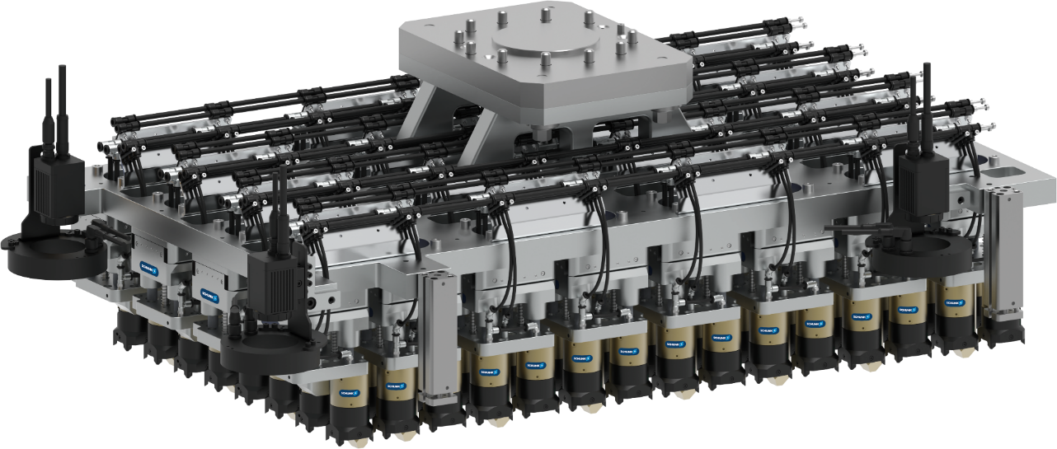
Project references
SCHUNK Engineering GTAT
ID: 1573882
ID: 1535228
Battery production e-mobility
Transfer of 120 cylindrical battery cells simultaneously, incl. 32 compensation units
Engine block handling truck
Handling of an approx. 350 kg heavy engine block for trucks

Slide 9
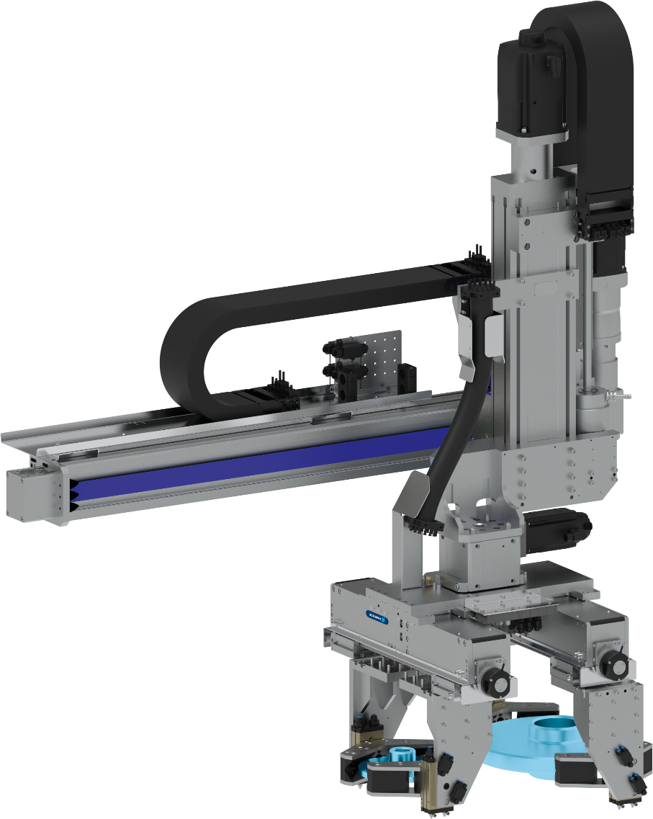
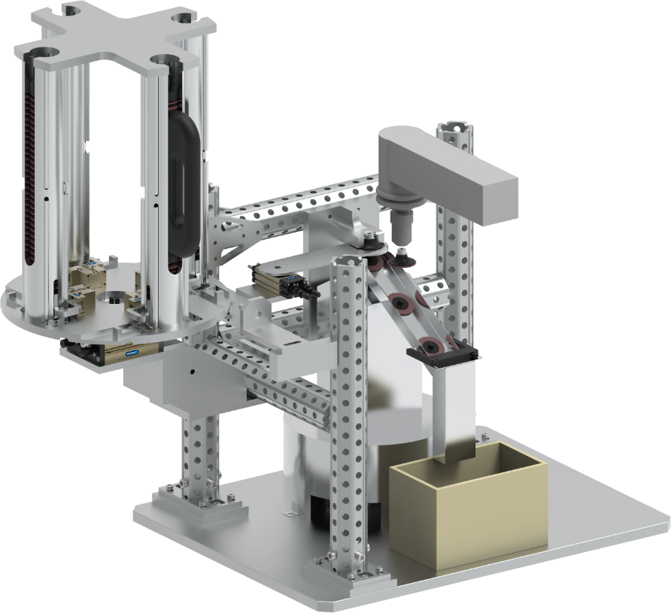
Project references
SCHUNK Engineering GTAT
ID: 1568940
ID: 1569896
Automotive - Brake disc coating
Gripping and swiveling of brake disks for coating to reduce particulate emissions during braking (EURO 7)
Handling and deburring of sheet metal parts
System for automatic grinding disc change when worn

Slide 10
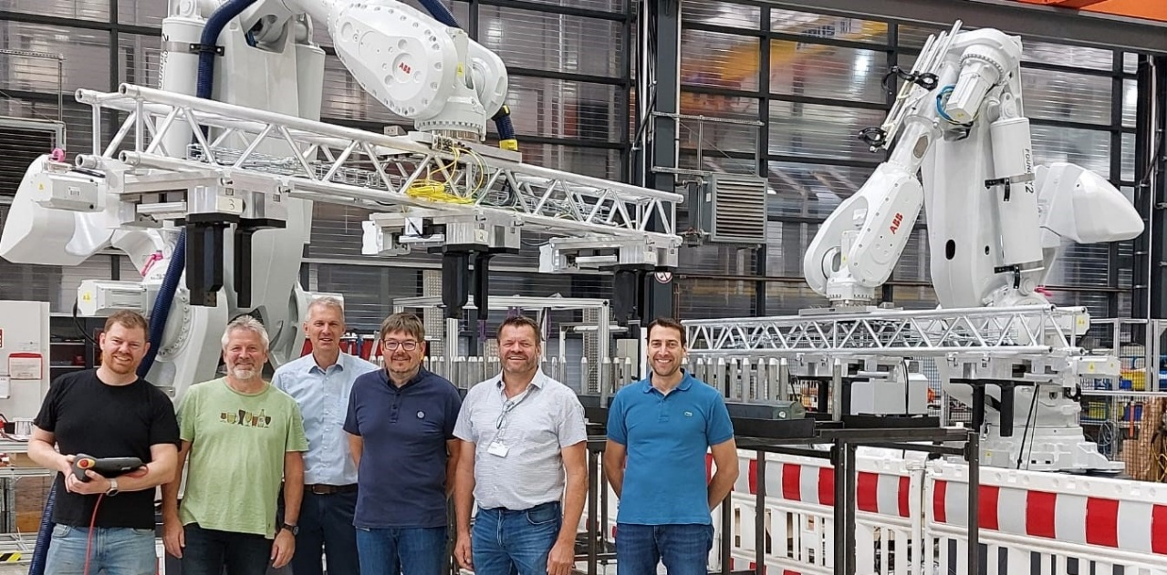


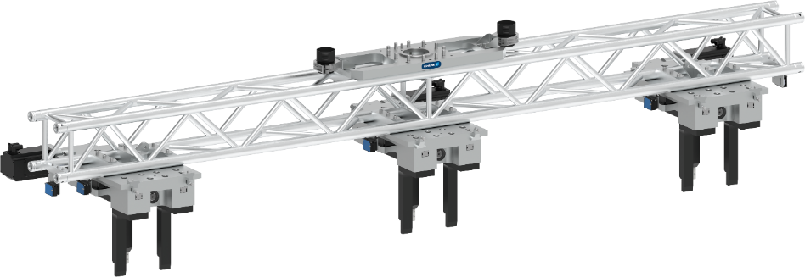
Project references
SCHUNK Engineering GTAT
ID: 1472620 oder 1511530 (links / rechts)
Machine tending - Lean Automation:
test specimen production for impact tests
Clamping station (right), workpiece magazine (center) and turning station (left).
Handling by gripper with shaft interface.
Handling of 4-meter steel beams weighing up to 500 kg
Handling of very long and heavy components: gripper assemblies along a truss to reduce weight

Slide 11

Hand in hand for tomorrow
SCHUNK Engineering GTAT
SCHUNK – The ideal partner for your application
We would be happy to make a personal appointment on site to discuss the application and possible concepts
We would be happy to provide you with a quote for your projects
We would be happy to present our specific solutions and concepts - also to a larger group of participants

Slide 13
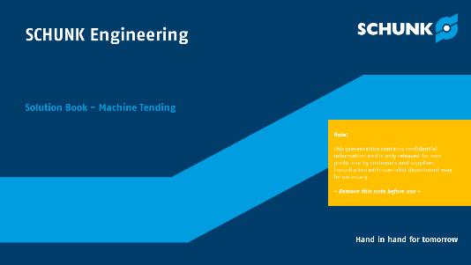
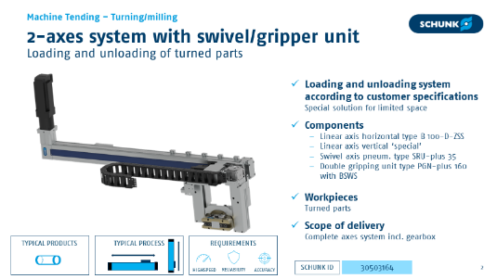
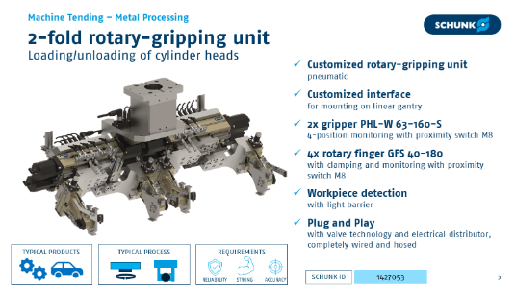
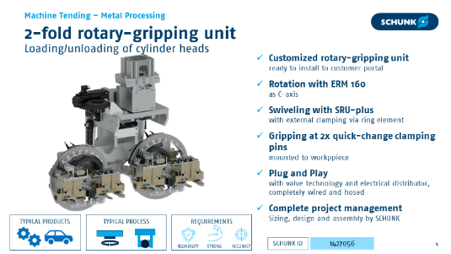

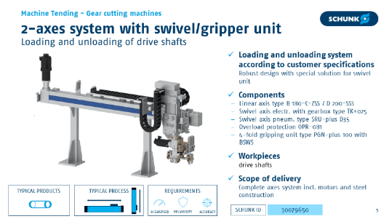
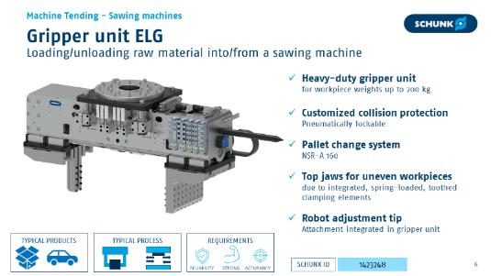



Solution Books
SCHUNK Engineering GTAT
Internal Information
Solution Books with product and application examples for GTAT can be found in the STB in the new industry tiles.
  Automotive
  Consumer Goods
  Life Science
  Logistic
  Machine Tending
  Metal Processing
  …
ppt-files available in DE/EN
exemplarily

