Slide 1

SCHUNK Engineering
Clamping technology | Gripping technology | Automation technology
Note:
This presentation contains confidential information and is only released for non-public use by customers and suppliers.
Consultation with specialist department may be necessary.
- Remove this note before use -

Slide 2
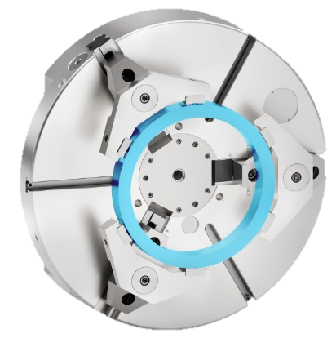
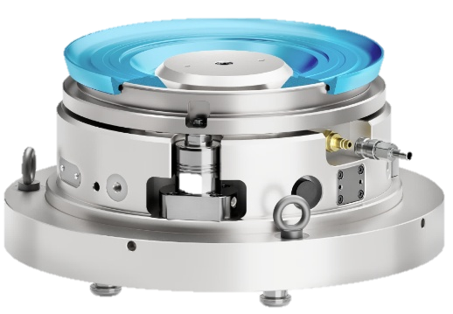
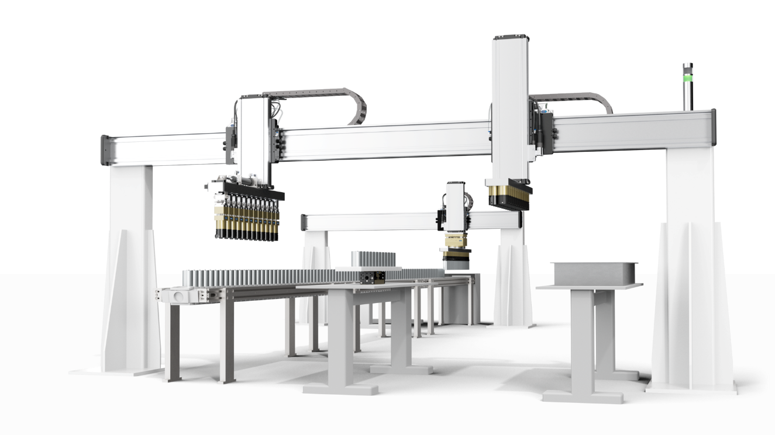
Tailor-made systems and solution
- across all divisions, internationally
SCHUNK Engineering
Clamping technology
Gripping technology
Automation technology
more than 1250
projects per year
Notes:
Lauffen: >300 projects per year
Hausen: >750 projects per year
Mengen lathe chucks: >200 projects per year
Mengen stationary lathe chucks: xxx projects per year

Slide 3
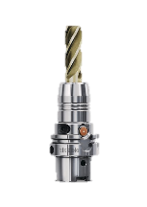
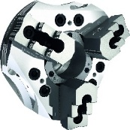
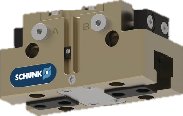
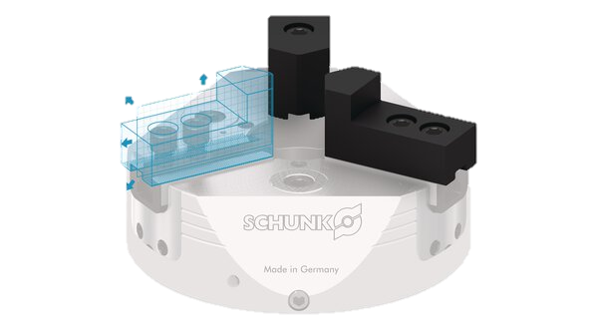
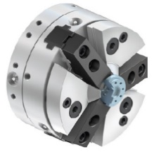
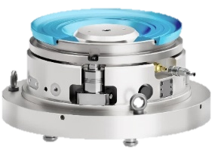
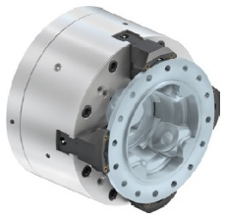
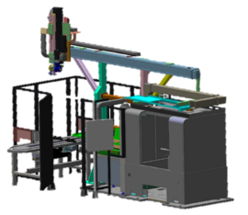
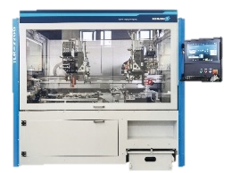
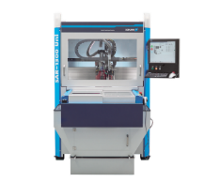
4 Levels of partnership - SCHUNK offers more
SCHUNK Engineering
Level 1
Standard Components
Level 2
Customized Components
SCHUNK Engineering
Level 3
Large Scale Projects
Level 4
Machines

Slide 4
More then 250 professionals - one goal:
Making your project a success
SCHUNK Engineering
>50 specialists
10 product areas
Price indication and calculation in advance
Concept development
Mechanic/Hydraulic/Electronic/ Software
FEM simulation
Cycle time analysis
Support in 34 INTECs
Repair / maintenance
Ad-hoc service in the event of system downtime
Sales Engineering
Design
After-Sales-Service
Project management
Production and assembly
Central coordination
Industry-specific requirements management
Time and cost planning
Highest quality standards
Production of small series
Worldwide supplier network
Cleanroom assembly possible
Notes:
Lauffen: 52 employees, 10 specialists, 2 product areas
Hausen: 160 employees, 30 specialists, 6 product areas
Mengen lathe chucks: 40 employees, specialists team, 2 product areas
Mengen stationary lathe chucks: xx employees, xx specialists, x product areas

Slide 5



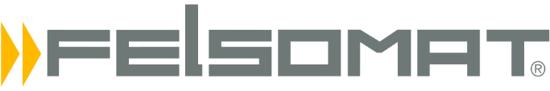








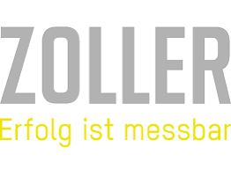



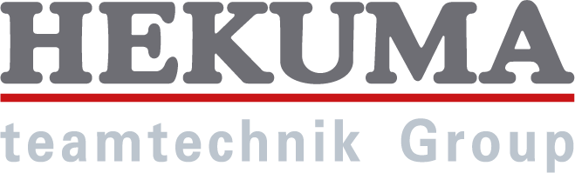
Customer references ... a selection
SCHUNK Engineering

Slide 6
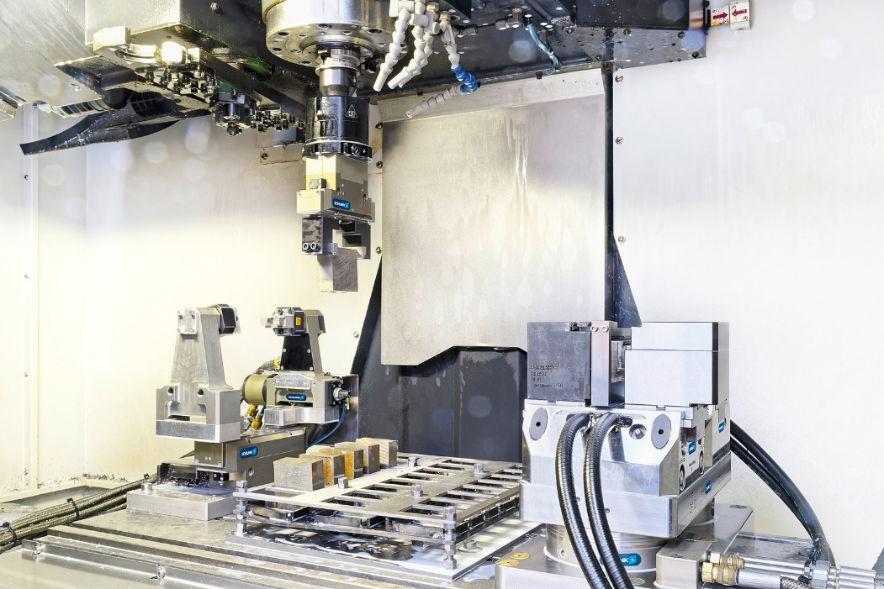
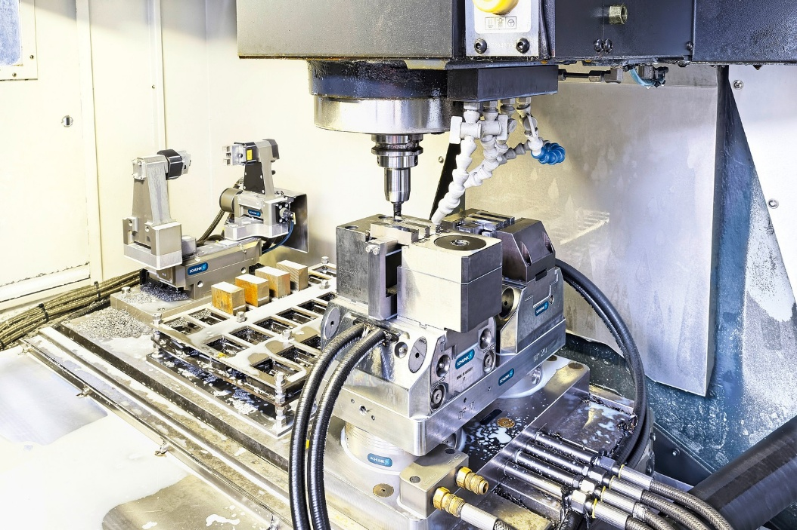

Project references
SCHUNK Engineering
Machine tending - Lean Automation:
test specimen production for impact tests
Clamping station (right), workpiece magazine (center) and turning station (left).
Handling by gripper with shaft interface.
Economical automation has increased both flexibility and machine utilization in sample preparation.

Slide 7
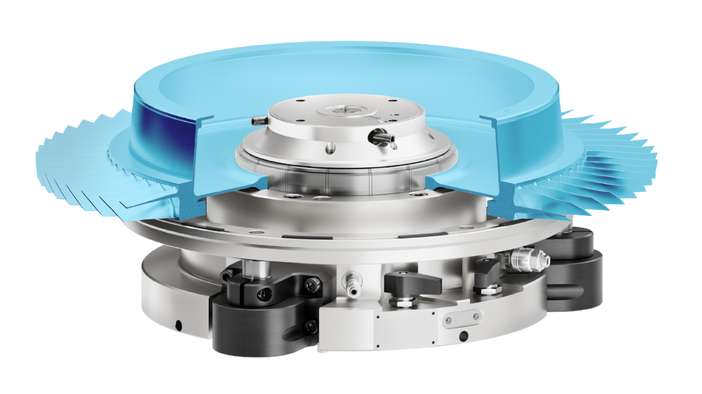
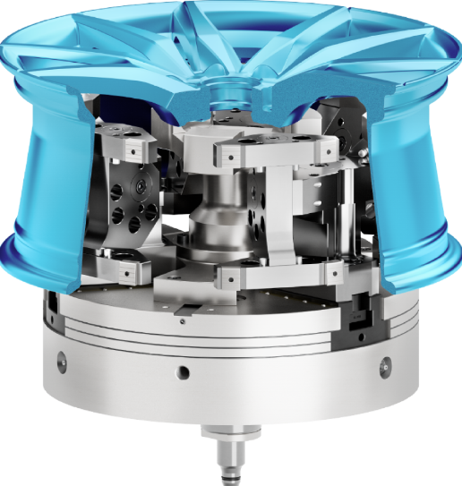
Project references
SCHUNK Engineering
Clamping of car rims for turning operations:
Hard pendulum jaws for inner clamping
Out-of-roundness of <0,05 mm due to clamping at 24 clamping points.
Compensation of axial run-out faults due to pendulum jaws. Fitting to SCHUNK ROTA NCO 400.
Clamping of turbine rotors:
Hydraulic expansion arbor
Axial runout accuracy of < 0,005 mm.
Vibration dampening can be switched off.
Safety bolt indicates secure clamping.

Slide 8
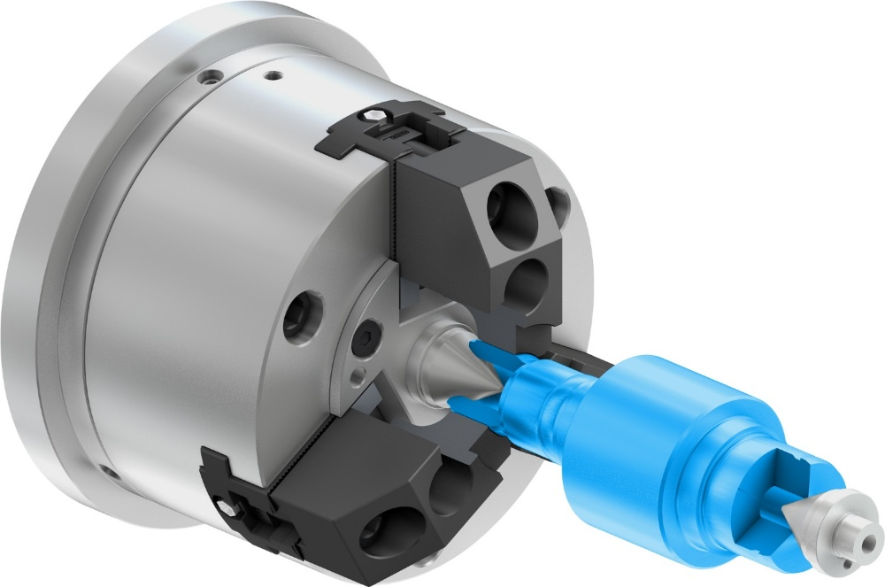
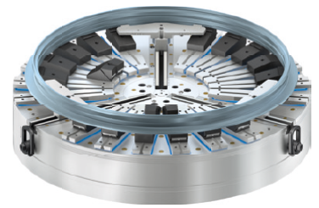
Projektreferenzen
SCHUNK Engineering
Spannen von Wellen bei denen die Referenz die Zentrierbohrung ist
Zentrieren des Werkstücks zwischen den Zentren. Drehmomentübertragung für Zerspanung über radiale Spannung.
Verformungsarmes Spannen von filigranen Bauteilen
Werkstück wird mit dem Zentrierfutter zentriert und mit der Magnetspannplatte axial gespannt.

Slide 9
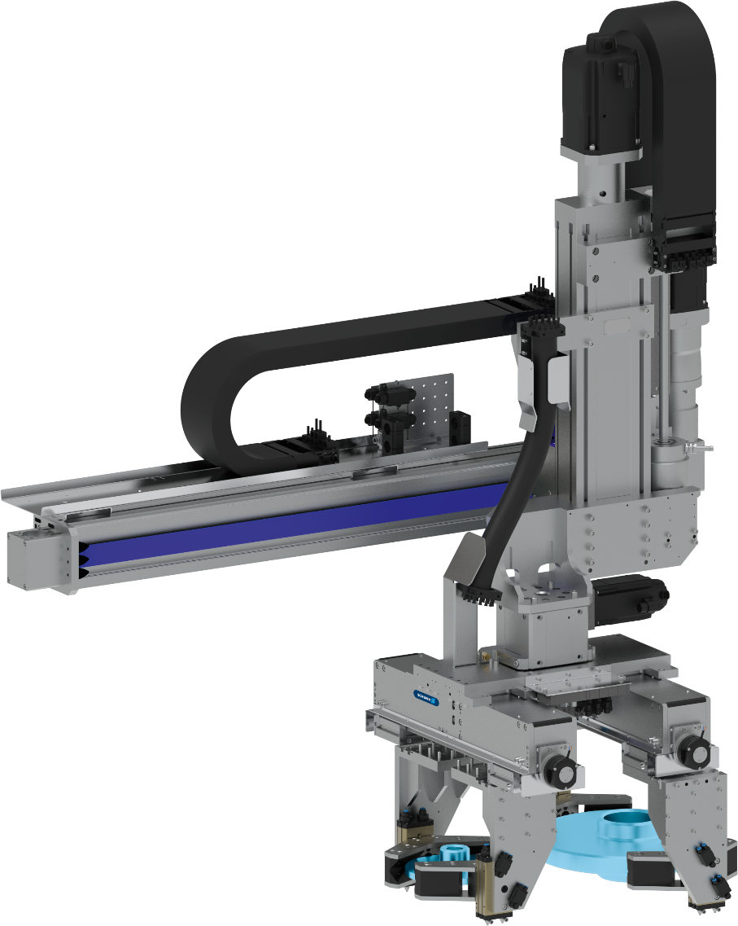
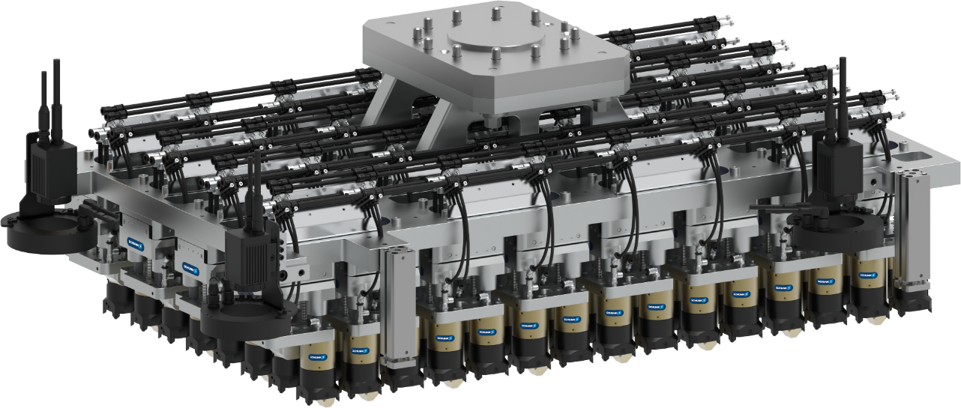
Project references
SCHUNK Engineering
ID: 1573882
ID: 1568940
Battery production e-mobility
Transfer of 120 cylindrical battery cells simultaneously, incl. 32 compensation units
Automotive - Brake disc coating
Gripping and swiveling of brake disks for coating to reduce particulate emissions during braking (EURO 7)

Slide 10
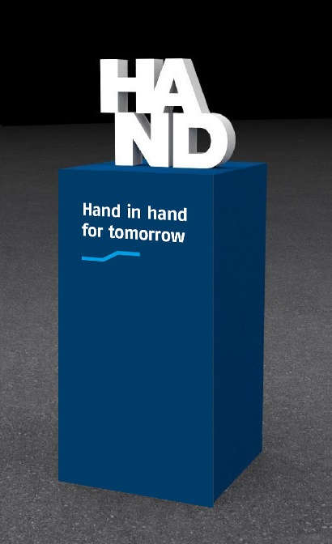
Hand in hand for tomorrow
SCHUNK Engineering
SCHUNK – The ideal partner for your application
We would be happy to make a personal appointment on site to discuss the application and possible concepts
We would be happy to provide you with a quote for your projects
We would be happy to present our specific solutions and concepts - also to a larger group of participants

