Slide 1
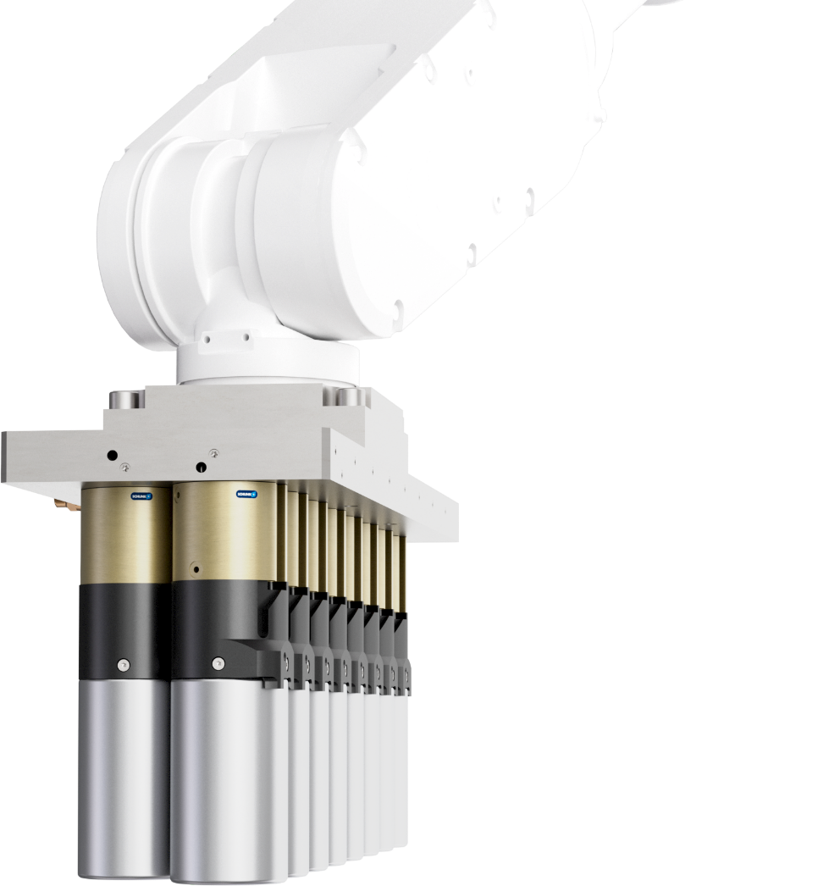
Round cell gripper
RCG
for handling battery cells with Ø 46 mm

Slide 2
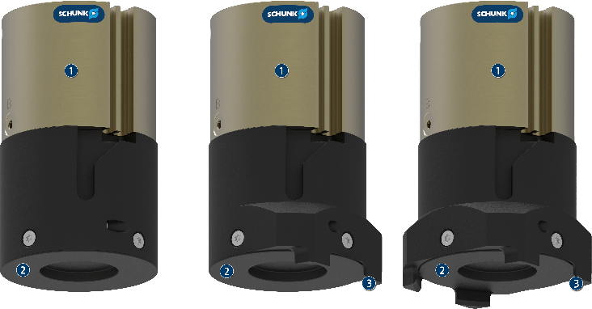
Handling of round battery cells
Round cell gripper RCG
Handling of individual round cells Ø46 mm in all common formats
Compact dimensions of the single gripper ensures maximum packing density of battery cells
Process reliability through sensory workpiece and status detection
Multiple gripper units can be configured from a combination of several round cell grippers for specific processes
Technical data:
  Magnetic holding force ≥70 N
  Gripping force maintenance Yes
  Workpiece detection Yes
  Piston stroke monitoring Yes
  Actuation pneumatic

Slide 3
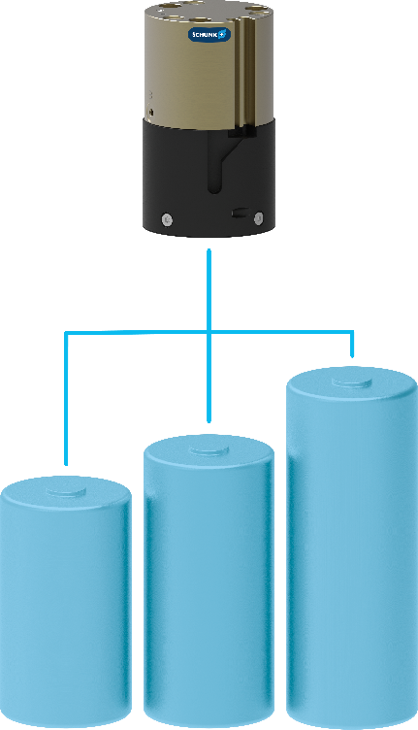

Functional description
Round cell gripper RCG
Pneumatically controlled magnetic gripper for handling round battery cells with a diameter of 46 mm
RCG 46-0
RCG 46-2
RCG 46-4
Pneumatic drive with c-slot for piston stroke monitoring system
Electrically decoupled contact surface to protect the charged battery cell that is in flat contact
The centerings in versions -2 and -4 are used to compensate for placement tolerances when picking up the battery cells.

Slide 4
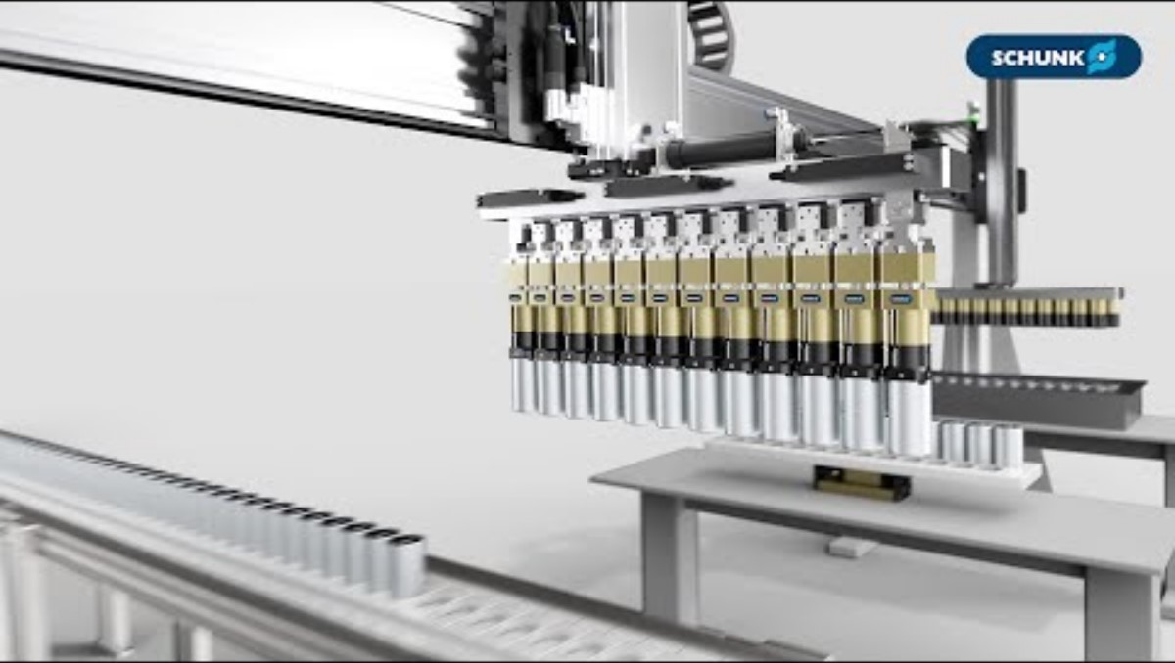
Application example:
From round cells to battery packs
Round cell gripper RCG
Link to Video:
https://youtu.be/8hTcyJfyrPs?si

Slide 5
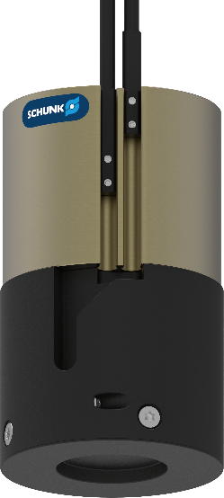
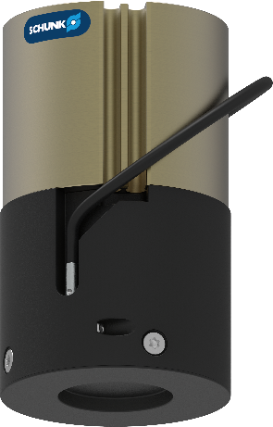
Product details: Sensors
Round cell gripper RCG
Workpiece detection via part presence monitoring with an inductive proximity switch
The status detection "magnet activated" or "magnet deactivated" is ensured via the piston stroke monitoring system with magnetic switches.

Slide 6
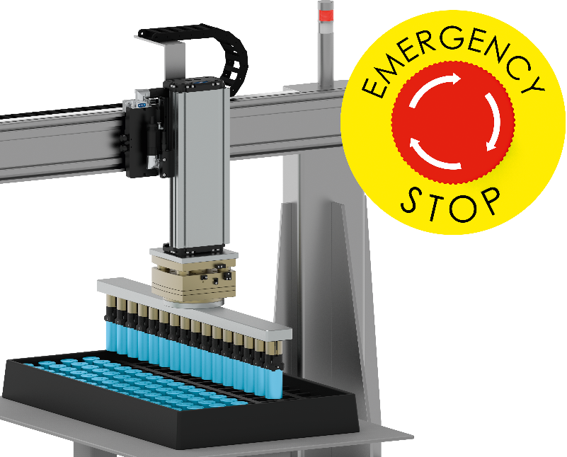
Product details: Gripping force maintenance
Round cell gripper RCG
Gripping force maintenance in the event of a compressed air failure is provided by the principle of the permanent magnet. The magnetic holding force holds the battery cell securely, avoiding workpiece loss, and ensures maximum process reliability.

Slide 7
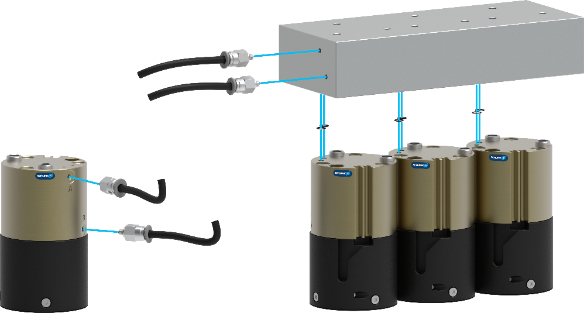
Product details: Pneumatic connections
Round cell gripper RCG
Pneumatic connection: Choice of side main air connections or bottom-side direct air connections for space-saving integration of several individual grippers in a gripping system.
side main air connections
A: Activate magnet
B: deactivate magnet
Bottom-side direct air connections for interference-free actuation
a: Activate magnet
b: deactivate magnet

Slide 8
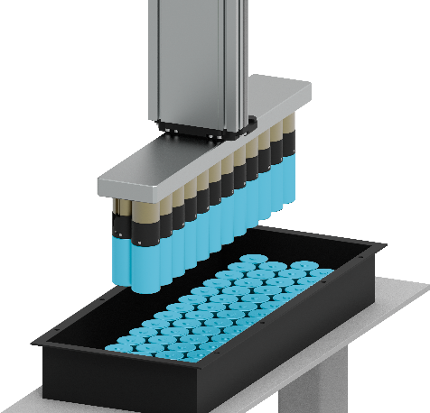
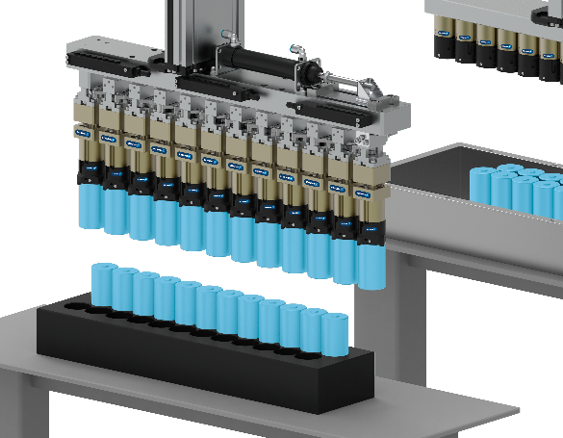
Examples for gripping units
Round cell gripper RCG
The round cell gripper RCG can be set up as an individual multiple gripper unit in order to realize the specific cell spacing depending on the application. Whether one, two, ... or even several hundred individual grippers.
Cell spacing units also offer the option of changing the distance between several battery cells during the pick-&-place process. The number of cells to be gripped and the cell spacings are individually adapted to the application.

Slide 9
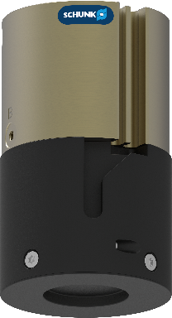
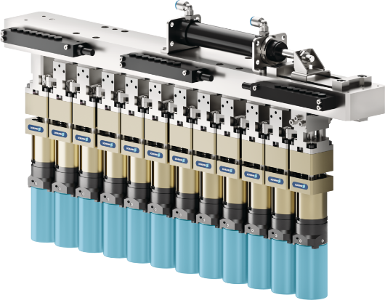
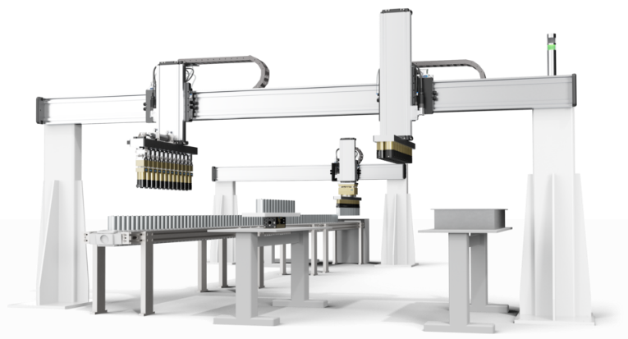
Interested?
Round cell gripper RCG
SCHUNK offers you the complete solution, whether as a single component or as a complete system.
Tell us more about your application – our experts will find the right solution together with you.​
Contact us for a non-binding consultation appointment at ​e-mobility@de.schunk.com

