Slide 1


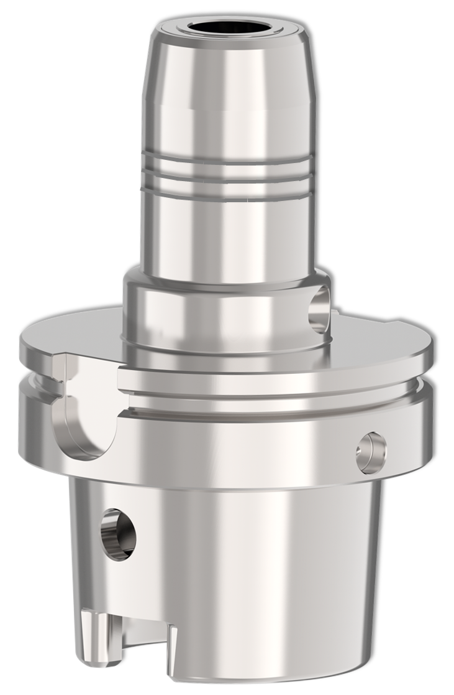
Technical Training and More

Slide 2
Facts
The new product line TENDO Silver was launched at EMO 2023!
TENDO Silver is classified in the "Economy" segment and complements/add TENDO E compact
TENDO Silver is available in one length version and in a total of nine interfaces
HSK-A63, HSK-A100, BT30, BT40, BT50, SK40, SK50, CAT40 und CAT50
TENDO Silver closes the portfolio gap between the TENDO E compact, as well as the TENDO P and represents a tool holder that offers the best price-performance ratio in the direct clamping range

Slide 3



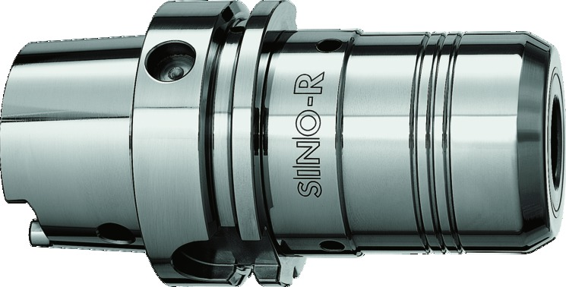
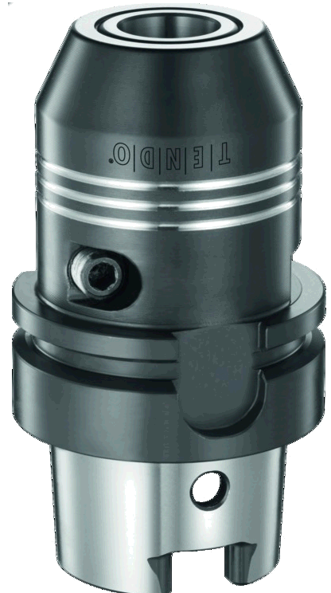

Current toolholder segmentation
“The problem solver”
Specialist for milling /
thread milling
„Premium toolholder“
High lifetime & repairable
Options such as Coolflow available
36 months warranty
iTENDO²
Tech
Premium
Upselling
Upselling
Economy
„Door opener“
Best price / performance ratio
Allrounder (direct clamping) with focus on drilling applications
„Allrounder“
Best price / performance ratio
Highest torques
Basic

Slide 4
Differentiation
“The problem solver”
Massive outer contour (no DIN)
Small portfolio – 47 variants / up to 7 different clamping diameters / 1 gage length per interface
Clamping direct & by intermediate sleeves
„Premium toolholder“
Outer contour DIN conform
Widest portfolio – 26 interfaces / up to 16 clamping diameters / 3 gage length versions per interface
All clamping diameters via direct clamping and or per GZB-S intermediate sleeves possible
Through-hardened material, maximum warranty on the market, repairable
iTENDO²
Tech
Premium
Upselling
Upselling
„Allrounder“
Massive outer contour (no DIN)
Medium size portfolio – in the most common interfaces available - 85 variants / up to 5 different clamping diameters / 2 gage length per interface
Intermediate strategy (Bundle) - not all clamping diameters possible via direct clamping
Surface hardened, not repairable
„Door opener“
Outer contour DIN conform
Medium size portfolio – 9 interfaces / up to 16 clamping diameters / 1 gage length per interface
All clamping diameters via direct clamping and or per GZB-S intermediate sleeves possible
Surface hardened, not repairable
Economy
Basic

Slide 5
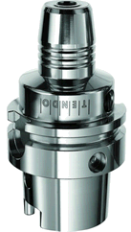
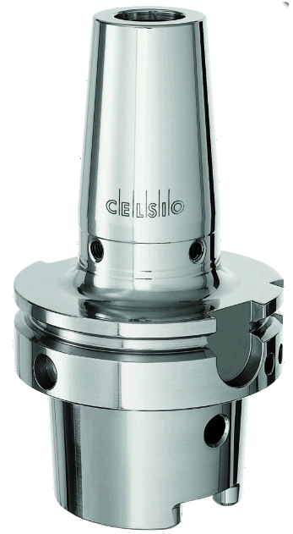
Technical comparison (HSK-A63 Ø20mm)
[Nm]
[N/mm²]

Slide 6
Portfolio comparison

Slide 7
When to use what?
The "allrounder”, preferred for general milling operations
Threading
HPC – High Performance Cutting / Milling
Finishing operations
Economy
Drilling
Light milling operations / Finishing operations
Economy
Drilling
Light milling operations / Finishing operations
Reaming (Zero)
Applications against pull out (Secure)
MQL applications
CoolFlow Option
Premium

Slide 8
Starting point of the argumentation
„Customized advice“ →
Pick-up the customer individual and depending on the machining operation (milling or drilling) and the toolholding system used, bring technical arguments for an upgrade/upgrade (examples follow)
SINO-R
TENDO Platinum
Premium
20%
TENDO E compact
UPGRADE
TENDO Silver
Economy
WELDON, CELSIO, ER Collet Chuck
WELDON, CELSIO, ER Collet Chuck
Basic
80%
Milling operations
Drilling operations

Slide 9
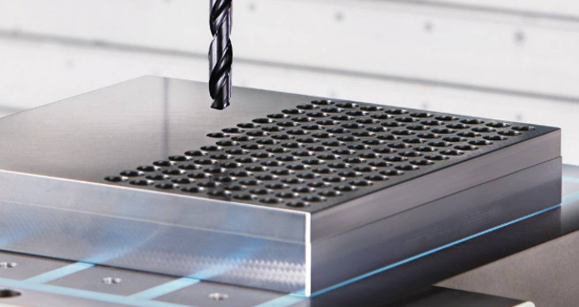
Upselling example
Customer is using ER collet chucks in a drilling/boring application
  Advantages of the common clamping technology
    Flexibility through modularity (collet system)
    All shank types & shank tolerances can be clamped
    Large diameter range including intermediate shank diameter (e.g. D= 12,8mm)
    Kind of damping effect
  Disadvantages of the ER clamping technology
    Poor runout accuracy
    Poor change repeatability poor
    Length presetting more difficult possible (Two-handed clamping operation Length presetting and tightening of the nut)
    Poor balancing grade (multi-part system)
    Dirt susceptible
    Risk of slipping during the clamping process (safety first)
Customer problem: Position and positioning accuracies of the holes very inaccurate!
Economy
Basic

Slide 10
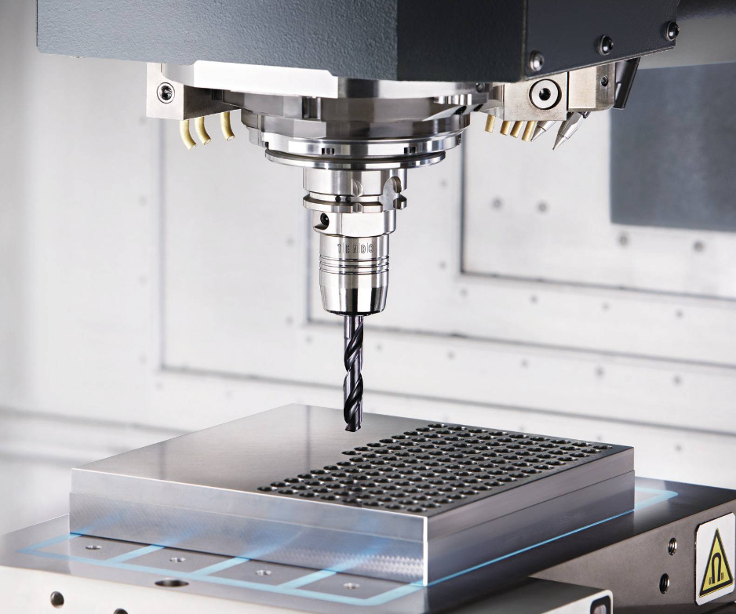
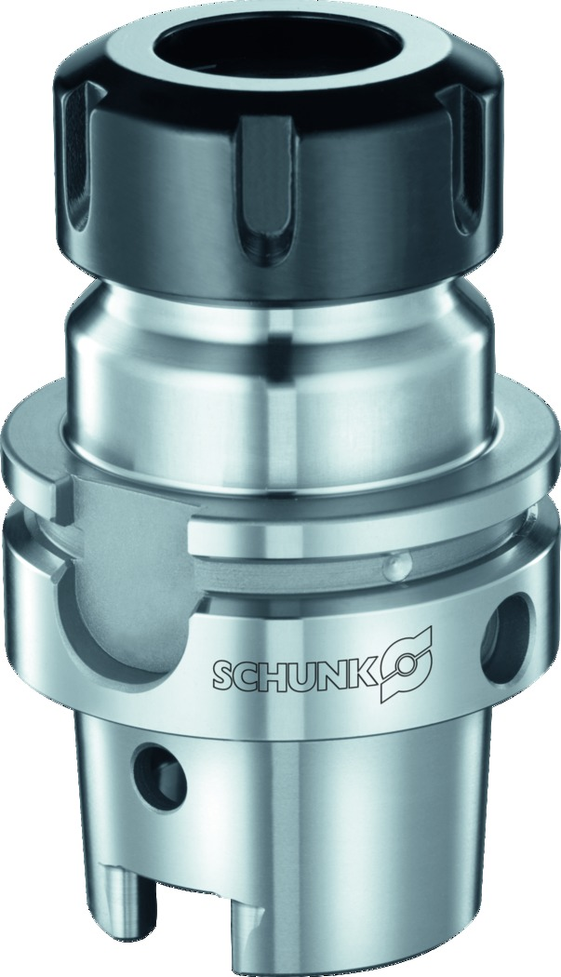
Upselling example
Upgrade possibility to TENDO Silver
  Advantages when upgrading to TENDO Silver
    Due to the very high concentricity and repeatability during the tool change, better form and position tolerances, as well as better positioning accuracy are achieved and thus the process reliability is significantly increased
    Very easy handling (clamping of the tool) and the very low maintenance/cleaning effort greatly reduce setup times
    The investment for TENDO Silver is minimally above the purchase price of a SCHUNK ER technology or comparable suppliers (toolholder, collet, clamping nut and wrench), due to the long service life of TENDO Silver a quick amortization is achieved
    Recommendation:
The higher the quality of the workpiece and the tools used, the more worthwhile it is to switch to TENDO Silver
The more demanding the operations are in terms of form and position tolerances, the more worthwhile it is to switch to TENDO Silver
As soon as drilling operations (solid drilling, reaming, tapping, counterboring) are involved, it is worth switching to TENDO Silver
Economy
Basic

Slide 11
Upselling example
Premium
Argumentation when upgrading to TENDO P
  Same advantages as TENDO Silver and……
    More interface selection / different length variants available
    Option Zero is available specifically for reaming
    For better cooling of the cutting edge and improved chip evacuation, the CoolFlow option is available
    Option Secure is available for pullout protection
    Inquiries about MQL minimum quantity lubrication can be covered
    A change to TENDO P is also an upgrade in terms of quality and warranty (through-hardened material, maximum warranty on the market, repairable in most cases (via our SCHUNK Service))
Economy
Basic

Slide 12
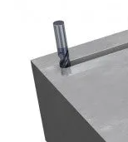
Upselling example
Customer is using heatshrinking when milling grooves
  Advantages of the common clamping technology
    High radial rigidity
    Slim contour / good accessibility to cutting edge and workpiece
    Tool holders can be obtained at low cost
    Good balance quality
  Disadvantages of the heatshrinking technology
    Poor runout accuracy
    Hardly any damping properties / short tool life (cutting edge chipping)
    Frequent shrinkage leads to a early loss of clamping force, runout loss and loss of torque (low long life approx. 500 actuations / depends on the clamping diameters - not repairable)
    Peripheral equipment necessary - expensive to purchase and maintain
    Tool change time long and costly
    Not sustainable
    Customer problem: Vibrations occurring during the machining process cause, among other things, a poor workpiece surface, rapid tool cutting edge wear, and thus increased scrap!
    This means additional time and costs
Economy
Basic

Slide 13
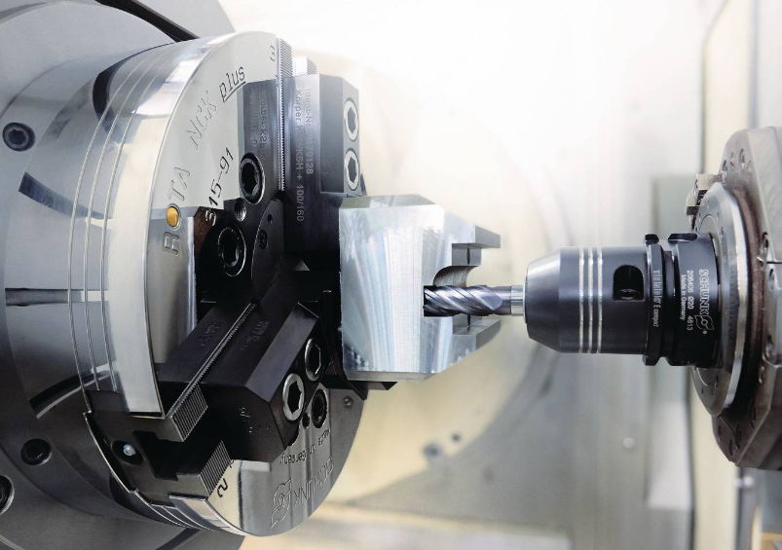
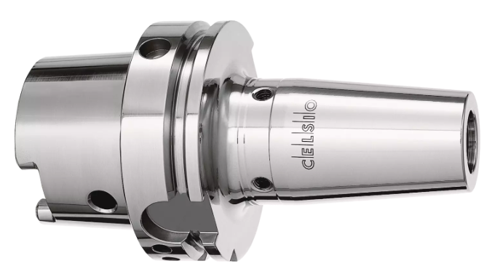
Upselling example
Upgrade possibility to TENDO E compact
    Due to the very high runout accuracy and repeatability during tool change, better form and position tolerances, as well as a better workpiece surface / surface quality are achieved and thus the scrap rate is significantly reduced
    Due to the damping properties of TENDO E compact, the cutting edge of the tool is protected and the tool life is increased
    Very easy handling (clamping of the tool) and the very low maintenance/cleaning effort greatly reduce the set-up times
    The investment for TENDO E compact is higher than the purchase price of a SCHUNK CELSIO or comparable supplier, but due to the long service life of TENDO E compact, amortization is quickly achieved
    Recommendation:
The higher the requirements for surface quality, form & position tolerances, the more worthwhile the changeover to TENDO E compact
A change is worthwhile in order to increase work safety (risk of burns, vapors from oil residues, etc.), since a heat shrink & cooling unit is no longer required
To become more sustainable (reduce power consumption and CO2 emissions and thus reduce energy costs) a change to TENDO E compact is also worthwhile
Economy
Basic

Slide 14
Upselling example
Customer is using WELDON mounts for coat milling
Advantages of the common clamping technology
    Very high radial stiffness
    Pull-out protection (positive clamping that completely prevents pull-out movements)
    Tool holder available at very low cost
    No peripheral device or mounting block required (similar to TENDO)
    Handling very easy and very fast
  Disadvantages of the WELDON Aufnahmen
    Runout accuracy very poor
    Deflection of the tool during clamping - poor concentricity and poor dimensional and positional tolerance during machining
    Hardly any damping / short tool life (cutting edge chipping)
    Only tool shanks of type HB can be clamped - tool is more expensive to purchase than HA
    Massive contour / poor accessibility to cutting edge and workpiece
    Length presetting only possible to a limited extent (within the scope of the WELDON clamping area)
    Additional shank diameters cannot be clamped, only the nominal diameter
Customer problem:
Displacement and interference contour / collision problems during its processing.
Economy
Basic

Slide 15
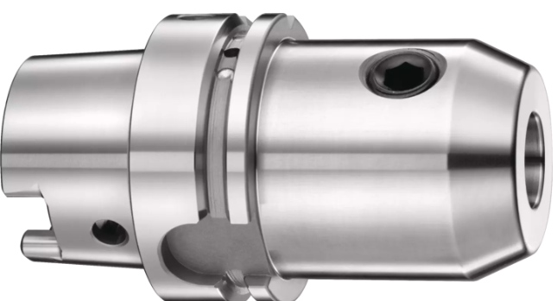
Upselling example
Upgrade possibility to TENDO E compact
  With the SCHUNK GZB-S you are flexible and can also clamp other shank diameters
  Due to the very high concentricity and repeatability during tool change, better form and position tolerances, as well as a better workpiece surface / surface quality are achieved, thus significantly reducing the scrap rate
  Due to the damping properties of TENDO E compact, the cutting edge of the tool is protected and the service life of the tool is increased
  The investment for TENDO E compact is significantly higher than the purchase price of a WELDON, the amortization can be achieved through the improved workpiece quality and extended tool life.
  Recommendation:
  The longer the tool cantilevers, the greater the effect of deflection/displacement due to one-sided clamping, therefore it is worth changing to a TENDO for long cantilever toolholders
  The higher the requirements for surface quality and form & position tolerances, the more worthwhile it is to switch to TENDO E compact
  The higher the quality of the workpiece and the tools used, the more worthwhile it is to switch to TENDO E compact
Economy
Basic

Slide 16
Cross selling example
Cross Selling possibility to TENDO Silver in the same segment
  Additional problem Interference contour and runout accuracy
    Due to the slimmer design / contour of the tool holder compared to TENDO E compact, there are no more interfering contour problems during application
    Outside contour is DIN conform
    Direct clamping from clamping diameter Ø6 to Ø32 possible - better runout accuracy guaranteed
    If required, there is also the combination with GZB-S possible
    The investment for TENDO Silver is minimally higher than the purchase price of TENDO E compact

Slide 17
Summary / Differentiation
Premium & high quality toolholder, direct clamping, largest portfolio, technical features, mirror polished, highest lifetime / number of clamping cycles (over 23,000 clamping cycles -tested), 36 months warranty, repairable, modifications with Zero, Secure and CoolFlow possible, MQL also possible!
DIN conform - like TENDO P, similar technical features like TENDO P, other material (42CrMoS4 (1.7227)) than TENDO P (X38CrMoV5-1 (1.2343), not all interfaces and length versions like TENDO P, no upgrade/modification like Zero, Secure or CoolFlow possible, not repairable, polished - not mirror polished, 12 months warranty, defined portfolio (no special solutions!), MQL option not implementable, “but” attractive list price!

Slide 18
Pricing – TENDO overview
TENDO Silver
TENDO P
TENDO EC
HSK-A63
260€
390€
234€
HSK-A100
440€
525€
394€
BT30
230€
379€
207€
BT40, SK40, CAT40
250€
389€
219€
BT50, SK50, CAT50
370€
495€
332€

Slide 19
Discounting
List price
as of July 1
INTEC
TENDO P HSK-A63
-43%
→222,30€
390€
Project discounts for end customers
possible after arrangement
TENDO Silver
HSK-A63
-55%
→ ~117€
260€
TENDO EC HSK-A63
-50%
→ ~117€
234€

Slide 20
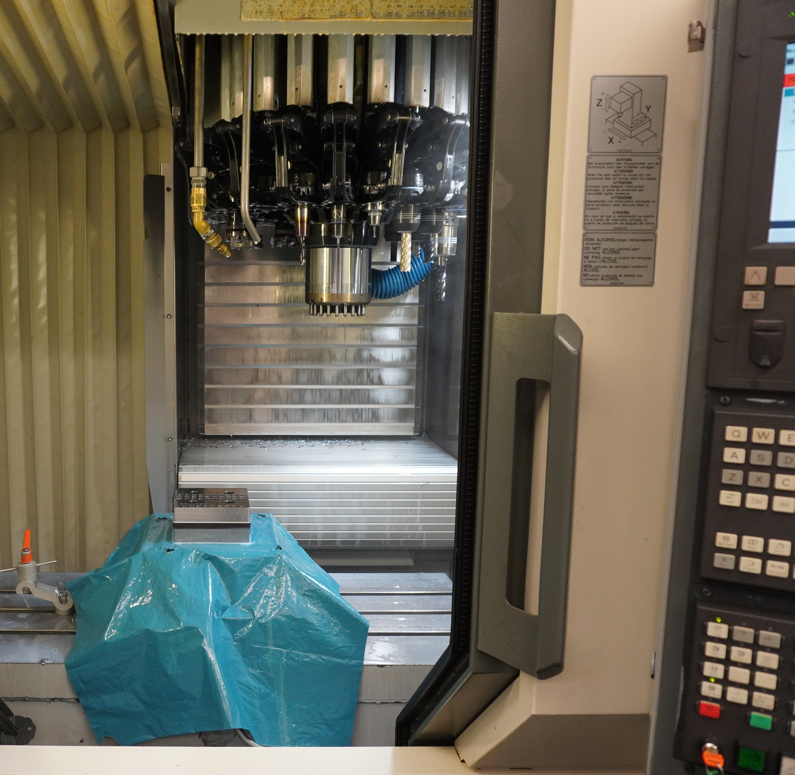
Drilling application with TENDO P / Silver
TENDO Silver and TENDO P
Application details:
Operation: Blind-hole Ø12mm, 20mm deep
Material: 42CrMo4 (1000 N/mm²)
Tool: solid carbide drill Ø12mm
Cooling: internal
Cutting Data n=2600 rev./min
vc=100 m/min
fz=0,15 mm/rev.
vf=750 mm/min
Machine: CHIRON FZ15S

Slide 21
Drilling application:
Phases and forces in drilling
TENDO Silver and TENDO P
Phases:
1: Center Drilling
2: Drilling
3: Retracting
Force XY
Force Z
1
2
3

Slide 22
Drilling application:
TENDO P and TENDO Silver
TENDO Silver and TENDO P
Force XY
Force Z
Low forces while center drilling and retracting
→ Long tool life
→ best roundness of hole

Slide 23
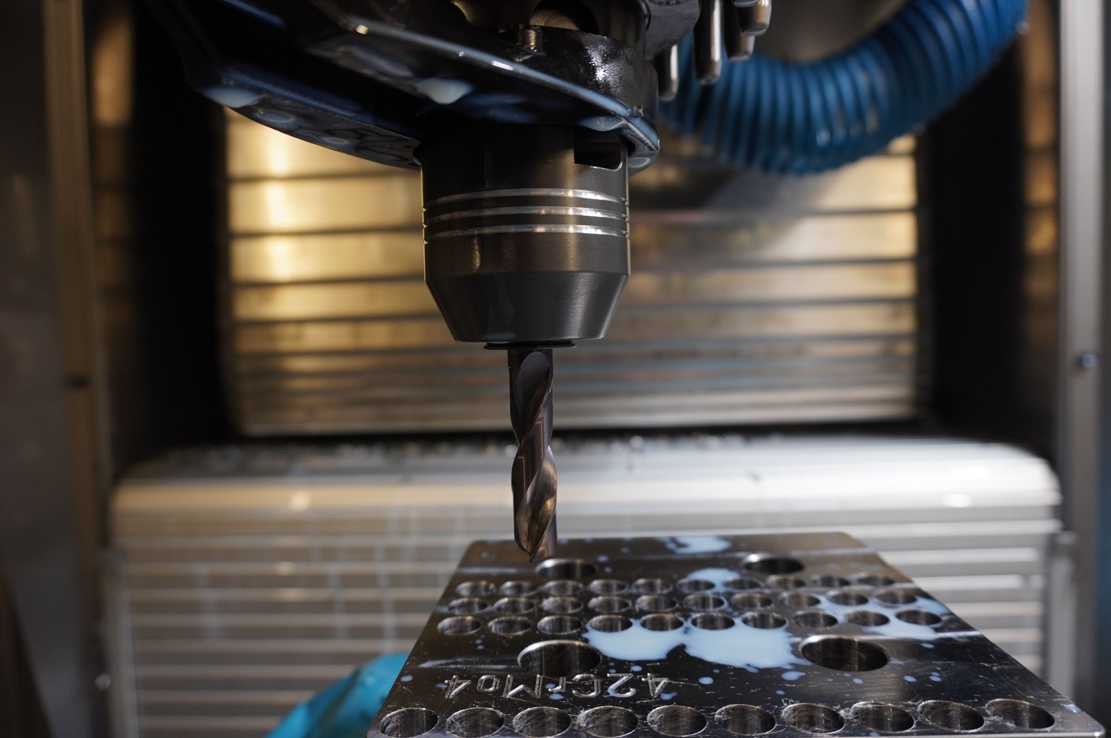
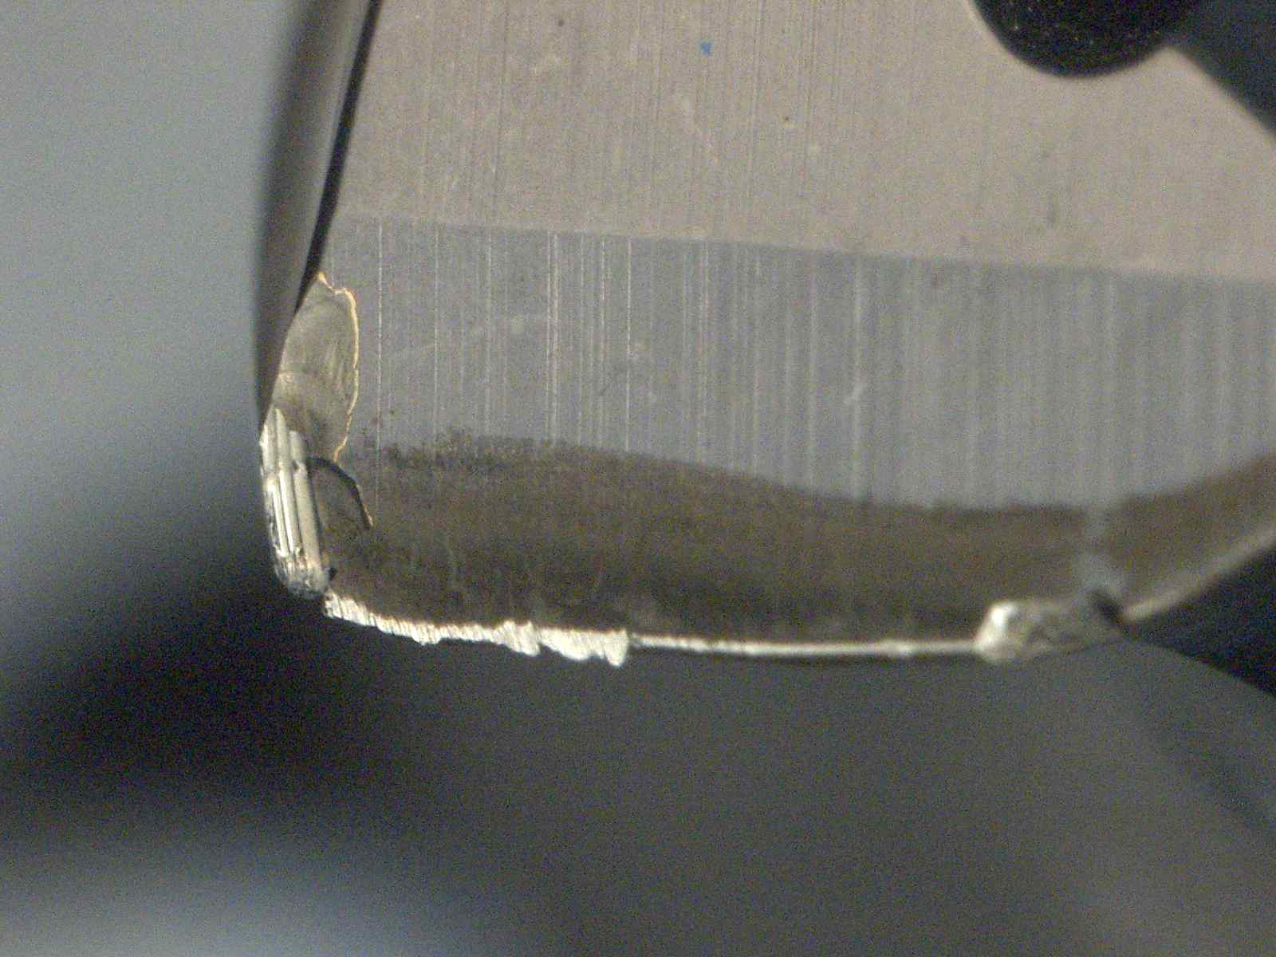
Drilling application:
What about TENDO EC?
TENDO Silver and TENDO P
Force XY
Force Z
Runout with TENDO EC and Sleeve → 10µm on tip of drill
→ Raised Forces in XY while whole drilling process and retracting
→ lowered surface quality and tool life

Slide 24
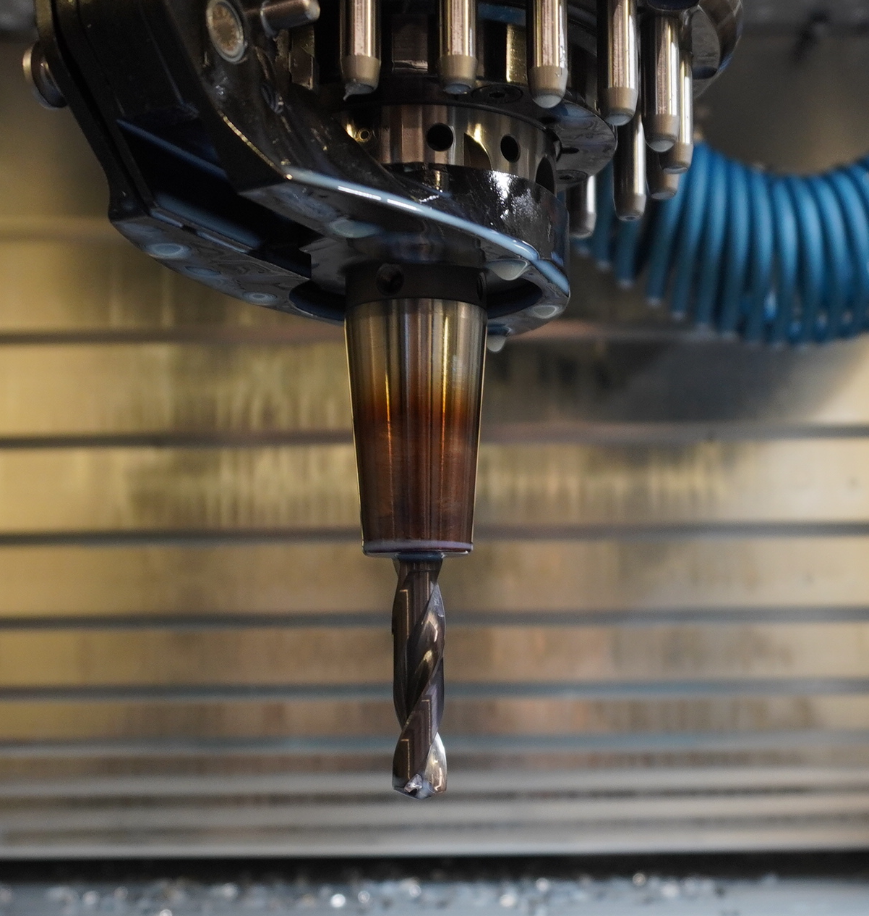
Drilling application:
What about CELSIO?
TENDO Silver and TENDO P
Force XY
Force Z
Due to low dampening effect vibrations while center drilling and retracting
lowered roundness of hole
lowered tool life

Slide 25
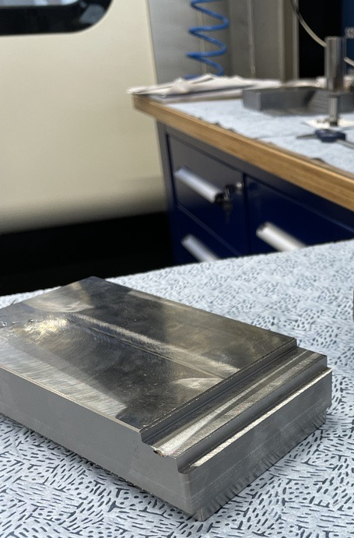
Milling / Finishing application
TENDO Silver and TENDO P
Application details:
Operation: Shoulder Finishing ap18 ae 1…2mm
Material: 16MnCr5 (600 N/mm²)
Tool: solid carbide endmill Ø12mm, 4 flutes
Cooling: dry
Cutting Data: n=3800 rev./min
vc=145 m/min
fz=0,077 mm/rev.
vf=1150 mm/min
Machine: CHIRON FZ15S

Slide 26
Milling / Finishing application
TENDO Silver and TENDO P
Roughness on workpiece with TENDO P and TENDO Silver is comparable

Slide 27

Comparison based on technical data
TENDO Silver and TENDO P
Both toolholders are designed in the same way:
→ Sealing, Screw and expansion sleeve
Difference: Material and manufacturing process
Result: no difference in runout and torque and equal performance in both applications

Slide 28
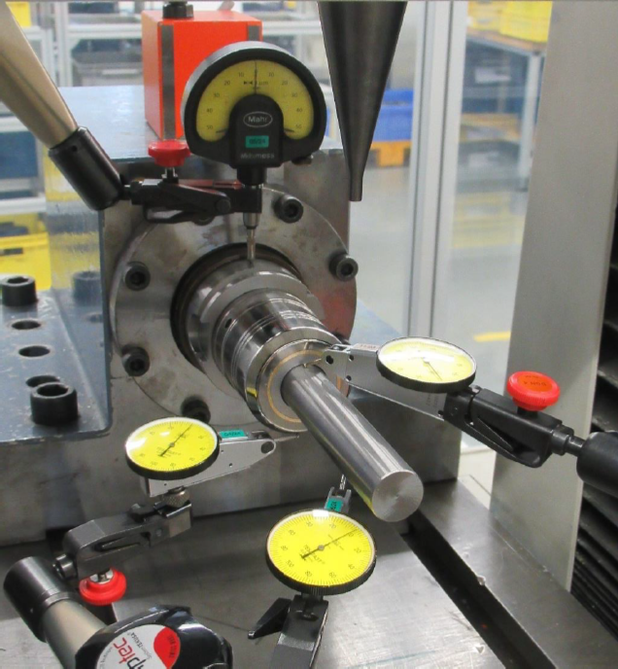
Comparison based on technical data
TENDO Silver and TENDO P
No difference in radial stiffness:

Slide 29
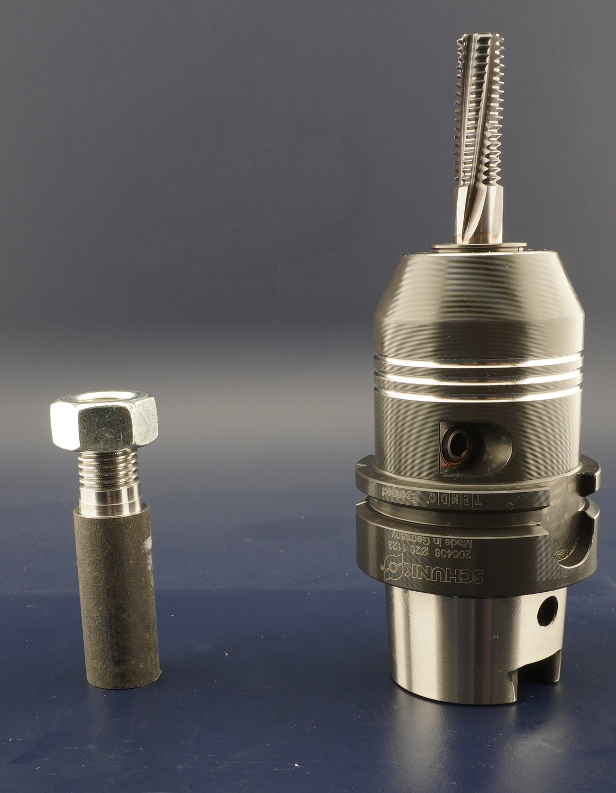
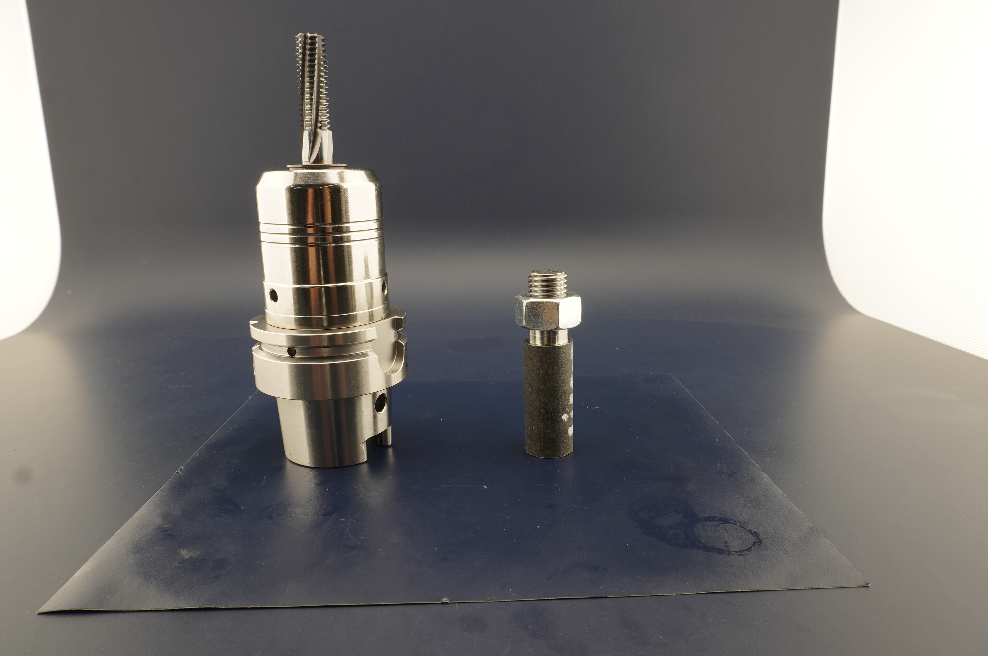
Threading application with
TENDO EC and SINO
TENDO E compact and SINO-R
Application details:
Operation: Thread M16, 23mm deep
Material: 42CrMo4 (1000 N/mm²)
Tool: Thread mill Ø16mm
Cooling: dry
Cutting Data n=2600 rev./min
vc=100 m/min
fz=xxx mm/rev.
vf=1518 mm/min
Machine: DMU60P

Slide 30
Comparison based on technical data
TENDO E compact and SINO-R
Both toolholders are designed differently (Hydraulic vs. SINO-Technology)
Difference: Material and manufacturing process
Result: higher torque with SINO, better runout with TENDO EC

Slide 31
Comparison based on technical data
TENDO E compact and SINO-R
Comparison of radial stiffness:
→ measured stiffness is nearly comparable

Slide 32
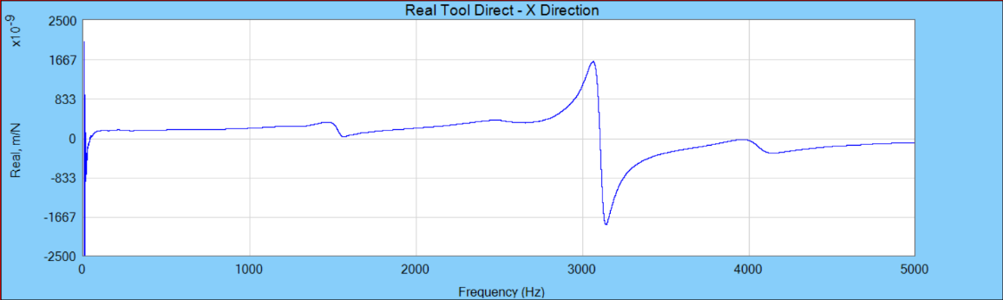
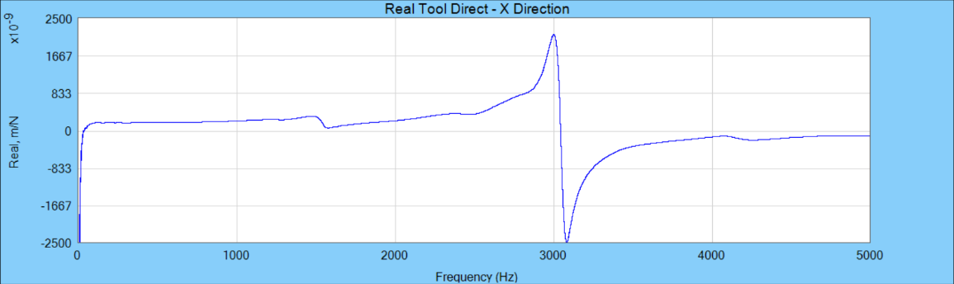
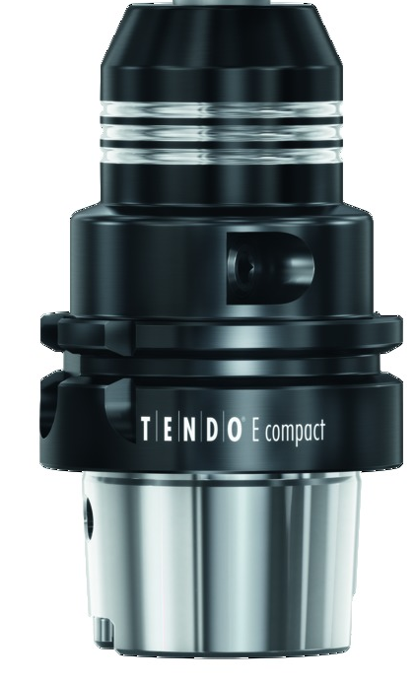
Comparison based on technical data
TENDO E compact and SINO-R
appr. 3400 m/N
Dyn. Felxibility
Dyn. Felxibility
approx. 4750 m/N

