Slide 1
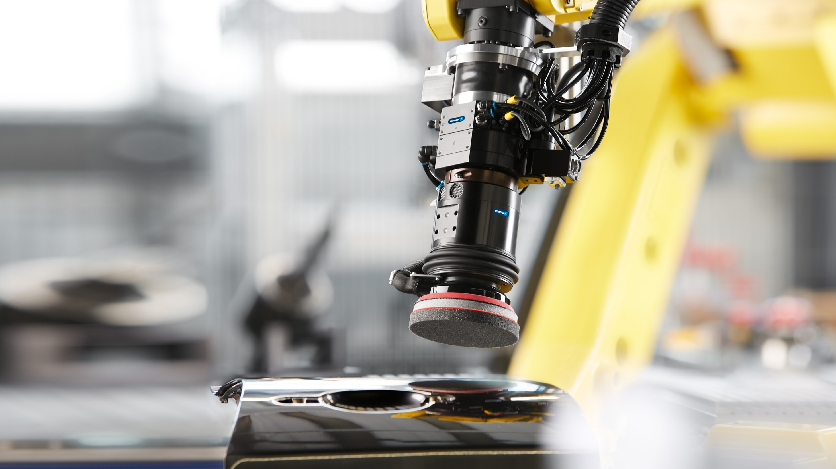


A Robot Application Center

Slide 2

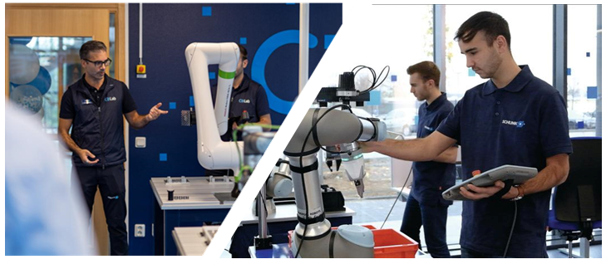
SCHUNK supports your automation process
CoLab Concept
How can the CoLab support
Exemplary set up of the target application
Validation of automation approaches for your production
Identifying and eliminating challenges of automation
Selection of suitable SCHUNK components
Ihre Vorteile
Feasibility study of the automation process
Live demonstration and customer training in the CoLab
Provision of extensive test documentation including hardware setup, approach and recommendations of SCHUNK application experts

Slide 3
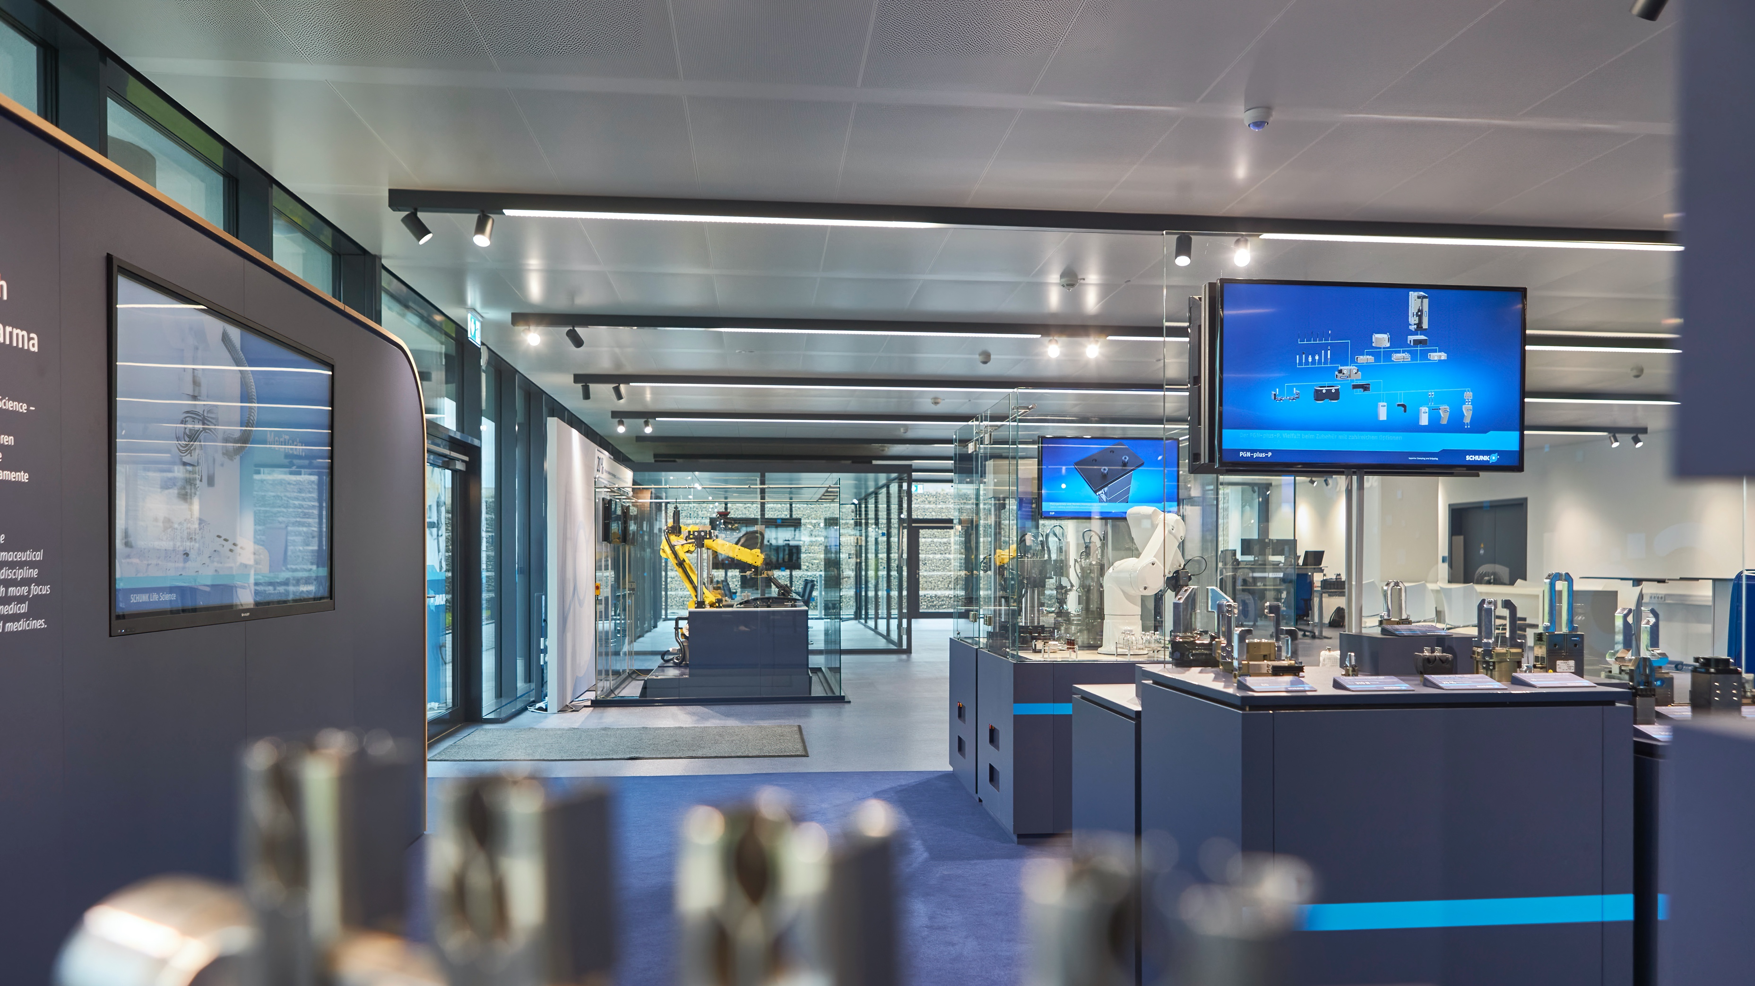




CoLabs validate your applications
Over 275
visits and workshops
Validation is free
of charge
Over 1.500
validated applications
Feasibility test and documentation from application experts
Live demonstration und customer training
More than 70 robots are available for tests

Slide 4


CoLabs world wide
12
Salgueiro (BR)
Tokyo (JPN)
's-Hertogenbosch (NCA)
Competence around the world
Nitra (SVK)
Marne-la-Vallee (FRA)
Lurate Caccivio (ITA)
Querétaro (MEX)
Södertälje (SWE)
Lauffen (GER)
Shanghai (CHN)
Hausen (GER)
Morrisville (USA)
Notes:
- CoLab Ausbau / Internationalisierung läuft auch bei uns im Vertrieb durch Henry

Slide 5
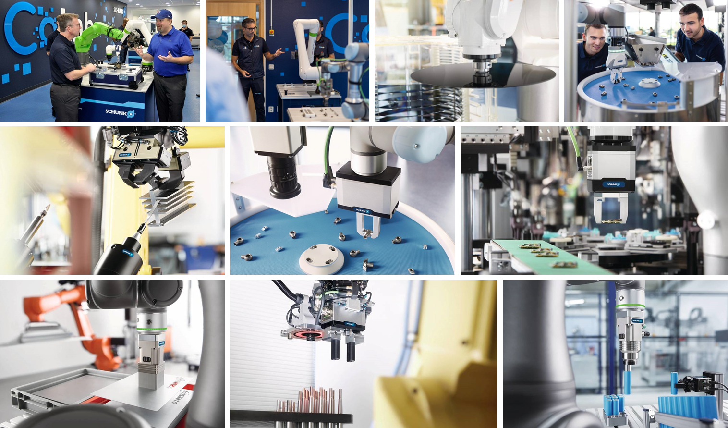

Application focus
Validations in the CoLab
The big 5
  ADHESO
  Material Removal
  Magnetic Gripper
  General Gripper Validation
  ORG
Application focused solutions
  2D Grasping Kit
  Quality Inspection
  Machine Tending

Slide 6
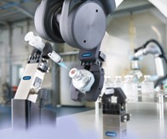
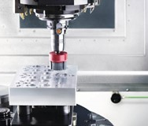
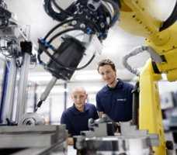

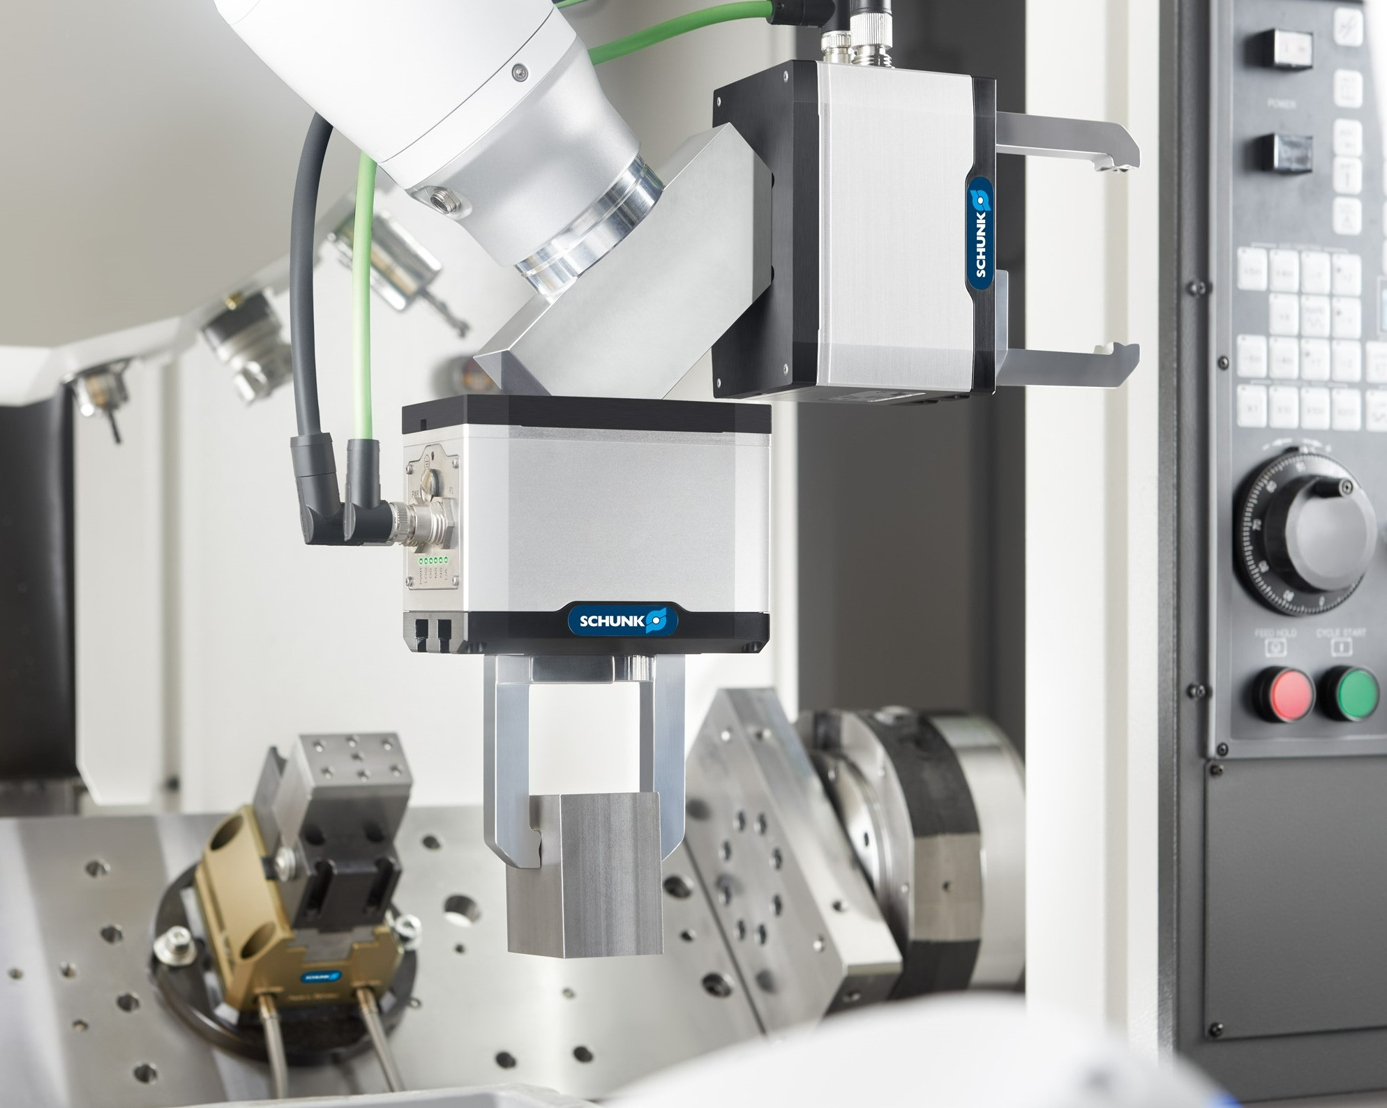
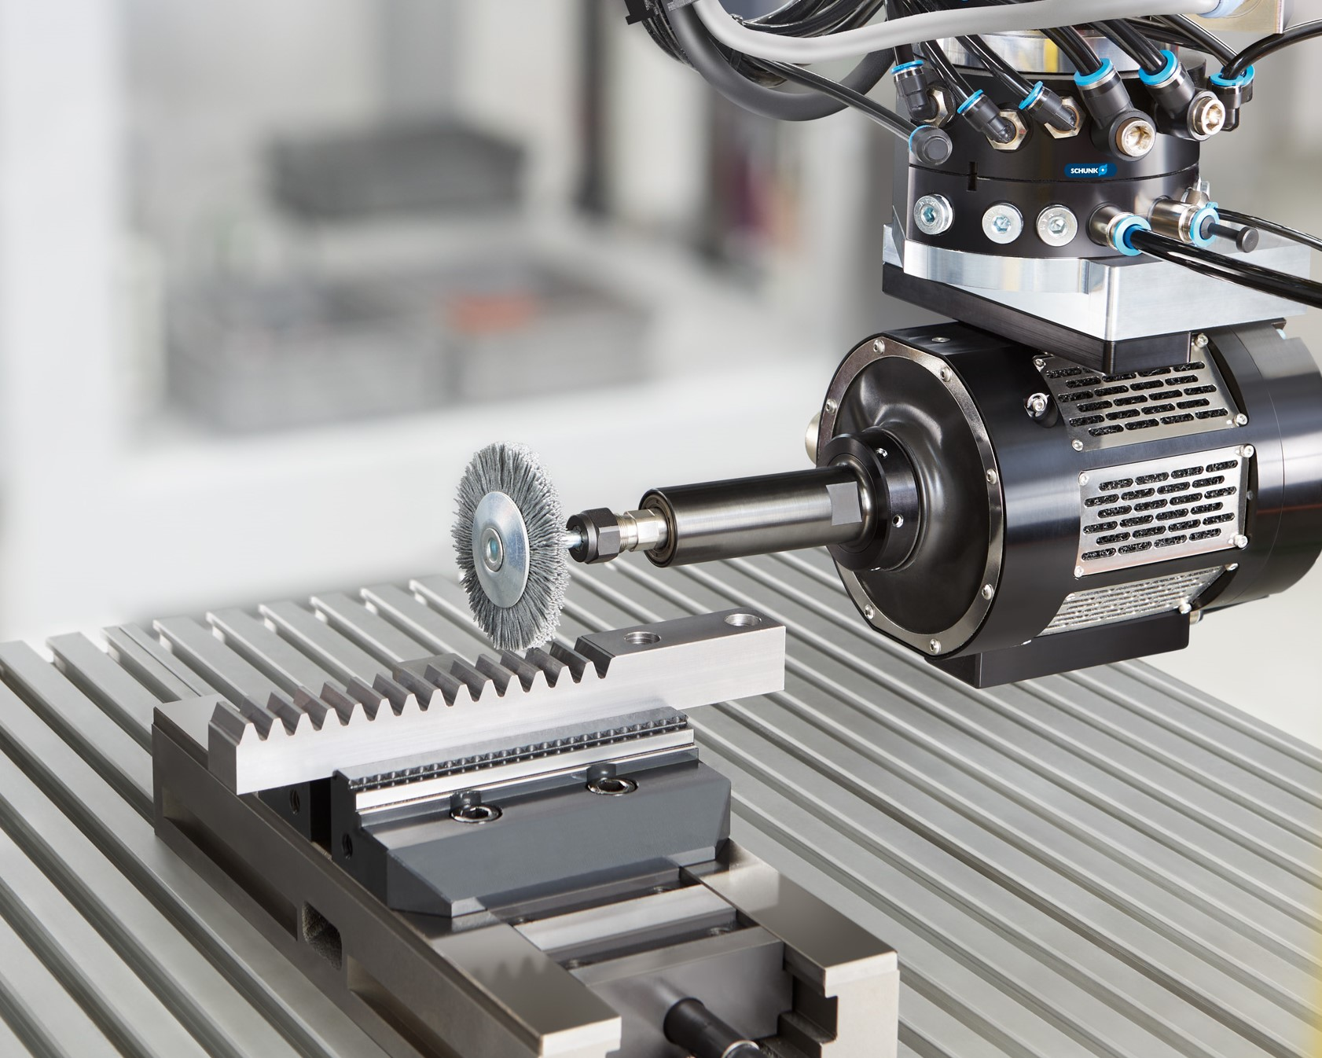
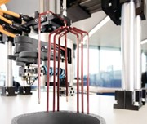
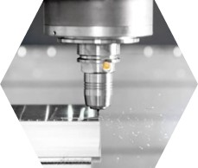

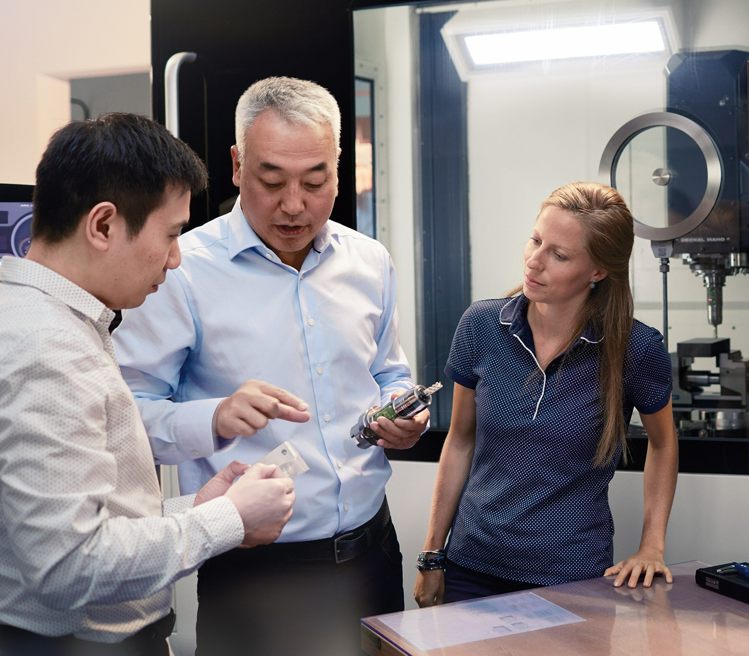
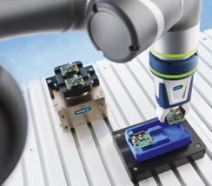
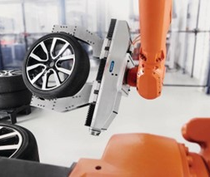
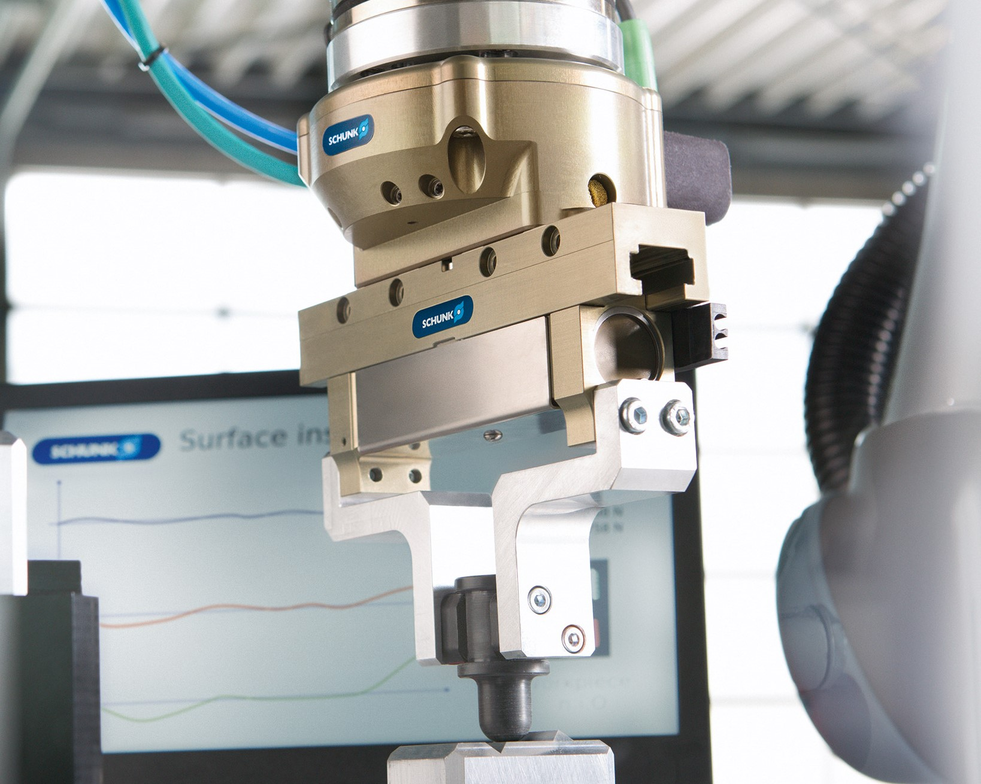
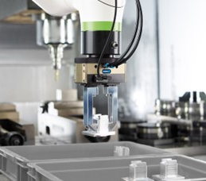
Center for Exchange and Development
CoLab Activities
Training center for SCHUNK and partners
Application center for customer validations
Support own R&D
Partner-network with robot manufacturers and integrators
Showroom for prooven and new technologies

Slide 7








Use the CoLab to your advantage
Contact your SCHUNK Regional Sales Manager
Discuss the requirements of your application with our application experts
Validation of your application in the CoLab
Stay tuned and watch the latest application on our YouTube Playlist
Watch the validation results and get recommendations for products and parameters

