Slide 1
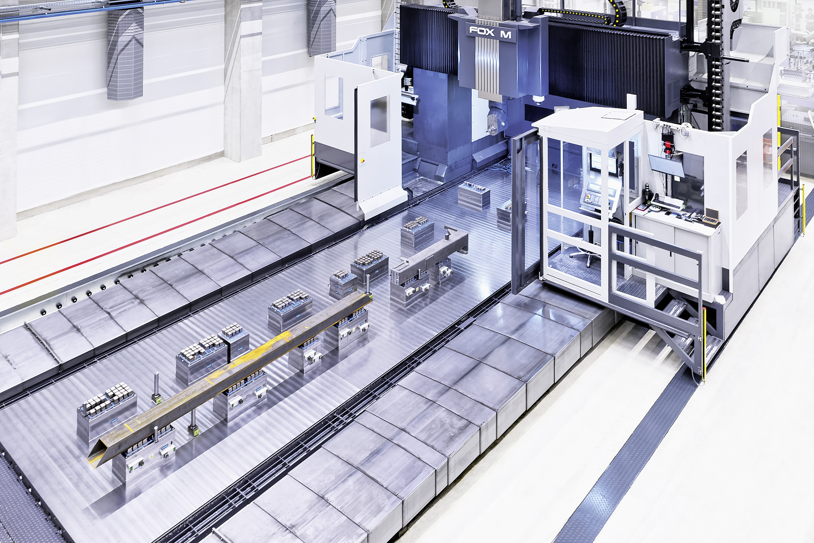

Standard double magnets
MAGNOS – Magnetic Clamping Technology

Slide 2
Overview sizes
MAGNOS – Standard double magnets
ID 1546522 MFRS-DM-A1-050 430x315x346
ID 1546528 MFRS-DM-A1-050 630x315x346
ID 1546542 MFRS-DM-A1-050 815x315x346
ID 1546544 MFRS-DM-A1-050 1030x315x346

Slide 3
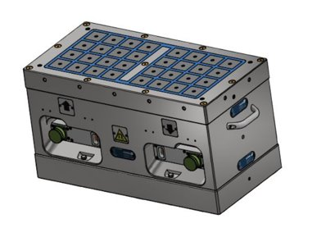
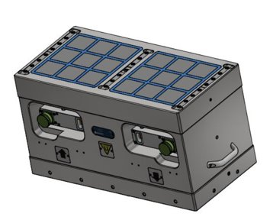
General concept
MAGNOS – Standard double magnets
Workpiece clamping
on top magnet
A1-050 pole size
Clamping against machine table
on bottom magnet
A2-070 pole size

Slide 4
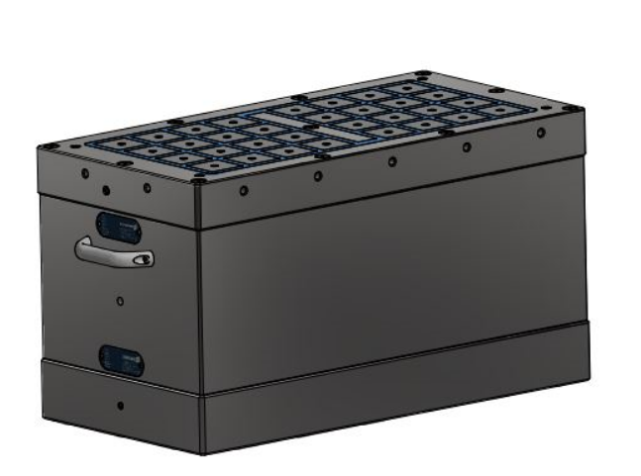
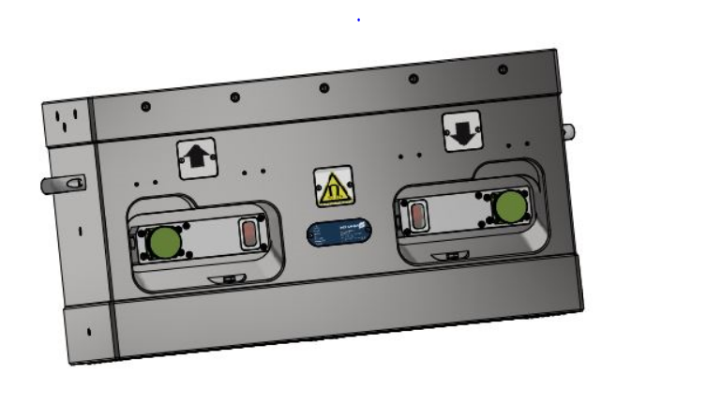
General concept
MAGNOS – Standard double magnets
Brass cap
to close fixing holes
Status indicator
for workpiece clamping
Handles
for easy positioning
Threads
arround the chuck for free customer use
Status indicator
for machine table clamping

Slide 5
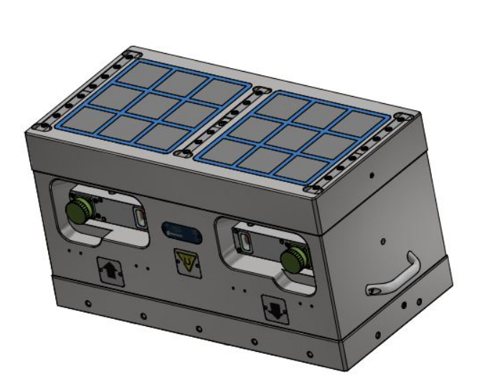
General concept
MAGNOS – Standard double magnets
Height 346 mm
for optimal assesibility
400mm height with pole extensions 50-54
Rollers on machine table side
with gap 1,5mm
for hand positioning

Slide 6
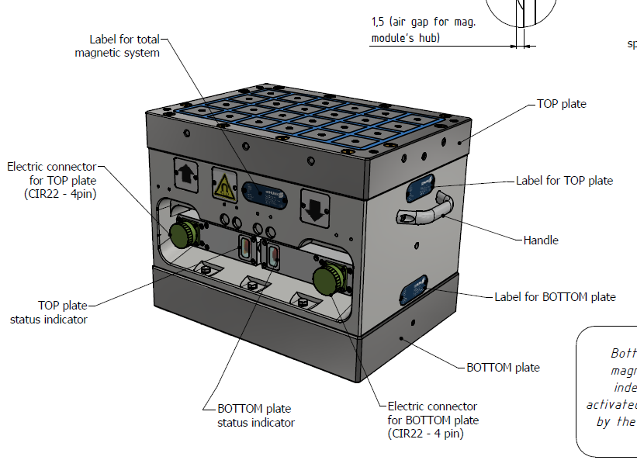
MFRS-DM-A1-050 430x315x346
MAGNOS – Standard double magnets

Slide 7
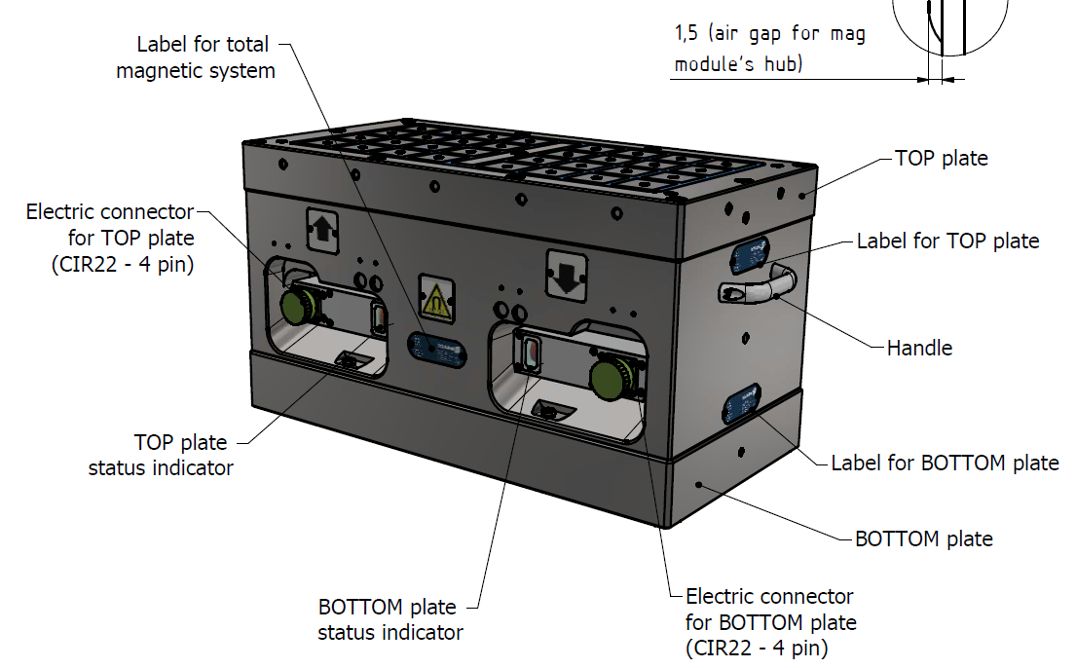
MFRS-DM-A1-050 630x315x346
MAGNOS – Standard double magnets

Slide 8
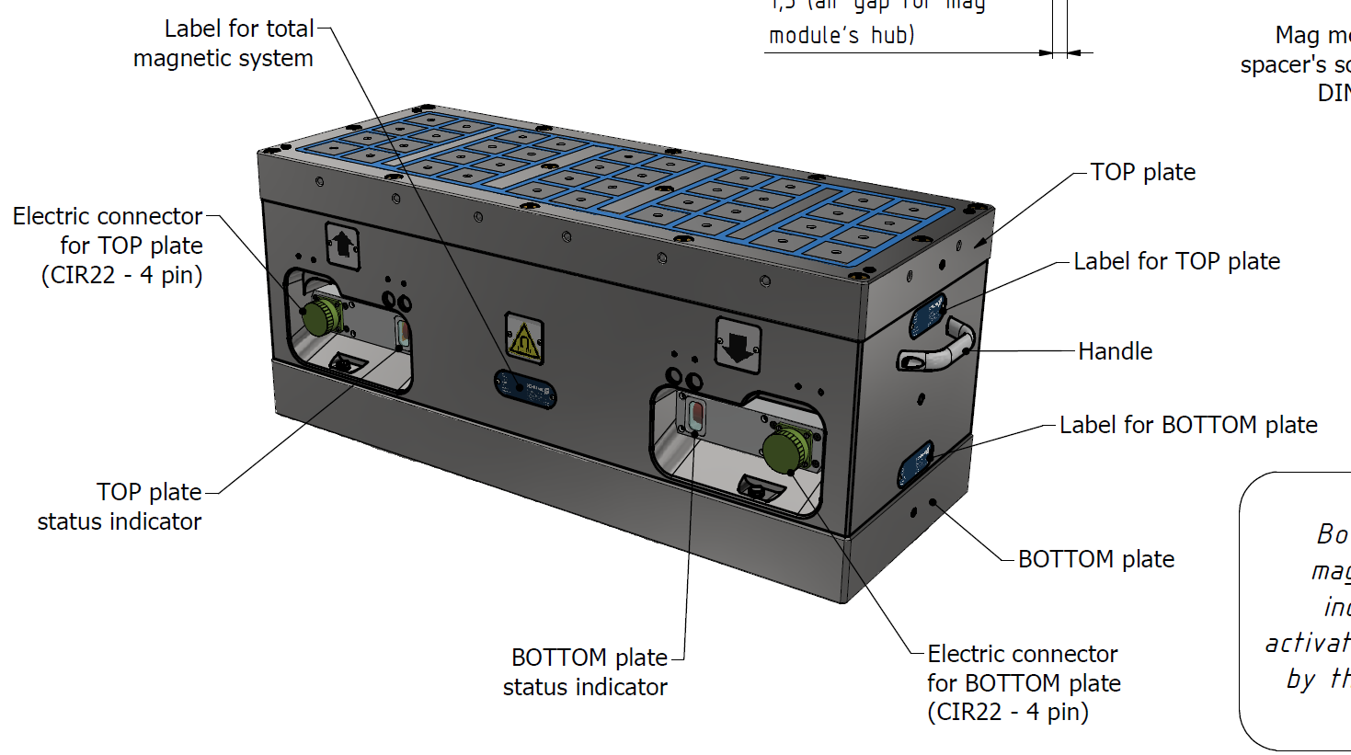
MFRS-DM-A1-050 815x315x346
MAGNOS – Standard double magnets

Slide 9
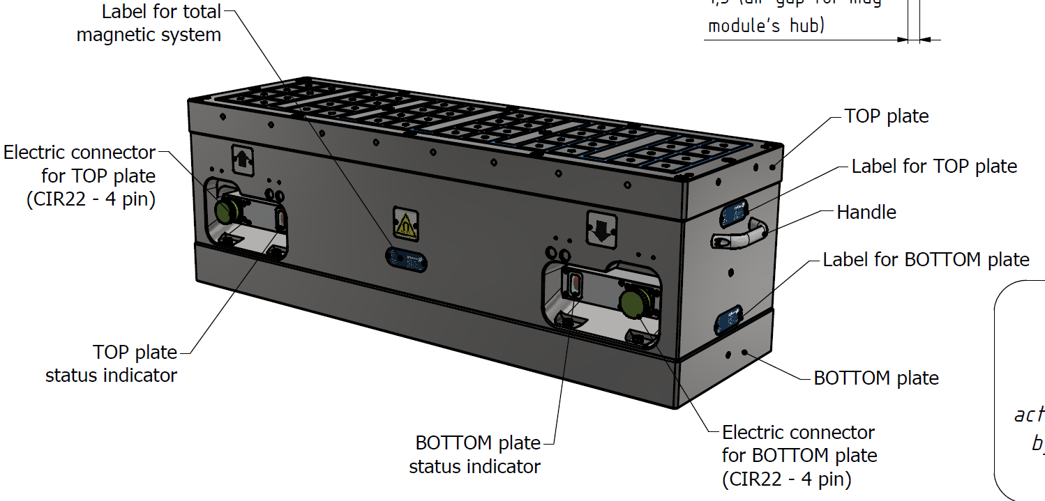
MFRS-DM-A1-050 1030x315x346
MAGNOS – Standard double magnets

Slide 10
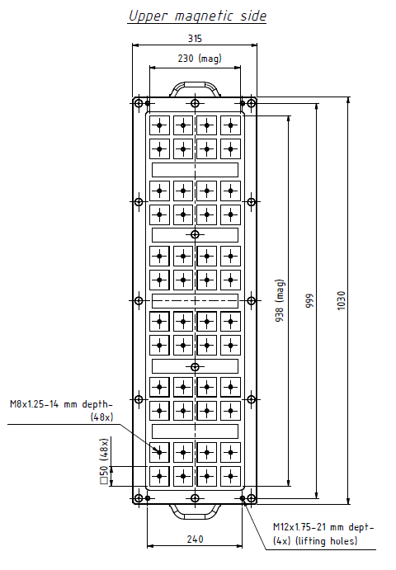
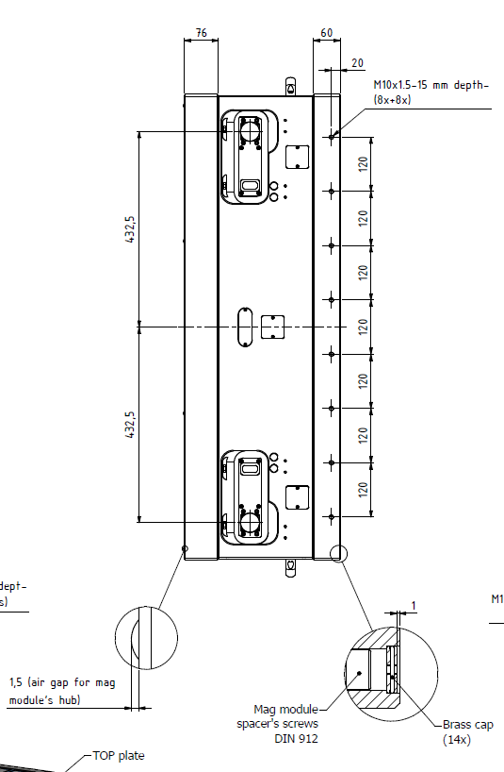
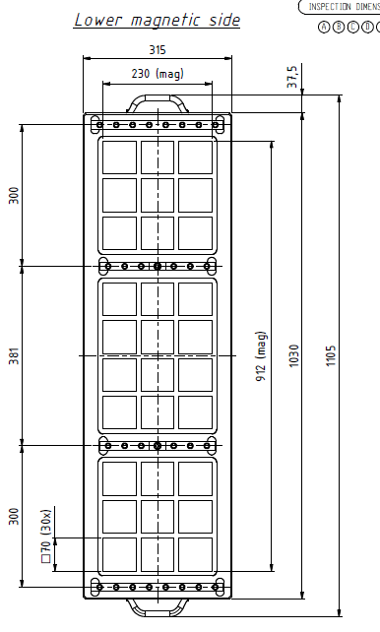
Details
MAGNOS – Standard double magnets

Slide 11
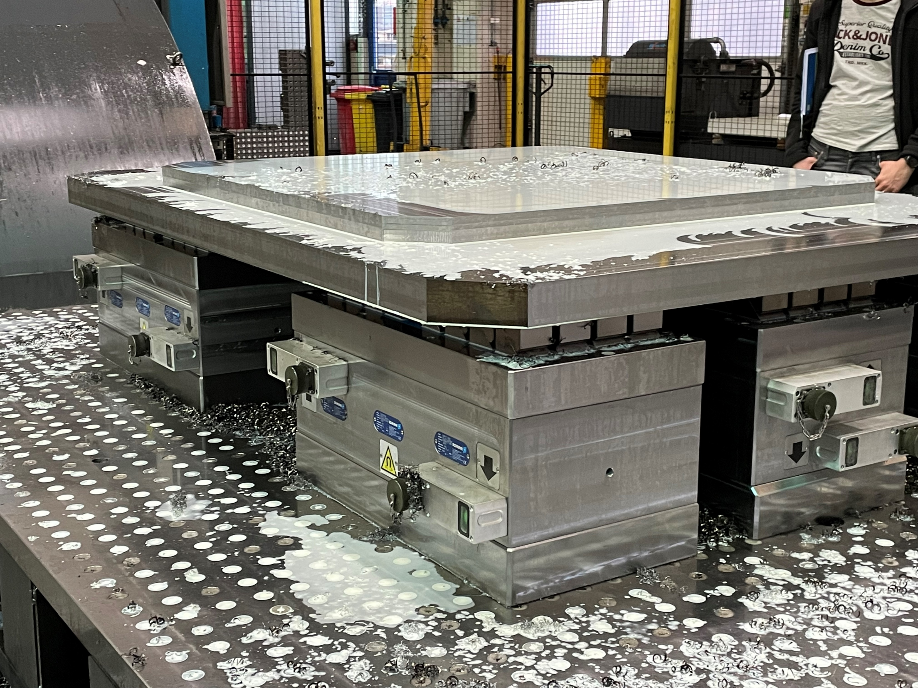
Application
MAGNOS – Standard double magnets

Slide 12
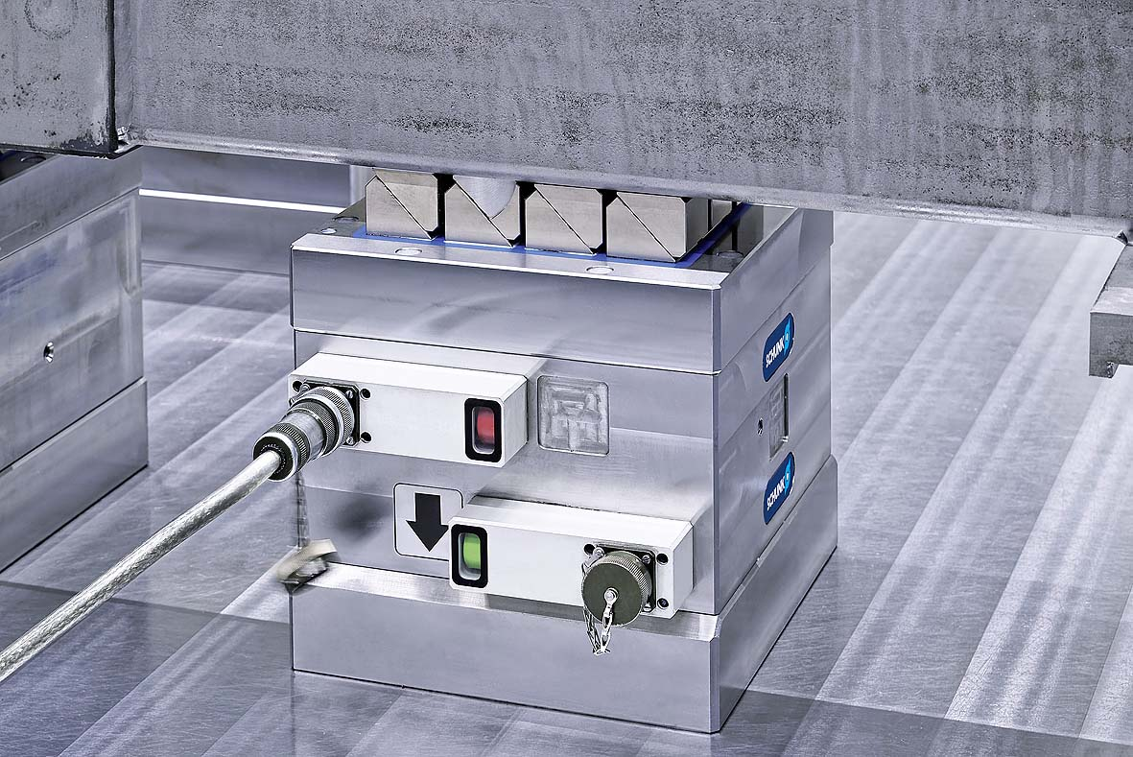
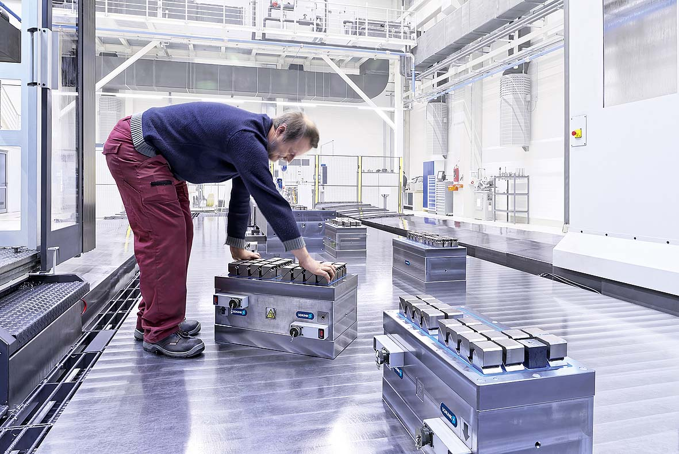
Application
MAGNOS – Standard double magnets

Slide 13
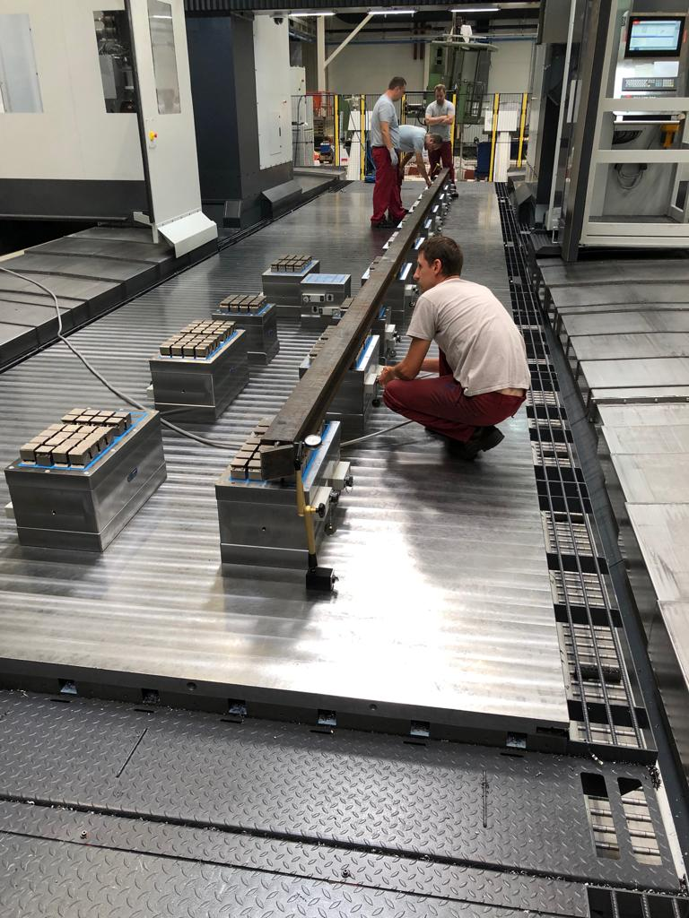
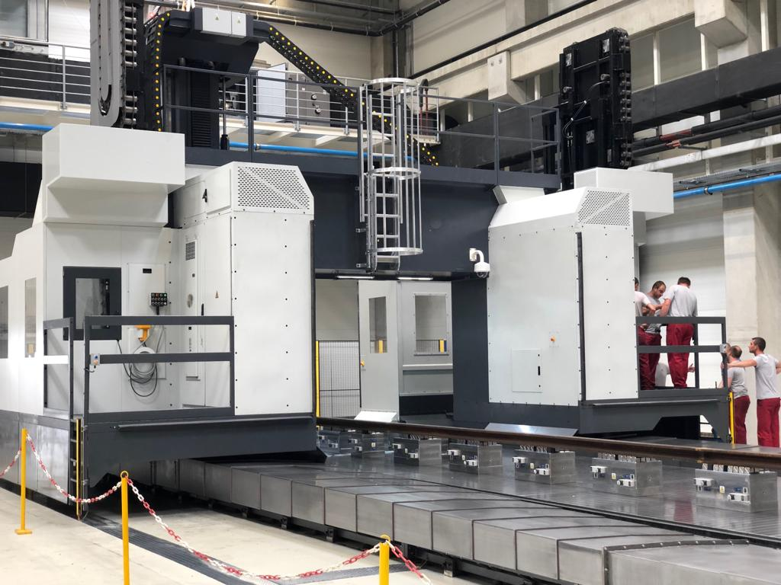
Application
MAGNOS – Standard double magnets

Slide 14
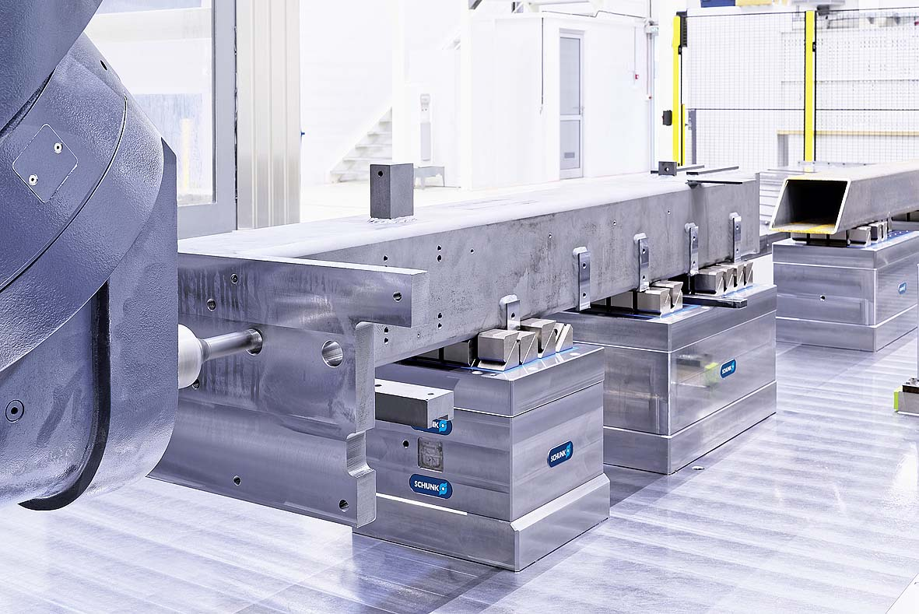
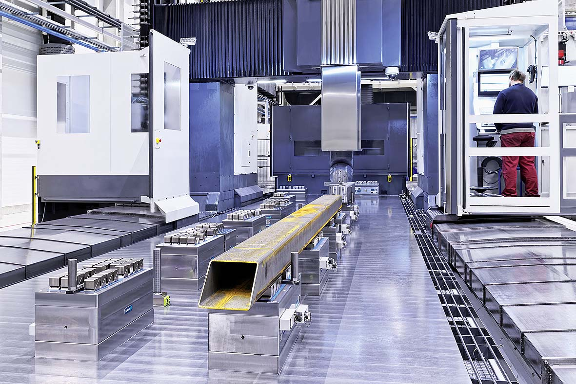
Application
MAGNOS – Standard double magnets

Slide 15
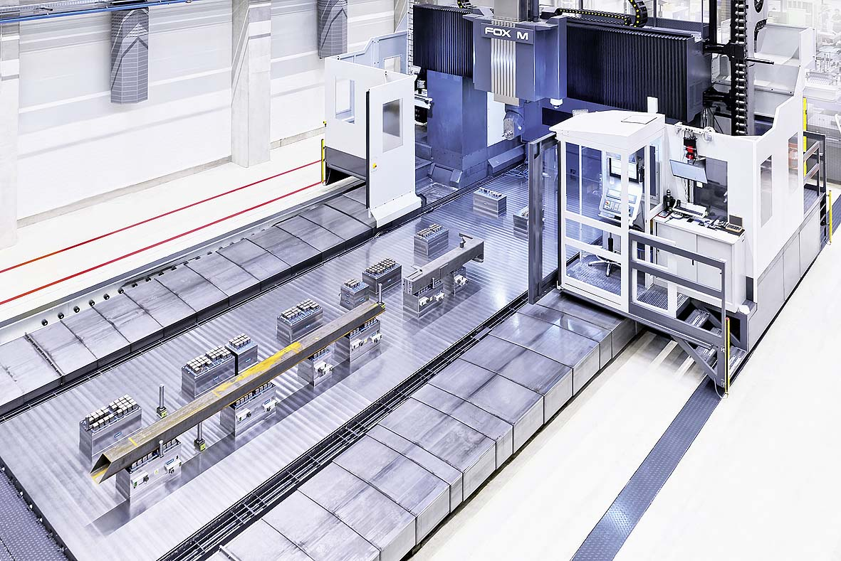
Application
MAGNOS – Standard double magnets

Slide 16
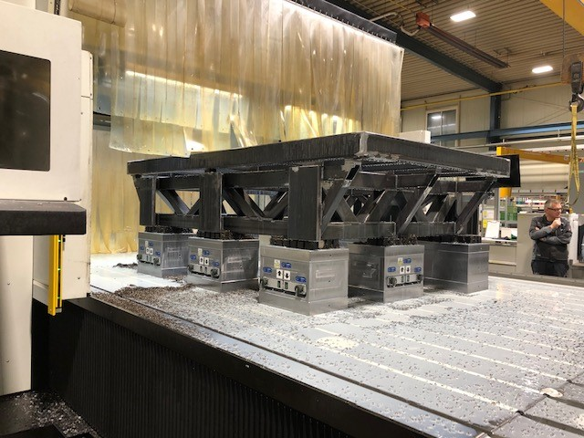
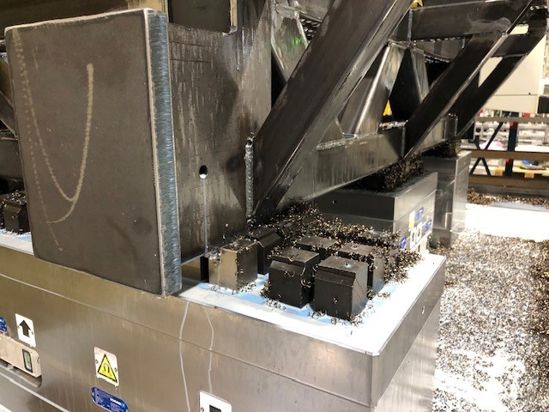
Application
MAGNOS – Standard double magnets

Slide 17
Where to use
MAGNOS – Standard double magnets
For each Machine type
  Medium and big machine tables
  Gantry machine
  Column machine
For every table
  Machine table with T-Nuts
  Machine table wit flat steel plate
  Machine table with grid pattern

Slide 18

Benefits / Advantages
MAGNOS – Standard double magnets
Fully flexibility to allow all clamping situations
Reducing of set up time for different large workpieces
Free positing on machine table (independent from slots/ or thread holes)
With the help of the rollers on the machine table side, the modules are easy to position
Easy to handle, the customer can move the double magnets by hand without any crane
No additional riseres needed, 5 Axis machining with swivel head
Ergonomics for employees
Keep all advantages of magentic clamping, deformation-free clamping of workpeices
Modular system
Test equipment available

