Slide 1
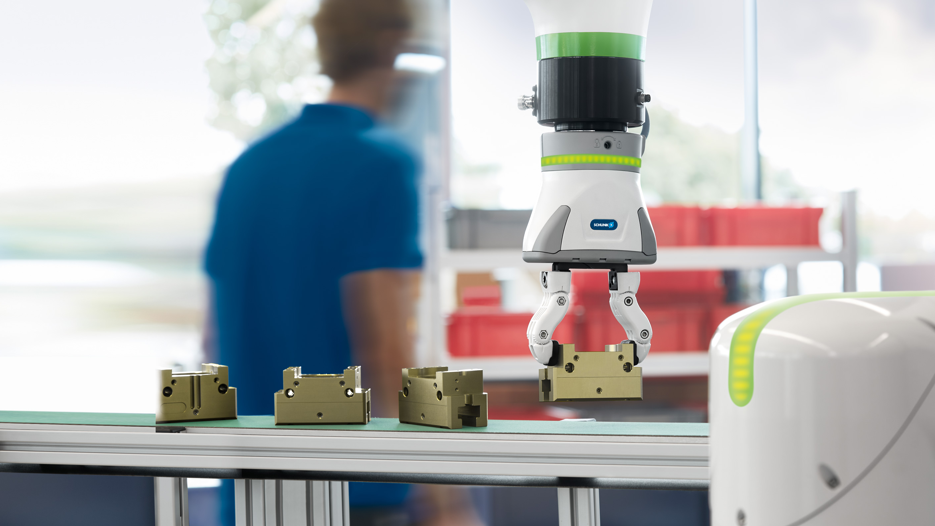

Automatic jaw quick-change system
BSWS-R

Slide 2
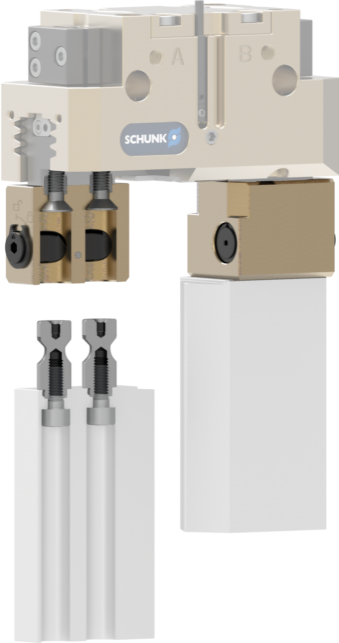
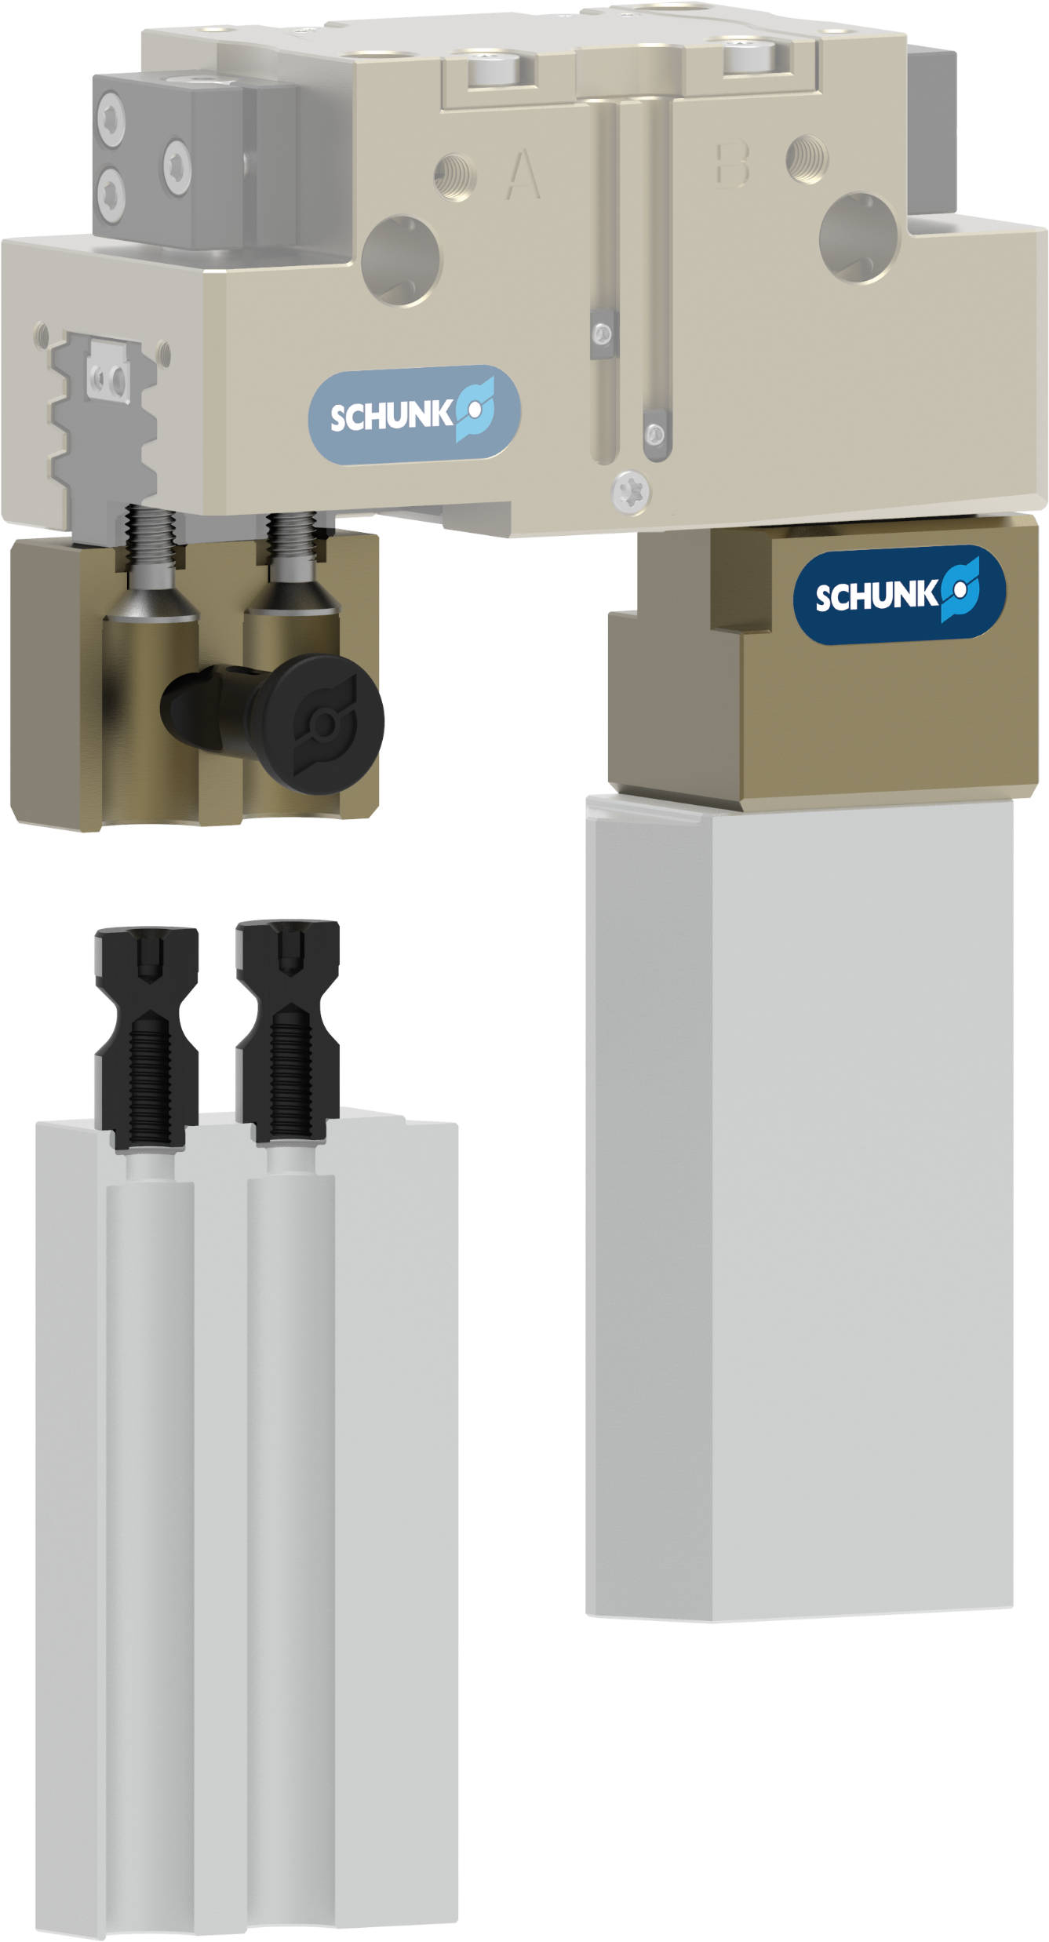
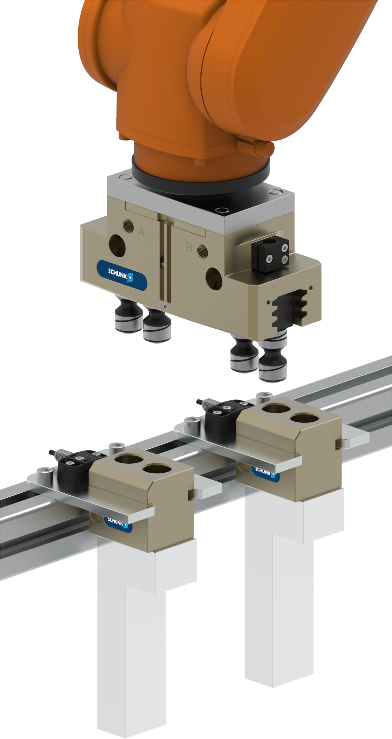


The BSWS Family
Automatic jaw quick-change system – BSWS-R
BSWS
(tool-actuated)
BSWS-M
(tool-free)
BSWS-R
(automatic)

Slide 3
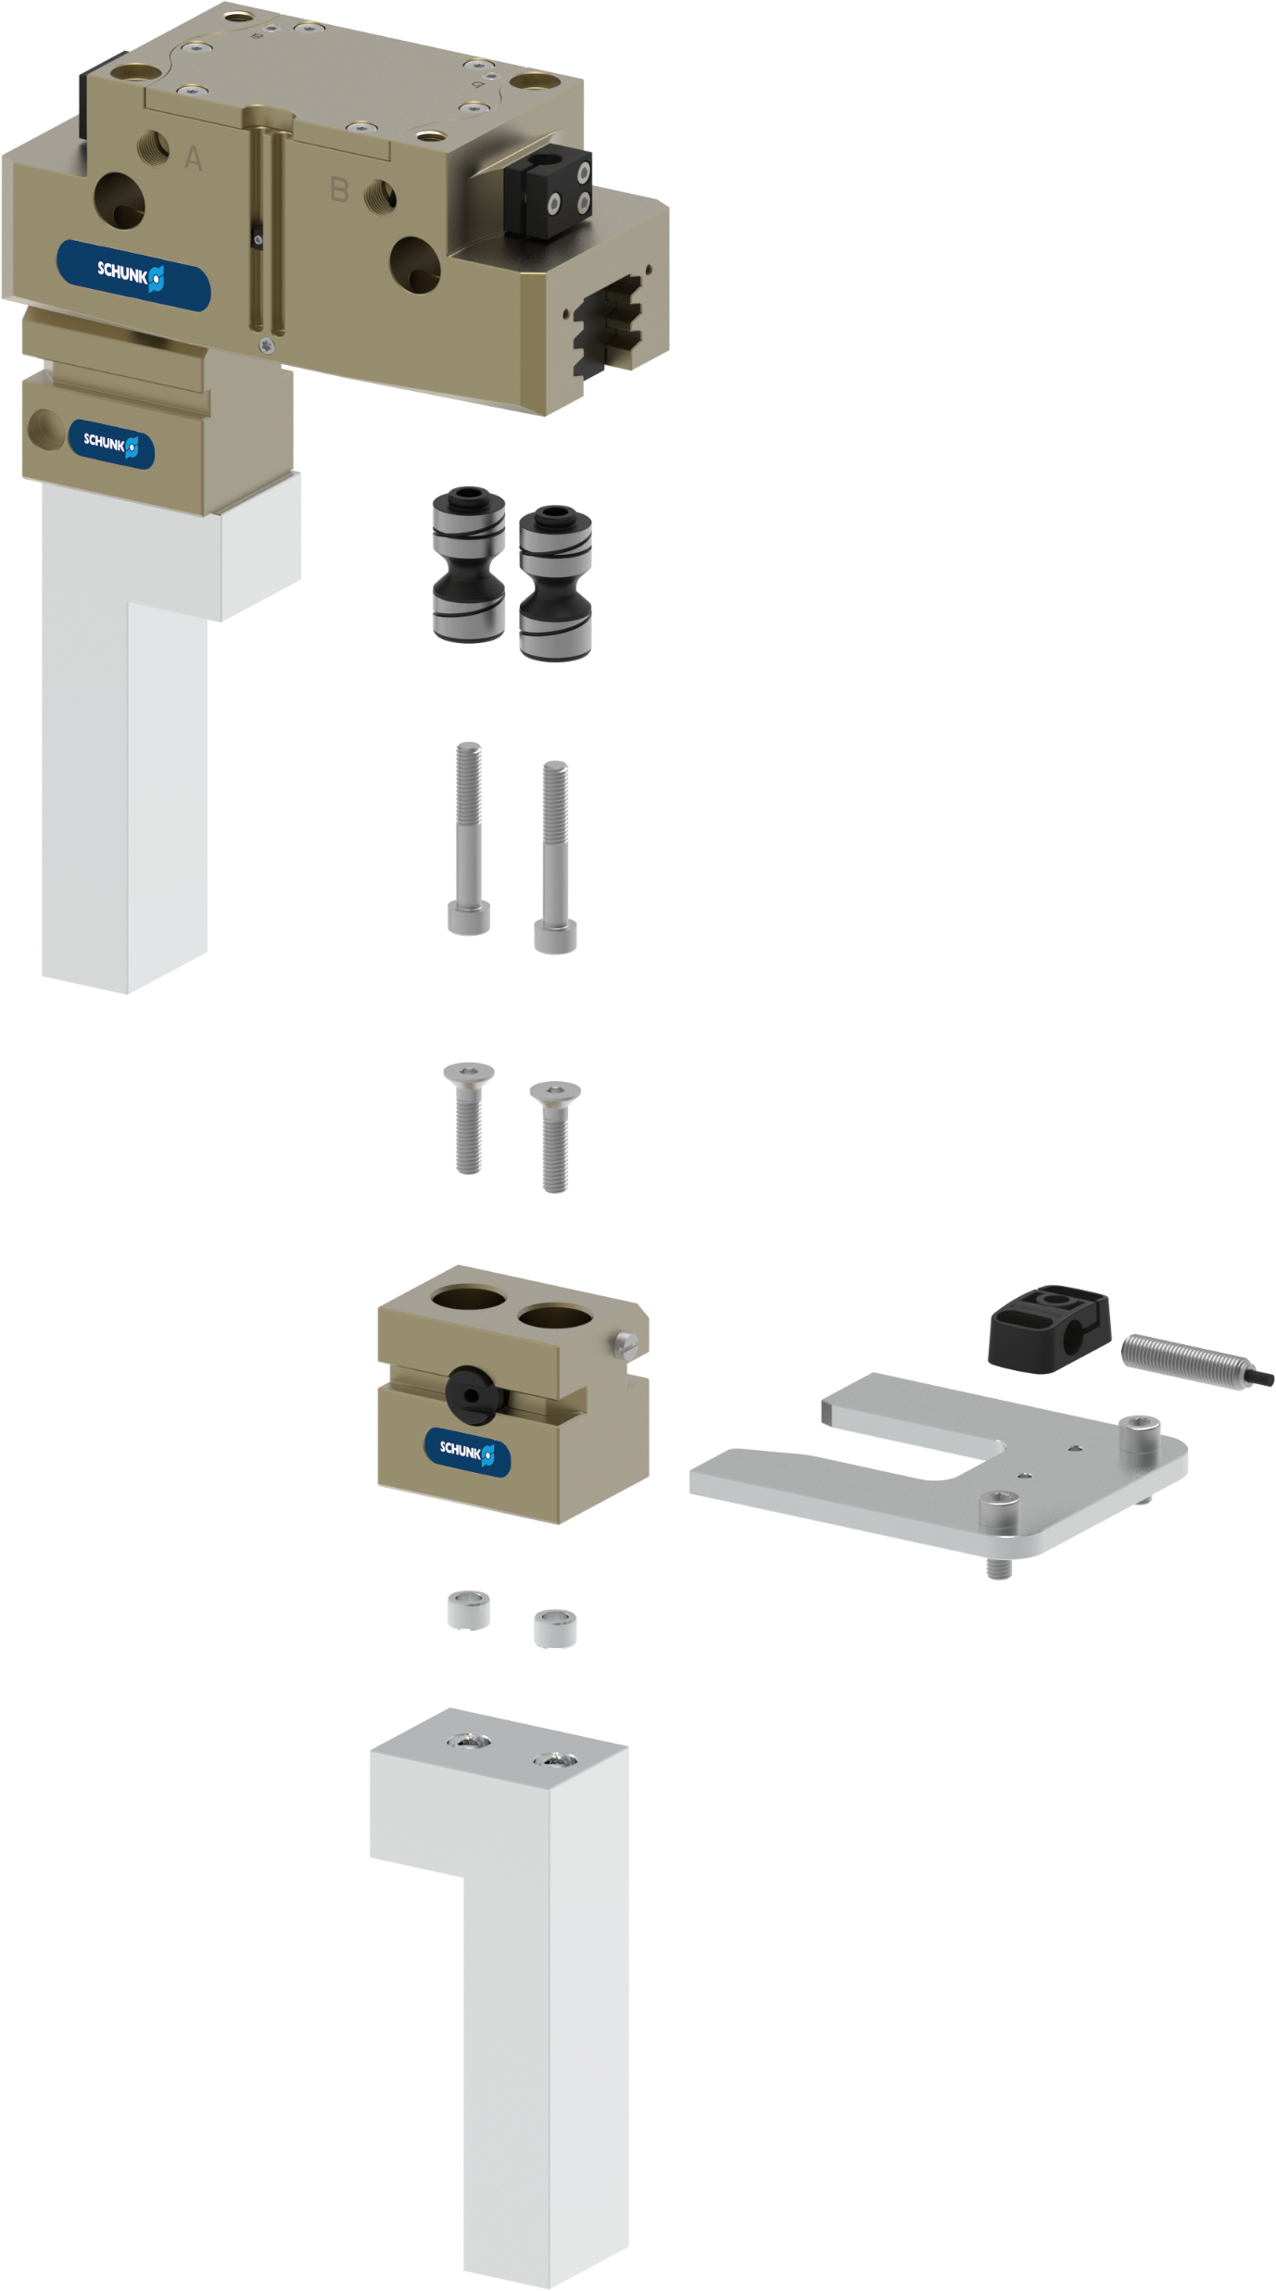
Structure
Automatic jaw quick-change system – BSWS-R
BSWS-AR
Jaw quick-change
adapter pin
Single parts
AS-IN-BSWS-SR
Mounting kit for inductive proximity switch
BSWS-BR
Jaw quick-change
basis
BSWS-SR
Storage station
Customized gripper finger

Slide 4
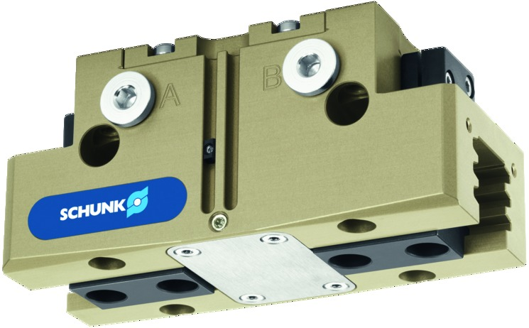
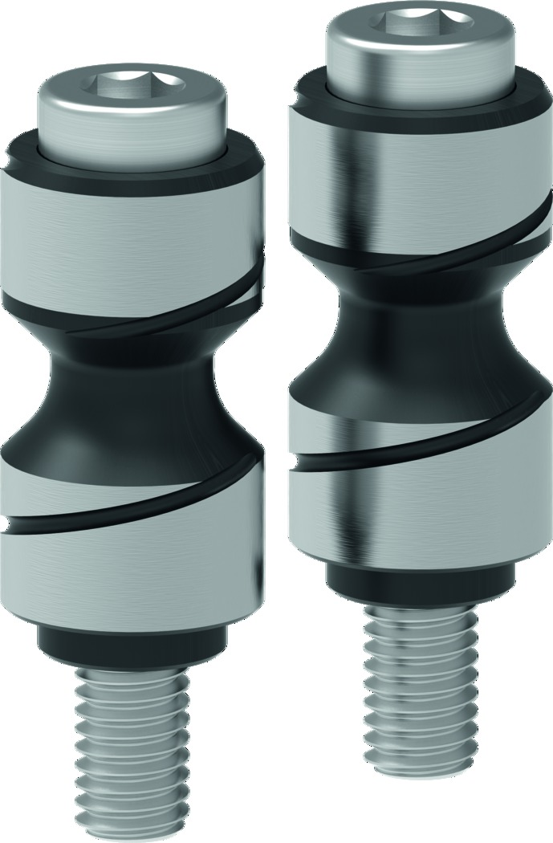
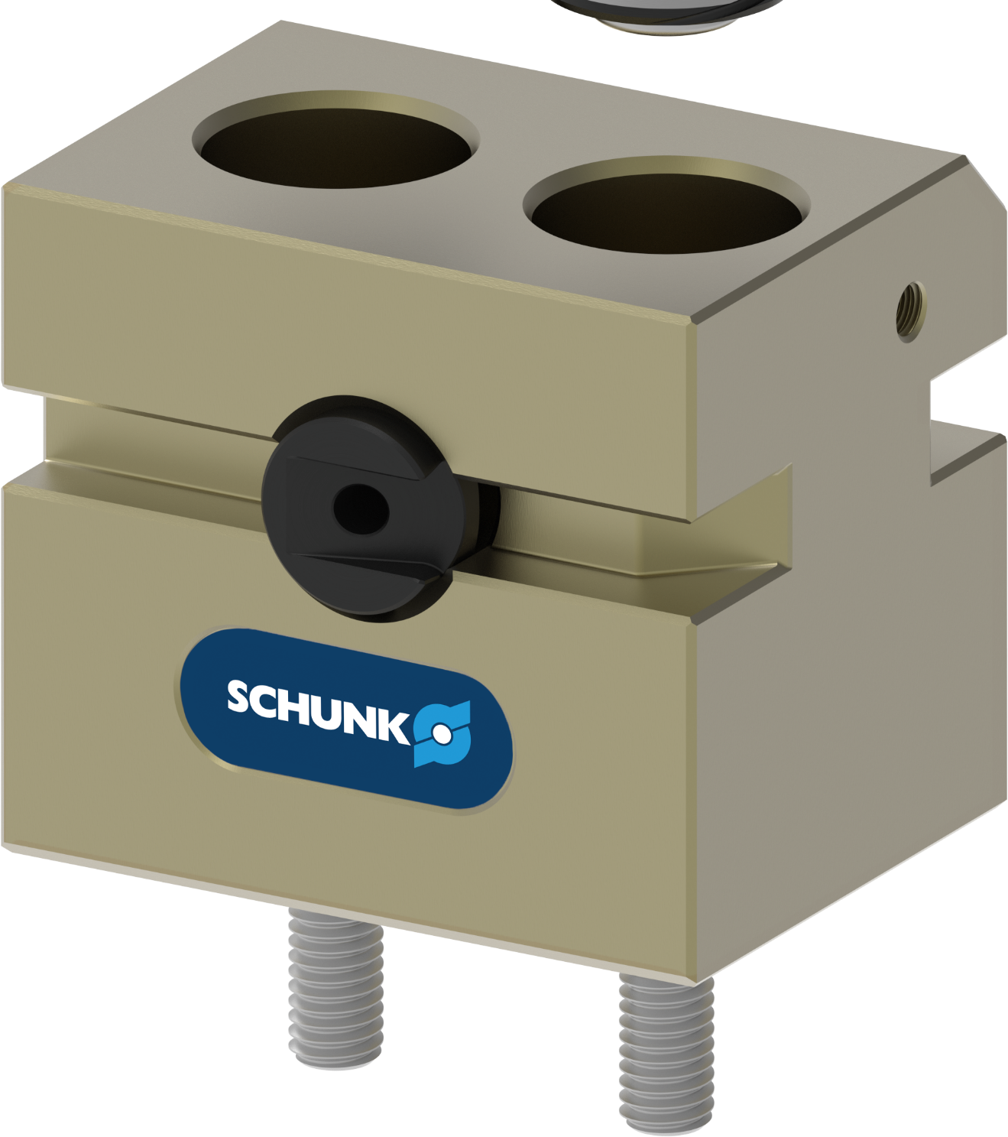
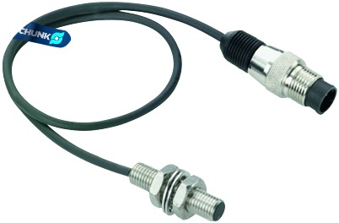
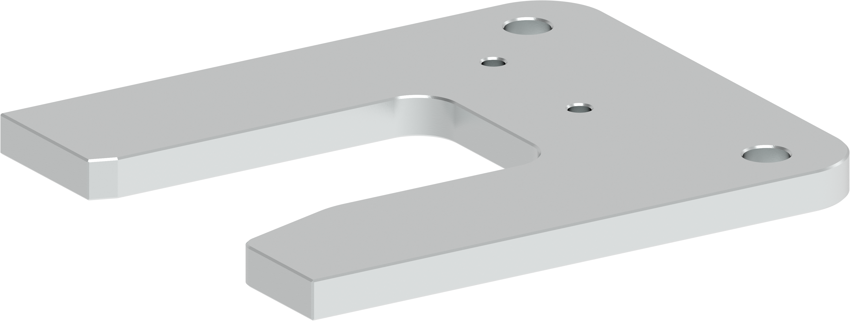
BSWS-R, 9 Sizes
Automatic jaw quick-change system – BSWS-R
Fingerprint | Jaw quick-change adapter pin | Jaw quick-change basis | Jaw quick-change storage station | Mounting kit for proximity switch
PGN-plus-P 50 | BSWS-AR 50 | BSWS-BR 50 | BSWS-SR 50 | AS-IN40-BSWS-SR 50/64
PGN-plus-P 64 | BSWS-AR 64 | BSWS-BR 64 | BSWS-SR 64
PGN-plus-P 80 | BSWS-AR 80 | BSWS-BR 80 | BSWS-SR 80 | AS-IN40-BSWS-SR 80/100
PGN-plus-P 100 | BSWS-AR 100 | BSWS-BR 100 | BSWS-SR 100
PGN-plus-P 125 | BSWS-AR 125 | BSWS-BR 125 | BSWS-SR 125 | AS-IN80-BSWS-SR 125/160
PGN-plus-P 160 | BSWS-AR 160 | BSWS-BR 160 | BSWS-SR 160
PGN-plus-P 200 | BSWS-AR 200 | BSWS-BR 200 | BSWS-SR 200 | AS-IN80-BSWS-SR 200
PGN-plus-P 240 | BSWS-AR 240 | BSWS-BR 240 | BSWS-SR 240 | AS-IN80-BSWS-SR 240/300
PGN-plus-P 300 | BSWS-AR 300 | BSWS-BR 300 | BSWS-SR 300

Slide 5
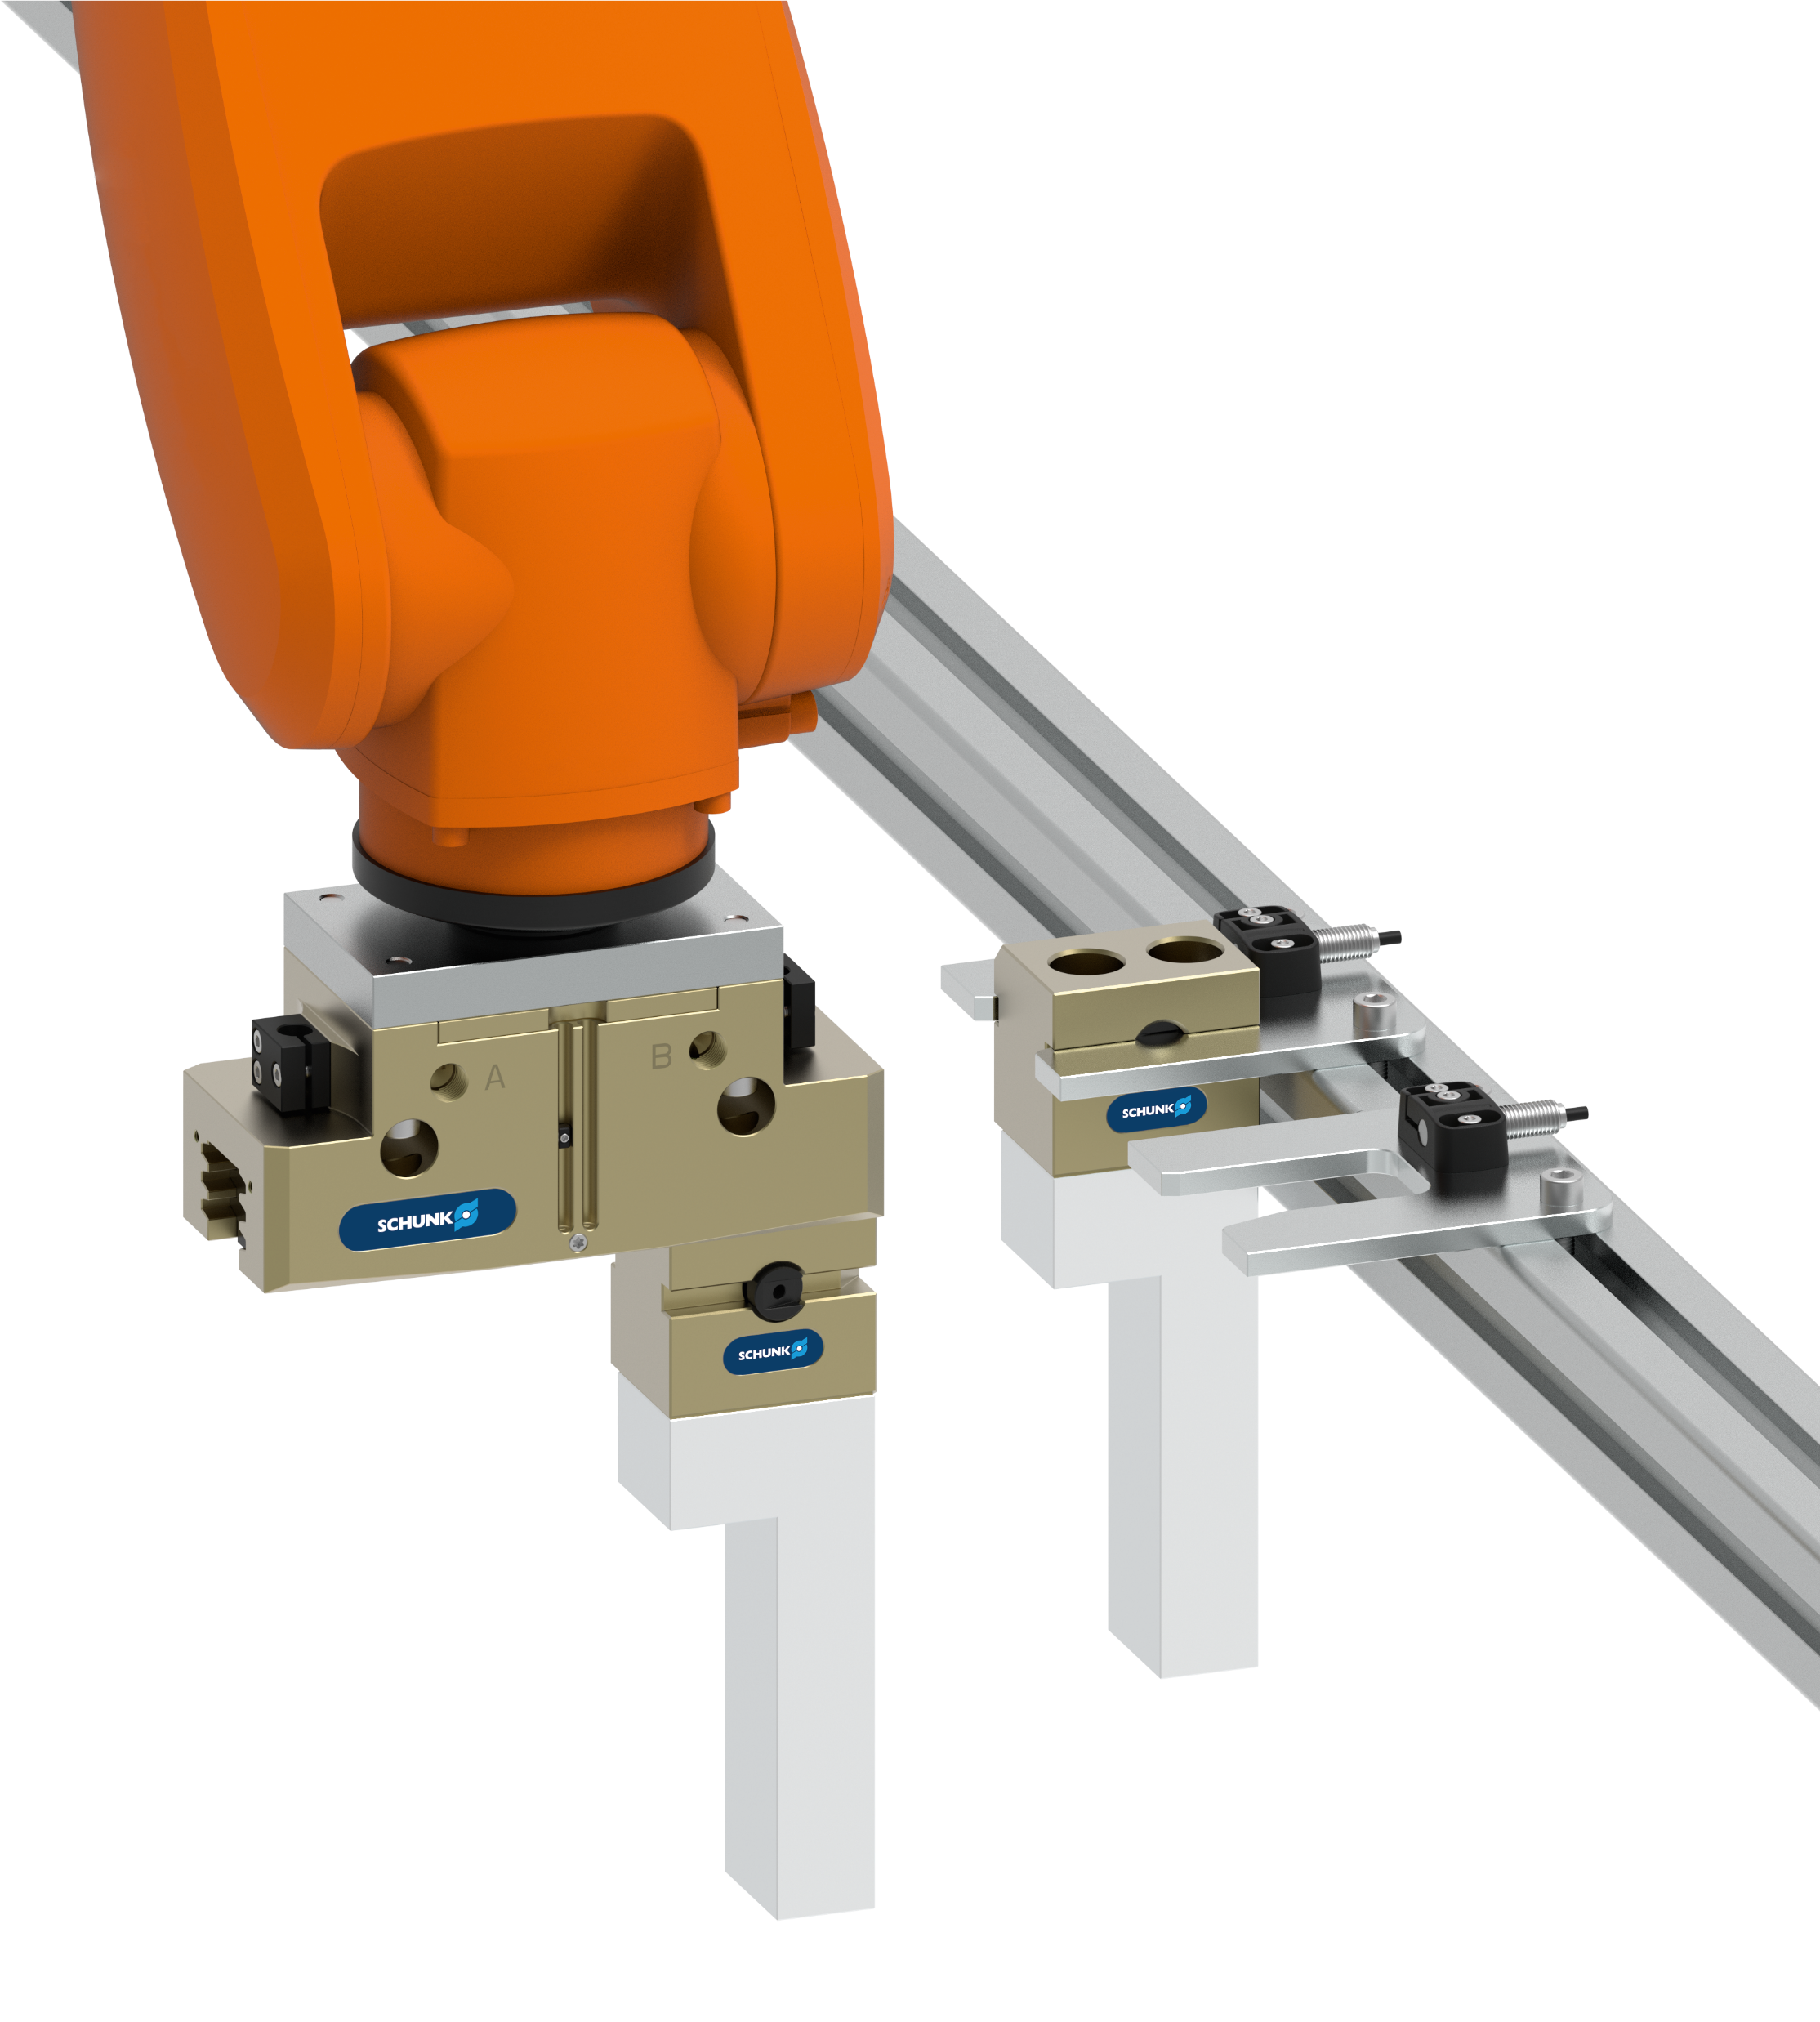
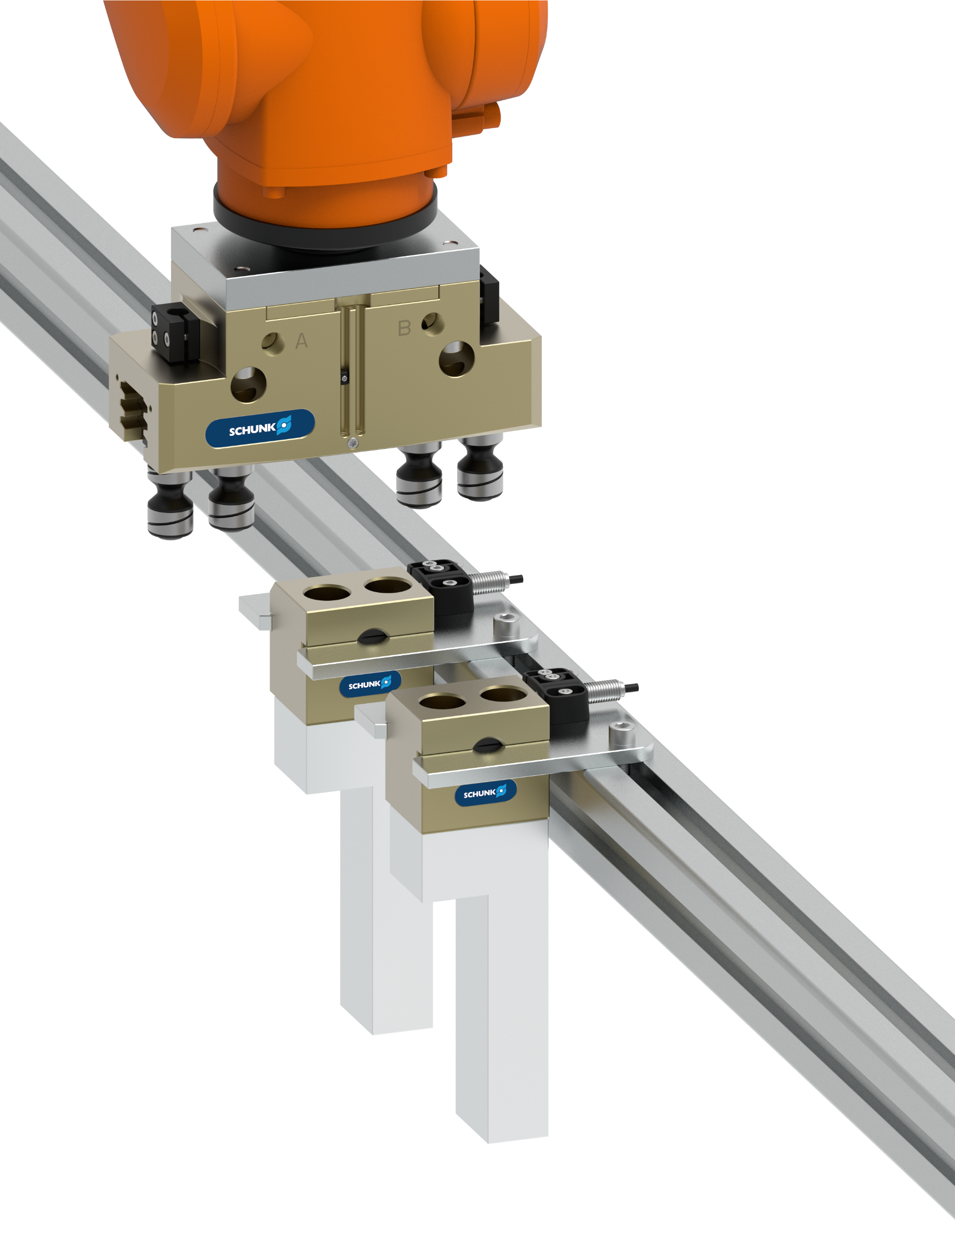

Functional description
Automatic jaw quick-change system – BSWS-R
Quick-change process in three steps.

Slide 6
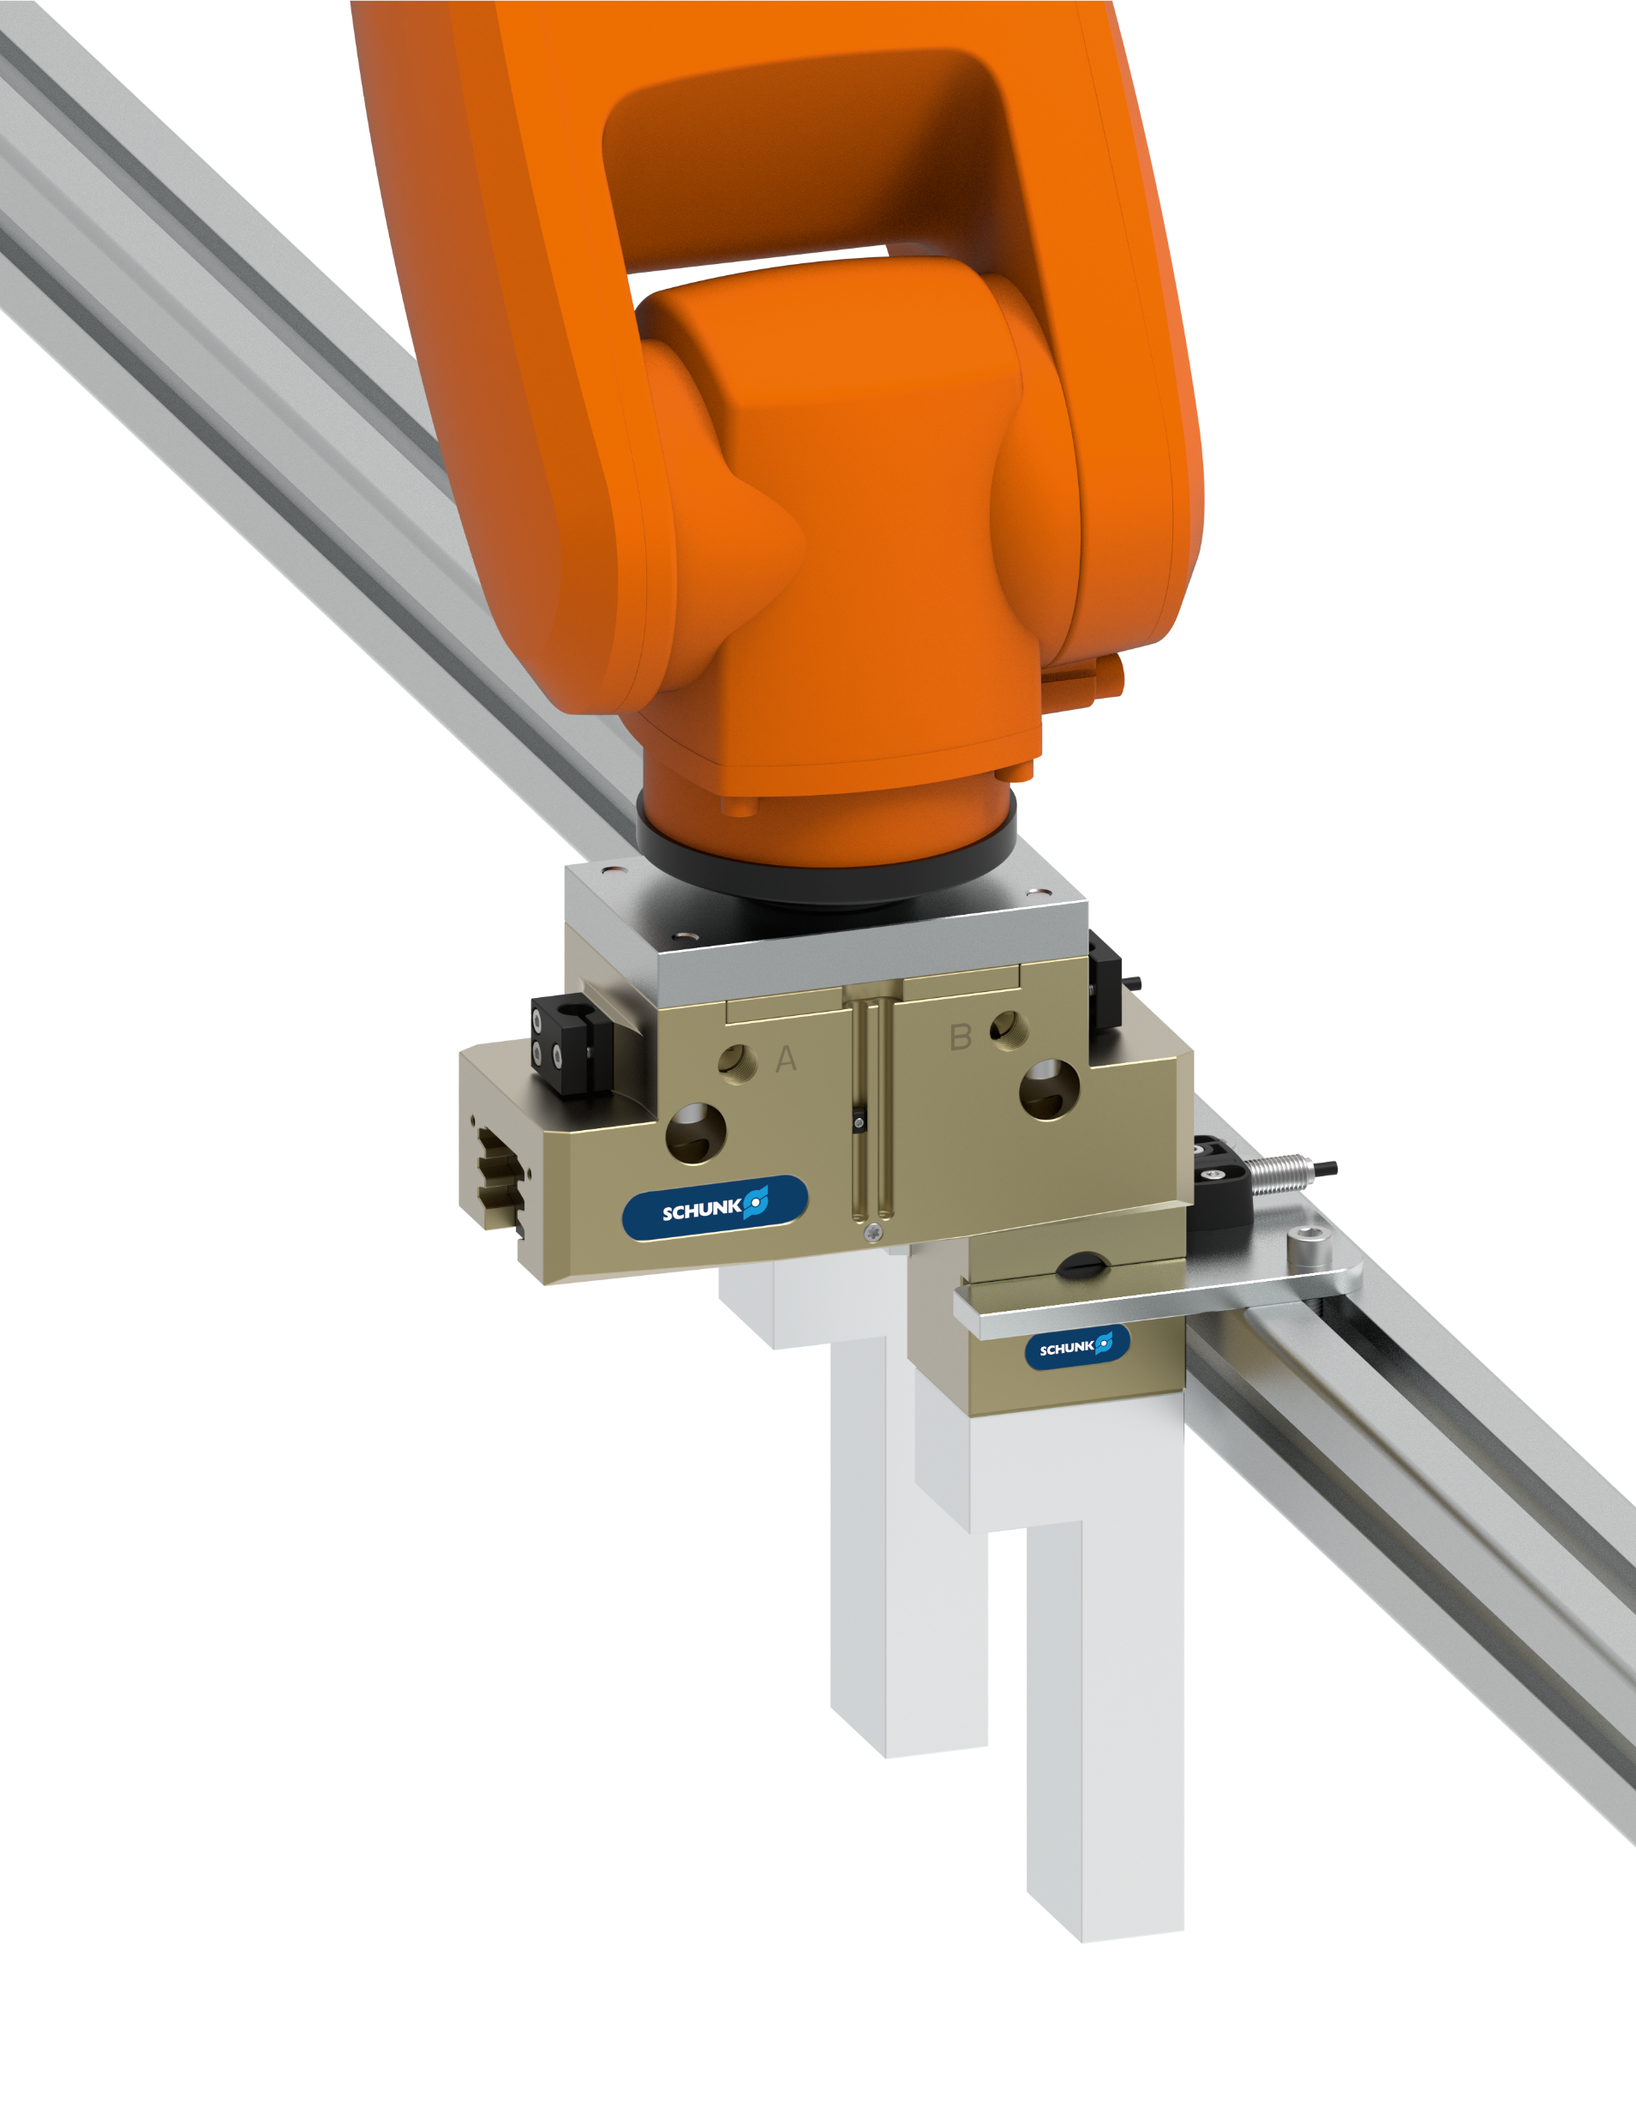
Functional description
Automatic jaw quick-change system – BSWS-R
1. Pre-positioning
2. Run-in
(unlock)
3. Extend
3
1
2
1
1
2

Slide 7
Functional description
Automatic jaw quick-change system – BSWS-R
1. Pre-positioning
2. Run-in
3. Extend
(lock)
1
1
1
2
2
2
2
3

Slide 8
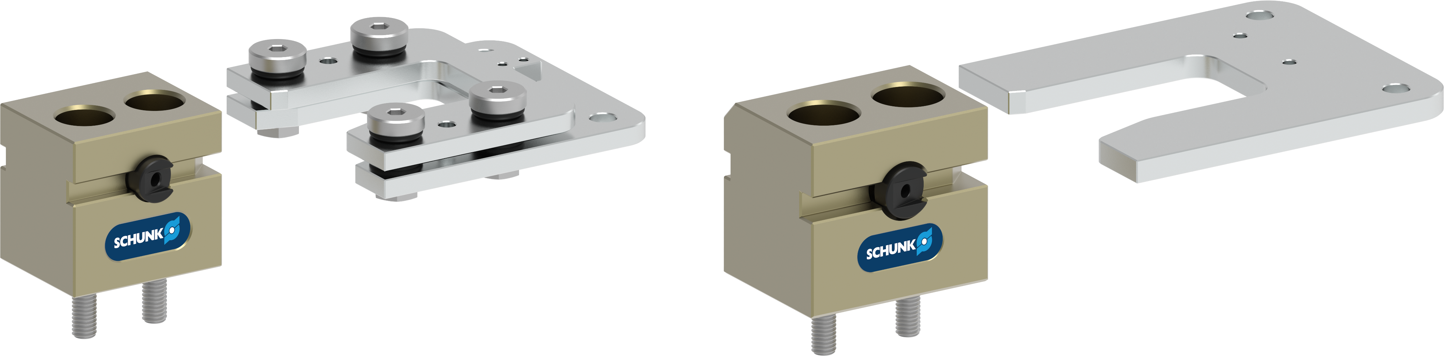
Storage station
Automatic jaw quick-change system – BSWS-R
Difference sizes
BSWS-SR 50 - 100
Storage station
BSWS-SR 125 - 300
Storage station

Slide 9
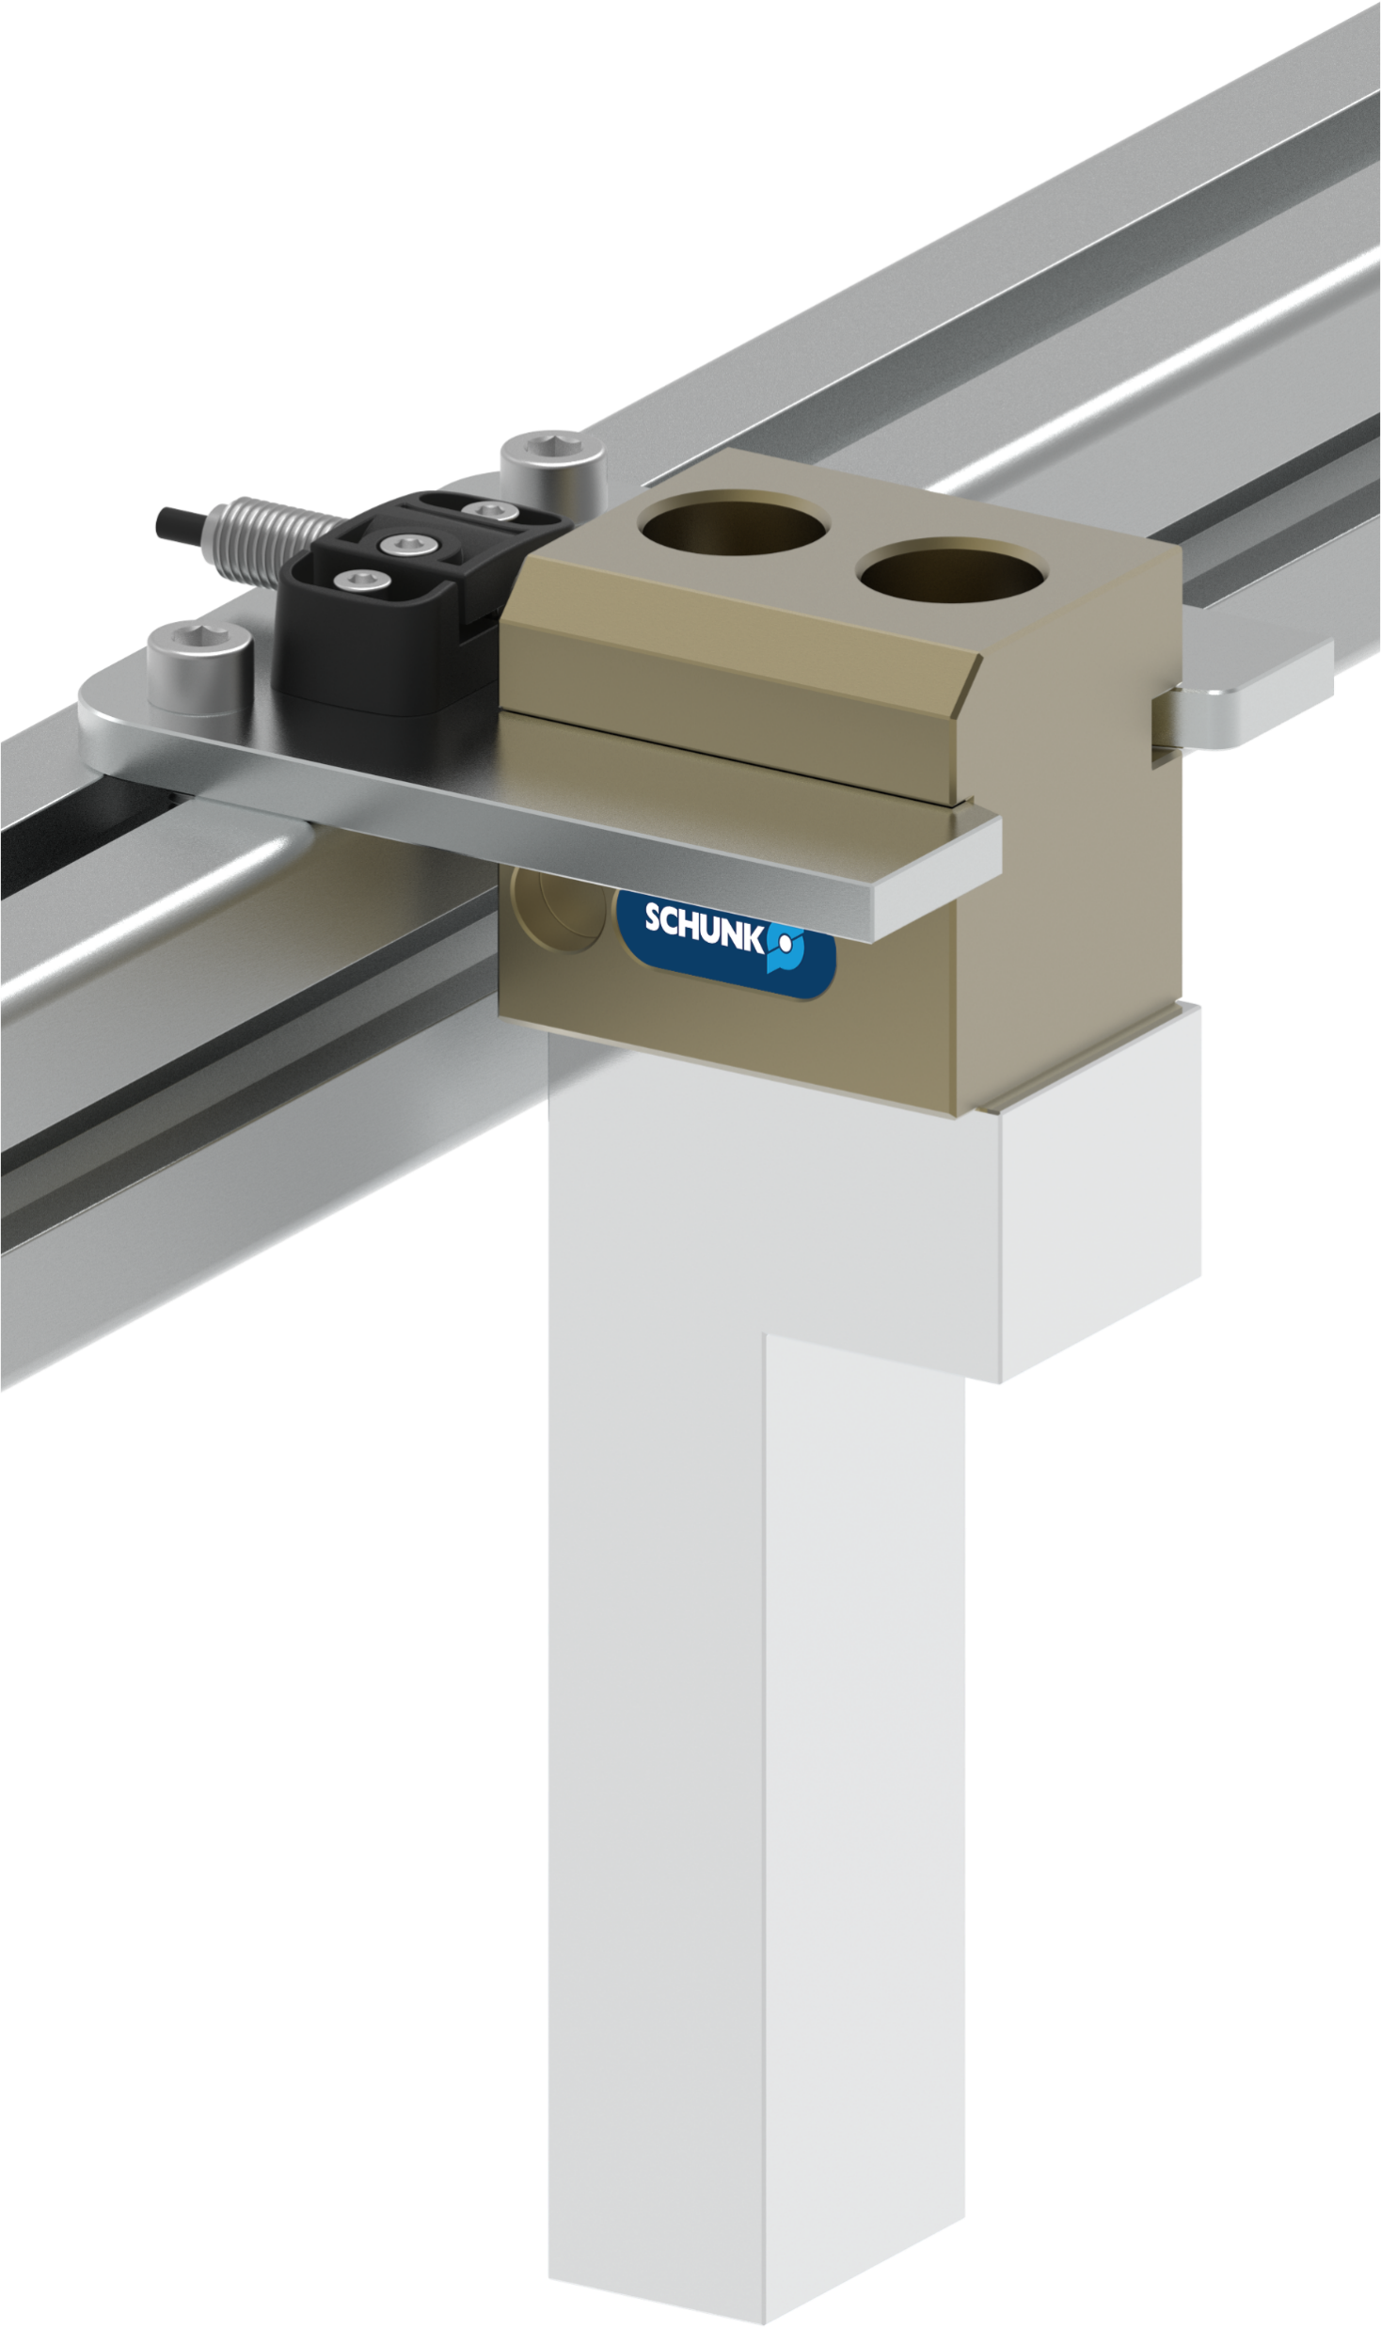
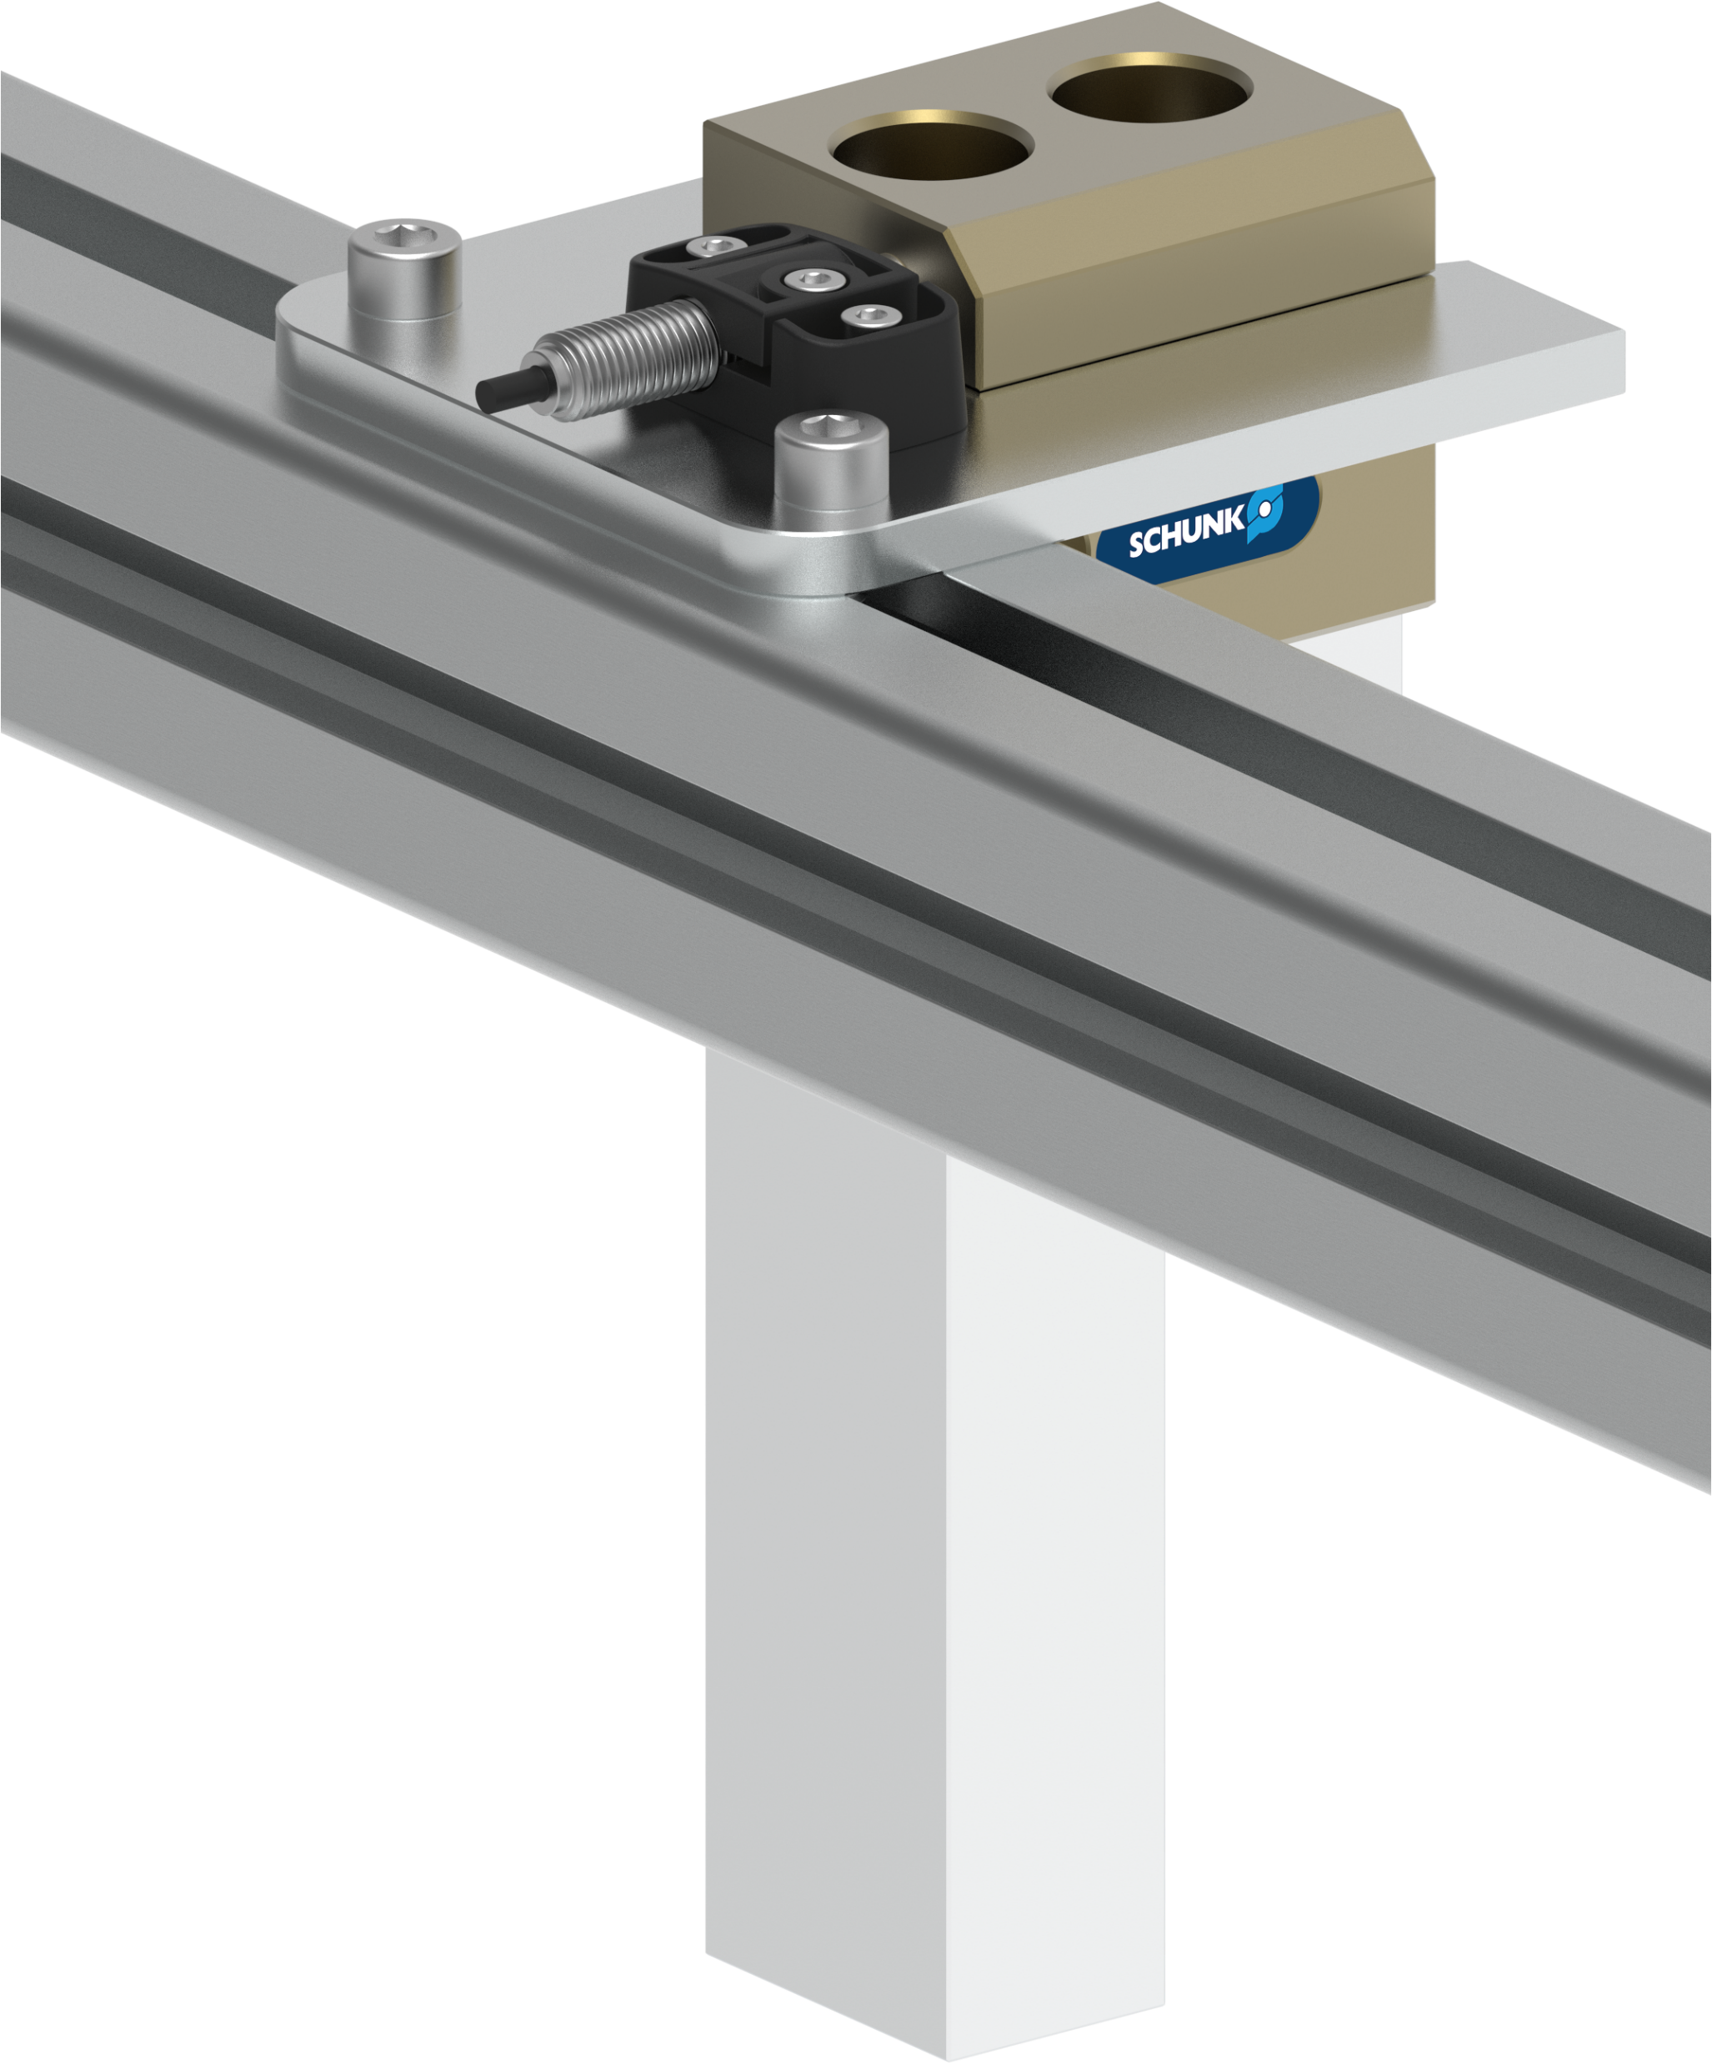
Presence control
Automatic jaw quick-change system – BSWS-R
Inductive detection for monitoring the presence of the basis in the storage station
To detect the presence of the BSWS-BR basis in the BSWS-SR storage station, the station can be equipped with an inductive proximity switch.

Slide 10
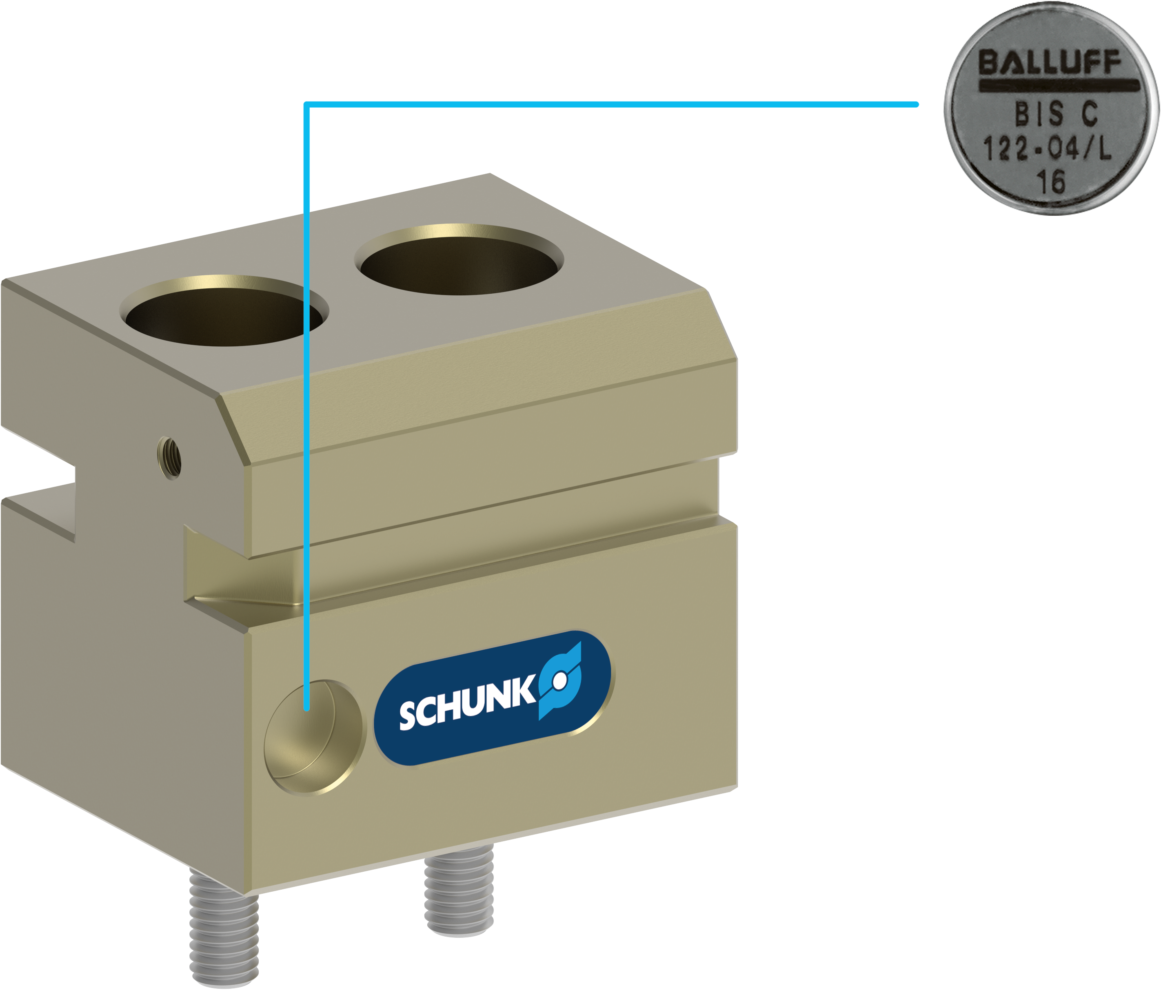
Coding
Automatic jaw quick-change system – BSWS-R
RFID data carrier for finger coding
The BSWS-BR basis is prepared for mounting an RFID data carrier. The RFID data carrier according to DIN 69873 enables the coding of the workpiece-specific gripper fingers.

Slide 11

Advantages – Your benefits
Automatic jaw quick-change system – BSWS-R
Automatic change of gripper fingers simple, energy-free and without manual action, simply by the movement of the robot
Also suitable for operation on cobots storage station prevents overloading of the robot through elastic bearings
PGN-plus-P fingerprint enables universal use and retrofitting for a wide range of gripper series
Simple finger design a screw through the gripper fingers is no longer necessary, only a thread has to be inserted into the finger
Process reliability by sensing the presence of the gripper fingers in the storage station by an inductive proximity switch
No mixing up of the gripper fingers due to finger coding using an RFID data carrier

