Slide 1

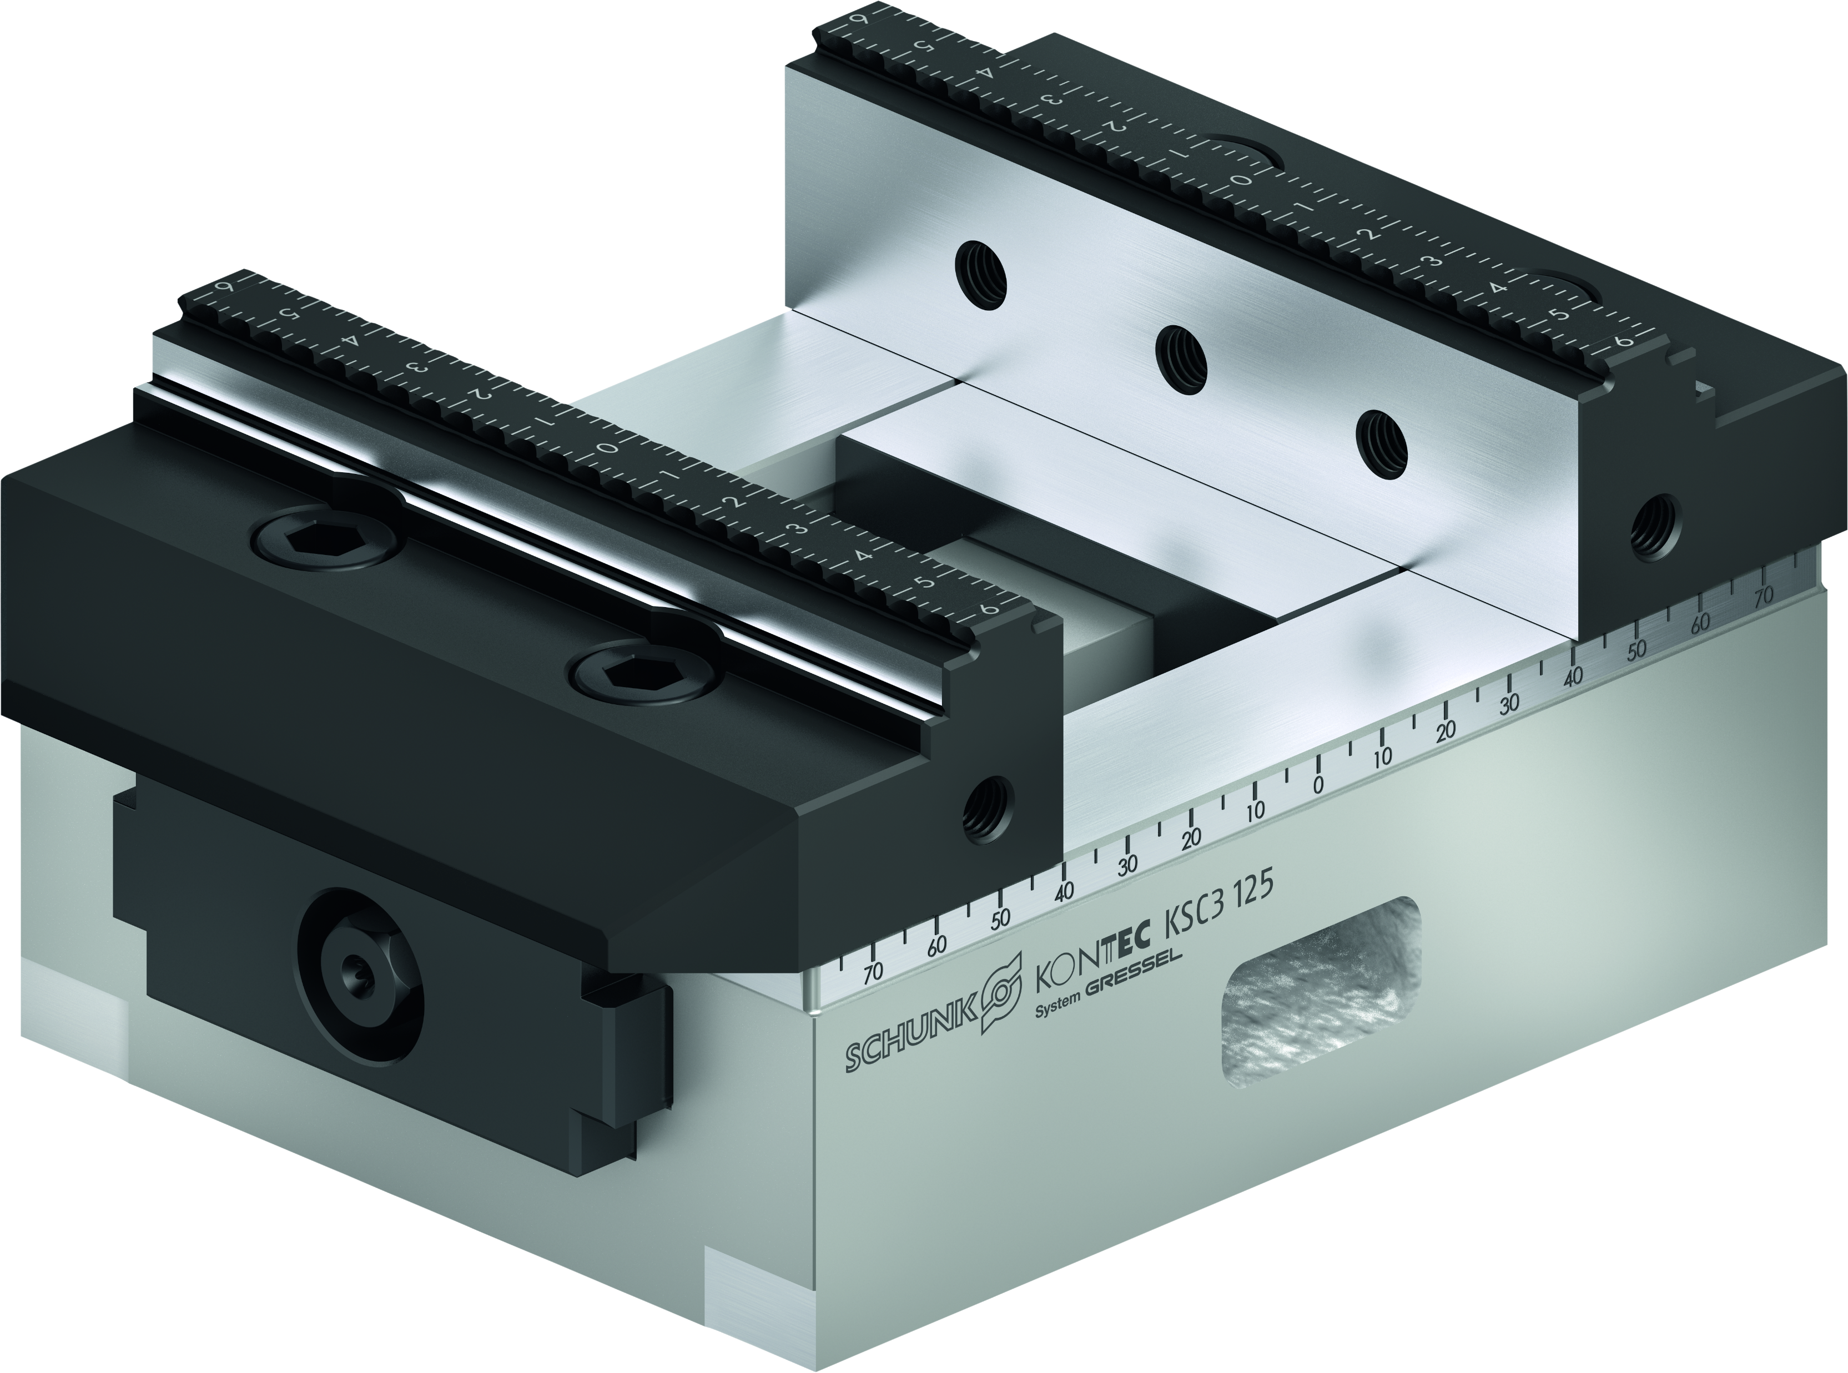
KONTEC KSC3
Proven maximum Precision with even higher Process Reliability

Slide 2

Highlights
KONTEC KSC3
Nickel-plated base body for optimal corrosion protection
High clamping forces and high precision
Optimized interfering contour for some sizes
Wide range of system and top jaws
Laser-etched ruler
Large clamping range

Slide 3
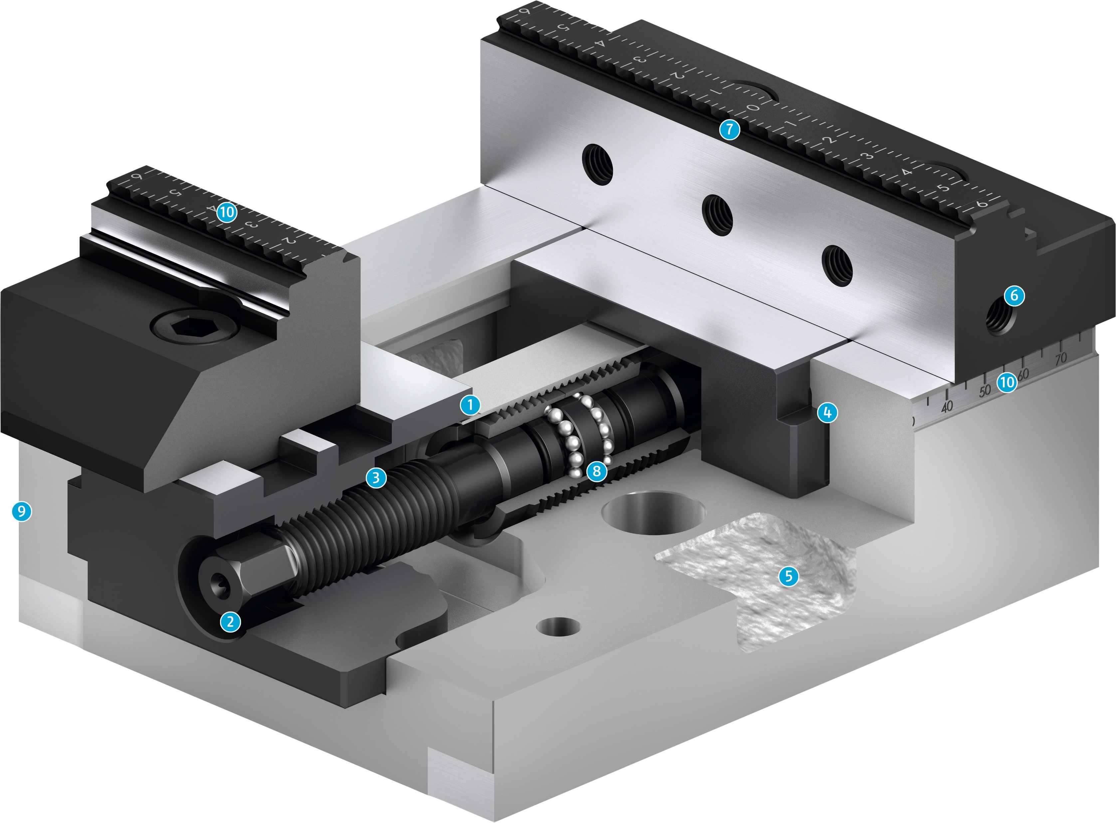
Sectional diagram
KONTEC KSC3
Closed System
Recessed hexagonal connection
Spindle drive
Long slide
Drainage slots
Mounting threads
System jaws with grip step and and smooth clamping surface
Ball bearing mounted, backlash free spindle
Low height
Laser-etched ruler
1
2
7
3
10
4
6
5
6
1
4
10
7
3
8
9
5
8
2
9
10

Slide 4
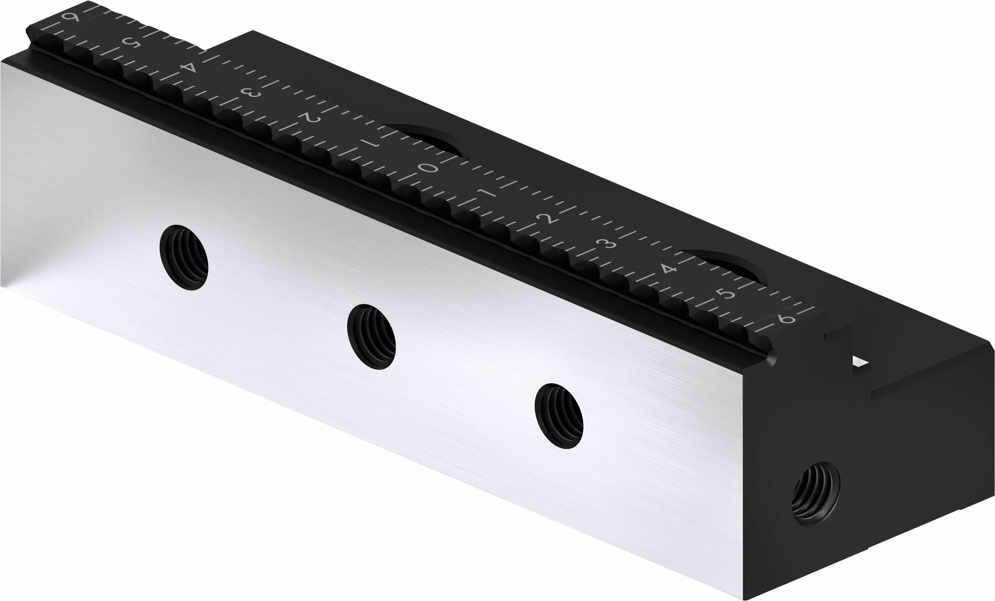
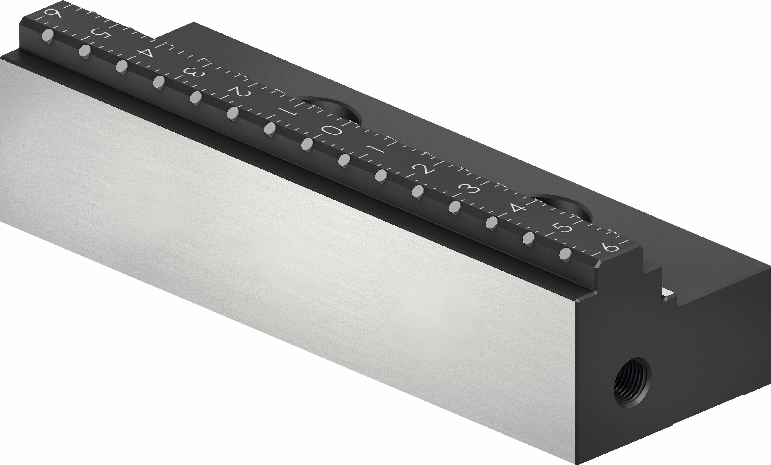
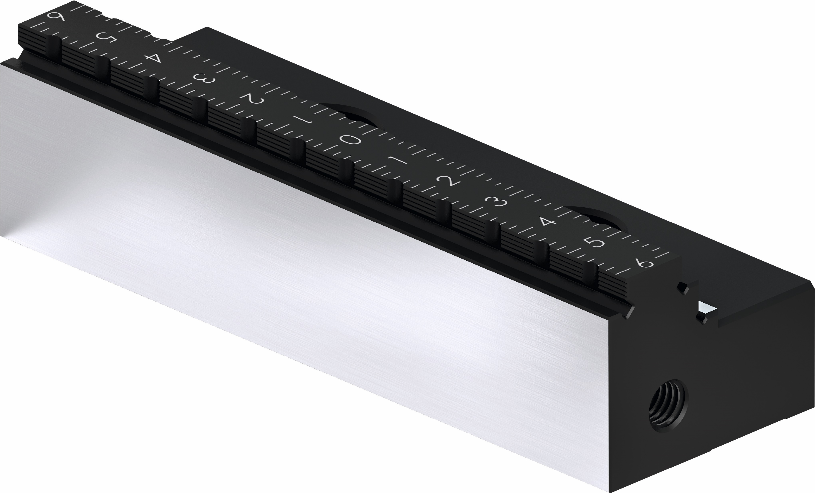
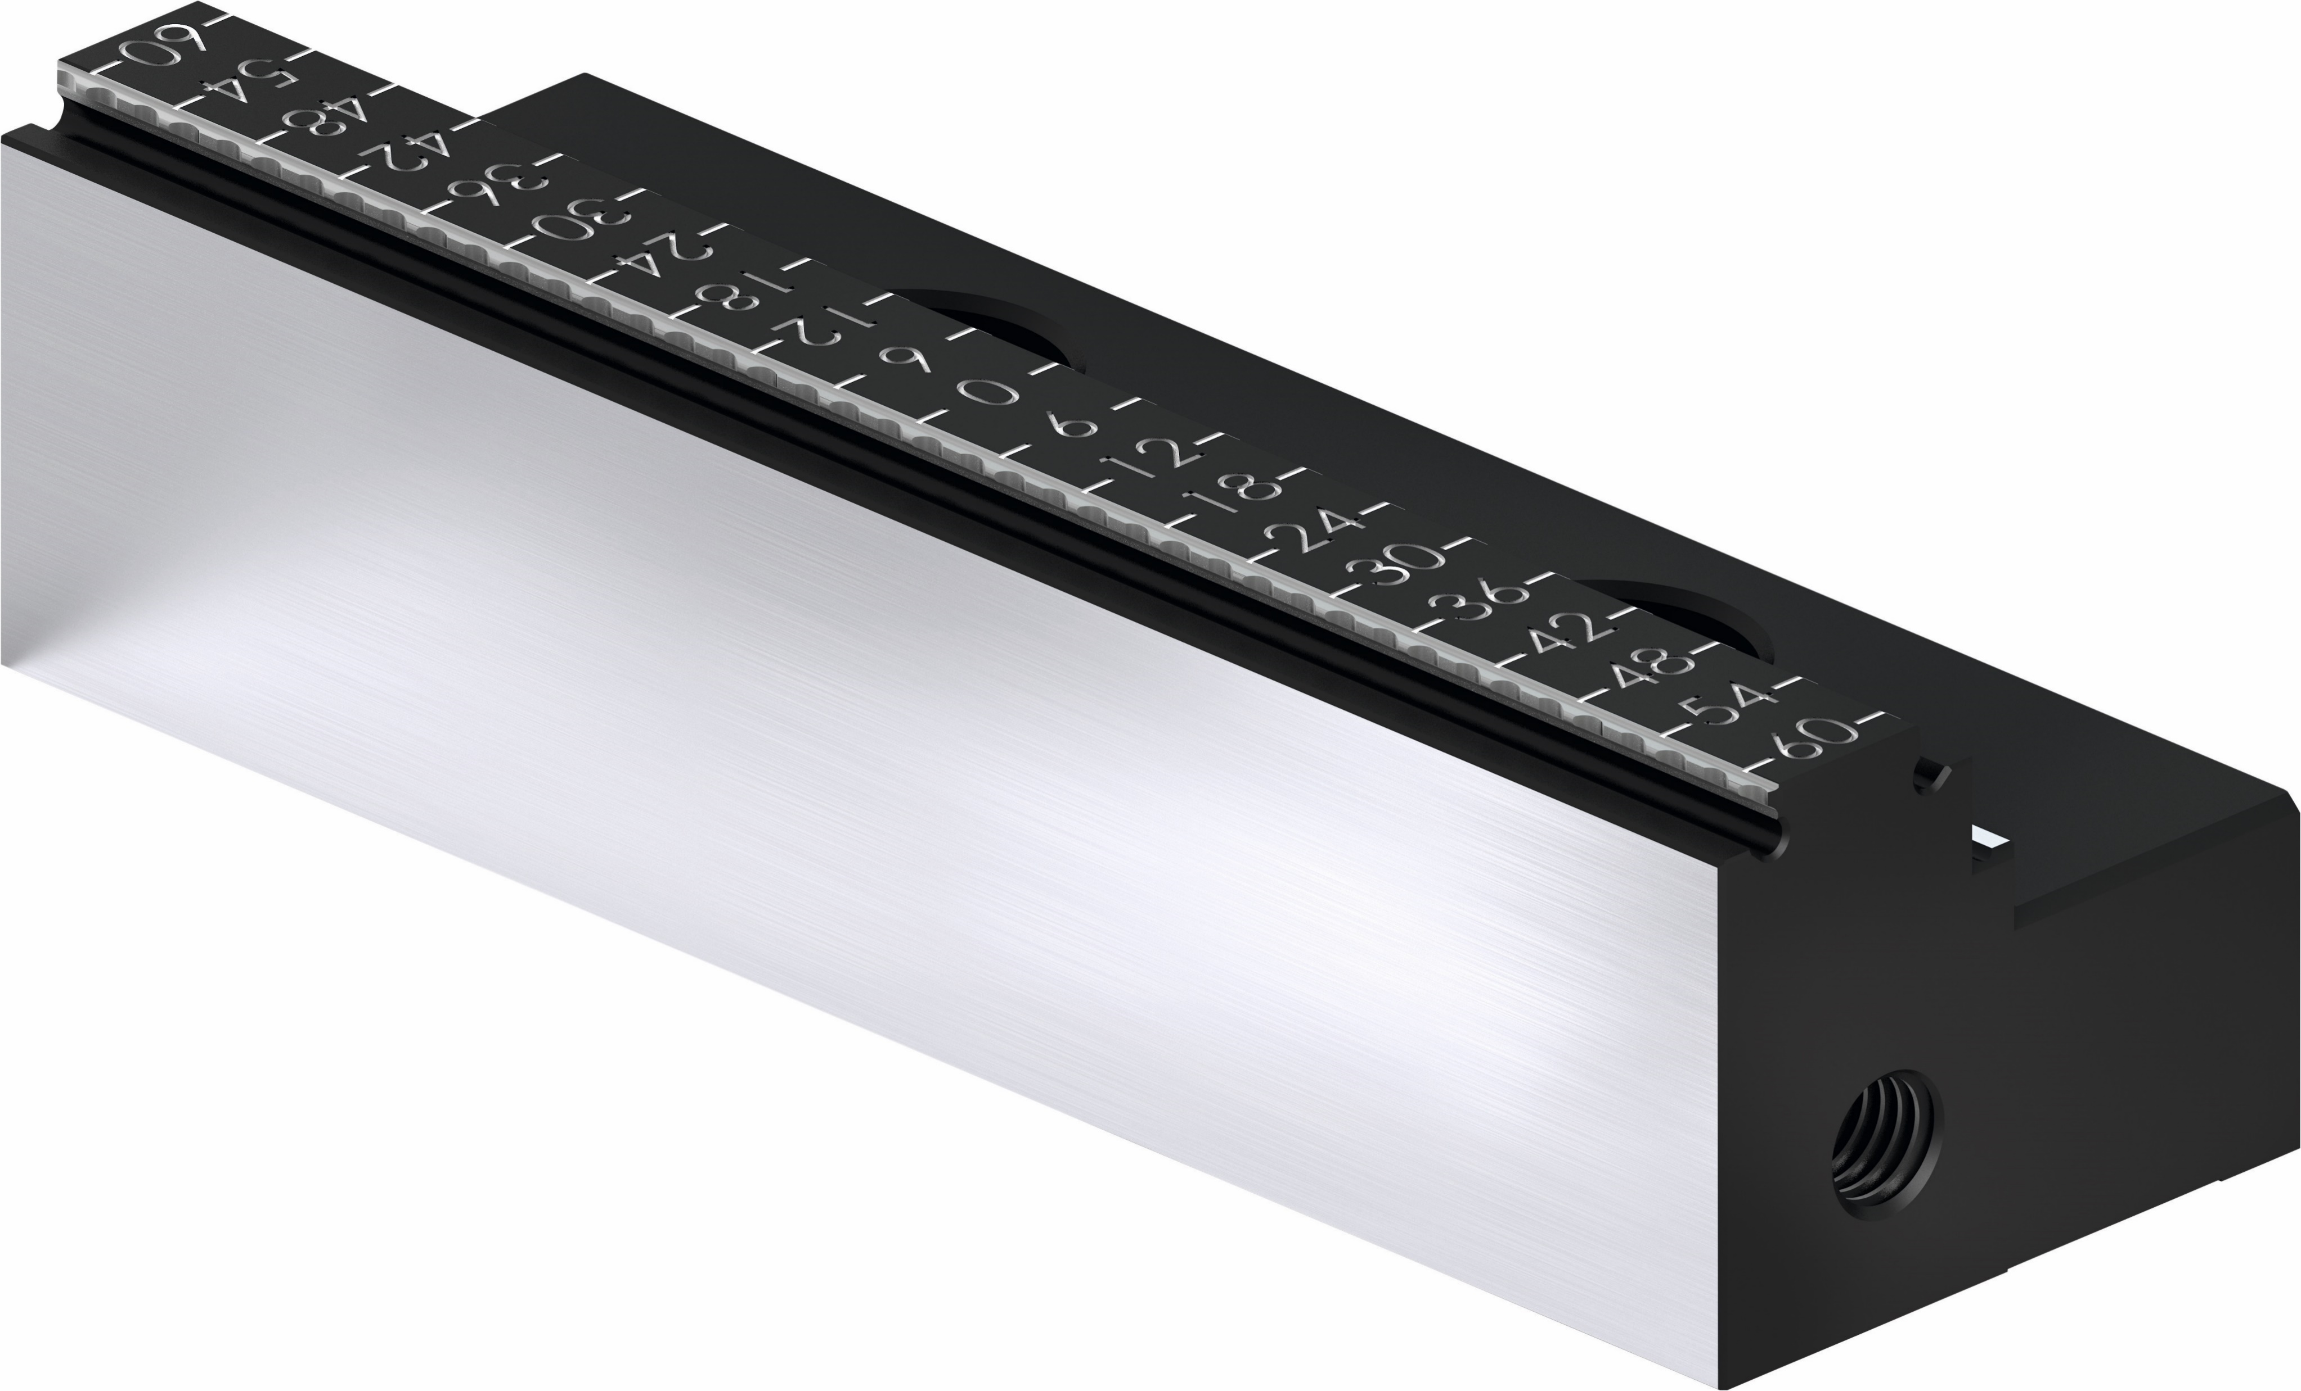
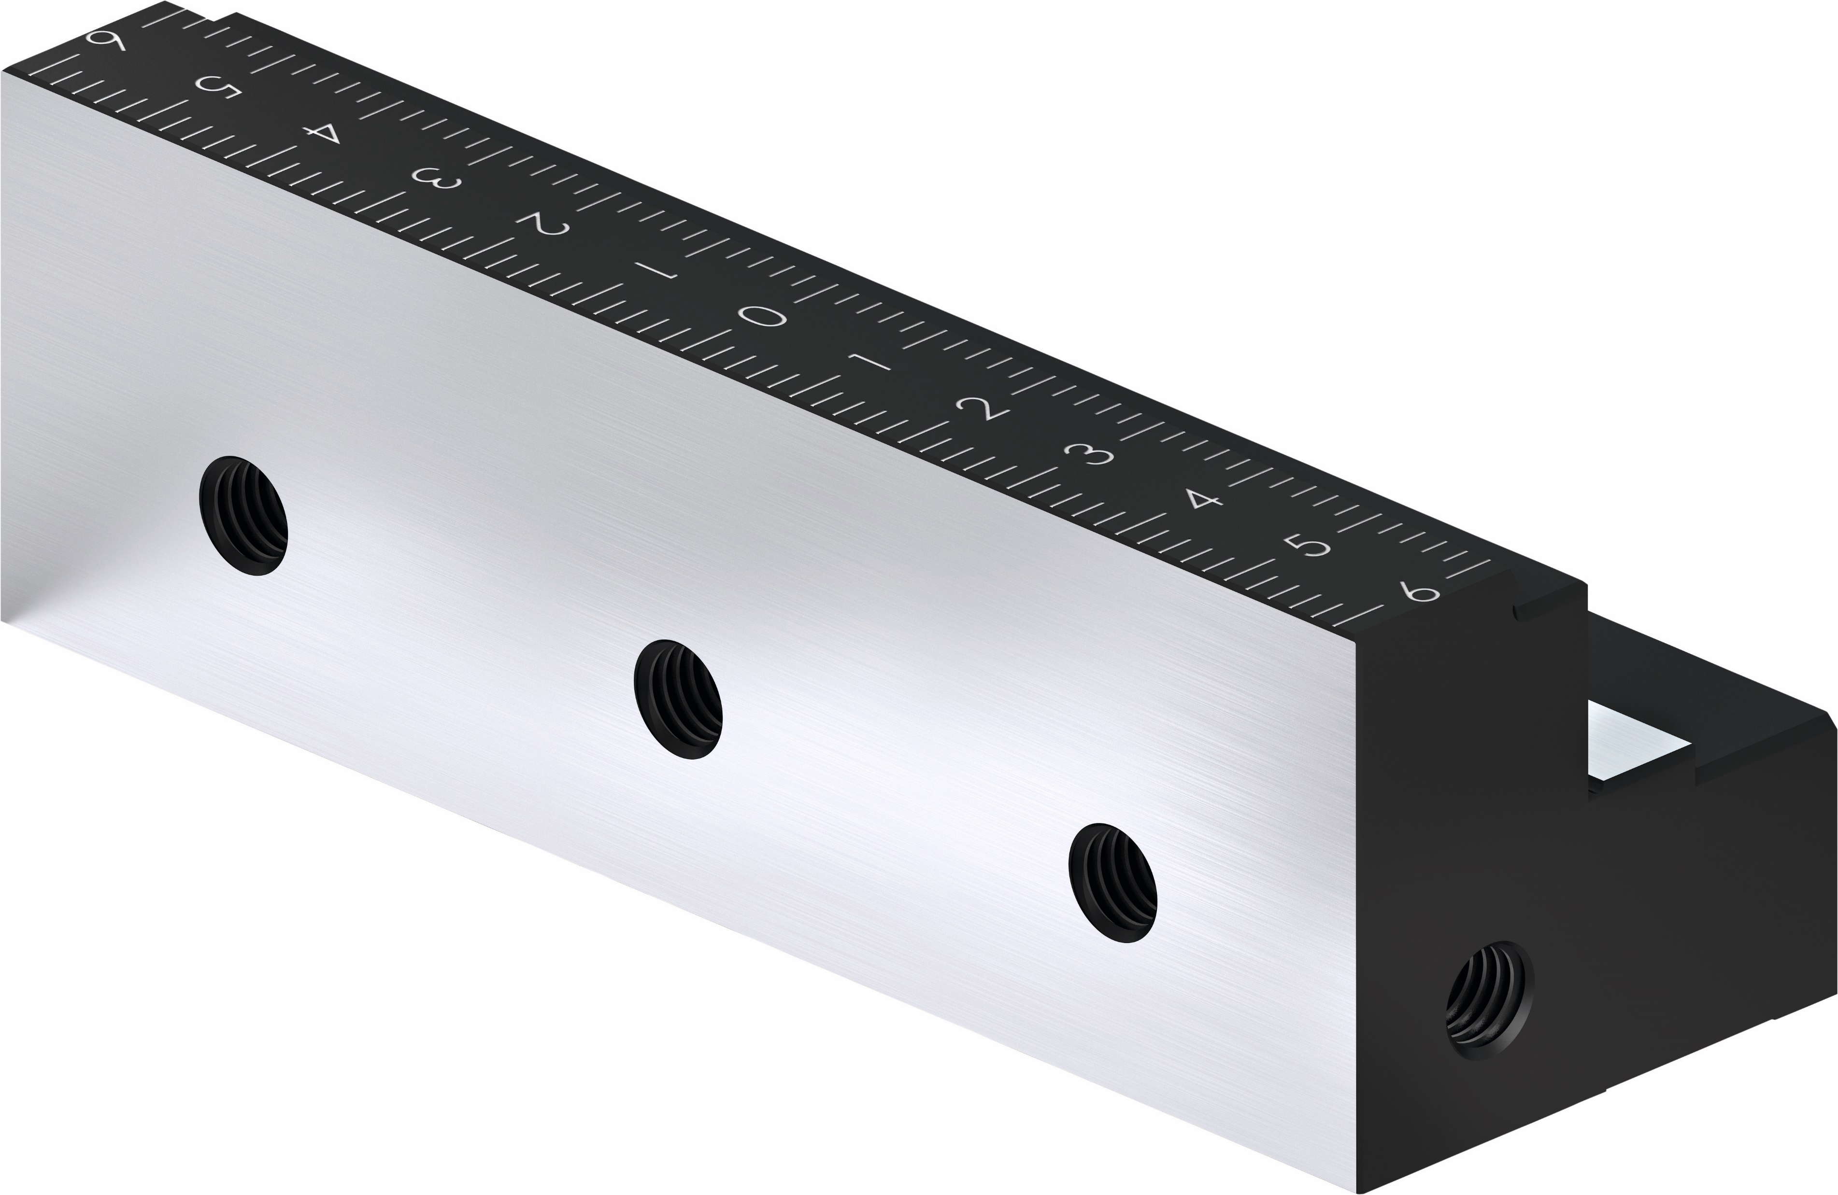
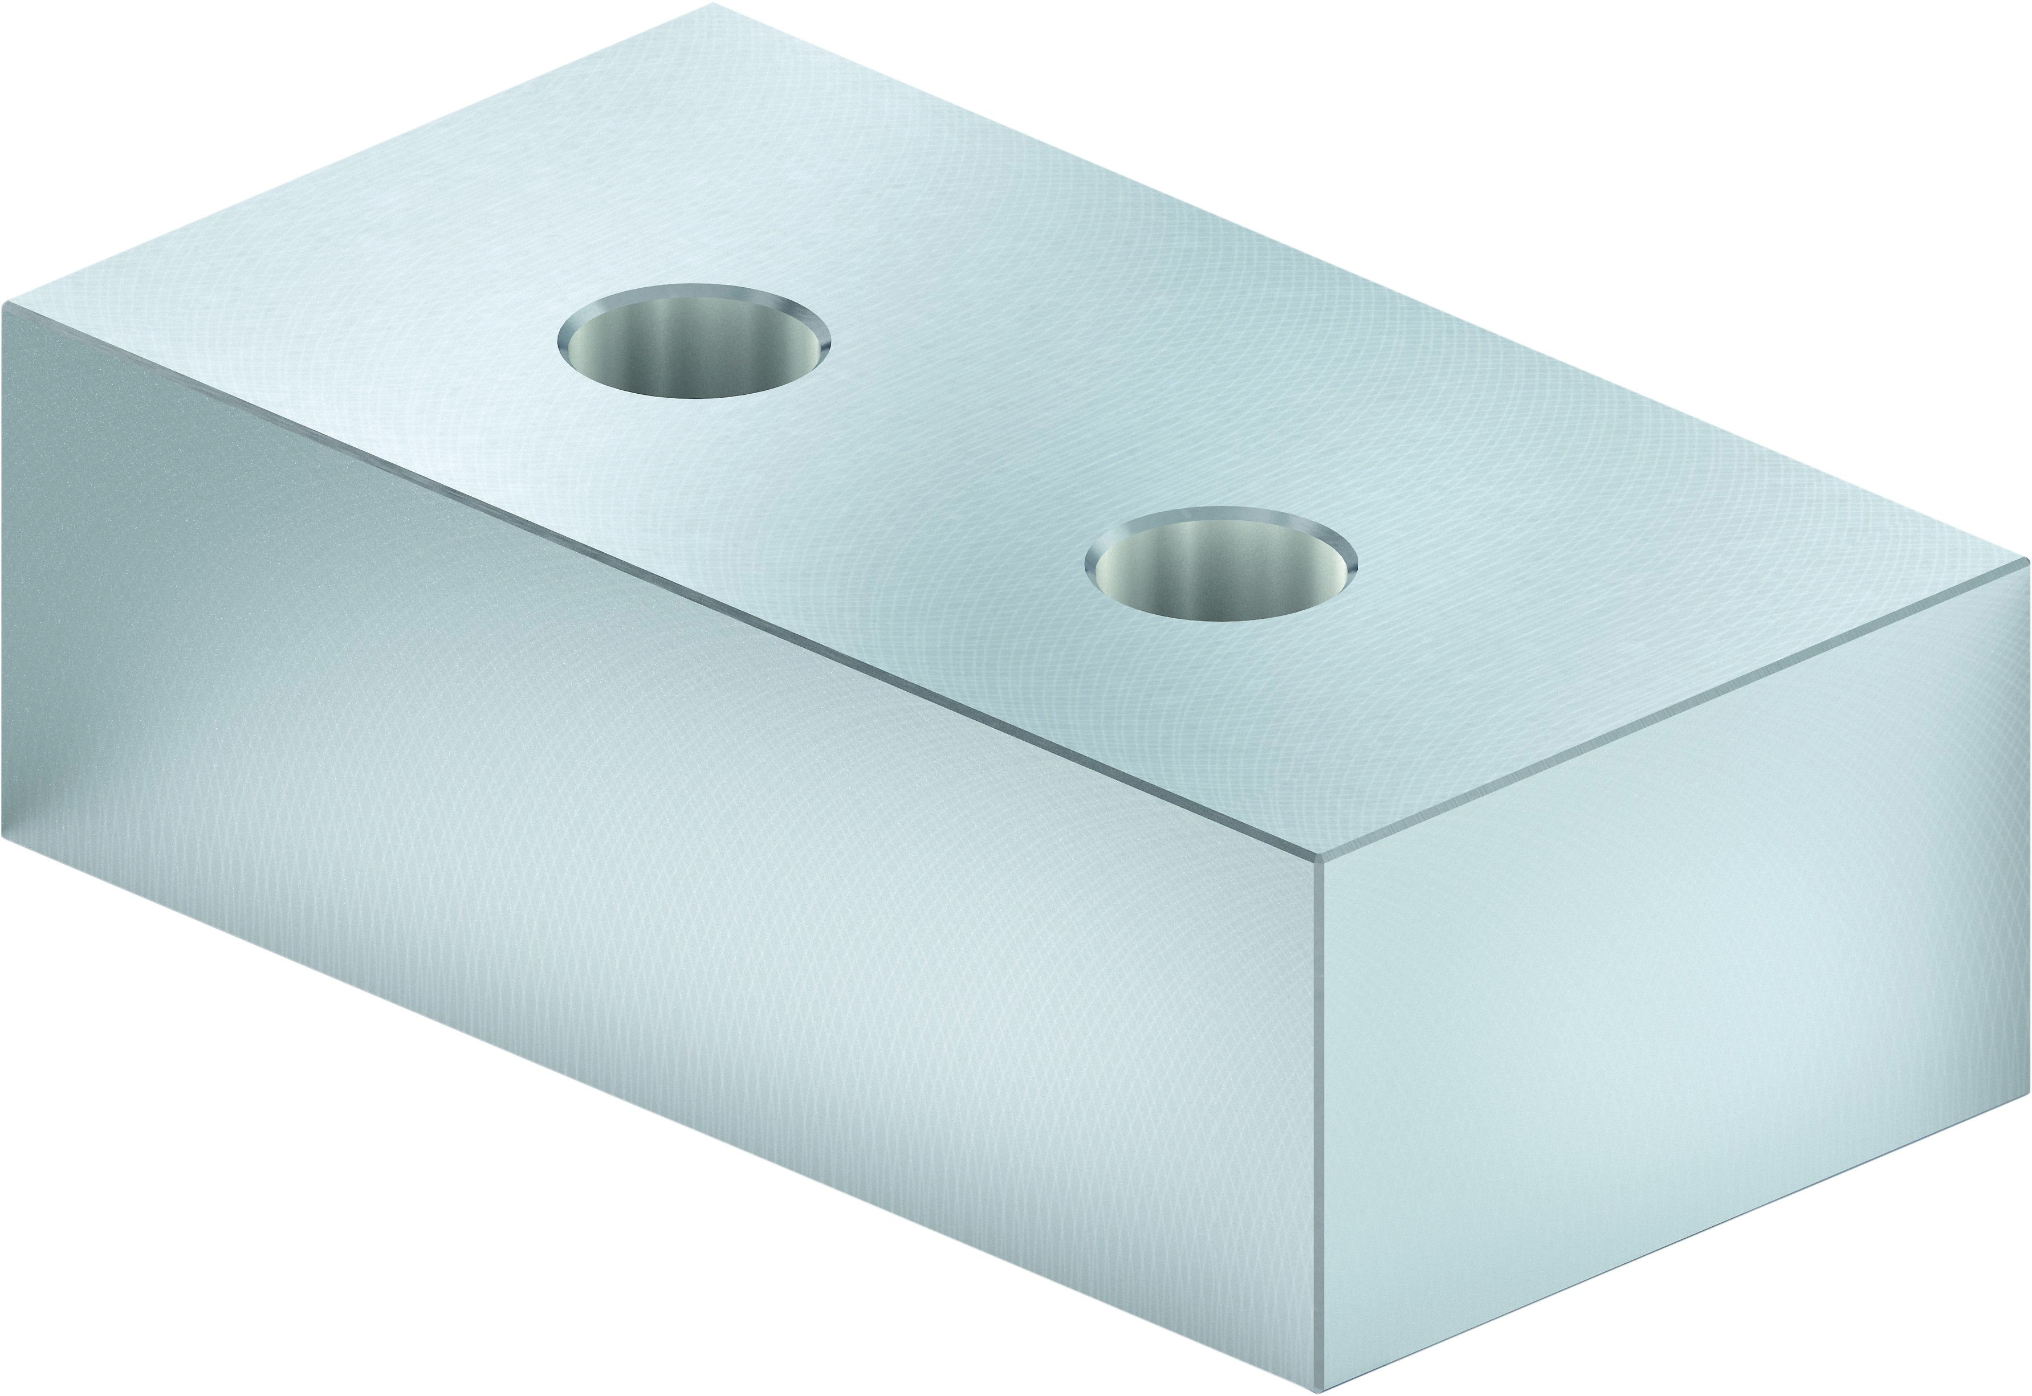
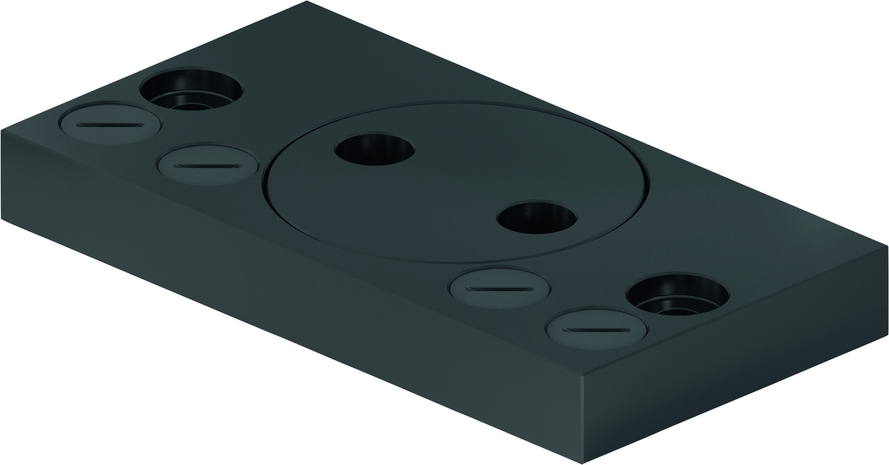
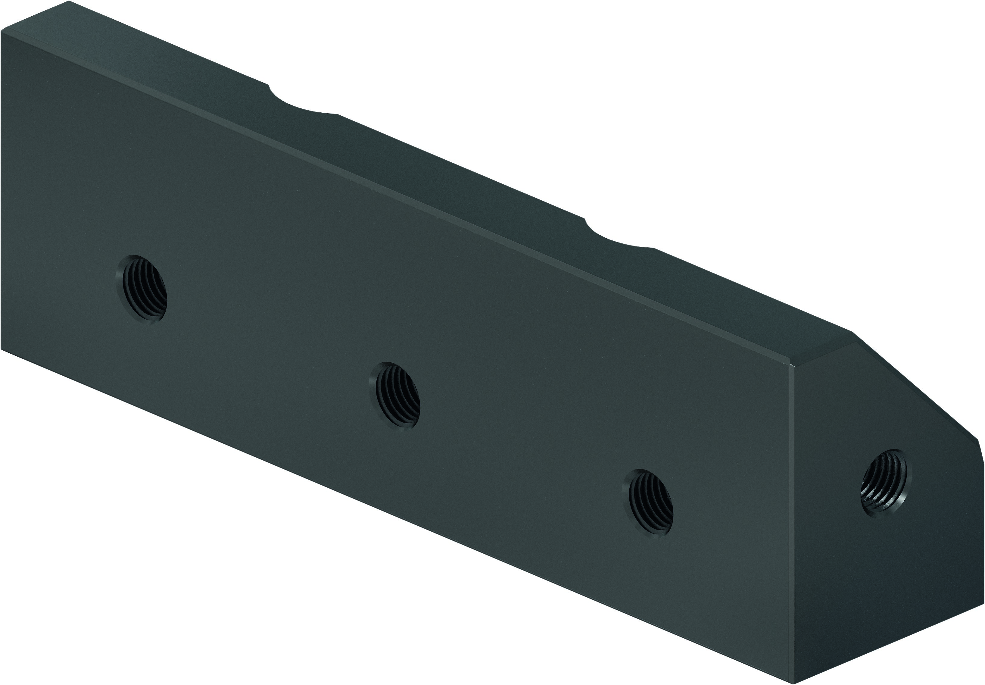
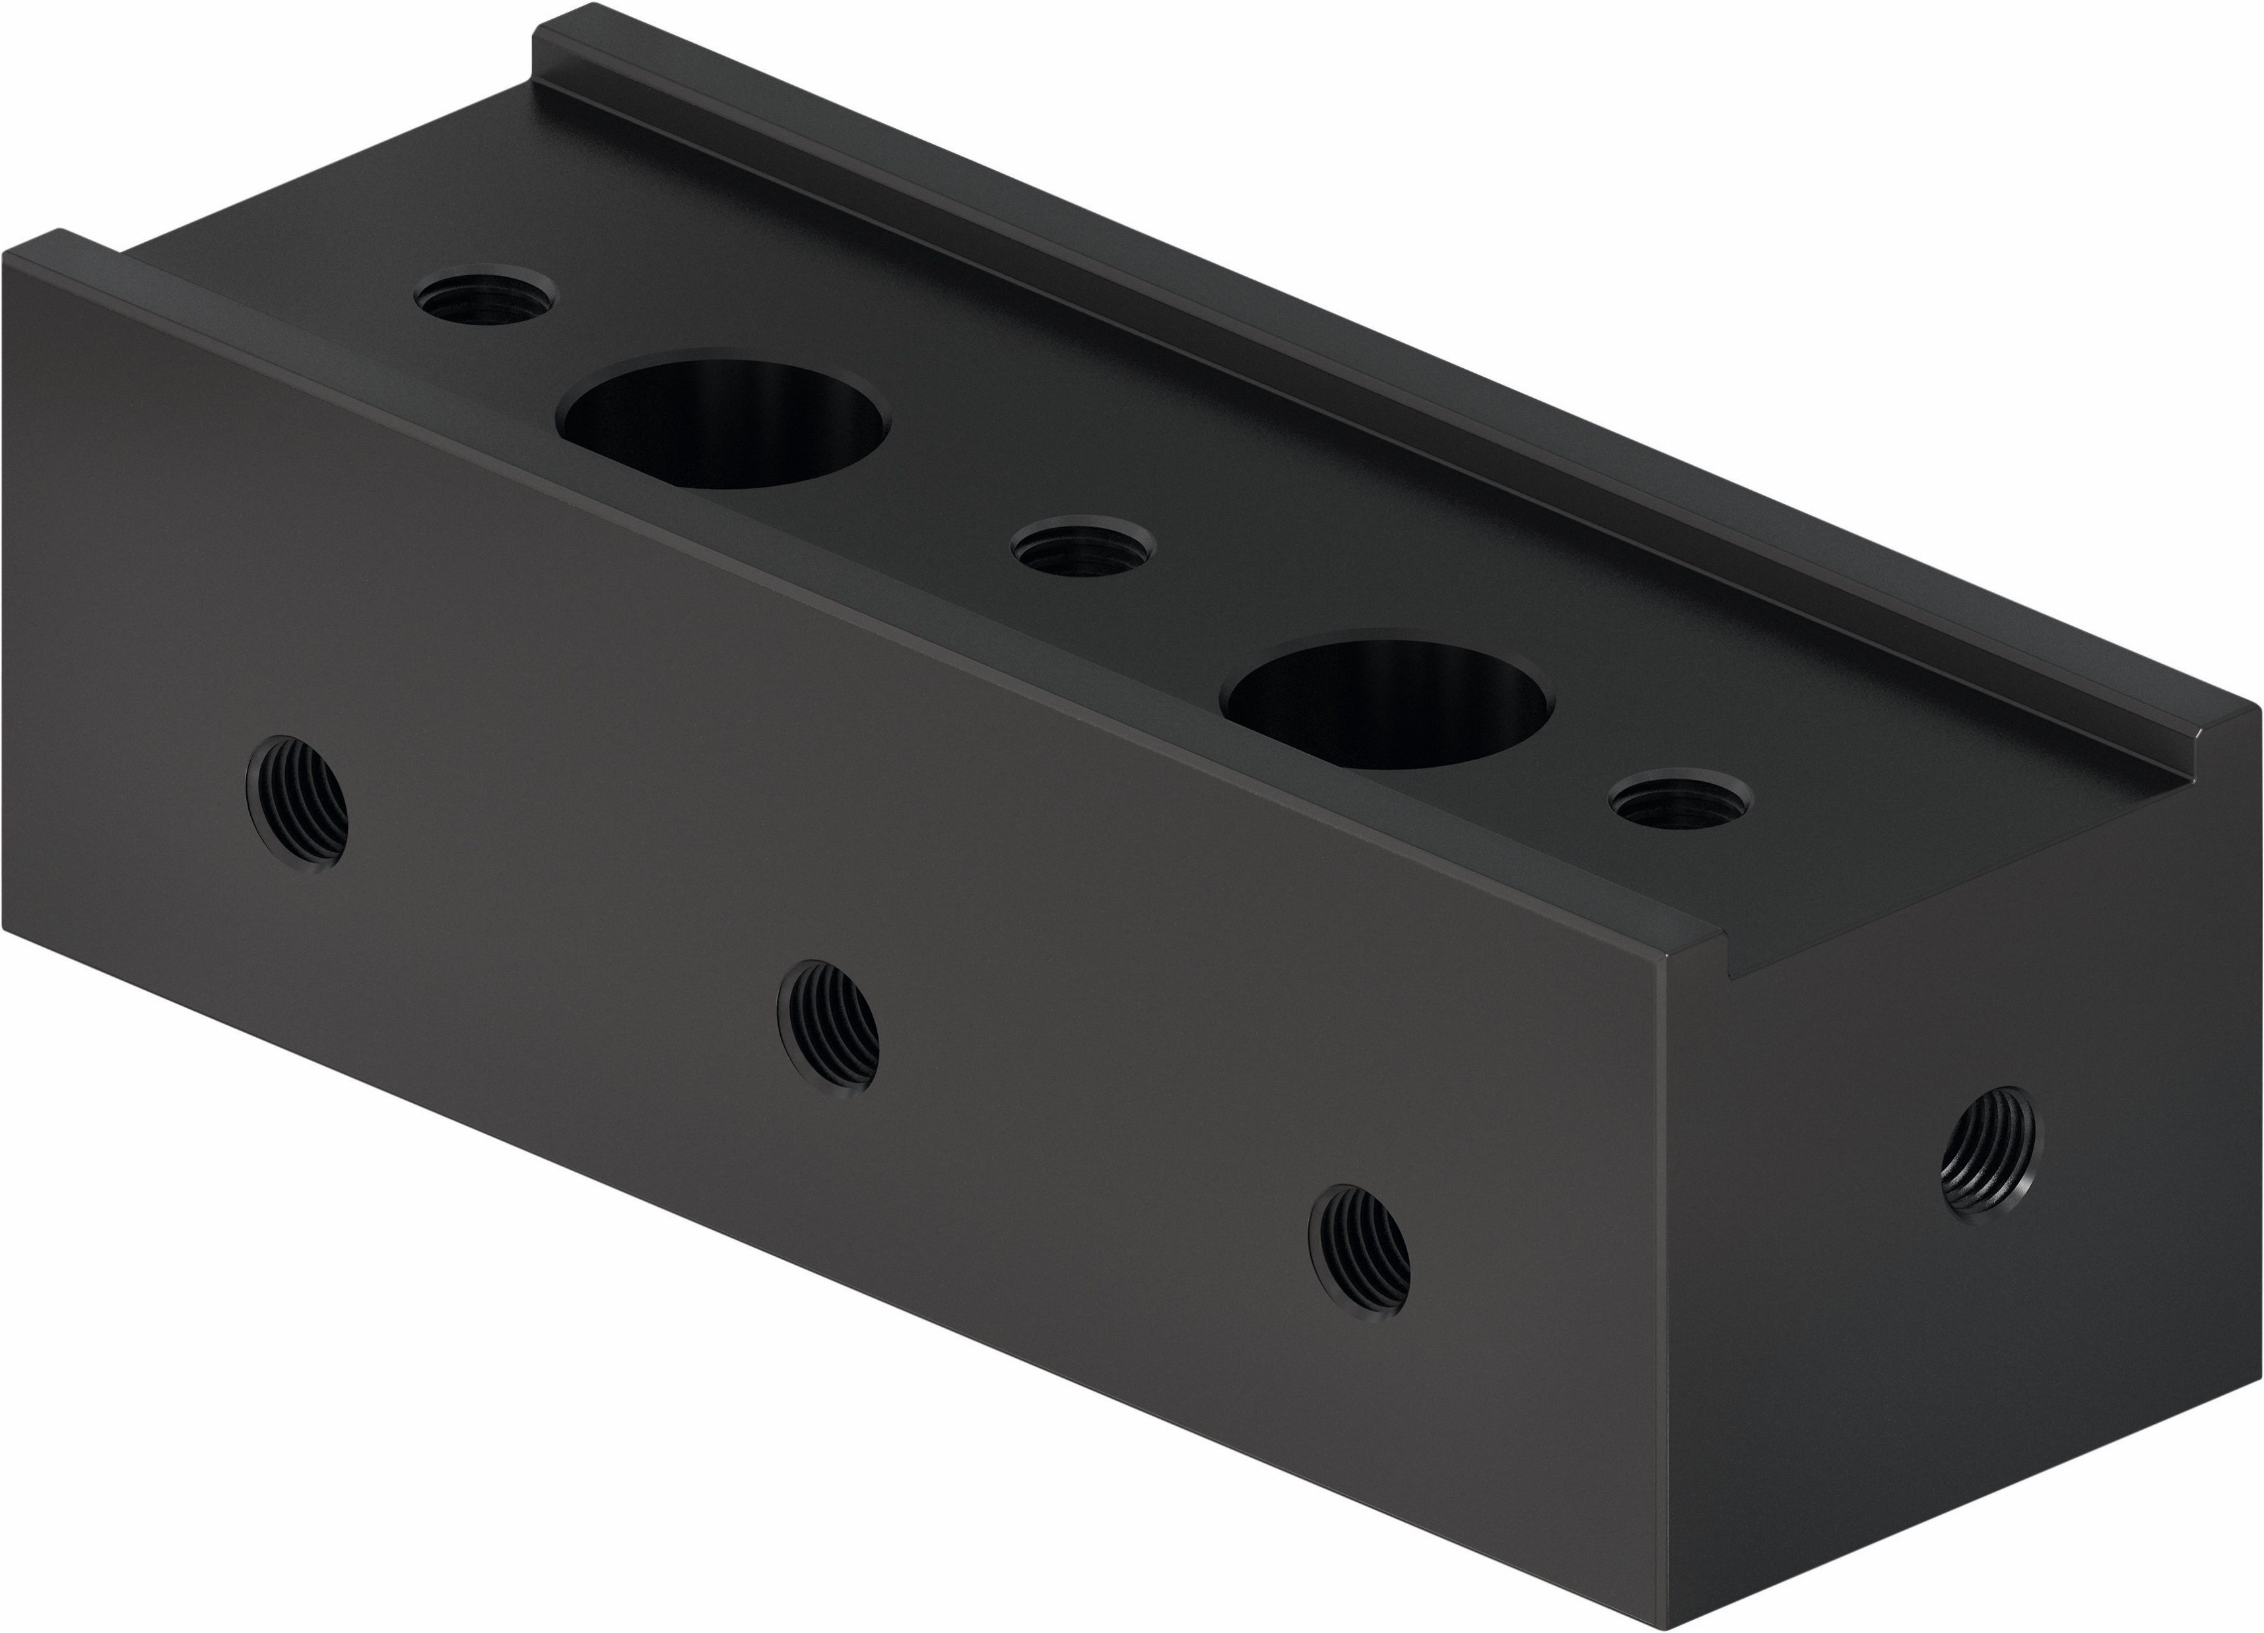
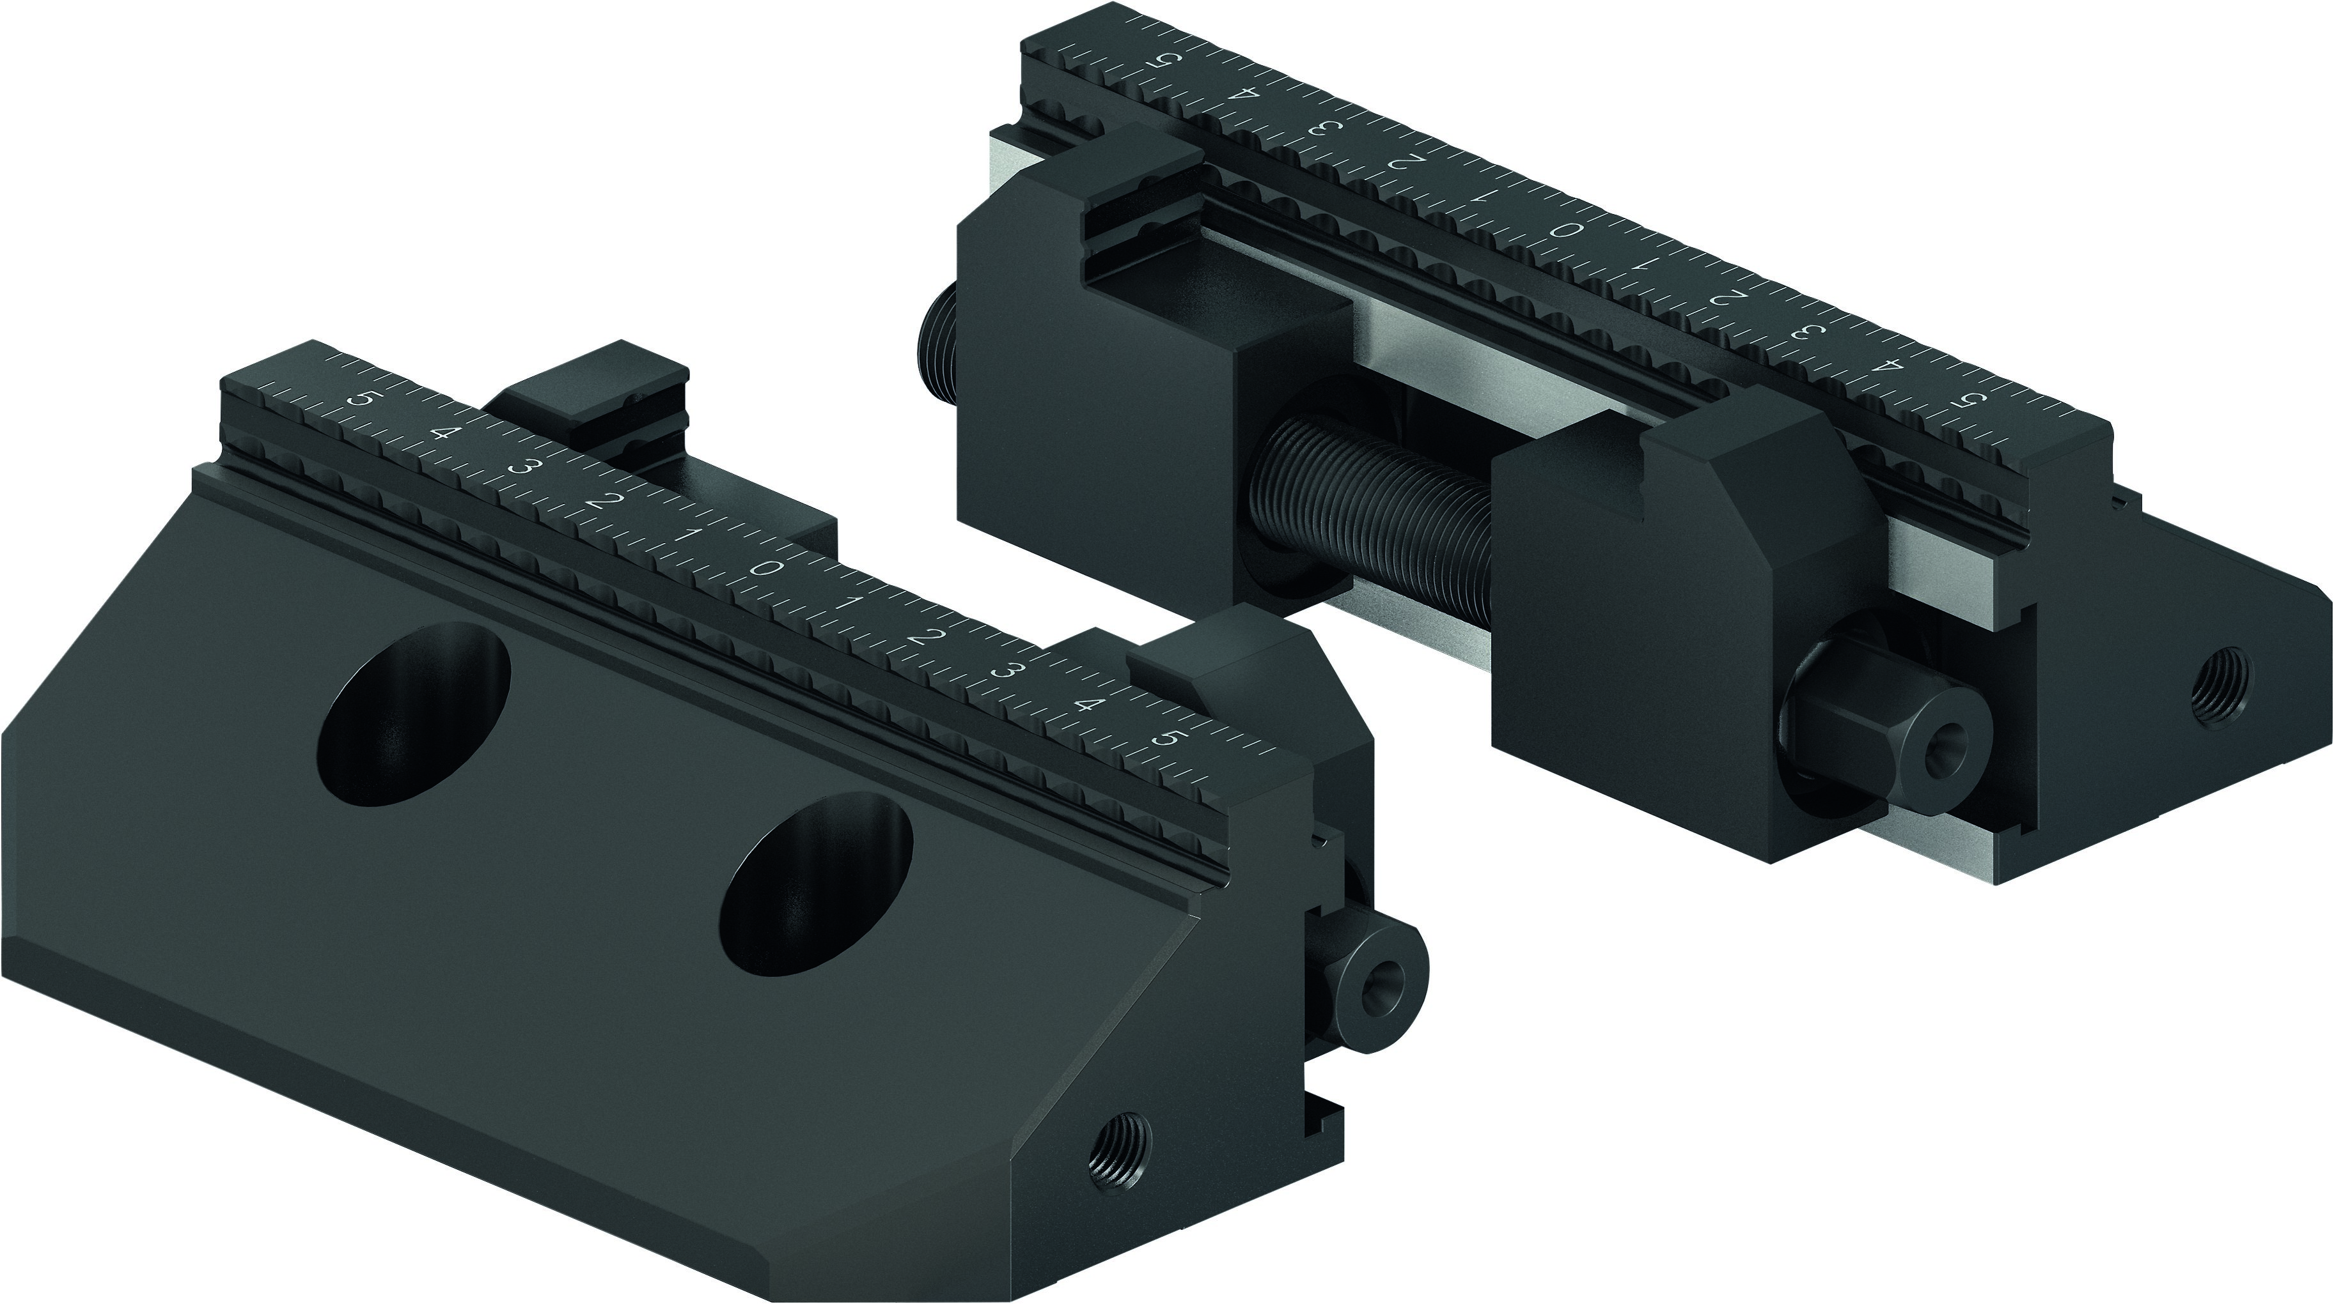
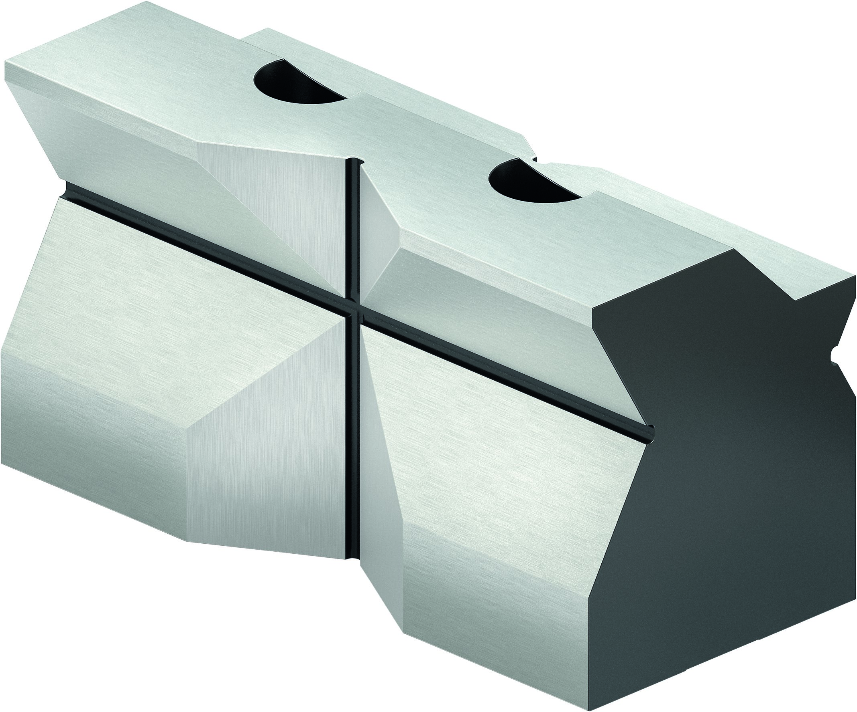
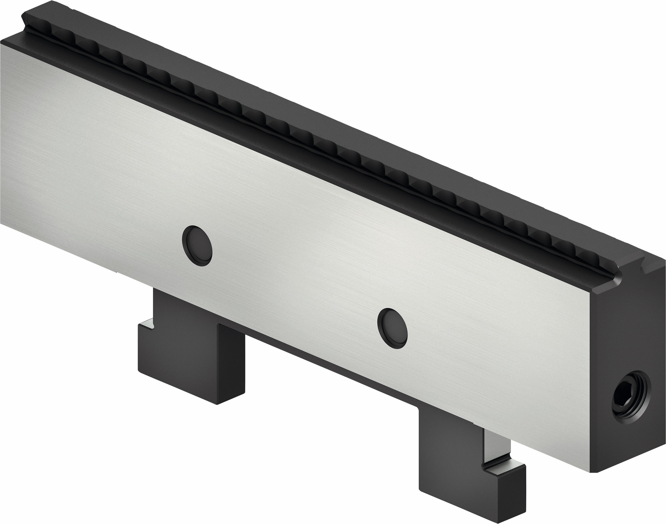
System jaws
KONTEC KSC3
Reversible grip jaw | Reversible jaw carbide-grip | Reversal jaw soft-grip | Reversible jaw with embossed profile
Reversible jaw | Alu jaw | Swivel and Adapter plate | 5-axis jaw
Combi jaw | 6-fold jaw system | Prismatic jaw | Central jaw grip

Slide 5
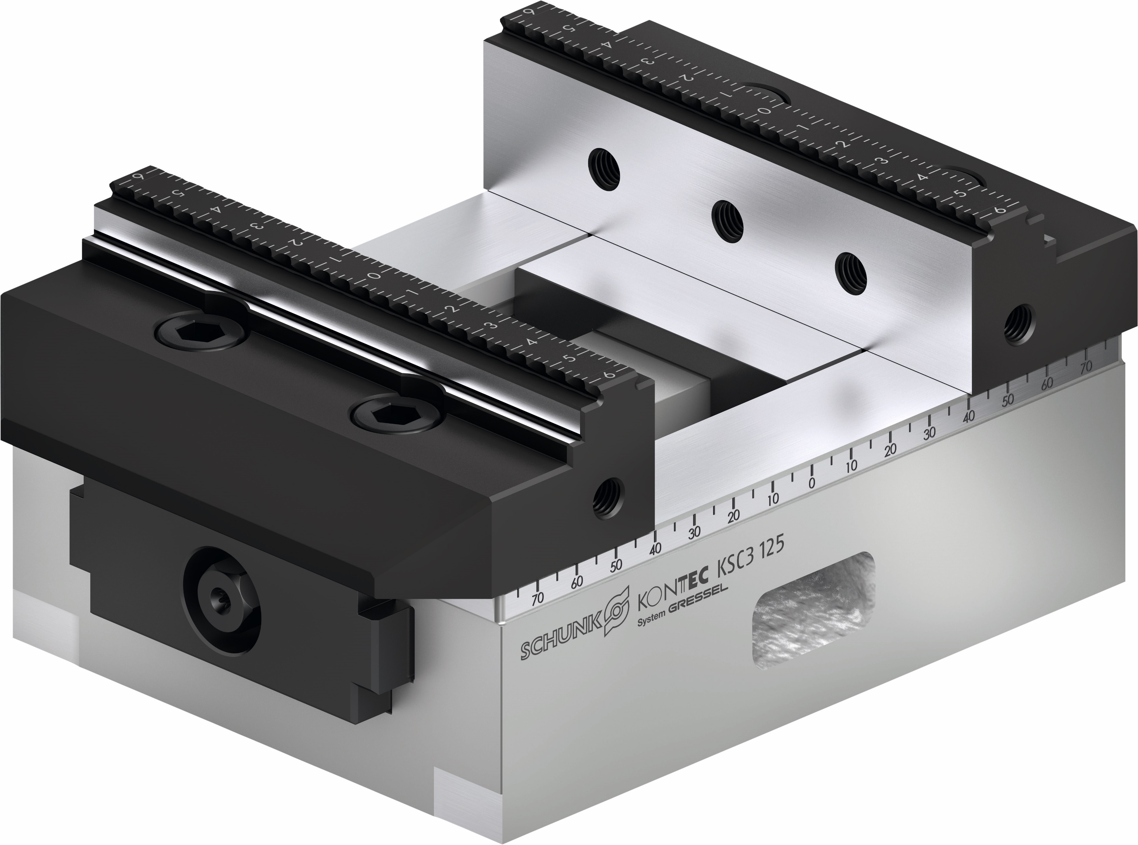
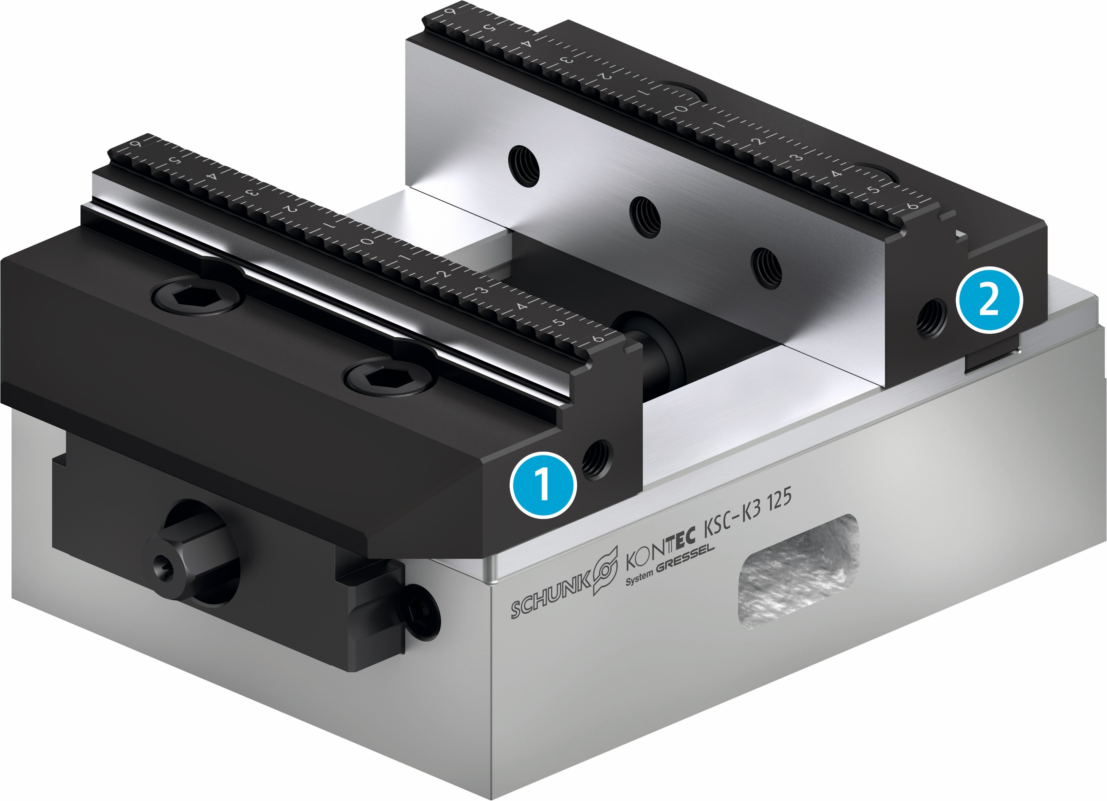
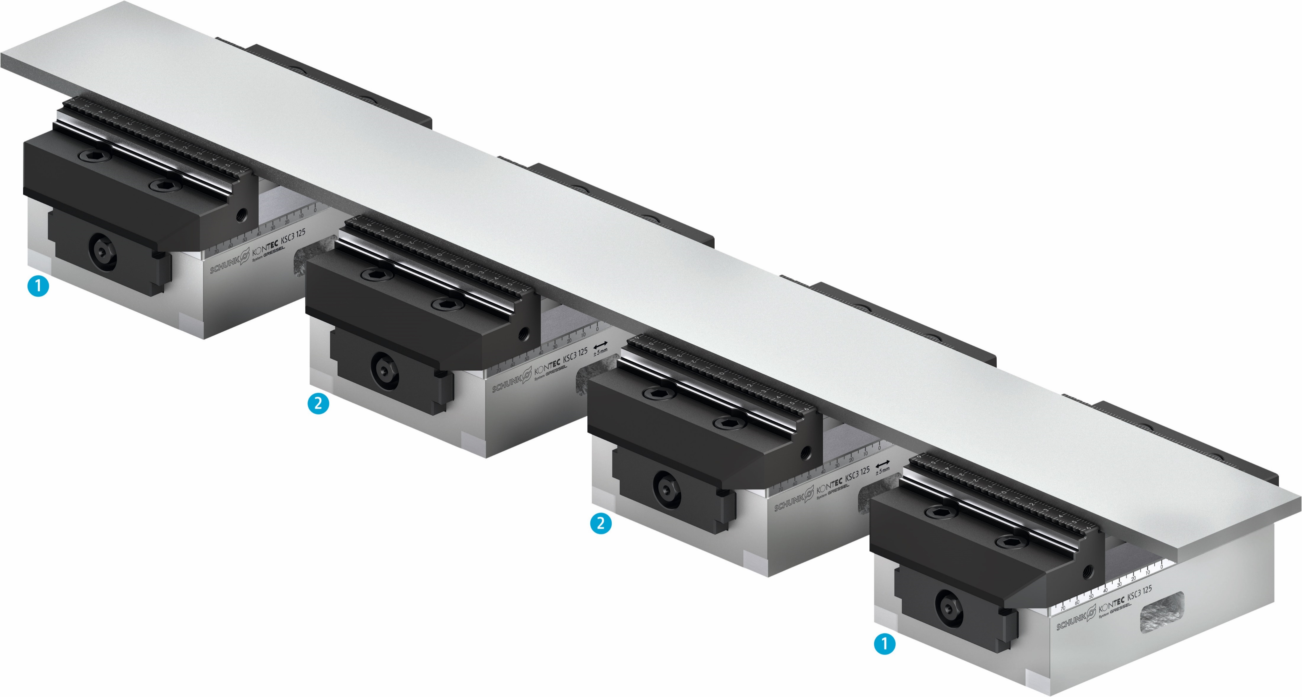
Versions
KONTEC KSC3
2
1
1
2
2
1
Centric Clamping Vise
The KSC3 is a centric clamping vise in the standard version.
Single-Acting Vise
Specifically for the second-side machining, the KSC3 is also available as a single-acting vise. The base body of the KSC-K3 has a fixed jaw with a continous traverse groove in the base body.
Floating Version
Due to the compensation, the system jaws contact the workpiece and holt it in position. This counteracts vibrations and deformations when clamping long workpieces.
1
Centric vise
1
Movable jaw
2
Floating version
2
Fixed jaw

Slide 6
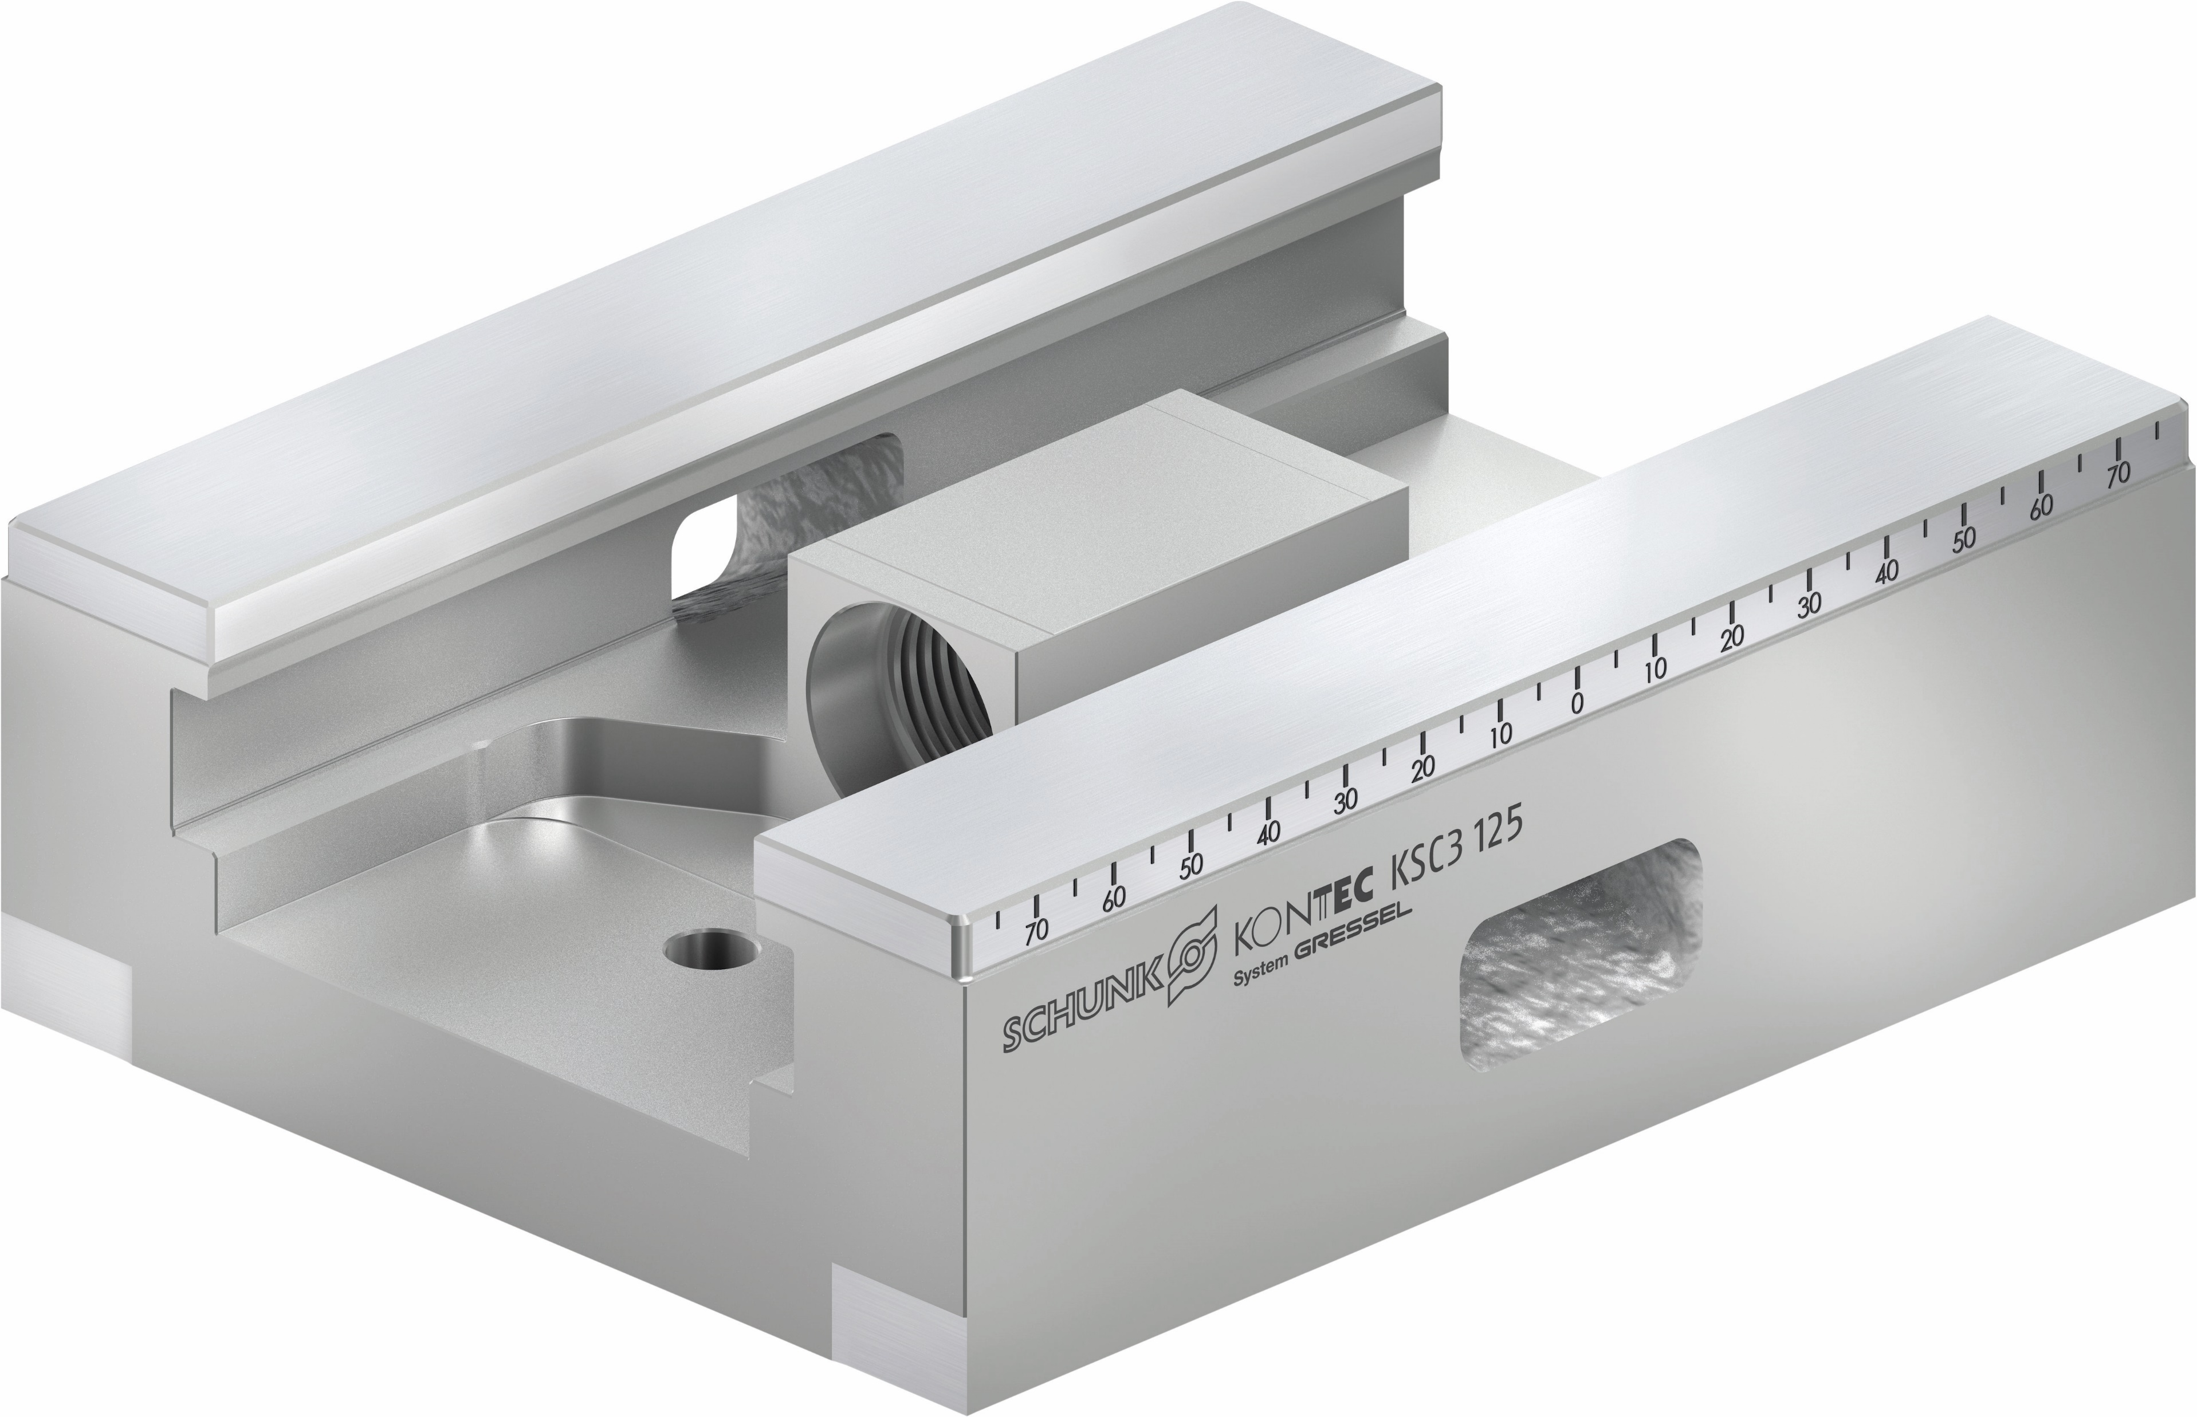
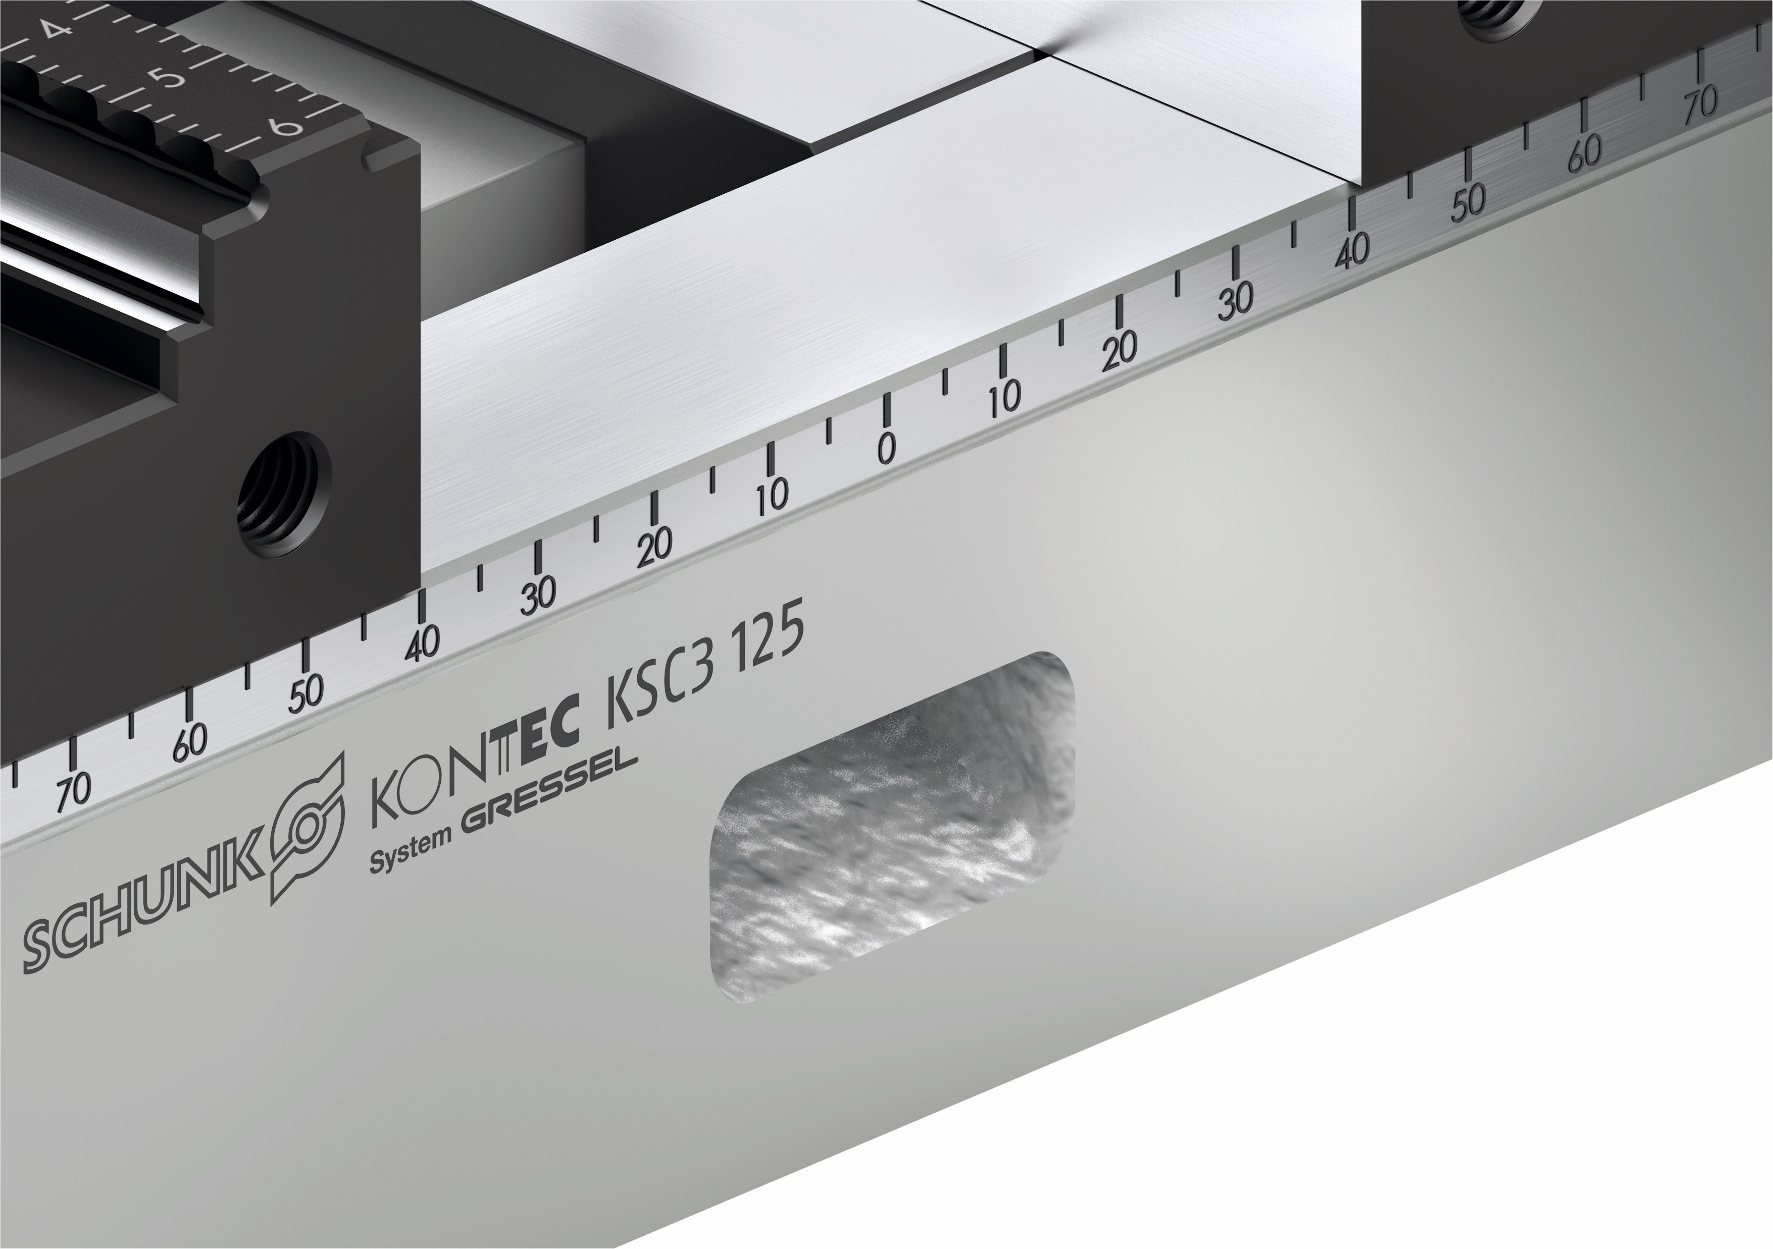
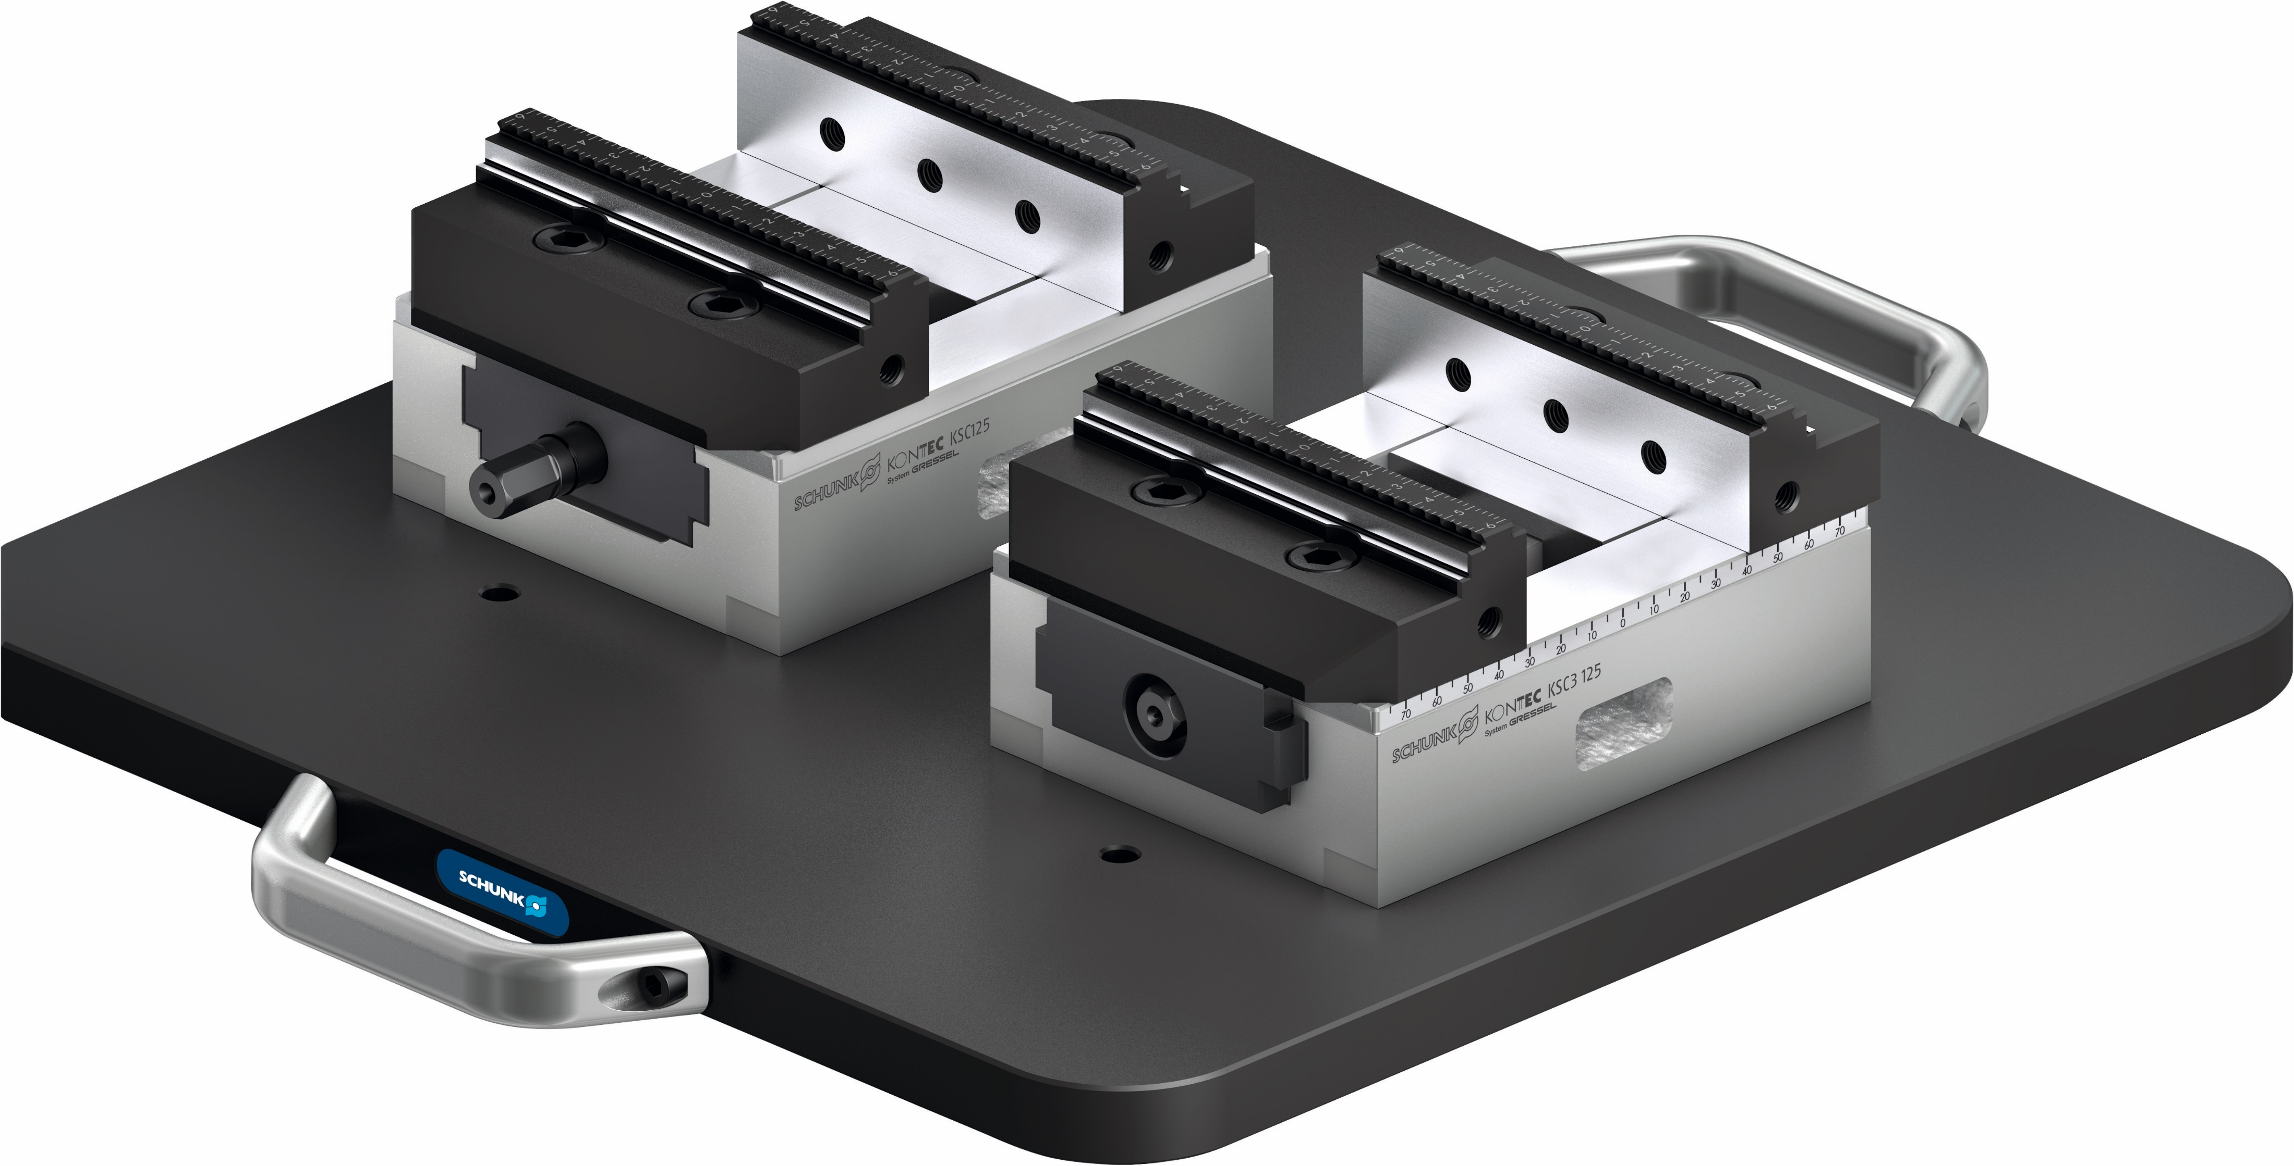
Highlights
KONTEC KSC3
100% compatibility with the KSC generation
The clamping vises of the KSC3 generation are 100% compatible with the clamping vises of the KSC generation.
Nickel-plated base body
For the best corrosion protection the base body of the KSC3 has been completely nickel-plated.
Laser-etched ruler
For easier alignment of the system jaws and workpieces the KSC3 has laser-cut scales on the base body and on the system jaws.

Slide 7
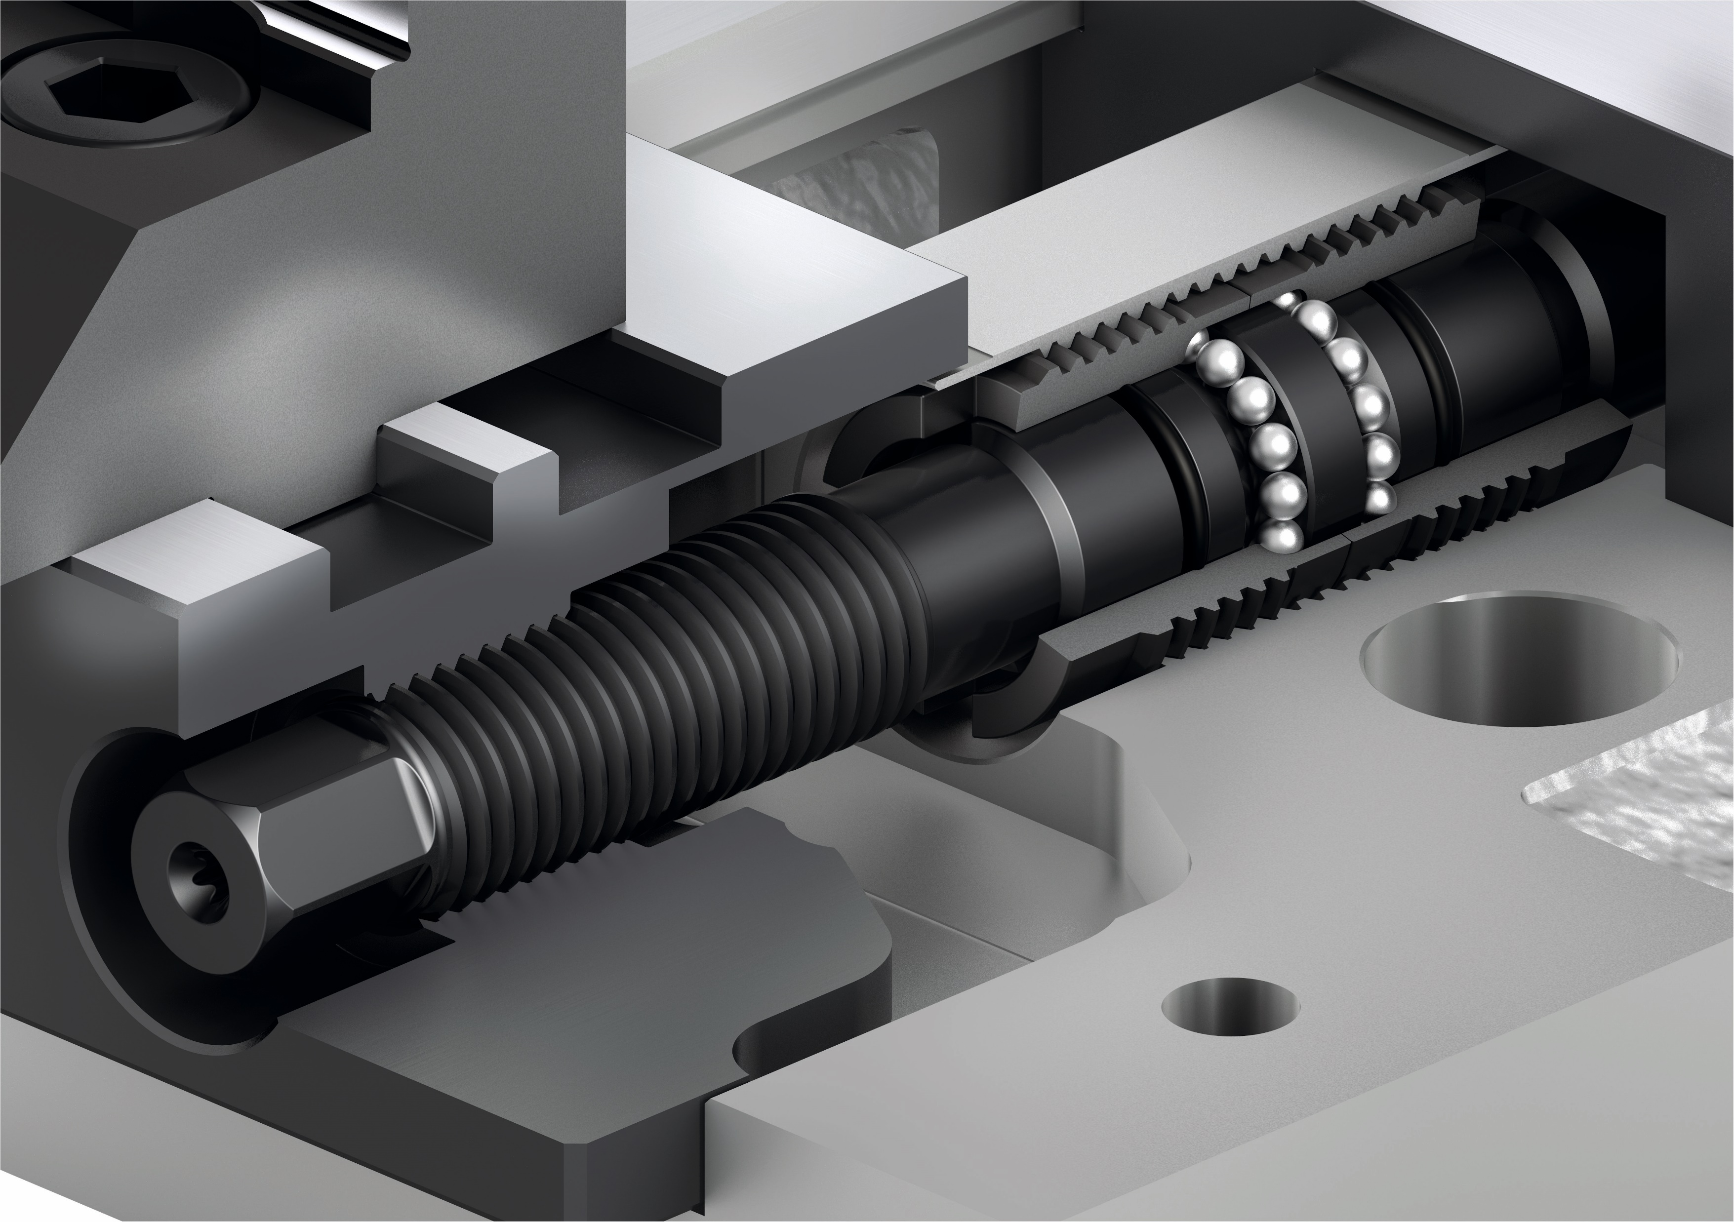
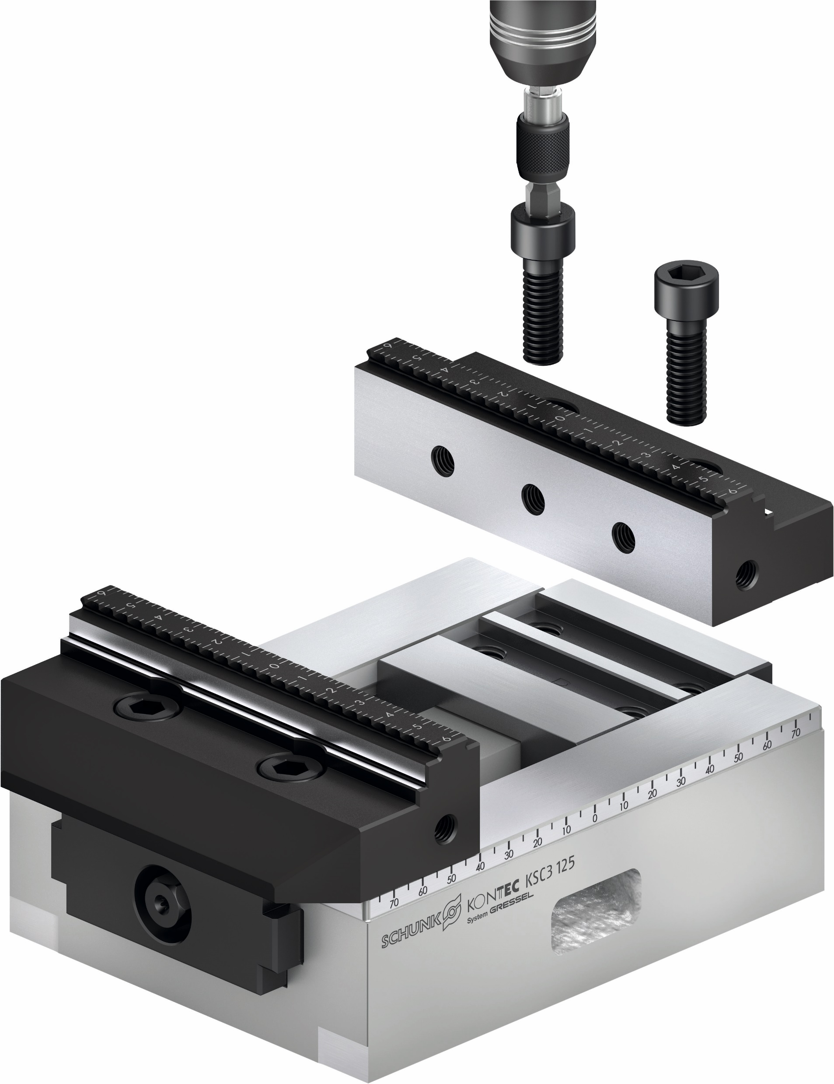
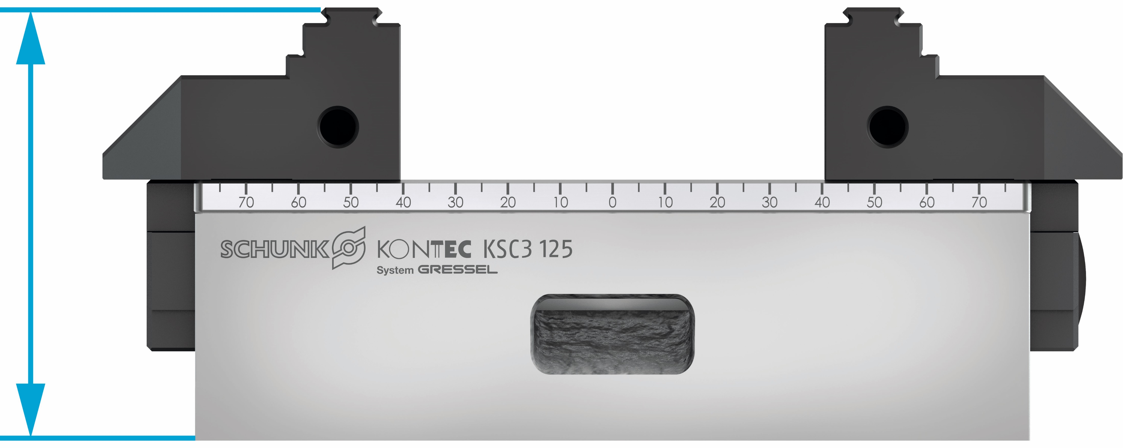
Highlights
KONTEC KSC3
Closed System
The spindle is always sealed, regardless of the clamping position. Therefore the spindle drive is protected against chips and coolant.
Extremely flat design
The KSC3 only takes up a small amount of space and offers best accessibility for 5-sided machining.
Jaw change with just two screws
The system jaws can be changed very quickly and easily by loosening just two screws.

Slide 8
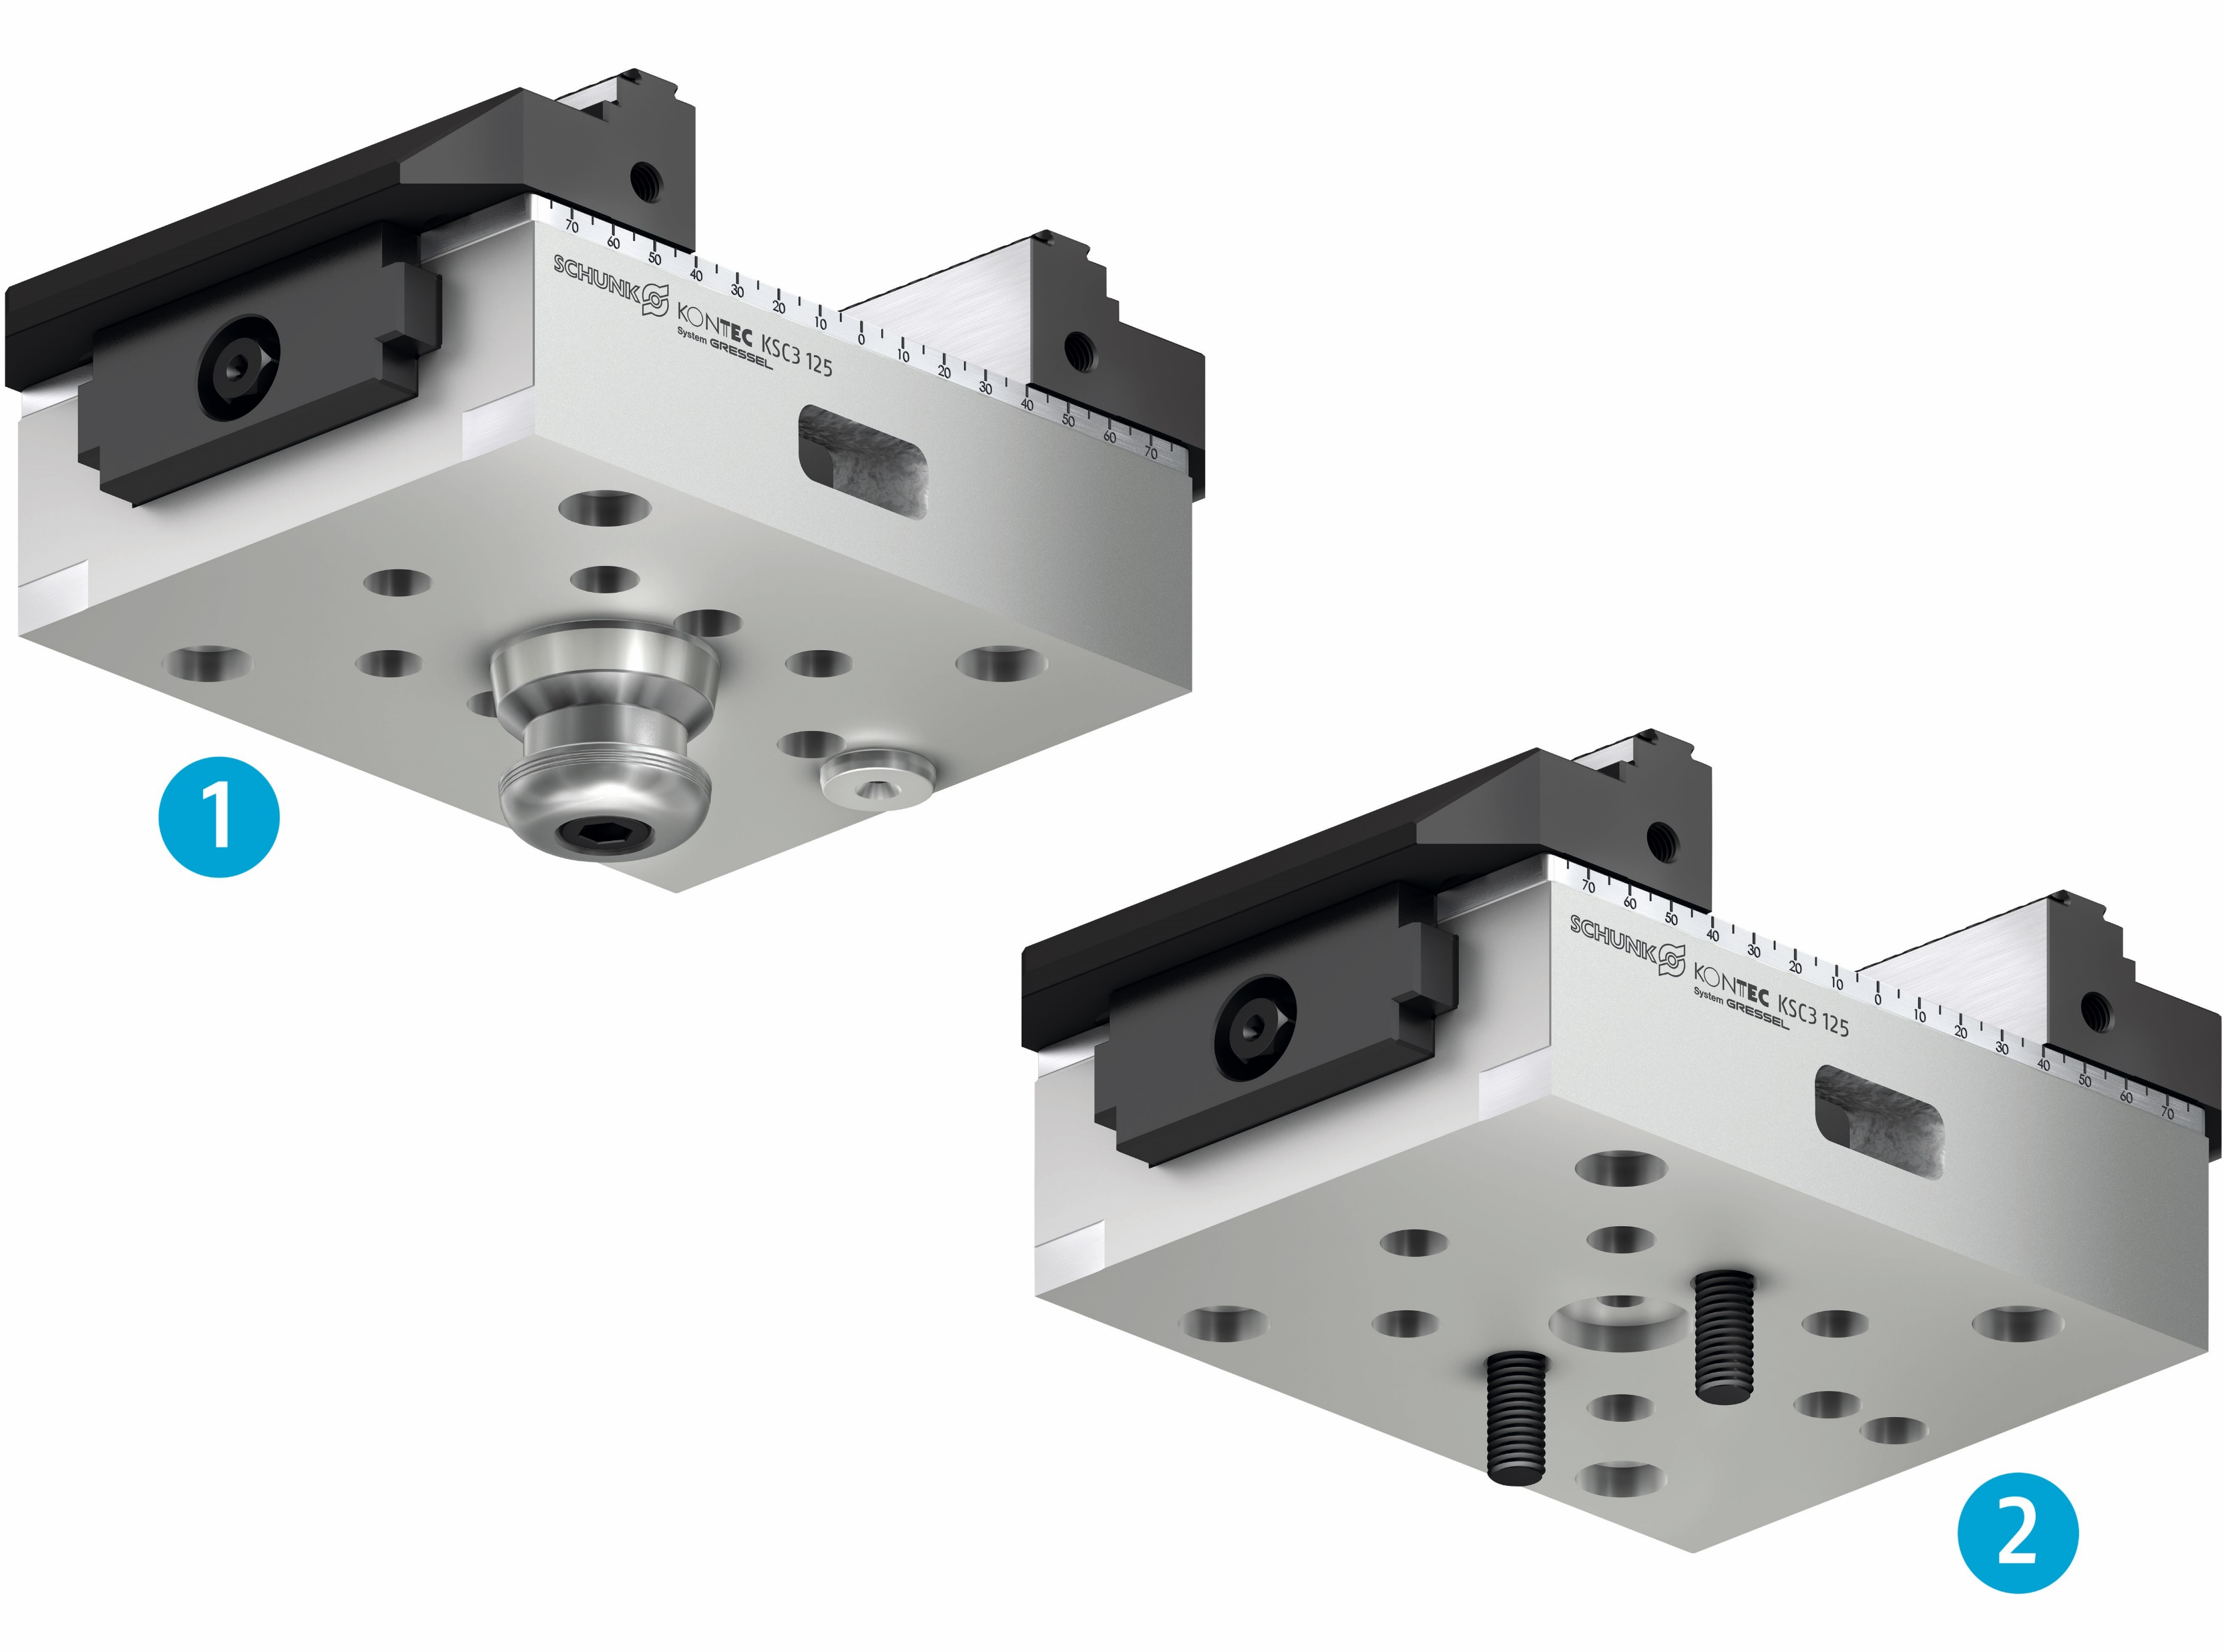
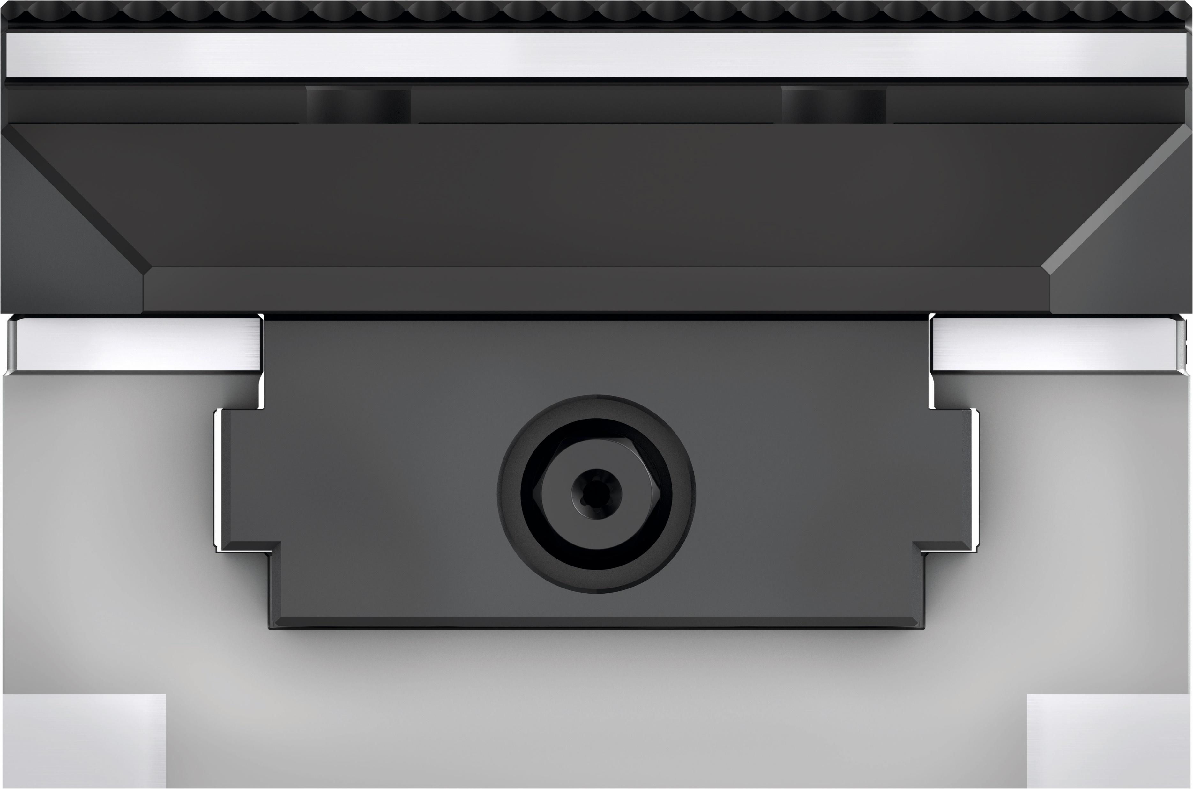
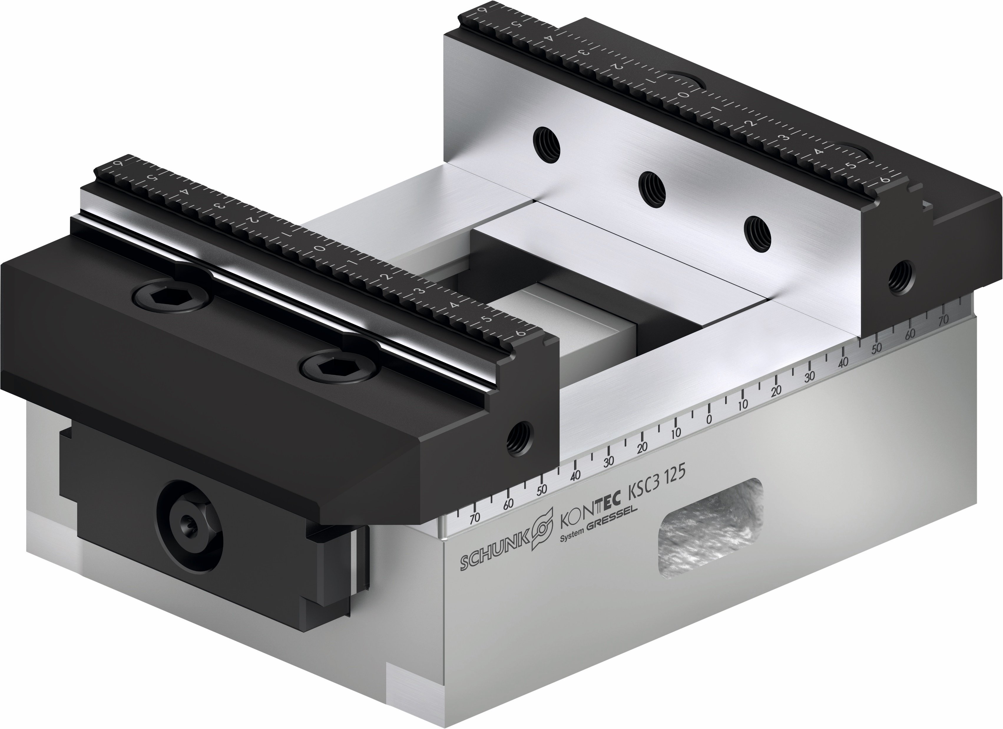
Highlights
KONTEC KSC3
1
2
Mounting options
The KSC3 offeres several options for mounting on the machine table, which are built into the base body.
Sealing of the jaw guidance
The base jaw is fitted with high precision in the base jaw guidance. This results in minimal gap dimensions and optimal protection against falling chips.
Visual marking of the end position
The end position of the KSC3 are visually marked. This means that the end position can be determined quickly.
1
Befestigung über Nullpunktspannsystem
2
Befestigung über Schrauben

Slide 9
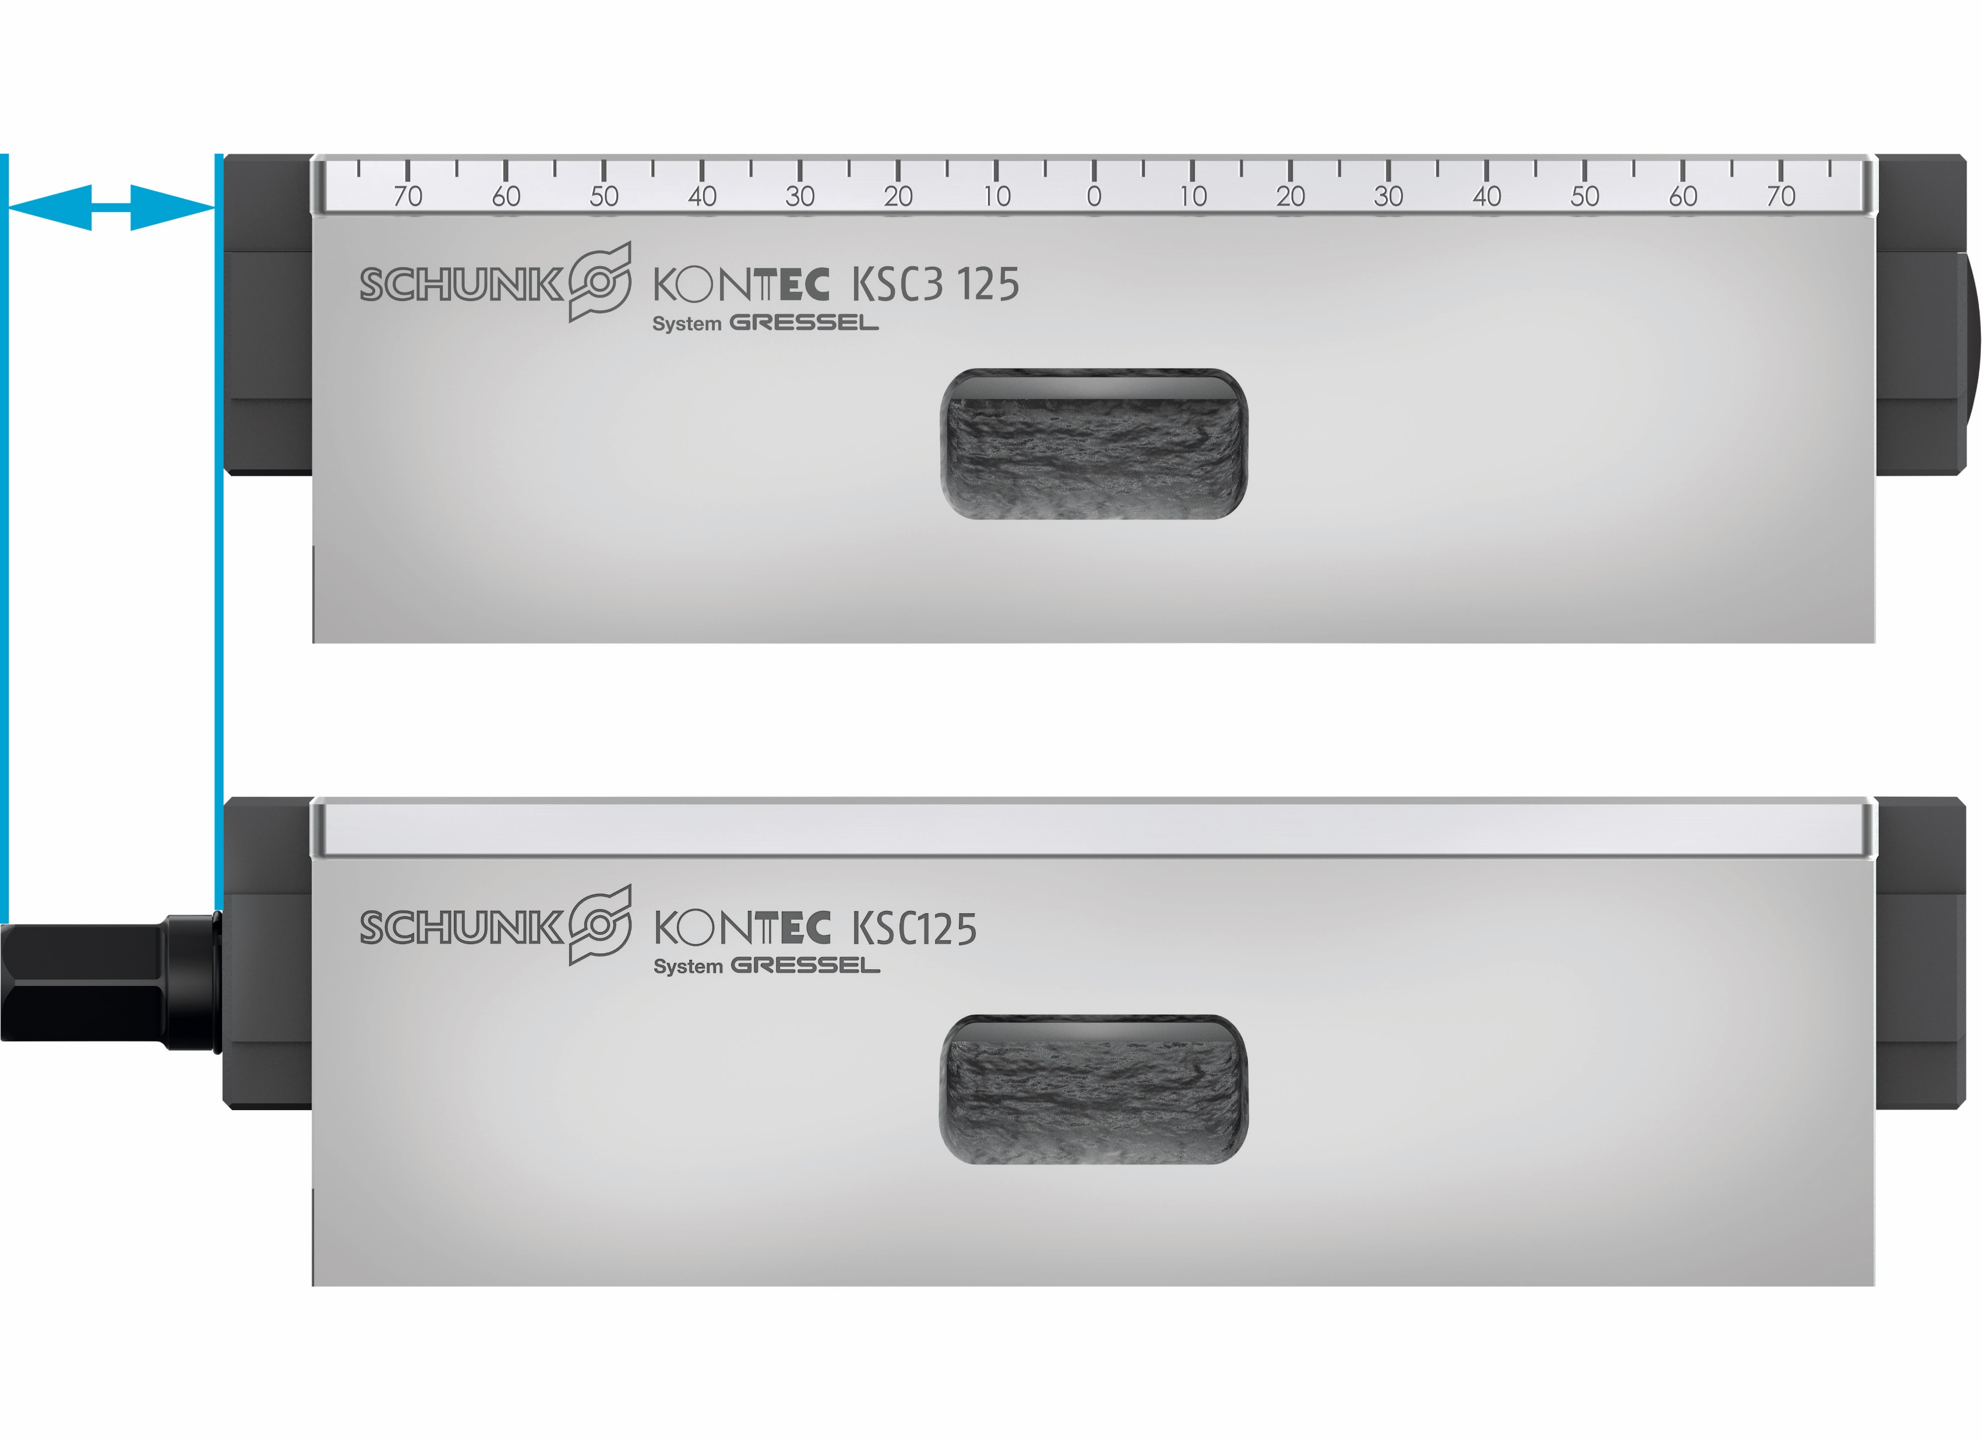
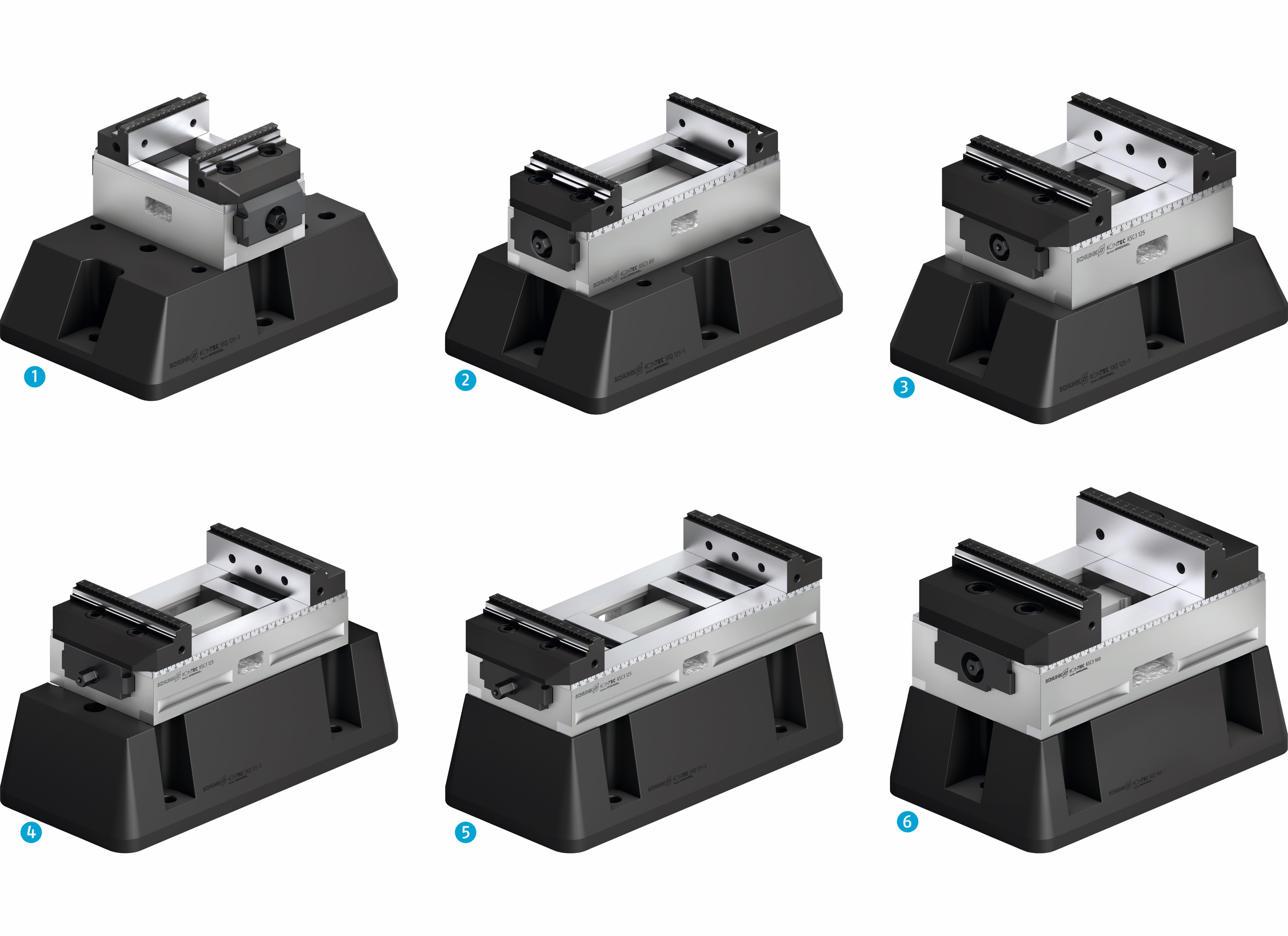
Highlights
KONTEC KSC3
Improved interfering contour
The hexagonal connection has been countersunk in the base body for sizes 80-130, 125-160 and 160-280.
Optimal Accessibility
By using brackets, the clamping vises can be lifted off the machine table. This allows improved accessibility of the machine spindle to the workpiece.

Slide 10
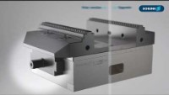
Video
KONTEC KSC3

Slide 11
Size 80
KONTEC KSC3
Technical data
Description | ID | Vise width | Max. clamping force | Max. torque | Length compensation | Repeat accuracy | Weight
 |  | [mm] | [kN] | [Nm] | [mm] | [mm] | [kg]
KSC3 80-130 | 1508857 | 80 | 25 | 90 |  | ±0,01 | 3,1
KSC3 80-130-S | 1514209 | 80 | 25 | 90 | ±3 | ±0,01 | 3,1
KSC3 grip 80-130 | 1514206 | 80 | 25 | 90 |  | ±0,01 | 3,9
KSC3 80-190 | 1514208 | 80 | 25 | 90 |  | ±0,01 | 4,5
KSC3 80-190-S | 1514220 | 80 | 25 | 90 | ±3 | ±0,01 | 4,5
KSC3 grip 80-190 | 1514207 | 80 | 25 | 90 |  | ±0,01 | 5,5

Slide 12
Size 125
KONTEC KSC3
Technical data
Description | ID | Vise width | Max. clamping force | Max. torque | Length compensation | Repeat accuracy | Weight
 |  | [mm] | [kN] | [Nm] | [mm] | [mm] | [kg]
KSC3 125-160 | 1514241 | 125 | 35 | 100 |  | ±0,01 | 6,3
KSC3 125-160-S | 1514247 | 125 | 35 | 100 | ±5 | ±0,01 | 6,5
KSC3 grip 125-160 | 1514238 | 125 | 35 | 100 |  | ±0,01 | 8,7
KSC3 125-235 | 1514242 | 125 | 35 | 100 |  | ±0,01 | 9,5
KSC3 125-235-S | 1514248 | 125 | 35 | 100 | ±5 | ±0,01 | 9,5
KSC3 grip 125-235 | 1514239 | 125 | 35 | 100 |  | ±0,01 | 12
KSC3 125-300 | 1514246 | 125 | 35 | 100 |  | ±0,01 | 12,5
KSC3 125-300-S | 1514249 | 125 | 35 | 100 | ±5 | ±0,01 | 12,5
KSC3 grip 125-300 | 1514240 | 125 | 35 | 100 |  | ±0,01 | 14,5

Slide 13
Size 160
KONTEC KSC3
Technical data
Description | ID | Vise width | Max. clamping force | Max. torque | Length compensation | Repeat accuracy | Weight
 |  | [mm] | [kN] | [Nm] | [mm] | [mm] | [kg]
KSC3 160-280 | 1514250 | 160 | 50 | 175 |  | ±0,015 | 25
KSC3 160-280-S | 1514255 | 160 | 50 | 175 | ±5 | ±0,015 | 25
KSC3 160-480 | 1514254 | 160 | 50 | 175 |  | ±0,015 | 35
KSC3 160-480-S | 1514256 | 160 | 50 | 175 | ±5 | ±0,015 | 35

