Slide 1
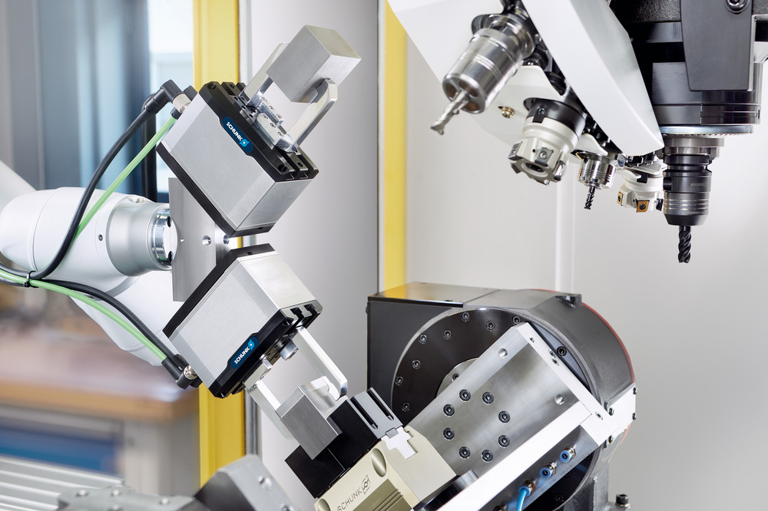

Flexible universal gripper EGU
&
Flexible small parts gripper EGK

Slide 2
Mechatronische Greifer – vielseitig einsetzbar
Universal gripper EGU and small parts gripper EGK
The flexibilization of production processes and the increasing variance to batch size one in the is having a massive impact. Mechatronic gripper solutions offer many advantages for the requirements of modern process flows.
Flexible in use: party variety, adjustment options (positioning, stroke, force, gripmode),
Future-proof thanks to new software functions that can be added at a later date
Connectivity: added value trough standardized interfaces (flexible and easy networking with all relevant robot and controller manufacturers possible)
Process feedback: for greater process stability and reliability thanks to integrated sensor and analysis options
Independent of compressed air: for more cleanliness and sustainability even in mobile applications

Slide 3
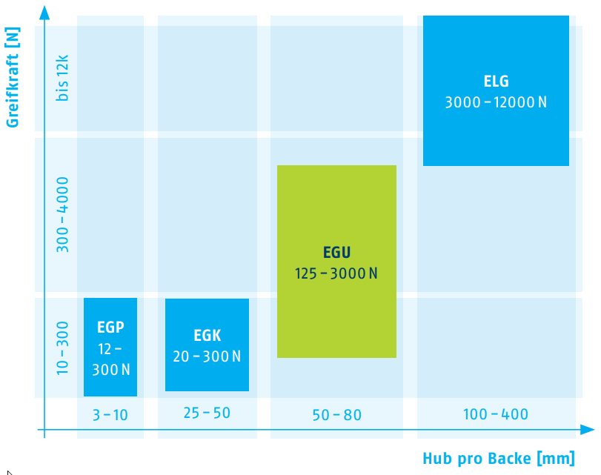
The right electric gripper for almost every task
Universal gripper EGU and small parts gripper EGK
Four product series, optimally matched to different areas of application in terms of gripping force and stroke
You can quickly find the right gripping solution for your application
High degree of standardization and common electronics and software platform (today: EGU and EGK)
Gripping Force [N]
EGU
150 – 3000 N
Stroke per jaw [mm]

Slide 4
Applications we follow with EGU
Universal gripper EGU and small parts gripper EGK
Machine Tool Industry
Flexible loading and unloading of machine tools
Fully automated systems and partly automated systems with different workpieces
Mainly automated with industrial robots, also Cobots
Harsh environment with chips and coolant

Slide 5
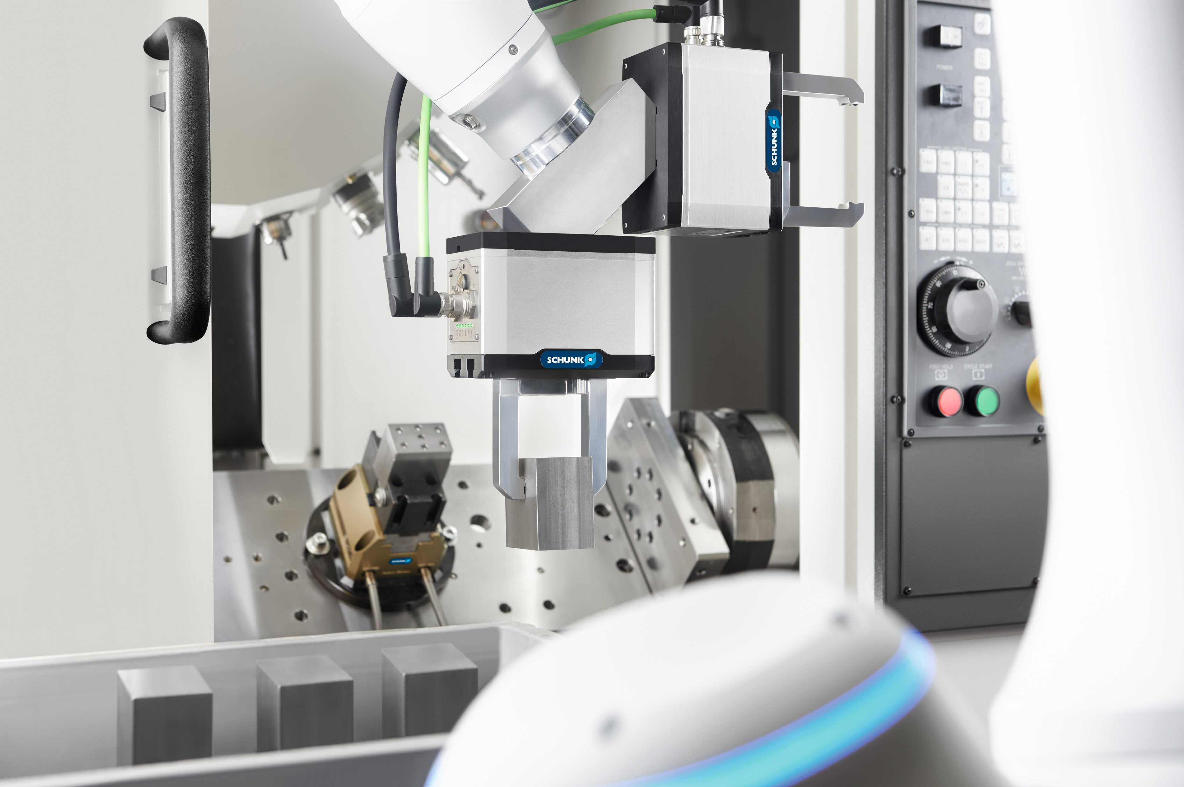

Slide 6
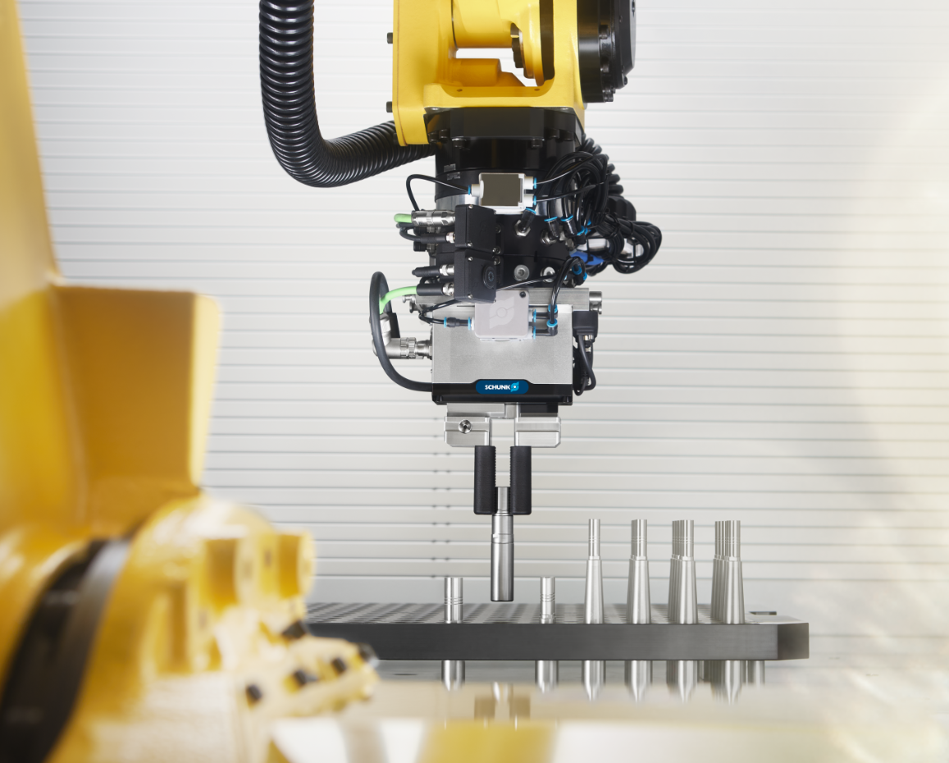
Applications we follow with EGU
Universal gripper EGU and small parts gripper EGK
Assembly and joining tasks e.g. in the automotive sector
High diversity of parts
External finger loads from the process
Flexible picking and palletizing tasks in logistics
High diversity of parts
Large and heavy parts, like boxes or cartons

Slide 7
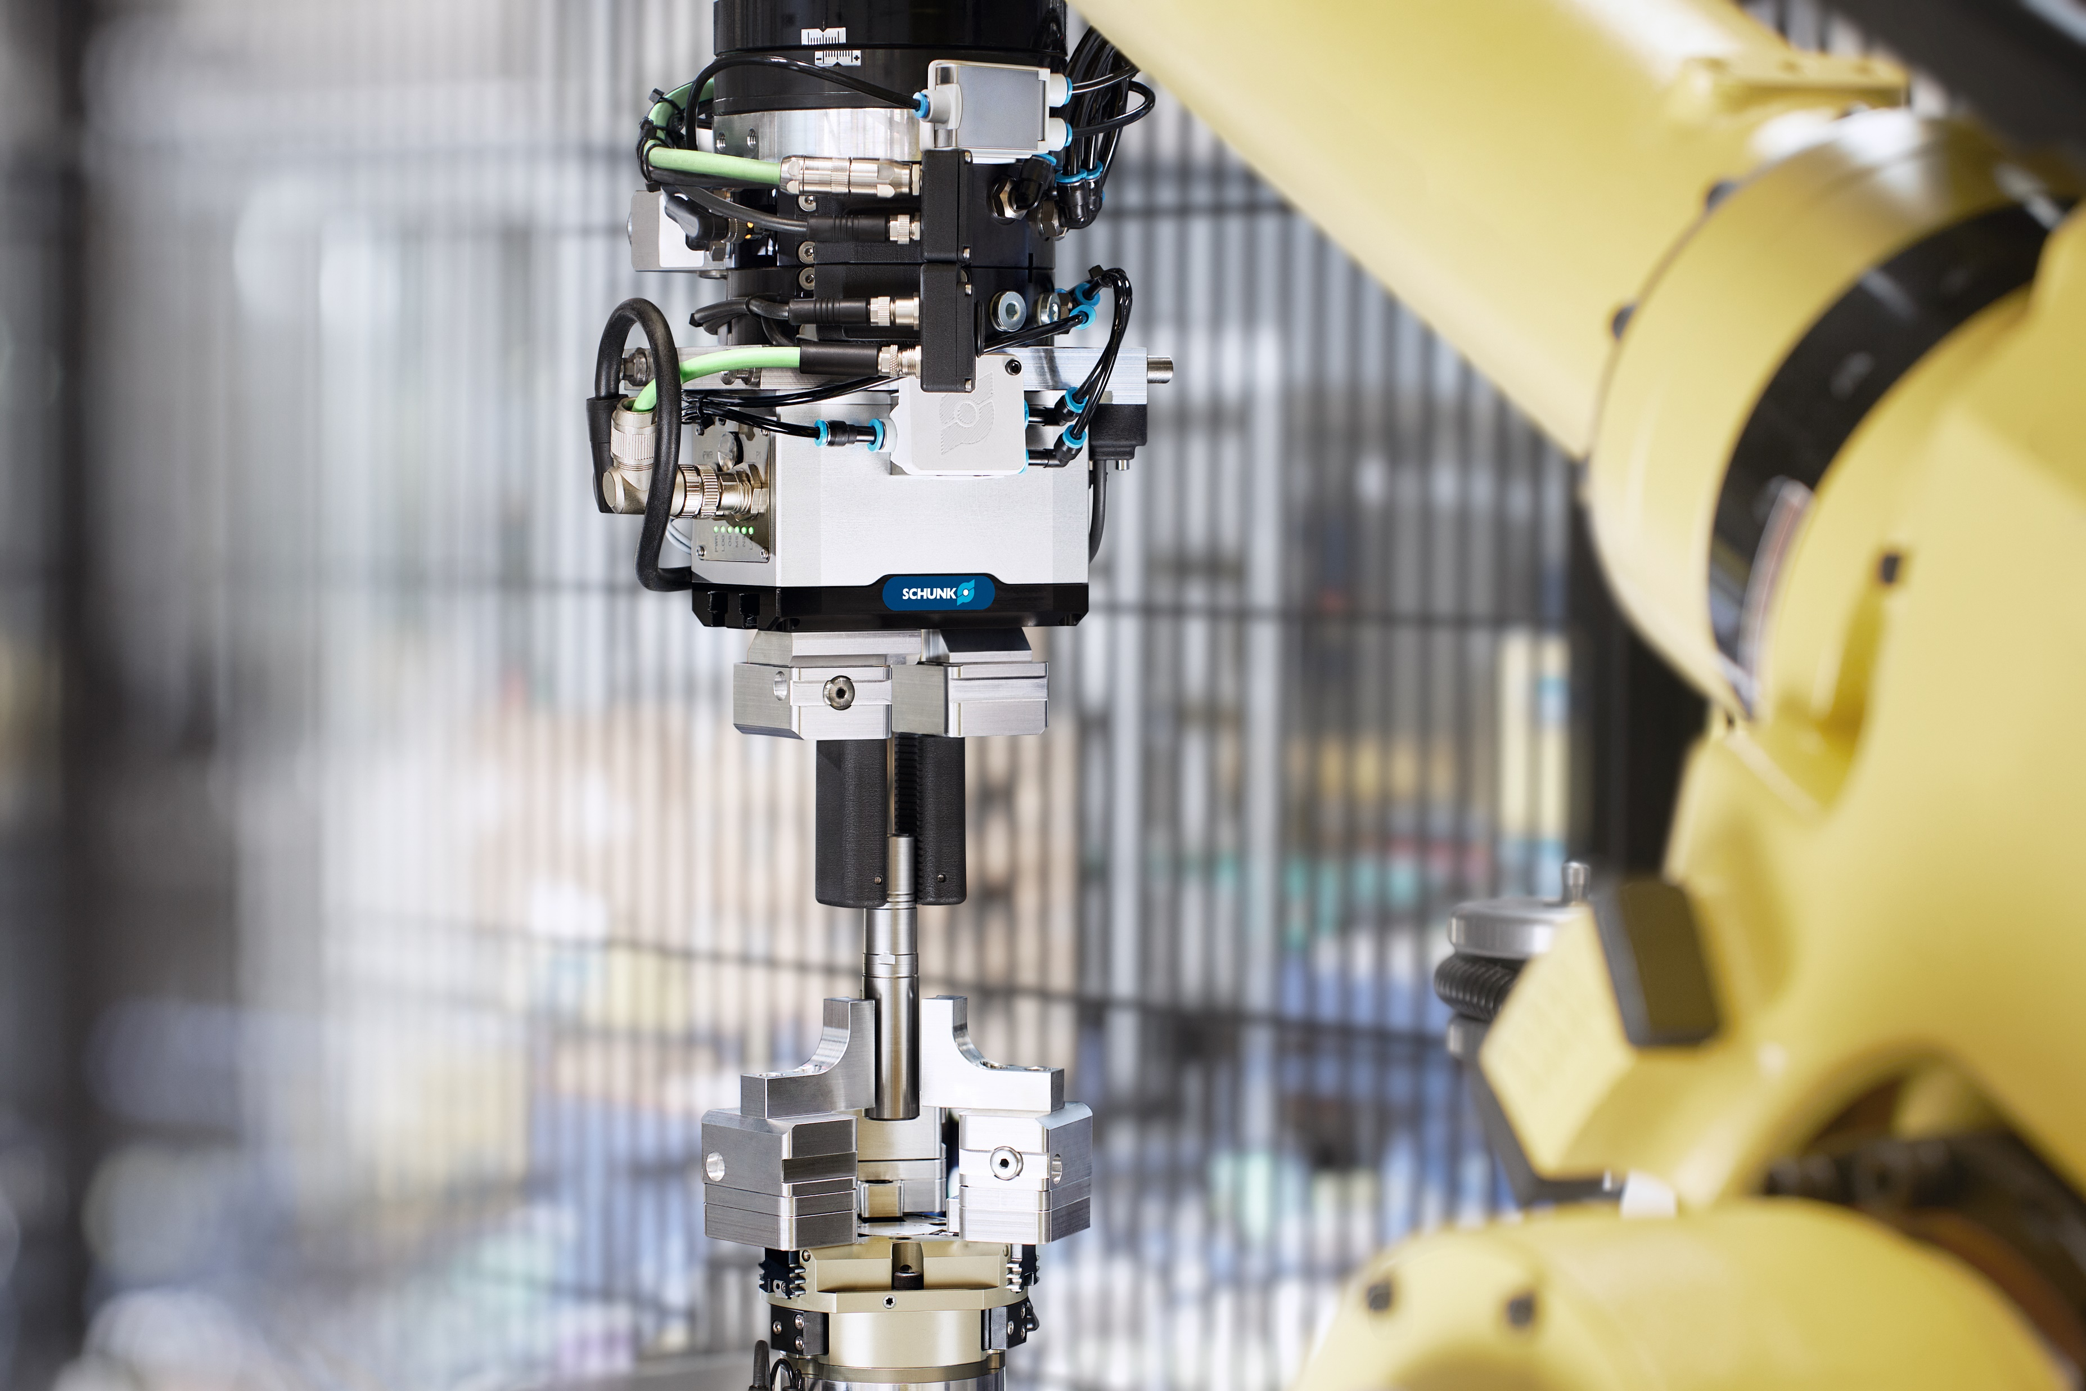

Slide 8
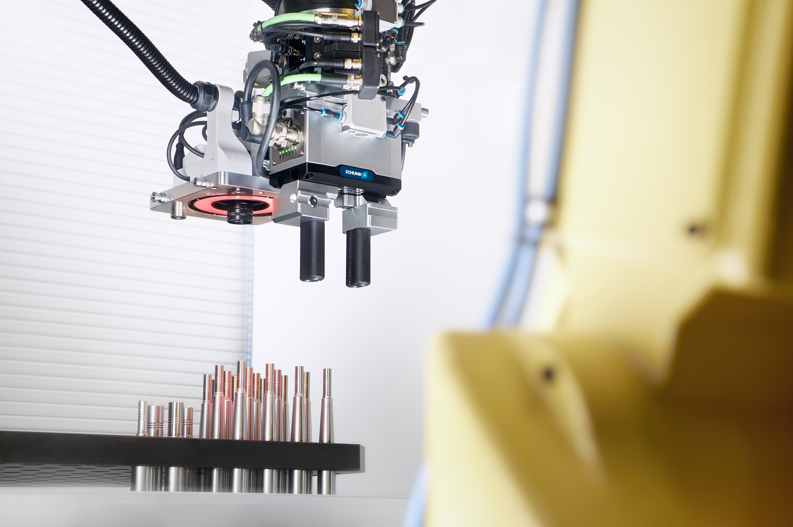

Slide 9
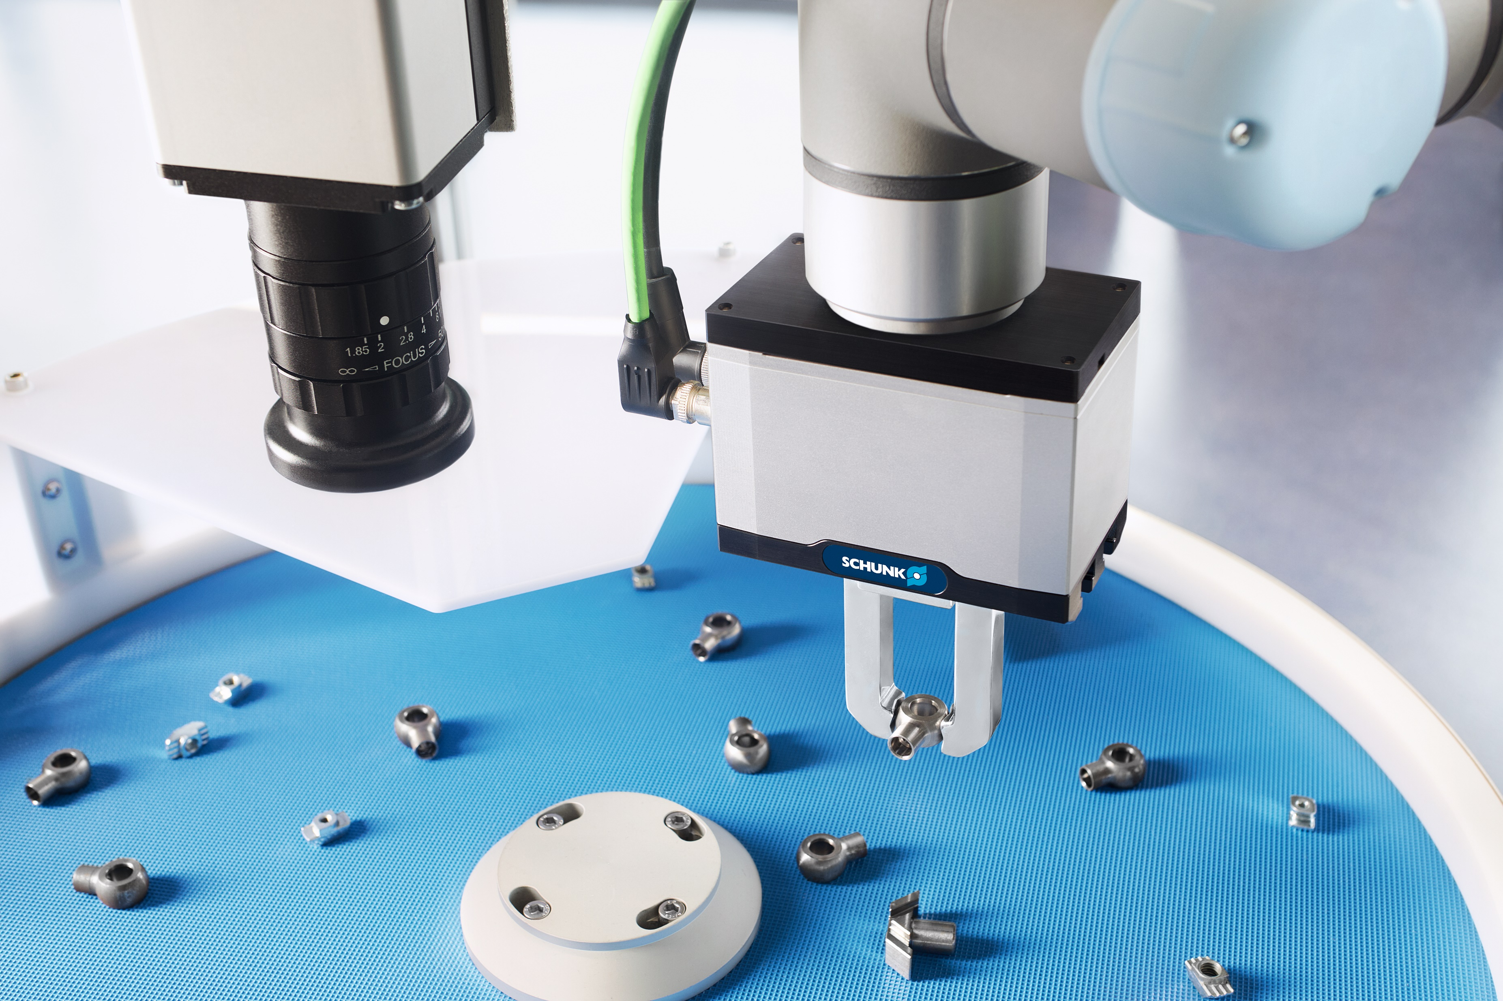

Slide 10
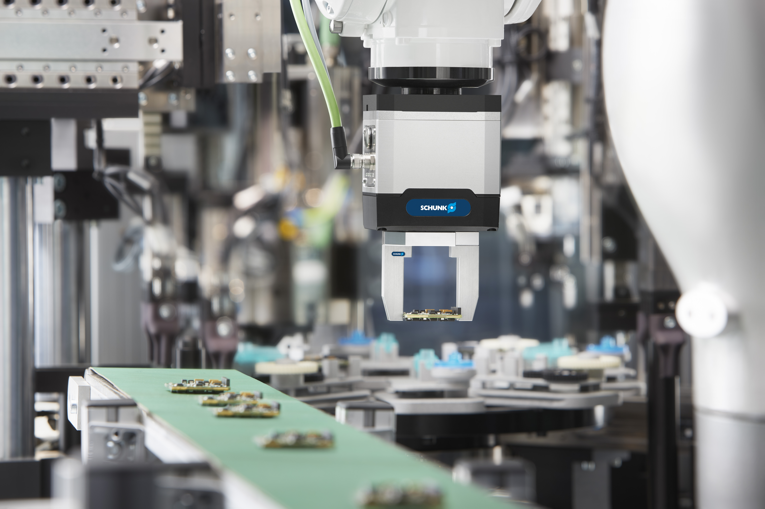
Applications we follow with EGK
Universal gripper EGU and small parts gripper EGK
Electronics Industry – PCB Manufacturing
Handling of various PCB sizes at end of the production line
Feeding into typical End-of-Line Testing like Automated-Optical-Inspection (AOI) or
Flying-Probe-Test (FPT)
Delicate workpieces
High demands on process stability

Slide 11
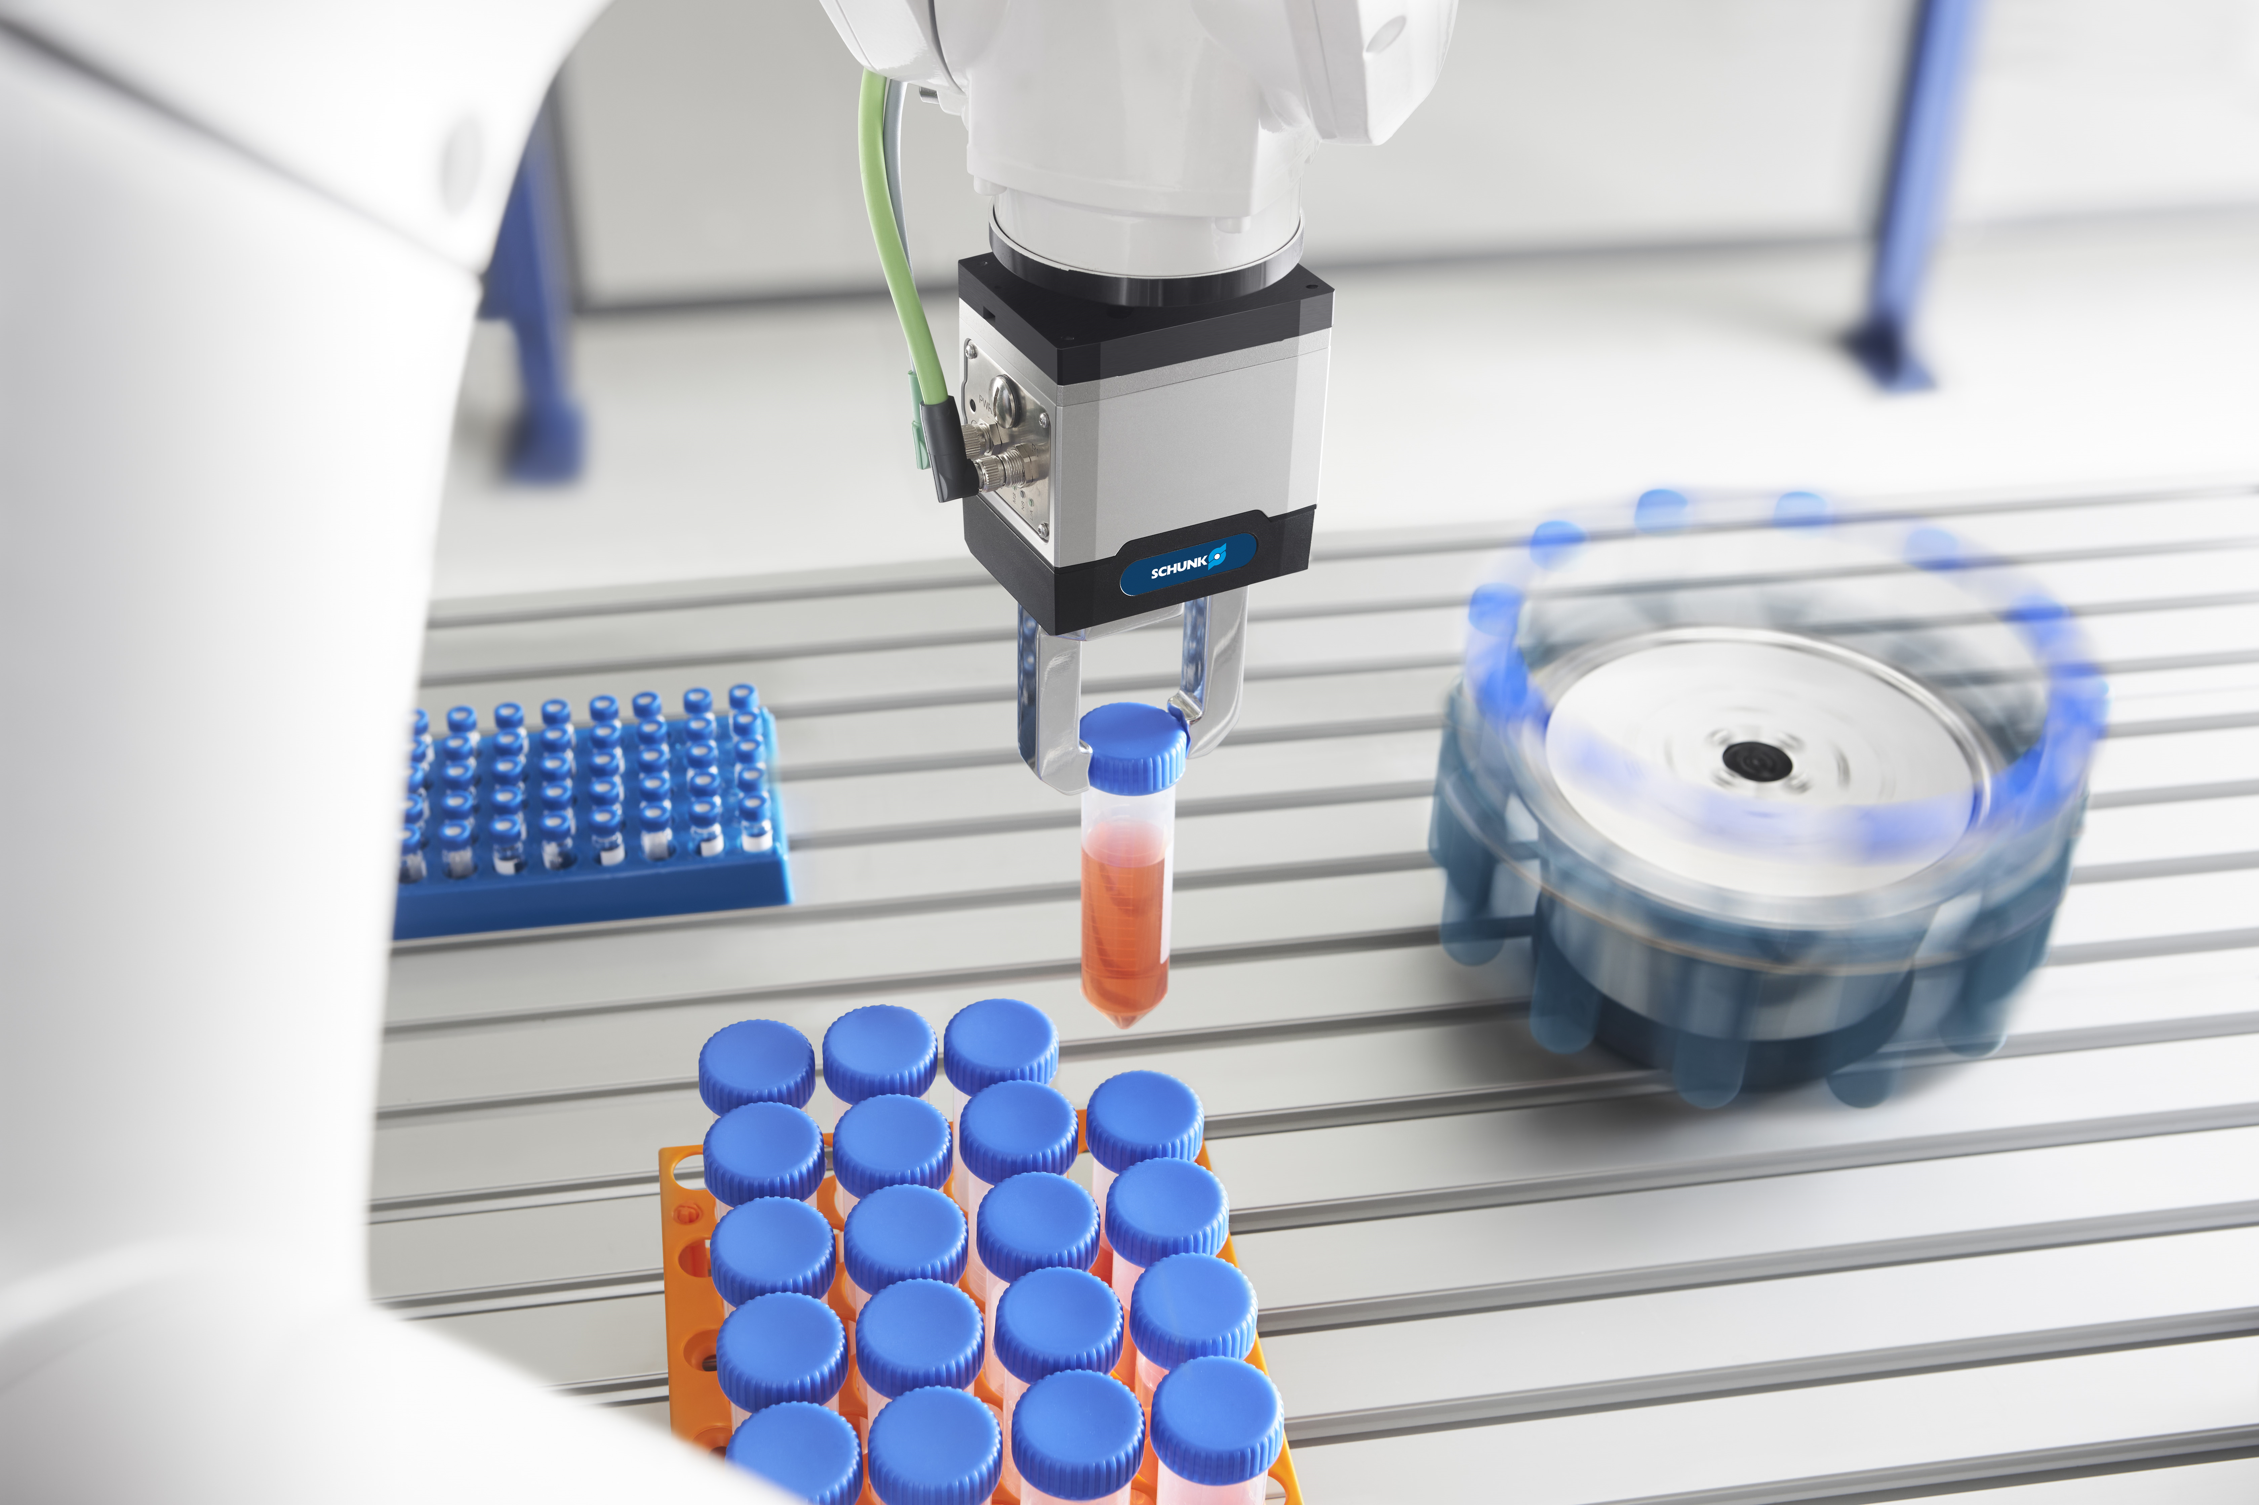
Applications we follow with EGK
Universal gripper EGU and small parts gripper EGK
Lab Automation
Handling of trays and samples, e.g. carpules, vials, petri dishes
Feeding of the samples into test procedures
Delicate workpieces
High demands on process stability
Requirements for cleanroom suitability and lubrication (H1)

Slide 12


Slide 13
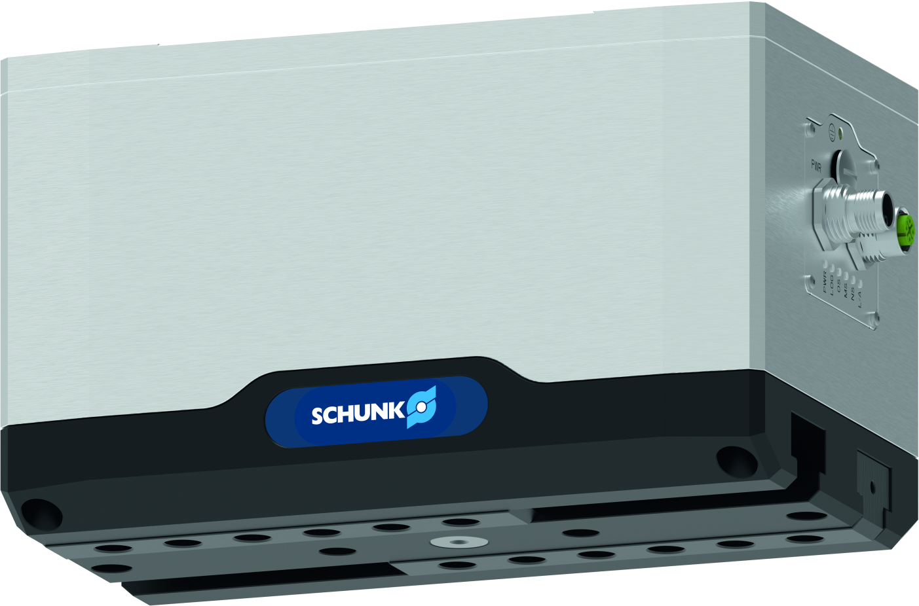
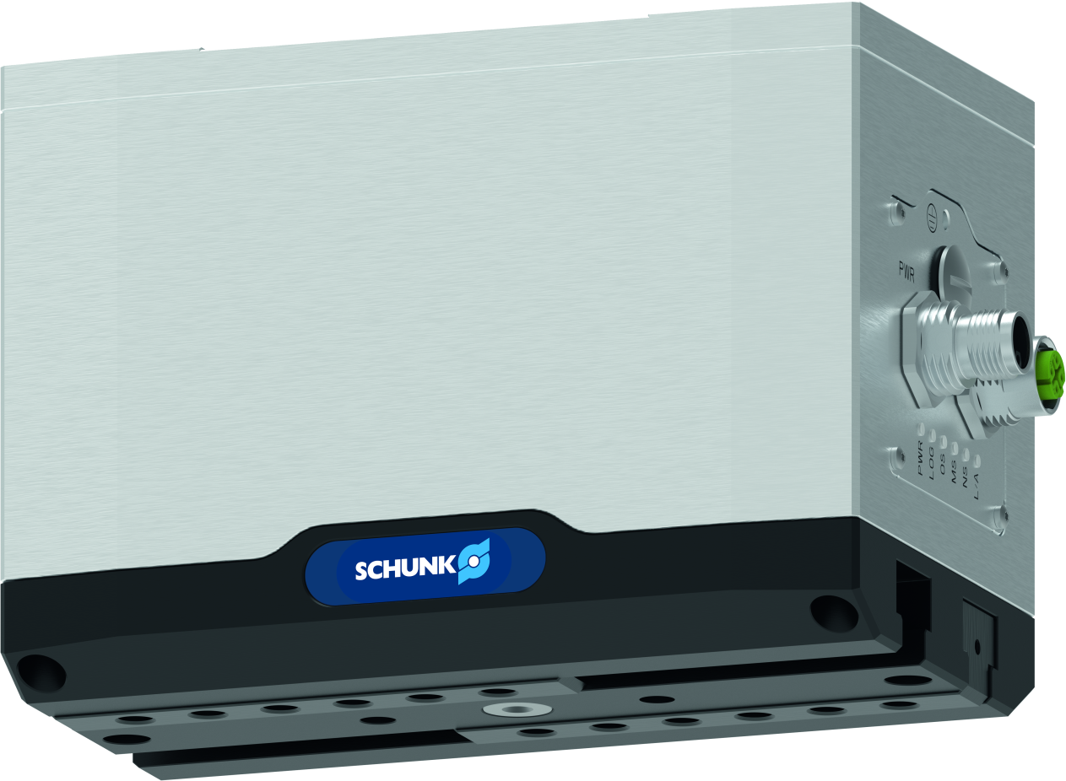
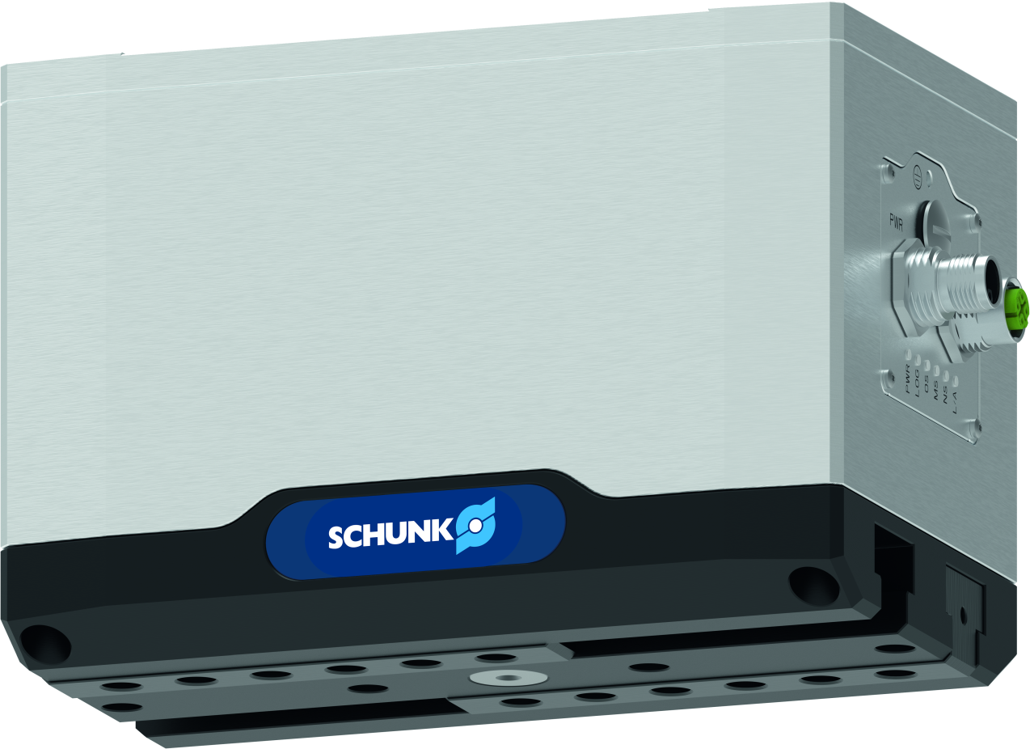
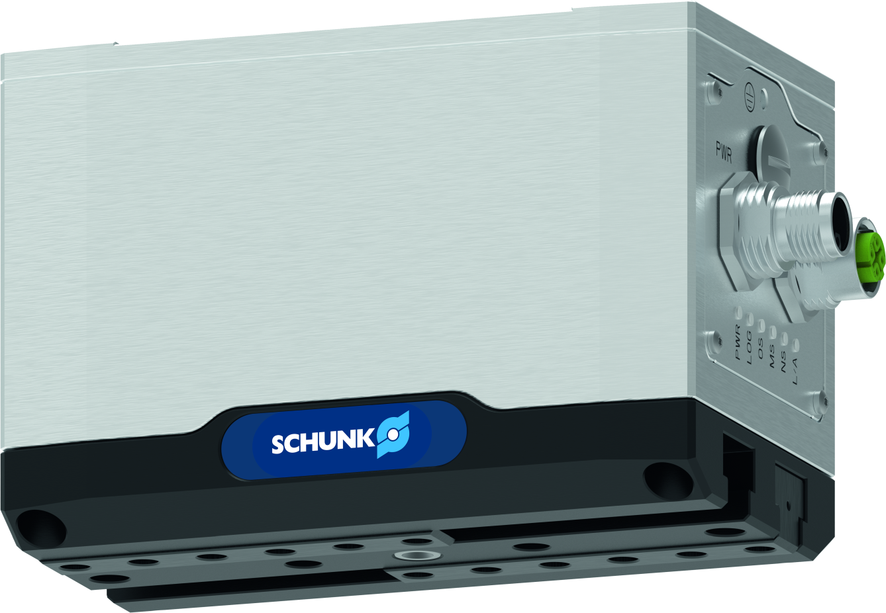
Flexible universal gripper EGU
Universal gripper EGU and small parts gripper EGK
Series lineup
EGU 50
EGU 60
EGU 70
EGU 80
150 to 450 N
102 mm stroke
80 mm finger length
1.49 kg
325 to 975 N
120 mm stroke
125 mm finger length
2.90 kg
650 to 1950 N
140 mm stroke
160 mm finger length
4.52 kg
1000 to 3000 N
160 mm stroke
200 mm finger length
7.72 kg
Reference is the version with gripping force maintenance.
Difference without gripping force maintenance:
reduced max. force (BasicGrip only)
slightly reduced mass
Difference with dust protected version:
slightly minimized stroke (-10 mm per jaw)
slightly higher mass

Slide 14

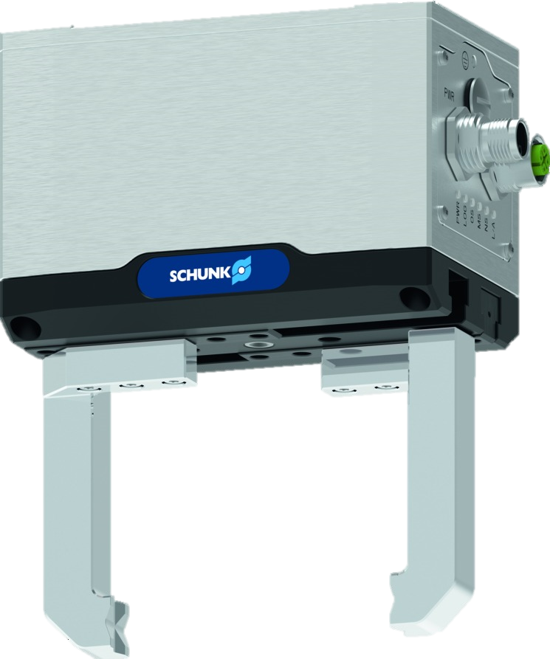
Flexible universal gripper EGU
Universal gripper EGU and small parts gripper EGK
Versatile and productive
due to the large and freely programmable jaw stroke with continuous gripping force adjustment for flexible workpiece handling
Robust and reliable
with sealed design and proven guidance particularly suitable for the harsh ambient conditions of machine loading
Maximum process reliability
by avoiding workpiece loss due to integrated gripping force maintenance with loss detection
Always referenced
Both emergency stop and power failure due to integrated absolute encoder
100% gripping force without start-up distance
with almost constant gripping force over the entire finger length due to integrated spur gear
Minimal integration effort
compatible with the leading manufacturers on the market due to a wide range of communication interfaces, as well as PLC function blocks and robot plug-ins

Slide 15
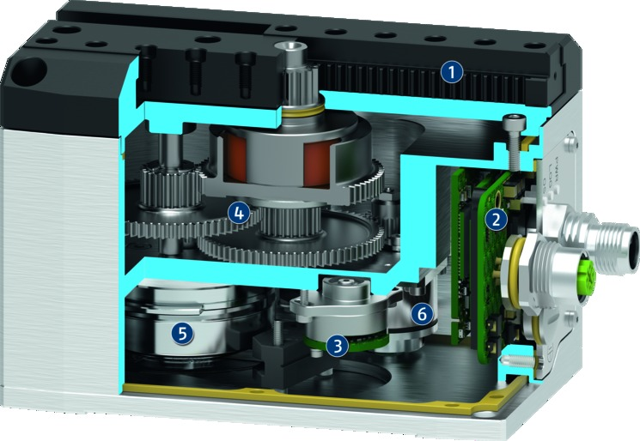
Flexible universal gripper EGU
Universal gripper EGU and small parts gripper EGK
Sturdy and resistant T-slot guidance
for large finger lengths, external forces and moments. Optionally available as dust-tight version.
Fully integrated and sealed control and power electronics
with status LEDs and M12 plug connectors for connecting the voltage supply and communication.
High-resolution, output-side absolute encoder
for precise positioning of the gripper jaws with permanent absolute position feedback.
Sealed drive train with spur gear and pinion/rack principle
for a nearly constant acting gripping force over the entire finger length, without a minimum approach distance.
Brushless flat motor
for limited space and high torques due to external rotor.
Electromagnetic brake
with additional mechanism for maintaining gripping force and position during standstill or power failure.
Picture: PROFINET version with gripping force maintenance
The yellow seals show the sealing surfaces of the gripper.

Slide 16
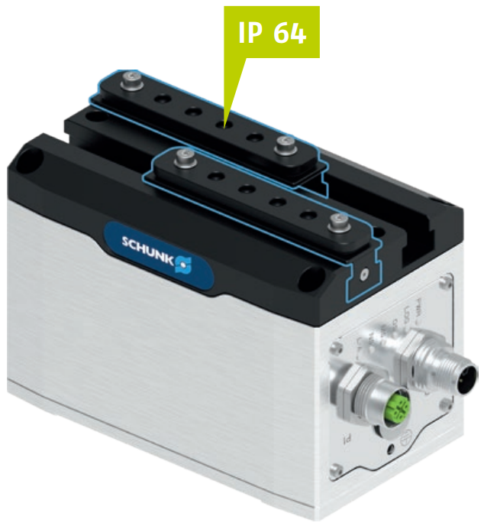
Flexible universal gripper EGU
Universal gripper EGU and small parts gripper EGK
Increased protection class with dust-tight version
against penetrating dust and liquids into the guide area of the base jaw and the rack-and-pinion principle
Suitable for use in particularly harsh environmental conditions, e.g. grinding applications
Protection class IP 64: Dust-tight and splash-proof
Basic protection of the electronics IP 67: Dust-tight, protected against temporary submersion
IP 67

Slide 17
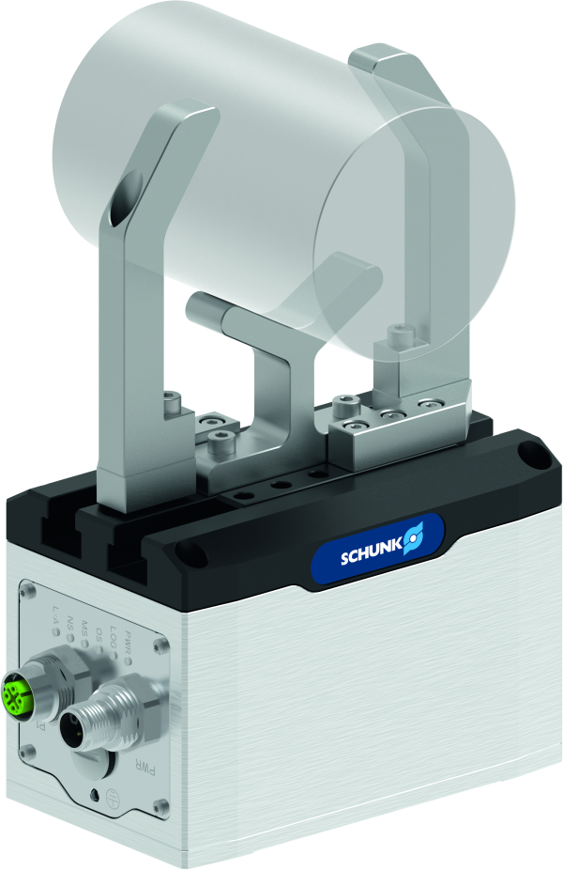
Flexible universal gripper EGU
Universal gripper EGU and small parts gripper EGK
Mounting option for additional attachment
Additional threads and fittings are located in the guidance housing for mounting an application-specific design in order to implement additional functions
Example: a pressure element can be mounted to center the workpiece.

Slide 18
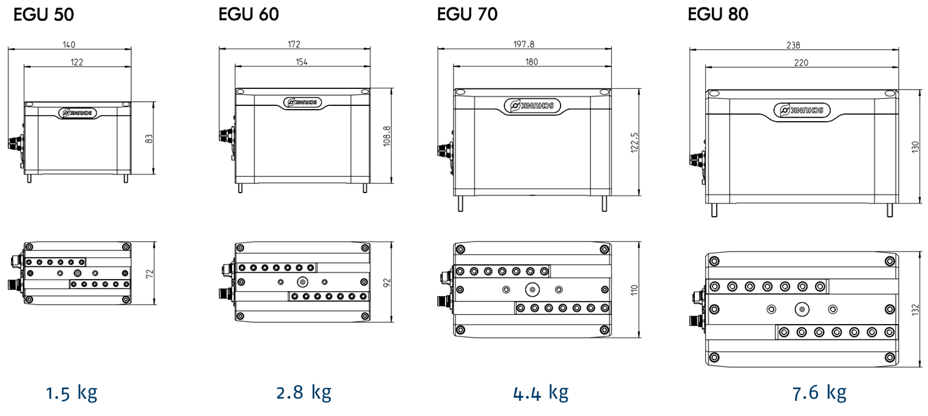
Flexible universal gripper EGU
Universal gripper EGU and small parts gripper EGK

Slide 19
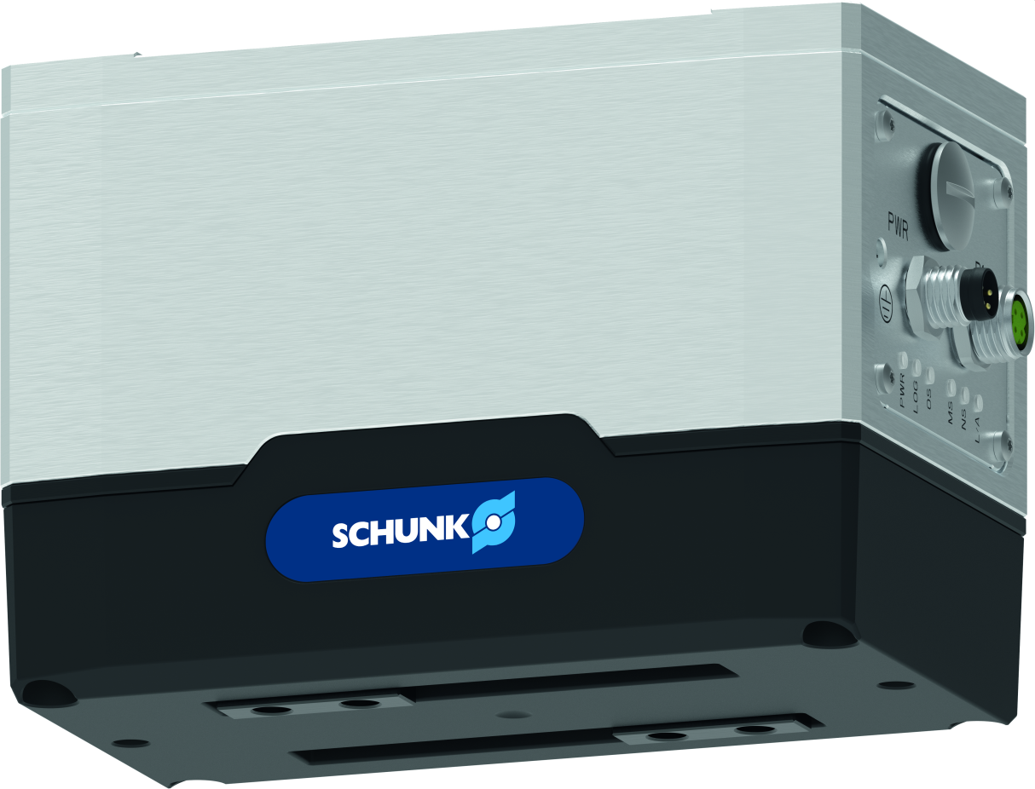
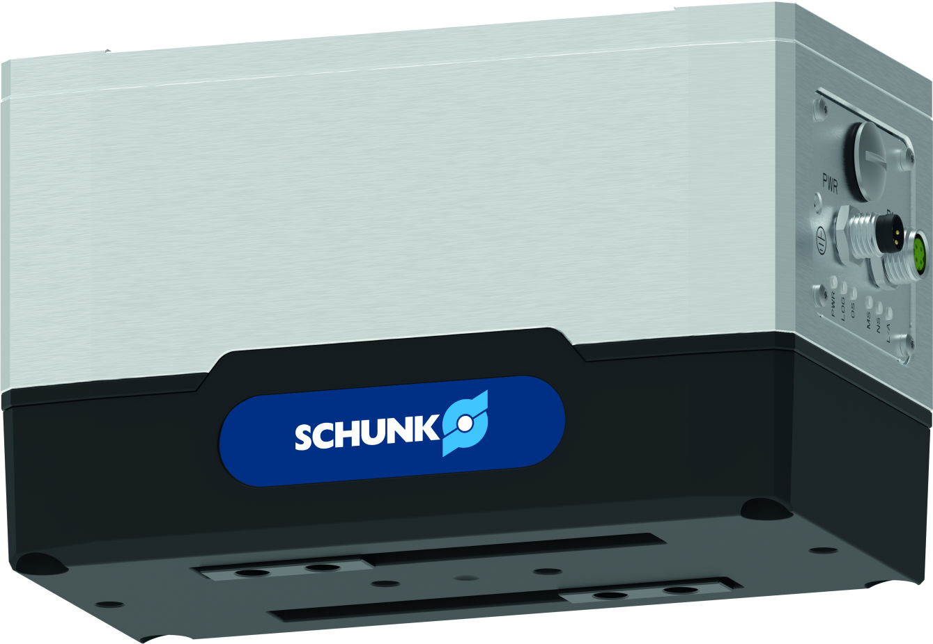
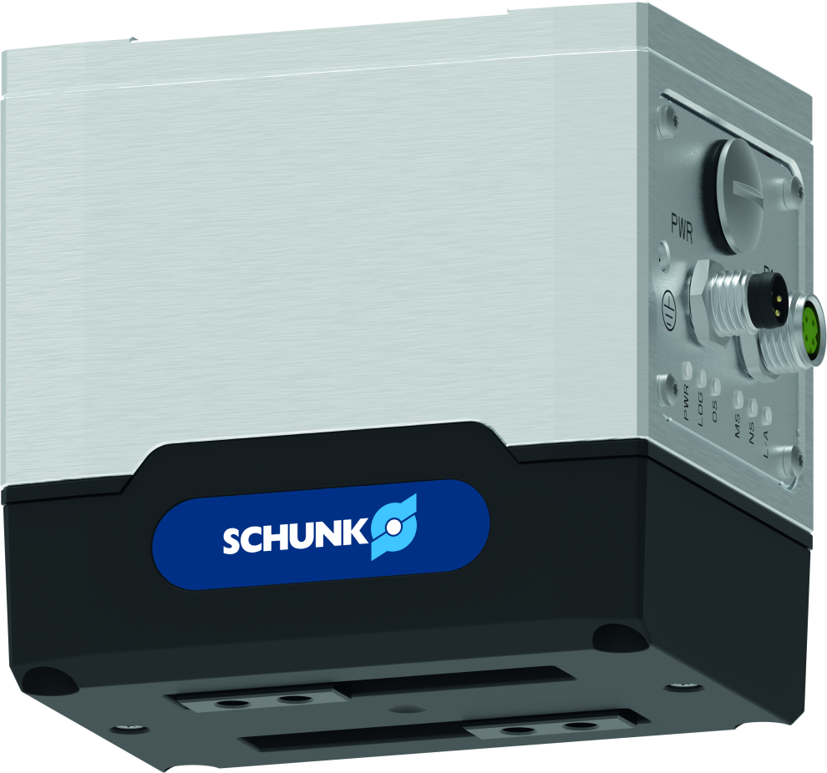
Flexible small parts gripper EGK
Universal gripper EGU and small parts gripper EGK
Series lineup
EGK 25
EGK 40
EGK 50
20 to 50 N
53 mm stroke
70 mm finger length
0.62 kg
55 to 150 N
83 mm stroke
100 mm finger length
1.02 kg
150 to 300 N
103 mm stroke
130 mm finger length
1.63 kg
Reference is the version with gripping force maintenance.
Difference without gripping force maintenance:
Slightly reduced mass

Slide 20
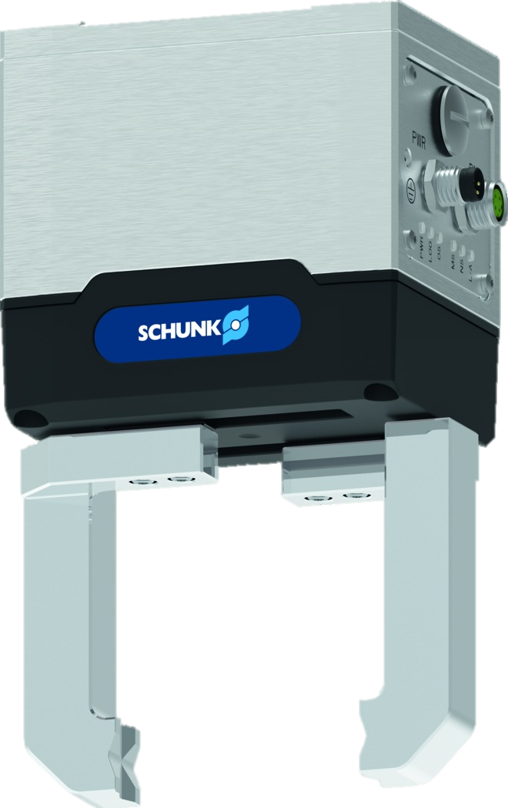
Flexible small parts gripper EGK
Universal gripper EGU and small parts gripper EGK
Versatile and productive
due to the large and freely programmable jaw stroke with continuous gripping force adjustment for flexible workpiece handling
Reliable and sensitive
Particularly suitable for the requirements of laboratory automation and electronics production due to the sealed design and smooth-running profiled rail guide
Maximum process reliability
by avoiding workpiece loss due to integrated gripping force maintenance with loss detection
Always referenced
Both emergency stop and power failure due to integrated absolute encoder
100% gripping force without start-up distance
with constant gripping force over the entire finger length due to integrated spur gear
Minimal integration effort
compatible with the leading manufacturers on the market due to a wide range of communication interfaces, as well as PLC function blocks and robot plug-ins

Slide 21
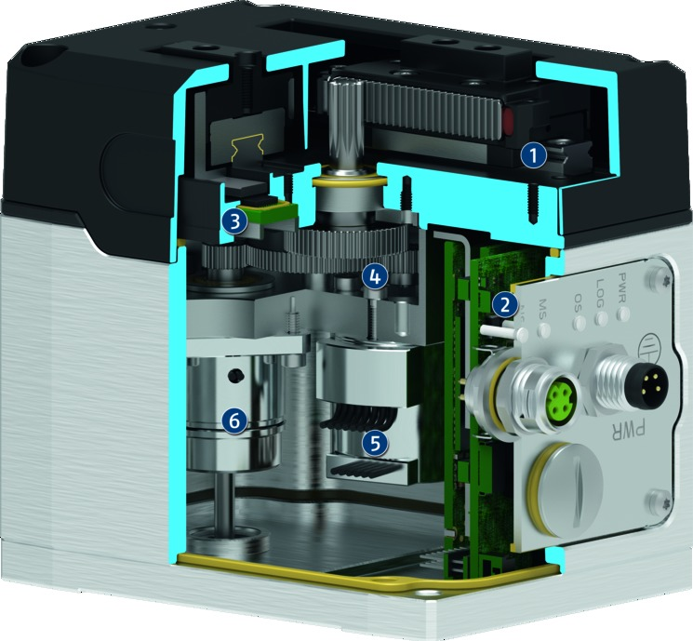
Flexible small parts gripper EGK
Universal gripper EGU and small parts gripper EGK
Smooth profiled rail guidance
with stainless steel front seal and food-compliant lubrication and cover made from resistant polycarbonate.
Fully integrated and sealed control and power electronics
with status LEDs and M8 plug connectors for connecting the voltage supply and communication.
High-resolution, output-side absolute encoder
for precise positioning of the gripper jaws with permanent absolute position feedback.
Sealed drive train with spur gear and pinion/rack principle
for a constant acting gripping force over the entire finger length, without a minimum approach distance.
Brushless flat motor
for limited space and high torques due to external rotor.
Electromagnetic brake
with additional mechanism for maintaining gripping force and position during standstill or power failure.
Picture: PROFINET version with gripping force maintenance
The yellow seals show the sealing surfaces of the gripper.

Slide 22
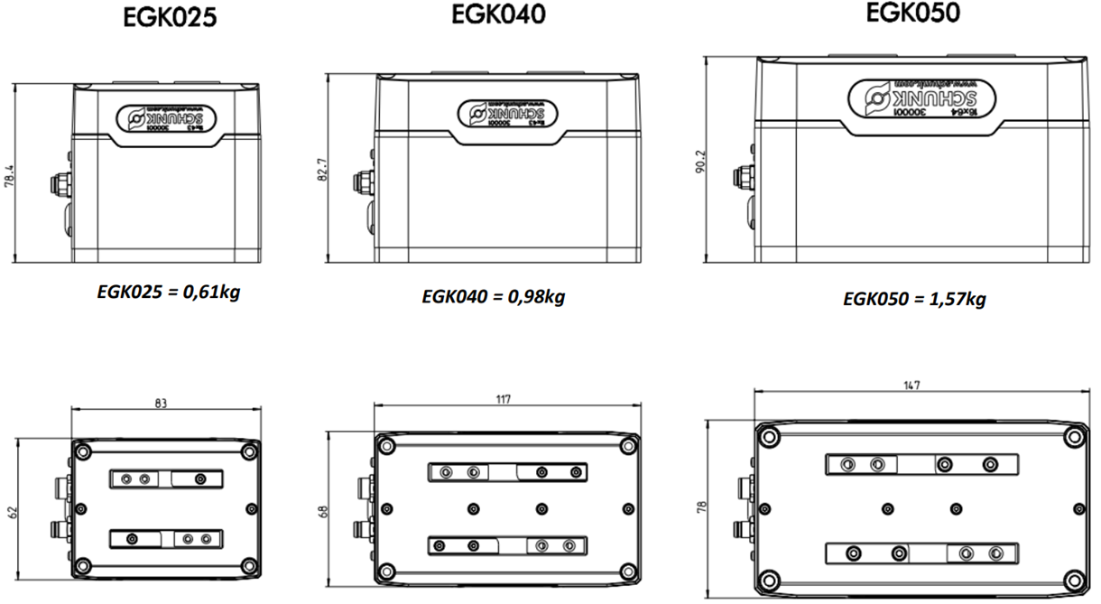
Flexible small parts gripper EGK
Universal gripper EGU and small parts gripper EGK

Slide 23





Connectivity
Universal gripper EGU and small parts gripper EGK
A wide range of available communication interfaces simplifies dealing with the variety of control and robot manufacturers and ensures time savings during integration.
Industrial Ethernet enables direct integration without additional gateways into the control environment of leading PLC manufacturers on the market.
IO-Link is independent and offers flexibility in connecting to additional networks.
With the Modbus RTU serial interface, the gripper can be connected to the tool flange of leading robot manufacturers without external cable routing.

Slide 24
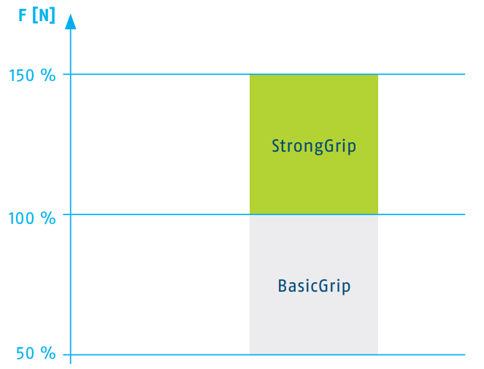
Gripping Mode EGU
Universal gripper EGU and small parts gripper EGK
BasicGrip and StrongGrip are available
BasicGrip: Gripping speed is automatically optimizied to the selected gripping force setting, permanent re-gripping is possible
StrongGrip: Maximum gripping force is generated and then stored by the gripping force maintenance, permanent re-gripping is possible within an adjustable time window
StrongGrip requires a pause time between two gripping cycles
Greifkraft

Slide 25
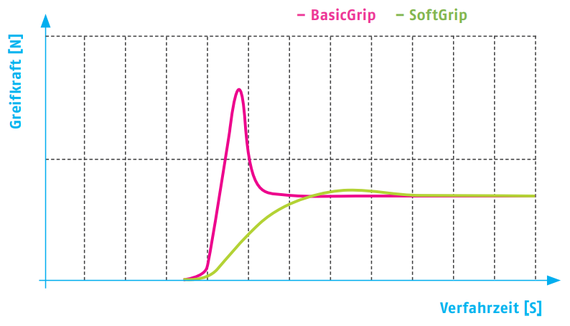
Gripping Mode EGK
Universal gripper EGU and small parts gripper EGK
BasicGrip and SoftGrip are available
BasicGrip: Gripping speed is automatically optimizied to the selected gripping force setting
SoftGrip: Particularly gentle gripping of fragile workpieces. Impulse forces are reduced to a minimum when hitting the workpiece
Permanent gripping and continuous operation of the motor in both gripping modes
Greifkraft
Verfahrzeit

Slide 26
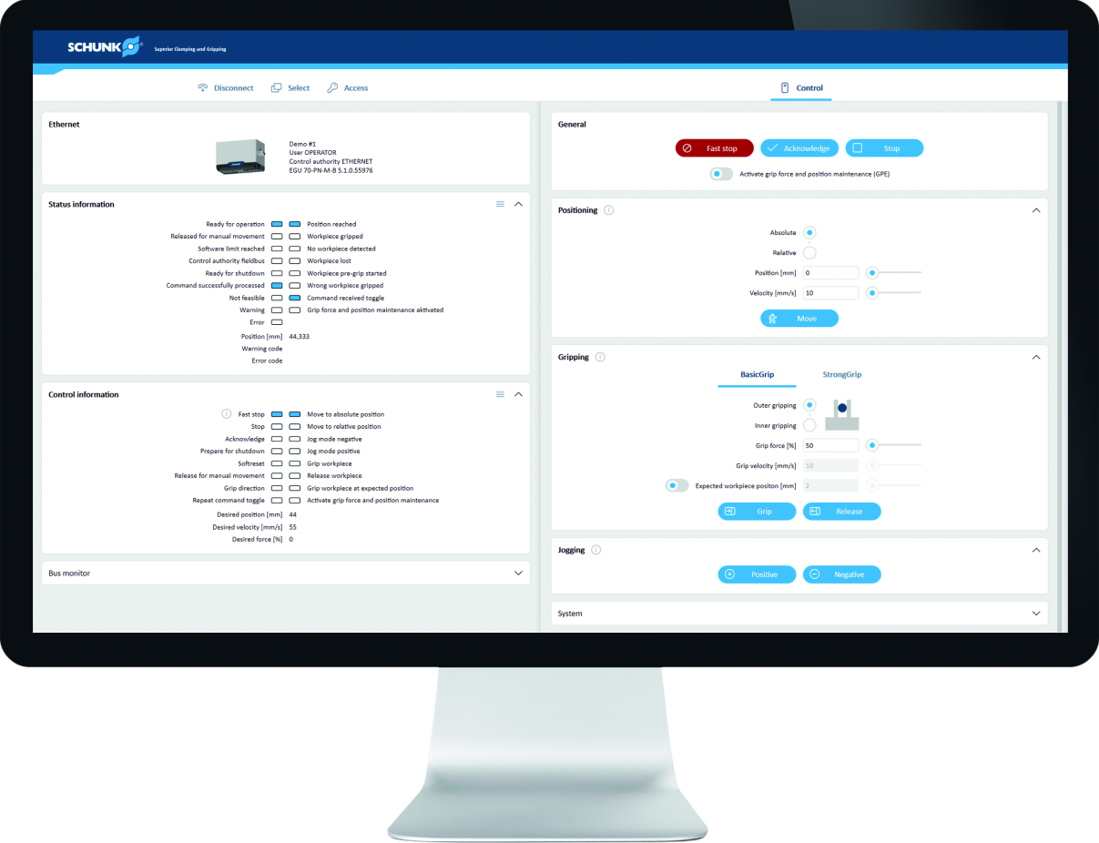
Commissioning Software MTSN2
Universal gripper EGU and small parts gripper EGK
Supports the user by easing the commissioning and parameterization effort
User-friendly use of all gripper functions without the need for a PLC
Additional functions: address assignment, diagnostics, firmware update, parameter backup and bus monitor
Initial application validations can be carried out in an uncomplicated manner
The gripper is connected to the computer directly via the network interface
Demo-Mode
available
Get it @ www.schunk.com/downloads-software

Slide 27
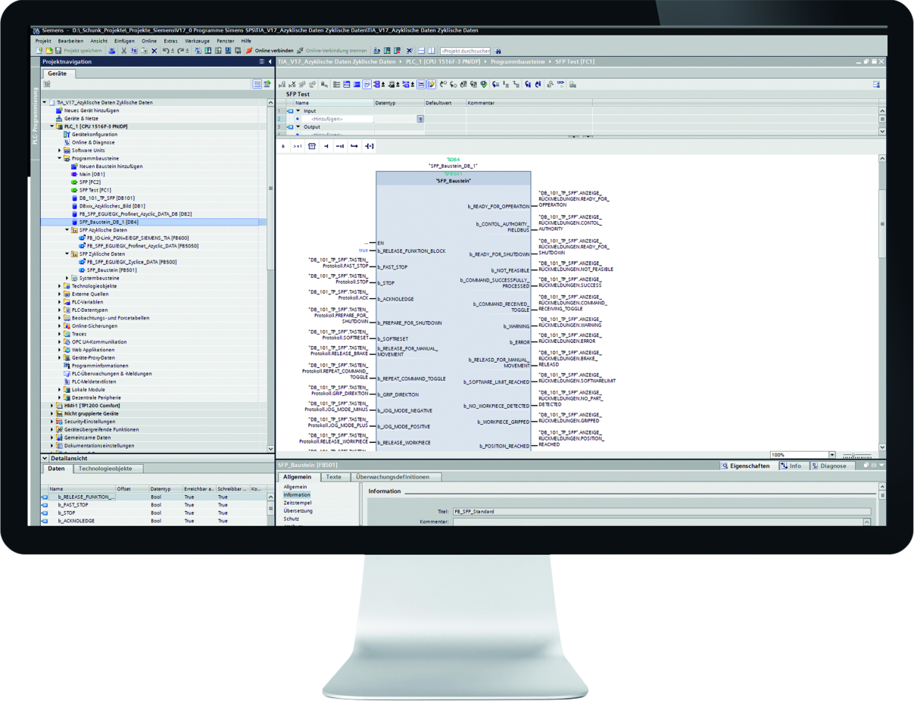



PLC integration via function blocks
Universal gripper EGU and small parts gripper EGK
Seamless interaction between gripper and PLC control
Available for leading PLC manufacturers
Reduces the programming effort to a minimum
Supported PLC manufacturers:
TIA Portal V17 for PROFINET and IO-Link
Studio 5000 Logix Designer for EtherNet/IP and IO-Link
TwinCAT 3.1 for EtherCAT and IO-Link
Get it @ www.schunk.com/downloads-software

Slide 28
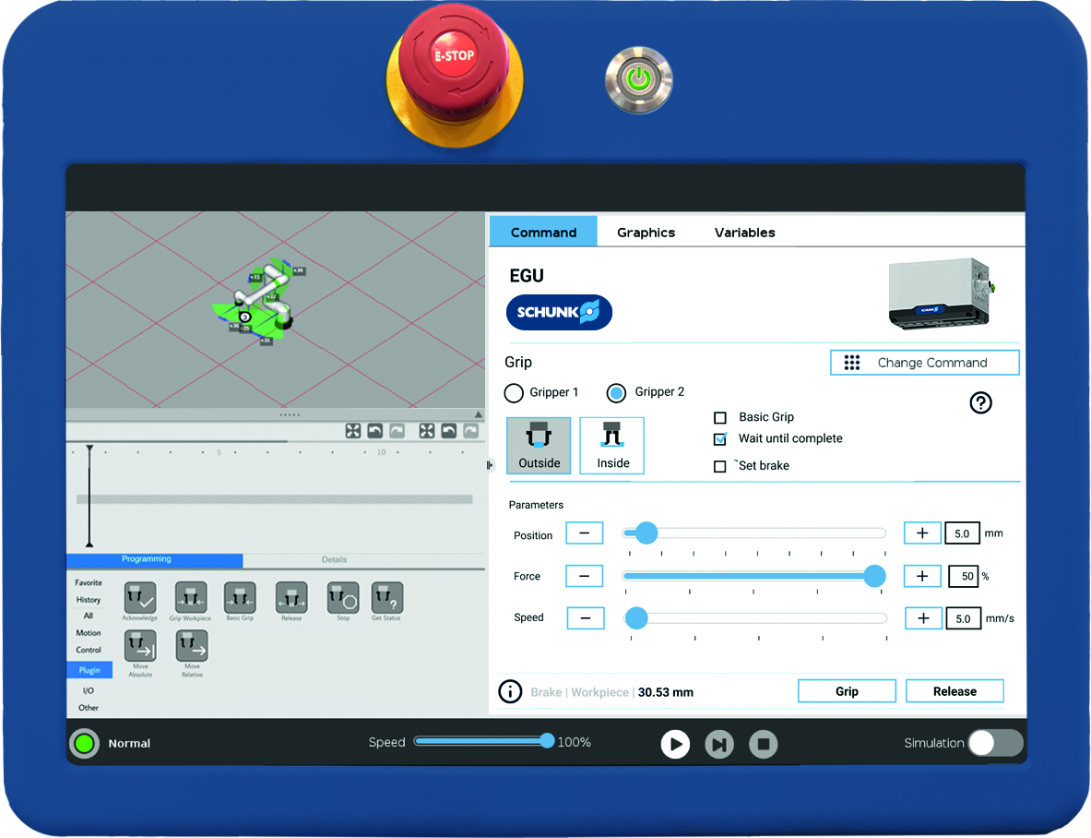




PLC integration via function blocks
Universal gripper EGU and small parts gripper EGK
Seamless interaction between gripper and PLC control
Available for leading PLC manufacturers
Reduces the programming effort to a minimum
Supported PLC manufacturers:
E-Series via Modbus RTU (tool port)
CRX-Series via Modbus RTU (tool port)
YRC1000micro & Smart Pendant via EtherNet/IP
Get it @ www.schunk.com/downloads-software
OmniCore C30 via EtherNet/IP

Slide 29
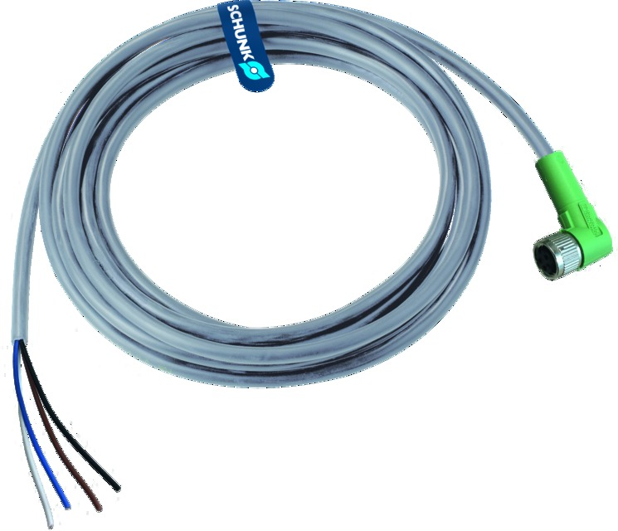
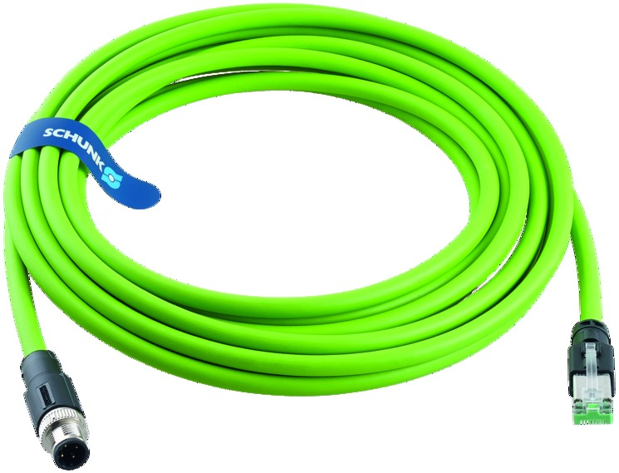
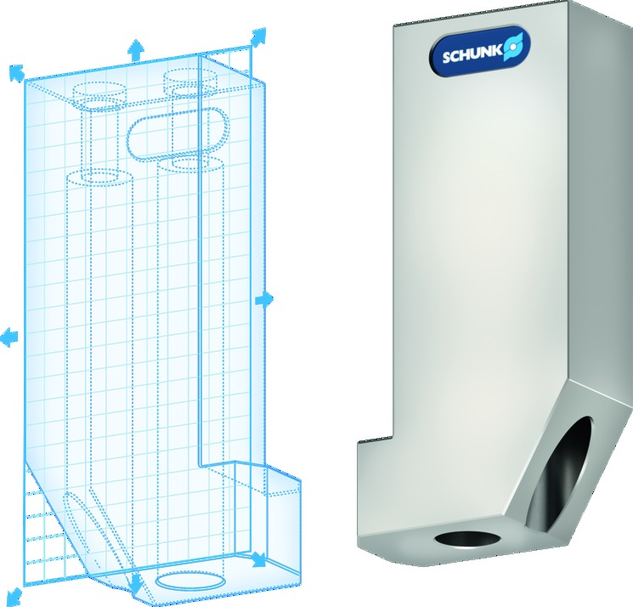
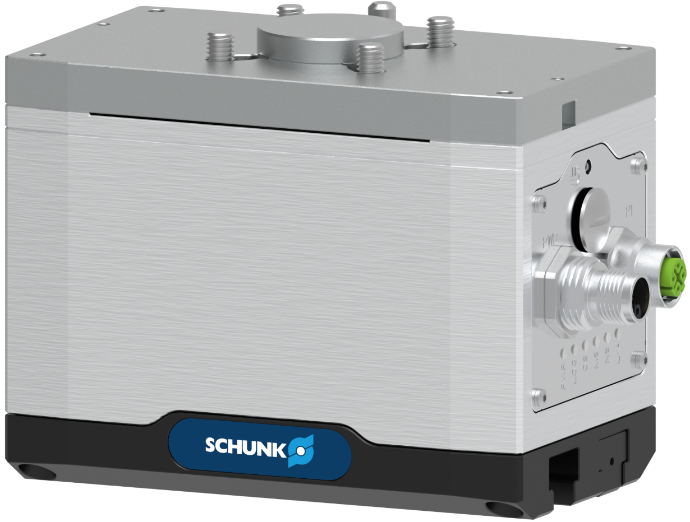
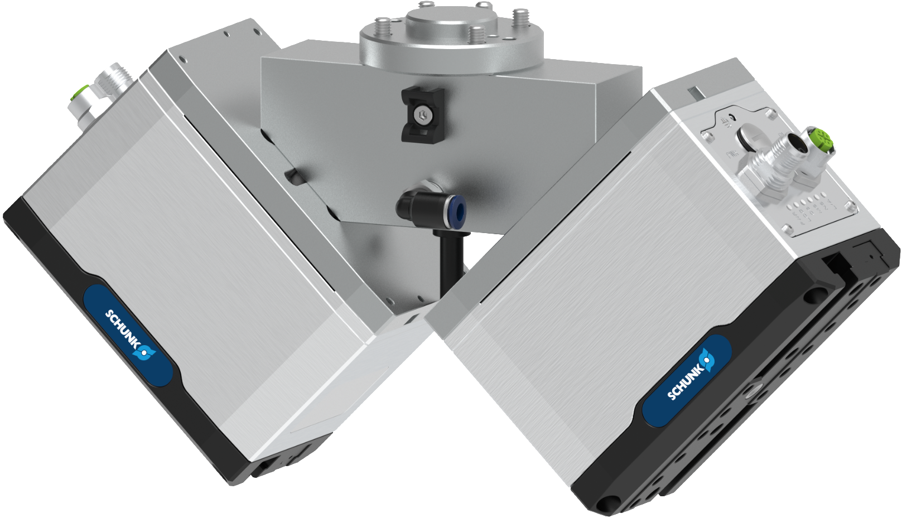
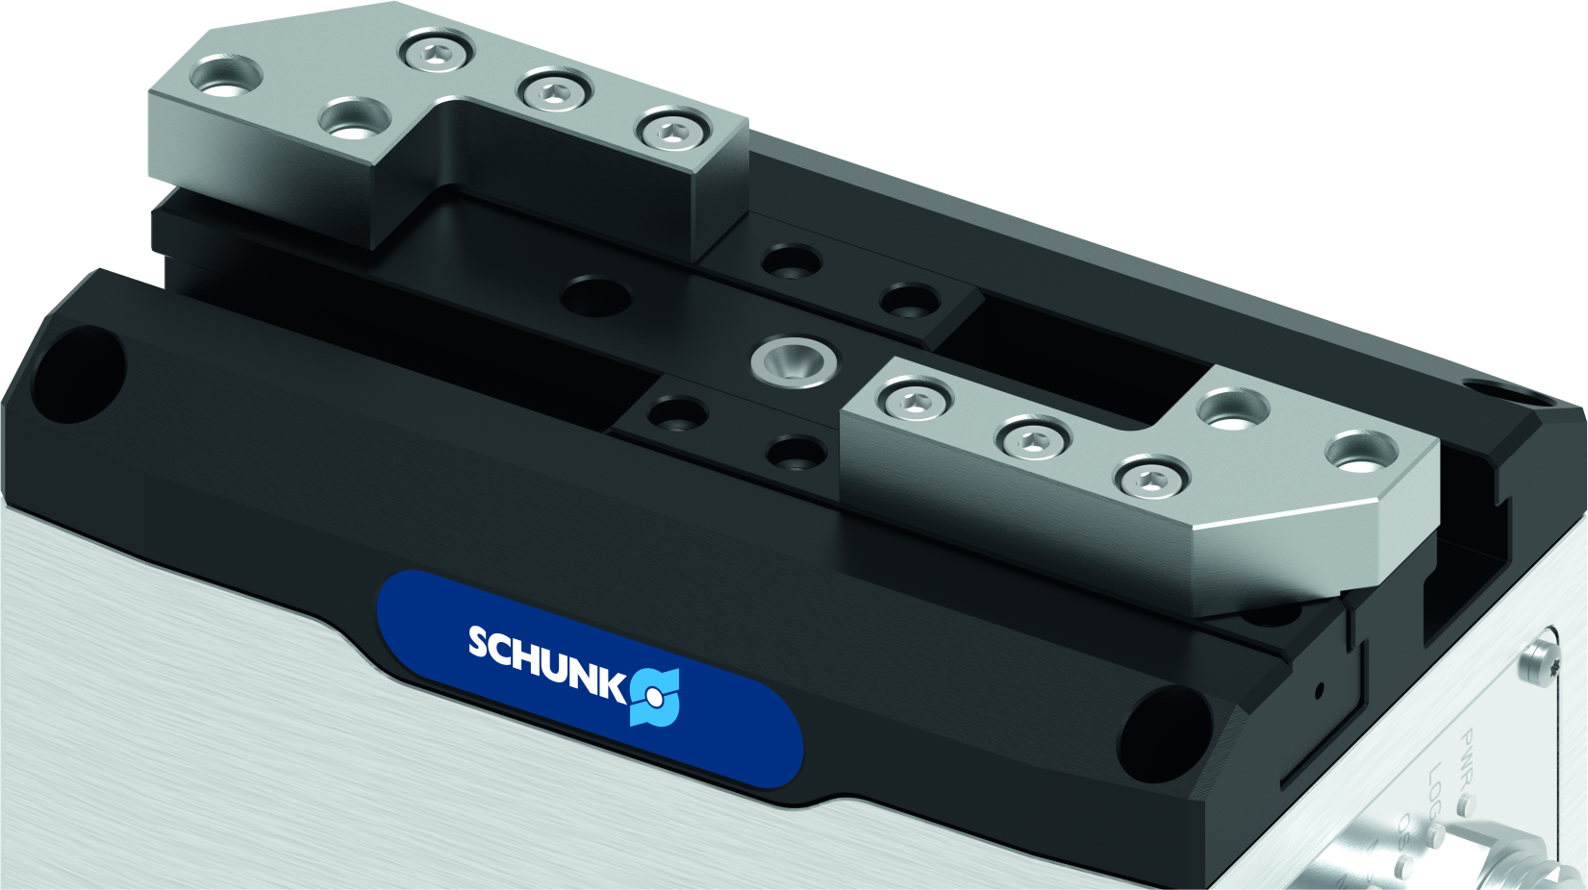
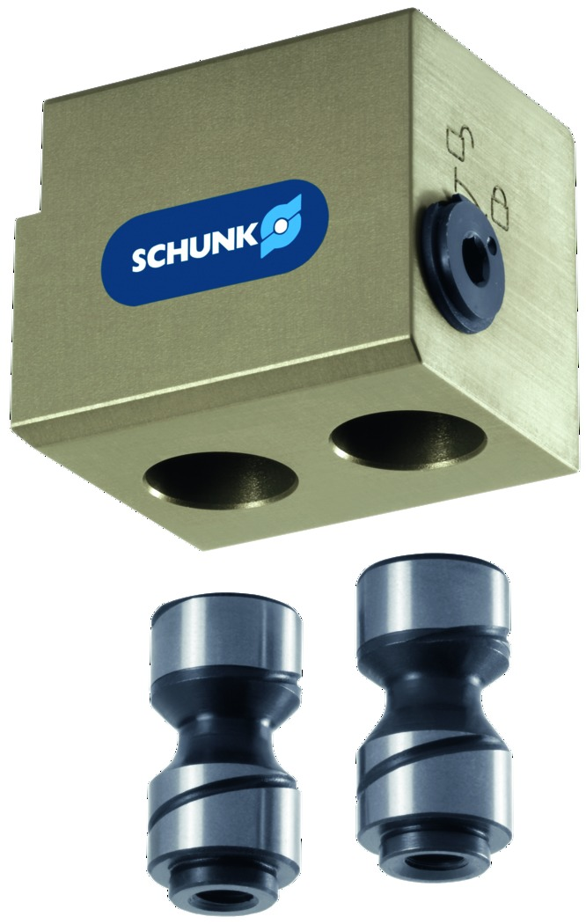
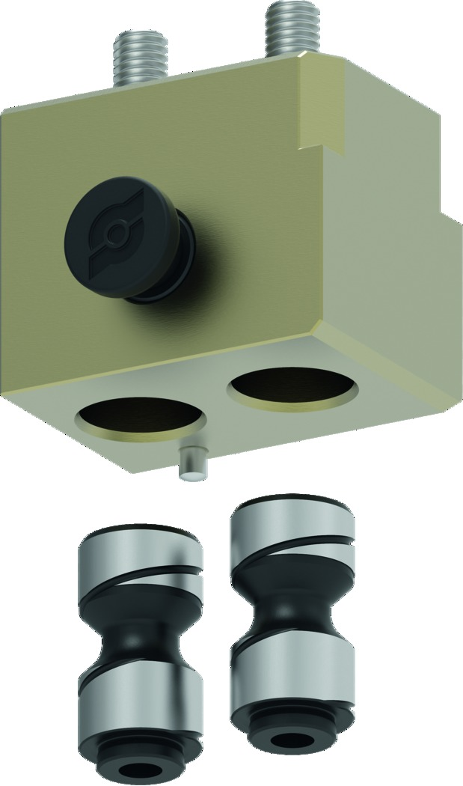
Accessories
Universal gripper EGU and small parts gripper EGK
Power and Communication Cables
for Industrial Ethernet and IO-Link
in 5- and 10-meter length,
Suitable for drag chain or robot applications with torsion,
angled and straight connectors
Single and Double ISO-Adapters
from ISO 31.5 to ISO 80, availibility for specific sizes according to reasonable configuration weight, made of a single piece of aluminium, blow-off-nozzle for double gripper, cable management for double gripper
Customized gripper fingers
configurable in a very short time via a license-free and browser-based web tool in combination with the intermediate jaw
Robot specific cable kits
for direct connection or external cabeling, for single or double gripper configuration
Intermediate jaws
for compensation of the lateral offset of the base jaws, aligned connection option, base jaw connection of PGN+P
Jaw quick-change system
BSWS and BSWS-M
in combination with intermediate jaw
(not available for EGK 25)

