Slide 1
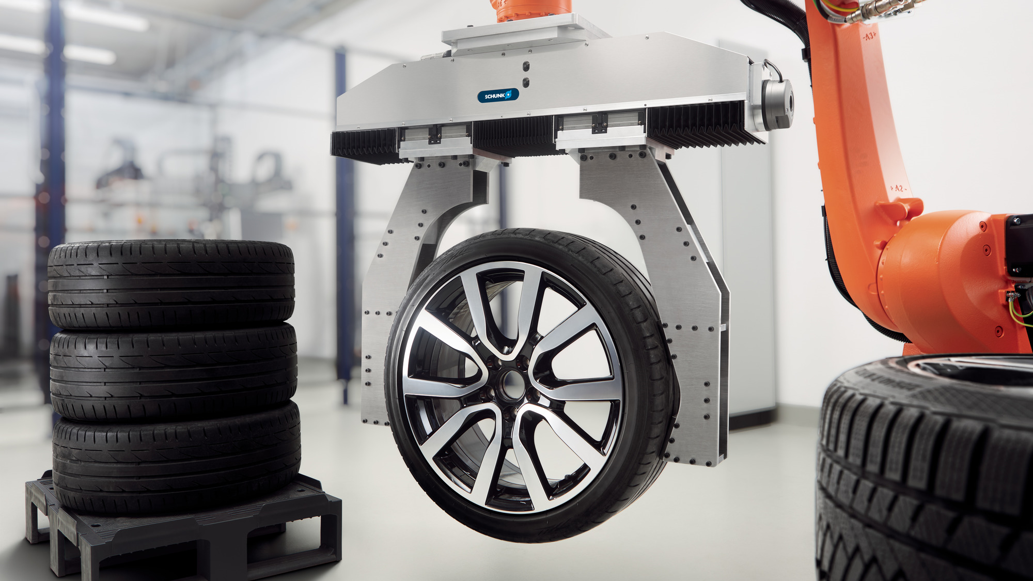

Short presentation
ELG

Slide 2
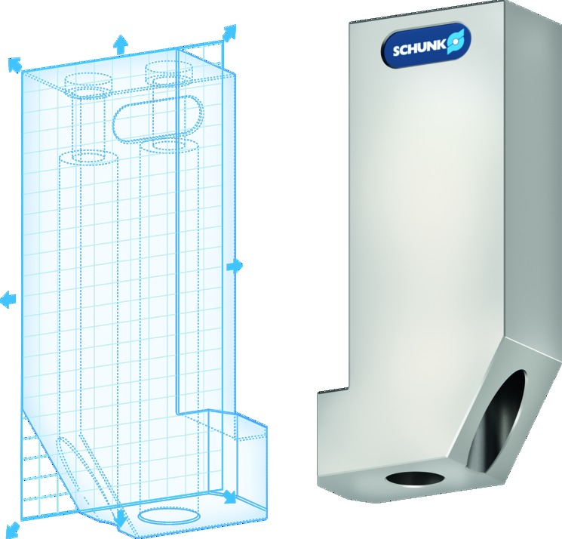
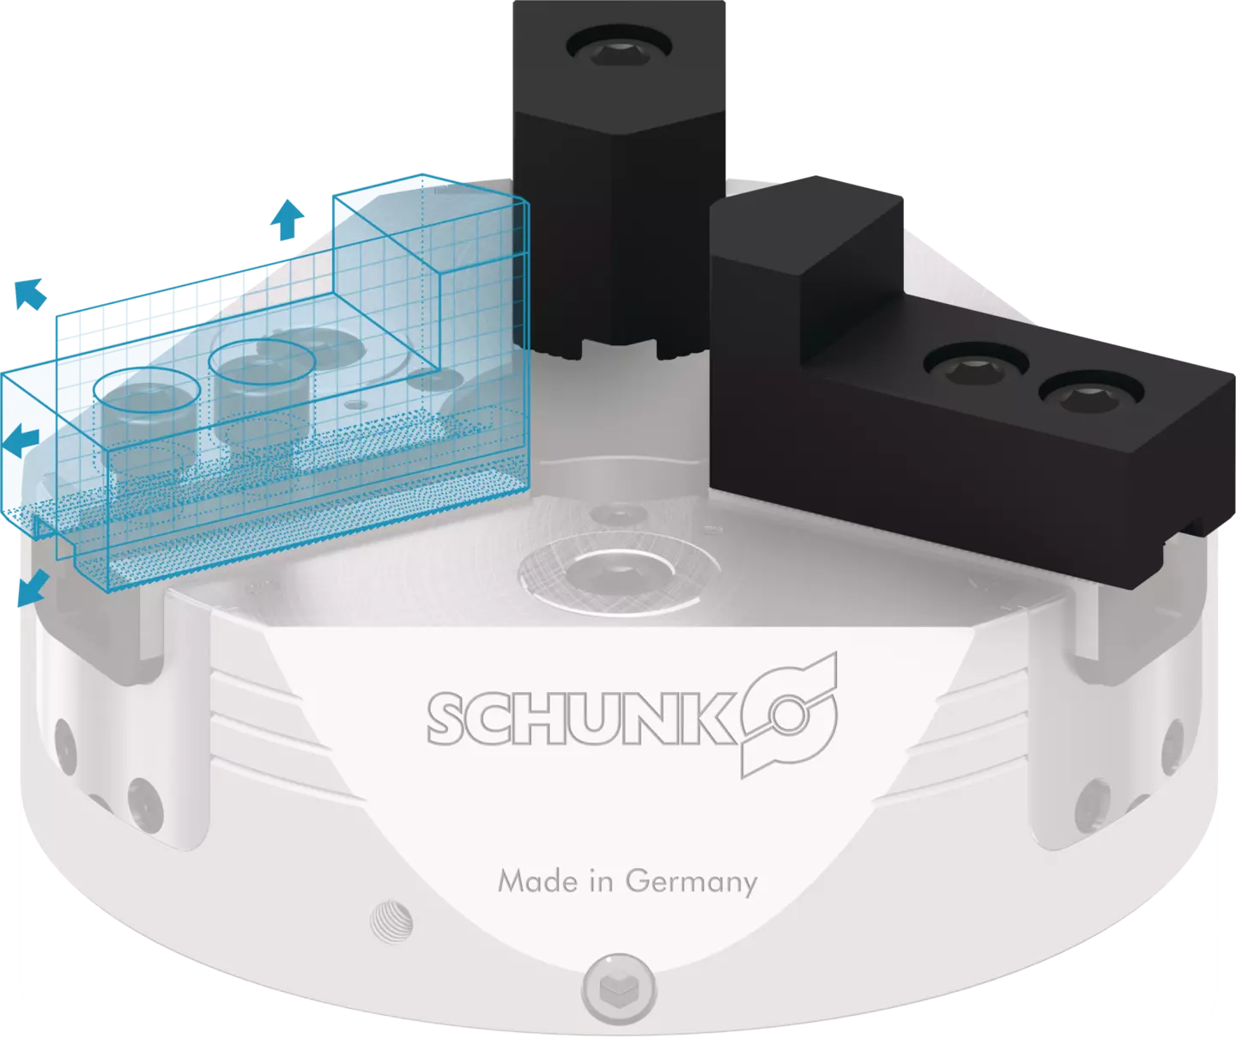
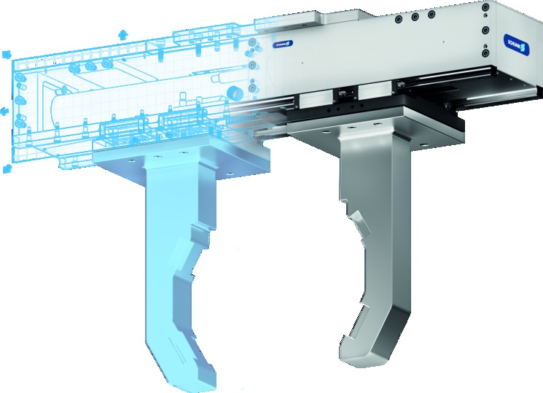
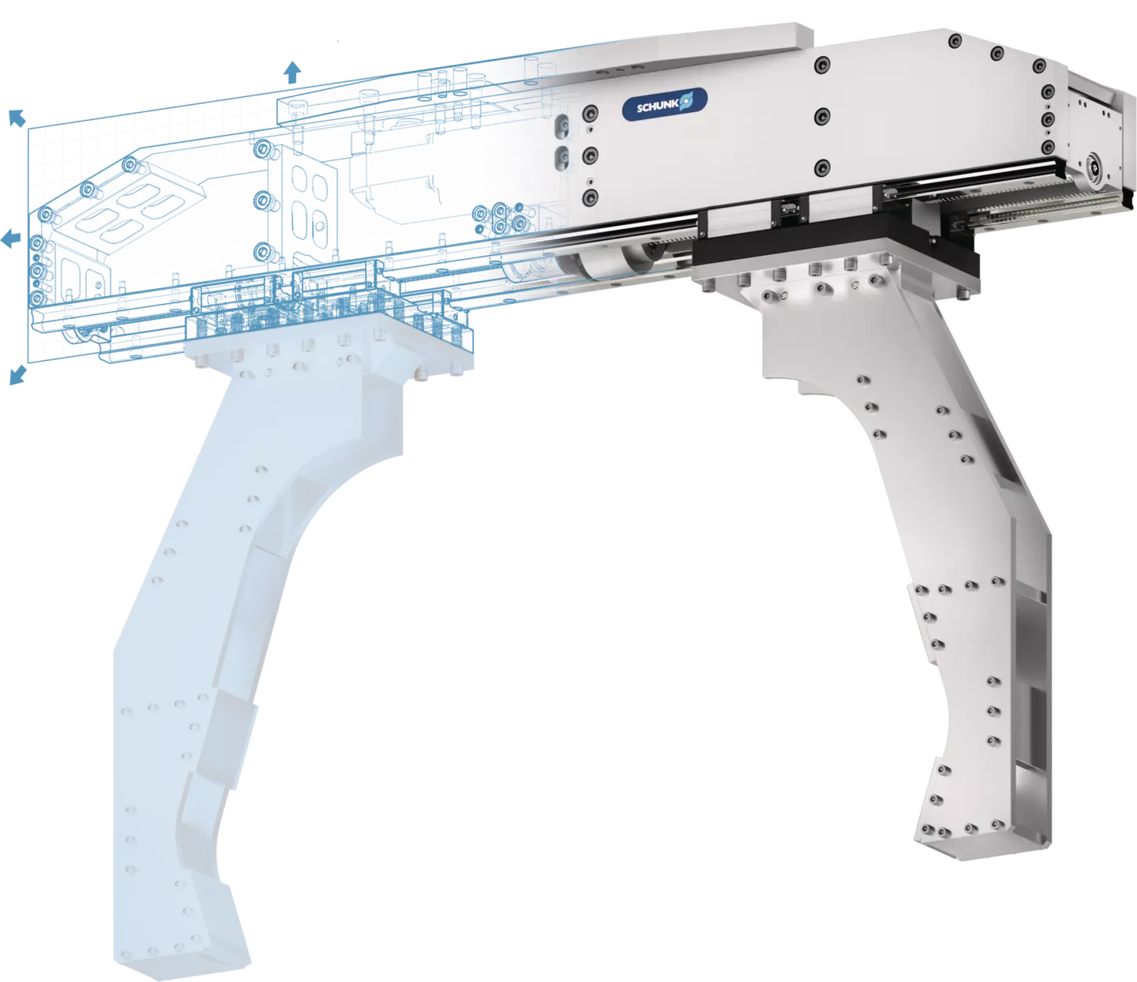
Configurators at SCHUNK

Slide 3
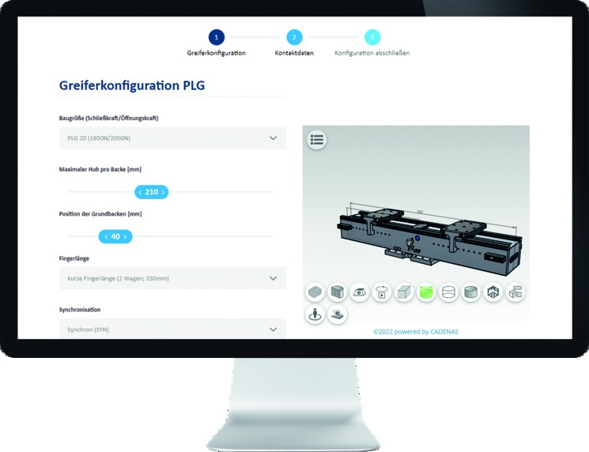
Why configuration?
Configurators at SCHUNK
Web-based & license-free online tool
→ No CAD program required
No development knowledge required
→ Saves resources
Product & CAD data
SCHUNK expert knowledge
→ Reduction of risk
Exclusion of incorrect/impossible configurations
Fast and simple
Price and delivery time

Slide 4
Placement in the portfolio

Slide 5
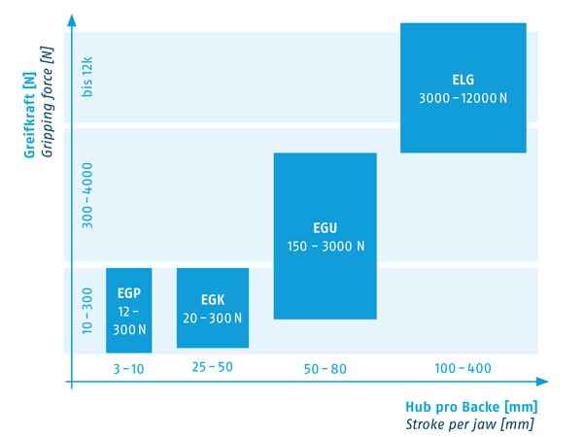
Portfolio-Strategy Mechatronic Gripping
Placement in the portfolio
ELG
1000 – 12000N
Notes:
LEG

Slide 6
Product presentation

Slide 7
Technical data
Product presentation
4 sizes
  ELG 10 gripping force 1.000 N
  ELG 30 gripping force 3.000 N​
  ELG 75 gripping force 7.500 N​
  ELG 120 gripping force 12.000 N​
Stroke from 100 mm - 400 mm (Per jaw)
Synchronous / or asynchronous variant
Finger length up to 800mm (in 2 versions)
For various drive motors (BOSCH, SIEMENS, Allen-Bradley, KUKA, FANUC, SEW)​
  Other motors on request
The electric gripper for large
workpieces with stroke configurable
in mm-steps

Slide 8
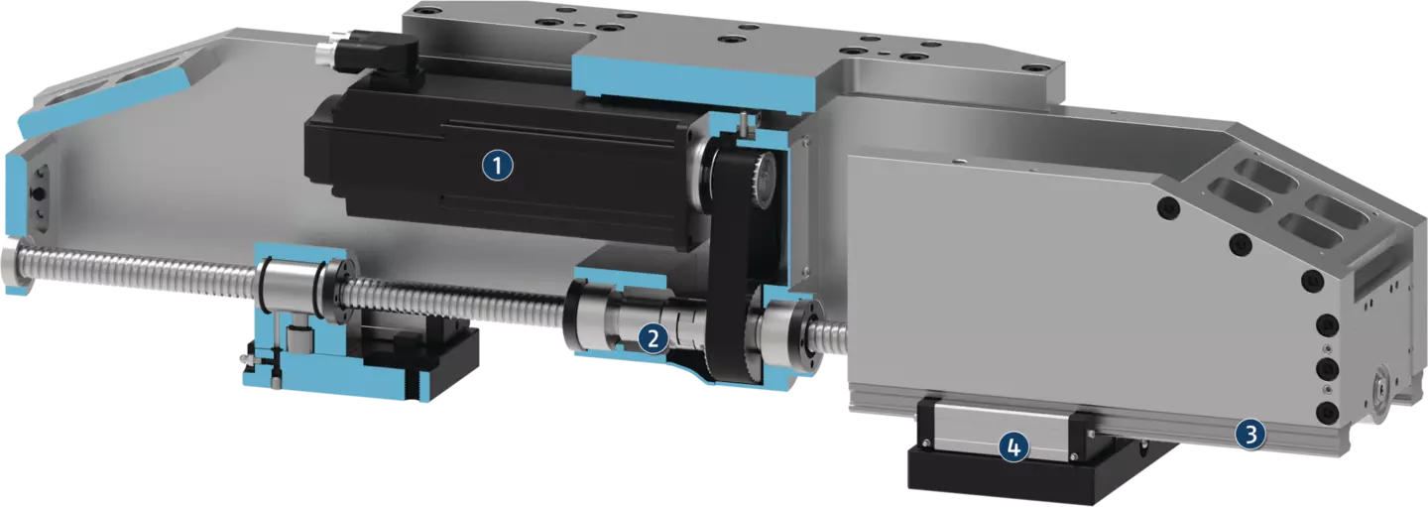
Functional description
Product presentation
Drive motor
Kinematics
Linear guiding
Base jaw

Slide 9
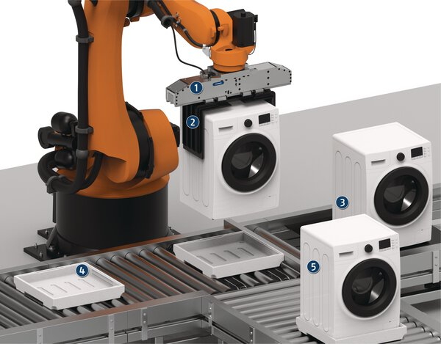
Application example
Product presentation
Handling of washing machines in the end-of-line packaging process
Application-specific large stroke gripper ELG
Gripper fingers
„Feeding“ washing machine
Feeding packing
Further transport of the packed washing machine

Slide 10
Application video
Product presentation
https://www.youtube.com/watch?v=EgEsUy_knxE&t=2s

Slide 11
Variants and options

Slide 12
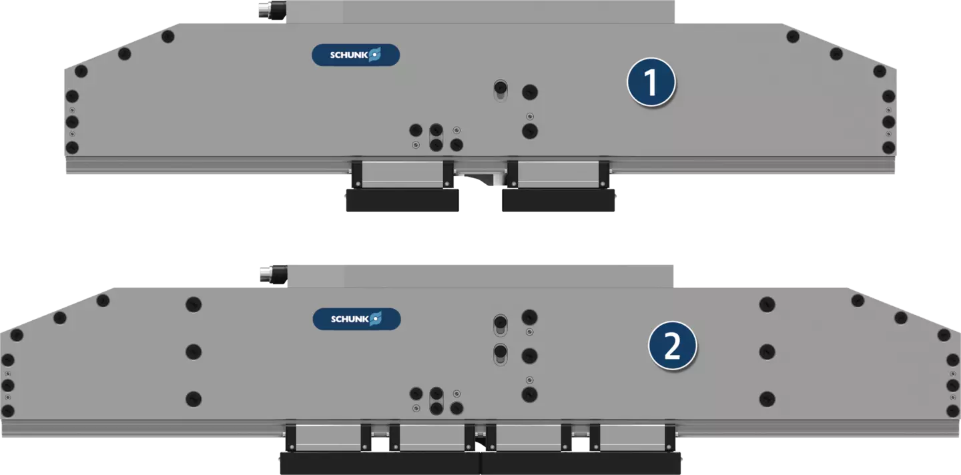
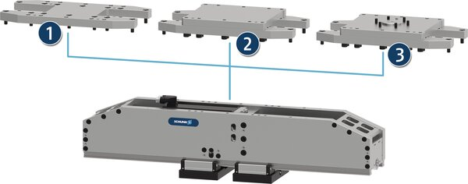
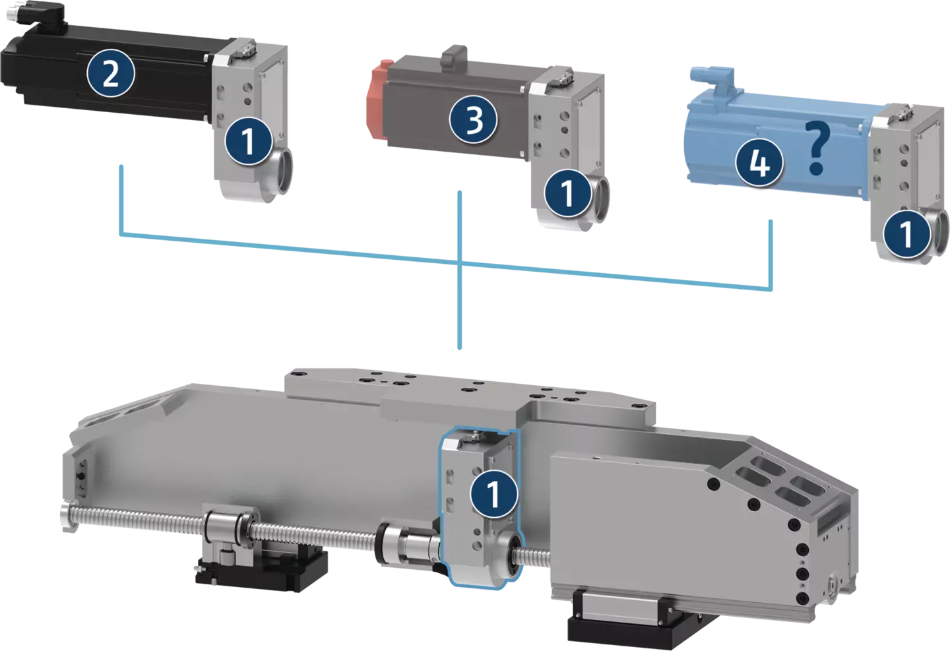
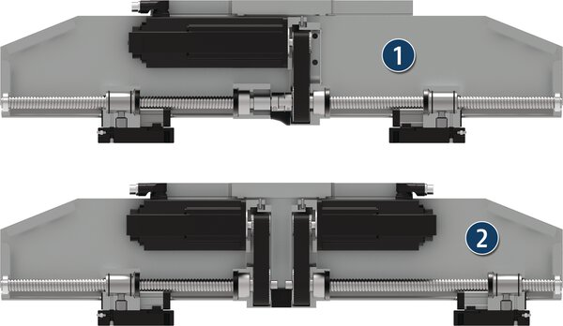
Configurable variants
Variants and options
The gripper can be configured in two finger versions.
2 carriages per base jaw
4 carriages per base jaw
Different mounting options can be configured.
One piece adapter
Adapter two-piece (with blank)
Adapter two-piece with ISO flange
Finger version
Gripper mounting
Various drive motors can be adapted to the gripper to enable flexible control and integration into existing control concepts.
Synchronous drive with one drive motor (1) or
asynchronous drive with two drive motors (2) possible.
Synchronous / Asynchronous
Drive motors

Slide 13
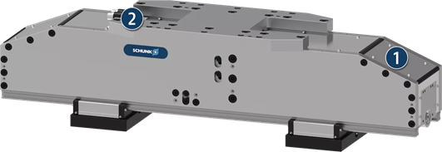
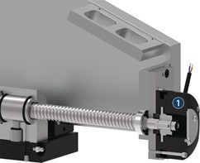
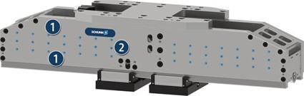
Configurable options
Variants and options
The cover plates close the gripper on the mounting side. This increases the protection against external influences.
Cover plates
The electrical holding brake blocks the movement of the spindle and thus effectively clamps the position of the base jaws.
Lateral mounting options
on the gripper for additional attachments such as cameras, sensor distributors, blow-out nozzles, etc..
Can’t be combined with the "Weight Optimization" option.
Position clamping
Lateral mounting options

Slide 14
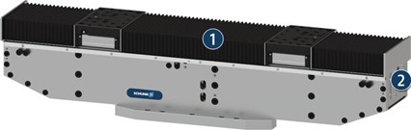
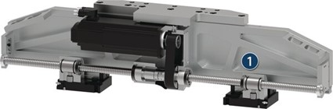
Configurable options
Variants and options
The bellow closes the gripper on the side of the base jaws. Only possible in combination with "Cover plates" option.
Improves the protection of the gripper against environmental influences.
Bellow
Cut-outs in the side plates reduce the weight by up to 15%.
Can't be combined with the "lateral mounting options" option.
Weight optimization

Slide 15
Configurator

Slide 16
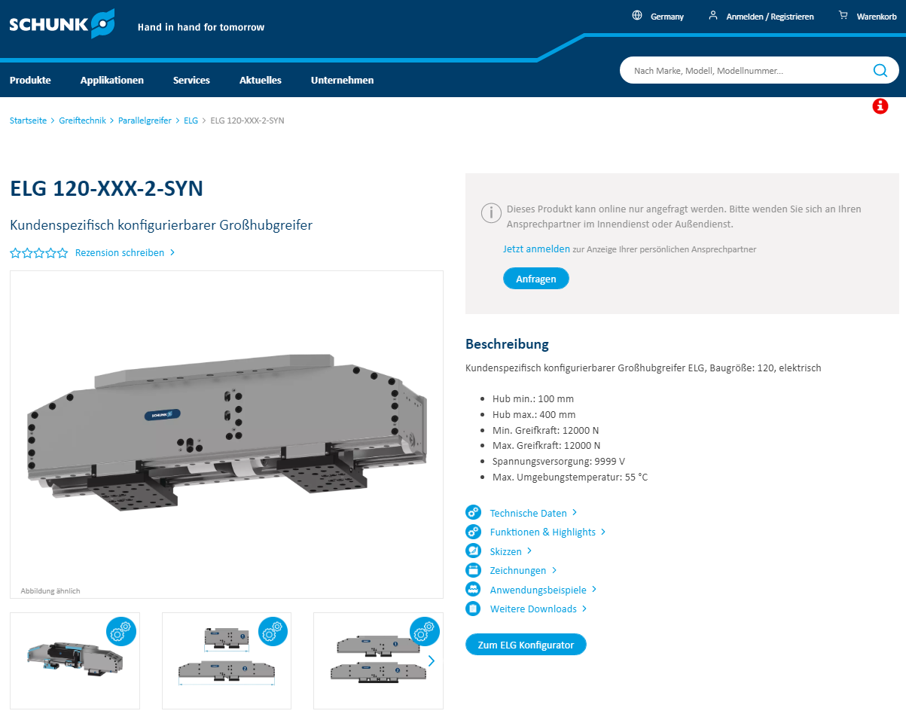
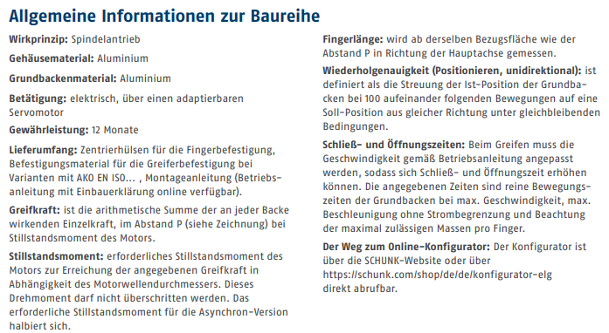
The way to the configurator
Configurator
Via series page
Via product page
Via link in catalog chapter
Via direct link: https://schunk.com/de/de/konfigurator-elg

Slide 17
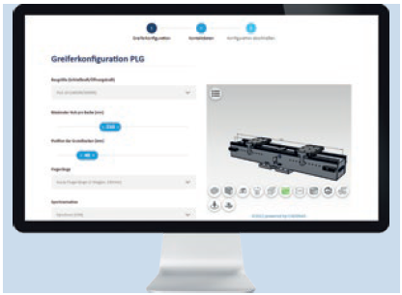
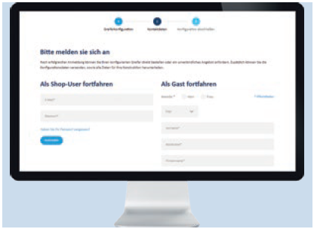
In three steps to the customized large stroke gripper
Configurator
Step 1: Gripper configuration
The price and delivery time of the current design status are displayed immediately
and the 3D preview visualizes it in real time.
Size selection
Configuration of the gripper stroke
Selection of the variant (finger variant, synchronization, gripper mounting...)
Selection of options (position clamping, weight optimization...)
Step 2: Contact details
Online Login
Login with SCHUNK shop user account or
Login as guest

Slide 18
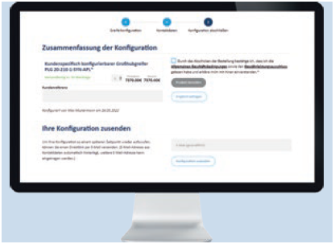
In three steps to the customized large stroke gripper
Configurator
Step 3: Complete configuration
CAD download, requesting a quote, or ordering the configured gripper
Specify the number of grippers
Order product directly or
Request a quote (to order from SCHUNK via the usual ordering processes)
Send configuration as a link
Download the CAD-files

