Slide 1

Product presentation
PGL-plus-P
Universal gripper

Slide 2
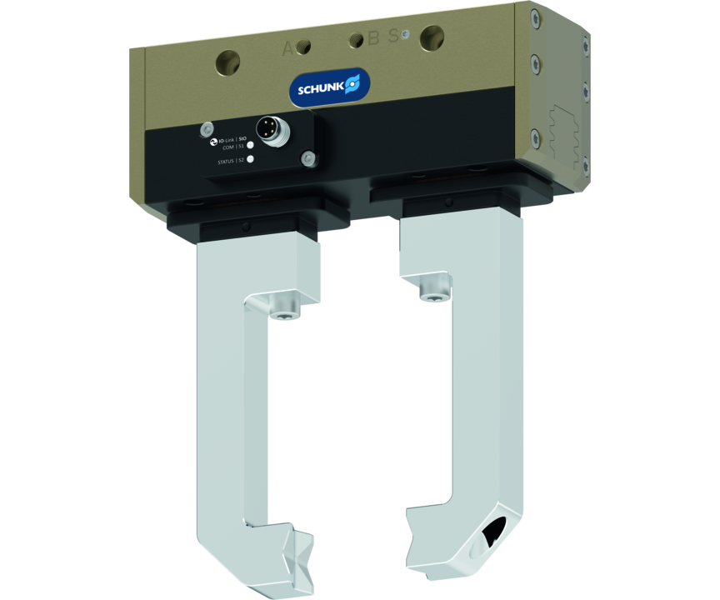
Universal gripper
Universal 2-finger parallel gripper with a large jaw stroke, integrated sensor system and high payload due to use of a multi-tooth guidance
The world's first pneumatic gripper with safe and certified gripping force maintenance.
100% safe and certified

Slide 3

Flexible. Robust. Safe.

Slide 4
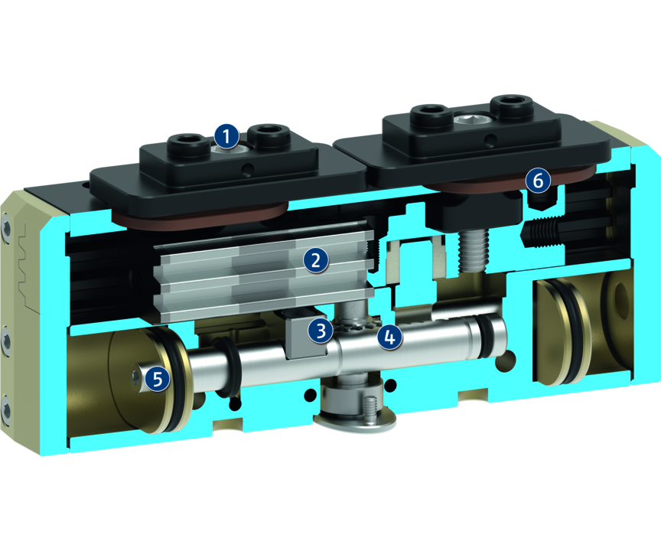
Principle of function
Functional description
By applying pressure to the opposing drive pistons, the multi-tooth guided base jaws are directly driven via a drive type fastening. The jaw stroke is synchronized by means of rack-and-pinion kinematics. This ensures powerful and centric opening and closing of the gripper.
1
Base Jaw
2
Multi-tooth guidance
3
driver
4
Kinematics
5
Pneumatic drive piston
6
Dust cover

Slide 5
Advantages – Your benefits
Secure, certified gripping force maintenance, GripGuard Holds the gripped workpiece safely and also ensures a permanent gripping force of min. 80% in case of pressure drop. It also ensures that no dangerous, spontaneous jaw movements can occur in the event of a pressure drop.
Integrated sensor system for precise and process-reliable monitoring of the complete gripper stroke via IO-Link
Large jaw stroke enables flexible handling of a wide range of parts
Dirt protected due to IP 64 as standard and the metal-encapsulated, additionally sealed design at the base jaws
Robust interior multi-tooth guidance for high moments and use of long gripper fingers
With food-compliant lubrication as standard as a solution for an easy entry into medical technology, lab automation, pharmaceutical and food industry. The requirements of EN 1672-2:2020 are not fully met.
Fastening on two gripper sides in four screw directions for universal and flexible gripper assembly
Air supply via hose-free direct connection or screw connections for universal and flexible gripper assembly

Slide 6
Technical data
Technical data overview
Size | Stroke per jaw | Closing force | Opening force | Recommended workpiece weight | Weight | Max. permissible finger length
 | [mm] | [N] | [N] | [kg] | [kg] | [mm]
10 | 10 | 220 .. 300 | 220 .. 300 | 1.1 | 0.46 .. 0.5 | 100
13 | 13 | 350 .. 480 | 350 .. 480 | 1.8 | 0.8 .. 0.85 | 130

