Slide 1

Product presentation
MTB
Parallel gripper

Slide 2
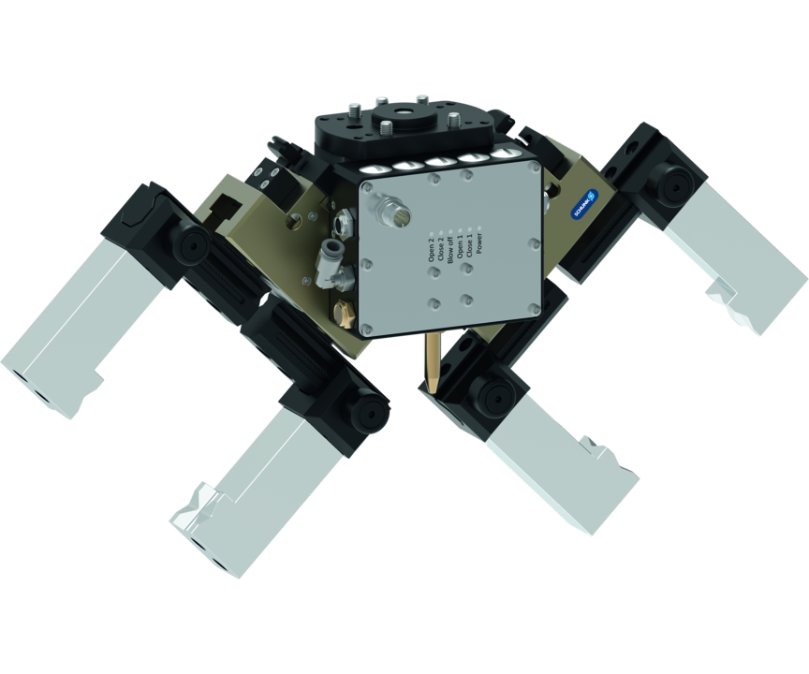
Parallel gripper
The MTB application kits enable quick and easy implementation of automated machine loading. The specific application kits take on the important key role of workpiece handling and workpiece clamping. They seamlessly fit into the machine environment.
The right bundles for a quick entry into automated machine loading and unloading
Ready for operation on the robot in five steps

Slide 3

Modular. Flexible. Easy.

Slide 4
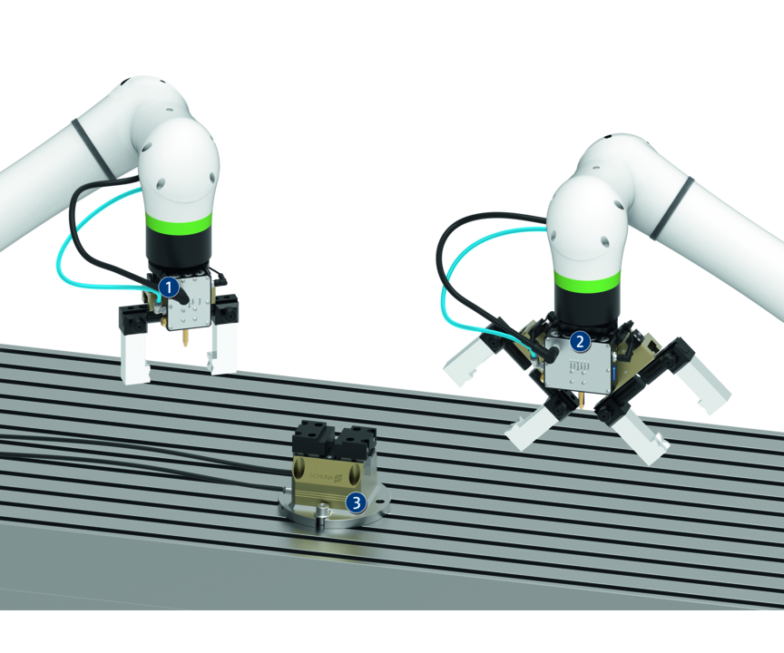
Principle of function
Functional description
The robot is an important key element in automated machine loading. It deals with the feeding of raw parts and also removes the finished products. The MTB application kits combine the SCHUNK SYNERGY from gripping and clamping technology and provide support both when clamping the workpieces within the machine and when handling them with the robot.
1
Single gripper
2
Double gripper
3
Clamping force block

Slide 5
Advantages – Your benefits
The perfect match. Due to the high application specialization of the application kits, you do not have to search long for a suitable solution. Use your time for more important things.
Increased productivity. You don't have an employee available for a third shift? Let the robot work for you.
Relieve employees. Protect your employees from dirty, dangerous and tedious tasks such as manual loading and cleaning operations.
Plug & work. The seamless integration of the components into the robot control system saves you from having to carry out extensive integration work.

Slide 6
Technical data
Technical data overview
Description | Stroke per jaw | Weight | Closing force | Opening force | Recommended workpiece weight
 | [mm] | [kg] | [N] | [N] | [kg]
Single Gripper JGP-P 80 | 8 | 0.99 | 550 | 610 | 2.75
Single Gripper JGP-P 100 | 10 | 1.38 | 870 | 930 | 4.35
Double Gripper JGP-P 64 | 6 | 1.62 | 350 | 375 | 1.75
Double Gripper JGP-P 80 | 8 | 2.1 | 550 | 610 | 2.75
Vise PGS3 100 | 2 | 5

