Slide 1
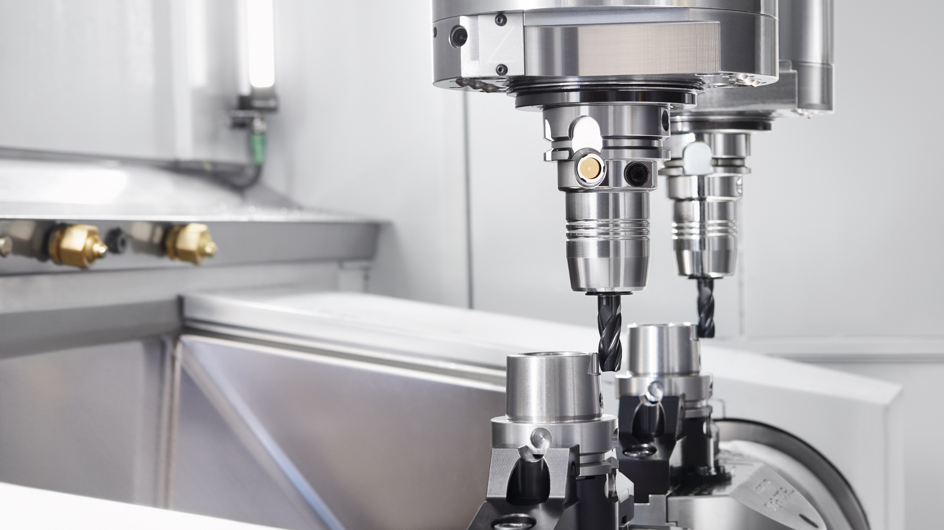

iTENDO² the intelligent way to an optimized process
Thomas Wittkowski

Slide 2
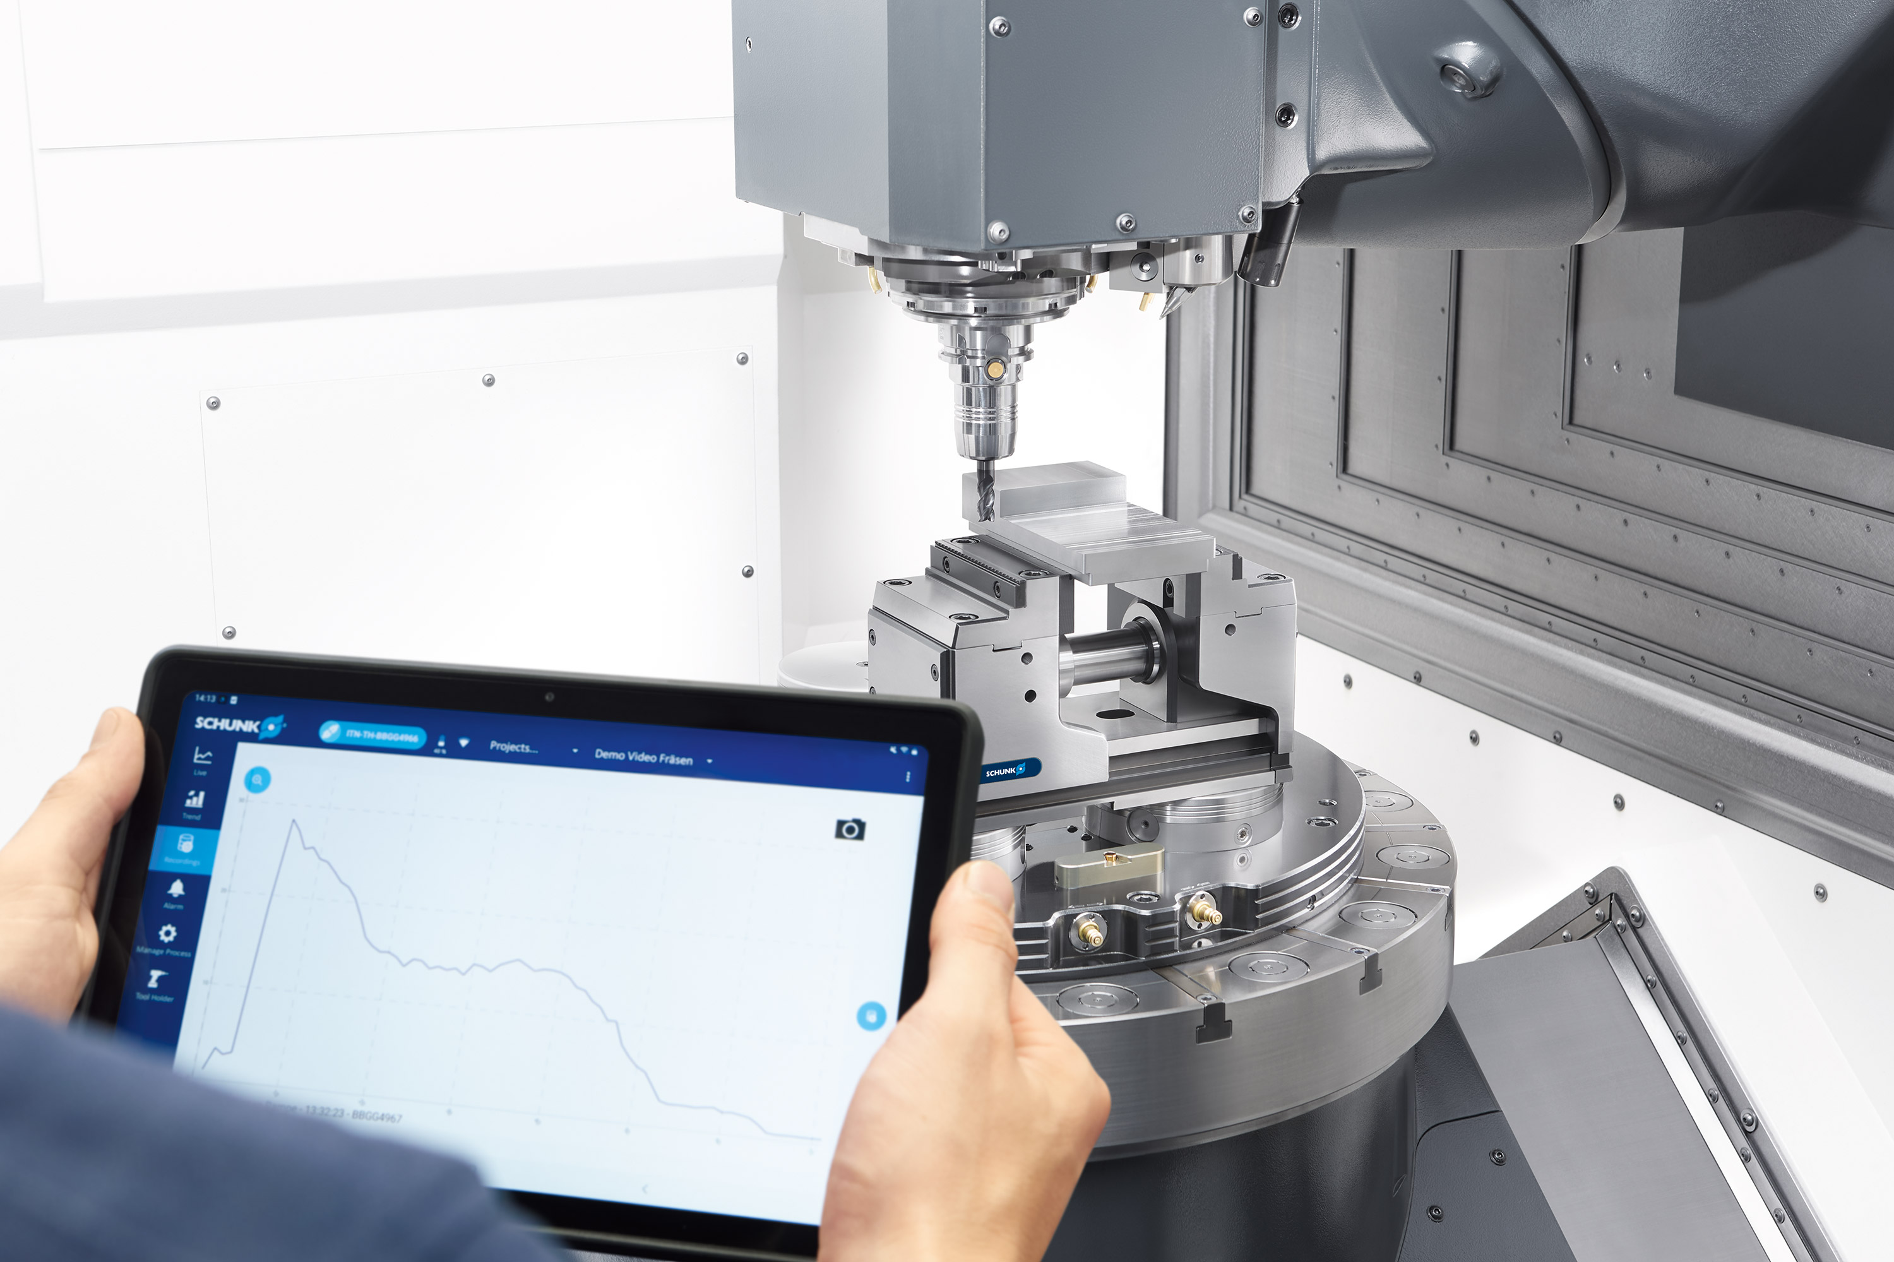

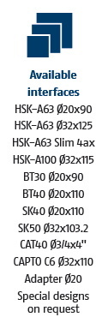
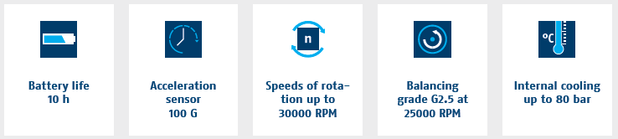
Acceleration sensor 100G integrated
Detecting vibrations close to the process
Wireless signal transmission to tablet
30.000 rpm
No change of contour compared to SCHUNK standard toolholder

Slide 3
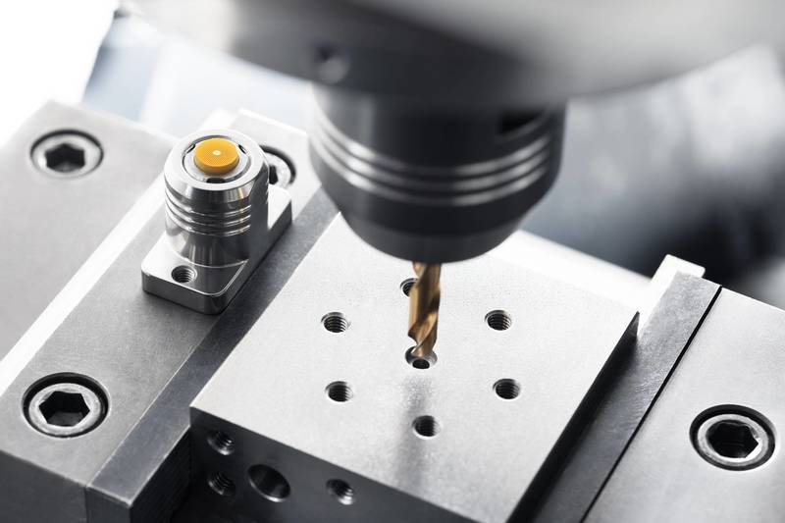
iTENDO² seismo as static version with magnetic base
Very simple to position in the machine room
Immediately ready for use without preparation
Wireless signal transmission to tablet

Slide 4
Newest presentation iTENDO²
iTENDO²
Newest presentation available in iTENDO TEAMs folder:
https://schunkgmbh.sharepoint.com/:f:/r/sites/iTENDOGesamt-O365/Freigegebene%20Dokumente/065-%20Sales%20DE%20-%20EN/ENGLISH/presentations?csf=1&web=1&e=jc6Gp8
Access to iTENDO TEAMs folder is managed by Thomas Wittkowski.

Slide 5
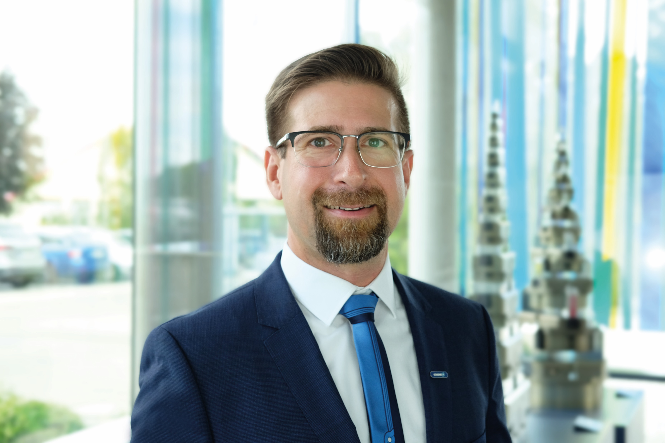
Contact at SCHUNK:
Thomas Wittkowski
Product Specialist iTENDO
thomas.wittkowski@de.schunk.com
Mobil: +49 151 72122408

