Slide 1

Product presentation
HLM
Stroke module

Slide 2
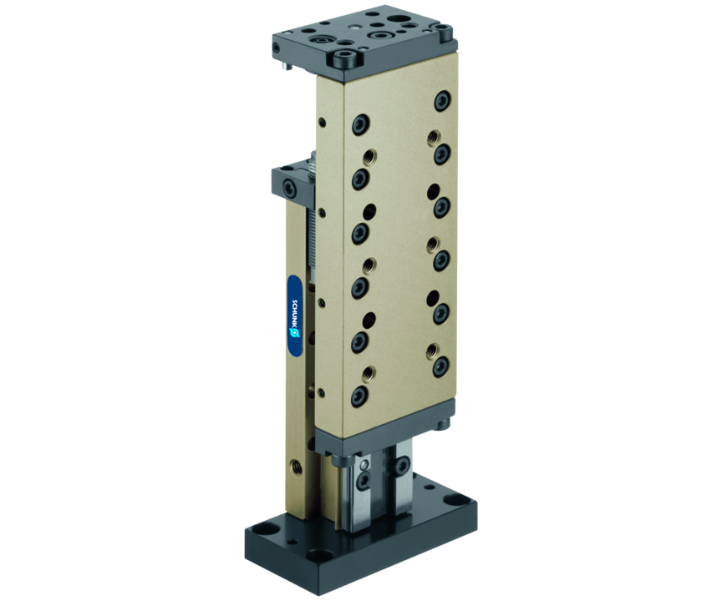
Stroke module
Stroke module with optimized length, with pneumatic drive and pre-loaded crossed roller bearings, free from play

Slide 3

Modular. Compact. Loadable.

Slide 4
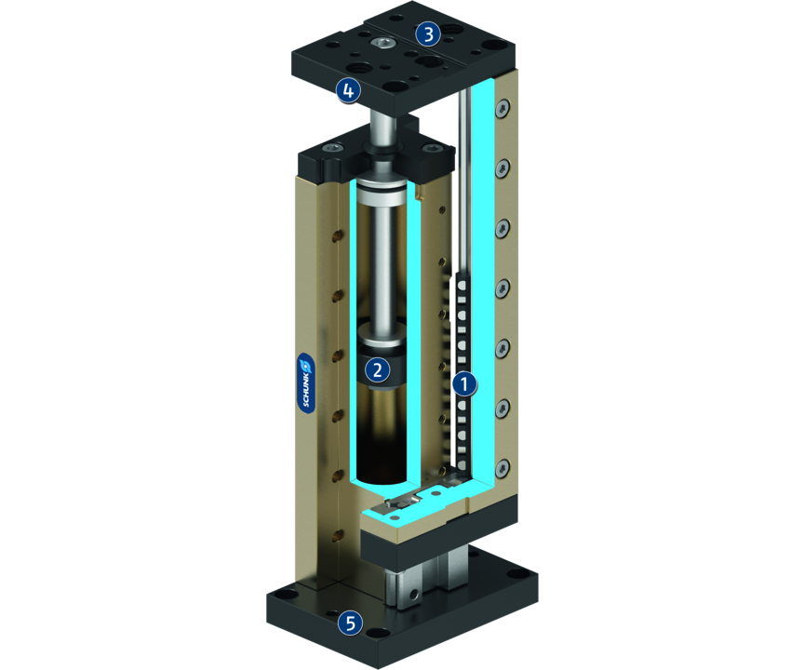
Principle of function
Functional description
The linear sliding movement is facilitated by a drive piston that is actuated with compressed air.
1
Cross roller guidance
2
Drive
3
Mounting pattern
4
Damping adjustment
5
Module fastening

Slide 5
Advantages – Your benefits
Crossed roller guide design and solid design ensured high load bearing capacities and end position accuracy in all installation positions
Pretensioned junction rollers That means absolutely scope-free
High basic load ratings in all load directions
Standardized fixing bores and connection dimensions identical for LM series for numerous combinations with other components from the modular system
Shock absorbers and proximity switches integrated in the projecting surfaces for vibration-free movements and end position monitoring
Rod lock by means of clamping cartridge for safety in case of emergency stops

Slide 6
Technical data
Technical data overview
Size | Stroke | extend force | retracted force | Weight
 | [mm] | [N] | [N] | [kg]
25 | 25 .. 59 | 67 | 50 | 0.5 .. 0.66
50 | 25 .. 100 | 120 | 103 | 0.85 .. 1.39
100 | 25 .. 150 | 294 | 247 | 1.62 .. 3.24
200 | 50 .. 150 | 482 | 415 | 3.42 .. 5.64

