Slide 1

Product presentation
PMP
Gantry axis

Slide 2
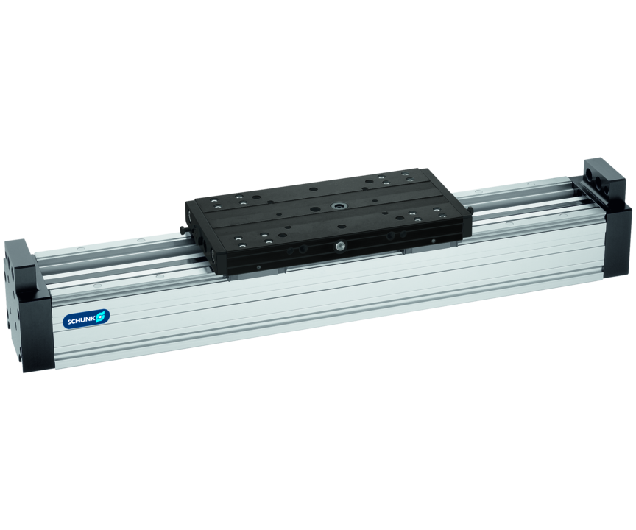
Gantry axis
Linear axis with integrated pneumatic drive cylinder and pretensioned recirculating ball-bearing guides, free from play

Slide 3

Loadable. Modular. Precise.

Slide 4
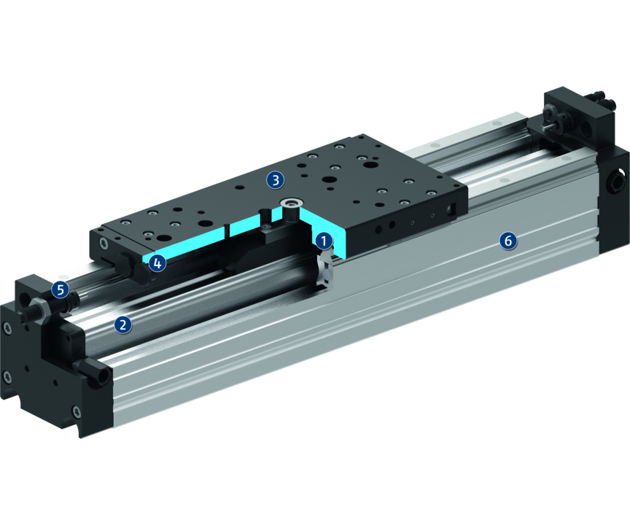
Principle of function
Functional description
The axis carriage is driven by a rodless pneumatic cylinder and precisely guided profiled rail guides.
1
Profiled rail guide
2
Drive
3
Mounting pattern
4
Damping adjustment
5
End position adjustability
6
Profile

Slide 5
Advantages – Your benefits
High moment load capacity due to the use of high-performance profiled rail guides
High degree of rigidity due to special extruded profile geometry
A ground serration ensures high precision and surface quality of the base jaws as well as an increased service life through machined locating surfaces for the guide
Efficient complete solutions due to numerous axis combination possibilities
Manifold options (cable drag chain, bellow, intermediate position, etc.) for special optimization to fit your particular application
Standardized mounting bores for numerous combinations with other components from the modular system

Slide 6
Technical data
Technical data overview
Size | Weight
 | [kg]
16 | 3 .. 4
25 | 6.8 .. 8.8

