Slide 1

Product presentation
KLM
Stroke module

Slide 2
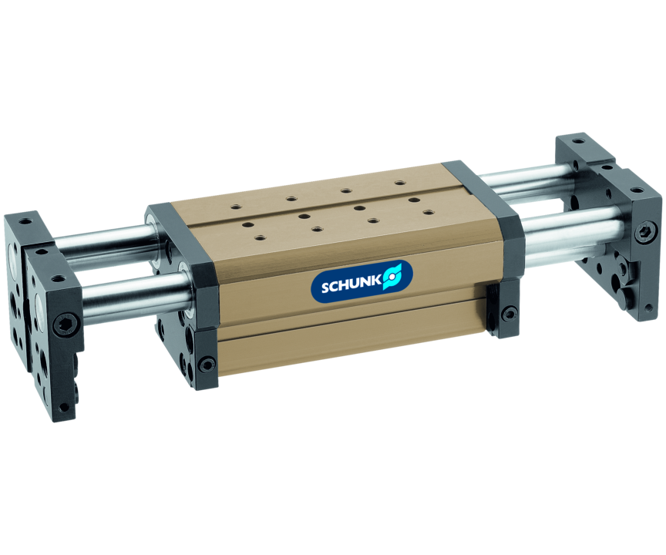
Stroke module
Linear module with pneumatic drive and ball bushing guide
The linear module with round guides and the most possible combinations from the modular assembly automation system.
More than 10,000 combination possibilities

Slide 3

Modular. Robust. Reliable.

Slide 4
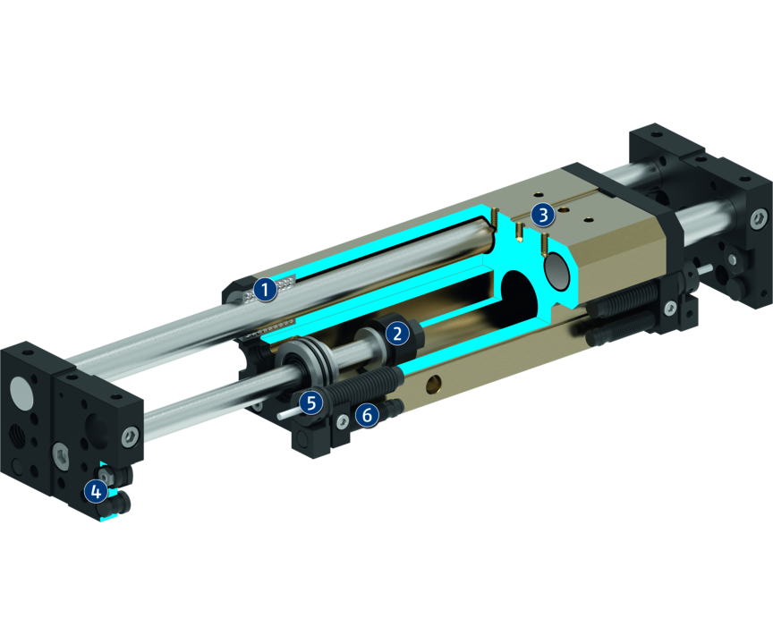
Principle of function
Functional description
The linear module is driven via a double-acting pneumatic cylinder which is integrated in the base body, and guided by two opposing guide rods.
1
Ball bushing guide
2
Drive
3
Mounting pattern
4
Damping adjustment
5
End position adjustability
6
Sensor system

Slide 5
Advantages – Your benefits
Double bearing of the guide shafts in the ball bushing for high load bearing capacity and repeat accuracy < 0.015 mm
Shock absorbers and proximity switches integrated in the projecting surfaces for vibration-free movements and end position monitoring
Strongly dimensioned guide shafts for high rigidity
High basic load ratings in all load directions
Standardized mounting bores for numerous combinations with other components from the modular system
Several intermediate positions possible for maximum flexibility in applications
Rod lock by means of clamping cartridge for safety in case of emergency stops

Slide 6
Technical data
Technical data overview
Size | Stroke | extend force | retracted force | Weight
 | [mm] | [N] | [N] | [kg]
25 | 25 .. 59 | 67 | 50 | 0.5 .. 0.66
50 | 13 .. 125 | 120 | 103 | 1.3 .. 2.14
100 | 25 .. 225 | 294 | 226 | 2.3 .. 5.18
300 | 50 .. 300 | 753 | 633 | 6.8 .. 13.2

