Slide 1

Product presentation
JGP-P
Universal gripper

Slide 2
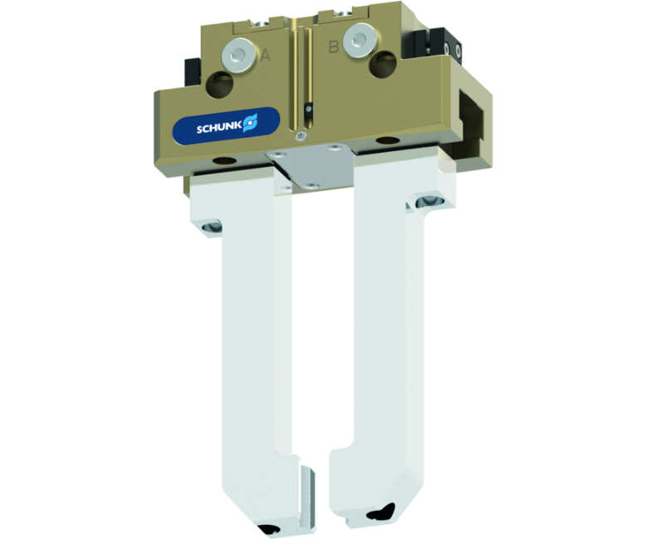
Universal gripper
Universal 2-finger parallel gripper with T-slot guidance and the optimum price-performance ratio
The high-performance gripper with diverse monitoring options – including inductive
Ten suitable sensor systems for the gripper

Slide 3

Reliable. Loadable. Alternative.

Slide 4
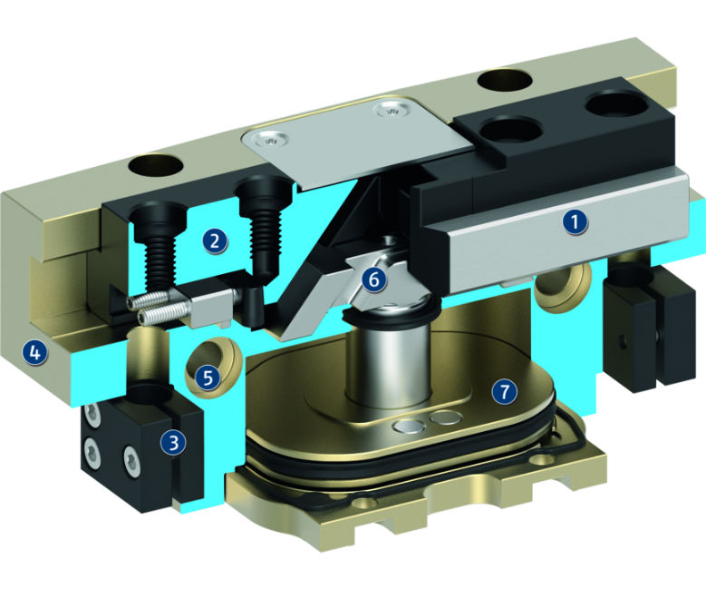
Principle of function
Functional description
The piston is moved up and down by compressed air.
The angled active surfaces of the wedge-hook produce a synchronized, parallel jaw motion.
1
T-slot guidance
2
Base Jaw
3
Bracket for sensors
4
Housing
5
Centering and mounting possibilities
6
Wedge-hook design
7
Piston

Slide 5
Advantages – Your benefits
A firm focus on the essentials for maximum profitability
Sturdy T-slot guidance for the precise handling of different workpieces
Comprehensive sensor accessory program for versatile querying possibilities and stroke position monitoring
Maximum piston surface area for maximum gripping forces
Wedge-hook design for high power transmission and synchronized gripping
Mounting from two sides in three screw directions for universal and flexible gripper assembly
Air supply via hose-free direct connection or screw connections for universal and flexible gripper assembly

Slide 6
Technical data
Technical data overview
Size | Stroke per jaw | Closing force | Opening force | Recommended workpiece weight | Weight | Max. permissible finger length
 | [mm] | [N] | [N] | [kg] | [kg] | [mm]
40 | 2.5 | 180 .. 235 | 200 .. 260 | 0.9 | 0.08 .. 0.1 | 55 .. 60
50 | 2 .. 4 | 220 .. 490 | 235 .. 520 | 1.1 .. 1.9 | 0.17 .. 0.2 | 66 .. 75
64 | 3 .. 6 | 350 .. 920 | 375 .. 1050 | 1.75 .. 3.6 | 0.27 .. 0.35 | 80 .. 90
80 | 4 .. 8 | 550 .. 1500 | 610 .. 1600 | 2.75 .. 5.5 | 0.51 .. 0.63 | 100 .. 110
100 | 5 .. 10 | 870 .. 2200 | 930 .. 2400 | 4.35 .. 8.75 | 0.9 .. 1.1 | 125 .. 145
125 | 6 .. 13 | 1400 .. 4200 | 1520 .. 4450 | 7 .. 15 | 1.4 .. 1.9 | 160 .. 180
160 | 8 .. 16 | 2500 .. 6300 | 2800 .. 6900 | 12.5 .. 24.5 | 3 .. 3.8 | 200 .. 220
200 | 25 | 3800 .. 5050 | 4050 .. 5500 | 19 | 5.4 .. 7 | 240 .. 280
240 | 30 | 5300 .. 7800 | 5600 .. 8300 | 26.5 | 8.7 .. 11.8 | 280 .. 320
300 | 35 | 6600 .. 8200 | 6800 .. 8400 | 33 | 13.7 .. 17.2 | 300 .. 350

