Slide 1

Product presentation
OPS
Collision and overload sensor OPR

Slide 2
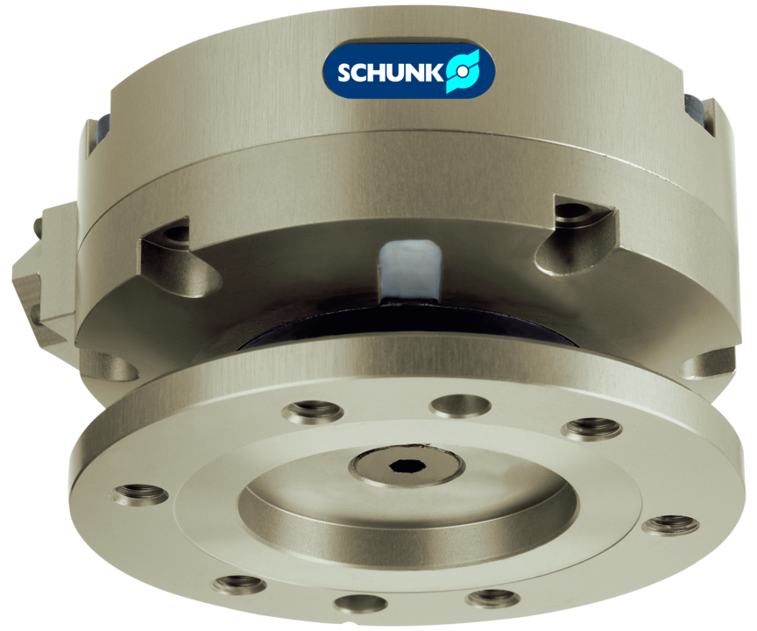
Collision and overload sensor OPR
Collision and overload protection with automatic reset for protecting robots and handling units against damage resulting from collisions or overload conditions.

Slide 3

Compliant. Highly responsive. Easy monitoring.

Slide 4
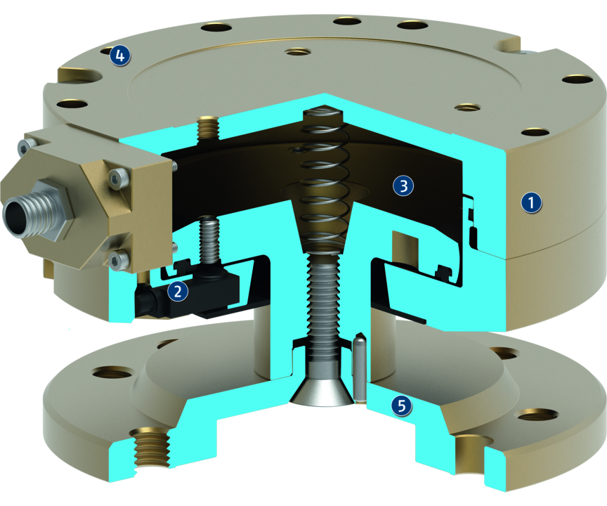
Principle of function
Functional description
In case of a collision, the mounting flange will be deflected. This simultaneously actuates a sensor whose signal triggers the system’s emergency stop mechanism.
After deflection a manual reset of the OPS can be done and the unit can be returned into its original position.
1
Housing
2
Sensor system
3
Pneumatic pistons
4
Centering and mounting possibilities
5
Mounting flange

Slide 5
Advantages – Your benefits
Triggering force and torque can be adjusted via the operating pressure for optimal protection of your robots and components
Integrated monitoring for signal transmission without delay in case of collisions so that the robot can be stopped immediately
ISO adapter plates as an option for easy assembly to most of robot types without any manufacturing costs/work

Slide 6
Technical data
Technical data overview
Size | Axial deflection | Angular deflection | Deflection rotatory | Responsiveness | Weight
 | [mm] | [°] | [°] | [mm] | [kg]
80 | 12 | 12 | 360 | 0.1 | 0.4
100 | 14 | 12 | 360 | 0.1 | 0.7
160 | 8 | 5 | 360 | 0.2 | 4.3
200 | 9.5 | 4 | 45 .. 360 | 0.3 | 7

