Slide 1

Product presentation
ELG
Electrical longstoke gripper

Slide 2
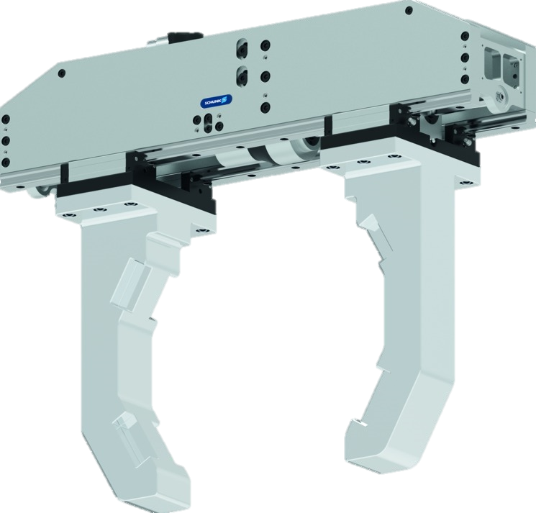
Long-stroke gripper
Electric 2-finger parallel gripper with lightweight profile rail guide and adaptable servomotor
Stroke per jaw up to 400 mm
Gripping forces up to 12000 N

Slide 3
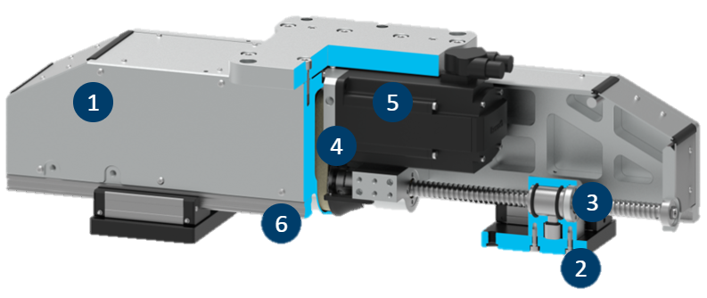
Functional description
Functional description
The two ball-screw spindle drives, which move the base jaw, are driven by one or two servomotors via a toothed belt.
With two drives every jaw can be moved individually from each other. During the actuation with a servomotor, a coupling synchronizes the right-to-left and the left-to-right spindle with each other.
1
Housing
2
Base jaw
3
Spindle
4
Transmission kinematics
5
Drive motor
6
Linear guiding

Slide 4
Advantages – Your benefits
High moments due to double profiled rail guide suitable for using long gripper fingers (up to 800mm)
Extremely narrow design for minimal interfering contours
Adaptable drive motor for versatile approach and easy integration into existing control concepts
Position and torque-controlled movement of the gripper For very flexible gripping of various geometries and types of components
Synchronized but also asynchronous moving of the base jaws for various gripping applications
Safety functions such as STO and SLS can be realized by the use of a suitable drive motor and controller
Various options available

Slide 5
Technical data
Technical data overview
Size | Stroke per jaw | Gripping force | Recommended workpiece weight (form-fit gripping) | Max. permissible finger length | Weight (without motor)
 | [mm] | [N] | [kg] | [mm] | [kg]
30 | 100 – 400 | 3000 | 50 | 400 / 800 | 14,2 – 38,4
75 | 100 – 400 | 7500 | 130 | 400 / 800 | 24,7 – 64,5
120 | 100 – 400 | 12000 | 130 | 400 / 800 | 42,2 – 74,3

