Slide 1

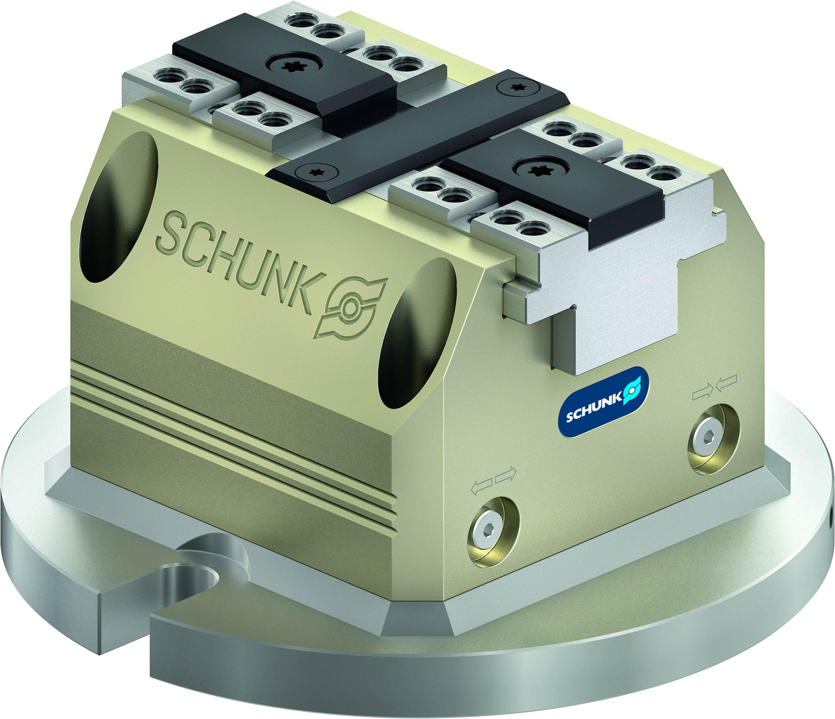
TANDEM PGS3
Perfection and reliabilty for simple, automated machine loading

Slide 2












Gripping Systems
Clamping Technology
Chuck Jaws
Lathe Chucks
Stationary Workholding
Toolholders
Hydraulic Expansion Technology
VERO-S
TANDEM
ROTA
KONTEC
Tombstones
MAGNOS

Slide 3
TANDEM 3
Challenges
Increasing relevance of the set-up process

Slide 4
TANDEM PGS3
Advantages – Your benefits
Integrated console plate
Ready for immediate use
Base body made of light aluminium
Low height
Optimized outside contour
Cubic design
High efficiency of the wedge hook system
Precision wedge hook clamping force block for top-quality demands
Optimal jaw support due to the use of a very long base jaw guidance

Slide 5
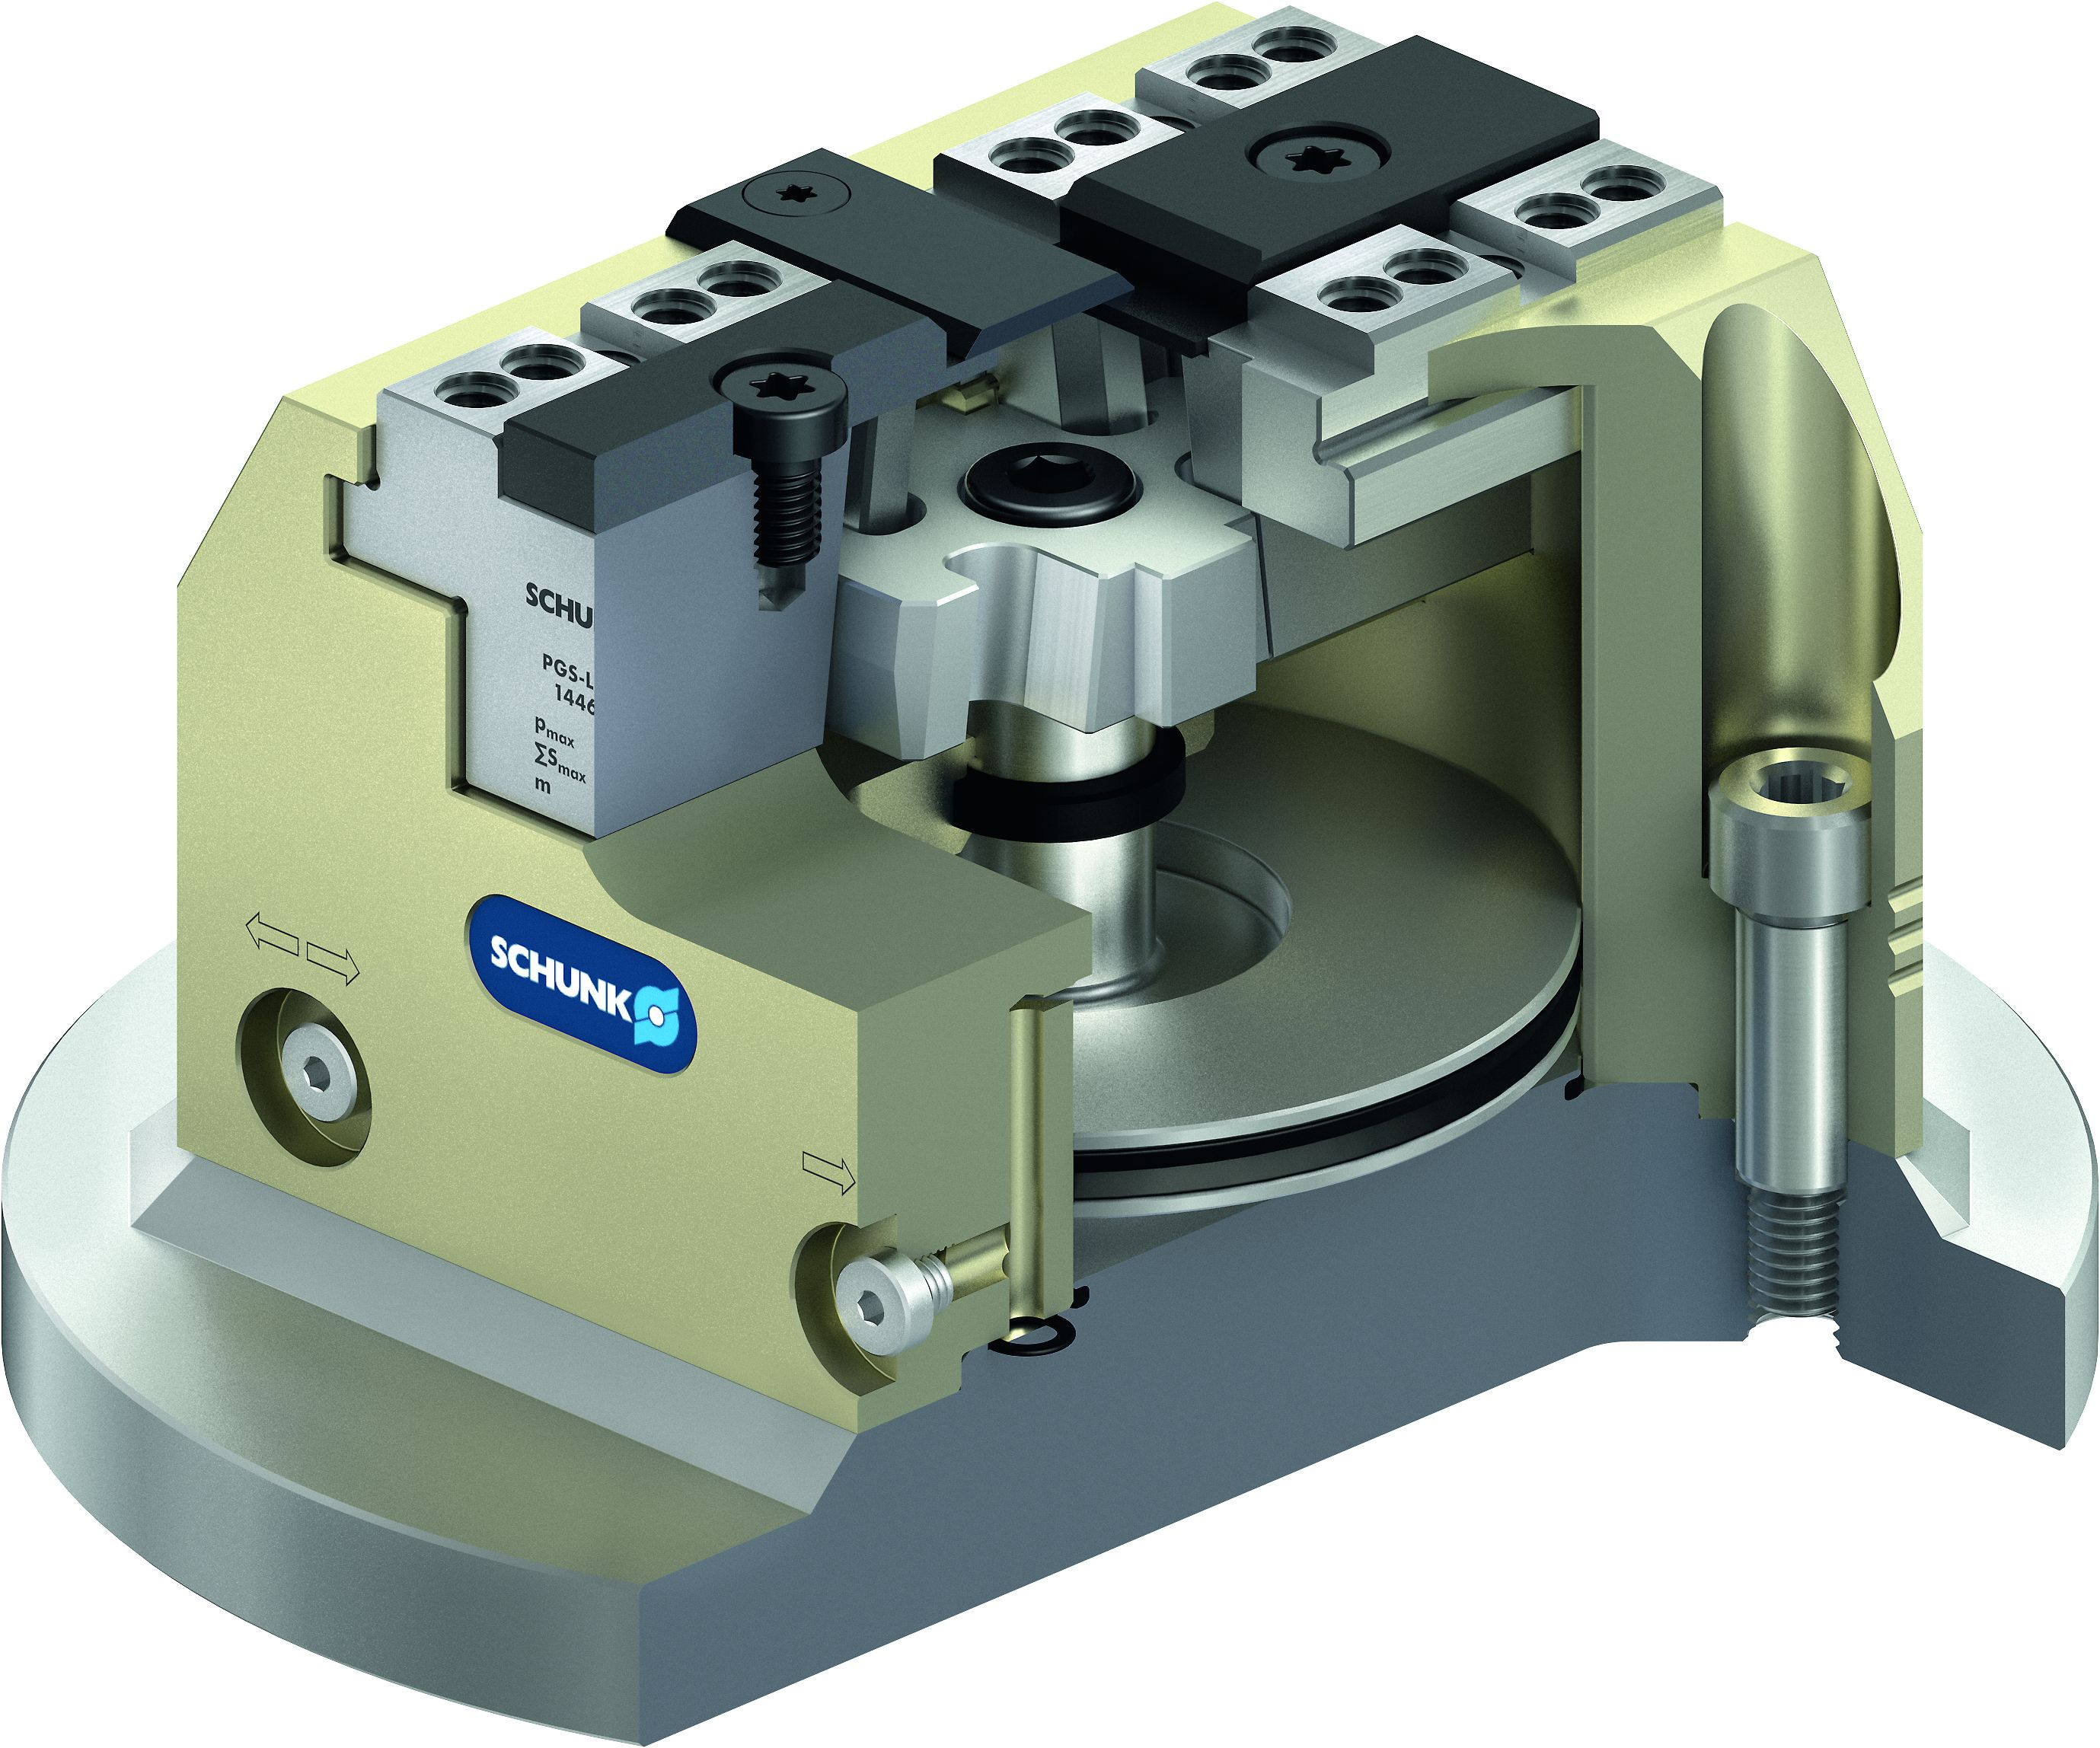

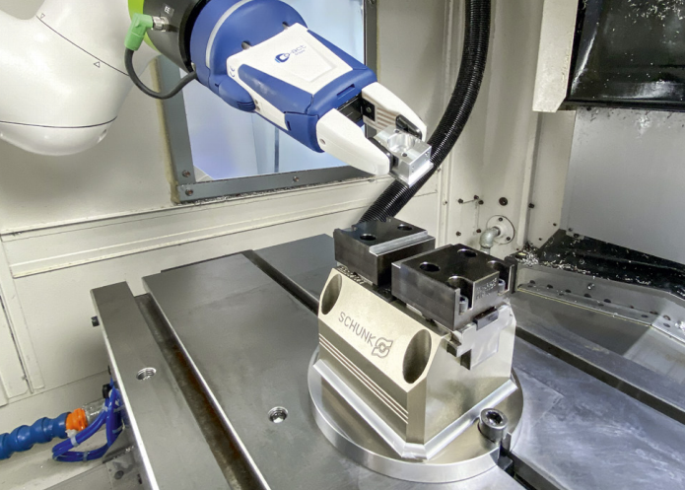
TANDEM 3 Lead Vises
Way above 300 standard versions
 | Pneumatic PGS3
Standard stroke
 | PGS3
 | Size | 100 | 140
 | Jaw stroke (mm) | 2 | 3
 | Number of versions | 1 | 1
 | Pneumatic PGS3-LH
Long stroke
 | PGS3-LH
 | Size | 100 | 140
 | Jaw stroke (mm) | 6 | 7
 | Number of versions | 1 | 1
The TANDEM PGS3 clamping force block
A strong combination partner for light machining and simple automation tasks.

Slide 6
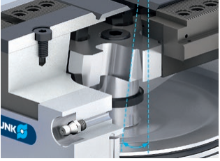
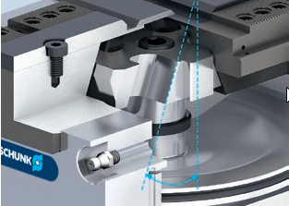
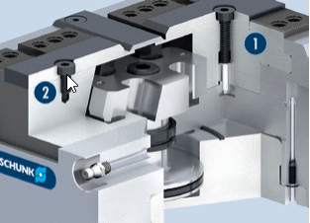
TANDEM 3
Variants
1
2
Standard stroke
For the standard stroke, a high force transmission is achieved via a small wedge angle.
Advantage: High clamping forces.
Long stroke (-LH)
For a long stroke, a larger jaw stroke is achieved via an increased wedge angle. Due to the enlarged angle, however, the LH version achieves a lower clamping force than the standard stroke version. Advantage: Longer jaw stroke.
With fixed jaw (-F)
One chuck jaw is screwed immovably to the body. The force transmission takes place via the movable jaw.
Fixed clamping jaw
Movable clamping jaws
1
2

Slide 7
TANDEM PGS3
Clamping force and jaw stroke

Slide 8
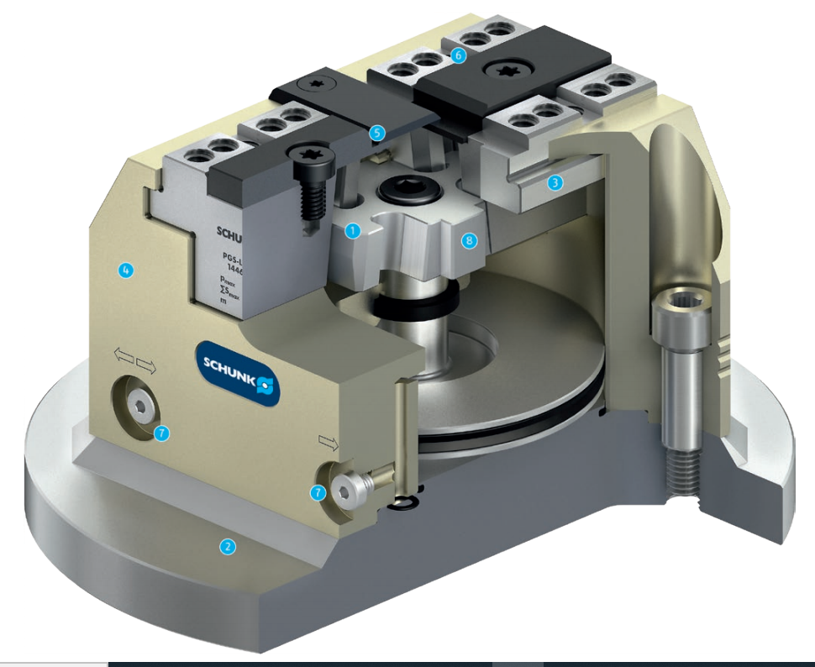
TANDEM PGS3
Functional diagram
6
Wedge hook drive
Integrated console plate
Long jaw guidance
Compact design
Improved design which is insensitive to dirt
Jaw interface with tongue and groove
Simple lateral control of the clamping force block
Piston guided in the body
5
1
2
3
1
8
3
4
4
5
6
7
7
7
8
2

Slide 9
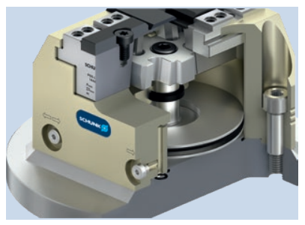
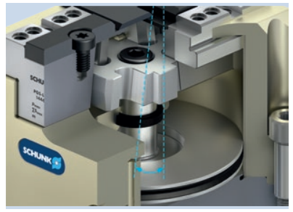
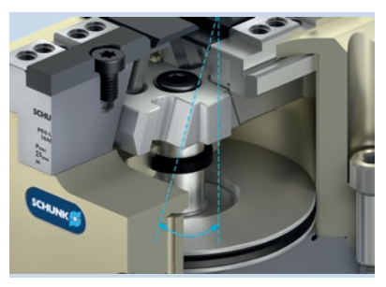
TANDEM PGS3
Highlights
Pneumatic drive
Clamping and loosening is performed via a double-acting pneumatic cylinder with permanent pressure.
Standard stroke
For the standard stroke, a high force transmission is achieved via a small wedge angle.
Benefit: The PGS3 has high clamping forces.
Long stroke
For a long stroke, a larger jaw stroke is achieved via an increased wedge angle. Due to the enlarged angle, however, the LH-version achieves a lower clamping force than the standard stroke version.
Advantage: Longer jaw stroke.

Slide 10
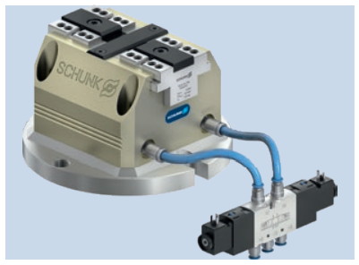
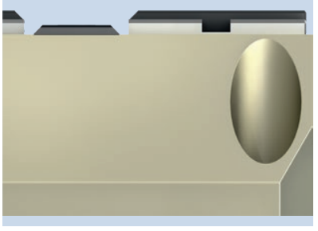
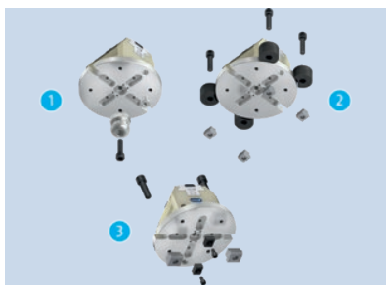
TANDEM PGS3
Highlights
Easy commissioning
Quickly and easy commissioning. Due to the integrated console plate, the clamping force block can be mounted directly on the machine table or quick-change pallet system. The lateral air connections allow the vise to be controlled directly with a 5/3-way valve.
Chip-repellent design
The special design of the base jaw and cover strip prevents chips becoming permanently lodged. During the clamping process, the chips are pushed from the base jaw by the incline of the cover strip.
Mounting options
The clamping force block can be used for minimizing the set-up time. It can be placed on the VERO-S NSE3 with anti-twist protection using the existing VERO-S interface.
Fastening via quick-change pallet system
Fastening via cylindrical clamps
Mounting via T-nuts
1
2
3

Slide 11
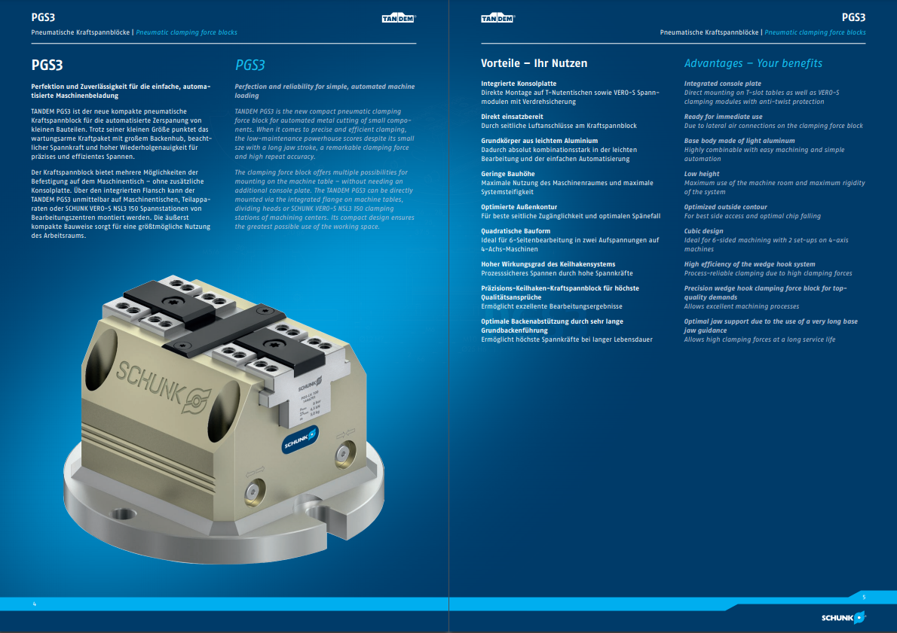
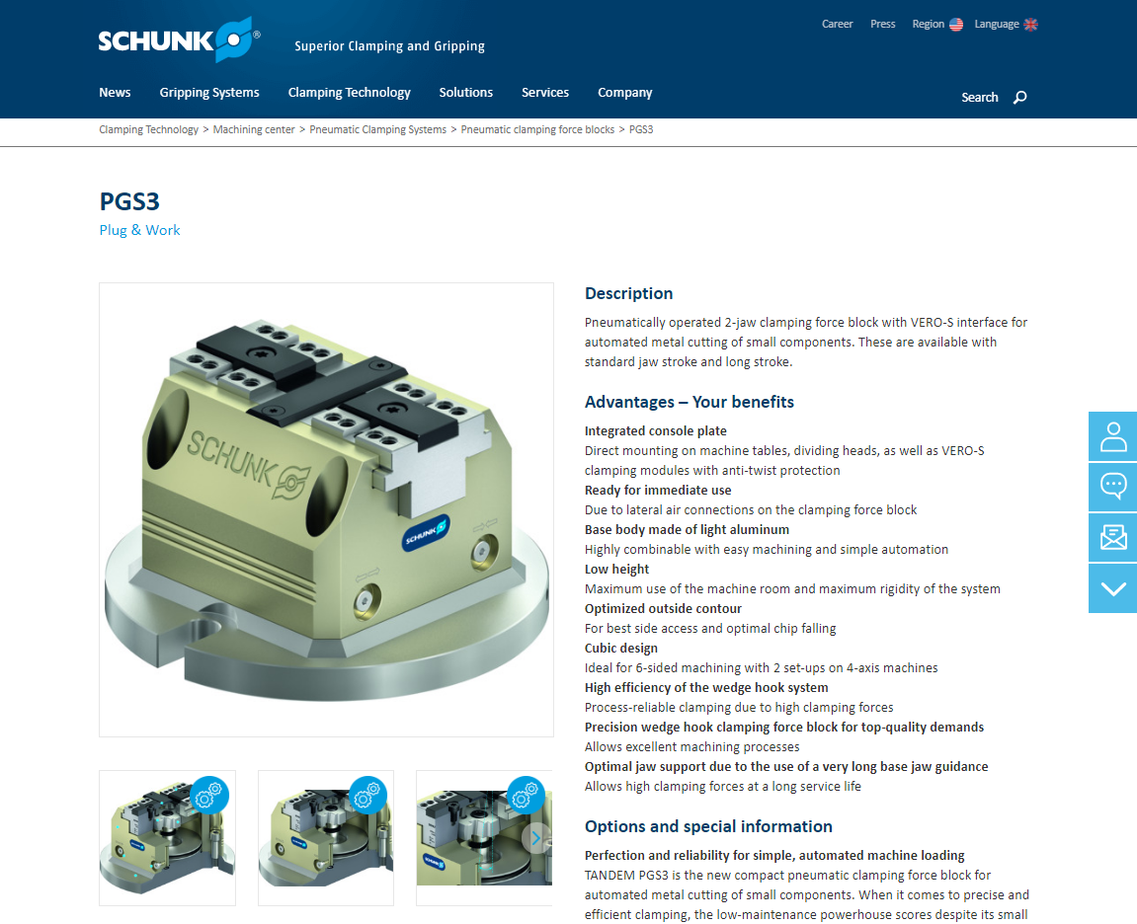
TANDEM PGS3
Documents
Catalog chapter
Homepage

Slide 12
TANDEM PGS3 top jaws

Slide 13
TANDEM PGS3 Jaws
Top jaw blanks
Mounting: Via tongue and groove
KTR/KTR-H
KTR/KTR-H
Description | ID | Length [mm] | Width [mm] | Height [mm]
KTR 100 | 0402121 | 47 | 55 | 25
KTR 140 | 1349707 | 65 | 70 | 35
KTR-H 100 | 1349708 | 47 | 55 | 48
KTR-H 140 | 0402222 | 65 | 70 | 70

