Slide 1

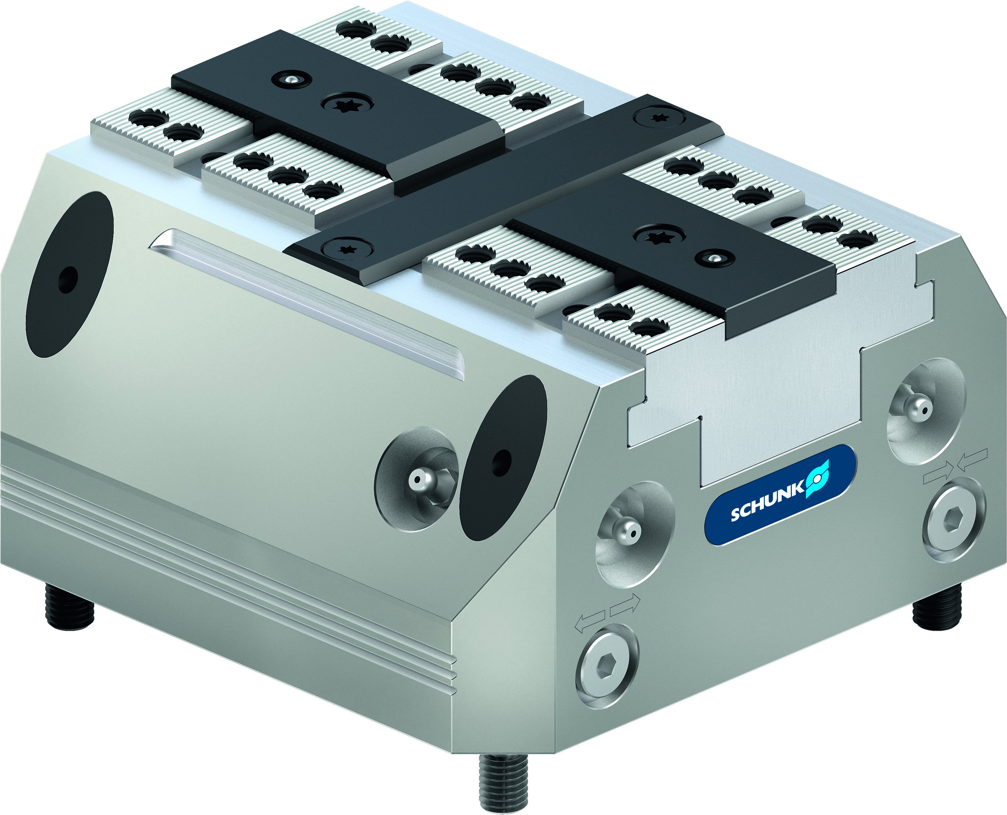
TANDEM KSF3
Spring-loaded powerhouses for tower and storage solutions

Slide 2












Gripping Systems
Clamping Technology
Chuck Jaws
Lathe Chucks
Stationary Workholding
Toolholders
Hydraulic Expansion Technology
VERO-S
TANDEM
ROTA
KONTEC
Tombstones
MAGNOS

Slide 3
TANDEM 3
Challenges
Increasing relevance of the set-up process

Slide 4
TANDEM KSF3
Advantages – Your benefits
Spring-packaged clamping force blocks
Patented monotoring of the base jaw position via dynamic pressure
Workpiece presence control through the base jaw
Precision wedge hook clamping force block for top-quality demands
Square design with ideal outside contour
High efficiency of the wedge hook system
Base jaws with tongue and groove or fine serration as standard
Optimal jaw support due to the use of a very long base jaw guidance
All functional parts are ground and hardened

Slide 5
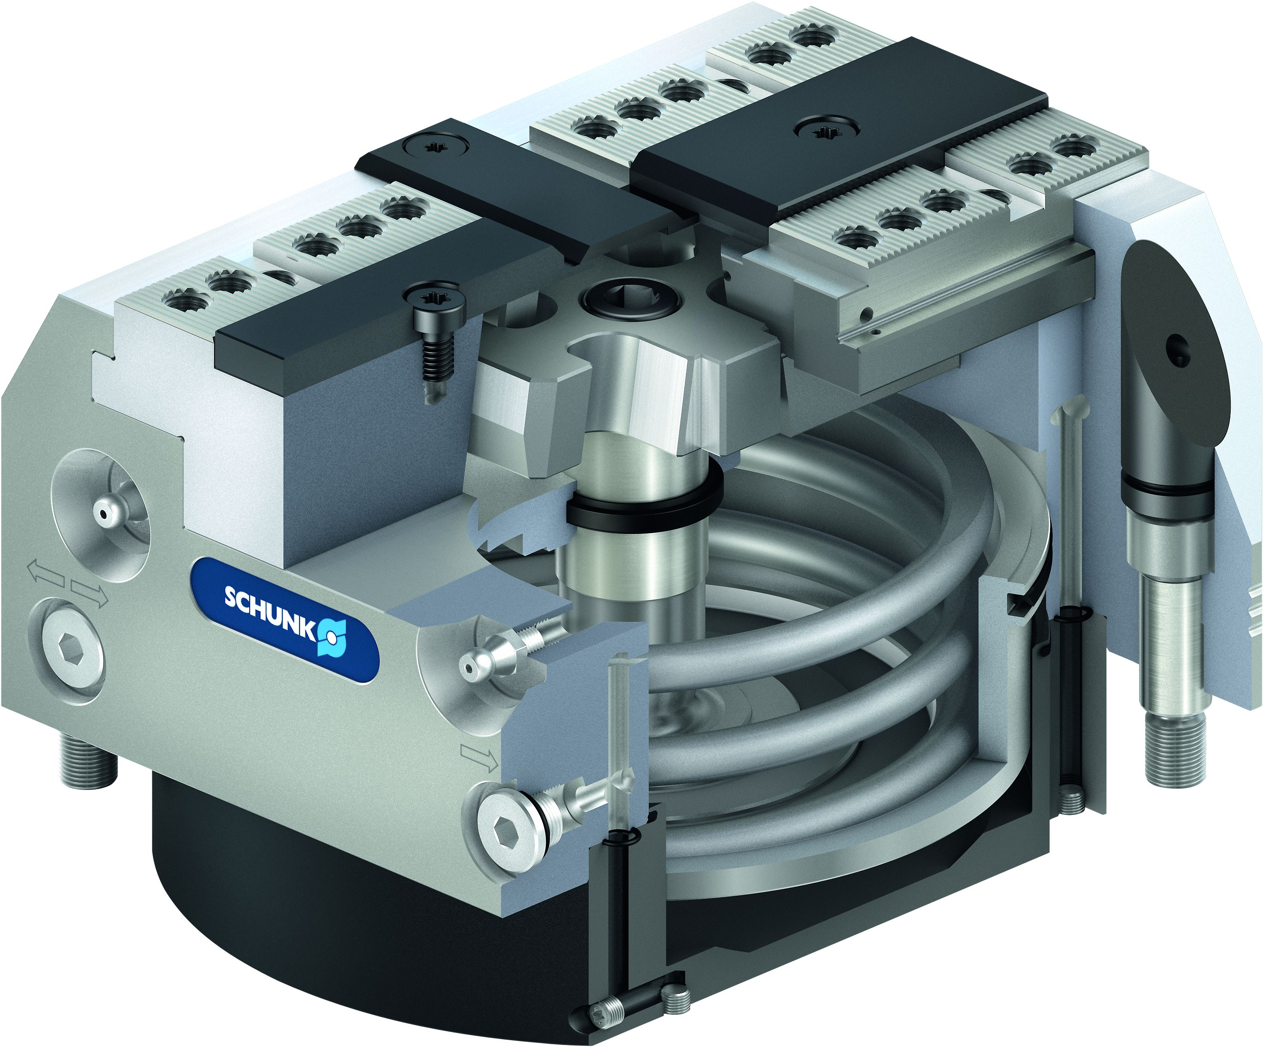
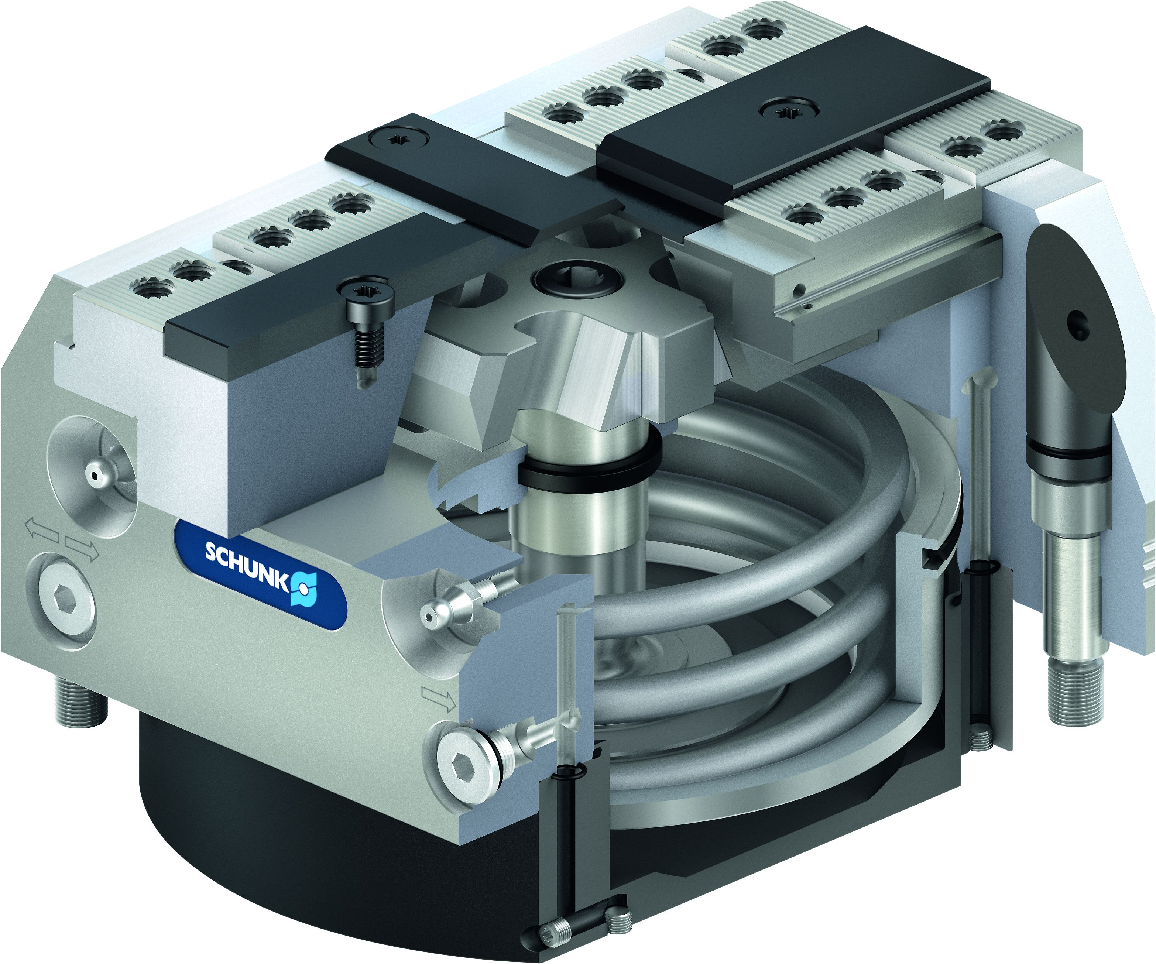
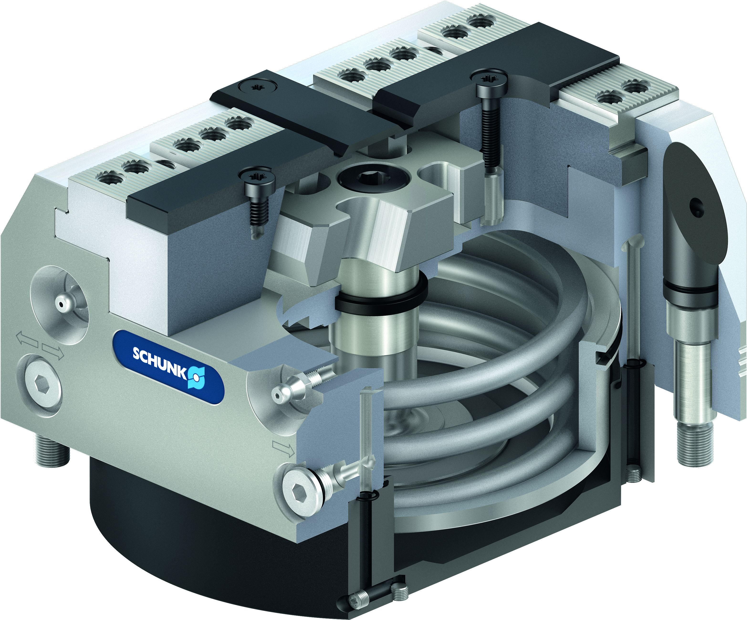
TANDEM 3 Lead Vises
Way above 300 standard versions
 | Spring force KSF3
Standard stroke
 | KSF3
 | Size | 100 | 160 | 250
 | Jaw stroke (mm) | 2 | 3 | 5
 | Number of versions | 4 | 4 | 4
 | Spring force KSF3-LH
Long stroke
 | KSF3-LH
 | Size | 100 | 160 | 250
 | Jaw stroke (mm) | 6 | 8 | 15
 | Number of Versions | 4 | 4 | 4
 | Spring force KSF3-F
With fixed jaw
 | KSF3-F
 | Size | 100 | 160 | 250
 | Jaw stroke (mm) | 4 | 6 | 10
 | Number of versions | 4 | 4 | 4

Slide 6
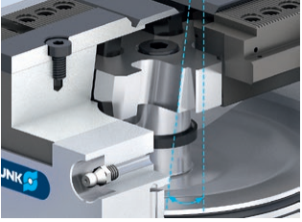
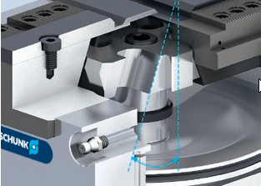
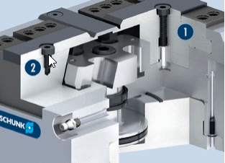
TANDEM 3
Variants
1
2
Standard stroke
For the standard stroke, a high force transmission is achieved via a small wedge angle.
Advantage: High clamping forces.
Long stroke (-LH)
For a long stroke, a larger jaw stroke is achieved via an increased wedge angle. Due to the enlarged angle, however, the LH version achieves a lower clamping force than the standard stroke version. Advantage: Longer jaw stroke.
With fixed jaw (-F)
One chuck jaw is screwed immovably to the body. The force transmission takes place via the movable jaw.
Fixed clamping jaw
Movable clamping jaws
1
2

Slide 7
TANDEM KSF3
Clamping force and jaw stroke

Slide 8
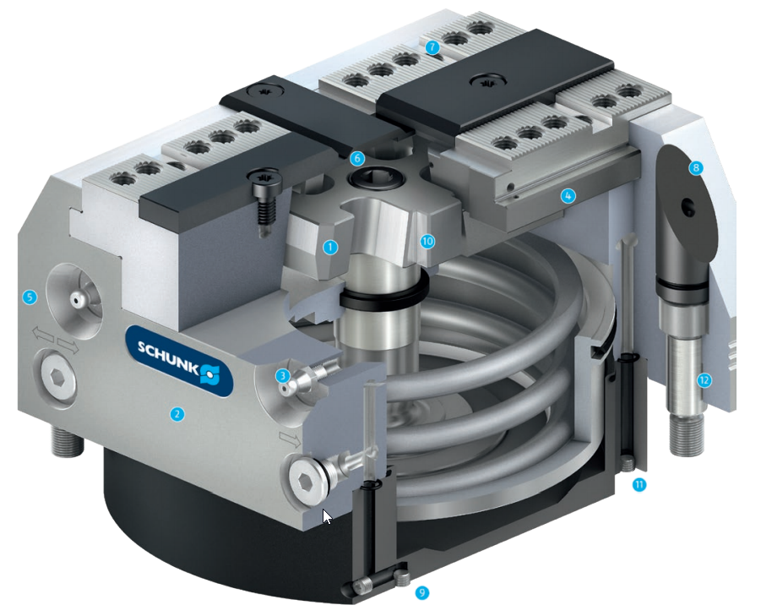
TANDEM KSF3
Functional diagram
7
Wedge hook drive
Hardened and extremely rigid base body
Sophisticated greasing system
Long jaw guidance
Low height
Improved design which is insensitive to dirt
Standard jaw interface
Ideal outside contour
Control of the clamping force block
Piston guided in the body
Greasing channels in the cover plate
Fitting screws available as an option
1
2
6
8
3
4
4
1
10
5
5
6
7
3
12
2
8
9
11
10
11
9
12

Slide 9



TANDEM KSF3
Highlights
Chip-repellent design
The special design of the base jaw and cover strip prevents chips becoming permanently lodged. During the clamping process, the chips are pushed from the base jaw by the incline of the cover strip.
Cover plugs for the mounting screws
All four mounting screws are sealed with anodized aluminium plugs. Chip build-up is therefore completely eliminated in advance.
Alignment edge
An alignment edge is recessed into the side of the clamping force block. It extends parallel to the jaw guidance and enables an exact alignment of the vises to the machine table.

Slide 10
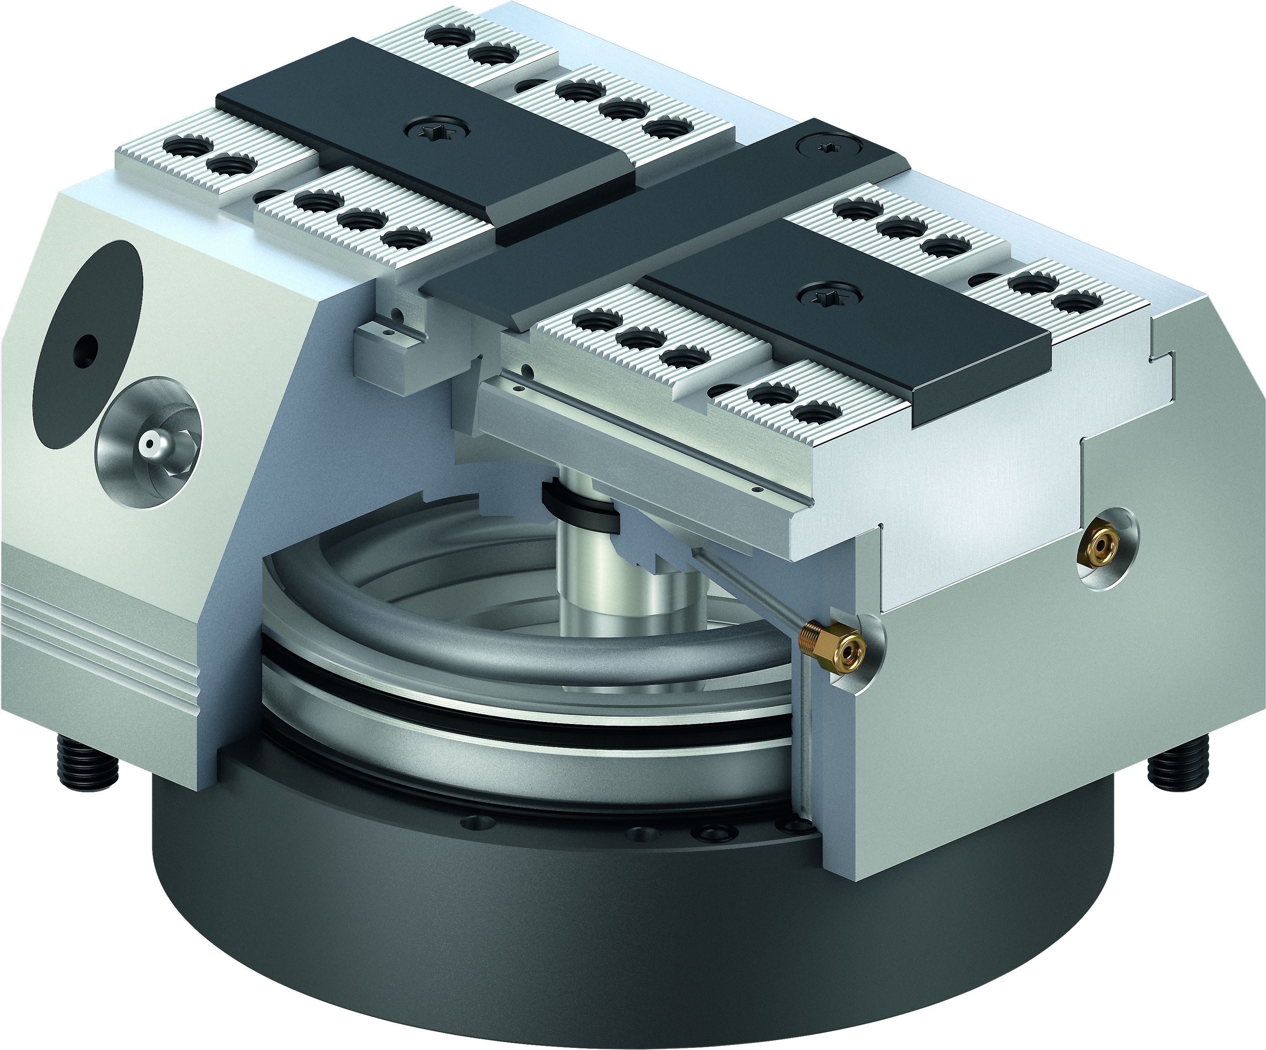
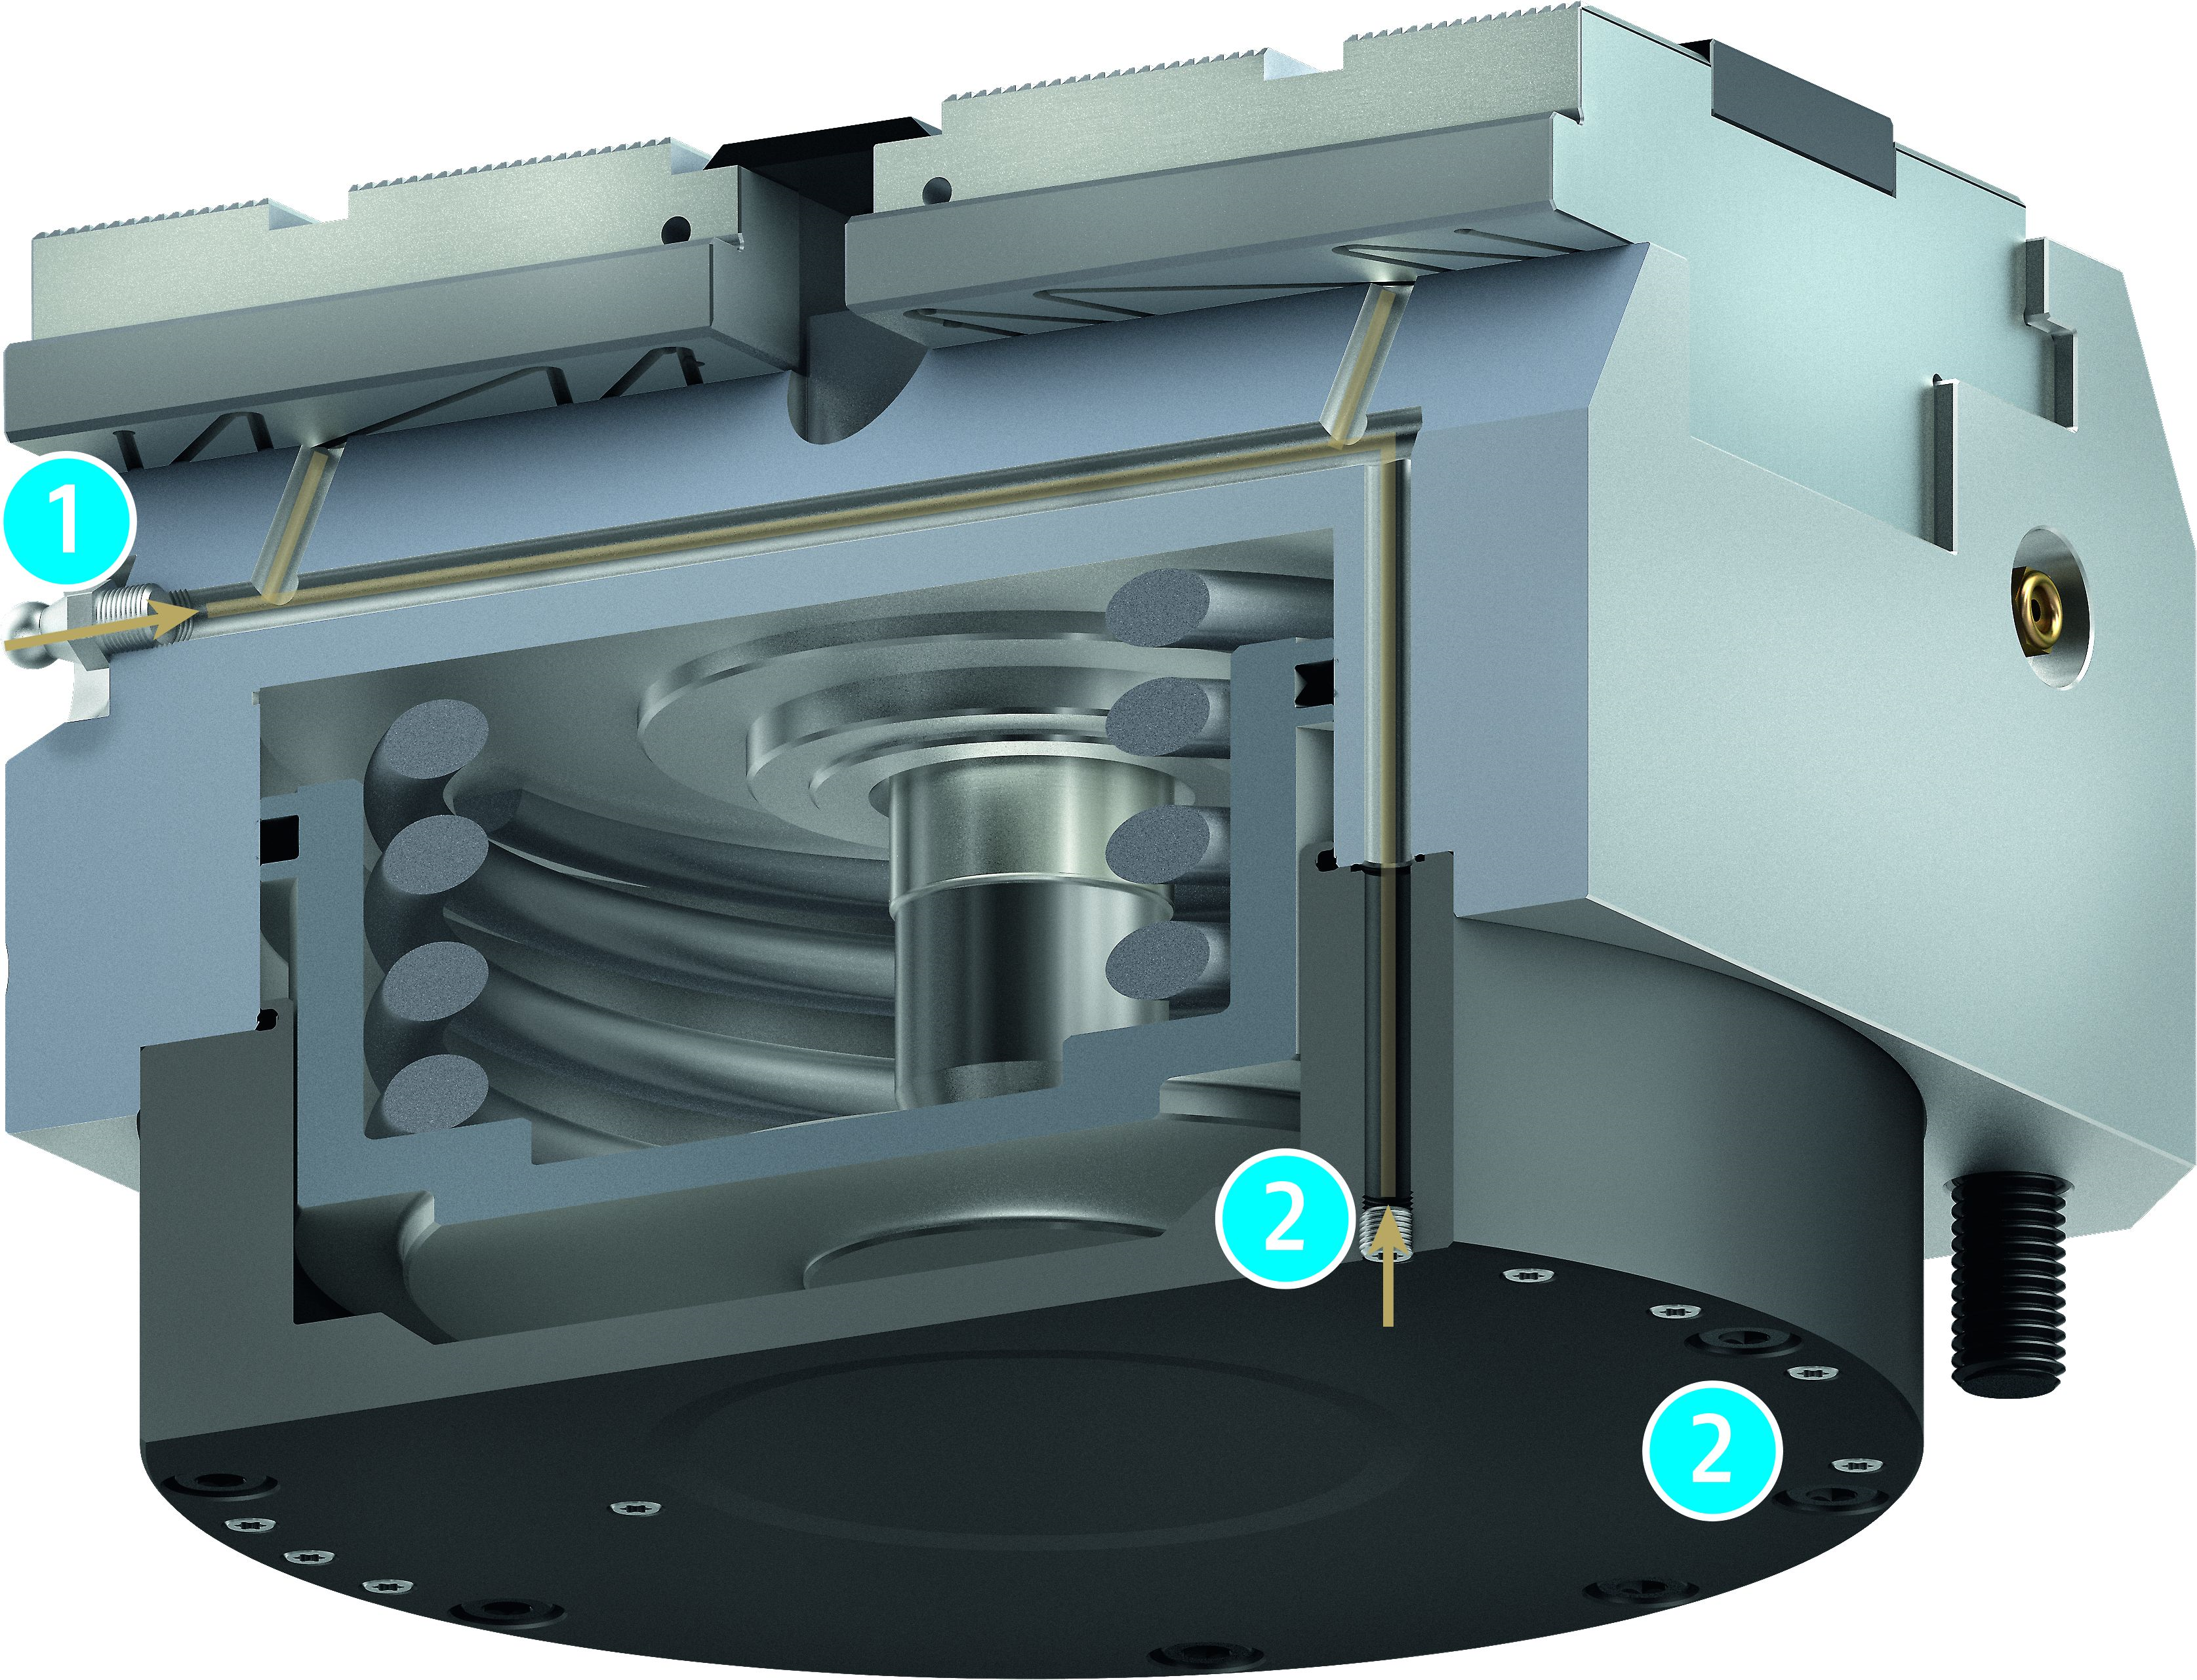
TANDEM KSF3
Highlights
Coolant drainage hole
All clamping force blocks are equipped with a coolant drainage hole. This allows penetrated coolant to be drained to the outside. The drainage hole is sealed with a sintered filter to prevent the entry of chips.
Greasing system
Manual greasing: A grease is used to supply all friction surfaces (jaw guidance, piston guide, and diagonal pull) evenly.
Central greasing: The connections on the base side are used to supply all friction surfaces evenly with grease.
1
2

Slide 11


TANDEM KSF3
Standardized
1
1
2
1
Jig-produced positioning (-Z)
In order to position several clamping force blocks very accurately in relation to one, another on the clamping devices, jig-produced positioning bores are integrated in the Z-version.
Positioning bore
Pneumatic monitoring (-PM)
The base jaw positions can be queried via dynamic pressure. Transfer via the base jaw enables compressed air to be fed through into the system jaws.
Via dynamic pressure
Air transfer to system jaw
1
1
2

Slide 12
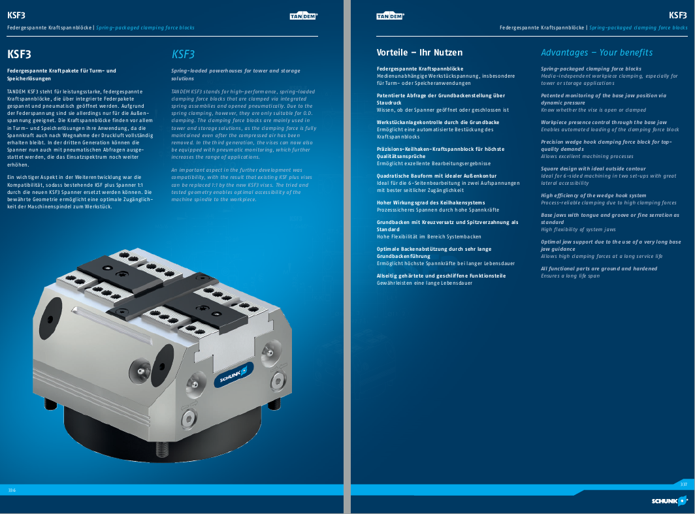
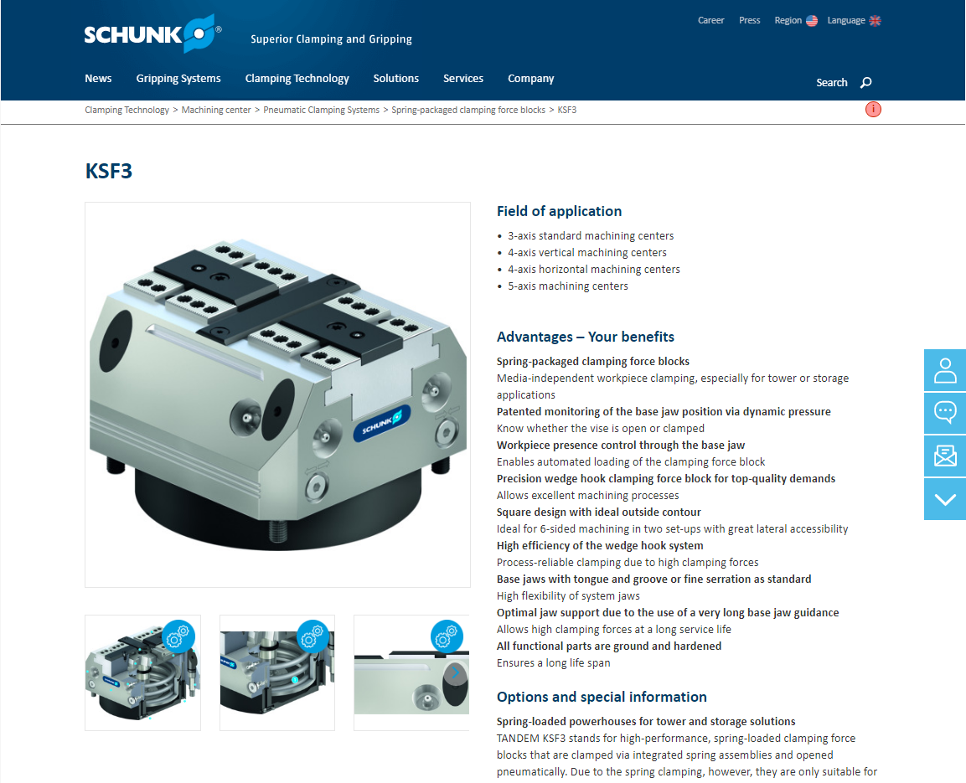
TANDEM KSF3
Documents
Catalog chapter (link follows)
Homepage (link follows)

Slide 13
TANDEM System jaws and top jaws
Maximum flexibility due to the modular system consisting of supporting jaws and a large selection of top jaws

Slide 14

TANDEM Jaws
Advantages – Your benefits
Individually adjustable for new clamping tasks
Supporting jaw system
Large modular system of matching top jaws

Slide 15
TANDEM 3 Jaws
Top jaw blanks
Mounting: Via tongue and groove | Mounting: Via fine serrations 1,5 x 60°
KTR / KTR-H | STR / STR-H | STR-S
3-axis jaws
S3A-G5
5-axis jaws
S5A-G5
Supporting Jaw and SCHUNK Jaw Program
TBA-D | Clamping jaws

Slide 16
TANDEM 3 Jaws
STR/STR-H
Description | ID | Length [mm] | Width [mm] | Height [mm]
STR 64 | 0402100 | 28,5 | 34 | 20
STR 100 | 0402101 | 42 | 55 | 25
STR 140 | 1349709 | 62 | 70 | 35
STR 160 | 0402102 | 66 | 80 | 40
STR 250 | 0402103 | 108 | 125 | 50
STR-H 64 | 0402200 | 28,5 | 34 | 35
STR-H 100 | 0402201 | 47 | 55 | 50
STR-H 140 | 1349710 | 70 | 70 | 70
STR-H 160 | 0402202 | 76 | 80 | 80
STR-H 250 | 0402203 | 120 | 125 | 100
KTR/KTR-H
Description | ID | Length [mm] | Width [mm] | Height [mm]
KTR 64 | 0402120 | 28,5 | 34 | 16
KTR 100 | 0402121 | 47 | 55 | 25
KTR 140 | 1349707 | 65 | 70 | 35
KTR 160 | 0402122 | 76 | 80 | 40
KTR 250 | 0402123 | 120 | 125 | 50
KTR-H 64 | 0402220 | 28,5 | 34 | 35
KTR-H 100 | 0402221 | 47 | 55 | 48
KTR-H 140 | 1349708 | 65 | 70 | 70
KTR-H 160 | 0402222 | 76 | 80 | 77,5
KTR-H 250 | 0402223 | 120 | 125 | 100
S3A-G5
ID | Length [mm] | Width [mm] | Height [mm]
1471165 | 25,5 | 34 | 22
1471166 | 36 | 50 | 26
1471167 | 48 | 69 | 31
1471168 | 48 | 80 | 31
1471187 | 66 | 125 | 40
S5A-G5 | Length [mm] | Width [mm] | Height [mm]
ID | Length [mm] | Width [mm] | Height [mm]
1471189 | 25,5 | 34 | 40
1471190 | 36 | 50 | 50
1471197 | 49,5 | 69 | 50
1471198 | 58,5 | 80 | 50
1471200 | 72 | 125 | 110
STR-S
Description | ID | Length [mm] | Width [mm] | Height [mm]
STR-S 64 | 0402110 | 25 | 34 | 20
STR-S 100 | 0402111 | 42 | 55 | 25
STR-S 140 | 1349712 | 55 | 70 | 38
STR-S 160 | 0402112 | 60 | 80 | 40
STR-S 250 | 0402113 | 90 | 125 | 50
TBA-D
ID | Interface | Length [mm] | Width [mm] | Height [mm]
0402294 | W-65-1 | 63,6 | 65 | 34
1349715 | W-90-1 | 83 | 90 | 53
0402295 | W-100-1 | 92,8 | 100 | 53
0402296 | W-125-1 | 113,4 | 125 | 63

Slide 17
ABP-h plus
Base plates for KSP plus clamping force blocks

Slide 18

ABP-h plus Base Plates
Advantages – Your benefits
VERO-S interface
Pneumatic connection from three sides
Versatile in use
Manually operable pneumatic valves
Integrated pressure maintenance valve
Media transfer at the base

Slide 19

ABP-h plus Base Plates
Functional diagram
TANDEM KSP plus clamping force block
Pneumatic connection from three sides
Integrated pressure gauge
Manually operable pneumatic valves
VERO-S interfacee
Media transfer at the base
1
2
1
3
4
2
5
6
2
5
4
2
3
6

Slide 20
KSL 3
Base plates for KSP3 and KSH3 clamping force blocks

Slide 21

KSL3 base plates
Advantages – Your benefits
Vero-S interface
Prepared for cylindrical clamps and T-nuts

