Slide 1
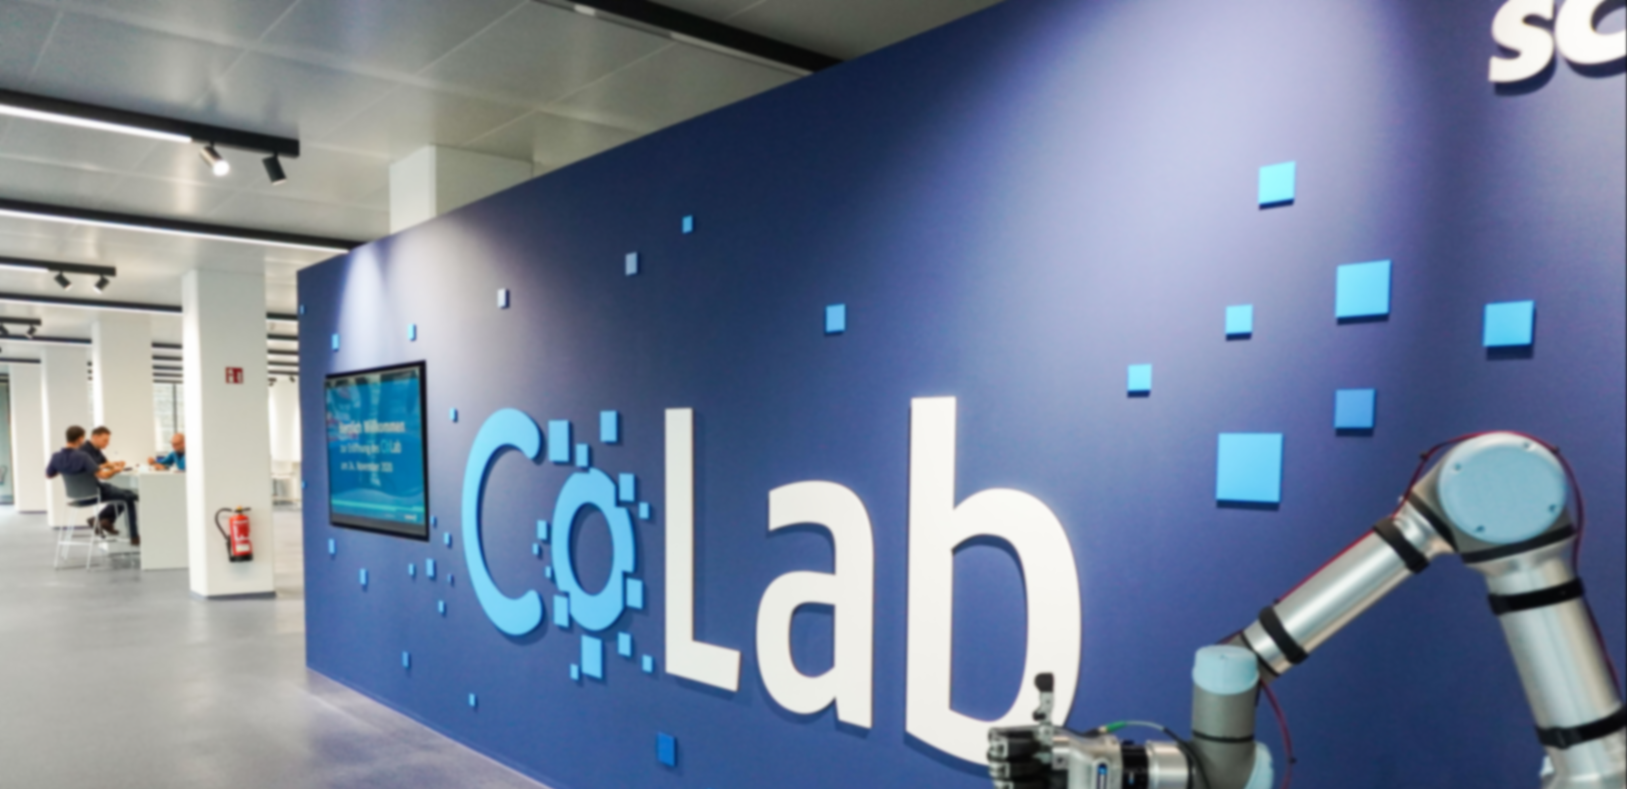


Germany

Slide 2
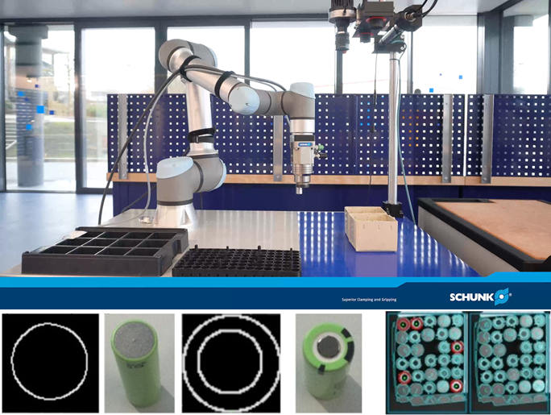
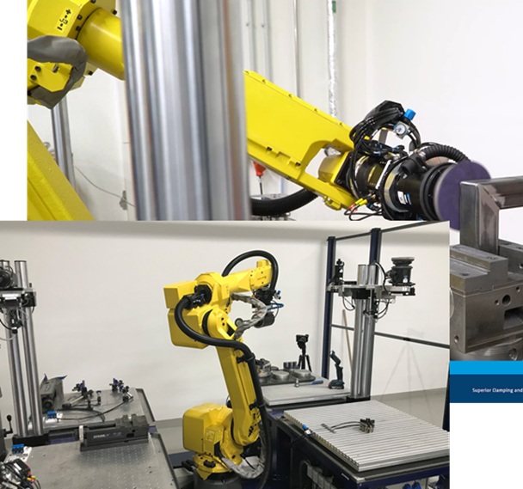
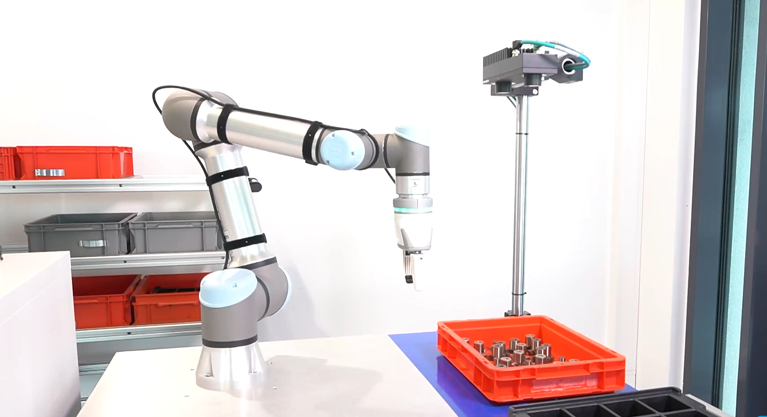
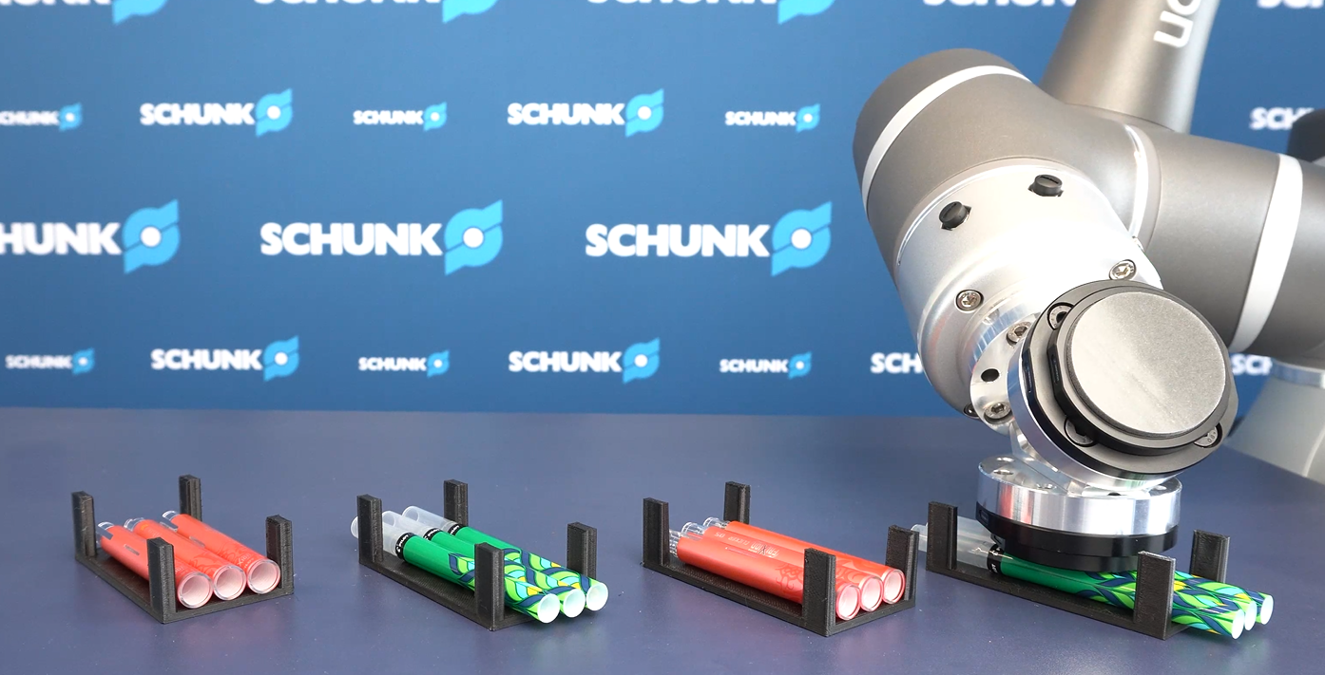
Motivation & Mission
Our Motivation
Test SCHUNK products for your application in advance
Show feasibility and reduce investment risks for you
How do we do this?
Exemplary set-up of example applications
Examination of critical points of the automation task
Pre-test and parameter determination
Documentation in reports and videos
Live demonstration and training

Slide 3

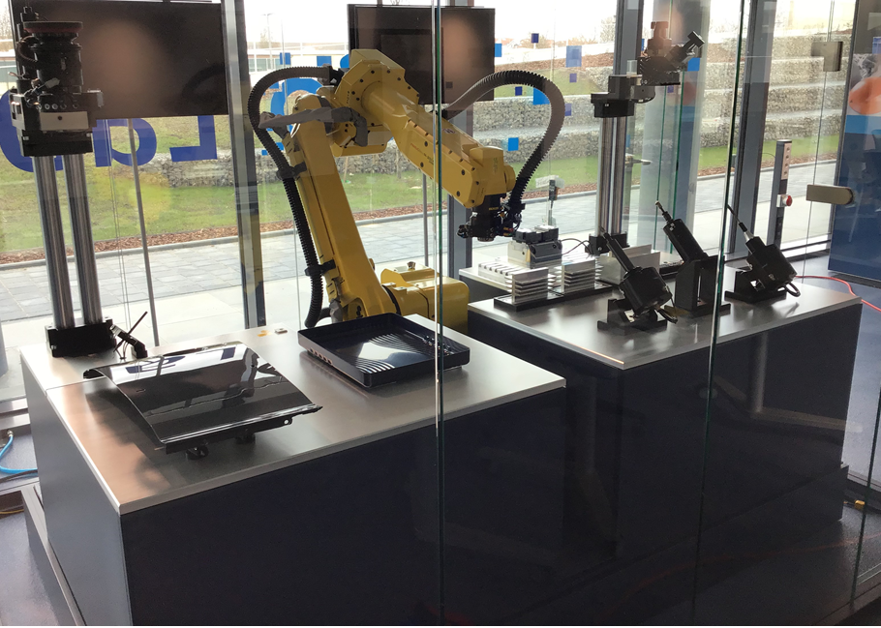
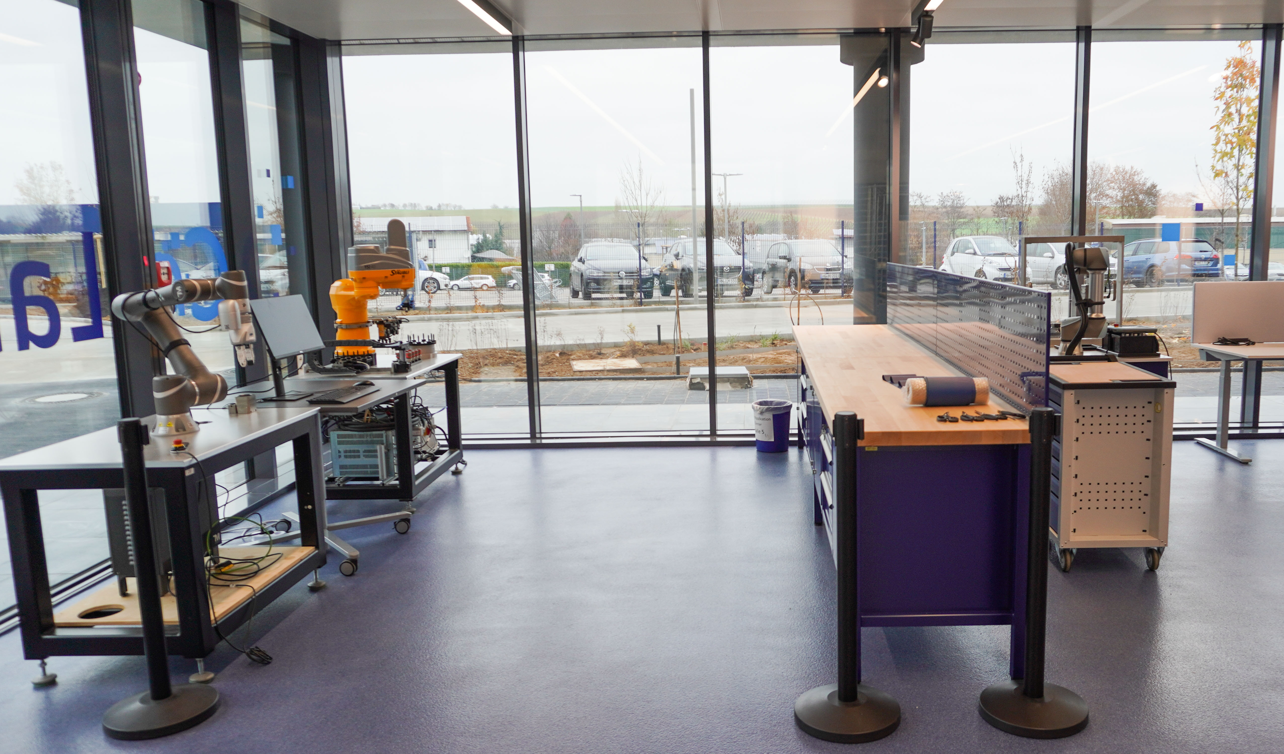
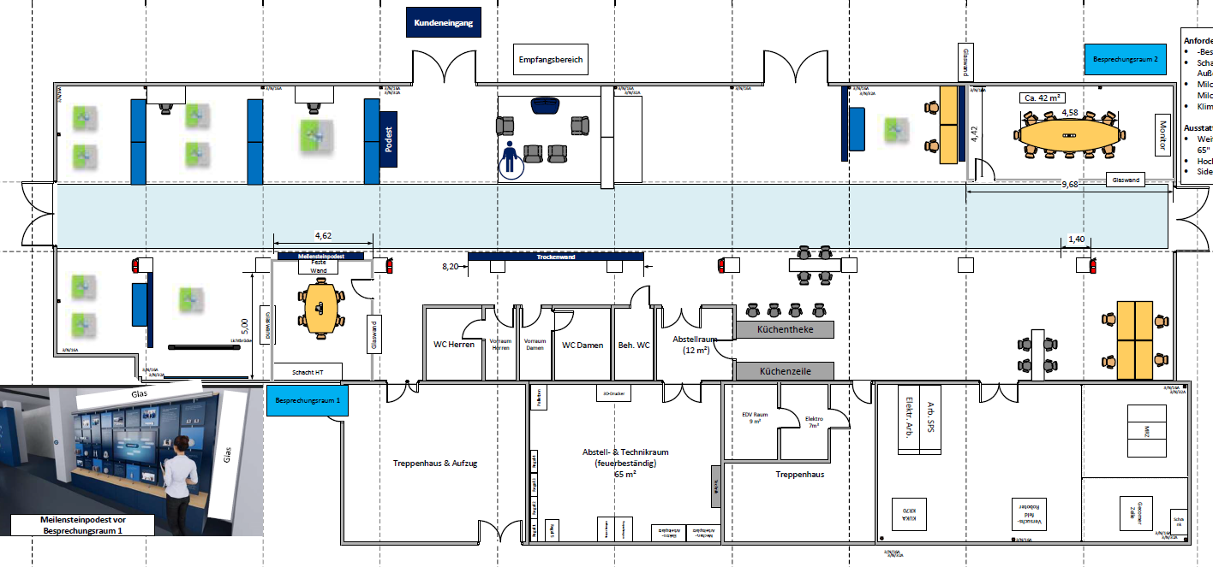
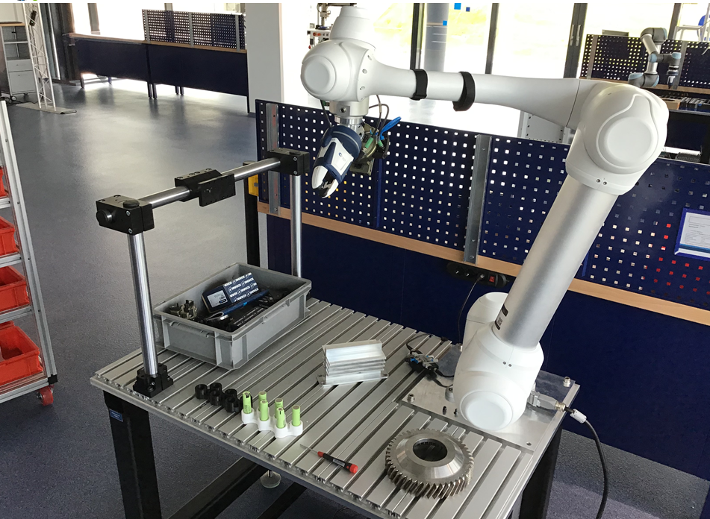
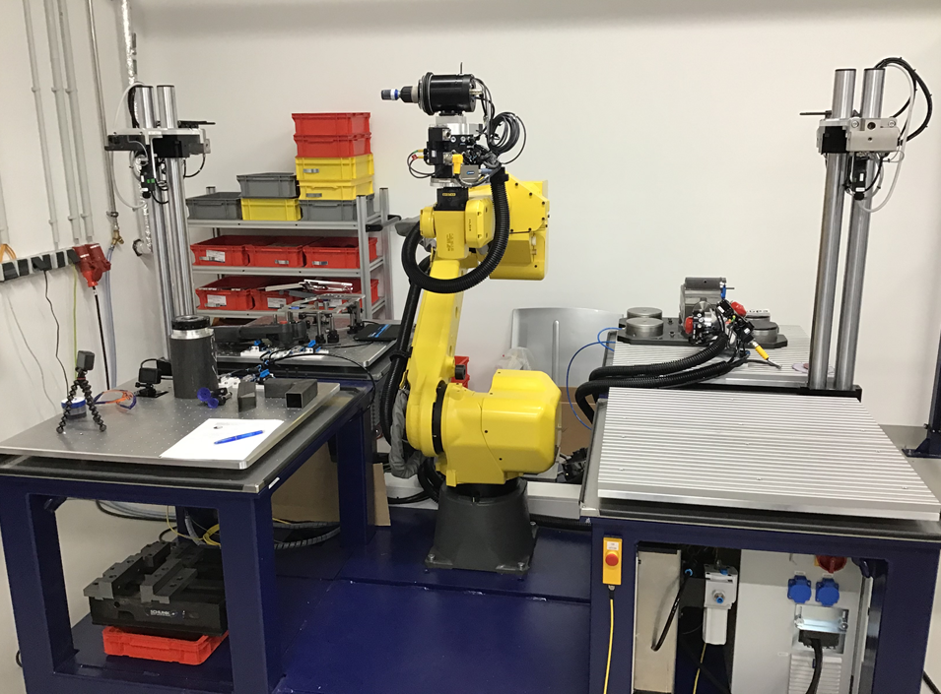
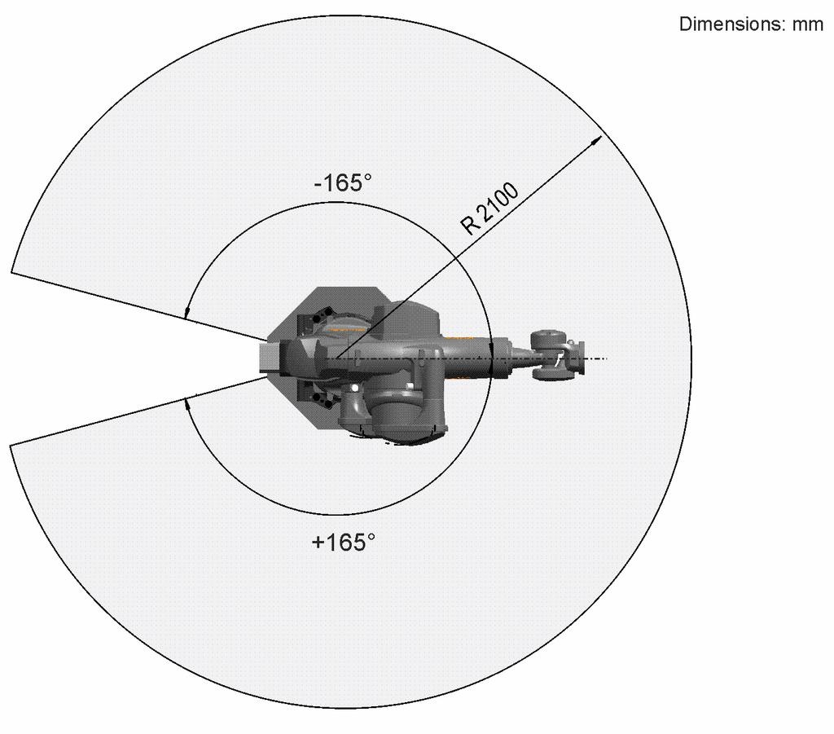
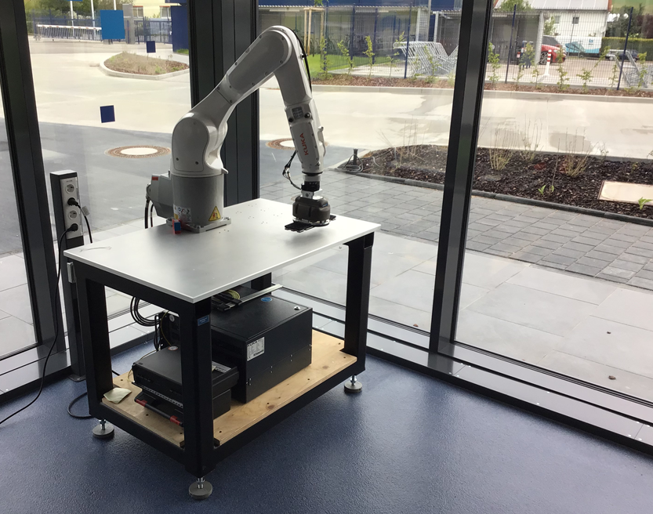
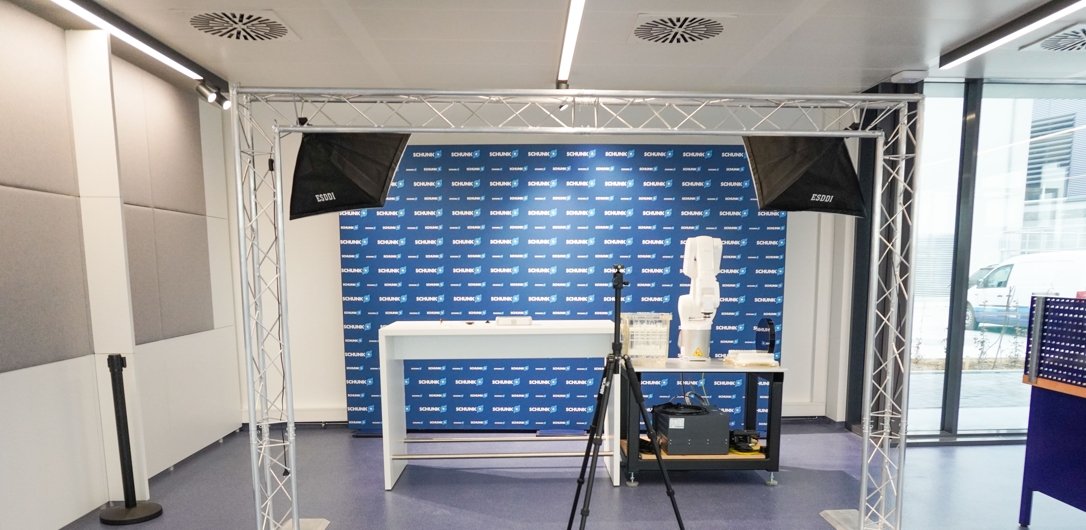
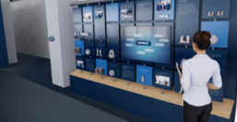
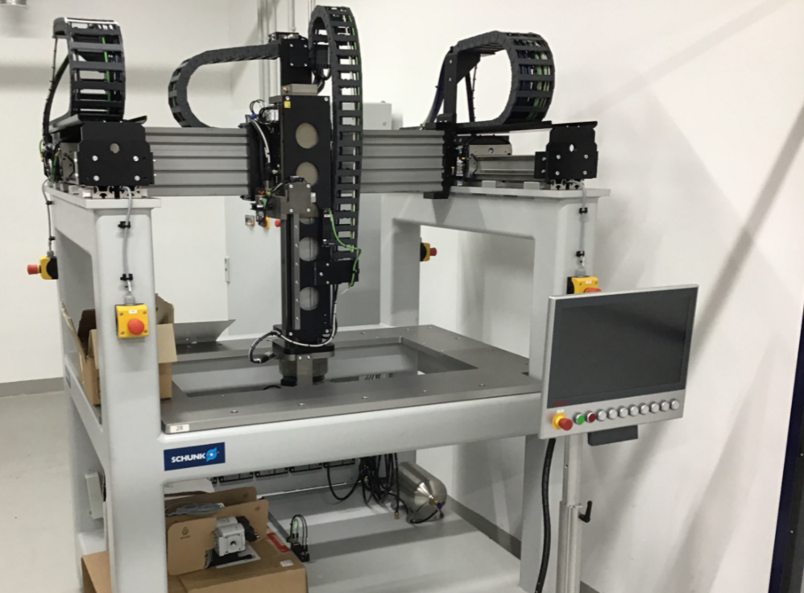
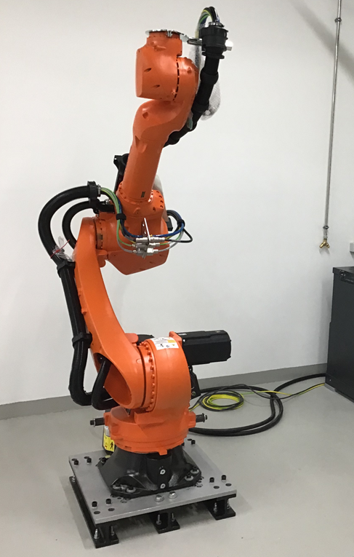
Germany Layout
UR5e
Kuka KR10
CoBot Application Area
Doosan M1013
Omron TM5
Omron TM5-Camera
Material Removal
Material Removal
Video Area
Meeting Area
KUKA KR70
Battery/HairPin

Slide 4
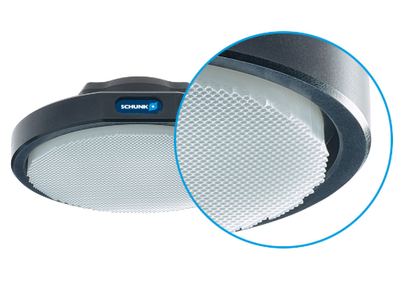
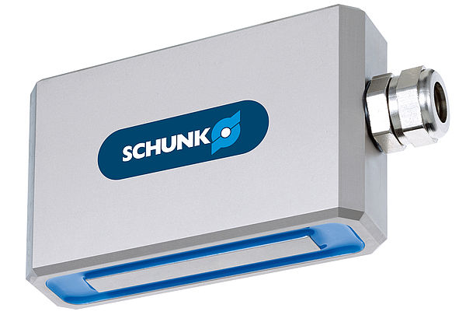
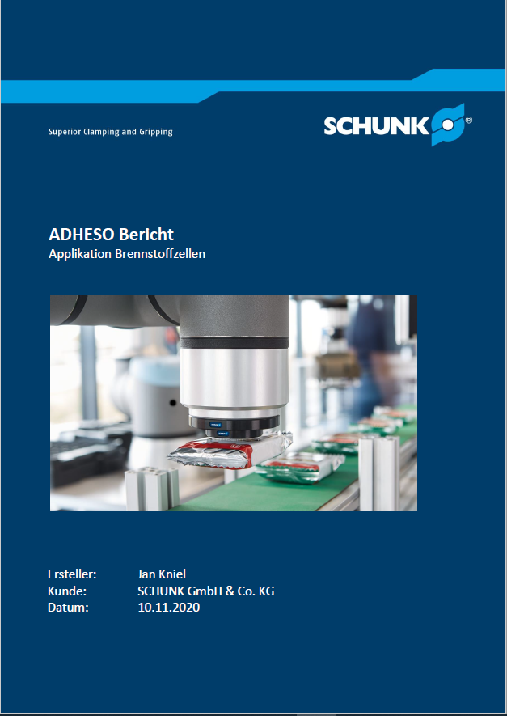
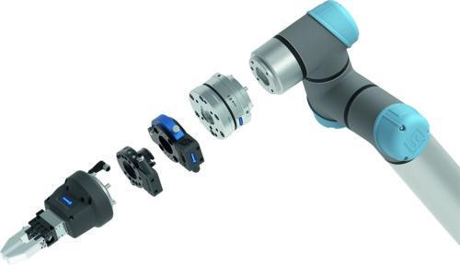



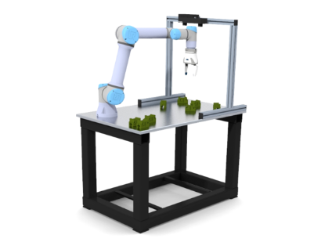
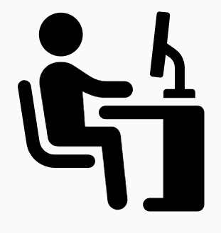
Service offer
Report:
Ideal use of components in the specific application
→ reduce your investment risk
Recommendation on process parameters
→ faster implementation
Product validation
ADHESO
Magnetic grippers
Smart Grasping
Plug&Work
Material Removal
Product
Application validation
Your automation
task
Robot + Product
Doosan
Kuka
Universal Robots
Techman
Fanuc
Exemplary
application setup
Setup description with component list
Video documentation of the exemplary
implementation
Customer training

Slide 5
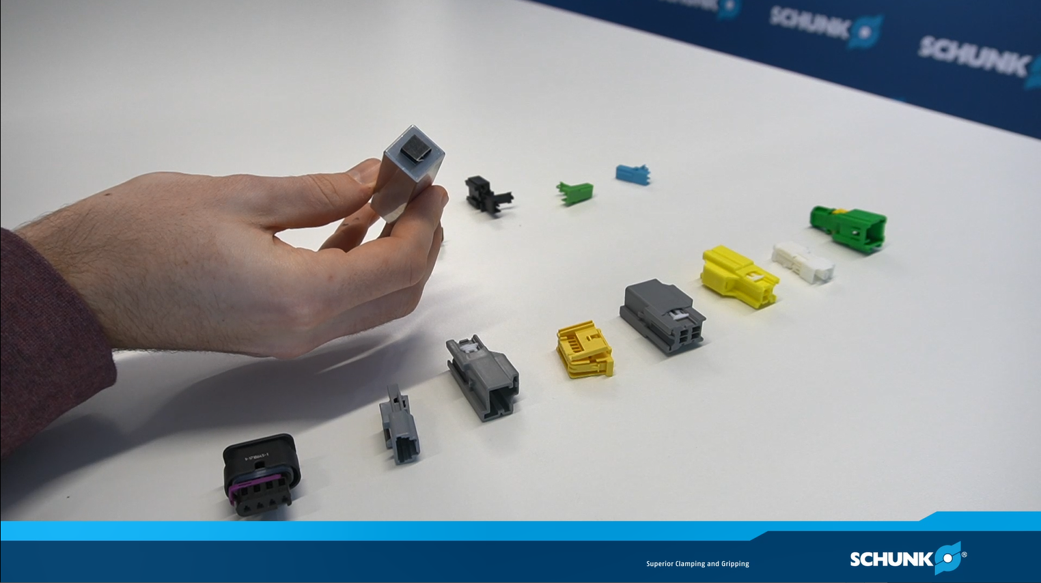
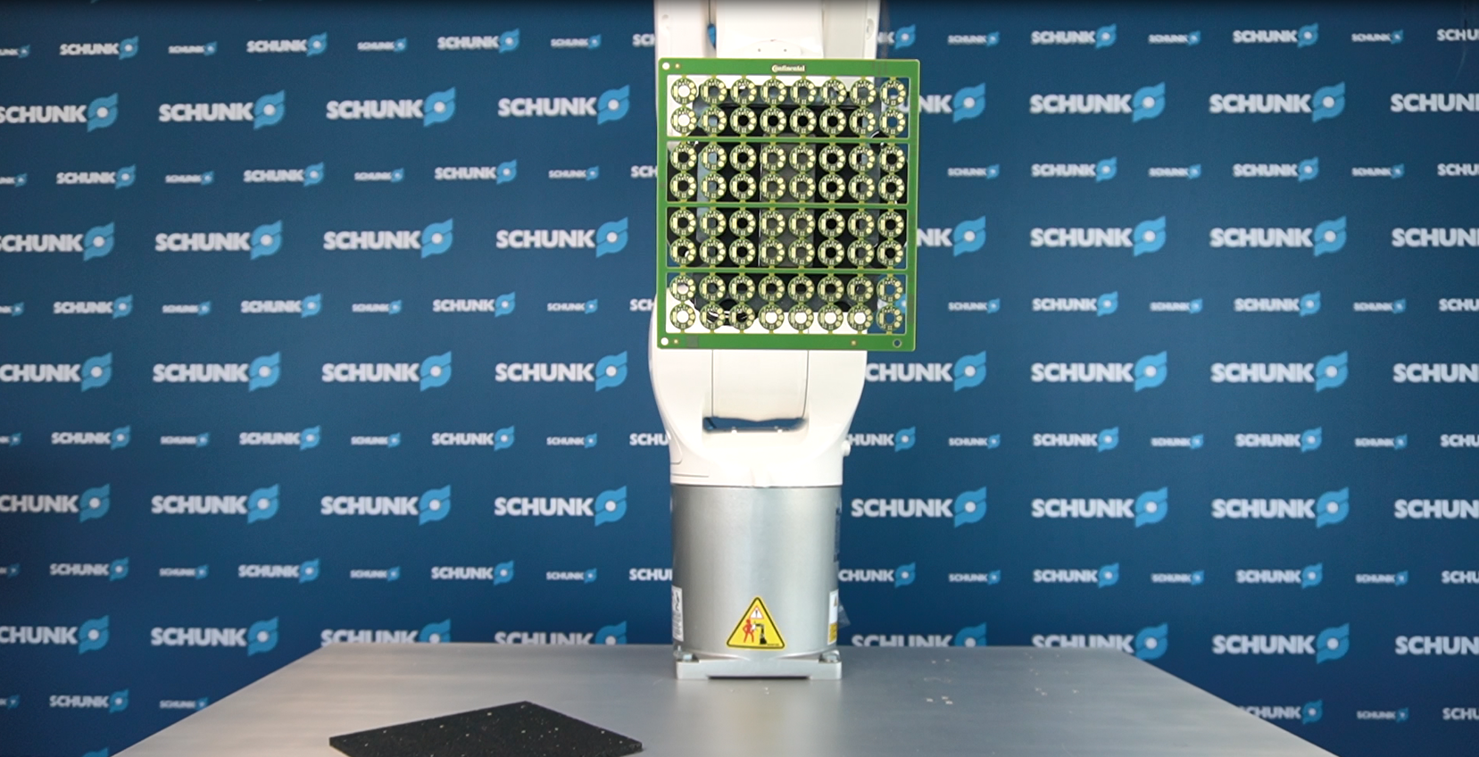
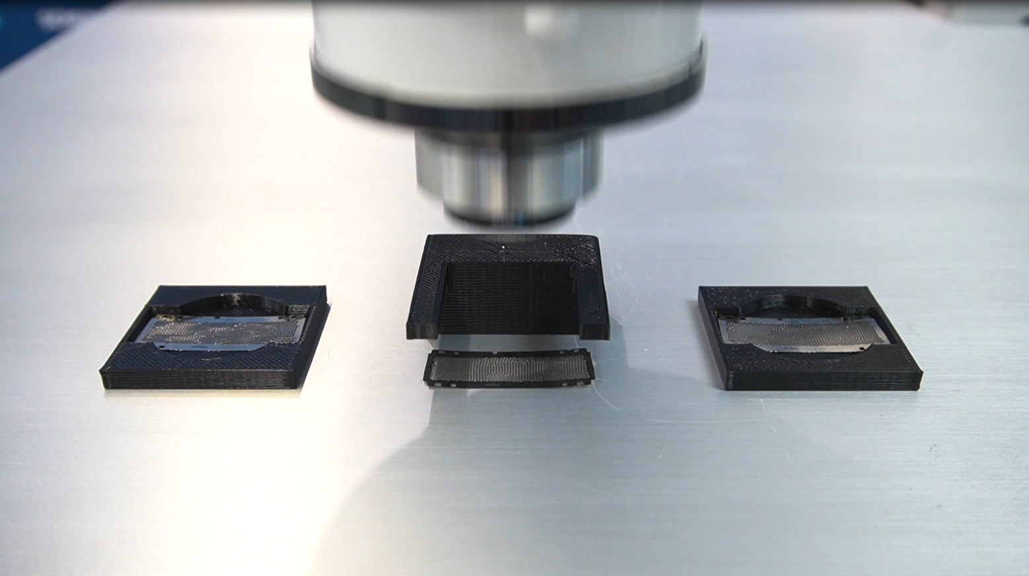
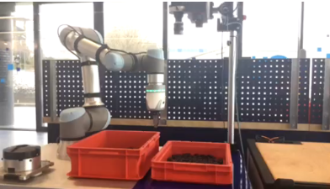
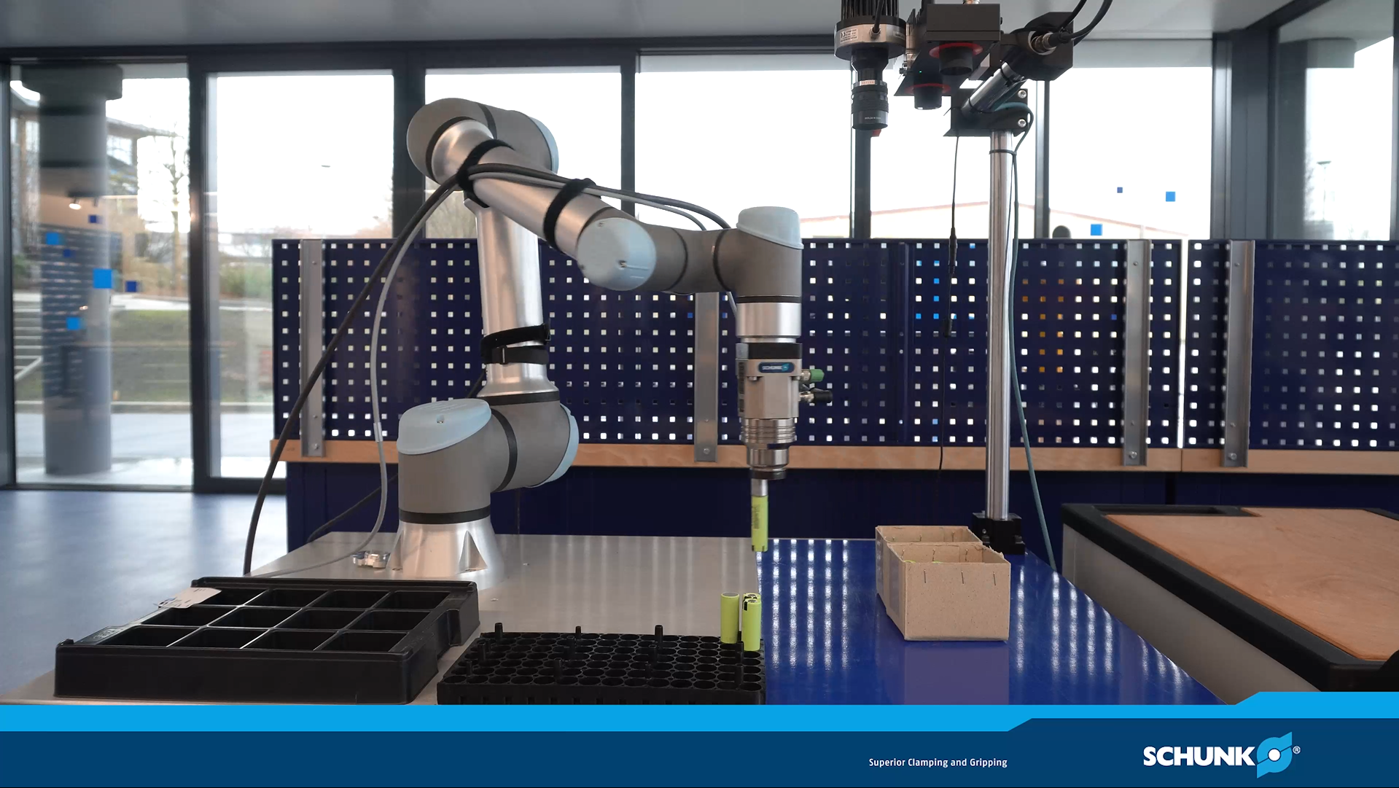
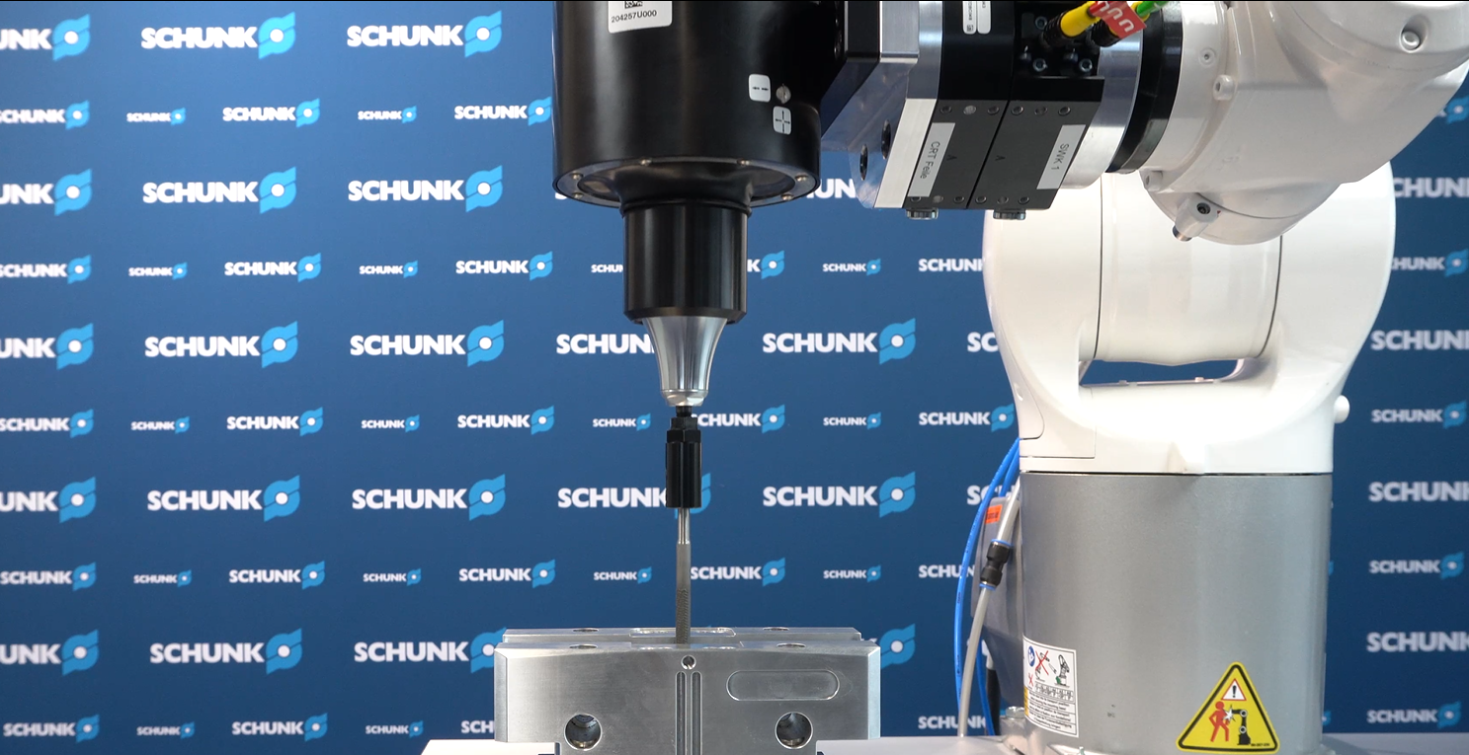
Service offer
Get in touch with contact person
Send parts
Get pictures, videos, report
Your SCHUNK Area sales manager
You do not know who to contact?
Find your contact here.
Customer parts:
SCHUNK GmbH & Co. KG
CoLab - H.5A.2 - Gebäude 11
Robert-Bosch-Straße 12
DE-74336 Brackenheim, Germany

Slide 6

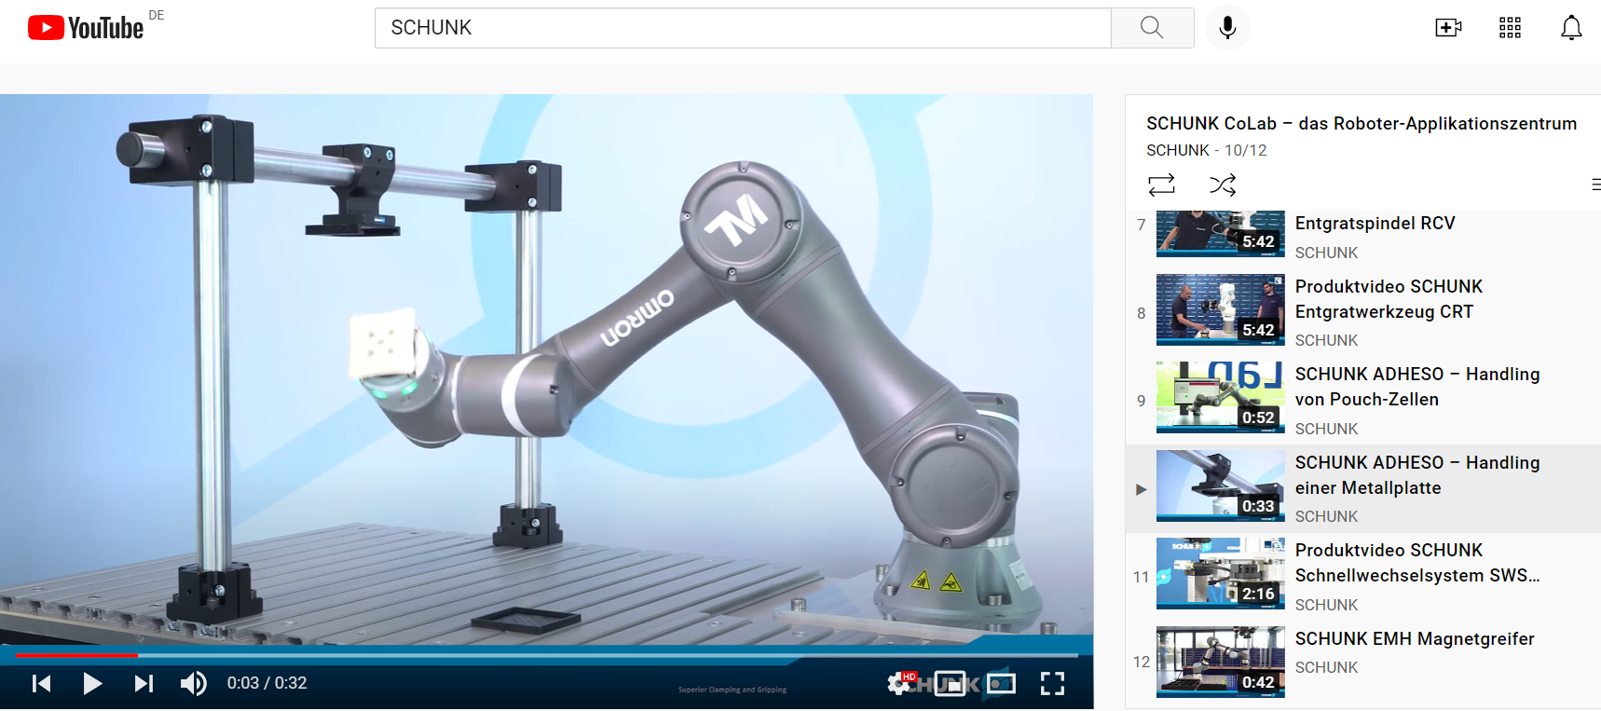
on
Watch our playlist on Youtube!

