Slide 1

Product presentation
SRU-mini
Universal swivel unit

Slide 2
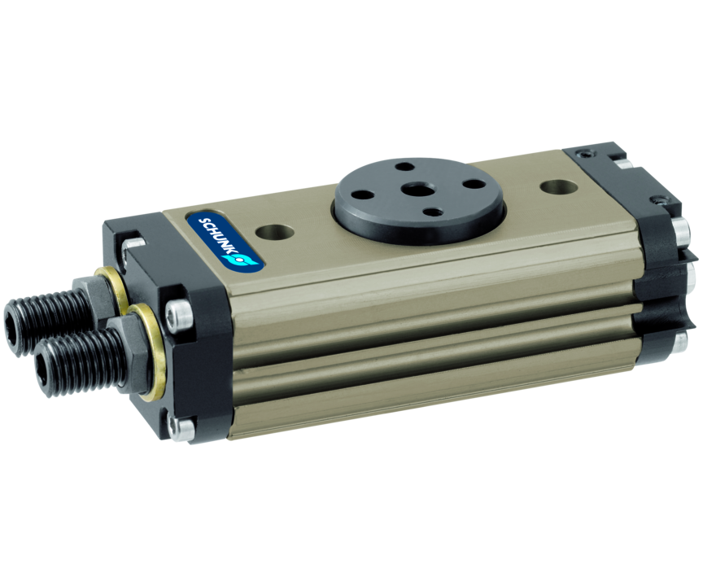
Universal swivel unit
Light and fast miniature swivel unit with multiple options such as fluid feed-through, hydraulic damping, elastomer damping, and a pneumatic center position
Highest performance from the smallest space, with a swivel time starting from 0.11 seconds.

Slide 3

Fast. Compact. High Performance.

Slide 4
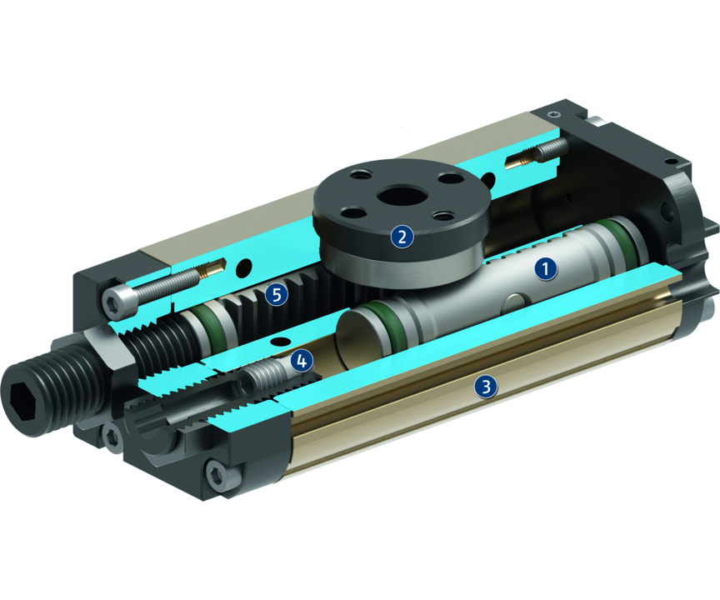
Principle of function
Functional description
When subjected to pressure, the two pneumatic pistons move their end faces in a straight line in their respective bores thus turning the pinion by means of the serrations on their sides.
1
Damping
2
Bearing
3
Housing
4
End position
5
Kinematics

Slide 5
Advantages – Your benefits
Finely graded series with a steady increase in torque for multiple cases of application, the correct size as a standard product is available
Always with large end position adjustability for flexible adjustability of the swivel angle
Fluid feed-through can be used for gases, fluids, and vacuum therefore no interfering hoses
scope-free end positions for high accurancy
Middle position for flexible manufacturing
Series extends upwards with the SRU-plus, for a wide range of applications

Slide 6
Technical data
Technical data overview
Size | Angle of rotation | Torque | Weight | Repeat accuracy
 | [°] | [Nm] | [kg] | [°]
8 | 180 | 0.16 .. 0.2 | 0.15 .. 0.22 | 0.07
10 | 180 | 0.24 .. 0.28 | 0.18 .. 0.26 | 0.07
12 | 180 | 0.6 .. 0.75 | 0.39 .. 0.54 | 0.07
14 | 180 | 1 .. 1.15 | 0.47 .. 0.65 | 0.07

