Slide 1

Product presentation
PR
Universal rotary unit

Slide 2
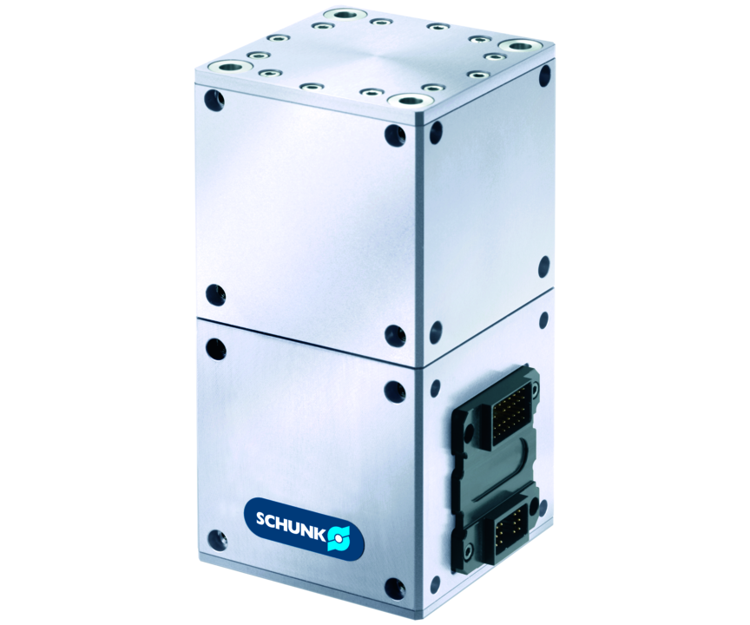
Universal rotary unit
Servo-electric rotary unit with angle of rotation > 360°, precision gear and integrated electronics

Slide 3

Loadable. Flexible. Robust.

Slide 4
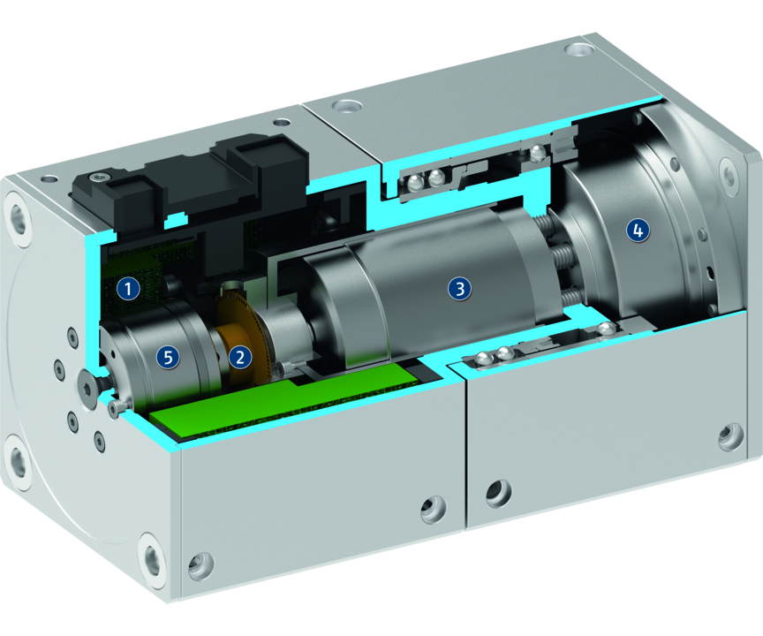
Principle of function
Functional description
The rotary unit has a Harmonic Drive®precision gear, which is directly driven by a brushless DC-servo drive.
1
Control electronics
2
Encoder
3
Brushless DC servomotor
4
Harmonic Drive® gears
5
Brake

Slide 5
Advantages – Your benefits
Brushless DC servomotor for flexible use by controlled position, velocity, and torque
High torque, velocity, and precision for fast acceleration and short cycle times at a high precision
Fully integrated control and power electronics for creating a decentralized control system
Versatile actuation options for simple integration into existing control concepts via PROFIBUS-DP, or CAN
Standard connecting elements and integrated control concept for extensive combination possibilities with other mechatronic modules

Slide 6
Technical data
Technical data overview
Size | Nominal torque | Max. torque | Max. RPM | Weight
 | [Nm] | [Nm] | [1/min] | [kg]
70 | 3.6 .. 10 | 16 .. 51.2 | 25 .. 78 | 1.7
90 | 12.8 .. 44.8 | 20.8 .. 58.4 | 25 .. 78 | 3.4
110 | 22.4 .. 88 | 61.6 .. 184 | 13 .. 42 | 5.6

