Slide 1

Product presentation
RM-W
Vane swivel unit

Slide 2
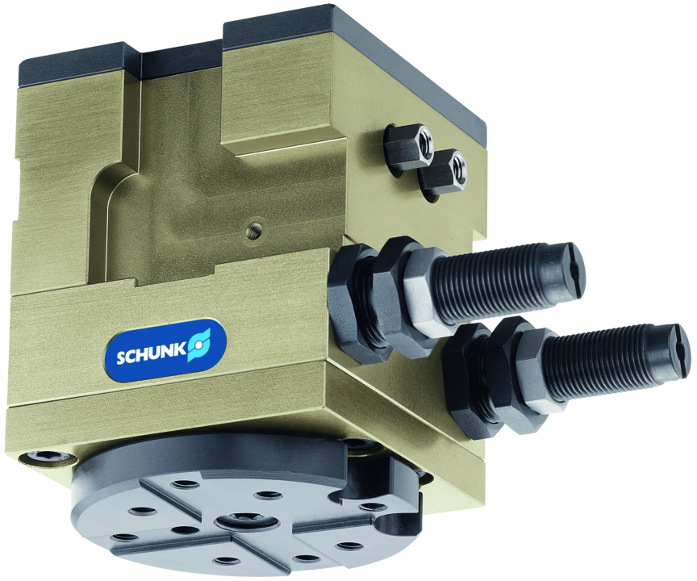
Vane swivel unit
Vane swivel unit with high torque for fast rotation tasks

Slide 3

Modular. Compact. Flexible.

Slide 4
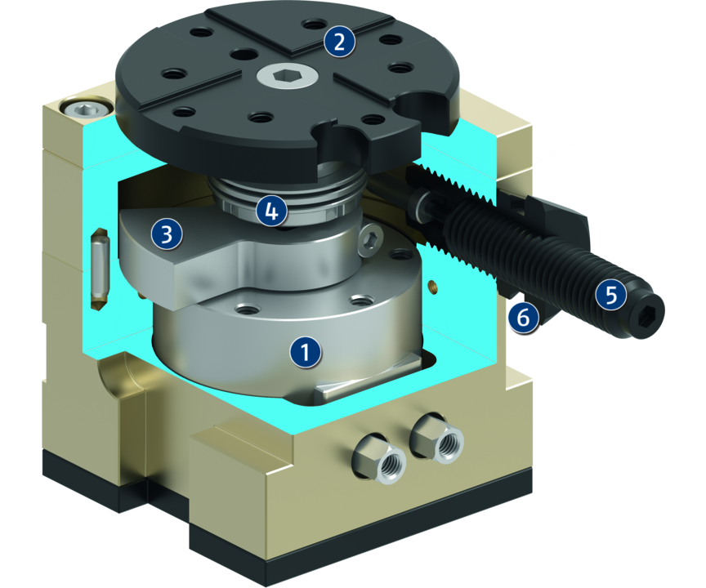
Principle of function
Functional description
The drive is pneumatic and based on the rotor principle. The rotary table is very robust due to axial and radial bearings.
1
Drive
2
Mounting pattern
3
Stop lever
4
Robust bearing
5
End position damping
6
Swivel angle adjustment

Slide 5
Advantages – Your benefits
Stop system with integrated fine adjustment of rotation angle for sensitive adjustment of end positions
Direct drive of the rotary table with integrated rotor cylinder ensured highest repeat accuracies
Very compact design for minimal interfering contours
Solid axial and radial bearings for the rotary table for high load bearing capacities in all directions
End-position monitoring with optional standardized monitoring sets
Integrated shock absorbers with adjustable absorption characteristics for optimal damping
Standardized mounting bores for numerous combinations with other components from the modular system

Slide 6
Technical data
Technical data overview
Size | Angle of rotation | Torque | Weight | Repeat accuracy
 | [°] | [Nm] | [kg] | [°]
50 | 90 .. 180 | 0.7 | 0.65 | 0.044
110 | 90 .. 180 | 1.95 | 1.12 | 0.036
200 | 90 .. 180 | 4 | 2.1 | 0.044
310 | 90 .. 180 | 22 | 8.3 | 0.046

