Slide 1

Product presentation
PRH
Universal rotary unit

Slide 2
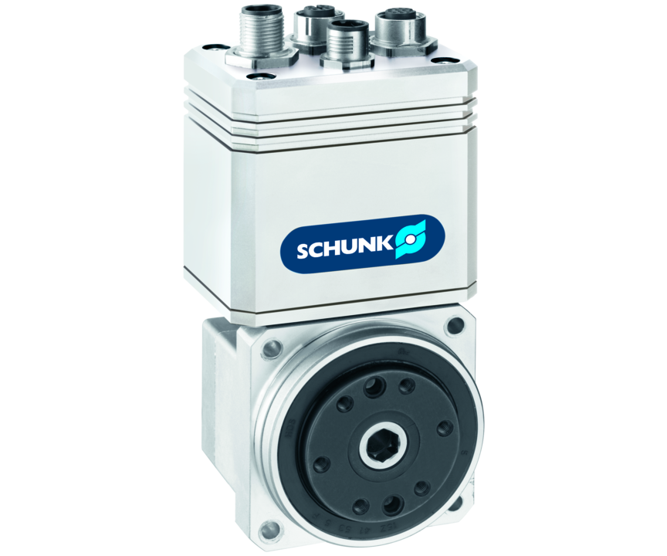
Universal rotary unit
Servo-electric miniature rotary unit with angle of rotation > 360°, center bore, and precision gear
The most accurate miniature rotary module with integrated control electronics.
0.004° repeat accuracy

Slide 3

Precise. Compact. Bus capable.

Slide 4
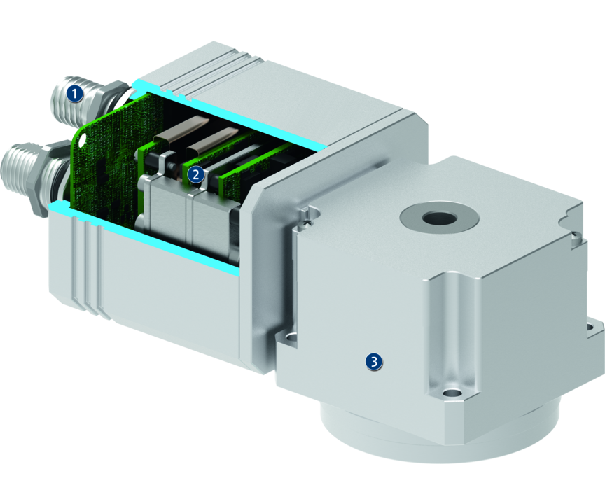
Principle of function
Functional description
The rotary unit has a Harmonic Drive®precision gear, which is directly driven by a brushless DC-servo drive.
1
Electrical connection
2
Control electronics
3
Drive with gear

Slide 5
Advantages – Your benefits
Brushless DC servomotor for flexible use by controlled position, velocity, and torque
High torque, velocity, and precision for fast acceleration and short cycle times at a high precision
Fully integrated control and power electronics for creating a decentralized control system
Versatile actuation options for simple integration into existing control concepts via PROFIBUS-DP, or CAN
High protection class up to IP65 for use in very dirty environments
Compact design for minimal interfering contours and for use in confined spaces

Slide 6
Technical data
Technical data overview
Size | Nominal torque | Peak torque | Nominal speed | Max. RPM | Max. mass moment of inertia | Repeat accuracy | Weight
 | [Nm] | [Nm] | [1/min] | [1/min] | [kgm²] | [°] | [kg]
50 | 0.75 .. 2 | 1.8 .. 4.8 | 35 .. 117 | 60 .. 200 | 0.005 .. 0.057 | 0.004 | 0.75
60 | 1.8 .. 4.2 | 4.5 .. 11 | 35 .. 117 | 60 .. 200 | 0.012 .. 0.125 | 0.004 | 0.97
75 | 3.5 .. 6.8 | 9 .. 28 | 30 .. 100 | 60 .. 200 | 0.04 .. 0.3 | 0.004 | 1.55

