Slide 1

Product presentation
SKE
Swivel heads

Slide 2
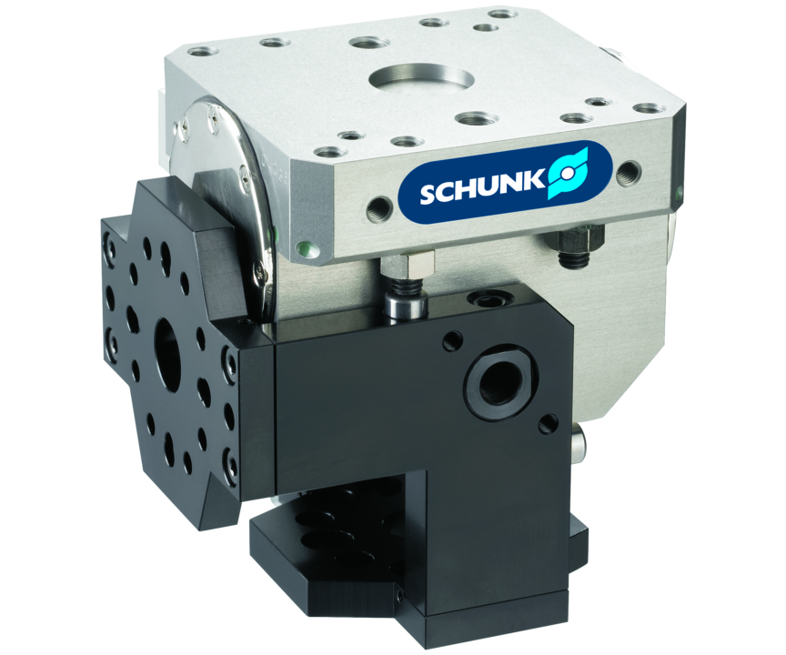
Swivel heads
Swivel head with 90° swivel angle and single-piston drive for simple swiveling tasks

Slide 3

Compact. Fast. Productive.

Slide 4
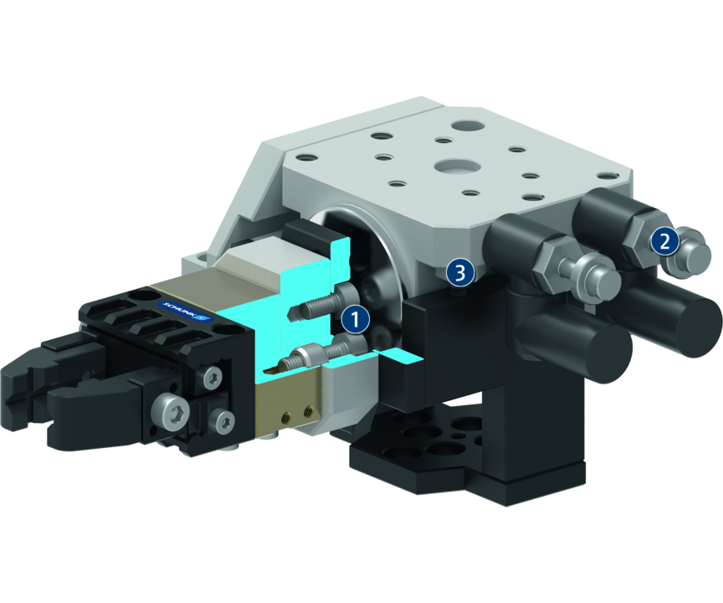
Principle of function
Functional description
A double-acting piston integrated in the housing turns the die 90° swivel axis. The piston speed is restricted by flow control couplings, ensuring that it travels cleanly to the end position.
1
Screw connection diagram for adapter plates
2
Flow control valves
3
End position adjustability

Slide 5
Advantages – Your benefits
90° swivel head with integrated end position stops
Low weight and compact design for short cycle times
Standardized interfaces to many grippers in the RH series for fast gripper assembly without using intermediate plates

Slide 6
Technical data
Technical data overview
Size | Angle of rotation | Torque | Weight | Repeat accuracy
 | [°] | [Nm] | [kg] | [°]
18 | 90 | 0.4 | 0.13 | 0.03
22 | 90 | 0.75 | 0.2 | 0.03
40 | 90 | 5 | 0.92 | 0.03
55 | 90 | 9 | 1.95 | 0.03

