Slide 1

Product presentation
SRU-plus-D
Universal swivel unit

Slide 2
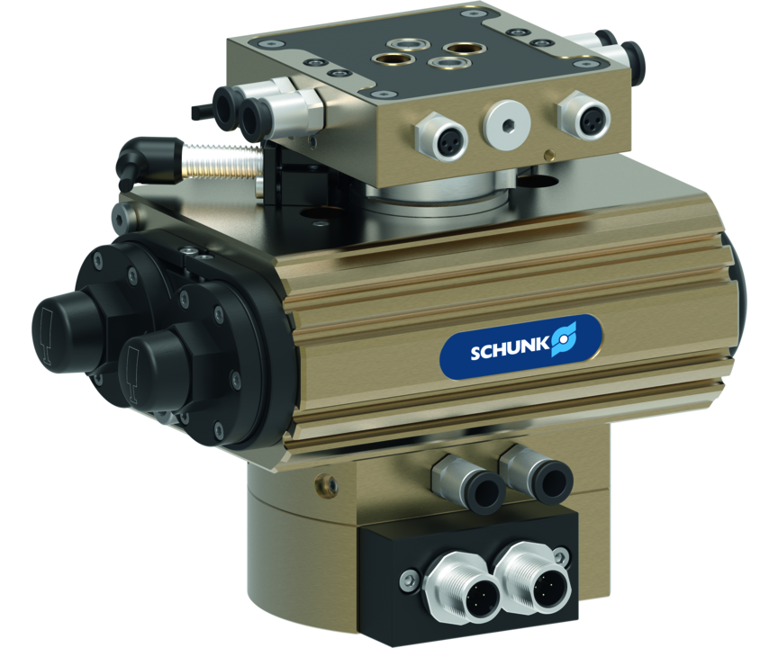
Universal swivel unit
Universally usable unit for pneumatic swivel and turning movements

Slide 3

Robust. Fast. High Performance.

Slide 4
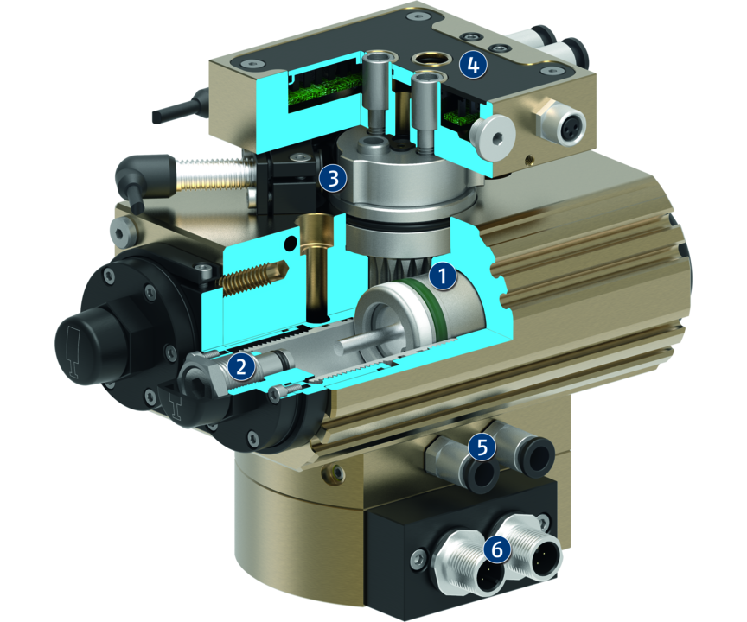
Principle of function
Functional description
When subjected to pressure, the two pneumatic pistons move their end faces in a straight line in their respective bores thus turning the pinion by means of the serrations on their sides.
1
Drive
2
Swivel angle adjustment
3
Inductive monitoring with fixed control cam
4
Electrical rotary feed-through
5
Connections for fluid feed-through
6
Connections for electric rotary feed-through

Slide 5
Advantages – Your benefits
Finely graded series with a steady increase in torque for multiple cases of application, the correct size as a standard product is available
Swivel angle can be selected as either 90° or 180° complete flexibility in selecting the angle of rotation, application-specific angles possible on request
Drive-side M12 plug connectors for electrical rotary feed-through for simple commissioning and maintenance
Middle position can be selected as pneumatic or locked The locked middle position can be unlocked when loaded. The two types of middle positions always allow further rotation in either direction.
Fluid feed-through can be used for gases, fluids, and vacuum therefore no interfering hoses
Electrical rotary feed-through for long-lasting, reliable feed-through of sensor, actuator or optionally bus signals
Choice of electronic magnetic sensors or inductive proximity sensors for absolute variability of position monitoring
Exchangeable screw-in guide sleeves (bushing) allow for easy maintenance and rapid exchange t after several million cycles.

Slide 6
Technical data
Technical data overview
Size | Angle of rotation | Torque | Weight | Repeat accuracy
 | [°] | [Nm] | [kg] | [°]
20 | 90 .. 180 | 3 .. 3.4 | 1.2 .. 2.61 | 0.05
25 | 90 .. 180 | 4.6 .. 5 | 1.6 .. 3.45 | 0.05
30 | 90 .. 180 | 9 .. 9.5 | 2.4 .. 4.4 | 0.05
35 | 90 .. 180 | 13.4 .. 14 | 2.65 .. 5.2 | 0.05
40 | 90 .. 180 | 19.2 .. 20 | 4.2 .. 8.75 | 0.05
50 | 90 .. 180 | 50.3 .. 52 | 9.4 .. 14.95 | 0.05
60 | 90 .. 180 | 70 .. 72 | 12.8 .. 19.95 | 0.05

