Slide 1

Product presentation
BSWS-PGZN-plus
Jaw quick-change system

Slide 2
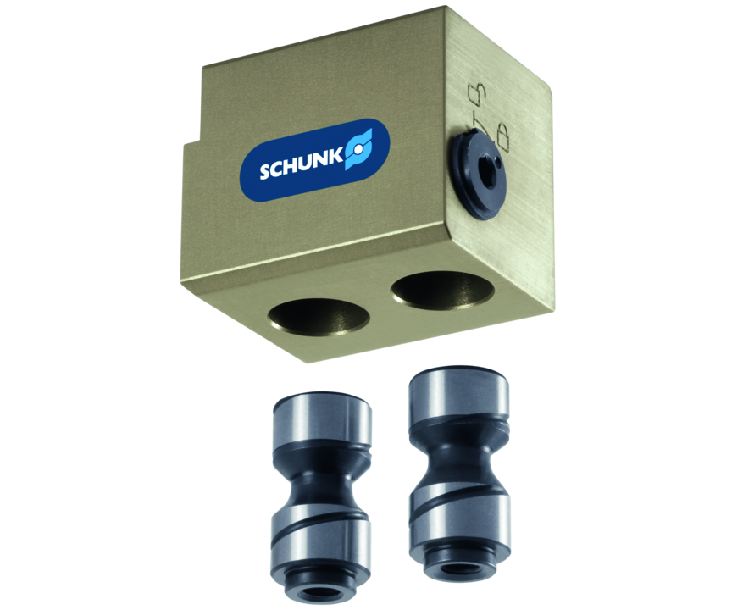
Jaw quick-change system
The jaw quick-change system BSWS allows top jaws to be exchanged on the gripper manually and rapidly. One adapter pin (BSWS-A) and a base (BSWS-B) are required for each gripper jaw.In case of reverse assembly and provided that no additional height is created, one adapter pin (BSWS-AR) and an assembly kit (BSWS-UR) per gripper jaw are required. Another effect of the BSWS-UR is that there are no more disturbing mounting holes in the finger contours.
Up to 90% reduction in set-up time

Slide 3

Productive. Flexible. Cost-effective.

Slide 4
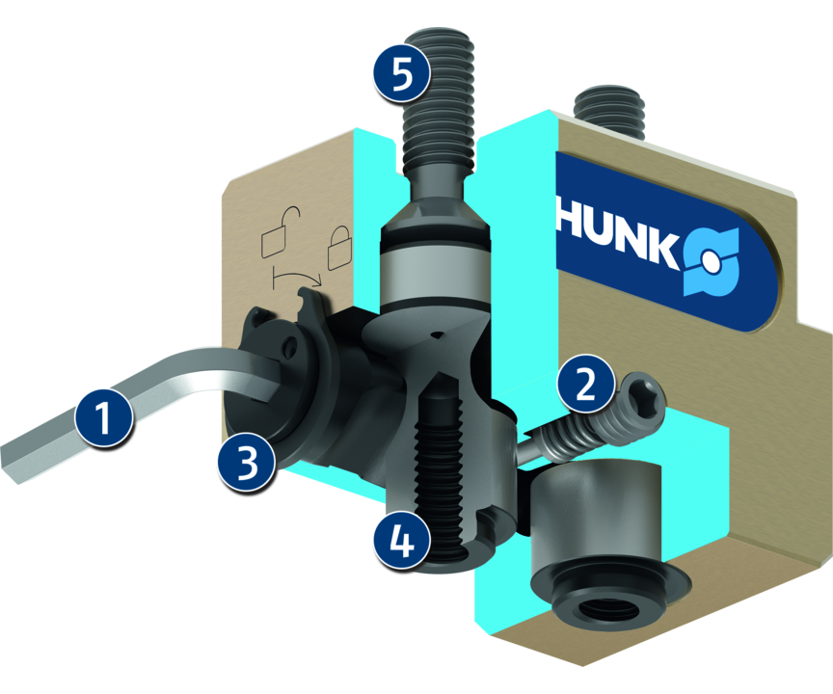
Principle of function
Functional description
One adapter pin (BSWS-A) and a base (BSWS-B) are required for each gripper jaw. In case of a reverse assembly and provided that no additional height is created, one adapter pin (BSWS-AR) and an assembly kit (BSWS-UR) are required per gripper jaw. The BSWS consists of a base, which is firmly screwed to the gripper, and two adapter pins, which are fastened to the top jaws to be exchanged.
The form-fit locking mechanics ensures a fast exchange of the gripper fingers.
1
Hexagon socket wrench
2
Safety element
3
Locking bolt
4
Adapter pin BSWS-A
5
Screw connection for mounting on the gripper

Slide 5
Advantages – Your benefits
Universal application possibilities By using the BSWS, just one single gripper is necessary for various applications
Manual jaw change via locking mechanics easy and fast for a high gripper flexibility
Saving time when converting applications Different workpieces can be handled by exchanging the gripper fingers
Alternative possibility of inserting the locking bolt into the base jaws The changeability and free choice of jaw design has no impact onto the inferring contours

Slide 6
Technical data
Technical data overview
Size | Weight | Number of pins per Id.-No. | Material
 | [kg]
50 | 0.002 .. 0.2 | 1 .. 2 | 42CrMo4+QT
64 | 0.005 .. 0.34 | 1 .. 2 | 42CrMo4+QT
80 | 0.011 .. 0.66 | 1 .. 2 | 42CrMo4+QT
100 | 0.024 .. 1.19 | 1 .. 2 | 42CrMo4+QT
125 | 0.044 .. 2.1 | 1 .. 2 | 42CrMo4+QT
160 | 0.077 .. 3.5 | 1 .. 2 | 42CrMo4+QT
200 | 0.16 .. 0.9 | 1 .. 2 | 42CrMo4+QT
240 | 0.3 .. 1.5 | 1 .. 2 | 42CrMo4+QT
300 | 0.41 .. 2 | 1 .. 2 | 42CrMo4+QT

