Slide 1

Product presentation
DDF 2
Rotary feed-through for robots

Slide 2
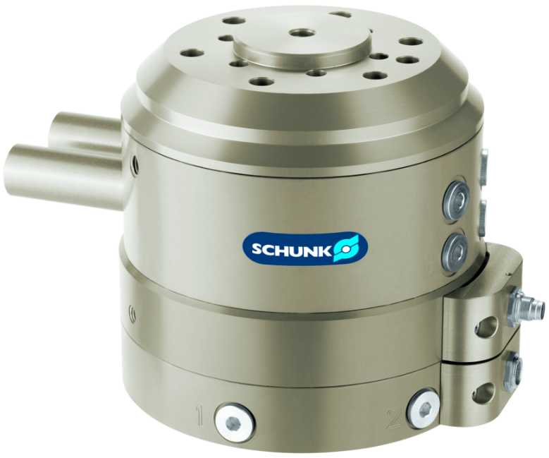
Rotary feed-through for robots
For feeding through electric signals and pneumatics for use on robots even when they are endlessly rotating
Feed-through of pneumatic and electric signals - combined or individually even when endlessly rotating.
With a max. speed of rotation of 120

Slide 3

Powerful. Flexible. Energy-efficient.

Slide 4
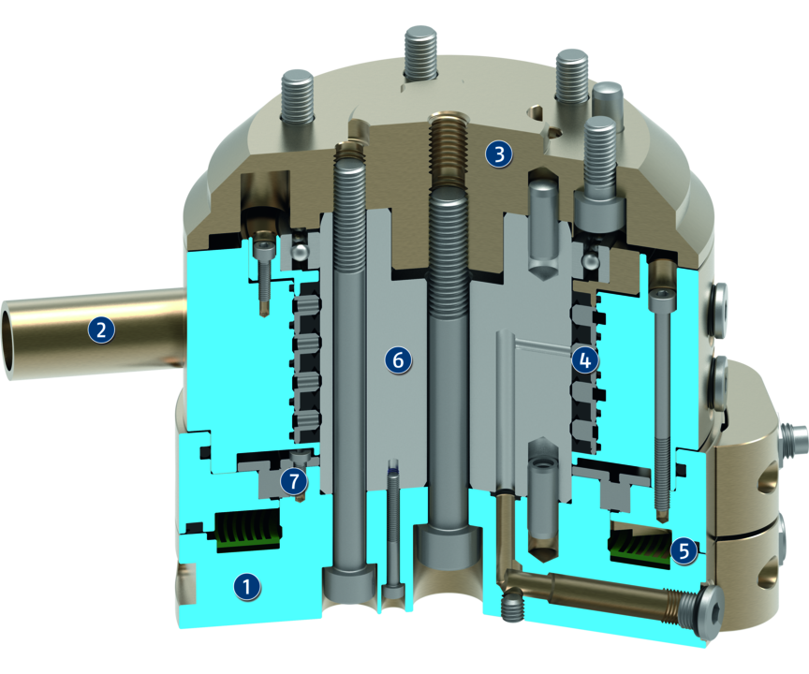
Principle of function
Functional description
The DDF 2 facilitates rotation of the robot axis by more than 360°, without hoses and cables twisting around the axis. Integrated air feed-throughs and slip ring contacts reliably supply the tool with air and electricity, even at high speeds.
The integrated ISO flange is mounted on the flange of the robot. A ring surrounds the shaft. The ring is connected to a non-rotating part of the robot via a torque support. When the robot flange turns, the shaft turns in the ring.
A slip ring which is integrated in the shaft and the housing, thereby transmits electrical signals from the fixed housing into the rotating shaft. Electric signals and up to four pneumatic lines are fed through.
1
Housing
2
Torque support
3
ISO flange
4
Pneumatic feed-through
5
Slip ring
6
Steel shaft
7
Rolling-contact bearing

Slide 5
Advantages – Your benefits
Combined air and electric feed-through for extensive supply to your gripper system/tool
ISO mounting pattern for easy assembly to most types of robots without needing additional adapter plates
Complete series of 12 sizes for best selection of size
Electrical plug for easy change in case of cable break at the robot arm or gripper
Shaft made of steel adapted performance for modern robots
Three versions in one unit Transmission of pneumatic and electrical signals individually or in combination
Newly developed, smooth running and particularly long lasting seals ensure a low starting and continuous torque, so that smaller and more economical drives can be used and that particularly small rotary movements are possible.

Slide 6
Technical data
Technical data overview
Size | Recommended handling weight | Max. drive speed | Max. speed of rotation | Nominal torque | Angle of rotation | Starting torque | No. of fluid feed-throughs | Number of electrical feed-throughs | Weight
 | [kg] | [1/min] | [°/s] | [Nm] | [°] | [Nm] |  |  | [kg]
31 | 6 | 120 | 720 | 0.8 | 360 | 1.3 | 2 | 4 | 0.45 .. 0.5
40 | 10 | 120 | 720 | 1.5 | 360 | 2 | 2 | 4 | 0.75 .. 0.9
040-1 | 20 | 110 | 660 | 3 | 360 | 4.5 | 4 | 6 | 2
50 | 10 | 120 | 720 | 1 .. 1.5 | 360 | 1.3 .. 2 | 2 | 4 | 0.45 .. 0.95
050-1 | 25 | 110 | 660 | 3 | 360 | 4.5 | 4 | 6 | 2.1
63 | 35 | 110 | 660 | 3 | 360 | 4.5 | 4 | 6 | 2.2
80 | 100 | 100 | 600 | 8 | 360 | 10 | 4 | 6 | 5.9
080-1 | 150 | 90 | 540 | 22 | 360 | 25 | 4 | 10 | 13.1

Slide 7
Technical data
Technical data overview
Size | Recommended handling weight | Max. drive speed | Max. speed of rotation | Nominal torque | Angle of rotation | Starting torque | No. of fluid feed-throughs | Number of electrical feed-throughs | Weight
 | [kg] | [1/min] | [°/s] | [Nm] | [°] | [Nm] |  |  | [kg]
100 | 125 | 100 | 600 | 8 | 360 | 10 | 4 | 6 | 6.1
100-1 | 175 | 90 | 540 | 22 | 360 | 25 | 4 | 10 | 13.3
125 | 225 | 90 | 540 | 22 | 360 | 25 | 4 | 10 | 13.9
160 | 250 | 90 | 540 | 22 | 360 | 25 | 4 | 10 | 14.2

